Slide 1


Slide 2


Single Sign-On(SSO)
By : Mr. Shivam Supekar

Slide 3

SSO
What is Single Sign-On?
SSO (Single Sign-On) allows users to log in once and access multiple applications without re-authenticating.
Centralized authentication system.
Improves user experience and security.
Reduces password fatigue.

Slide 4
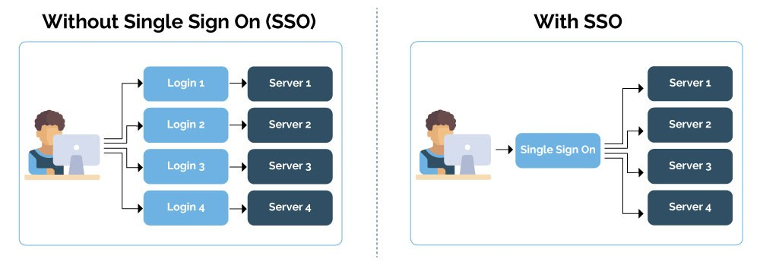

Slide 5
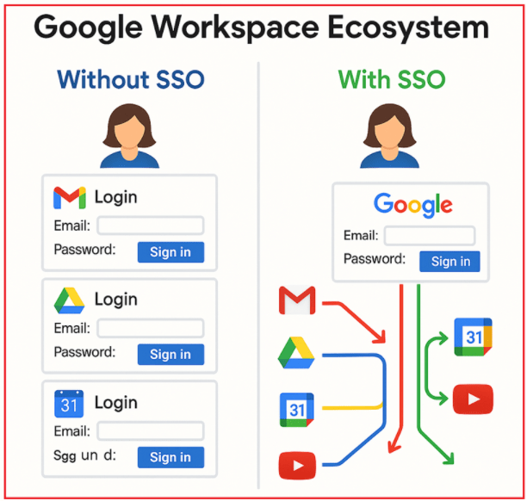

Slide 6
Why SSO is Important?
Seamless login across multiple systems
Stronger security (centralized identity control)
Less password reuse
IT support cost (fewer password reset requests)
Better compliance & auditing

Slide 7
How SSO works (High-Level)
User tries to access a protected application
App redirects to Identity Provider (IdP)
User authenticates with IdP
IdP generates a token (JWT, SAML, ID Token)
Token is sent back to the application
Application verifies token → gives access

Slide 8
Common Protocols Used in SSO
OAuth 2.0 – Authorization framework
OpenID Connect (OIDC) – Identity layer on top of OAuth
SAML 2.0 – XML-based enterprise SSO
JWT Token – Token format used widely in .NET apps

Slide 9
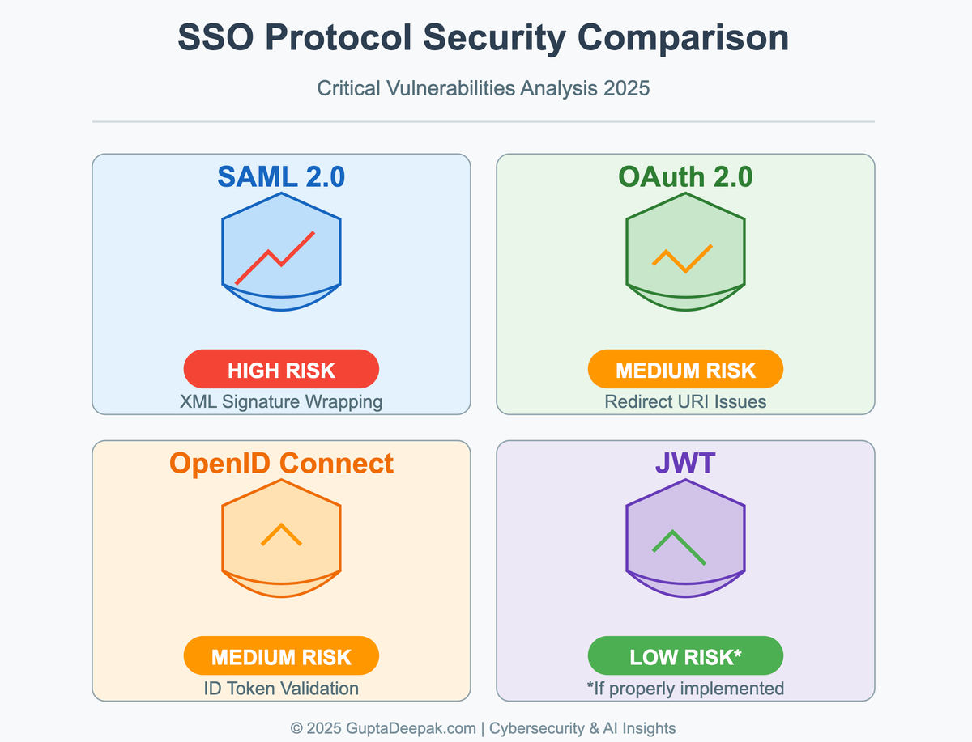

Slide 10
Identity Provider Examples
Azure Active Directory
Google Identity Platform
Facebook Login
GitHub Login
Auth0
Okta
IdentityServer (Open-source .NET based)

Slide 11
SSO in .NET
.NET supports SSO through:
Microsoft Identity Platform
OpenID Connect Middleware
Azure AD Authentication
External Login Providers
IdentityServer / Duende

Slide 12
SSO Architecture in .NET Apps
.NET App (Client) → Uses OpenID Connect
Identity Provider → Azure AD / IdentityServer
Token Validation → .NET Middleware
Access Token → Access protected APIs
Refresh Token → Silent reauthentication

Slide 13
SSO Flow in .NET
Configure Authentication Schemes
Register OpenID Connect Options
Redirect user to login page
Receive token (id_token + access_token)
Validate the token
Store user claims
Allow access based on roles/claims

Slide 14
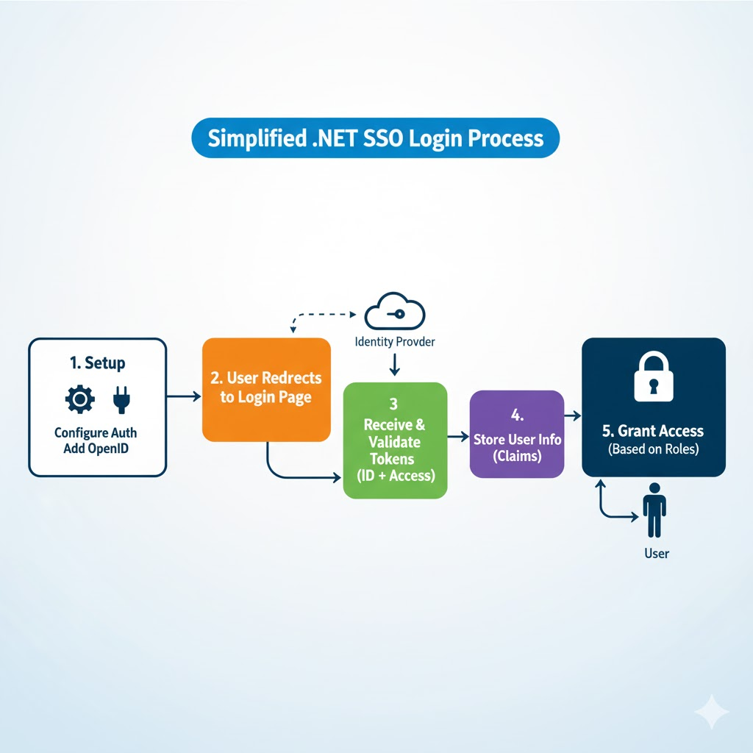

Slide 15
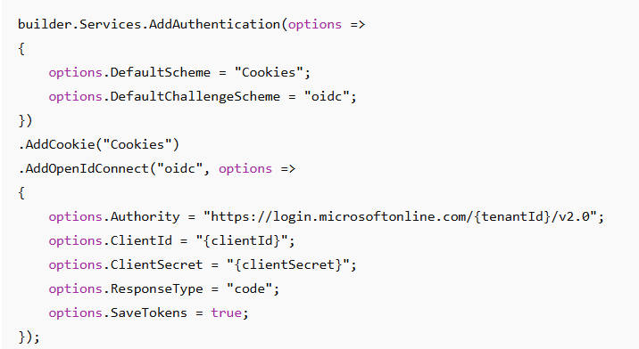
Code Snippet-Add SSO in .NET

Slide 16
Role-Based Access with SSO
Claims-based authorization
Roles fetched from Identity Provider
Role stored in ID Token
.NET uses [Authorize(Roles="Admin")]
Centralized permission management

Slide 17
Benefits of Implementing SSO in .NET
Simplified user management
Centralized security policy enforcement
Easy integration with cloud IdPs
Scalability for enterprise apps
Better user experience across web + mobile

Slide 18
Challenges in SSO
Requires token handling correctly
Need correct clock synchronization
Role/claims mapping issues
Logout complexity (single logout)
Security considerations (token expiration)

Slide 19
Best Practices
Use HTTPS only
Store tokens securely
Validate tokens using middleware
Use short-lived access tokens
Implement refresh token rotation
Enable MFA at IdP level
Monitor login audits and logs

