Slide 1


Slide 2


SignalR
By : Mr. Shivam Supekar

Slide 3

SignalR
What is SignalR ?
SignalR is a real-time communication library in ASP.NET.
Enables instant updates between server and client.
Uses WebSockets, Server-Sent Events, or Long Polling automatically.
Ideal for live, interactive applications.

Slide 4
Why SignalR?
Automatically manages real-time connections
Supports broadcasting messages to multiple clients
Handles connection fallbacks
Scales easily with cloud services (Azure SignalR)
Reduces manual handling of WebSocket logic

Slide 5
Where SignalR is Used
Chat applications
Live dashboards
Notifications & alerts
Multiplayer games
Collaborative tools (Google Docs style)
Stock price or live score updates
IoT live monitoring

Slide 6
How SignalR works
Client connects to a Hub
The Hub manages all connected clients
Server pushes messages to clients
Clients send messages to server
Connection stays open for live updates

Slide 7
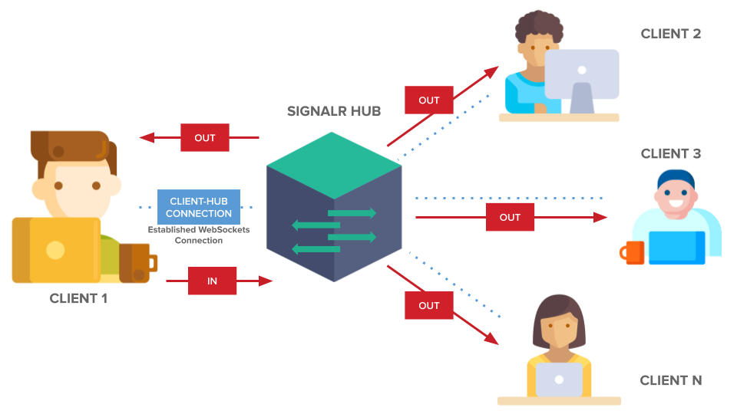

Slide 8
Key Components of SignalR
Hub → Central messaging component
Client → Web, mobile, desktop
Connection → Persistent communication
Transport Protocols → WebSockets, SSE, Long Polling
Backplane → Scaling across servers

Slide 9
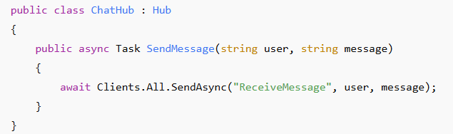

Creating a Hub
Configuring SignalR in Program.cs

Slide 10
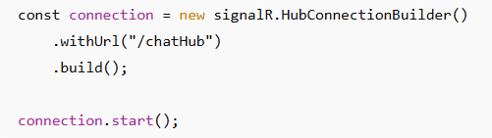

Client-Side Connection(JS)
Receiving Messages on Client
Sending a Message from Client

Slide 11
SignalR Features
Real-time messaging
Group messaging
Authentication & authorization support
Strongly typed Hubs
Automatic reconnection
Scalable with Redis / Azure SignalR

Slide 12
Real World Example – Chat App
SignalR enables:
Live chat
User join/leave notifications
Typing indicators
Private messages via groups

Slide 13
Benefits of SignalR
Very easy to implement compared to raw WebSockets
Handles all reconnection & fallback logic
Built-in scalability options
Works with JavaScript, .NET, Java, React, Angular
Cloud-friendly and production ready

Slide 14
Note
Blazor Server uses SignalR internally
In Blazor Server, every UI interaction (click, input, button press) already uses a SignalR connection.
A SignalR connection is automatically created between browser ↔ server.
No need to configure manually.
What this means:
UI updates happen in real-time
Changes to component state sync automatically
The connection is persistent
You don’t write SignalR code for this. Blazor Server does it internally.

