Slide 1


Slide 2


Unit Testing
By : Mr. Shivam Supekar

Slide 3

Unit Testing
What is Unit Testing?
Unit Testing is the process of testing individual units/components of code.
A “unit” usually refers to a function, method, or class.
Ensures each piece of code behaves as expected.
Tests are usually automated, repeatable, and fast.

Slide 4
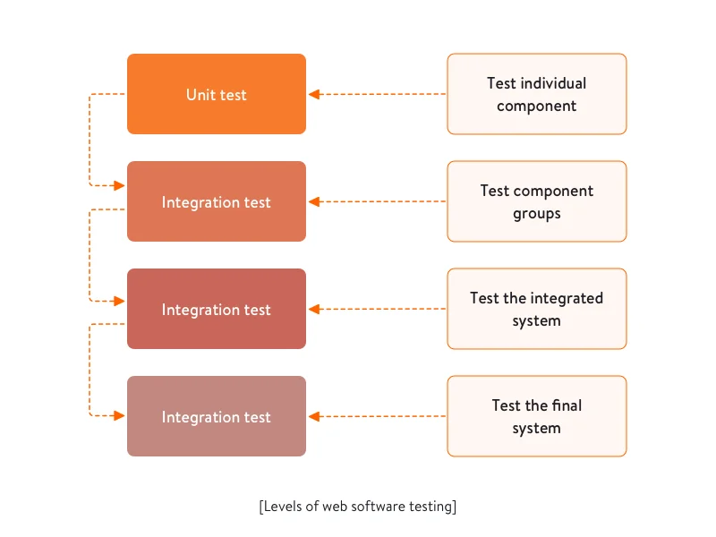

Slide 5
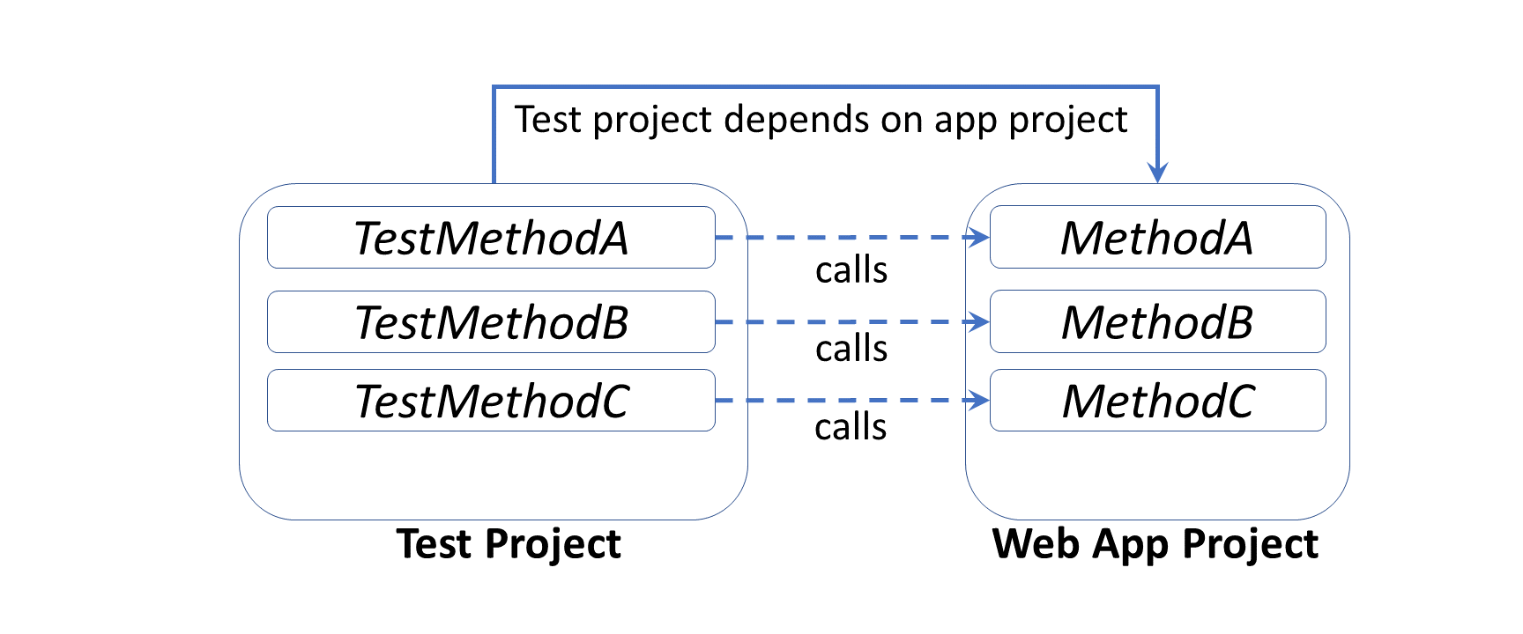
Unit Testing in .Net

Slide 6
Purpose of Unit Testing
Validate correctness of individual units.
Catch defects early in the development cycle.
Prevent bugs from spreading to other modules.
Build confidence that the code works as intended.

Slide 7
Why Unit Testing is Important in .NET
Helps maintain clean, modular, and testable code.
Supports safe refactoring (modifying code without breaking functionality).
Ensures predictable, stable application behavior.
Integrates well with tools like Test Explorer, CI/CD, Azure DevOps, and GitHub Actions.

Slide 8
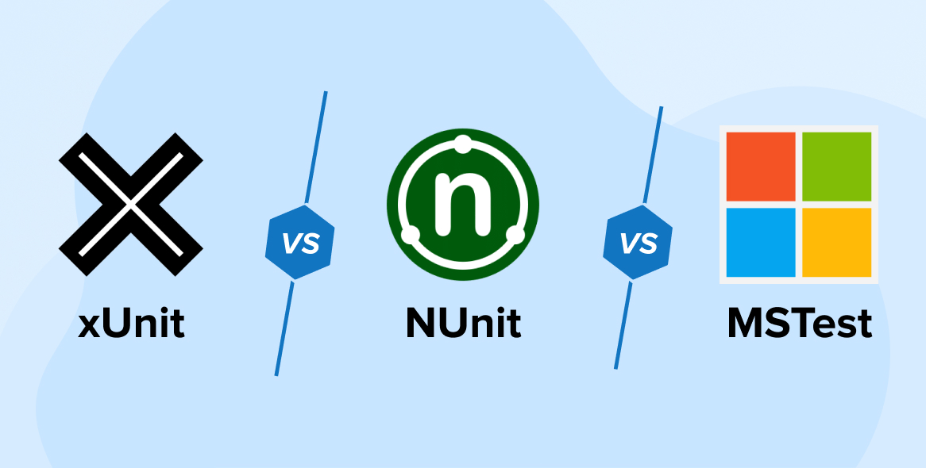
Unit Testing Frameworks in .NET
xUnit → Most preferred and modern testing framework
NUnit → Flexible, widely used
MSTest → Official Microsoft testing framework
All these integrate seamlessly with Visual Studio/VS Code.

Slide 9
How Unit Testing Works
Create a separate test project in the solution.
Write test methods that call actual functions from the main project.
Use assertions to compare expected vs actual results.
Run tests locally or automatically through CI/CD pipelines.

Slide 10
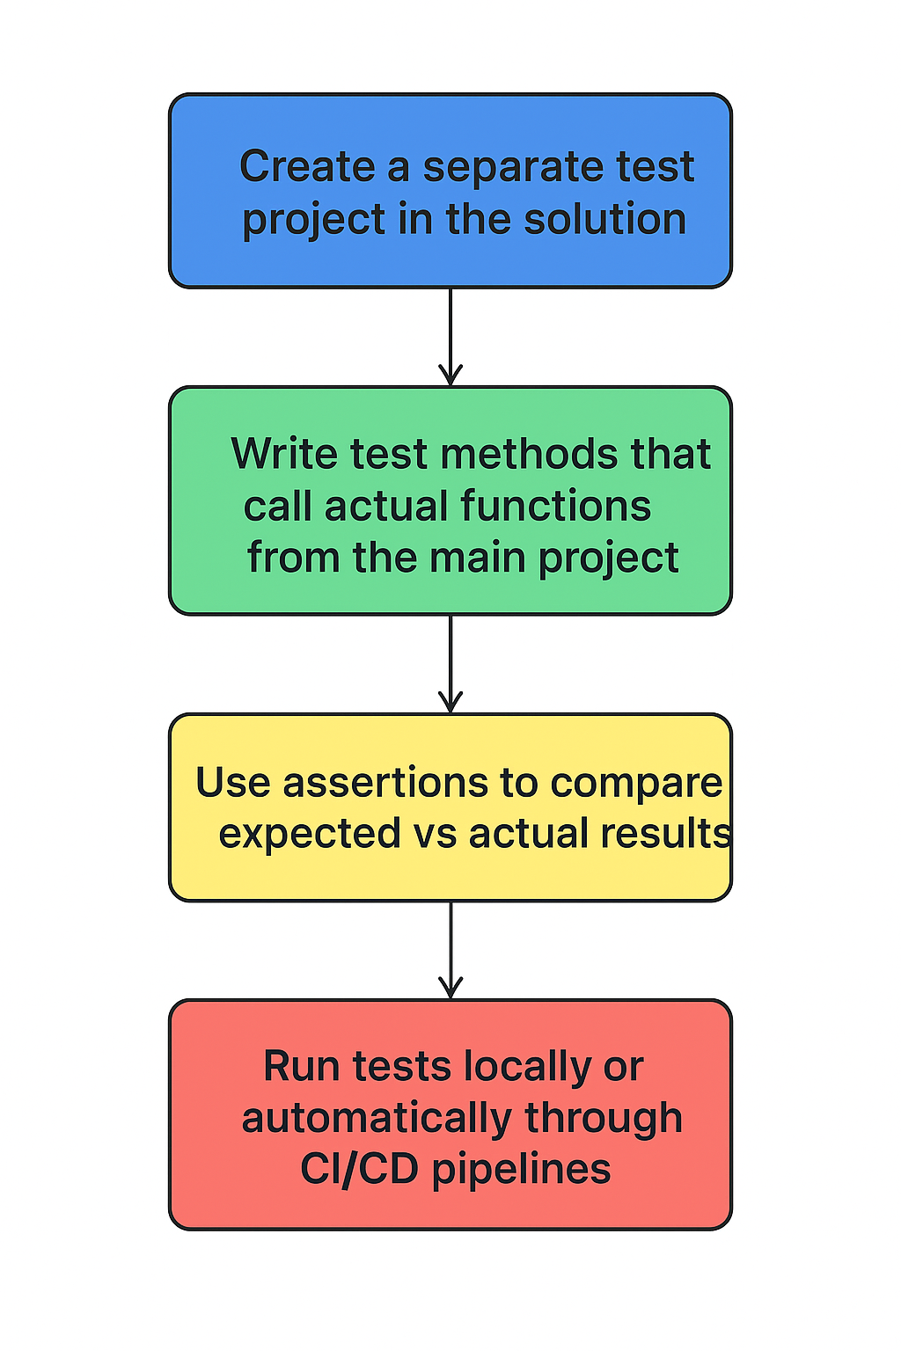

Slide 11
Benefits of Unit Testing
Early detection of bugs
Better code quality
Faster debugging
Reduced cost of fixing errors
Encourages writing clean, maintainable architecture
Makes future updates easier and safer.

Slide 12
Real Examples of What Unit Tests Can Check
🗝️ Key Examples of Unit Testing usage are :
Validating business logic (e.g., bill calculations)
Correct data transformations
Edge cases (null values, invalid inputs)
Ensuring exceptions are thrown correctly
Verifying performance-critical functions

Slide 13
Unit Testing in Enterprise Projects
Acts as a safety net during big project changes
Ensures teams can work in parallel confidently
Helps maintain quality across large codebases
Essential for DevOps, Agile, and Microservices

