Slide 1


Slide 2


1 / 12
Foundational Concepts - I
By :Mr. Shivam Supekar

Slide 3

Agenda
1
Introduction
2
Understanding SSMS
3
SQL BASICS
4
Data Types, Tables, Keys
CRUD, Query Optimization(Indexes, SQL profiler)
Aggregate Functions
5
6
7
Use Cases
8
Assignment
9
Debrief

Slide 4

Introduction to DBMS and MSSQL
What is a DBMS ?
A Database Management System (DBMS) is software that stores, organizes, and manages data efficiently.
It supports data retrieval, manipulation, and administration in a multi-user environment.
Why MSSQL?
Microsoft SQL Server (MSSQL) is a popular relational DBMS used for storing and managing structured data
It offers powerful tools like SQL Server Management Studio (SSMS) for database development, management, and administration
Key Features of MSSQL:
Supports SQL for querying and managing data
Provides security, backup, and recovery mechanisms
Enables high performance and scalability

Slide 5
SQL Server Management Studio
What is SSMS?
SQL Server Management Studio (SSMS) is a graphical interface for managing Microsoft SQL Server.
It helps database developers and administrators interact with databases visually or through T-SQL.

Slide 6
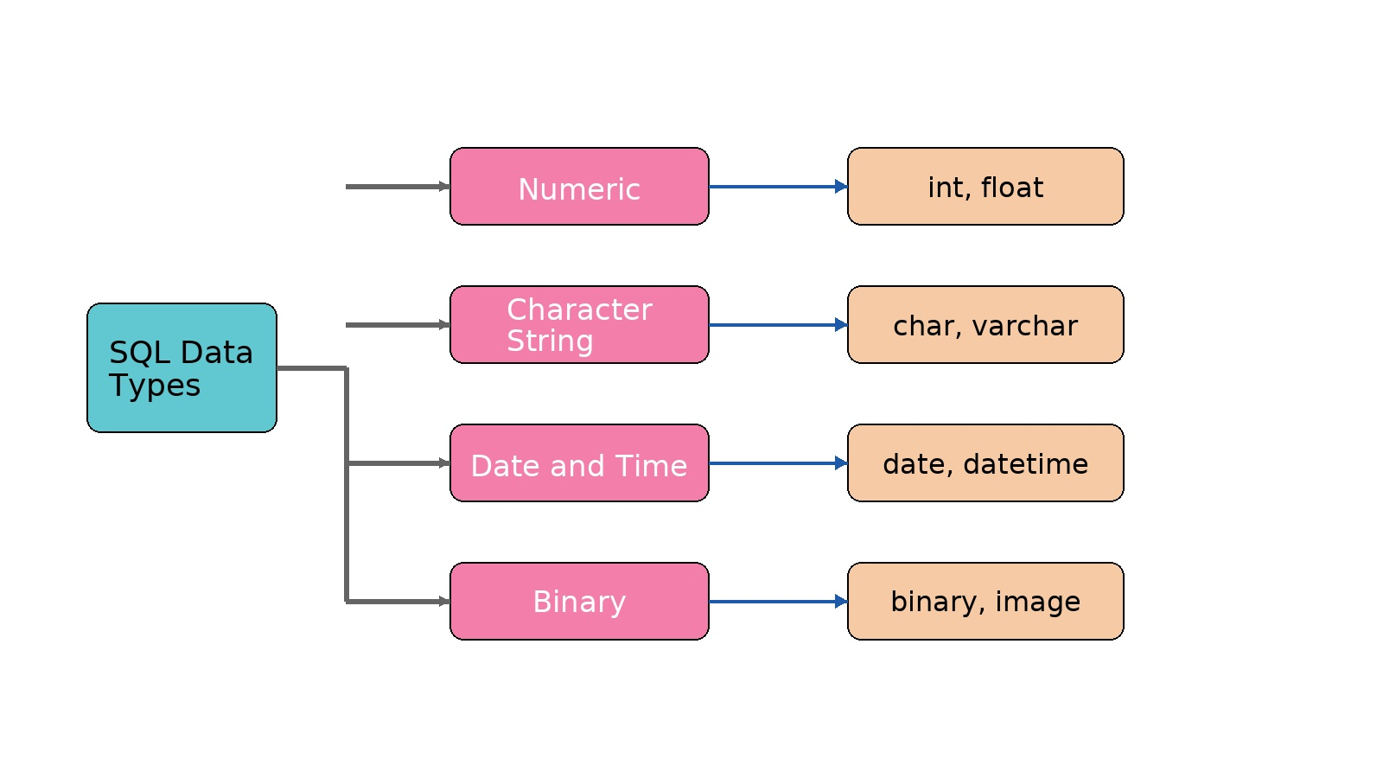
Data Types
6

Slide 7
Data Types
Examples :
Int : INT = 25
Float: FLOAT = 88.65
Char : CHAR(5) = ‘AB’
Varchar : VARCHAR(50) = ‘Shivam’
Date : DATE = ‘2000-02-08’
DateTime : DATETIME = GETDATE()
Time : TIME = '14:30:00’
7

Slide 8
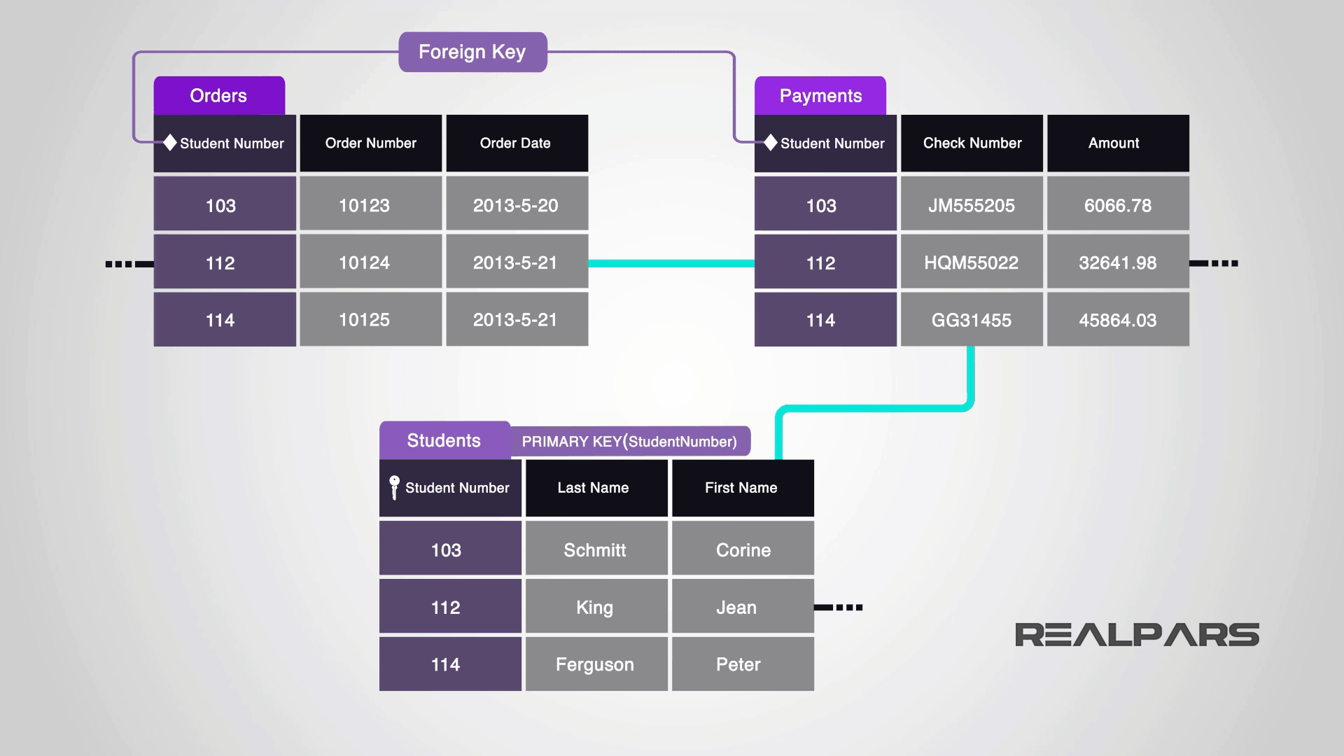
Tables
🗂️ What Is a Table?
A table is a structured set of data organized into rows and columns.
Each row represents a single record.
Each column represents a field with a specific data type (e.g., name, age, email).
All data in SQL is stored in tables — they are the foundation of any relational database.
8

Slide 9
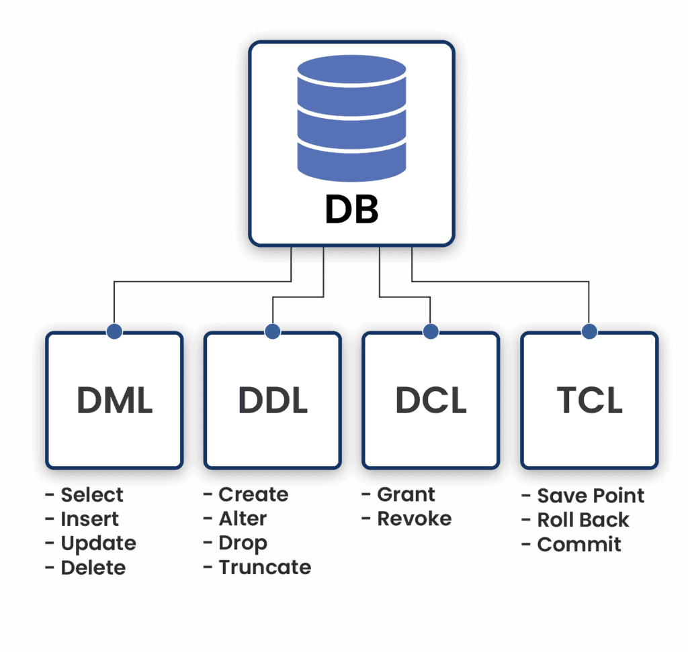
SQL Basics

Slide 10
DML(Data Manipulation Language)
Command | Syntax Example
SELECT | SELECT column1, column2 FROM table_name WHERE condition;
INSERT | INSERT INTO table_name (col1, col2) VALUES (val1, val2);
UPDATE | UPDATE table_name SET col1 = val1 WHERE condition;
DELETE | DELETE FROM table_name WHERE condition;

Slide 11
DDL(Data Definition Language)
Command | Syntax Example
CREATE | CREATE TABLE table_name (col1 datatype, col2 datatype);
ALTER | ALTER TABLE table_name ADD column_name datatype;
DROP | DROP TABLE table_name;
TRUNCATE | TRUNCATE TABLE table_name;

Slide 12
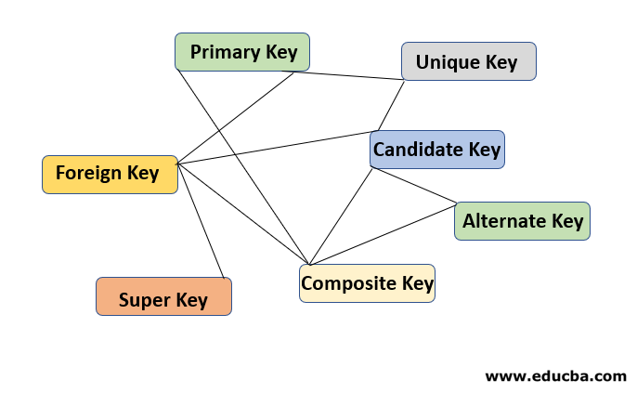
Keys
12

Slide 13
Types of Keys
Keys | Definition
🔑 Primary Key | A column (or combination of columns) that uniquely identifies each row in a table. Cannot contain NULL values. Only one primary key per table.
🔑 Foreign Key | A column that references the primary key of another table. Enforces referential integrity between tables. Can contain duplicates and NULL
🔑 Composite Key | A combination of two or more columns used together to uniquely identify a row. All columns in the composite key together act as the primary key
🔑 Unique Key | Ensures all values in the column are unique across the table. Unlike primary key, it can accept one NULL (in SQL Server)
🔑 Candidate Key | A column (or set of columns) that can uniquely identify a row. Every table can have multiple candidate keys, but only one becomes the primary key.
🔑 Alternate Key | A candidate key that was not chosen as the primary key. Still uniquely identifies rows, but not used as the main identifier.
🔑 Super Key | A set of one or more attributes that uniquely identifies a record in a table. Includes all candidate keys plus any extra attributes
13

Slide 14
Commonly Used Keys
Key Type | Description
Primary Key | Uniquely identifies each record in a table
Foreign Key | Establishes a link between two tables
Unique Key | Ensures all column values are distinct, allowing one NULL.
14

Slide 15
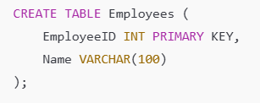
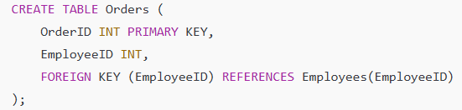
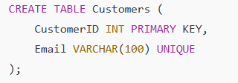
Commonly Used Keys
Primary Key | Foreign Key | Unique Key
15

Slide 16
Commonly Used Keys
Primary Key
Use Case: To uniquely identify each record in a table.
Example: In an Employees table, EmployeeID is the Primary Key because each employee must have a unique ID.
Foreign Key
Use Case: To establish relationships between tables and maintain referential integrity.
Example: In a Orders table, EmployeeID is a Foreign Key referencing the Employees table, ensuring an order is always linked to a valid employee.
Unique Key
Use Case: To prevent duplicate values in non-primary columns.
Example: In the Employees table, Email should be unique for every employee.
16

Slide 17
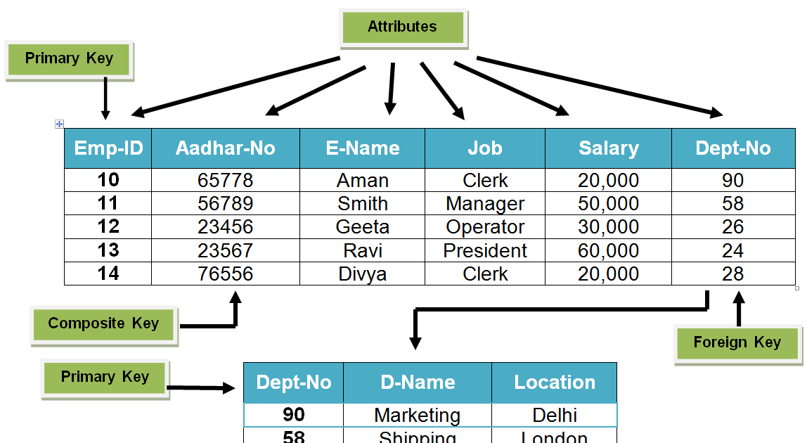
Relationship Between various Keys
17

Slide 18
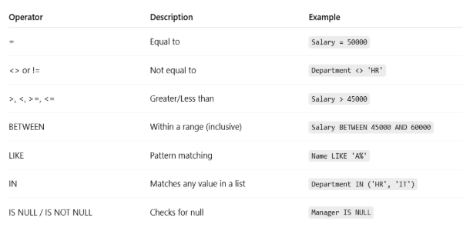
Conditional Operators

Slide 19
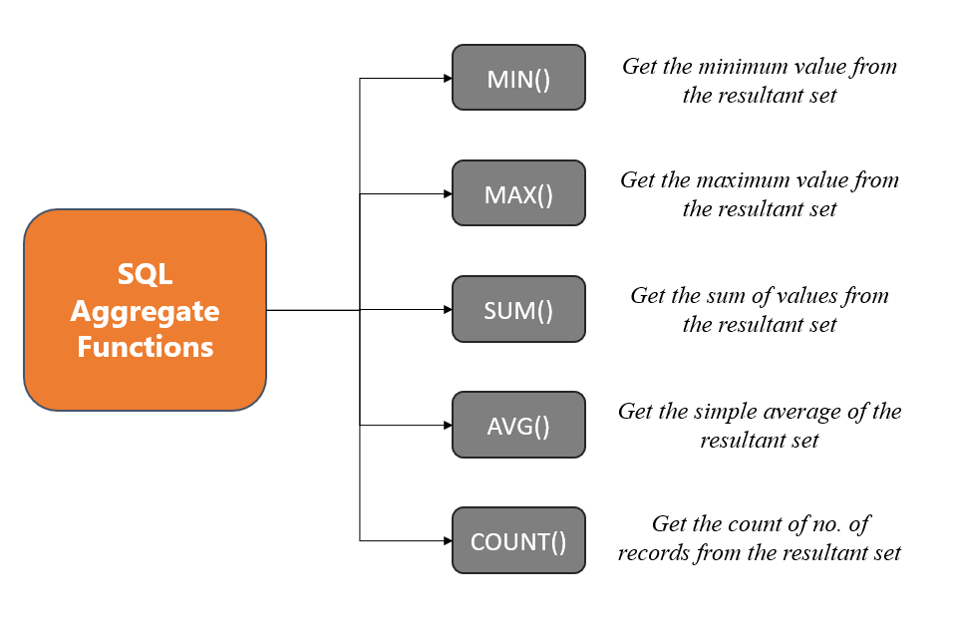
Aggregate Functions
19

Slide 20
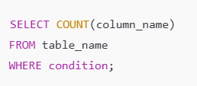


Aggregate Functions
Aggregate Functions | Syntax
COUNT()
SUM()
AVG()
20

Slide 21
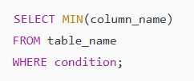

Aggregate Functions
Aggregate Functions | Syntax
Min()
MAX()
21

Slide 22




COUNT()
Description | Syntax
Count All Rows
Count Specific Column (excluding NULLs)
Count with WHERE Condition
Count DISTINCT Values
22

Slide 23
Use Cases
Topic | Real-World Use case
DBMS / MSSQL | Banks use MSSQL to store customer accounts, transactions, and loan data securely
SSMS & SQL Basics | E-commerce platforms use SSMS to query customer orders and filter product inventory.
Tables & Data Operations | Universities use structured tables for students, courses, and enrollments with keys.
Optimization & Indexes | Fintech apps use indexes to speed up search on millions of transactions.
Aggregate Functions | HR systems calculate average salaries, total working hours, and department stats

Slide 24

Assignment
Task 0: Create Smart Meter Database Tables
Objective: Create the database tables needed to store smart meter readings, and customer details.
Instructions: Write SQL CREATE TABLE statements to define the following two tables:
1. Customers
CustomerId
Name (customer name)
Address
Region (e.g., North, South, East, West)
2. SmartMeterReadings
MeterId
CustomerId
Location (e.g., rooftop, basement)
InstalledDate
ReadingDateTime
EnergyConsumed

Slide 25
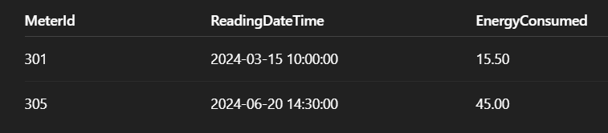
Assignment
Task1 :
Write a query to
Fetch all smart meter readings where:
EnergyConsumed is between 10 and 50 kWh
ReadingDateTime is between '2024-01-01' and '2024-12-31'
Exclude meters installed after '2024-06-30'
OUTPUT FORMAT:

Slide 26
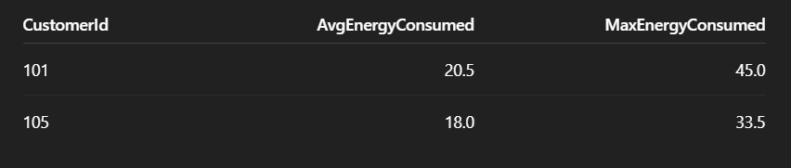
Assignment
Task2 :
For each customer, calculate:
Average energy consumed per reading
Maximum energy consumed in a single reading.
Only include readings from the current year.
OUTPUT FORMAT:

Slide 27

+
+
+
+
LEVEL
Stretch Goals
+
UP
+
+
Smart Meter Energy Summary
Objective: Analyse smart meter readings with moderate filtering and grouping.
Write a query to:
For each meter, calculate:
Total energy consumed during peak hours (6 PM to 10 PM)
Number of readings recorded during that time
Only include meters that:
Have more than 10 readings in total
Were installed before 2025-01-01
Consider only readings from the current year

Slide 28
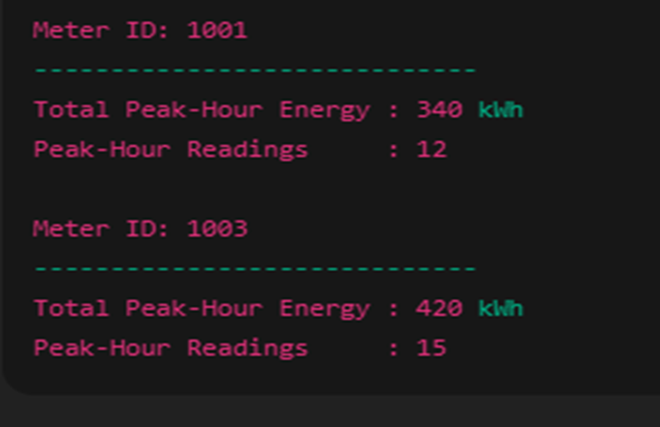
+
+
+
+
LEVEL
Stretch Goals
+
UP
+
+
Output format :

Slide 29
Debrief
Introduction to DBMS and MSSQL
SSMS
SQL Basics
Data Types,Tables,Keys
CRUD, Query Optimization
Aggregate Functions
Use cases

Slide 30
📘 Official Resources (High-Quality & Up-to-Date)
https://learn.microsoft.com/en-us/sql/sql-server/?view=sql-server-ver16
References

Slide 31
Q&A

