Slide 1


Slide 2


Dependency Injection and Configuration
By : Mr. Shivam Supekar

Slide 3

Agenda
1
Dependency Injection (DI) Basics
2
Configuration in .NET core
3
Working with appsettings.json
4
configuration
5
Use Cases
6
Assignment
7
Debrief

Slide 4

Dependency Injection(DI)
Dependency Injection :
Dependency Injection (DI) is a design pattern used to supply a class with its required dependencies from the outside rather than creating them internally.
In simpler terms:
"Instead of a class creating its own tools, they're handed to it when needed.“

Slide 5
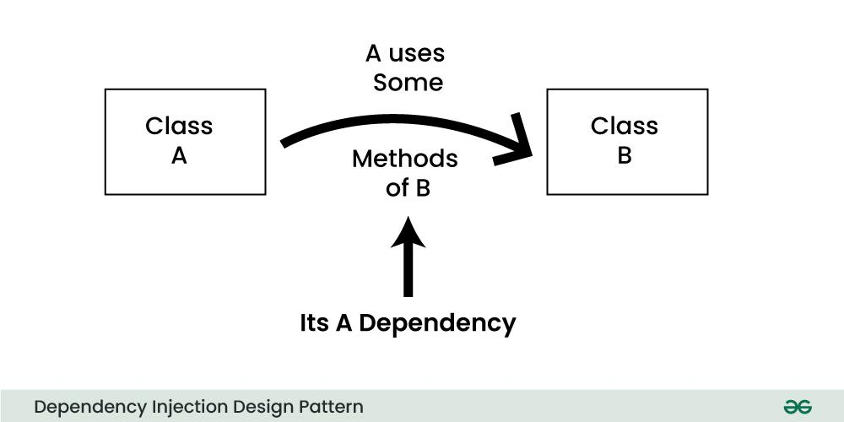

Slide 6

Dependency Injection(DI)
Why is DI Important?
Hard-coding dependencies makes code:
Rigid
Hard to test
Difficult to maintain
DI promotes loose coupling and code reuse
Common Real-Life Analogy
"A coffee machine shouldn't grow its own beans — it should be given beans to work with." → The beans = dependency → Giving them to the machine = injection

Slide 7
Dependency Injection(DI)
🗝️ Key Benefits of Dependency Injection
Benefit | Explanation
Testability | Easier to inject mock services during unit testing
Decoupling | Reduces tight connection between classes and their dependencies
Maintainability | Easier to swap or upgrade components without changing core logic
Reusability | Services can be reused across multiple components

Slide 8
DI in .NET Core
Built-in DI Container
Lightweight, integrated in ASP.NET Core
Register services in Program.cs or Startup.cs
Service Lifetimes
Lifetime | Description | Use case
Transient | New instance every time requested | Stateless, lightweight services
Scoped | One instance per HTTP request | Share data during request lifecycle
Singleton | Single instance for app lifetime | Shared resources ,caches, configs

Slide 9

DI in .NET Core
Syntax Examples :
Why Choose the Right Lifetime?
Performance: Avoid unnecessary object creation
Data Consistency: Scoped shares data during a request
Thread Safety: Singletons must be thread-safe

Slide 10
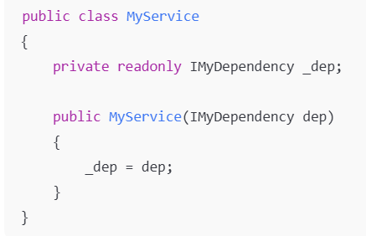
Constructor Injection
Constructor Injection
Services are provided to a class through its constructor parameters.
The DI container automatically injects required dependencies when creating instances.
Promotes clear dependencies and easier testing.

Slide 11
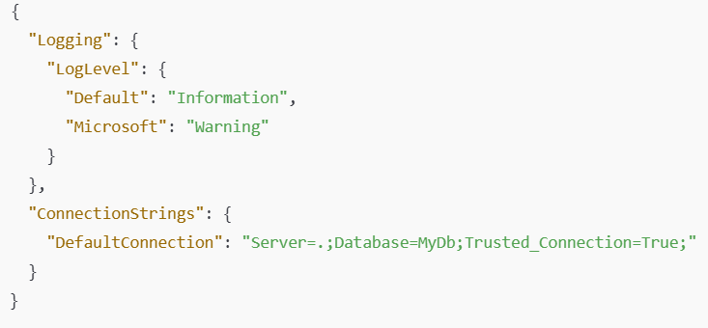
Appsettings.json Overview
🛠️ Structure of appsettings.json
JSON format configuration file
Stores key-value pairs and nested sections
Example:

Slide 12

Appsettings.json Overview
🛠️ Default loading in Program.cs
ASP.NET Core automatically loads appsettings.json at startup
Configuration is accessible via IConfiguration
Example:
🛠️ Environment-Specific Configs
Override settings per environment (e.g., Development, Production)
Files like appsettings.Development.json load automatically when environment matches
Supports safe, environment-specific customization

Slide 13
Accessing Configuration
✅Using IConfiguration Interface
IConfiguration is the main interface used to read values from appsettings.json and other sources.
It's automatically available in Program.cs, Startup.cs, and can be injected into services or PageModels.
✅ Key Points
Inject IConfiguration into constructors for access.
Values come from appsettings.json, environment variables, etc.
Supports binding to custom classes for structured config access.

Slide 14
Configuration Binding in ASP.NET Core
What is Configuration Binding?
Binds values from appsettings.json to C# classes
Enables type-safe and structured access to config data
Makes configuration easier to maintain and test
Why Use Configuration Binding?
✅ Type-safe access to settings
✅ Centralized config logic
✅ Works seamlessly with DI
✅ Supports multiple environments

Slide 15
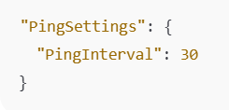
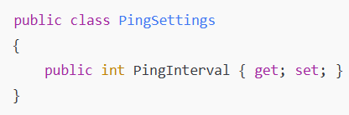
Configuration Binding in ASP.NET Core
Example-JSON configuration
✅ Stored in appsettings.json
Strongly Types class
✅ Property names must match JSON keys (case-insensitive)

Slide 16

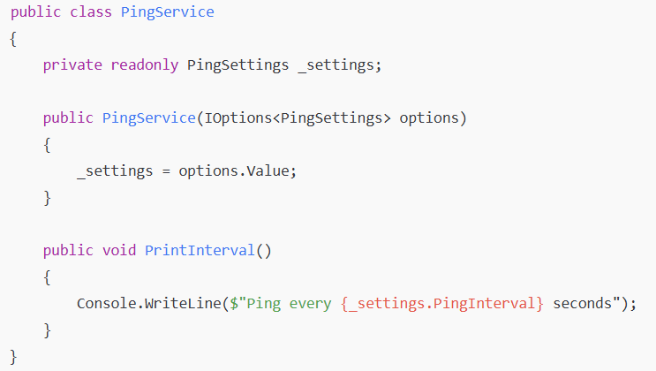
Configuration Binding in ASP.NET Core
Registering with DI
✅ Registers the section with the DI container
✅ Enables injection via IOptions<PingSettings>
Injection Using IOptions <T>
✅ Use .Value to access the bound configuration

Slide 17
Use Cases
🔧 Real-World Use Cases of Dependency Injection
Logging Services Inject ILogger<T> to log application events.
Database Access Inject DbContext for data operations using EF Core.
Configuration Access Inject IOptions<T> to access app settings.
Third-Party APIs Inject HTTP clients using IHttpClientFactory.
Authentication & Authorization Inject services for user identity and role checks.
Background Services Inject dependencies into IHostedService implementations.
Custom Business Logic Services Inject domain-specific services (e.g., billing, notifications).

Slide 18
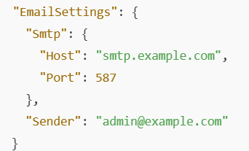

Assignment
🔧 Advanced Assignment 1: Custom Configuration Section with Nested Settings
Goal: Bind a complex, nested configuration section to a strongly typed class and inject it into a service.
Tasks :
Create a class structure with nested classes for binding
Register the configuration using Configure<EmailSettings>()
Inject into a service and log Host, Port, and Sender at startup

Slide 19
Assignment
🔧 Advanced Assignment 2: Using IOptionsMonitor<T> for Live Config Reload
Goal: Use IOptionsMonitor<T> to watch for config changes without restarting the application.
Tasks:
Create a FeatureToggleSettings class with a property like IsFeatureXEnabled
Bind it to "FeatureToggleSettings" in appsettings.json
Register it using services.Configure<T>()
Inject IOptionsMonitor<FeatureToggleSettings> into a singleton service
Log any changes to the setting using the OnChange() callback

Slide 20

Assignment
🔧 Advanced Assignment 3: Named Options for Multiple Config Sections
Goal: Use named options to bind and inject multiple configuration sections of the same type.
Tasks:
Define two sections in appsettings.json
Create a single class TimeoutSettings
Register both using named options:
Inject IOptionsSnapshot<TimeoutSettings> with name resolution
Log different timeout values for each service

Slide 21
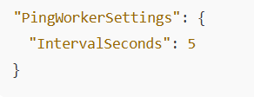
Assignment
🔧 Advanced Assignment 4: Binding Config to a Background Hosted Service
Goal : Bind configuration to a hosted background service (e.g., timer-based worker).
Tasks:
Create a section:
Bind to a PingWorkerSettings class and register it with DI
Create a BackgroundService that:
Injects IOptions<PingWorkerSettings>
Runs a timer loop that logs every X seconds based on the setting
Log at each interval using ILogger

Slide 22

+
+
+
+
LEVEL
Stretch Goals
+
UP
+
+

Slide 23
Debrief
Dependency Injection
Configuration in .NET Core
Configuration Binding
IOptions Pattern
Use cases

Slide 24
📘 Official Resources (High-Quality & Up-to-Date)
https://learn.microsoft.com/en-us/aspnet/core/fundamentals/dependency-injection
https://learn.microsoft.com/en-us/aspnet/core/fundamentals/dependency-injection#service-lifetimes
References

Slide 25
Q&A

