Slide 1


Slide 2


1 / 12
Foundational Concepts - I
By : Mr .Shivam Supekar

Slide 3

Agenda
1
Introduction to .NET
2
Data Types, Variables, Operators
3
Conditions, Loops
4
Use Cases
5
Assignment
6
Debrief

Slide 4

What is .Net?
Modern & Open-Source
Developed by Microsoft, .NET is a free, open-source platform supported by a global developer community.
All-in-One Development Platform
Use the same tools and libraries to build apps for web, desktop, mobile, IoT, AI, and cloud.
High Performance & Scalable
Provides fast, optimized runtime and powerful libraries for enterprise solutions.
Multi-Language Support
Compatible with C#, F#, and Visual Basic for flexible coding

Slide 5
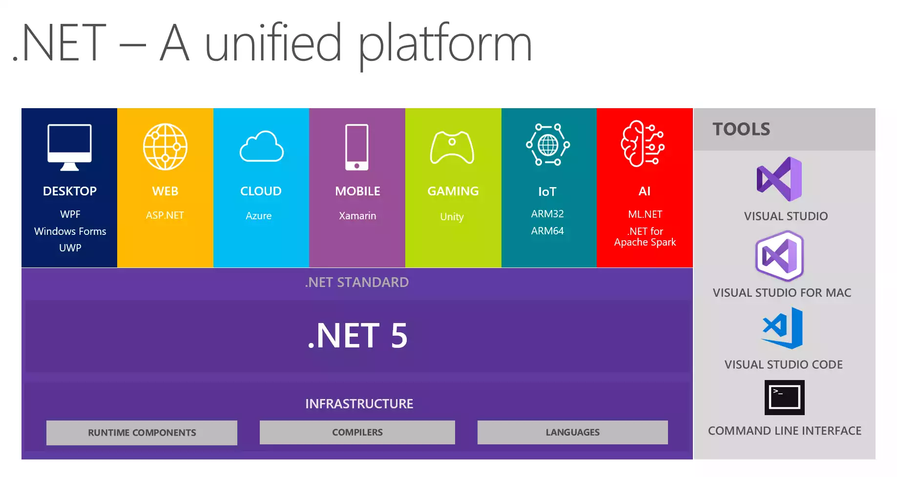

Slide 6
Why .Net Supports Multiple Languages?
🔹 Why Multiple Languages?
🌟 Developer Choice → Choose preferred language for productivity
🌟 Legacy Code Support → VB.NET and F# still widely used in enterprise
🌟 Programming Paradigms → Support both OOP (C#/VB.NET) and Functional (F#)
🌟 Unified Runtime (CLR) → All compile to CIL, run on same .NET platform
🌟 Interoperability → Mix and match components in different languages

Slide 7
 | C# | F# | VB.NET
Use Case | Modern apps, Web, APIs | Data, AI, analytics | Legacy systems
Paradigm | Object-Oriented | Functional-first | Object-Oriented
Strengths | Rich tooling, huge community | Concise, immutable data | Easy syntax, readable
Support | Actively developed | Actively supported | Maintenance only

Slide 8
.NET vs ASP.NET
Aspect | .NET | ASP.NET
Definition | A software development platform/framework | A web development framework within .NET
Purpose | Used to build all types of applications | Specifically used to build web applications
Application Types | Desktop, mobile, cloud, gaming, web, etc. | Web applications (websites, web APIs, etc.)
Includes | CLR, class libraries, languages (C#, VB.NET) | Libraries and tools for web development
Framework Types | General-purpose framework | Specialized framework under the .NET umbrella
Examples | WinForms, WPF, Console apps, etc. | ASP.NET MVC, ASP.NET Web Forms, Razor Pages

Slide 9
Components Of .Net
.NET Runtime (CLR)
.NET Class Library
Languages (C#, F#, VB.NET)
Asp.NET
Entity Framework(EF CORE)
.NET SDK AND CLI TOLS
Cross-Platform Support

Slide 10
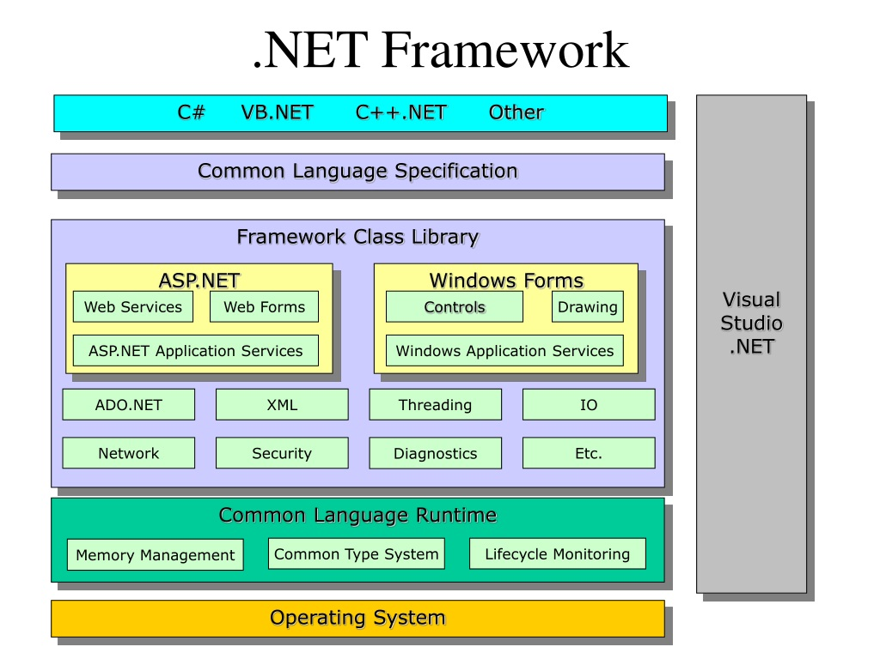

Slide 11

When you write C# code, how does your computer actually understand it?

Slide 12

CLR-The Heart of .NET
Meet the CLR — the Common Language Runtime.
Think of it as the interpreter, manager, and bodyguard for your code
Hey! , I Am CLR

Slide 13
CLR-The Heart of .NET
Interpreter – Translates your IL (Intermediate Language) into native machine instructions using the JIT Compiler
Manager – Allocates memory, cleans it up when not needed (Garbage Collector)
Bodyguard – Checks your code for security issues before running it
Doctor – Fixes problems on the fly by handling exceptions
(Note: IL (Intermediate Language) - A platform-independent, low-level code generated from C# before being converted to machine code by the JIT compiler.

Slide 14
CLR-The Heart of .NET
JIT Compilation
Security
CLR
Memory Management
Exception Handling

Slide 15
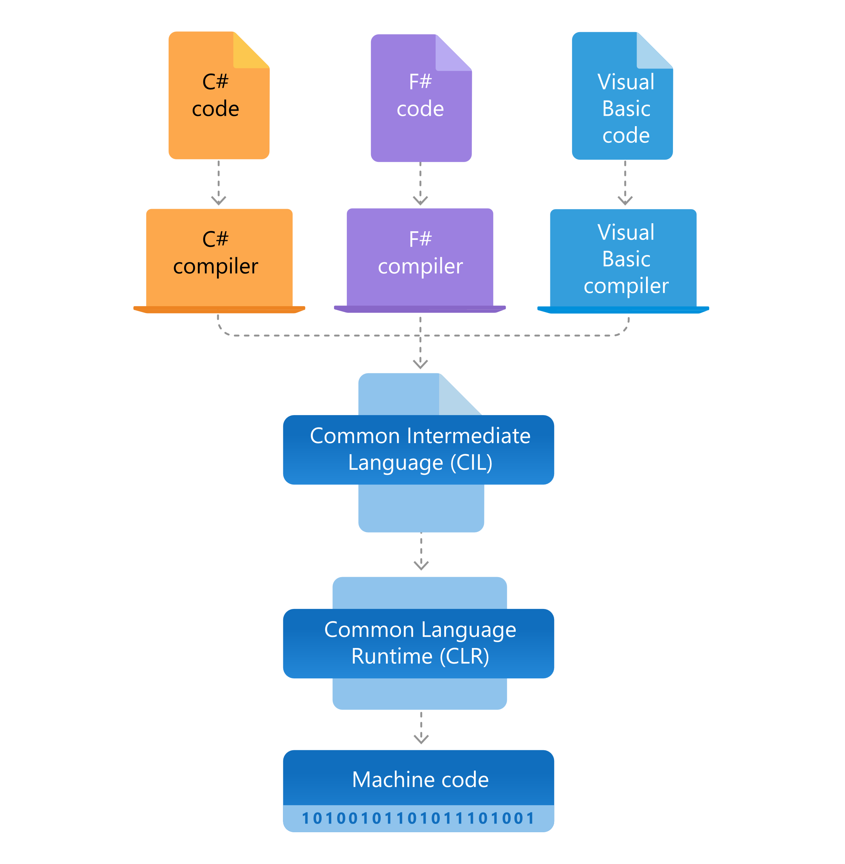

Slide 16
BCL-Base Class Library
Base Class Library (BCL): A comprehensive set of reusable classes, interfaces, and value types that are tightly integrated with the Common Language Runtime (CLR).
It includes libraries for:
File and directory manipulation (System.IO)
Networking (System. Net)
Collections (System.Collections)
Text processing (System.Text)
Security (System.Security)
Data access (System.Data)
XML processing (System.Xml)
And many other common programming tasks.

Slide 17
Components Of .Net
A set of tools and libraries tailored for building specific types of .NET applications (like web, desktop, or mobile).
Converts C# Intermediate Language (IL) code into native machine code at runtime for efficient execution.
Automatically frees memory by removing objects no longer in use.
Workload:
JIT (Just-In-Time) Compiler:
Garbage Collector (GC):

Slide 18
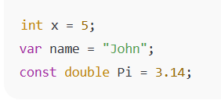
Data Types, Variables, Operators
Data Types.
Value Types(e.g. :int,double,bool) –store data directly.
Reference types(e.g. :sting,arrays,classes )-store memory addresses
Nullable types(e.g.: int?) –enable nullability for value types
Variables & Constants
Variables: store runtime data
Explicit : int x =5;
Implicit : var name =“John” ;
Constants : fixed values via const (e.g. :const double Pi =3.14;) –boost readability

Slide 19
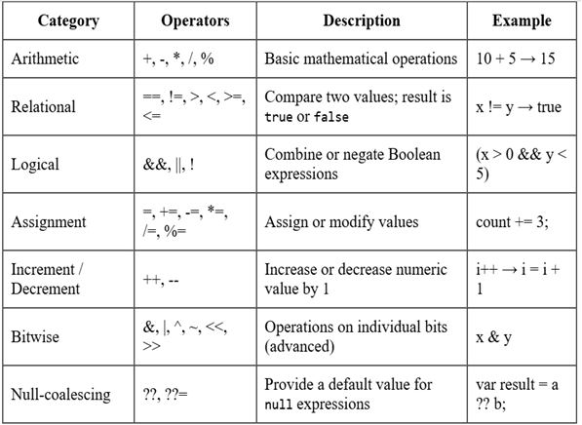
Types of Operators

Slide 20
Conditions
Control flow determines the order in which individual statements, instructions, or function calls are executed or evaluated in a program.
.NET provides conditional statements and loops to control this flow, enabling programs to make decisions and perform repetitive tasks efficiently.
The main conditional statements are:
if statement
if-else statement
if-else if statement (also called if-elif-else in some languages)
switch statements

Slide 21
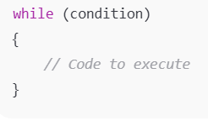
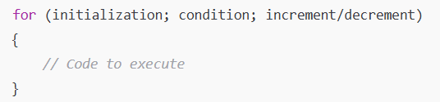
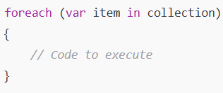
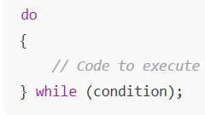
Loops
🔄 Looping Constructs in .NET :
While Loop
For Loop
Foreach Loop
Do-While Loop
ideal when iteration count is unknown
best for fixed or index-based loops
iteration over collections without index handling
useful for prompts or guaranteed single-run operations

Slide 22
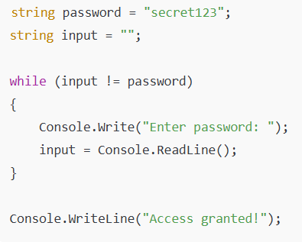
While Loop
🔄 While Loop:
Keeps running as long as the condition is true — number of repetitions unknown.
Real-World Analogy: Waiting at a bus stop until the bus arrives.
Eg: Suppose you want to keep asking the user to enter a password until they get it right.

Slide 23
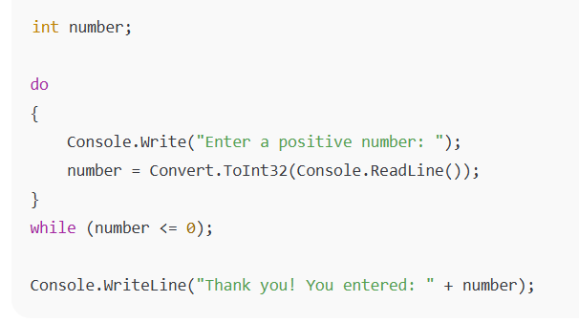
Do-While loop
🔄 Do-While Loop: Do First, Check Later
Always runs at least once, even if the condition is false.
Real-World Analogy: Trying a dish once before deciding if you like it.
Eg : Ask the user to enter a number and keep asking until they enter a positive number:

Slide 24
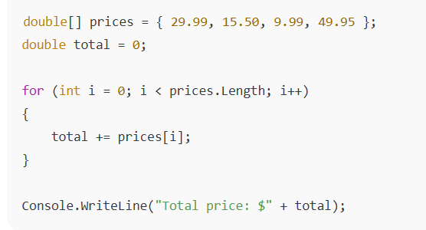
For Loop
🔄 For Loop: Count & Repeat
Used when you know exactly how many times to loop.
Real-World Analogy: Climbing exactly 10 steps in a staircase.
Eg : Calculate the total price of items in a shopping cart:

Slide 25
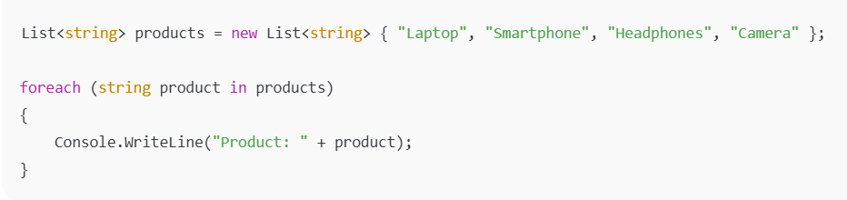
Foreach Loop
🔄 Foreach Loop: Go Through the Collection
Runs once for every item in a list, array, or collection.
Real-World Analogy: Calling each friend in your contact list.
Eg : Displaying Product Names in an E-commerce App

Slide 26
Use Cases
Construct | Real-World application scenario | Why its used
Value Types (int, double, bool) | Financial apps (e.g., counters, amounts, flags) | Store small, immutable values with high performance
Reference Types (class, string, array, List<T>) | Modeling users, carts, and shared data in web or enterprise systems | Enable complex, mutable objects and shared state
Operators & Conditions (e.g., &&, ==, if) | E-commerce checkout eligibility, business rule validations | Combine criteria and steer application logic
for Loop | Batch processing daily records or fixed-length data | Efficient for array indexing and summarizing data
foreach loop | Iterating through orders, UI lists, API collections | Clean, safe iteration without managing indices
while Loop | Validating user input until correct, processing streams or queues | Handles unknown-length tasks flexibly

Slide 27



Assignment
Write a console program that takes a meter serial number as input and prints it.
Sample Input :
Expected Output :

Slide 28


Assignment
Create a program that checks if a meter's reading is within a valid range (100–200).
Sample Input :
Expected Output :

Slide 29
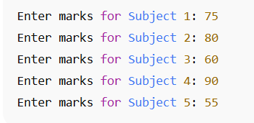
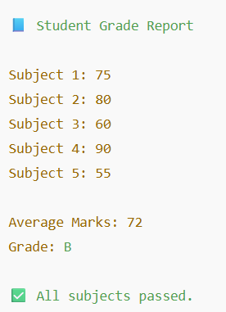
Assignment
Create a student grade evaluator that takes scores for five subjects, calculates average, assigns a grade, and flags failing marks using loops and conditional logic.
Sample Input:
Expected Output:

Slide 30
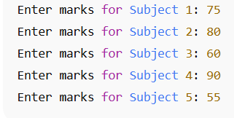
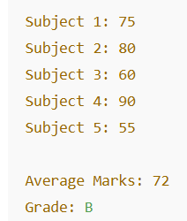
Assignment
Develop a number analysis tool that accepts a list of integers from the user, then calculates and displays the sum, average, highest, and lowest numbers using loops and arithmetic operators.
Sample Input :
Expected Output:

Slide 31
+
+
+
+
Stretch Goals
LEVEL
+
UP
+
Task 1: Meter Serial Number Input & Print
Original Task:
Take a meter serial number as input and print it.
Stretch Goals:
Input Validation:
Ensure the serial number follows a specific format like MTR-YYYY-XXX (e.g., MTR-2025-A1B2) using Regex.
Duplication Check:
Allow the user to enter multiple serial numbers and store them in a list.
Prevent duplicate entries and show a warning if one is repeated.
File I/O:
Save all entered serial numbers into a text file (serials.txt), one per line.
Checksum Validation:
Add logic to validate a simple checksum (e.g., last 2 digits must equal the sum of the digits in the year).
+

Slide 32
Debrief
.Net(C#)
Data Types,variables,Operators
Conditions , Loops
Use cases

Slide 33
📘 Official Resources (High-Quality & Up-to-Date)
Introduction to .NET - .NET | Microsoft Learn
References

Slide 34
Q&A

