Slide 1


Slide 2
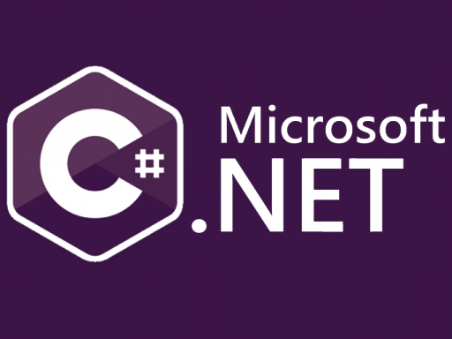

5 / 12
MVC and API Development
By: Mr. Shivam Supekar

Slide 3

Agenda
1
Create the Database
2
Connect with .NET
3
Create the model
4
Create the Controller
5
Add methods
6
Create the view
6
Apply methods in view
8
Use Cases
9
Assignment
10
Debrief

Slide 4
MVC
MVC is an architectural pattern that separates an application into three parts: Model, View, and Controller.
The Model represents the application's data and business logic.
The View is the user interface that displays the data (e.g., HTML or JSON).
The Controller handles user input, interacts with the Model, and chooses a View to render.

Slide 5
RestAPI
What is RestAPI?
REST API = Representational State Transfer Application Programming Interface
API (Application Programming Interface) : A way for two software applications to talk to each other. REST : A set of rules (architecture style) for designing APIs that are simple, scalable, and use HTTP (the same protocol as websites).
Uses HTTP methods (GET, POST, PUT, PATCH, DELETE).
Treats data as resources, each identified by a URL.
Stateless: each request is independent.
Returns data usually in JSON format.

Slide 6
HTTP METHODS
CRUD Operation | HTTP Method | RESTful Example | Description
Create | POST | POST /api/users | Creates a new user. The data for the new user is in the request body.
Read | GET | GET /api/users/123 | Retrieves the representation of the user with ID 123.
Update | PUT or PATCH | PUT /api/users/123 | Replaces the entire user object with the new data in the request body.
Delete | DELETE | DELETE /api/users/123 | Deletes the user with ID 123.

Slide 7
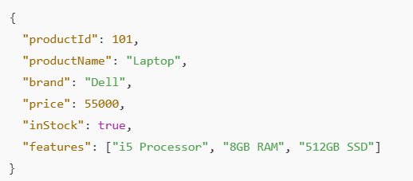
JSON
What is JSON?
JSON (JavaScript Object Notation)
A lightweight data format used to store and exchange information.
Easy for humans to read & write and easy for machines to parse & generate.
Mostly used in APIs to send data between client (browser/app) and server.
Looks like key–value pairs.

Slide 8
ADO.NET
What is ADO.NET?
ADO.NET (ActiveX Data Objects for .NET)
A data access technology in .NET.
It allows your C# / .NET application to connect to a database (like SQL Server, Oracle, PostgreSQL, etc.) and perform operations such as:
Read data
Insert new data
Update existing data
Delete data
Why use ADO.NET?
Before ADO.NET, connecting to databases was manual and complex, often tied to specific database vendors. ADO.NET gives a standardized and easy way to interact with different databases.

Slide 9
ADO.NET
What is ADO.NET?
ADO.NET (ActiveX Data Objects for .NET)
A data access technology in .NET.
It allows your C# / .NET application to connect to a database (like SQL Server, Oracle, PostgreSQL, etc.) and perform operations such as:
Read data
Insert new data
Update existing data
Delete data
Why use ADO.NET?
Before ADO.NET, connecting to databases was manual and complex, often tied to specific database vendors. ADO.NET gives a standardized and easy way to interact with different databases.

Slide 10
ADO.NET
Key Components of ADO.NET
Connection → Opens a link to the database.
Example: SqlConnection (for SQL Server).
Command → Used to run SQL queries or stored procedures.
Example: SqlCommand.
DataReader → Reads data fast and forward-only (one row at a time).
Example: SqlDataReader.
DataAdapter → Acts as a bridge between database and DataSet.
DataSet / DataTable → Stores data in memory (like an offline copy)

Slide 11
Structuring an API using a Service Layer For logic
A well-structured API separates code into distinct layers for maintainability.
The Controller layer handles raw HTTP requests and responses. It should be "thin."
The Service Layer contains the core business logic, validation, and orchestration.
The Data Access Layer (DAL) is responsible for all direct database communication.
This separation makes your application easier to test, reuse, and scale.

Slide 12
Structuring an API using a Service Layer For logic
Layer | Responsibility | Analogy
Controller Layer | Handles incoming HTTP requests and outgoing HTTP responses. Translates HTTP data into C# objects. | The Waiter
Service Layer | Contains the core application and business logic. Validates data, performs calculations, and orchestrates calls to the data layer. | The Head Chef
Data Access Layer (DAL) | Contains all the code that directly interacts with the database (e.g., ADO.NET code, SQL queries). | The Line Cook

Slide 13
Implementing Data Access Access Logic with ADO.NET in a service
The Data Access Layer (DAL) encapsulates all database code.
Methods in the DAL should map to CRUD operations (Create, Read, Update, Delete).
Read operations use ExecuteReader() and map the results to C# objects.
Create, Update, and Delete operations use ExecuteNonQuery().
The DAL's public methods should always return clean C# objects, not ADO.NET objects like a DataReader.

Slide 14
Ensuring Atomicity with Database Transactions
A database transaction groups a sequence of operations into a single, logical unit of work.
Its key property is atomicity: either ALL operations succeed, or NONE of them do.
If any single operation fails, the entire transaction is rolled back, undoing all changes.
Transactions are essential for maintaining data integrity and consistency.

Slide 15
Starting an Explicit Transaction with ADO.NET
In ADO.NET, you start a transaction by calling .BeginTransaction() on an open Connection object.
This method returns a Transaction object (e.g., NpgsqlTransaction).
All Command objects that are part of the transaction must have their .Transaction property set to this object.
The Transaction object itself is IDisposable and should be wrapped in a using statement.

Slide 16
Managing a Transaction with Commit and Rollback
The try...catch block is the essential structure for managing transactions.
You execute all your database commands inside the try block.
The very last line of a successful try block must be transaction.Commit() to make changes permanent.
If any exception occurs, the catch block is executed, where you must call transaction.Rollback() to undo all changes.

Slide 17
Defining API routes with Attribute Routing
Routing is how ASP.NET Core maps an incoming URL to a specific controller action method.
Attribute Routing is the preferred method for APIs, where you define routes directly on your controllers and actions.
A [Route(...)] attribute on the controller sets a base path (e.g., api/products).
HTTP verb attributes like [HttpGet] and [HttpPost] on the action methods complete the route.

Slide 18
Implementation of MVC design structure in Visual studio

Slide 19
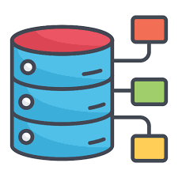
Create Database
Steps:
Choose a database (SQL Server, SQLite, etc.)
Create tables and relationships
Create database database_name;
Use database_name;
Create table employee Id (
INT PRIMARY KEY IDENTITY,
Name VARCHAR(100),
Email VARCHAR(100)
);

Slide 20
Data Connection with NpgsqlConnection
Npgsql is the official .NET data provider for the PostgreSQL database.
You must add the Npgsql NuGet package to your project to use it.
The NpgsqlConnection class is the specific ADO.NET component for connecting to PostgreSQL.
You must always properly open, close, and dispose of the connection, preferably with a using statement.

Slide 21

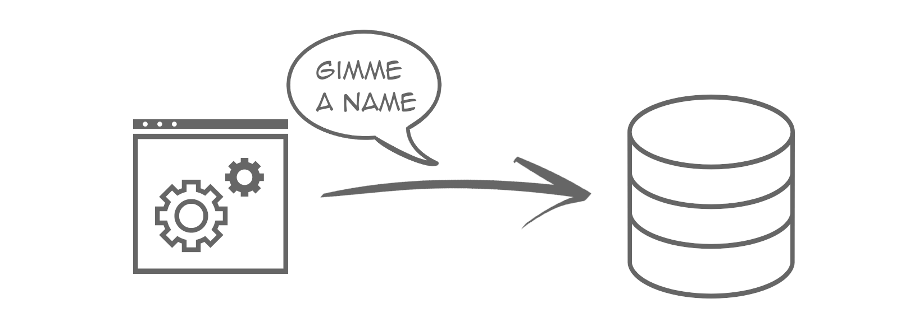
Connect with .NET
Steps:
Add connection string in appsettings.json :

Slide 22
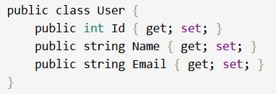
Create the Model
Steps:
Create a model class that maps to your table:
Add model to DbContext :

Slide 23
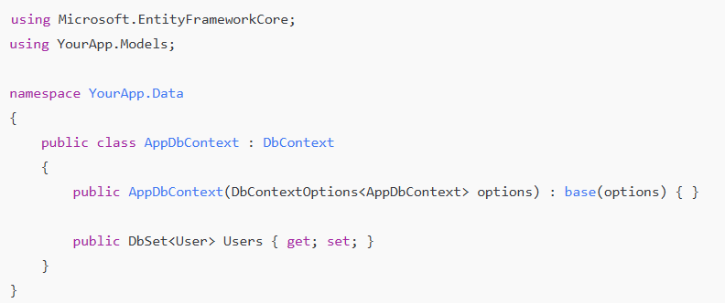
Create the DbContext
Steps:
Add Data/AppDbContext.cs :
DbContext is the bridge between your C# code and your SQL Server database.
It represents a session with the database

Slide 24
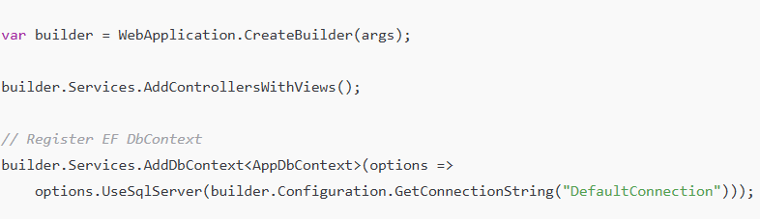
Register DbContext in Program.cs
Steps:

Slide 25

Code-First and Data-First
Steps:
If you want Code-First (let EF create tables): add and apply migrations
In Visual Studio Package Manager Console:
This will create the Users table according to your model.
If you already have an existing database (Database-First): scaffold model + context
Package Manager Console:
Scaffold-DbContext "Server=(localdb)\MSSQLLocalDB;Database=MyAppDB;Trusted_Connection=True;" Microsoft.EntityFrameworkCore.SqlServer -OutputDir Models -Context AppDbContext -DataAnnotations

Slide 26
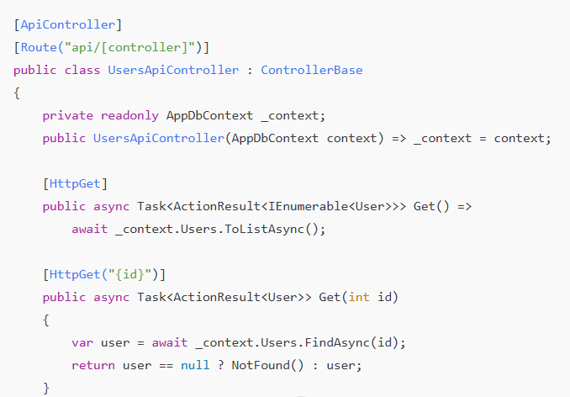
Create API Controller
Steps:
Add a new controller Controllers/UsersApiController.cs:
E.g,:

Slide 27
Add Methods
Purpose: Controller methods (also called actions) handle requests and define application behavior for different operations like displaying data, saving new records, editing, or deleting entries.
Common Methods in Controller
Index() – List all users Retrieves and displays all records from the database.
Create() – Show form / Save new user
GET Create: Displays the form to add a new user.
POST Create: Saves the new user to the database.
Edit() – Modify existing user
GET Edit: Loads the user data into a form for editing.
POST Edit: Saves the updated data.
Delete() – Remove a user
GET Delete: Displays confirmation for deletion.
POST DeleteConfirmed: Deletes the user from the database.

Slide 28
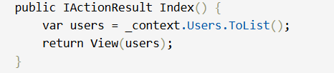
Add Methods
Example :

Slide 29

Apply Methods in View
Steps(optional)
Use Razor helpers to call controller actions:
Use form and @Html.BeginForm() for Create/Edit actions

Slide 30
Use Cases
Topics | Use cases
MVC | Clean separation of concerns for scalable web apps
Controllers | Handle requests, connect views & models
REST API | Serve data to frontends/mobile via HTTP verbs
Routing | Map URLs to actions; enable clean, dynamic paths
Filters | Add logging, auth, error handling (cross-cutting logic)
Services (BL) | Encapsulate business logic, injected via DI
CRUD | Core data operations – Create, Read, Update, Delete

Slide 31

Assignment
Assignment 1: Basic MVC Web App with CRUD
Objective: Build a simple MVC application to manage a list of products.
Tasks:
Create a Product model with properties: Id, Name, Description, Price.
Create a ProductController with actions for:
Listing all products (Index)
Viewing product details (Details)
Creating a new product (Create)
Editing an existing product (Edit)
Deleting a product (Delete)
Use in-memory data storage (e.g., a static list) to perform CRUD operations.
Implement basic routing so URLs follow RESTful conventions.

Slide 32
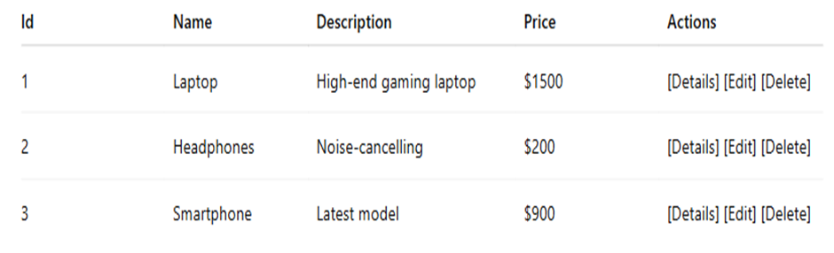
Assignment
Output Format: (e.g. for List All Products — /Products or /Products/Index)

Slide 33
Assignment
Assignment 2: RESTful API for Employee Management
Objective: Develop a REST API for employee data.
Tasks:
Create an Employee model with Id, Name, Department, Salary.
Implement an EmployeeController with REST endpoints:
GET /api/employees — List all employees
GET /api/employees/{id} — Get employee by ID
POST /api/employees — Add a new employee
PUT /api/employees/{id} — Update employee info
DELETE /api/employees/{id} — Delete an employee
Use routing attributes to configure routes.
Return appropriate HTTP status codes.
Use a simple in-memory list for storage.

Slide 34
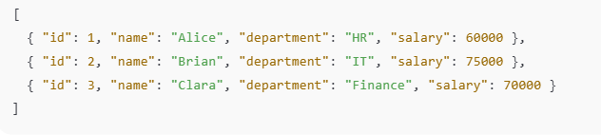
Assignment
Output Format: (e.g., for GET /api/employees)

Slide 35

+
+
+
+
LEVEL
Stretch Goals
+
UP
+
+
Implement Filters in MVC
Objective: Use filters for authentication and logging.
Tasks:
Create a custom authorization filter that restricts access to certain controller actions.
Implement a logging filter that logs action execution time and details.
Apply filters globally and on specific controller actions.
Demonstrate filters working in an MVC app with at least two controllers.

Slide 36
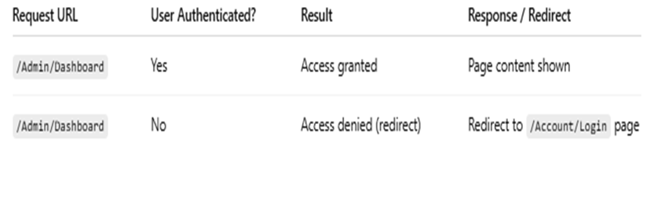
+
+
+
+
LEVEL
Stretch Goals
+
UP
+
+
Output Format :(e.g. for Authorization Filter)

Slide 37
📘 Official Resources (High-Quality & Up-to-Date)
References
https://learn.microsoft.com/en-us/aspnet/core/web-api/?view=aspnetcore-7.0
https://learn.microsoft.com/en-us/aspnet/core/data/ef-mvc/crud?view=aspnetcore-7.0

Slide 38
Thank you

