Slide 1


Slide 2


2 / 12
Foundational Concepts - II
By : Mr. Shivam Supekar

Slide 3

Agenda
1
Basic joins
2
Advanced Joins
3
Advanced SQL
4
Window Functions
5
Use Cases
6
Assignment
7
Debrief

Slide 4
Basic Joins
JOIN TYPE | DESCRIPTION | USE CASE EXAMPLE
INNER JOIN | Returns only matching rows from both tables. | List orders with matching customer details.
LEFT JOIN | Returns all rows from the left table, and matched rows from the right table. | Show all customers, even if they haven’t ordered.
RIGHT JOIN | Returns all rows from the right table, and matched rows from the left table. | Show all products, even those never ordered.
FULL OUTER JOIN | Returns all rows when there is a match in either table. | Combine customers and orders, including unmatched.

Slide 5
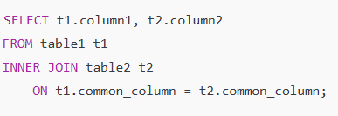
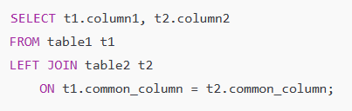
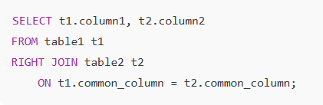
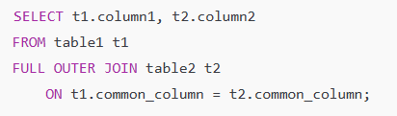
Basic Joins
JOIN TYPE | SYNTAX
INNER JOIN
LEFT JOIN
RIGHT JOIN
FULL OUTER JOIN

Slide 6
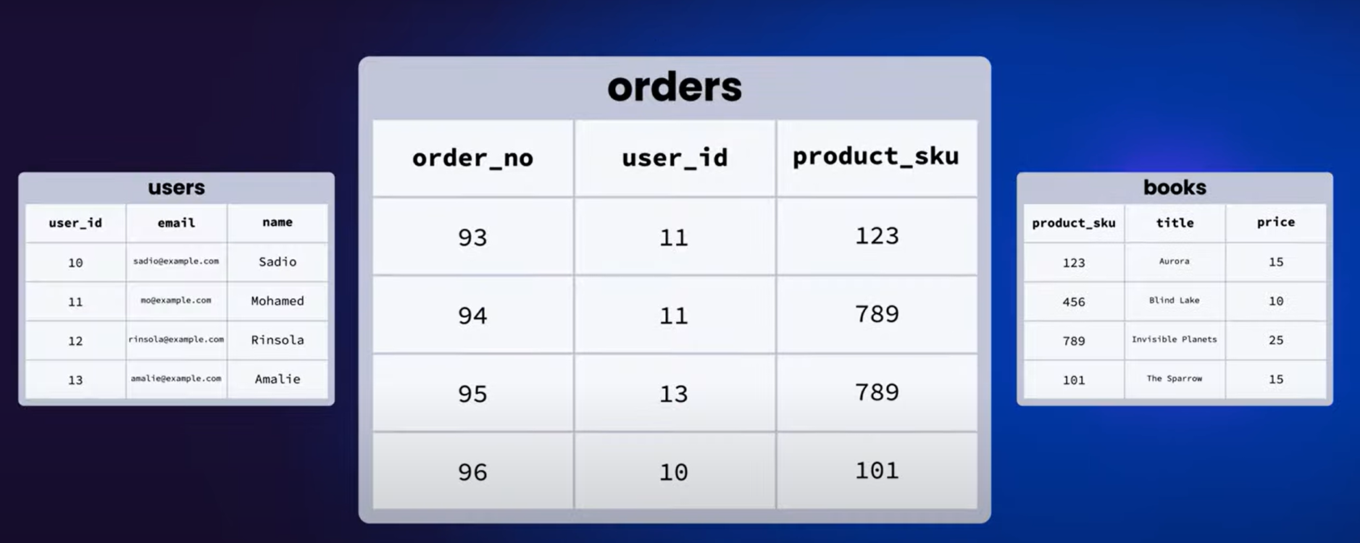
Tasks

Slide 7
Tasks
Find all the books all the users and all the order
Find all orders
Find particular user who has order these books
Find books users has order
Find total price of books user has order
Find the most valuable user
Find the range of books from high to low
Find the highest price book
Find the cheapest book
Find newly added books

Slide 8
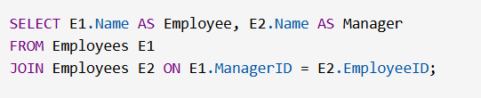

Advanced Joins
SELF JOIN | CROSS JOIN
Purpose: Compare rows within the same table. Use Case: Used to list employees alongside their managers from the same employee table. Key Idea: Table joins to itself using aliases. MSSQL Syntax: | Purpose: Combine every row from two tables. Use Case: Used to create all possible product and warehouse location pairs for inventory planning. Key Idea: No ON condition → full Cartesian product. MSSQL Syntax:

Slide 9
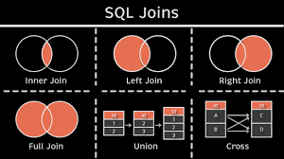
SQL Joins

Slide 10
Advanced SQL
COUNT
GROUP BY
HAVING
Used to count the number of rows in a table or group.
Can be used with * , a column name, or DISTINCT.
Ignores NULL values when used with a column name.
Commonly used with GROUP BY to count grouped values.
Groups rows that have the same values in specified columns.
Must be used with aggregate functions like COUNT, SUM, AVG, etc.
Columns in SELECT must be either in GROUP BY or aggregated.
Helps in summarizing data per group (e.g., per department, category).
Filters groups created by the GROUP BY clause.
Similar to WHERE, but used after aggregation.
Can include conditions using aggregate functions.
Comes after GROUP BY in the SQL query.

Slide 11


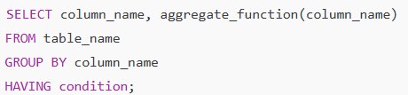
Advanced SQL
Clause | Syntax
COUNT()
GROUP BY
HAVING

Slide 12

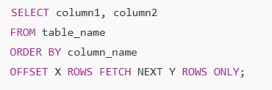
Advanced SQL
Clause | Syntax
TOP | TOP is used in SQL Server to limit the number of rows returned. It gives you the first N rows of a query result.
OFFSET _FETCH | It allows you to skip rows (OFFSET) and then fetch a certain number of rows (FETCH).

Slide 13

Window Functions
What are Window Functions ?
Why Use them ?
Perform calculations across a "window" of rows related to the current row.
Keep original rows — unlike GROUP BY.
Use the OVER() clause to define the window.
Ranking, running totals, moving averages, etc.
Provide row-level analytics within grouped data.

Slide 14
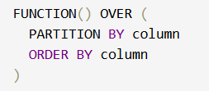
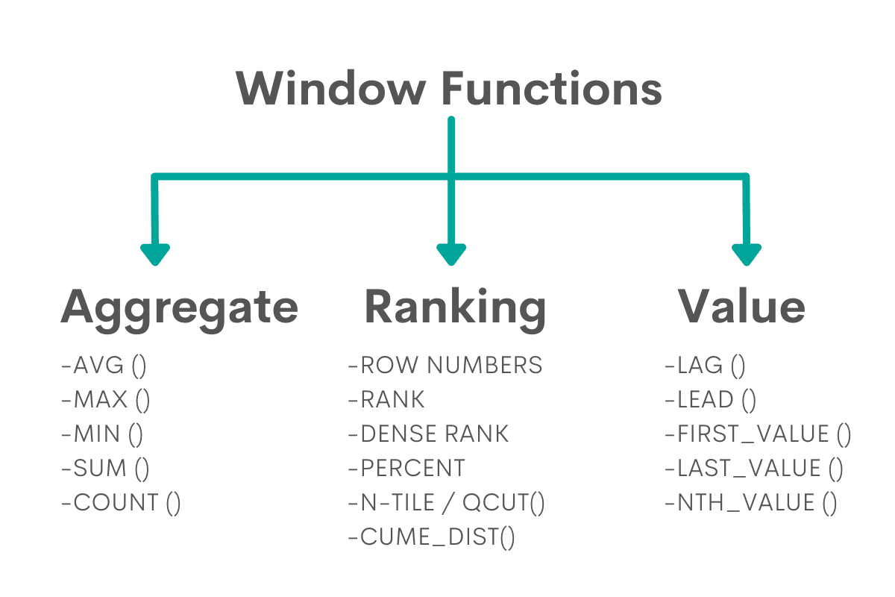
Window Functions
🔹 Basic Syntax:

Slide 15
Window Functions
Functions | Value Functions
ROW_NUMBER() – Unique number per row RANK() – Rank with gaps for ties DENSE_RANK() – Rank without gaps PARTITION BY – It divides (partitions) the result set into groups, and then the window function (like RANK(), ROW_NUMBER(), SUM(), etc.) is applied within each group separately. Example : | Access values from other rows relative to the current row. LAG() – Value from previous row LEAD() – Value from next row FIRST_VALUE() – First value in the window LAST_VALUE() – Last value in the window NTH_VALUE(n) – nth value in the window Example :

Slide 16
Tasks
Assignment 1 : Top N Books per User
Find the top 2 most expensive books purchased by each user.
Use joins (orders → books → users)
Apply ROW_NUMBER(), RANK(), and DENSE_RANK() with PARTITION BY user_id and ORDER BY price DESC
Assignment 2 : Ranking Users by Total Spending
Find how much each user spent in total and rank them
Use Sum(price) with PARTITION BY user_id
Apply RANK() and DENSE_RANK() to order users by total spending.

Slide 17
Use Case
SQL Concept | Real Project Example | How It’s Used
Joins (Inner, Outer, Conditions) | E-commerce platform (e.g., Amazon) | INNER JOIN customers with orders; LEFT JOIN to find inactive users
Self Join | Employee Management System (HR portal) | Find each employee’s manager within the same employee's table
Cross Join | Product Configurator (Apparel Store) | Generate all size × color combinations for inventory
COUNT, GROUP BY, HAVING | Sales Dashboard (e.g., Salesforce analytics) | Count sales per region; filter top performers using HAVING
Window Functions | Banking/Financial Reports (e.g., PayPal) | Running totals, rank customers, compare monthly spend with LAG, RANK, SUM OVER

Slide 18

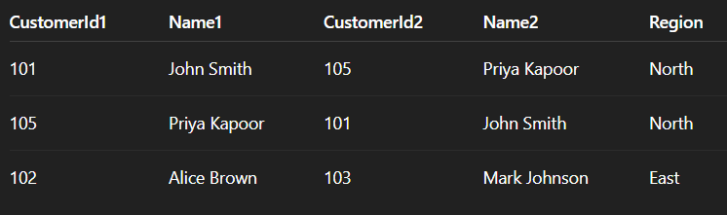
Assignment
Find pairs of customers in the same region (exclude pairing a customer with themselves).
OUTPUT FORMAT:

Slide 19
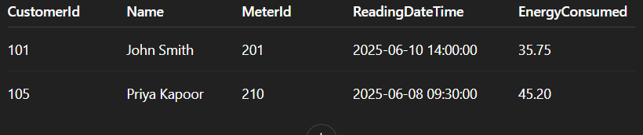
Assignment
List meters with readings over 30 kWh in last 30 days along with customer names.
OUTPUT FORMAT:

Slide 20
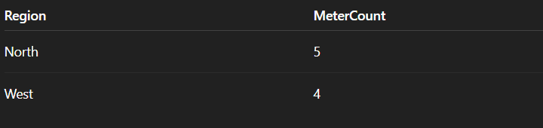
Assignment
Find the number of meters installed in each region, but only show regions that have more than 3 meters.
OUTPUT FORMAT:

Slide 21
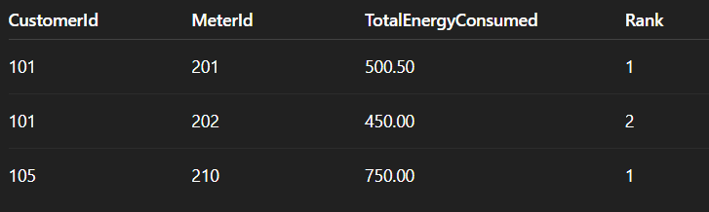
Assignment
Rank each meter per customer by total energy consumed (highest first).
OUTPUT FORMAT:

Slide 22
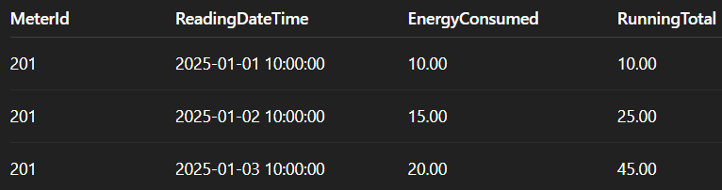
Assignment
For each meter, calculate the cumulative sum of energy consumed ordered by ReadingDateTime.
OUTPUT FORMAT:

Slide 23

+
+
+
+
LEVEL
Stretch Goals
+
UP
+
+
Stretch Goal:
Regional Customer Pair Analysis
Objective: Identify and analyse unique customer pairs within the same region.
Write a query to:
Find all unique pairs of customers who:
Belong to the same region
Have different customer IDs (exclude self-pairing)
Were both active in the past 90 days (e.g., LastActiveDate >= DateTime.Today.AddDays(-90))
Do not repeat pairs in reverse (i.e., if (A, B) is listed, skip (B, A))

Slide 24
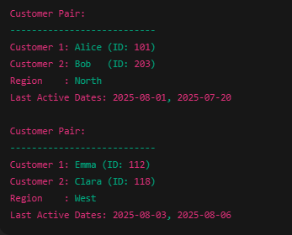
+
+
+
+
LEVEL
Stretch Goals
+
UP
+
+
Output Format :

Slide 25
+
+
+
+
LEVEL
Stretch Goals
+
UP
+
+
Peak Consumption per Meter
Identify the peak energy reading for each MeterId from the SmartMeterReadings table, using window functions.
For each MeterId, find the reading with the highest EnergyConsumed.
Show:
MeterId
ReadingDateTime
EnergyConsumed
MeterRank (based on energy consumption per meter using ROW_NUMBER() or RANK())

Slide 26
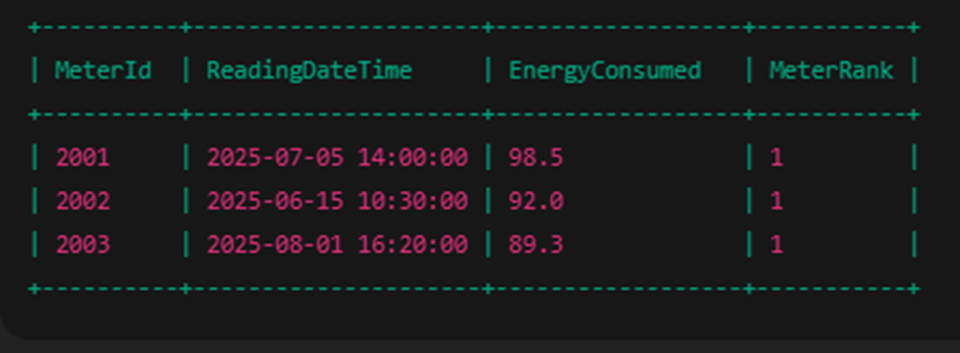
+
+
+
+
LEVEL
Stretch Goals
+
UP
+
+
Output Format :

Slide 27
Debrief
Basic Joins
Advanced Joins
Advanced SQL
Window Functions
Use cases

Slide 28
📘 Official Resources (High-Quality & Up-to-Date)
References
https://www.w3schools.com/sql/sql_join.asp
https://learnsql.com/blog/sql-window-functions-explained/

Slide 29
Q&A

