Slide 1


Slide 2


2 / 12
Understanding fundamentals of Stored Procedures
By : Mr. Shivam Supekar

Slide 3

Agenda
1
Stored Procedures Introduction
2
Create,Modify,parameters ,results
3
Handling Exceptions
4
Transactions(BEGIN,COMMIT,ROLLBACK)
5
Triggers, Views
6
Use Cases
7
Assignment
4
Debrief

Slide 4
Stored Procedures
Definition: A Stored Procedure is a precompiled set of one or more SQL statements stored in the database and executed as a unit.
Key Benefits:
🔁 Reusability – Define once, use many times
⚡ Performance – Faster execution due to precompilation
🔐 Security – Users can run procedures without direct table access
🛠️ Maintainability – Easier to manage logic in one place

Slide 5
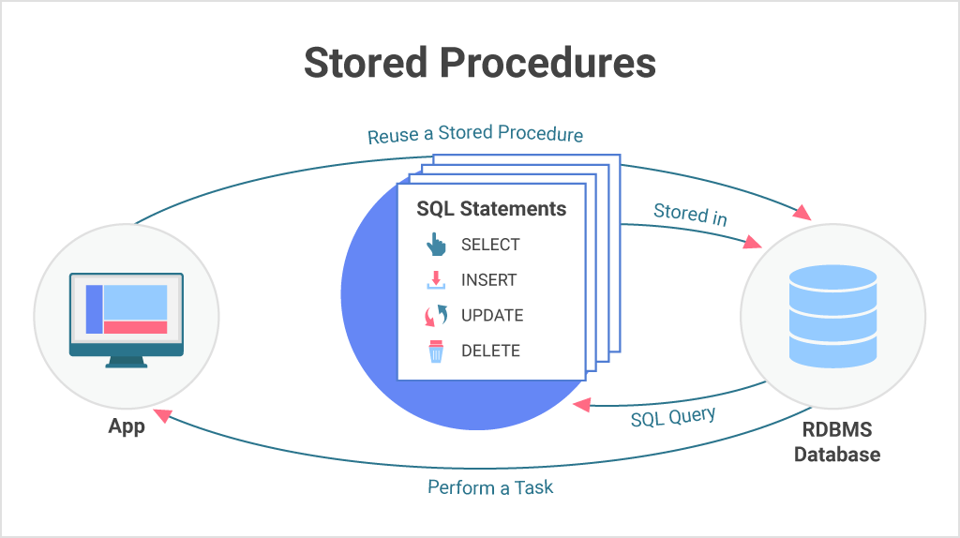

Slide 6
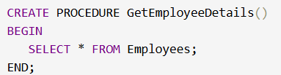

Creating And Modifying a Stored Procedure
Creating Stored Procedure :
Modifying a Stored Procedure :
Most RDBMS (like MySQL) don’t support direct modification.
Use DROP and CREATE :
SQL Server allows ALTER PROCEDURE

Slide 7
Procedure Parameters
Note :
In SQL Server (SSMS), there is no direct INOUT parameter type like in some other databases (e.g., MySQL, Oracle).
Instead:
By default, parameters are INPUT.
If you add the keyword OUTPUT, the parameter can return a value back.
A parameter can actually act as both input and output (so it works like INOUT) if you:
Pass a value into the procedure, and
The procedure modifies it and returns it back.

Slide 8
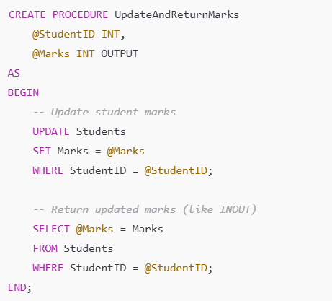
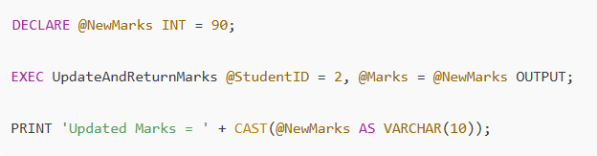
Procedure Parameters
Example of INOUT Behavior in SQL Server
Execution

Slide 9
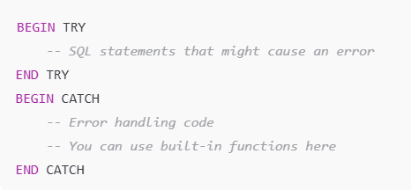
Handling Exceptions
⚠️ What is Exception Handling?
Exception handling allows a stored procedure to respond to runtime errors (e.g., division by zero, duplicate keys) without crashing
Commonly used Handler:
TRY…CATCH Block - Handles runtime errors inside T-SQL.
Syntax in MsSQL: Using Try Catch

Slide 10
Transactions in SQL
🟦 What is a Transaction?
A transaction is a sequence of one or more SQL operations treated as a single unit of work. It ensures data consistency, especially in multi-step operations.
Key Commands
Why use Transactions?
BEGIN / START TRANSACTION – Marks the start of a transaction
COMMIT – Saves all changes made in the transaction permanently
ROLLBACK – Undoes all changes if an error occurs
To maintain the ACID properties:
Atomicity – All or nothing
Consistency – Data remains valid
Isolation – Transactions don’t interfere with each other
Durability – Changes persist after success

Slide 11
BEGIN,COMMIT,ROLLBACK
.
BEGIN / START TRANSACTION:
COMMIT TRANSACTION:
ROLLBACK TRANSACTION:
Starts a new transaction.
Ensures that all following SQL statements are grouped into a single logical unit.
Saves all changes made during the transaction permanently to the database
Once committed, changes cannot be undone.
Cancels all changes made during the current transaction.
Used when an error occurs or the operation must be aborted..

Slide 12
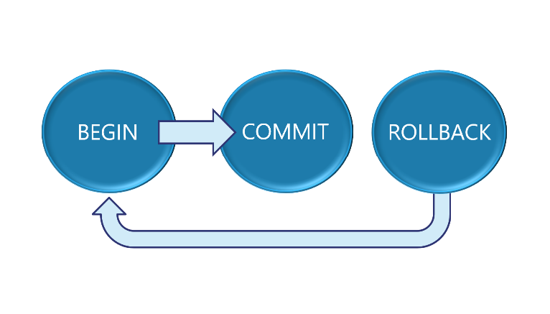

Slide 13

Triggers
What is a Trigger ?
A trigger is a stored program that automatically executes in response to specific events on a table(like INSERT,UPDATE or DELETE)
🔑Key Features:
Automatically runs when a specified database event occurs
Used for enforcing business rules, auditing, or maintaining logs
Can be defined to run BEFORE or AFTER the event
🔹 Example Use Case:
Log every new order inserted into an audit table automatically.

Slide 14
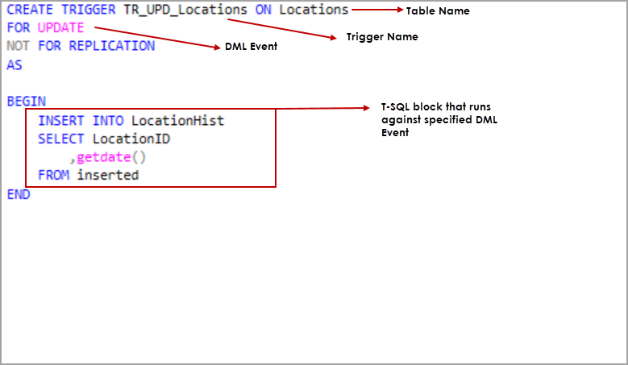
Triggers

Slide 15
Views
🔹What is a View ?
A view is a virtual table created by a SQL query.
It does not store data itself but shows data from one or more underlying tables.
🔹Why use Views?
Simplify complex queries
Enhance security by exposing only selected columns
Provide a consistent interface to changing database structures
🔹 Example Use Case:
Create a view to show only active employees from the Employees table.

Slide 16
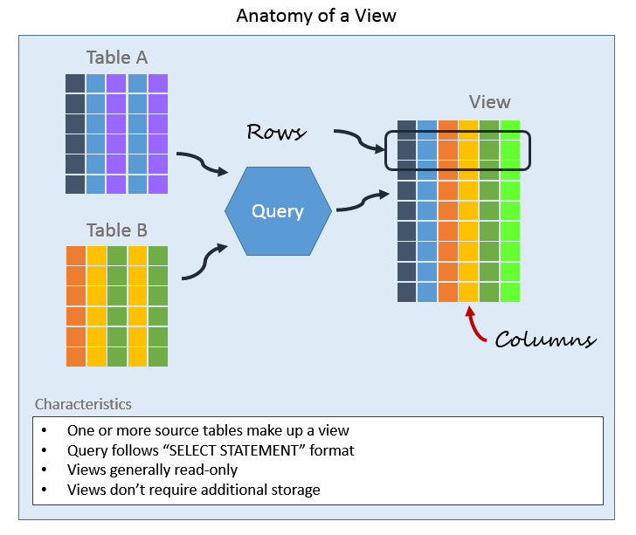

Slide 17
Use Case
Stored Procedures: Automate payroll calculations or monthly reports with reusable SQL logic.
Parameters: Fetch dynamic data like employee or customer details based on input values.
Exception Handling: Gracefully handle errors (e.g., failed inserts) and log issues for review.
Transactions: Ensure safe operations like bank transfers using BEGIN, COMMIT, and ROLLBACK
Triggers: Automatically log activities (e.g., order placements) for audit or compliance.
Views: Securely expose only necessary data(e.g., active employees) to limited users.

Slide 18

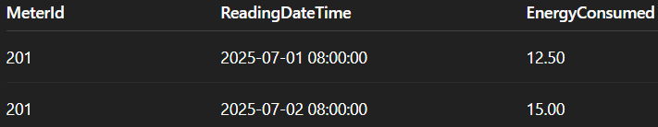
Assignment
Create a stored procedure that accepts a @CustomerId as input and returns all readings (MeterId, ReadingDateTime, EnergyConsumed) for that customer.
OUTPUT FORMAT:

Slide 19
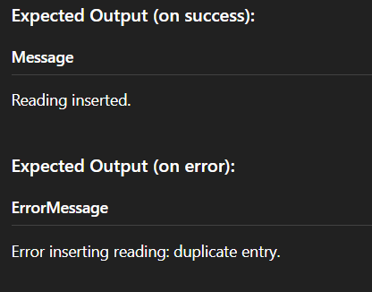
Assignment
Write a stored procedure that takes @MeterId, @ReadingDateTime, and @EnergyConsumed as input, inserts a new reading, and handles errors using TRY...CATCH. If successful, return a message.
OUTPUT FORMAT:

Slide 20
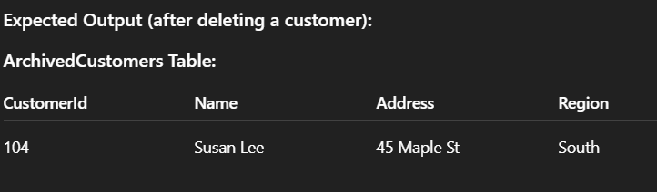
Assignment
Create an AFTER DELETE trigger on Customers that stores deleted customer details into a new table ArchivedCustomers.
OUTPUT FORMAT:

Slide 21
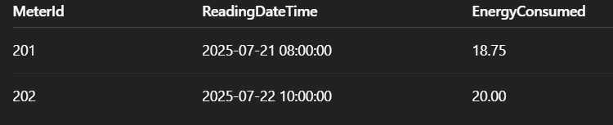
Assignment
Create a view LatestMeterReadings that returns the most recent reading per meter. Include: MeterId, ReadingDateTime, EnergyConsumed.
OUTPUT FORMAT:

Slide 22

+
+
+
+
LEVEL
Stretch Goals
+
UP
+
+
Create a Stored Procedure to Get Monthly Summary
Procedure Name: GetMonthlyEnergySummary
Parameters:
Requirements:
Return:
MeterID
TotalEnergyConsumed for that month
AverageEnergyPerReading
Only include meters with at least 5 readings in that month
Sort by TotalEnergyConsumed DESC

Slide 23
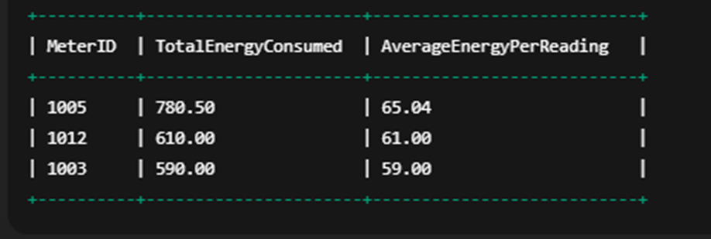
+
+
+
+
LEVEL
Stretch Goals
+
UP
+
+
Output Format:

Slide 24
+
+
+
+
LEVEL
Stretch Goals
+
UP
+
+
Monthly Energy Analysis View
Objective: Create a view for monthly tracking of customer energy usage.
Instructions:
Create a view vw_MonthlyCustomerEnergy that shows:
CustomerId
Month
Year
TotalEnergyConsumed
Use MONTH(ReadingDateTime) and YEAR(ReadingDateTime) in grouping.

Slide 25
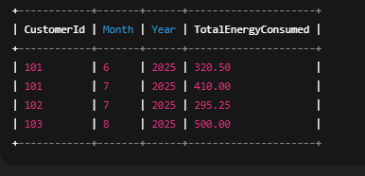
+
+
+
+
LEVEL
Stretch Goals
+
UP
+
+
Output Format:

Slide 26
Debrief
Stored Procedures
Handling Exceptions
Transactions
Triggers, Views
Use cases

Slide 27
📘 Official Resources (High-Quality & Up-to-Date)
References
https://www.w3schools.com/sql/sql_stored_procedures.asp
https://dev.mysql.com/doc/refman/8.0/en/sql-start-transaction.html
https://dev.mysql.com/doc/refman/8.0/en/triggers.html
https://dev.mysql.com/doc/refman/8.0/en/create-view.html

Slide 28
Q&A

