Slide 1


Slide 2


PostgreSQL Setup and Schema
By : Mr. Shivam Supekar

Slide 3

Agenda
1
Introduction to postgresSql
2
Installing PostgresSql and pgAdmin
3
Creating and managing Databases
4
Write SQL for Tables
5
Naming Conventions and Best practices
6
Developer-Focused Table Design
7
Use Cases
8
Assignment
9
Debrief

Slide 4

PostgreSQL
What is PostgreSQL?
Open-source RDBMS
Advanced, open-source relational database system
SQL-compliant, supports complex data types
Backed by a strong global community
Use Cases
Web & mobile apps
Analytics & data warehousing
Financial systems
Geospatial apps (PostGIS)
Microservices & cloud-native setups
Why Developers Prefer It
Highly extensible
Handles both relational & JSON data
SQL power + NoSQL flexibility
Secure, stable, cloud-ready

Slide 5
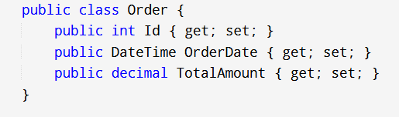
Creating C# Models
✅ Steps to Create a Model
Define a class with relevant properties
Use appropriate data types (e.g., int, string, DateTime)
Add constructors if needed for initialization
Apply data annotations for validation or metadata
Example :

Slide 6
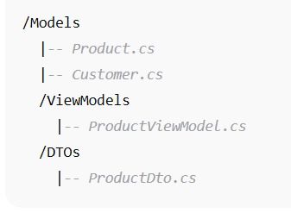
Structuring Models in a C# Project
📁 Recommended Folder Structure
📌 Separation of Concerns
Models: Core domain entities
DTOs: For API communication
ViewModels: Tailored to UI needs (MVC pattern)

Slide 7
Best Practices for Model Design
🛠️ Design Tips
Keep models simple and focused
Avoid putting business logic inside models
Use inheritance or interfaces only when justified
Consider record types for immutability (C# 9+)
✅ Do's
Use validation attributes ([Required],[Range])
Keep model names intuitive and singular
Use separate models for read and write operations if needed
❌ Don'ts
Don’t overload models with unrelated responsibilities
Don’t couple models tightly with UI or database schemas

Slide 8
Built-in Validation with DataAnnotations
✅ What Are DataAnnotations?
Attributes that add validation rules or metadata to model properties
Found in the System.ComponentModel.DataAnnotations namespace
Ensure data integrity before processing or persisting data
🧰 Common Validation Attributes:
Attribute | Purpose
[Required] | Ensures the field is not null/empty
[StringLength] | Limits string length (min/max)
[Range] | Validates numeric or date ranges
[EmailAddress] | Validates correct email format
[Compare] | Compares two fields (e.g., passwords)

Slide 9
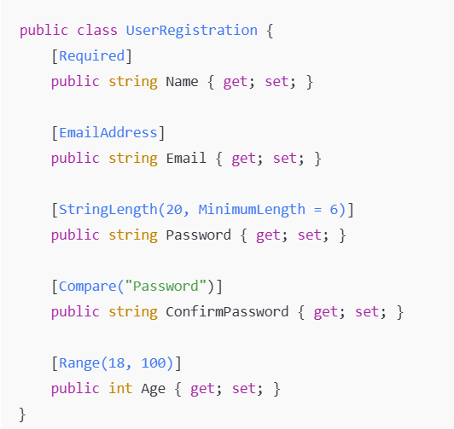
Using DataAnnotations in Models
✅ Example Model with Annotations
🧩 Benefits:
Enforces validation at the model level
Reduces boilerplate validation code
Works seamlessly with MVC model binding and Web API

Slide 10
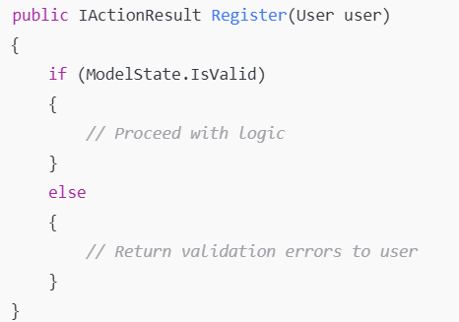
Applying Validation In Different App Types
🖥️ Web Applications (ASP.NET MVC / Web API)
Validation runs automatically during model binding.
Use ModelState.IsValid to check if input data is valid.

Slide 11
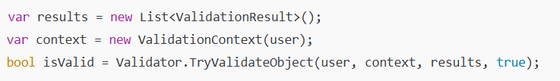
Applying Validation In Different App Types
📦 Console Apps / Unit Tests
Use Validator.TryValidateObject for manual validation.
Requires reference to System.ComponentModel.DataAnnotations
🧩 When to Use What?
Application Type | Validation Method
Web App | ModelState.IsValid
Console App | Validator.TryValidateObject
Unit Tests | Validator.TryValidateObject

Slide 12
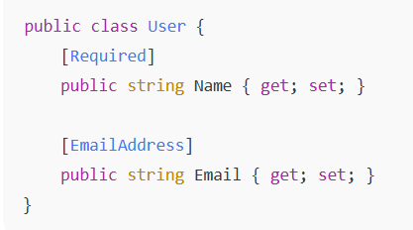
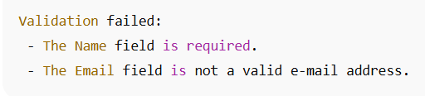
❌ Sample Output (Console):
swift
Example Output from Manual Validation
✅ Sample Model:
.
❌ Sample Output (Console):

Slide 13
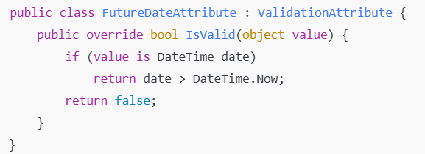
Custom Validation Logic in C#
🛠️ Why Custom Validation?
Built-in attributes( [Required] , [Range] ,etc) are great for common scenarios.
But sometimes you need custom rules, like:
Dates must be in the future
ID’s must match a specific format(e.g., prefix + digits)
🛠️ Create a Custom Attribute
Inherit from ValidationAttribute
Override IsValid (object value) method

Slide 14
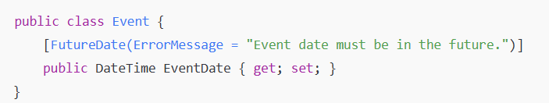
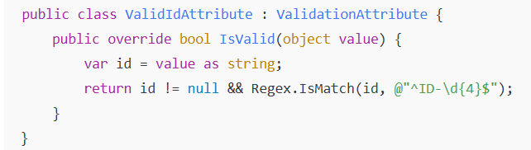
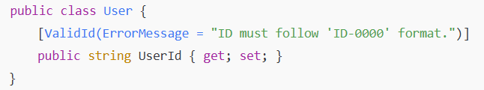
Using Custom Validation in a Model
🧩 Apply the Custom Attribute
🔍 Another Example: Validate ID Format

Slide 15
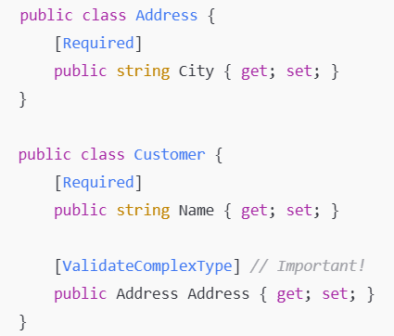
Nested Model Validation -Overview
🧱 What Is Nested Validation?
A model often contains child objects or collections (lists).
Validating these nested structures is common in real-world apps (e.g., Order with a list of Items).
🛠️ How It Works
Use [ValidateObject] logic by :
Decorating nested properties with [ValidateComplexType] (ASP.NET Core 5+)
Ensuring nested classes also use DataAnnotations

Slide 16
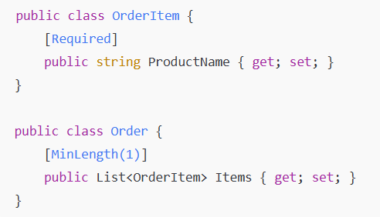
Validating Collections (List of Models)
🧩 Example: Order with a List of Items
✅ Validation Behavior
In ASP.NET Core, model binding will recursively validate lists of objects.
Each item in the list must satisfy its own validation attributes.

Slide 17
Use Cases
Concept | Real-World Use Case
Data Models | Represent a Customer, Order, or Product in an e-commerce, CRM, or inventory system
Creating & Structuring Models | Organize DTOs and domain models in a banking or healthcare app for clean architecture
Built-in Validation | Enforce input rules in user registration (e.g., required name, valid email) in web forms
Applying Validation in Code | Validate API input or test data in a payroll or billing system before processing
Custom Validation Logic | Ensure travel booking dates are in the future or validate custom ID formats in HR apps
Nested Model Validation | Validate nested data like an Invoice with a list of LineItems in accounting software

Slide 18

Assignment
🔧 Advanced Assignment 1: Multi-Meter Bulk Upload Validation
Scenario: A utility company uploads bulk smart meter registrations via a file or API.
Requirements :
Create a BulkMeterUploadRequest model :
UploadedBy (string ,[Required] )
UploadDate ( DateTime, [Required] , must be within the last 24 hours)
Meters (List of SmartMeter)
Define SmartMeter with :
SerialNumber ([Required] ,must be unique within the list)
FirmwareVersion ([]Required)
Location (nested object, with validation)
Tasks :
Enforce uniqueness of SerialNumber within the list (cross-item Validation)
Write code to:
Validate the request
Validate each smart meter
Aggregate and display all errors per meter, with index

Slide 19
Assignment
🔧 Advanced Assignment 2: Complex Conditional Validation Based on Meter Type
Scenario: Some meter fields are only required for certain meter types.
Requirements:
Create a SmartMeterDetail model with:
MeterId ([Required])
MeterType ("Residential", "Commercial", "Industrial")
MaxLoadCapacityKW (Required only for Commercial and Industrial meters)
CustomerContactEmail (Required only for Residential)
Tasks:
Implement a custom validation attribute or class-level IValidatableObject to:
Conditionally require fields based on MeterType
Test multiple combinations and log results

Slide 20
Assignment
🔧 Advanced Assignment 3: Nested Collections with Child Validation and Summary Errors
Scenario: A smart meter maintenance report contains multiple FaultRecord entries.
Requirements:
Create a MaintenanceReport model:
ReportId ([Required])
SubmittedBy ([Required])
Faults — List of FaultRecord
Define FaultRecord with:
FaultCode ([Required], limited to predefined list: ["E01", "E02", "E03"])
DetectedAt (Cannot be a future date)
SeverityLevel ([Range(1,5)])
Tasks:
Validate each fault record and:
Print out all errors
If more than 3 critical faults (SeverityLevel 5), return a high-priority flag

Slide 21
Assignment
🔧 Advanced Assignment 4: Configurable Validation Rules via Metadata
Scenario: Validation rules should be adjustable via a config or metadata class (simulated).
Requirements:
Create a MeterConfig model representing metadata:
MinKWhThreshold
MaxKWhThreshold
Create a MeterReading model with:
ReadingId, MeterId, KWhUsed
Tasks:
Implement a custom validator that accepts metadata/config and validates:
KWhUsed is within the allowed range (from config)
Simulate using MeterConfig as input for validation.
Test cases where the rule values change (e.g. threshold from 0–1000 to 10–800).

Slide 22

+
+
+
+
LEVEL
Stretch Goals
+
UP
+
+

Slide 23
Debrief
Data Model
Validation
Data Annotations
Nested Validation
Use cases

Slide 24
📘 Official Resources (High-Quality & Up-to-Date)
https://learn.microsoft.com/en-us/dotnet/api/system.componentmodel.dataannotations?view=net-8.0
https://learn.microsoft.com/en-us/aspnet/core/mvc/models/validation?view=aspnetcore-8.0
References

Slide 25
Q&A

