Slide 1


Basics of GIT
Chaitra

Slide 2
How to Resolve Merge Conflicts in Git
What is Git ? Basic Git Commands
01
What is a Git Merge Conflict? Basic Git Commands
02
How to Resolve Merge Conflicts in Git? How to Resolve Merge Conflicts in Git?
03

Slide 3
What is Git?
Git is an open-source, distributed version control system (VCS), which has a remote repository on the server-side and a local repository on the client-side.
This means that the file or code is not present in a central server, but there is a copy of the file stored on the client’s computer.
A distributed version control system enables multiple developers to work in parallel with each other without any code conflicts.
Git enables developers to revert and go back to an older version of the code whenever necessary.
Git helps both developers and non-tech professionals by keeping track of their project files. It makes it easier for multiple individuals to work together, and it plays an extremely significant role in big projects that involve large teams.

Slide 4
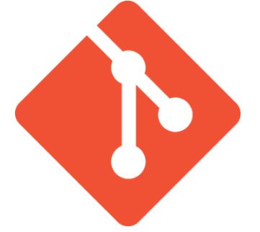
Basic Git Commands
git config
git init
git add
git diff
git commit
git reset
git status
git merge
git push
git pull

Slide 5
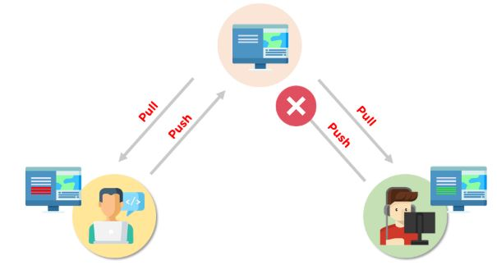
What is a Git Merge Conflict?
A merge conflict is an event that takes place when Git is unable to automatically resolve differences in code between two commits. Git can merge the changes automatically only if the commits are on different lines or branches.
EX: Git merge conflict works:
Let’s assume there are two developers:
Developer A and Developer B.
Both of them pull the same code file from the remote repository and try to make various amendments in that file.
After making the changes, Developer A pushes the file back to the remote repository from his local repository.
Now, when Developer B tries to push that file after making the changes from his end, he is unable to do so, as the file has already been changed in the remote repository.
To prevent such conflicts, developers work in separate isolated branches.
The Git merge command combines separate branches and resolves any conflicting edits.
Now that we have gone through the basics of the Git merge conflict, let’s look at the various types of conflicts next.

Slide 6
Types of Git Merge Conflicts
1. Starting the Merge Process
If there are changes in the working directory’s stage area for the current project, merging won’t start.
In this case, conflicts happen due to pending changes that need to be stabilized using different Git commands.
2. During the Merge Process
The failure during the merge process indicates that there is a conflict between the local branch and the branch being merged.
In this case, Git resolves as much as possible, but there are things that have to be resolved manually in the conflicted files.
We will now go over resolving merge conflicts in Git.

Slide 7
How to Resolve Merge Conflicts in Git?
The easiest way to resolve a conflicted file is to open it and make any necessary changes
After editing the file, we can use the git add a command to stage the new merged content
The final step is to create a new commit with the help of the git commit command
Git will create a new merge commit to finalize the merge

Slide 8
Git Commands to Resolve Conflicts
1. git log --merge
The git log --merge command helps to produce the list of commits that are causing the conflict
2. git diff
The git diff command helps to identify the differences between the states repositories or files
3. git checkout
The git checkout command is used to undo the changes made to the file, or for changing branches
4. git reset --mixed
The git reset --mixed command is used to undo changes to the working directory and staging area
5. git merge --abort
The git merge --abort command helps in exiting the merge process and returning back to the state before the merging began
6. git reset
The git reset command is used at the time of merge conflict to reset the conflicted files to their original state

Slide 9
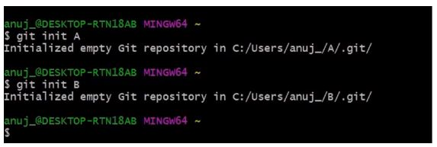
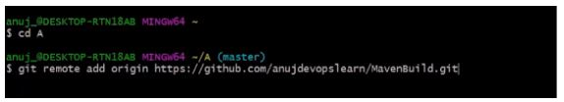
Demo: Resolving Git Merge Conflicts
First, initialize two repositories:
git init A
git init B
Add the remote address in the A repository:
git remote add origin *address*

Slide 10
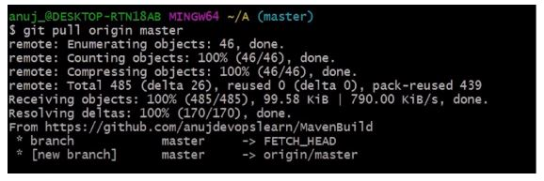

The next step is to pull all the changes in the central repository to the local repository.
git pull origin master
Follow the same process to add the origin in the B repository.
git remote add origin *address*

Slide 11
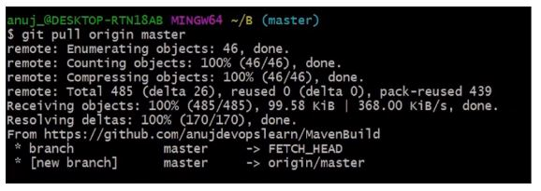
The pull command is executed again to retrieve all the content from the remote repository and move it to the local repository.
git pull origin master
Both of these repositories represent two different repositories of two different developers.

Slide 12

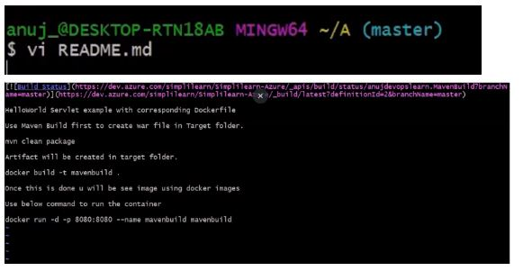
Let's get back to the A repository.
cd ../A
In the A repository, a readme file is opened in order to make various changes.
vi README.md

Slide 13
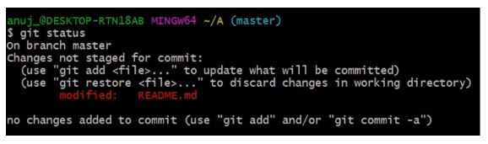
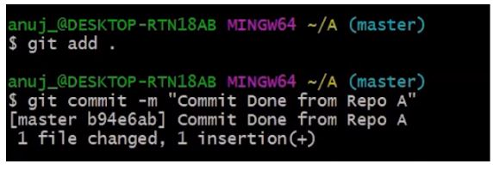
Make the necessary changes in the file, and then save it.
The git status command is then executed in order to see the reflected changes.
git status
The next step is to add these changes to the staging area and commit them.
git add.
git commit -m *commit message*

Slide 14
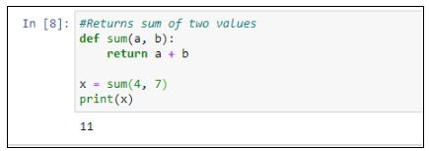

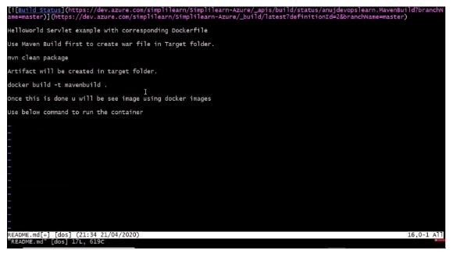
After the commit is finished, the changed file is pushed to the remote repository.
git push origin master
Now, return to the B repository.
cd B
Open a readme file
vi README.md

Slide 15
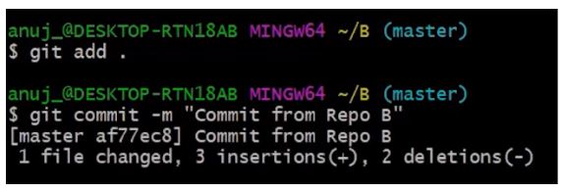
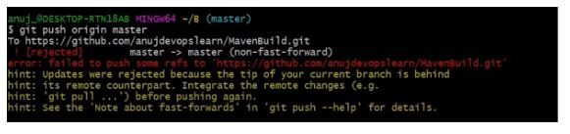
Make changes to the file, save it, and close it. After that, add the changed file and commit it.
git add.
git commit -m *commit message*
The next step is to push the file to the remote repository
git push

Slide 16
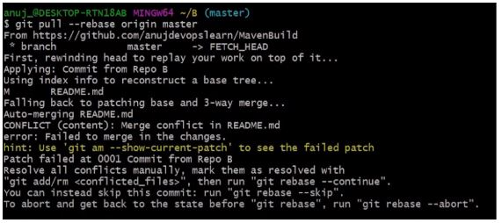
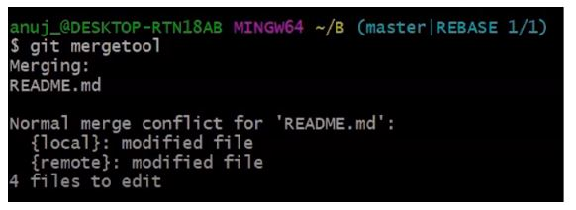
An error is shown, meaning that the updates are rejected.
Next, we need to execute:
git -- rebase origin master
Currently, there are visible conflicts that need to be resolved manually.
If you want to skip this commit, you can type git rebase --skip, or if you want to abort this rebase, you can type git rebase --abort.
After managing this conflict manually, we will open the merge tool.
git mergetool

