Slide 1


Slide 2
Linux
It’s an open source operating system (OS).
An operating system is the software that directly manages a system's hardware and resources, like CPU, memory, and storage.
The OS sits between applications and hardware and makes the connections between all of your software and the physical resources that do the work.
Working:
Linux is a Unix-like, open source and community-developed operating system (OS) for computers, servers, mainframes, mobile devices and embedded devices.
It is supported on almost every major computer platform, including x86, ARM and SPARC, making it one of the most widely supported operating systems.

Slide 3
Command Line / Kernel
Command Line
The Linux command line is a text interface to your computer.
Often referred to as the shell, terminal, console, prompt or various other names, it can give the appearance of being complex and confusing to use.
Kernel
It’s the main component of a Linux operating system (OS) and is the core interface between a computer's hardware and its processes.
It communicates between the 2, managing resources as efficiently as possible
A kernel is a constituent part of a larger operating system -- usually, in Linux distributions
the larger operating system contains a base of GNU tools, which is why many people refer to the kernel as Linux

Slide 4
Shell / Bash
Shell
It is responsible for the execution of all programs that you request from your terminal.
The line that is typed to the shell is known more formally as the command line.
The shell scans this command line and determines the name of the program to be executed and what arguments to pass to the program.
Bash
Bash is a command processor that typically runs in a text window where the user types commands that cause actions.
Bash can also read and execute commands from a file, called a shell script.

Slide 5
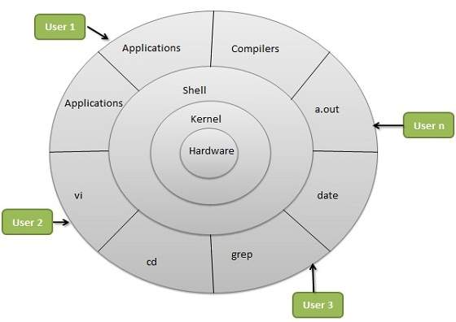
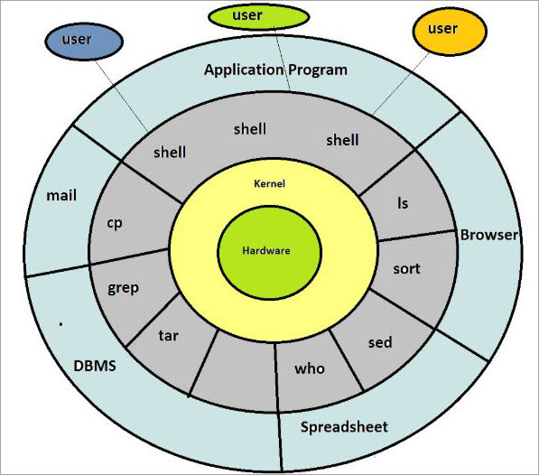

Slide 6
Advantages Of Linux
Security.
Software Updates.
Free to use (Low Cost).
Network Support
Flexibility.
Fast and easy installation.
Multitasking.
Run multiple desktops.

Slide 7
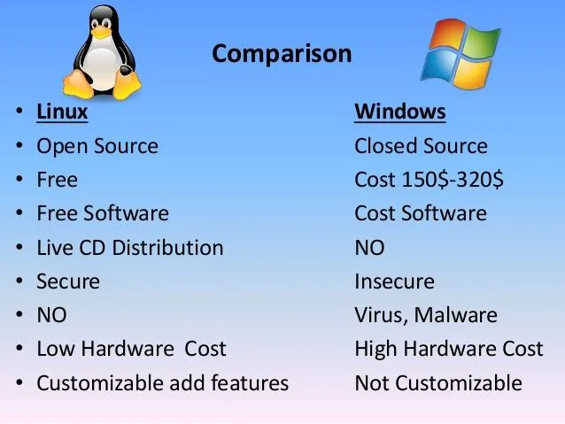

Slide 8
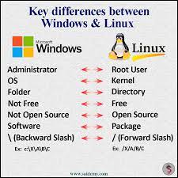

Slide 9
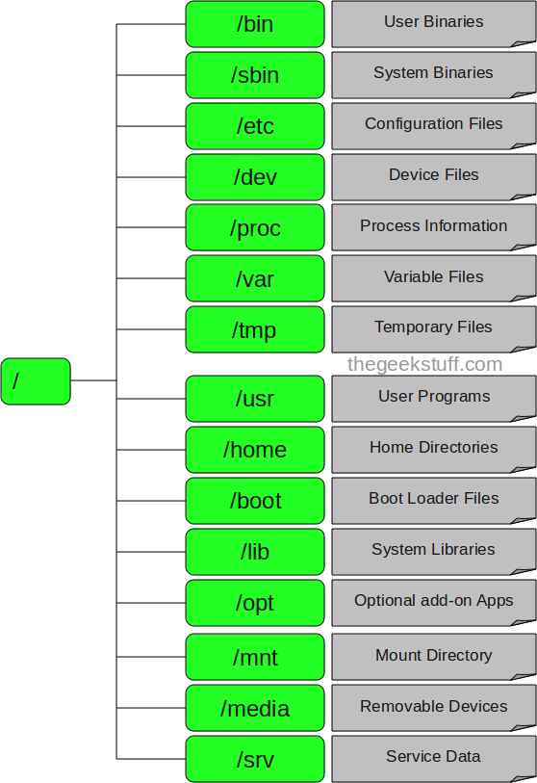
Linux Directory

Slide 10
Commands to create, copy, edit, change time of the files
Cat – create file
concatenate file
copy file
EX:- cat > file1
Touch – it create empty file & used for time stamp
Create empty file
Create multiple empty file
Change time of the file [ Access time (touch –a) / Modify time (touch –m) / Change time]
EX:- touch file1

Slide 11
Vi – it’s a editor which is used for editing programs
EX:- vi file1
W – to save
Q – quit
Q! – force quit
Nano – its also a editor
EX:- nano file1

Slide 12
Top – real time view of a running system
mkdir dir – create directory
cd – change directory
cd .. – (..)change parent (.) change current directory
pwd – print working directory
ls -a – to see all file
ls – list file
cp – copy the file
mv – move the file /rename the file
rm dir – remove directory
rmdir -p – remove both parent & child directory
rmdir -pv – remove root
rm -rf – remove forcefully
rm -r – remove empty files
touch .file1 – hidden file 1
mkdir .dir1 – hidden directory1
mv f1 dir1 – move f1 to directoey1

Slide 13
cat > file1 [ create file using cat command]
cat file1 [ to c the content inside the file1]
cat >>file1 [ to edit the file 1]
cat f1 f2 >all [ all the content of both f1 & f2 go to the all file ]
touch f1 [create file using touch command ]
stat f2 [change the time of f2]
touch -a f3 [change the access time of f3]
touch -m f4 [change the modify time of f4]
cp f1 f2 [copy the content of f1 to f2]
mkdir dir1 [create new directory]
mkdir dir1/dir2/dir3 [create directory inside directory]
mkdir dir1 dir2 dir3 [move directory at once]

Slide 14
cd dir [ go inside directory]
cd file [ go inside file]
Cd ../../.. [ come out of directory at once]
Man command [ stands manual for command]
man ls
man cd
man grep
whoami [ who r u logged in as]
Uname [show kernel config]
df [show disk usage]
df -h / df --help
du [show directory space usage]
du -h / du --help
du -sh [ human readable size in GB]

Slide 15
User
We can create a new user account by issuing the following command:
sudo useradd testuser
We can make sure that the user has been created in two ways:
id testuser .
output : uid=1007(testuser) gid=1009(testuser) groups=1009(testuser)
This will show the user id and the groups that the user is currently in
usually, a new group with the same username is assigned to the user.
2) By opening the following file: /etc/passwd.
So we can issue cat /etc/passwd and we will see the new user that has been created.
After creating the user using the command above, you notice that no user directories have been created inside /home directory, which is not good since the user cannot log in to his account.

Slide 16
User groups
You can see all of the groups you have by opening the following file:
cat /etc/group
Let’s create a group with the name chethu:
sudo groupadd chethu
Add user to a group - We will add the testuser user to the chethu group by:
sudo usermod -aG chethu testuser
Delete user from a group - You can delete the testuser from the group with:
sudo gpasswd -d testuser chethu
Delete a group - Let’s delete the previous group by:
sudo groupdel chethu

Slide 17
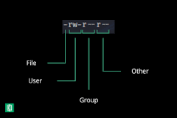
Linux File Permissions
The basic Linux permissions model works by associating each system file
The file owner.
The group members.
Others (everybody else).
Three file permissions types apply to each class of users:
read permission.
write permission.
execute permission.

Slide 18
Each write, read, and execute permissions have the following number value:
r (read) = 4
w (write) = 2
x (execute) = 1
- (no permissions) = 0
file (-)
directory (d)
EX:- [ -rw-r--r-- ] (644)
(file [-] / rw- (owner hv read & write) / r - - (group hv only read) / r - - (other user hv only read )
chmod 754 a.txt – [ rwx r-x r-- ]

Slide 19
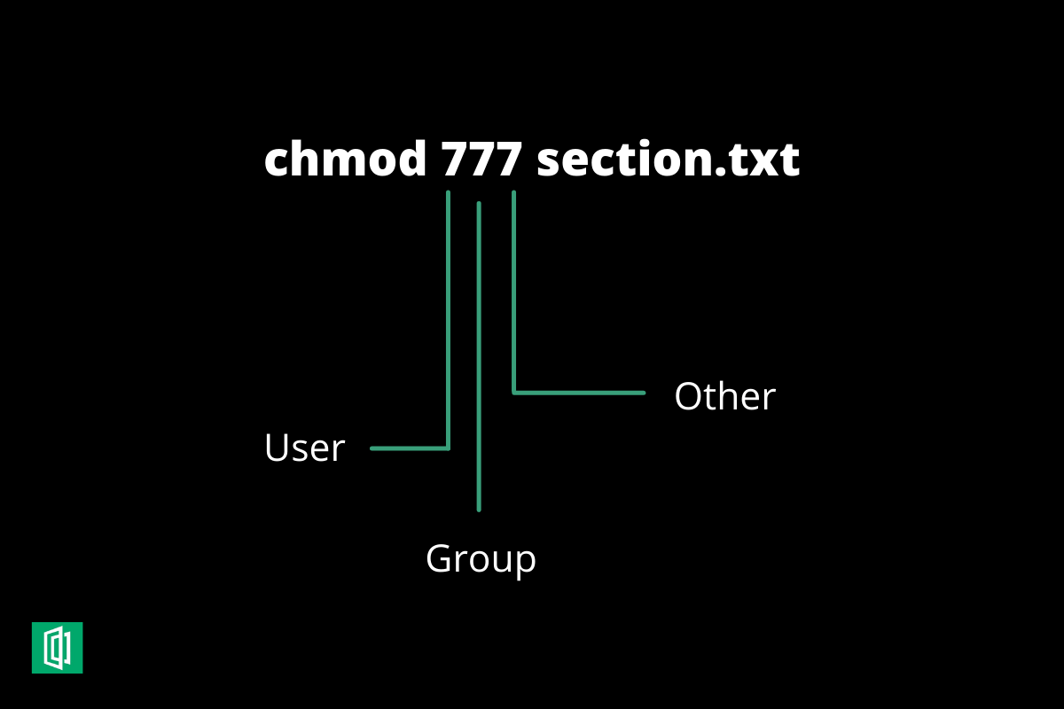
Use Symbolic Mode to modify permissions like the following:
Number Permission
0 No permission
1 Execute
2 Write
3 Execute and Write
4 Read
5 Read and Execute
6 Read and Write
7 Read, Write and Execute
EX:-
chmod 777 section.txt
EX:-
Owner: rwx = 4+2+1=7
Group: r-x = 4+0+1=5
Others: r-- = 4+0+0=4
EX:-
chmod 765 section.txt
permissions will be: -rwxrw-r-x.

Slide 20
Effect of Permissions on Files
Permission | Character | Meaning on File
Read | - | The file is not readable. You cannot view the file contents.
 | r | The file is readable.
Write | - | The file cannot be changed or modified.
 | w | The file can be changed or modified.
Execute | - | The file cannot be executed.
 | x | The file can be executed
 | s | If found in the user triplet, it sets the setuid bit. If found in the group triplet, it sets the setgid bit. It also means that x flag is set.
 | S | Same as s, but the x flag is not set. This flag is rarely used on files.
 | t | If found in the others triplet, it sets the sticky bit. It also means that x flag is set. This flag is useless on files.
 | T | Same as, t but the x flag is not set. This flag is useless on files.

Slide 21
Add Permission / To Remove The Permission
Now let’s add the execute permission to the user with:
chmod u+x section.txt
The permissions will be -rwxr--rw-
If you want to remove the permission:
you can use the same method but with “-” instead of “+”.
chmod u-x section.txt
And the permissions now are: -rw-r--rw-.

Slide 22
Remote Access To A Linux Server
Usually by using [ SSH ]
SSH server can be installed :
Yum install openssh-server (redhat)
Start the SSH server :
Service sshd start
Download a terminal :
putty

Slide 23
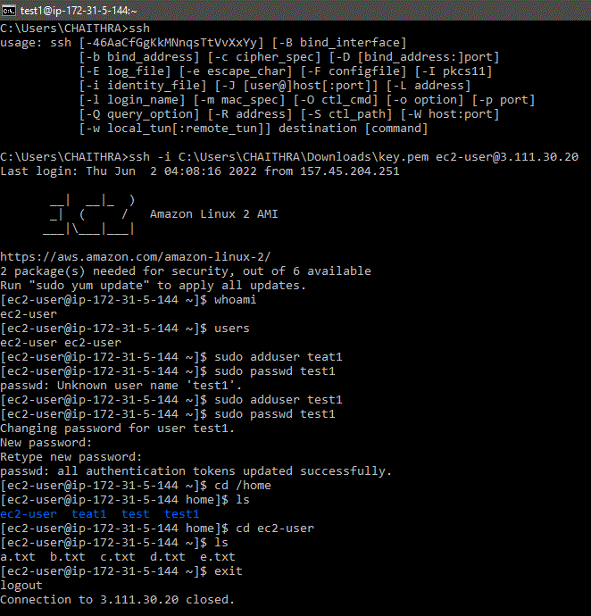

Slide 24
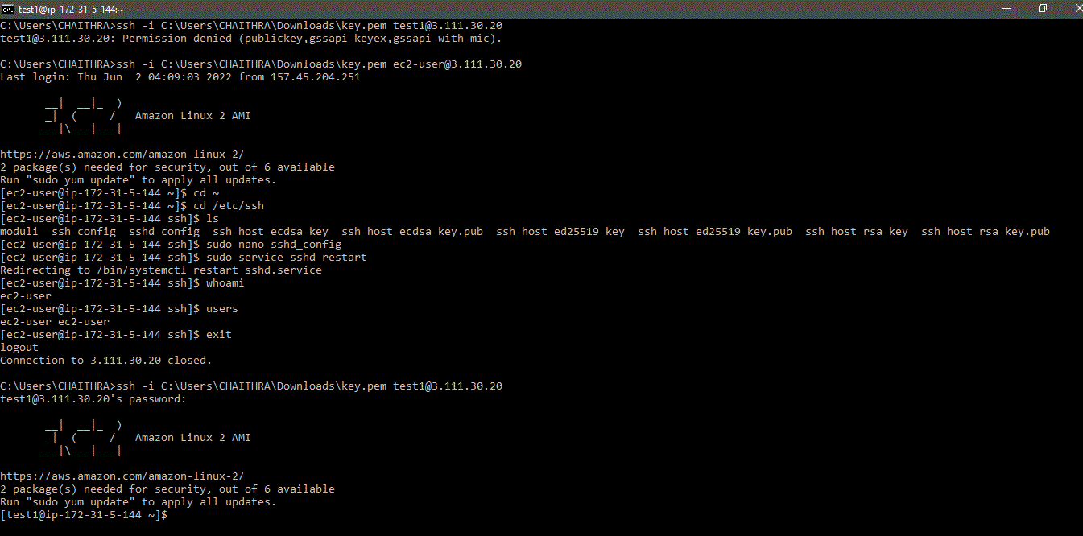

Slide 25
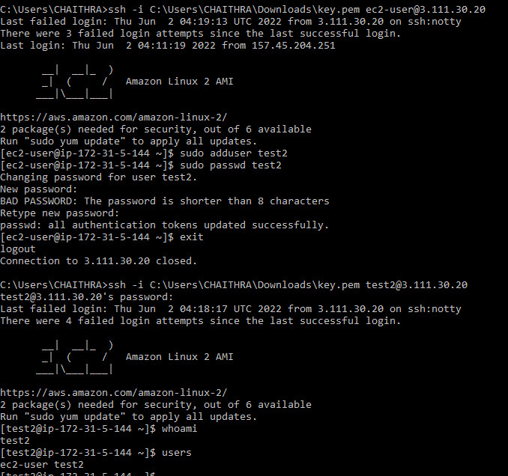

Slide 26
About “ls” Command / “Directory” Command
ls [list directory contents]
ls -a [list directory all contents]
ls -A [list directory almost all contents]
ls -l [long list format]
ls -lh [long list human read able format]
ls -l /etc [long list on given etc directory]
ls -ld [short list file by last modifying]
ls -lt [short list file by time]
ls –ltr [list file in reverse order]
. [ current directory ]
. . [ parent directory ]
~ [ home directory ]
/ [root directory ]

Slide 27
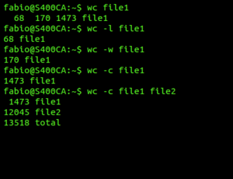
Wc Command
wc command to count the number of lines, words, and bytes in the files specified by the File parameter.

Slide 28
More & Less / Head & Tail
more and less have the option to view multiple files at once.
More Command
It allows us to view them as a single file separated by lines.
Less Command
It allows us to switch between them. However, both more and less display all the opened files with the same options.
Both commands write the result to standard output
Head Command
It will output the first part of the file
Tail Command
It will print the last part of the file..

Slide 29
Pipe / Crontab Commands
Pipe Command
lets you sends the output of one command to another
can redirect the standard output, input, or error of one process to another for further processing.
Ex:- man ls | cat >a.txt
Crontab
It’s a list of commands that you want to run on a regular schedule, and also the name of the command used to manage that list.
Ex:- crontab -e
crontab -u username -e
crontab -l
***** sh/home/linux/test.sh
*/10 **** sh/home/linux/test.sh

Slide 30
Input /Output Redirection
It allows us to change the standard input ( stdin ) ,standard output ( stdout ) & standard error (stderr) by executing a command on the terminal.
standard input ( stdin ) - [ > ]
standard output ( stdout ) - [ < ]
standard error (stderr) - [ 2> ]
Ex: wc < c.txt > d.txt
Standard output - [ >> ]
Standard input - [ << ]
Standard error - [ 2>> ]
Ex: >> /dev/null 2>&1

Slide 31
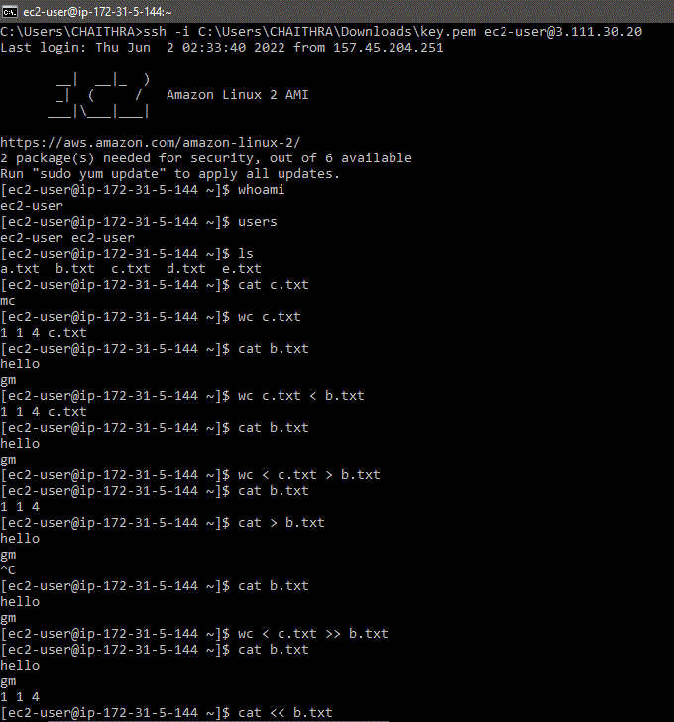

Slide 32
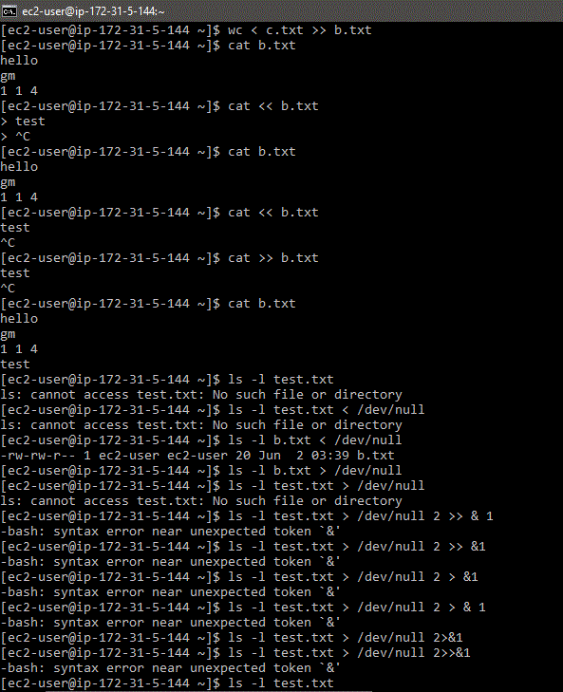

Slide 33
Features Of Shell Scripting
$ [shell variable]
Echo [ print the commands]
#! [which gives instruction to the program ( /bin/sh)]
# [it’s a comment]
Defining Variables [a=10]
Accessing Values [ echo $a]
Read only Variables
#! /bin/sh
Name = “Rahul”
Readonly Name
Name = “Ram”
#! /bin/sh
Name = “Rahul”
Name = “Ram”
Echo $ Name

Slide 34
Thank you

