Slide 1
AWS CLOUD
Cloud
Scaling
Cloud Terminology / Characteristics
AWS Region / Availability Zone / Instances / AMI
Low latency / High Throughput / High Availability / Fault tolerance
Factors To Consider When Choosing Your Region and AZ
Regional Services & Global Services
Billing & Pricing over view / Access AWS Services
IAM Services / IAM Authorization types / Root user V/S IAM user
Principle / Authentication / Authorization / MFA
Add users / Group users / Roles - in IAM / Policies
EC2

Slide 2
Instead Of Creating Own Data Centre Why We Use VM Or Cloud
Data Centre :-
Its a physical resource that helps businesses to store, organize, and operate data efficiently.
The scalability of Data Centre is huge in investment as compared to the cloud.
The maintenance cost is high because developers of the organization do maintenance.
Data Centres require experienced developers to operate and are considered not a viable option.
Performance is less than compared to investment
Virtual Machine :-
we can create more number of VM / we can create more number of OS
can use same port number / can use same OS / it take less time to create VM than physical
Cloud :-
Cloud is a virtual resource that helps businesses to store, organize, and operate data efficiently.
The scalability of the cloud required less amount of investment.
The maintenance cost is less than service providers maintain it.
Cloud is easy to operate and is considered a viable option.
Performance is huge as compared with investment.

Slide 3
CLOUD
"The cloud" refers to servers that are accessed over the Internet, and the software and databases that run on those servers. Cloud servers are located in data centres all over the world. By using cloud computing, users and companies do not have to manage physical servers themselves or run software. applications on their own machines.
Cloud Service Models Cloud Deployment Models
3 types of cloud service models - 4 types of cloud deployment models -
Infrastructure as a Service (IaaS) 1. Private cloud
Platform as a Service (PaaS) 2. Public cloud
Software as a Service (SaaS) 3. Hybrid cloud
4. community could

Slide 4
SCALING
In cloud computing, scaling is the process of adding or removing compute, storage, and network services to meet the demands a workload makes for resources in order to maintain availability and performance as utilization increases.
The cloud has dramatically simplified these scaling problems by making it easier to scale up or down and out or in.
Horizontal Scaling : Instead of resizing an application to a bigger server, scaling out splits the workload across multiple
servers that work in parallel.
Vertical Scaling : Scaling up is the process of resizing a server (or replacing it with another server) to give it supplemental
or fewer CPUs, memory, or network capacity.

Slide 5
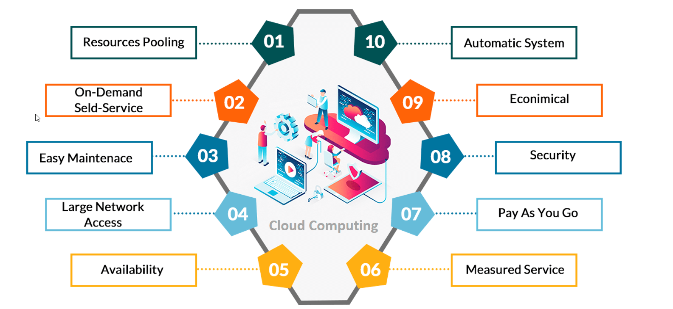
Cloud Terminology

Slide 6
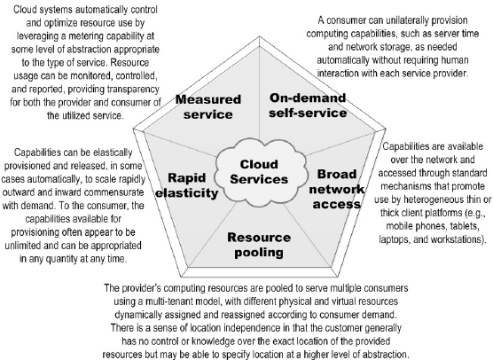
Cloud Characteristics

Slide 7
AWS Region / Availability Zone / Instances / AMI
AWS Region :-AWS maintains multiple geographic Regions, including Regions in North America, South America, Europe, China, Asia Pacific, South Africa, and the Middle East. AWS has the concept of a Region, which is a physical location around the world where we cluster data centres. We call each group of logical data centres an Availability Zone.
Each AWS Region consists of multiple, isolated, and physically separate AZs within a geographic area.
Availability Zone :-An availability zone is a logical data centre in a region available for use by any AWS customer. Each zone in a region has redundant and separate power, networking and connectivity to reduce the likelihood of two zones failing simultaneously. A common misconception is that a single zone equals a single data centre.
Each zone is composed of one or more datacentres equipped with independent power, cooling, and networking infrastructure. Availability zones are designed so that if one zone is affected, regional services, capacity, and high availability are supported by the remaining two zones.
Instances :- A “cloud instance” refers to a virtual server instance from a public or private cloud network. In cloud instance computing, single hardware is implemented into software and run on top of multiple computers. By using AWS EC2 helps users to avoid the investment in hardware up front, so the user can deploy and develop applications easier. It is used to launch many virtual servers, configure networking and security, and managing storage.
AMI :- An Amazon Machine Image (AMI) is a supported and maintained image provided by AWS that provides the information required to launch an instance. You must specify an AMI when you launch an instance. You can launch multiple instances from a single AMI when you require multiple instances with the same configuration.

Slide 8
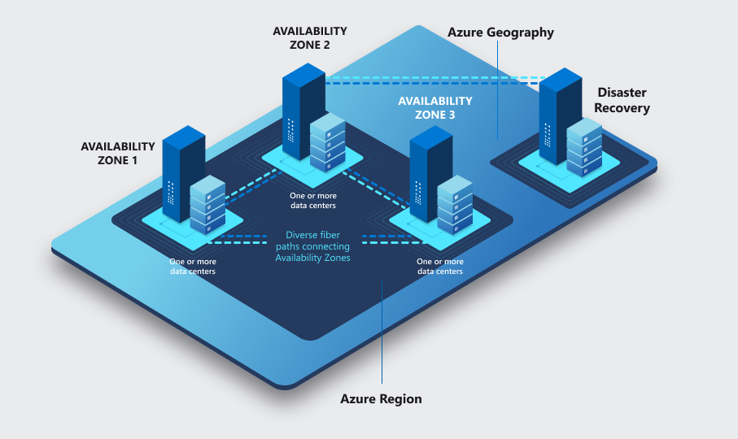
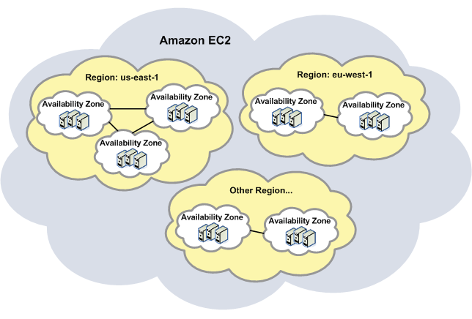

Slide 9
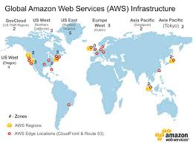
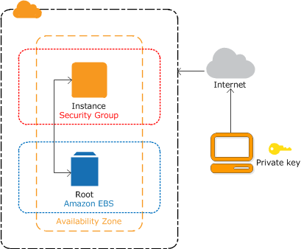
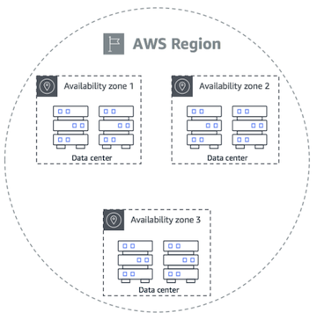
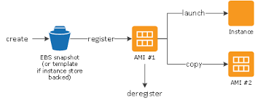

Slide 10
Low latency / High Throughput / High Availability
Lower Latency
is nearly always an improvement over slower packet transport. Low latency is desirable in online gaming as it contributes to a more realistic gaming environment.
However, the term low latency is most often used to describe specific business use cases, in particular high-frequency trading in capital markets.
High throughput
it’s a FIFO queues supports a higher number of requests per API, per second.
To increase the number of requests in high throughput for FIFO queues, you can increase the number of message groups you use. Each message group supports 300 requests per second.
High availability
is a quality of computing infrastructure that allows it to continue functioning, even when some of its components fail.
This is important for mission-critical systems that cannot tolerate interruption in service, and any downtime can cause damage or result in financial loss.

Slide 11
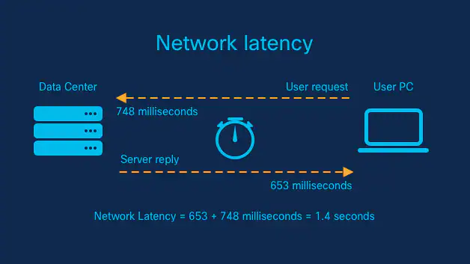
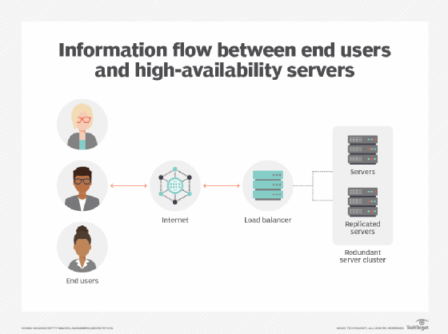
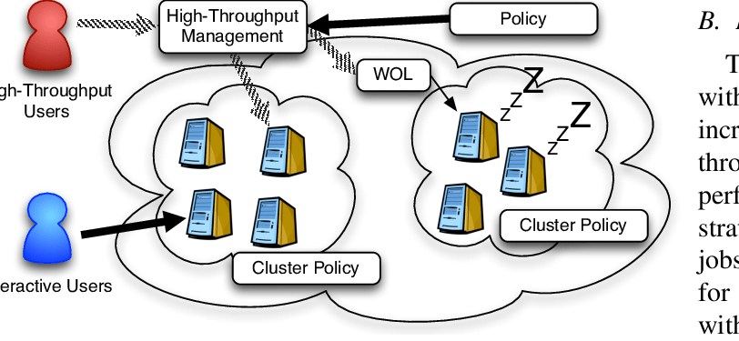
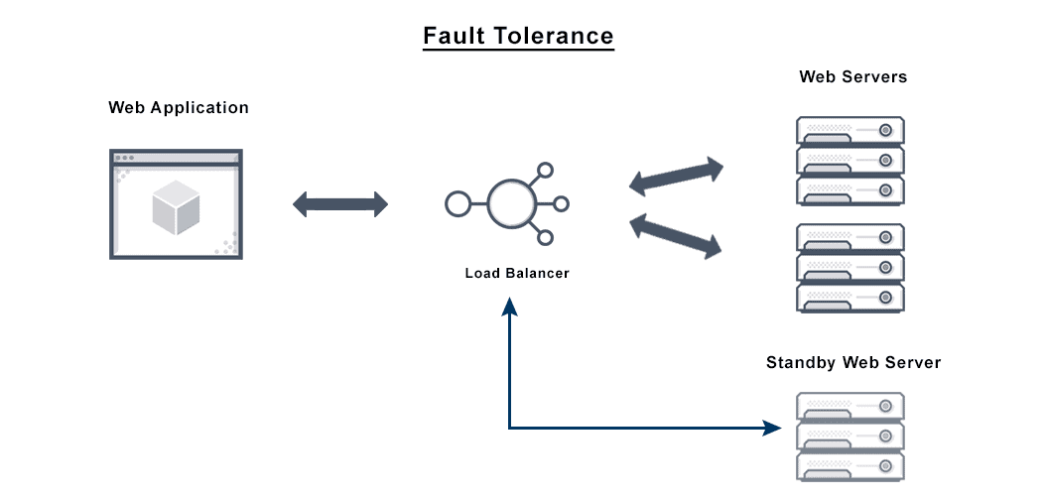

Slide 12
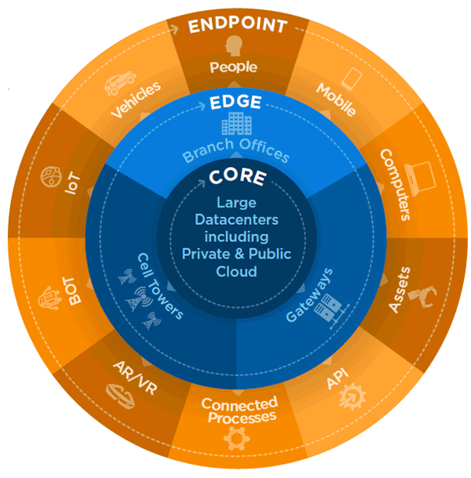
Fault-tolerance / Edge location
Fault-tolerance
is the ability for a system to remain in operation even if some of the components used to build the system fail.
Even with very conservative assumptions, a busy e-commerce site may lose thousands of dollars for every minute it is unavailable.
Edge location
is the nearest point to the consumer(user) who is consuming the AWS service.
In these locations, the server is not present but a small setup is there.
They are located in major cities around the world.

Slide 13
Factors To Consider When Choosing Your Region and AZ
1. Compliance
Usually, companies have to meet certain legal requirements.
For instance, you may wish to keep the data in the country the application is deployed in. Sometimes this is essentially the only factor considered when choosing AWS regions.
If you are obligated by law to host your data or application in a specific country or continent, then no other factor can outweigh this one.
2. Latency
A major factor to consider for user experience is latency. Reduced network latency can make substantial impact on enhancing the user experience.
Choosing an AWS Region with close proximity to your user base location can achieve lower network latency.
It can also increase communication quality, given that network packets have fewer exchange points to travel through.

Slide 14
3. Cost
AWS services are priced differently from one Region to another. Some Regions have lower cost than others, which can result in a cost reduction for the same deployment.
4. Services and features.
Newer services and features are deployed to Regions gradually.
Although all AWS Regions have the same service level agreement (SLA), some larger Regions are usually first to offer newer services, features, and software releases.
Smaller Regions may not get these services or features in time for you to use them to support your workload.

Slide 15
Global Services &Regional Services
Region service:
It’s a transport services whose principal purpose is to meet the transport needs of region.
Most of the AWS services are Region service.
Its specific for region only.
Global service:
AWS offers a broad set of global cloud-based products including
storage, compute, data base ML & AI, IOT, N/W & much more.
Its specific for Global only.

Slide 16
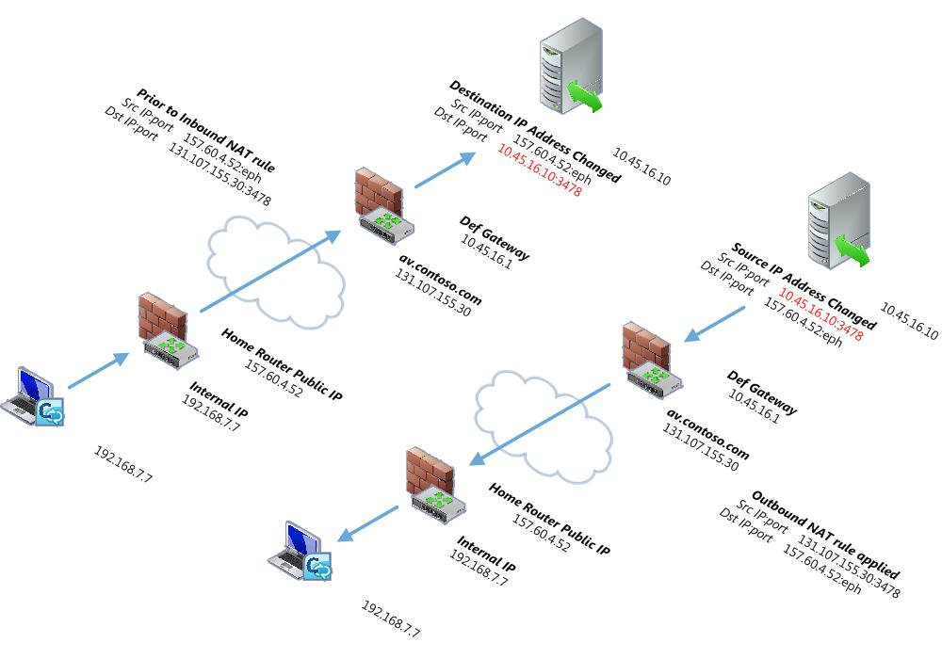
Billing & Pricing overview
There are 4 fundamental drivers of cost with AWS:
Compute – you pay only for the instance or resource you need, for as long as you use it, without requiring long-
term contracts or complex licensing.
Storage – you pay only for the instance or resource you need to store the data’
Inbound data transfer – (that is, packet data that is destined for the Amazon cloud servers
example, uploads and client requests) are free.
Outbound data transfer – is billed (that is, downloads from the cloud and responses to client requests).

Slide 17
Access AWS Services
To access the AWS services:
AWS Management Console (AMC).
– access by using console.
Command Line Interface (CLI).
– access by using commands
Application Program Interface (API).
– access by using programs

Slide 18
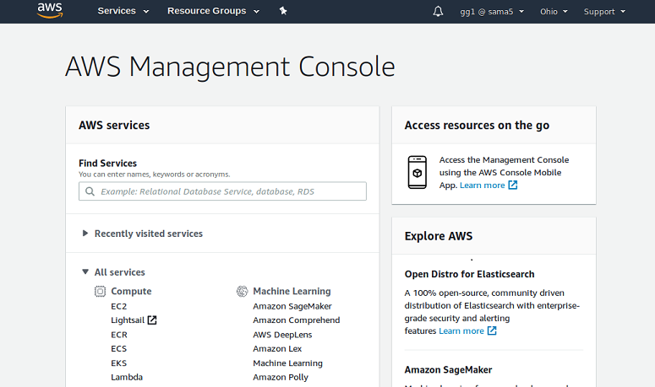
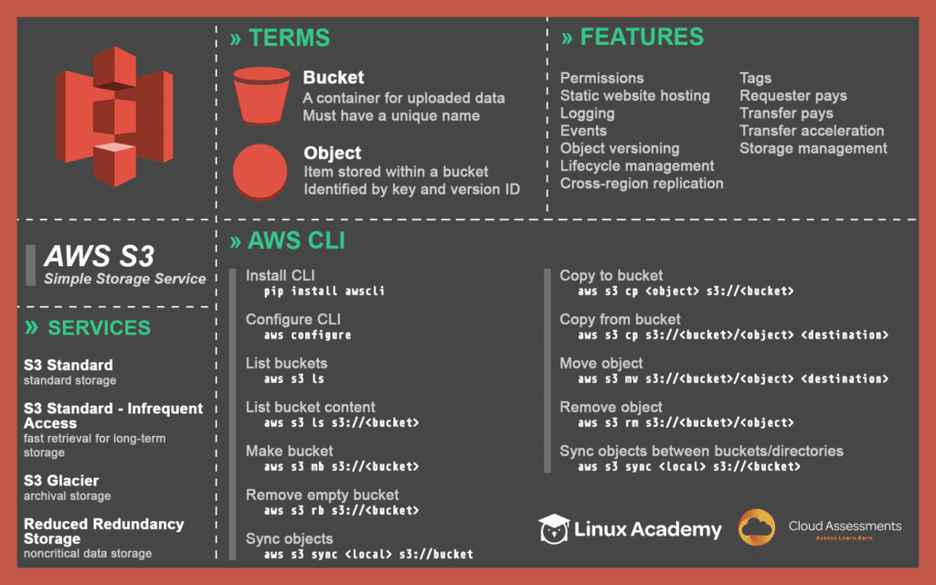
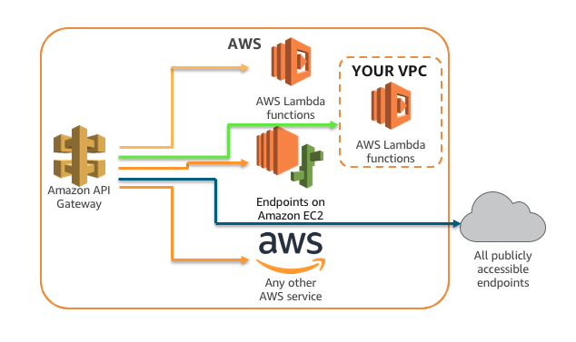

Slide 19
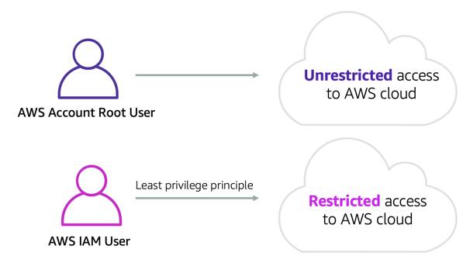
IAM Services / IAM Authorization types / Root user V/S IAM user
Identity and Access Management (IAM) is a web service that helps you securely control access to AWS resource. You use IAM to control who is authenticated (signed in) and authorized (has permissions) to use resources.
IAM Authorization types
Identity based policy
Resource based policy
Root user
When you first create an Amazon Web Services (AWS) account, you begin with one identity that has complete access to all AWS services and resources in the account. This identity is called the AWS account root user. You can sign in as the root user using the email address and password that you used to create the account.
IAM user
An AWS Identity and Access Management (IAM) user is an entity that you create in AWS to represent the person or application that uses it to interact with AWS. A user in AWS consists of a name and credentials. An IAM user with administrator permissions is not the same thing as the AWS account root user.

Slide 20
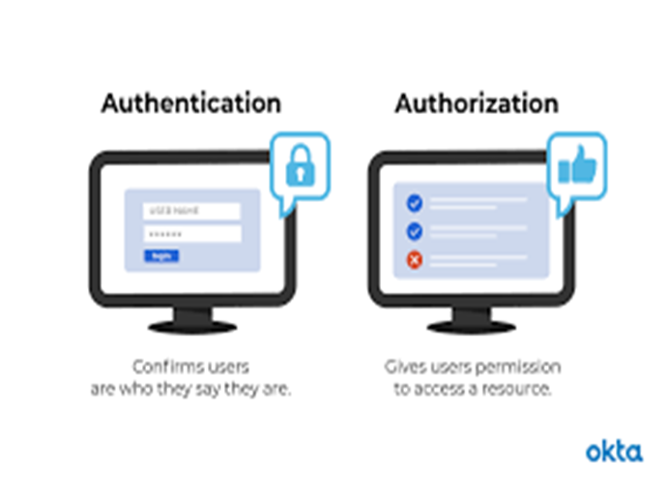
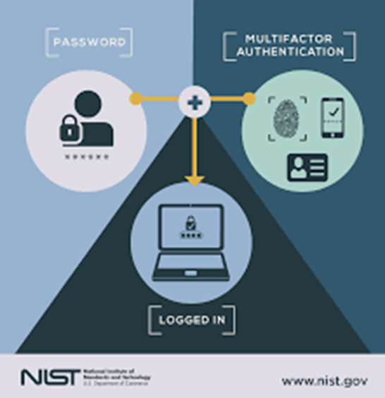
Principle / Authentication / Authorization / MFA
Principle
is a person or application that can make a request for an action or operation on an AWS resource.
Authentication
is how you sign in to AWS using your credentials.
You must be authenticated (signed in to AWS) as the AWS account root user, an IAM user, or by assuming an IAM role.
Authorization
that determines what an identity can access within a system once it's been authenticated.
An example of this would be an identity's permissions to access specific AWS resources.
Multi-factor authentication (MFA)
in AWS is a simple best practice that adds an extra layer of protection on top of your user’s name and password.

Slide 21
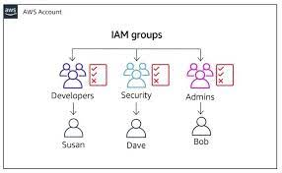
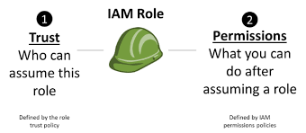
Add users / Group users / Roles - in IAM
IAM users
IT’s a resource in IAM that has associated credentials and permissions.
An IAM user can represent a person or an application that uses its credentials to make AWS requests.
This is typically referred to as a service account.
IAM Group users
It’s a collection of IAM users.
User groups let you specify permissions for multiple users, which can make it easier to manage the permissions for those users.
For example, you could have a user group called Admins and give that user group typical administrator permissions.
IAM Roles
is an IAM identity that you can create in your account that has specific permissions.
An IAM role is similar to an IAM user, in that it is an AWS identity with permission policies that determine what the identity can and cannot do in AWS.

Slide 22
Policies
AM policies define permissions for an action regardless of the method that you use to perform the operation.
For example, if a policy allows the Get User action, then a user with that policy can get user information from the AWS Management Console, the AWS CLI, or the AWS API.
Example policies: Amazon S3
Allows IAM users to access their own home directory in Amazon S3, programmatically and in the console (View this policy.)
Allows a user to manage a single Amazon S3 bucket and denies every other AWS action and resource (View this policy.)
WS CLI, or the AWS API.

Slide 23
EC2 Instances / It’s Benefits
EC2 Instances
An instance is a virtual server in the AWS Cloud.
With Amazon EC2, you can set up and configure the operating system and applications that run on your instance.
When you sign up for AWS, you can get started with Amazon EC2 using the AWS Free Tier.
It’s Benefits
Reliability, Amazon EC2 offers 99.9% availability for each Amazon EC2 region.
Security, Amazon works with Amazon VPC to provide robust networking and security for the compute resources.
Flexibility.
Cost Saving.
Elastic Computing.
Completely controlled.

Slide 24
Customized AMI / Public IP V/S Elastic IP
Customized AMI
An Amazon Machine Image (AMI) defines the programs and settings that will be applied when you launch an EC2 instance.
Once you have finished configuring the data, services, and applications on your ArcGIS Server instance, you can save your work as a custom AMI stored in Amazon EC2.
Public IP
when an instance is terminated the public IP attached to it gets released and further when you relaunch the same instance new IP address is assigned.
Elastic IP
Elastic IP do not change and they remain same even if you terminate the instance and later again restart the same instance.

Slide 25
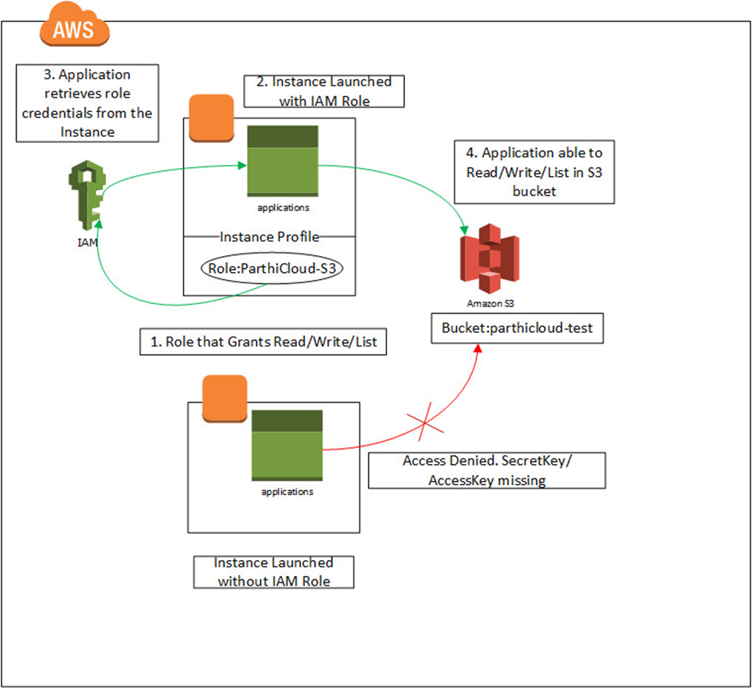
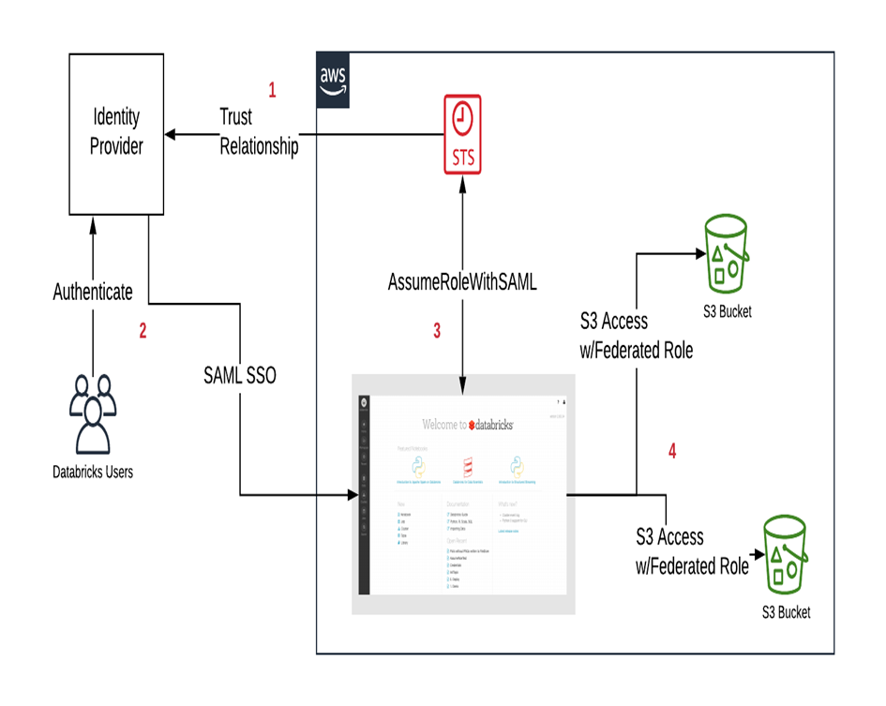
This are the 2 types for accessing service with the help of Access key & with the help of Role

Slide 26
Thank you

