Slide 1

Library management system
NAME : ROLL NO:
K.Chaitanya 23BFA02L22

Slide 2
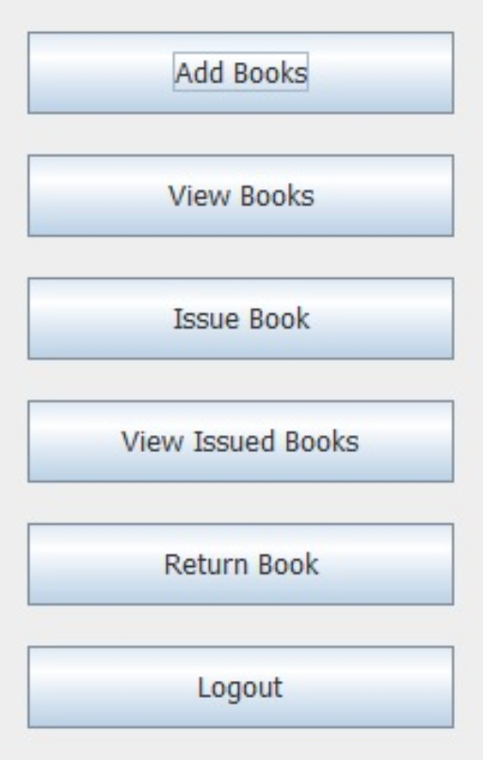
overview
1. To build a library management which contains two login :-
student and admin(librarian).
2. There will be various features like
• Searching of books
• Issuing and returning books
• Paying fine(if any) online
• Librarian can read information about any member
• Librarian can track the books issued by a particular student.

Slide 3
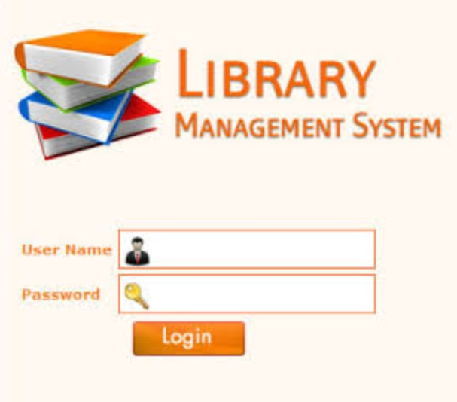
Module 1 - Student Login / Admin Login
Authentication of the user will be there.
• Username and password will be matched from our database. Once both username and password matches, then only a user is allowed to enter into the system.
• Similarly for admin there will be a authentication system.

Slide 4
Module 2 - Signup For New users
For new users there will be sign up option
Various details like registration number , username , password etc. will be taken from the user and then it will be updated in our database.
After this , the user will be redirected to the login page.

Slide 5
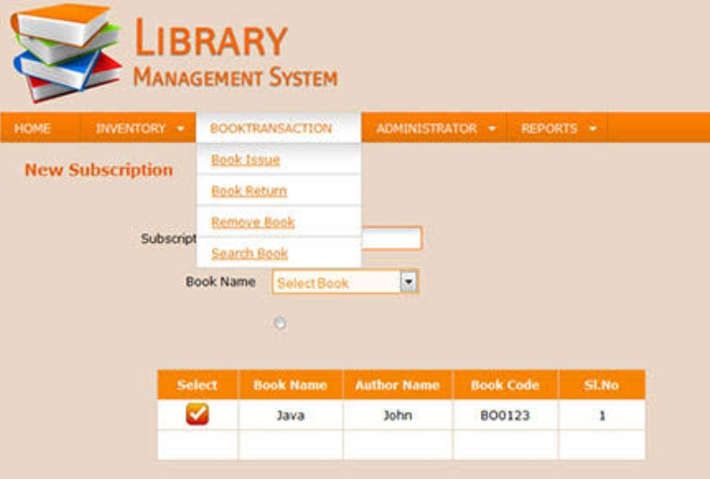
Module 3 - Student Profile
After successful login into system, user can see its details.
Various details which will be shown are:-
• Issued books
• Date of issue
• When to return
• Current fine the user has to pay
• Searching book in the library.

Slide 6
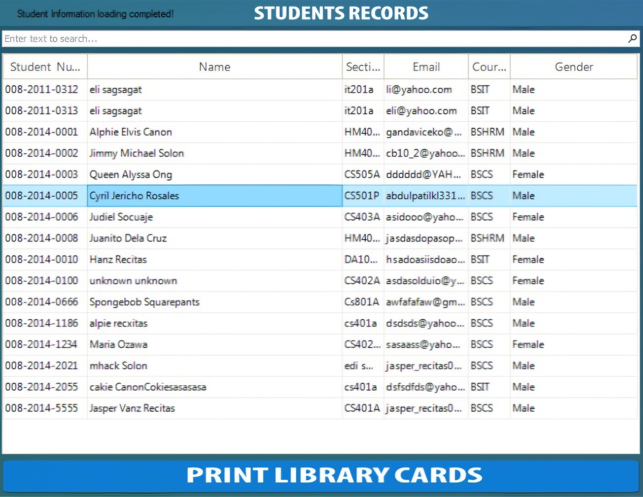
Module 4 - Admin Panel
After successful login admin can keep track of the books issued
It can also track various other details such as
• Fine of all students.
• Which book is issued by the student
• The number of copies of book which can help the librarian
to know which book to order.

Slide 7
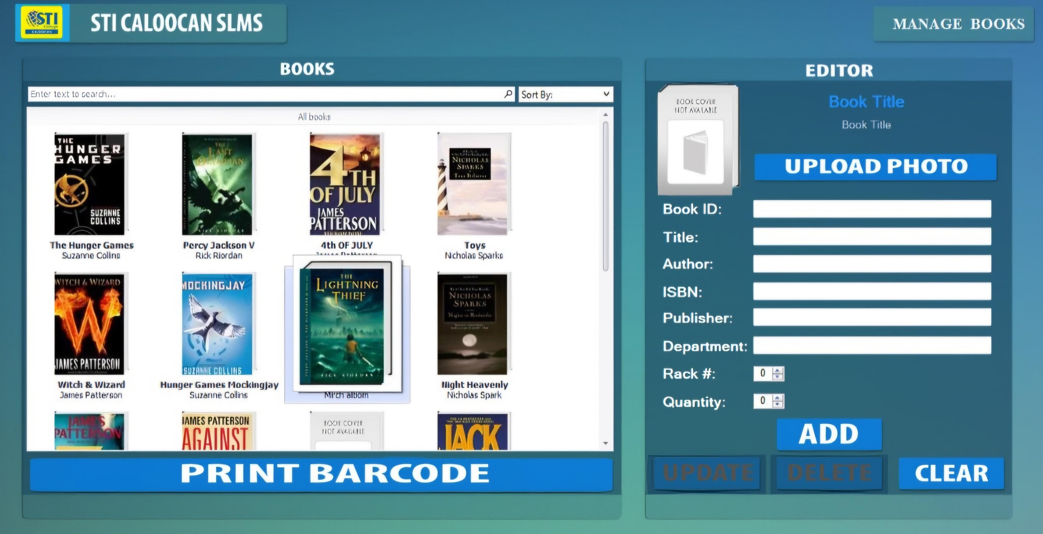
Module 5 – Book Search
Books present in the library can be searched.
The books can be searched on various parameters such as
• Subject wise Search- If a student wants a book related to open source programming then system will show all the books related to present in the library.
• Author Wise Search- Can search a book on particular author. The system will show all the books on that author available in the library
• Year Wise Search- Searching a book based on particular edition will be available.

Slide 8
Module 6 - Book Recommendation
In this , user will be allowed to recommend any book he/she require .
This information will go into the admin login where he can inform the higher authorities for supply of the books.

Slide 9
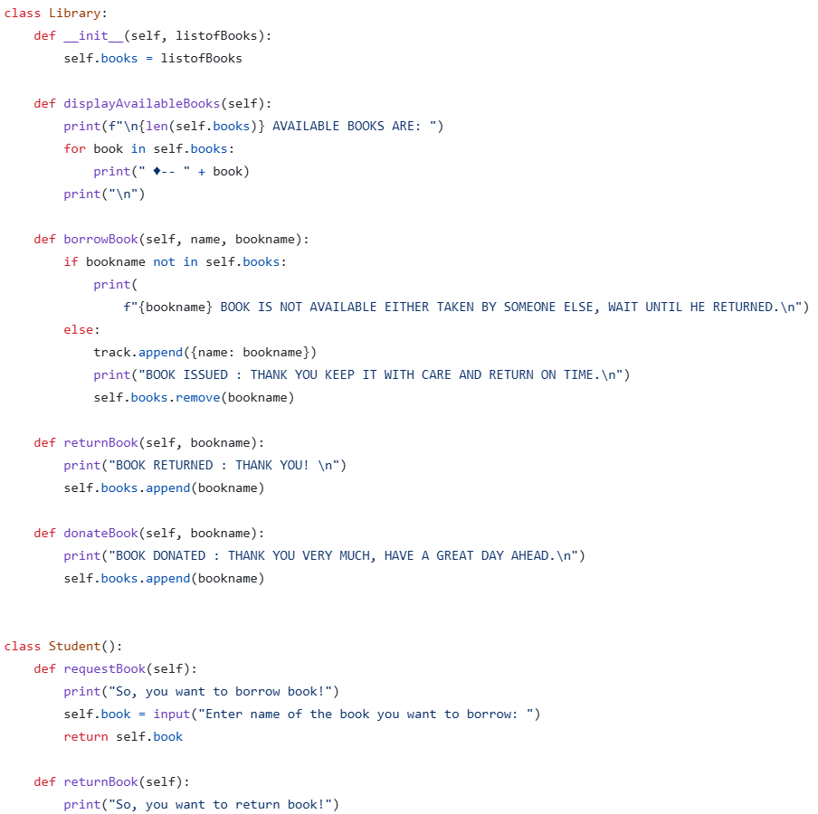
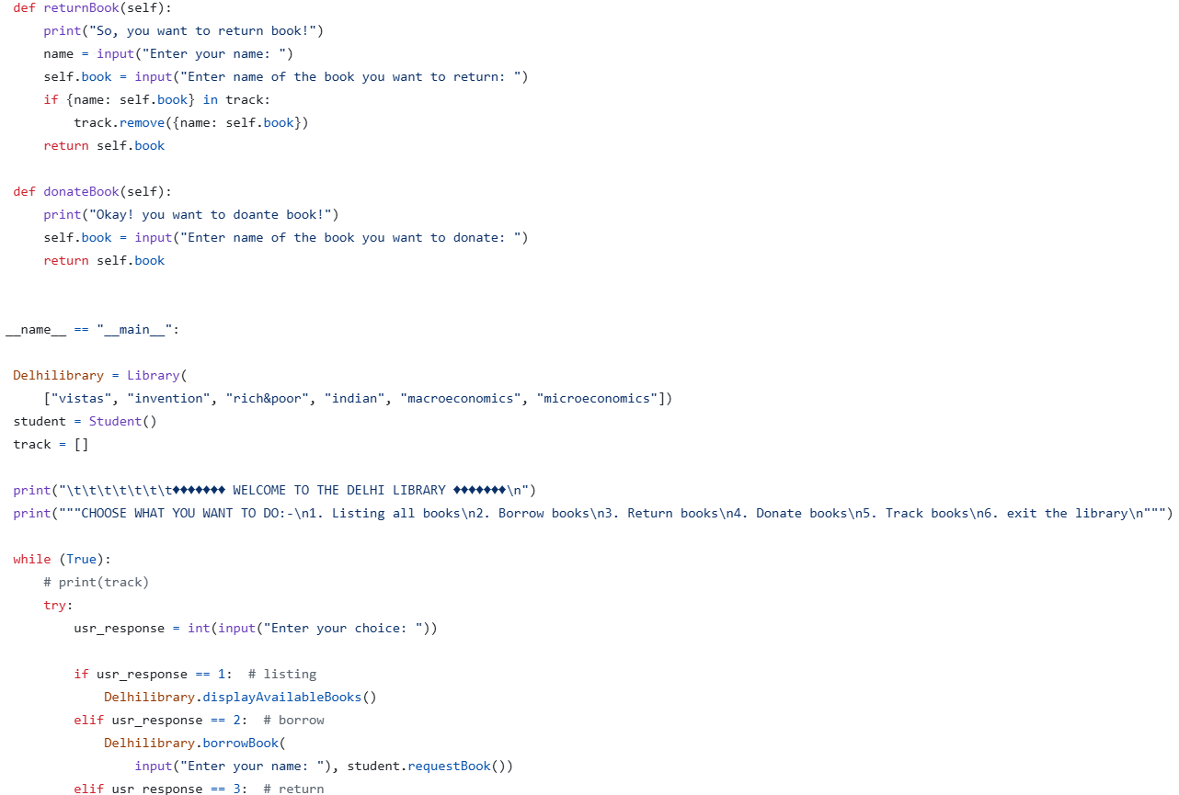
SOURCE CODE

Slide 10
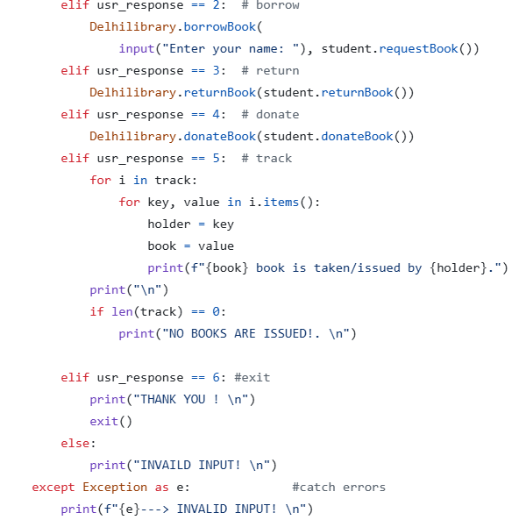

Slide 11
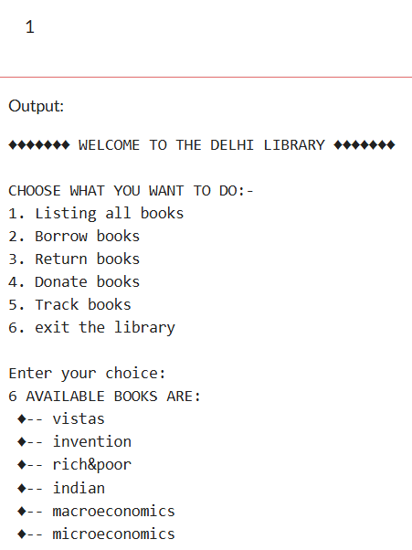
PROGRAM OUTPUT

Slide 12
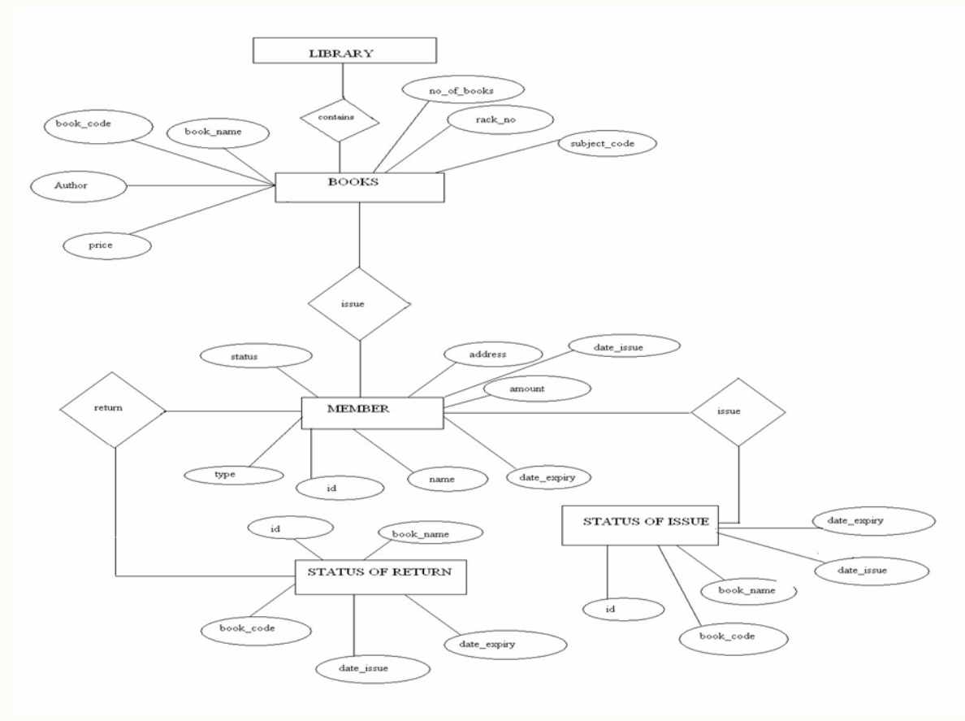

Slide 13




