Slide 1
ROLES AND RESPONSIBILITIES BIG DATA
OCTOBER 14, 2016

Slide 2
Organization
Transformation
Program Management
Infrastructure and Support
Delivery
Architecture
Data Governance

Slide 3
Organization - Delivery
Delivery
Frank Miller
VP BDA, API, SDN R/D
BDA Research
Dr. Ade Miller- Director
API Development
Gary Sidhu - Director
SDN Research
Bill Walker - Director
BDA Development
Tim Posey - Director

Slide 4
ORIGINAL: Initial Areas of Responsibility
Transformation
Program Management
Infrastructure and Support
Delivery
Architecture
Data Governance
Adam
Cloudera
CenturyLink
Bob Reedy / Matt Post
Andrew Clyne
Project Manager
BVA
Hadoop Admin
RSA
Hari Ganesan
Meg Hall—Transformation
Richard Henning
Andrew / Bruce
Odell / Marc
Frank / Anand / Mark Bragg
Sandeep / Joe Gance
RTE: Linda Soon
CDH: Adam Taylor
CDH: Suzanne Holshey
BA: Derek Strittmatter
Bruce Martin
Ed Pick
CTL: Keith Young Intl.
CTL: Chris Garner
Ferrell Semmes
Russ Jesser
Dan Ferretti
Ravi Enjeti
Doug Allpass
Sandra Montijo
Mick McMahon
Lori Shields
Glenn Balanoff
David Allen
Pat Hennessy
INS: Swaroop Trehan
New Big Data Team
Cognilytics (Hadoop and Decision Science)
Impetus
Cloudera
BVA: Business Value Assessment
Project Management
CA Agile Central Support
Program Communication
Program Dashboard
Front Door Process
Meeting Minutes
Resource Onboarding
Data Quality Assessment
Data Program Strategy
Data Security and Privacy
Data Quality
SLA
Server Support
Environment Quality
Network
Data
Security
Dev Ops
Use Case and Initiative Delivery
Hadoop Platform Delivery and Integration
PM: Robert Langhart w/Charles Hardin
IGS: Donna Gordon
Tools: Joshua Myers
Interface to Internal Network: David Uhl
Interface to security: John Knies / Chris Garner / Keith Young

Slide 5
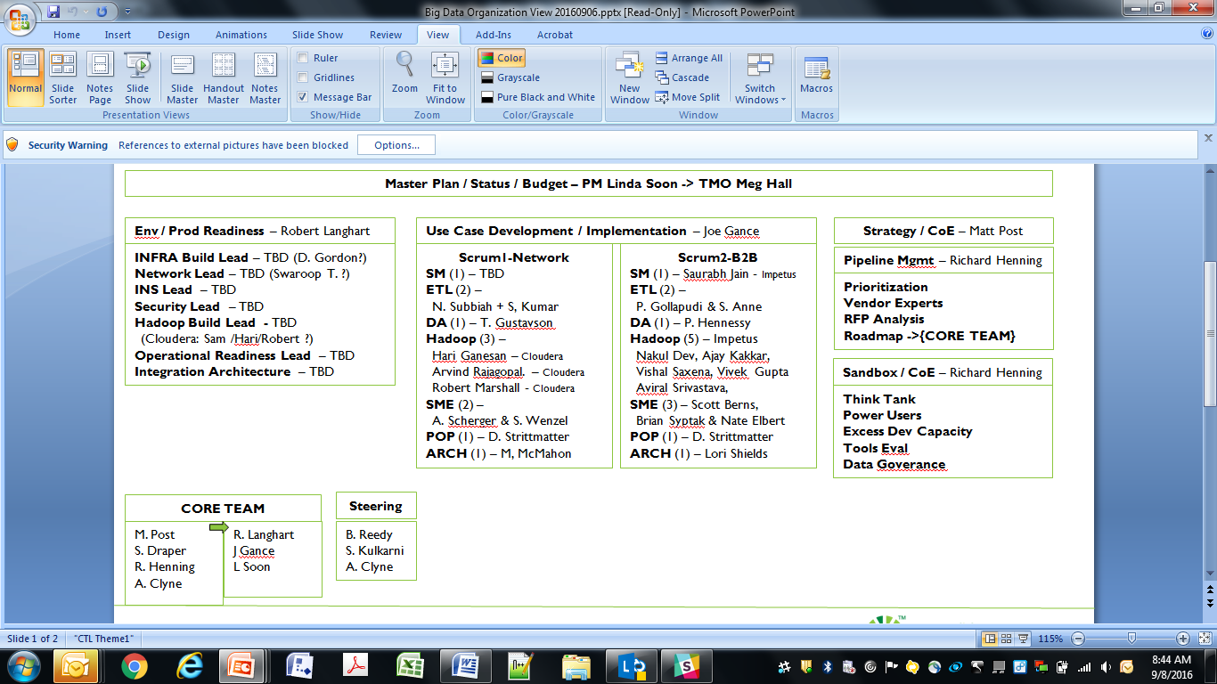
ORIGINAL: Draft of Initial Framework—Still in Development
BIG DATA | 2016 | CENTURYLINK CORPORATION | INTERNAL USE ONLY: PRIVATE & CONFIDENTIAL | PAGE 5

Slide 6
Roles: Overview
Function | Roles | Description
Data Science | Data Scientist | A person or collection of people with developer, statistical, and business domain expertise.
 | Application Developer | A person who develops new business applications and is a data steward for those applications.
 | Power Analyst | An analyst with programming skills that allow the creation of derived data products.
 | Analyst | A analyst who uses primarily SQL based analytic tools.
Data Engineering | Data Engineer | This role spans data management and analytics and is critical in the data discovery process. Has a domain understanding of both the data and the use cases and therefor is responsible for creating common profiles for data elements to facilitate reusability.
 | Data Stewards | The person responsible for the data elements contained in a data source from an originating system. Is responsible for creating and logging data.
 | Data Ingest (ETL) | Responsible for developing the ingest and processing to onboard new data feeds and to apply simple schemas. This is a development role and is also considered a Jr. Data Engineer.
 | Data Operations | Responsible for the maintaining Service Levels on the end-to-end data pipeline. This is an operational role.
 | Information Security (InfoSec) | Oversight and accountability for the installation and management of security systems across the entire organization's network and enforcing compliance to data security, privacy and retention policies and processes
BIG DATA | 2016 | CENTURYLINK CORPORATION | INTERNAL USE ONLY: PRIVATE & CONFIDENTIAL | PAGE 6

Slide 7
Roles: Overview
Function | Roles | Description
Architecture | Enterprise Architect | Owns the EDH Architecture and how it integrates with the other applications in the data center. Continuously explores new technology and determines how it integrates / impacts the EDH.
 | Hadoop Administrator | Responsible for cluster SLAs.
 | Network Administrator | Network support for cluster
 | Systems Administrator | Level 1/2 support for cluster
BIG DATA | 2016 | CENTURYLINK CORPORATION | INTERNAL USE ONLY: PRIVATE & CONFIDENTIAL | PAGE 7

Slide 8
Roles and Responsibilities - SCRUM
CHIEF PRODUCT OWNER
Set Priorities for the Program
Determines business value and prioritization of each MMP and/or Feature
Resolve prioritization and conflicts between Trains
Supports Train Product Owners during PI/Sprint planning and backlog refinement
TRAIN PRODUCT OWNER
Determines business value and prioritization of each MMP and/or Feature
Maintains prioritized product backlog for Train
Escalates changes in priority to Change Control Board for visibility and decisions
Supports Domain Product Owners during PI/Sprint planning and backlog refinement
DOMAIN PRODUCT OWNER
Maintains prioritized product backlog for Domain
Escalate changes in priority to Change Control Board for visibility and decisions
Supports Team Product Owners during PI/Sprint planning and backlog refinement
Handles demos and related acceptance
TEAM PRODUCT OWNER
Maintains prioritized product backlog for Team
Escalate changes in priority to Domain Change Control Board for visibility and decisions
PI/Sprint planning and backlog refinement
Handles demos and related acceptance

Slide 9
Roles and Responsibilities - SCRUM
CHIEF ARCHITECT
Responsible for Solution Design within Trains
Responsible for BIG DATA overall decisions, plans, goals and strategies
CHIEF SOLUTION ARCHITECT
Responsible for BIG DATA solution decisions, plans, goals and strategies
Provides direction to Enterprise Architects, Business Architects, and Solution Architects
Delivers architectural initiatives and provide oversight and support to Chief POs, Chief RTE and Chief POP
SOLUTION ARCHITECT PRIME
Responsible for Solution Design within Trains
Direct support for Chief Solution Architect
Drives resolution for architectural initiatives and provide oversight and support to Chief POs, Chief RTE and Chief POP
DOMAIN ARCHITECT
Provides reference architecture for the Domain
Resource to answer architectural questions
Responsible for Solution Design within Domains
Provides daily technical solution guidance and support to Scrum Team members
Responsible for delivery of content in line with solution expectations
Resolves inter-team technical communications and issue resolution
Responsible for substantive and regular communications on solution status

Slide 10
Roles and Responsibilities - SCRUM
CHIEF RTE
Insure MMP and Feature backlog grooming is in “ready state” prior to PI planning
Manages daily cross-Train dependencies between MMPs and/or Features
Mitigates cross-Train level risks, escalations and removes blockages to on time delivery
Prime accountability for all Release Trains
Responsible for inter-group communication and dependency resolution across Trains
Organizes, facilitates and leads Release Planning meetings
RTE PRIME
Secondary point of contact for all the chief RTE responsibilities
Prime accountability for all non-BIG DATA stories need for the BIG DATA program
TRAIN RTE
Insure team story backlog grooming is in “ready state” prior to PI planning
Responsible for substantive and regular communications on solution status
Runs the SoS (Scrum of Scrums) for Train
Responsible for inter-group communication, issue and dependency resolution within Train

Slide 11
Data Program Front Door Process → Use Case Intake
Use Cases
Use Case Definition
High Level Effort
1
3
2
4
A
Initial Prioritization
Classify
Prioritize
Rank vs Others
Rule Outs
6
Front Door Process
Governance Meeting Twice/week
Triages All Inputs across company
Reviews Business Case, Data Source, Use Case and High Level Design and Effort Requirements.
Prioritizes Inputs and schedules next steps with sponsors and technical owners vs latest Data Program plan and other use cases submitted.
Resource Requirement
Architect/Data Sources
5
7
B
8
Pilot and Refine
Test
Validate
Learn
Update
Rule Outs
C
Data Initiatives
Updates
5
1. Initiative 1 – Marketing – B2B
2. Initiative 2 – Marketing – Customer Churn
3. Initiative 3 – Finance – Revenue Recognition Staging
4. Initiative 4 – Network - Oceans
2
Data Platform Strategic Plan
4
8

Slide 12





Establish Full Spectrum of Data Governance
Scope: Across the spectrum of data management implications…
Meta Data Management: integrating, controlling and providing consistent definitions
Data Governance: planning, supervision and control over data and its use
Data Architecture, Analysis & Design: ensuring development at the project level adheres to data modeling standards, procedures and “Best Practices”
Document Record & Content Management: ensuring that documents are stored and easily accessible across the enterprise
8
1
Data Architecture, Analysis & Design
Database Management: management and maintenance of information stored in a computer system
Metadata Management
DCIS
DB
7
Document Record & Content Management
2
Data Warehousing & Business Intelligence Management: ensuring transactional data is summarized and aggregated into useful business value
Database Management
Data Governance
Data Security Management: ensuring that the right constituents have access do data when needed
Data Warehousing & Business Intelligence Mgnt
Data Security
Management
6
3
Reference & Master Data Management: managing common and consistent non-transactional data across the enterprise
Reference & Master Data Management
Data Quality
Management
Data Quality Management: defining, monitoring and improving data quality via defined metrics and measurements
Districts
PDP Code
Project Class
Data
5
4
BIG DATA | 2016 | CENTURYLINK CORPORATION | INTERNAL USE ONLY: PRIVATE & CONFIDENTIAL | PAGE 12

