Slide 1
Data Ingestion Patterns and security options
Prepared for CenturyLink,
by Sam Glover
as of August 25, 2016

Slide 2
Platform Architecture
Access Layer
Engines
Ingestion
Interactive
Storage Layer
Egress
ETL
Kafka
Flume
DistCp
Producer
Custom/HDFS API
SolR
Grid Compute
HDFS Command
JDBC
HBase API
ODBC
Spark DAG
MLlib
Custom
PIG
Girpah
Hive
Cloudera Manager
Sqoop
Impala
Spark
Map Reduce
Spark Streaming
Yarn
DistCp
Sentry/Record Service (Security Framework)
HDFS Command
Navigator
HDFS
HBase
Kudu
SolR
Custom/HDFS API
Encryption
Notes:
An enterprise data hub can store unlimited data, cost-effectively and reliably, for as long as you need, and lets users access that data in a variety of ways. Data can be collected, stored, processed, explored, modeled, and served in one unified platform. It’s connected to the systems you already rely on.
This diagram shows different components used for Storage, Processing, Access and Ingestion.
Security components we just discussed are highlighted. We will discuss the Ingestion components in more detail in following slides.

Slide 3
Ingest The Foundation of Hadoop’s Potential
Data can come from a variety of “silo-ed” sources
Existing databases
Sensor data
Server logs
Chat transcripts
Value of data is multiplied when combined and correlated with other data
“40% value improvement from combining data from multiple IoT sources” McKinsey Global Institute
Notes:
Typical enterprise applications get their data from various sources. Some of these sources are listed here, existing relational databases, sensor data, server logs and chat transcripts. Other types of data we see being loaded into the clusters includes Images, Audio files and other binary files.
As McKinsey Global institute said that value of data is multiplied when combined and correlated with other data. It is hard to do this in a silo-ed environment and Enterprise Data Hub lets you combine these datasets easier.

Slide 4
HDFS Command
The hdfs dfs utility has several subcommands
Most of these are named after standard Linux commands
The put and get subcommands copy data to and from the cluster
The put command copies a local file to HDFS
The get command copies a file from HDFS into the local filesystem
$ hdfs dfs -mkdir /training
$ hdfs dfs -put file.txt /training
$ hdfs dfs -ls /training
$ hdfs dfs -cat /training/file.txt
$ hdfs dfs -rm /training/file.txt
$ hdfs dfs -get /user/bob/data.txt bobsdata.txt
Notes:
Another difference from Linux is that home directories in HDFS tend to be under a directory called /user rather than one called /home.

Slide 5
HDFS Command Security
HDFS Authentication support Via Kerberos
Authorization – HDFS permissions and ACL’s (Sentry ACL Sync)
Encryption At Rest – Navigator Encrypt for HDFS
Encryption In Transit - SSL is supported between HDFS nodes
Notes:
HDFS Command will fail if user does not have access to the folder. Only user with right permissions to HDFS folders be able to ingest data.
Encryption At Rest is provided via Navigator Encrypt.

Slide 6
Apache Sqoop SQL to Hadoop
Efficiently exchange data between database and Hadoop
Bidirectional
Import all or partial/new data
Export for shared data access across systems
Easily get started with high performance connectors
Free to use
Optimized connectors for popular RDBMS, EDW, and NoSQL options
Notes:
Sqoop is an open source Apache project originally developed by Cloudera. Name is a contraction of SQl-to-hadOOP
Sqoop exchanges data between a database and HDFS. Can import all tables, a single table, or a partial table into HDFS. Data can be imported in delimited text, SequenceFile, or Avro format. It can import all or partial/new data since last import.

Slide 7
How Does Sqoop Work?
Sqoop is a client-side application that imports data using Map-only jobs
A basic import involves three steps orchestrated by Sqoop
Examine table details
Create and submit job to cluster
Fetch records from table and write this data to HDFS
Notes:
The diagram illustrates how Sqoop imports a table from a database into HDFS:
The user runs the Sqoop import command (e.g., on his or her workstation)
Sqoop connects to the database and gets metadata needed for the import job. This includes the table definition as well as determining the number of rows that the import will produce.
Sqoop submits a Map-only job (consisting of four map tasks by default, but configurable) that runs on the Hadoop cluster. Each task pulls a subset of the table from the database server. The Map-only tasks write their data as output in HDFS.

Slide 8
Sqoop Security
HDFS Authentication support Via Kerberos
Database authentication
Authorization – HDFS permissions and ACL’s (Sentry ACL Sync)
Database authorization
Encryption At Rest – Navigator Encrypt for HDFS
Encryption In Transit - SSL support depends on the RDBMS support
Notes:
As part of the Sqoop command you pass Database credentials (userid/password). These credentials determine users access rights for the database table.
Sqoop job will fail if user does not have access to the Import/Export folder. Only user with right permissions to HDFS folders be able to ingest data.
Encryption At Rest is provided via Navigator Encrypt.
SSL support depends on the database vendor and the driver used for Sqoop.

Slide 9
Apache Flume Log & Event Aggregation for Hadoop
Efficiently move large amounts of streaming/log data
Easily collect data from multiple systems (sources)
Built-in sources, sinks, and channels
Customize data flow to transform data on-the-fly
Reliable, scalable, and extensible for production
Manage and monitor with Cloudera Manager
Notes:
Flume can be used to efficiently move large amounts of log data which may be coming from WebServers, application logs or networking devices. Flume can be used to stream sensor data, social media data and data from Message Queues like MQ
It has support for built-in sources, sinks and channels.
Flume lets you customize data flow to transform data on the fly
Flume is Reliable, Scalable and Extensible for production applications. Its fully integrated with Cloudera Manager.

Slide 10
Components in Flume’s Architecture
Source
Receives events from the external actor that generates them
Sink
Sends an event to its destination
Channel
Buffers events from the source until they are drained by the sink
Agent
Java process that configures and hosts the source, channel, and sink
Notes:
A flume event represents a single event (e.g., a hit on a Web site) and is similar to an e-mail message in that it has one body and some number of headers. Headers are metadata; they are an unordered set of key/value pairs (which might include things like the timestamp or hostname) and are often used for routing traffic in a large collection workflow (well beyond the scope of this class). Flume can add and modify headers on the fly, so you might add headers that specify details about the origin of data and use that to determine where in HDFS that data is written. The body is the payload and is simply an array of bytes, so it can contain any type of content.
Headers are part of the “control plane” – their values aren’t usually what you’re ultimately interested in storing but might help you in figuring out where to store the data (message body) that you care about. For example, you might have a header containing the timestamp at which a message was generated or the hostname from which a log file originated. You could use these values when you specify an output path in HDFS (e.g., setting agent1.sinks.k1.hdfs.path = /flume/events/%{host}/%y-%m-%d in your configuration file would store the data in a directory based on the host header, and below that, within subdirectories based on the date portion of the timestamp). We show a basic example of this later in the chapter.

Slide 11
Flume Data Flow
This diagram illustrates how syslog data might be captured to HDFS
Message is logged on a server running a syslog daemon
Flume agent configured with syslog source receives event
Source pushes event to the channel, where it is buffered in memory
Sink pulls data from the channel and writes it to HDFS

Slide 12
Data Flow Customizations
Flume comes with many built-in sources, sinks, and channels
It is also possible to create your own implementations
Commonly used sources are, Syslog, Netcat, Exec, Spooling Directory, HTTP Source and Kafka
Commonly used sinks are, HDFS, HBase, Logger, Morphline/Search and Kafka
Built-in channels are Memory, File and Kafka
Additionally, Flume supports a few other ways to customize data flow
Can inspect, modify, or transform event data
Can control the format of messages written to the destination

Slide 13
Flume Security
Authentication support Via Kerberos
Authorization – HDFS permissions and ACL’s
Encryption At Rest – Navigator Encrypt
Encryption In Transit - SSL is supported
Notes:
Flume support Authentication via Kerberos. Flume agent can ingest data into a folder that the user has permissions.
Encryption At Rest is provided via Navigator Encrypt. Flume supports SSL communication between agent to Source and Sink

Slide 14
Apache Kafka Pub-Sub Messaging for Hadoop
Backbone for real-time architectures
Fast, flexible messaging for a wide range of use cases
Scale to support more data sources and growing data volumes
Zero data loss durability and always-on fault-tolerance
Built-in security and data protection
Seamless integration across the platform
Connect to Flume, Spark Streaming, HBase, and more
Manage and monitor with Cloudera Manager
Source System
Source System
Source System
Source System
Kafka
Hadoop
Security Systems
Real-time monitoring
Data Warehouse
Kafka decouples Data Pipelines
Notes:
Kafka brings Pub-Sub messaging to Hadoop. It decouples Data pipelines
Source systems can send the data to Hadoop and Non-Hadoop applications at the same time

Slide 15
Kafka Benefits
High-Throughput & Low Latency
Enterprise-Grade
Single broker handles 100MBs of reads/writes per second, from 1000s clients
Messages delivered in milliseconds
Over-the-wire encryption and Kerberos authentication for secure streaming
Robust monitoring and troubleshooting through Cloudera Manager
Scalable & Flexible
Simple Integration
Elastically scale and dynamically add Producers/Consumers without downtime
Reliable multi-tenant operations with client throttling
Easy development with APIs to connect with other tools and systems
Extend capabilities with Cloudera’s partner network
Durable & Reliable
Cost-Efficient
Messages persisted on disk for zero data loss
Highly-available with built-in fault-tolerance and replication
Modest cluster optimized to handle millions of messages per second
Single system for multiple, complete workloads with Cloudera

Slide 16
Kafka Architectural Overview
Each machine is called a Broker
Data written belongs to Topics (analogous to a Table in a database)
Each Topic is partitioned
Partitions are distributed across the Brokers
Partitions are also replicated (one replica per partition is Leader Partition)
Producers and Consumers talk to the Leader Partition
Producer
Producer
Kafka Cluster
Broker 1
Broker 2
Broker 3
Partition 1
(Leader)
Partition 2
(Leader)
Partition 3
(Leader)
Partition 2
Partition 1
Partition 1
Partition 3
Partition 3
Partition 2
Consumer
Consumer

Slide 17
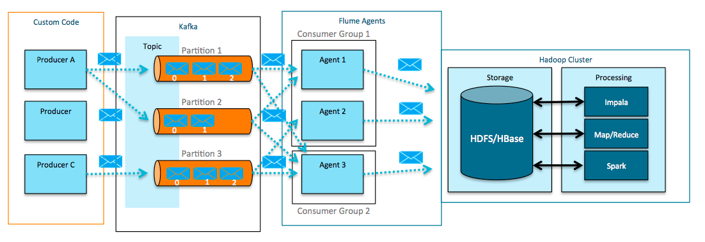
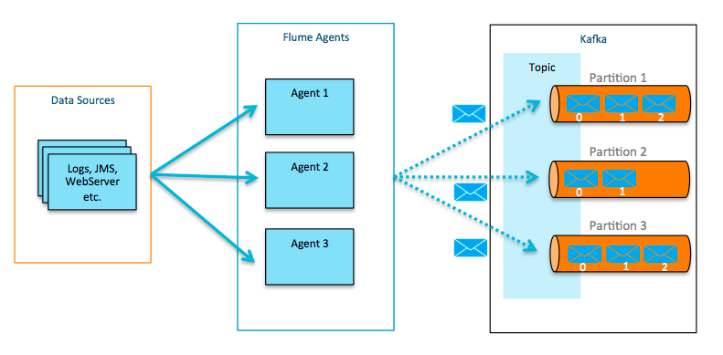
Kafka + Apache Flume
Kafka can be configured as a fast, reliable Flume Channel
Flume Sources and Sinks can be used as out-of-the-box Kafka Producers and Consumers
Flume Sinks Consume from Kafka:
Write data to HDFS, HBase, or Search
Flume Sources Write to Kafka:
Read from logs, files, jms, http, rpc, thrift, etc and write events to Kafka
Notes:
I talked about extending Flume functionality by creating custom, sources, sinks and channels. Before Cloudera started supporting Kafka which is more than a year back we built Flume integrations that include, Kafka source, sink and a channel.
You can leverage Flume Kafka Source to consume from Kafka and write data to HDFS or HBase or Search. Flume’s extensive ecosystem of Sources can be used to read from logs, files, jms, http, rpc, thrift, etc and write events to Kafka.
Flume channel gives the Flume events High Availability across nodes.

Slide 18

Cloudera Kafka 2.0 - Features
Feb. 2016
Based on upstream Kafka 0.9
Authentication support via Kerberos
SSL support
PLAINTEXT, SSL, SASL_PLAINTEXT and SASL_SSL
Client to Broker
Broker to Broker
New Java consumer
Mirrormaker rewrite
Reliability & Performance
Client quotas
Notes:
http://blog.cloudera.com/blog/2016/02/whats-new-in-clouderas-distribution-of-apache-kafka/
http://www.cloudera.com/documentation/kafka/latest/topics/kafka_new_features.html#xd_583c10bfdbd326ba-590cb1d1-149e9ca9886--6fc9__

Slide 19
Apache Kafka Security
Authentication support Via Kerberos
Authorization – Sentry integration is coming soon
Encryption At Rest – Navigator Encrypt
Encryption In Transit – SSL for Client to Broker and Broker to Broker is supported
Flume To Kafka - Kerberos Security is coming soon
Notes:
Most recent version of Kafka includes Authentication support via Kerberos. Topic level Authorization support using sentry is coming soon.
Encryption At Rest is provided via Navigator Encrypt.
Encryption in Transit – Secure client to broker and broker to broker communication is also part of the most of the more recent Kafka
Flume to Kafka does not yet support Kerberos. Changes required were committed in the upstream Flume project very recently and going to be in CDH very soon.

Slide 20
Canonical Ingestion Architecture
HDFS
Data
Sources
HBase/Kudu
High-Fidelity Archival
HBase-Spark/REST
Real-Time Serving
Application
Kafka/
Flume
Spark Streaming
Real-Time Notifications
Kafka
Morphlines
Real-Time Serving
Integrate with Apache Spark Streaming for real-time analysis of data
Write back to Kafka for further processing or to send to an application layer
Solr
Notes:
Here is a canonical Ingestion Architecture we find used across many Cloudera customer applications.
Data Sources can be any of the sources we talked about in the previous slides, Existing RDBMS data, Log files, sensor data or other types of data. Data is ingested into Kafka and or Flume which writes into HDFS.
For real-time use cases data is processed using Spark Streaming and written into data stores like, HBase/Kudu or Solr. Sometimes the data is written back into Kafka for further processing.
Other applications pick this data from these data stores and do their analytics or processing as required.

Slide 21
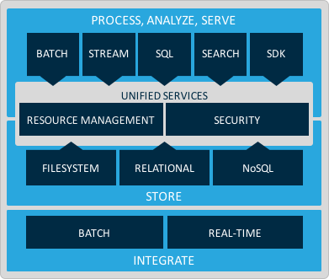
Cloudera makes Data Ingestion Fast, Easy, & Secure.
The leading big data platform from the leaders in enterprise Hadoop.
Fast Leadership in Kafka and Spark to help turn processing windows from hours to minutes.
Easy
Deliver optimum system utilization and meet SLA commitments, on-premises or in the cloud, with minimum effort.
Secure End-to-end Security, Governance, and Data Management
Notes:
To Recap.
Cloudera aims to make data processing Fast, Easy, and Secure
It focuses on development leadership in Kafka and Spark to help turn processing windows from hours to minutes
It helps easily deliver optimum system utilization and meeting SLA commitments with minimum effort
All while providing end to end security and data management so you can utilize more data, without introducing more risk

