Slide 1


Introduction to IoT(EC0424)
Iot and Wearable Technology
Presented by:
SHAH CHAITYA .T. (IU2441231748)
PATEL KANDARP (IU2441231758)
ZADAFIYA YUG (IU2341230594)

Slide 2
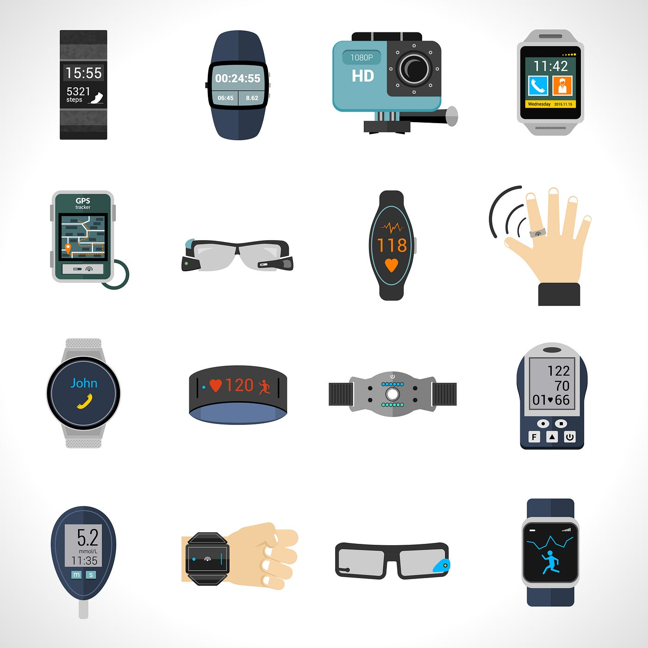
Introduction to Wearable Technology
Wearable technology is a kind of electronic device designed to be worn on the user's body.
The devices are hands-free gadgets with practical uses, powered by microprocessors and enhanced with the ability to send and receive data via the Internet.
These devices are usually equipped with sensors that track different data points (e.g., heart rate, temperature, location) and often connect to other devices through the internet or via Bluetooth.
Examples of Wearable IoT Devices:
Fitness Trackers: Monitoring steps, heart rate, calories burned, and sleep patterns
Smartwatches: Receiving notifications, making calls, and tracking activity levels
Medical Wearables: Continuous glucose monitoring, blood pressure tracking, ECG monitoring

Slide 3
Significance of Wearable Technology
Wearable technology is significant in the Internet of Things (IoT) because it allows for continuous, real-time monitoring of various personal metrics like heart rate, activity levels, and location, enabling seamless integration of personal data into the broader IoT ecosystem, which can be used for personalized health insights, proactive interventions, and enhanced user experiences across different applications like fitness, healthcare, and safety.
Key points about the significance of wearable technology in IoT:
i. Real-time Monitoring: Wearables connected to IoT networks enable real-time data transmission for immediate alerts and responses.
ii. Personalized Insights: IoT platforms analyze collected data to offer personalized health, fitness, and lifestyle recommendations.
iii. Healthcare Applications: Wearables support remote patient monitoring, early health issue detection, and medication adherence.
iv. Enhanced Safety Features: Wearables provide location tracking and emergency SOS functions, enhancing personal safety.
v. Integration with Other Devices: Wearable data integrates with smart home devices, creating a connected and automated living environment.

Slide 4
Components used in Wearable Devices
Wearable technology in the Internet of Things (IoT) uses sensors, connectivity, and data processing to collect and exchange data.
These devices are composed of several key components that work together to collect, process, and transmit data, providing users with real-time information.
The essential components of IoT wearable devices:
i. Sensors
ii. Actuators
iii. Connectivity Module
iv. Microcontroller
v. Communication with Data Processing Platform
vi. Power Source(Battery)
vii. User Interface(UI) and Software
viii. Enclosure (Physical housing)

Slide 5
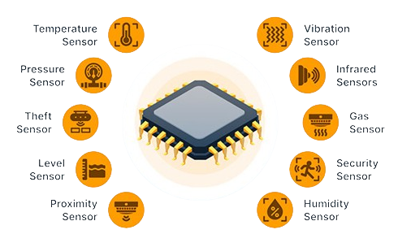
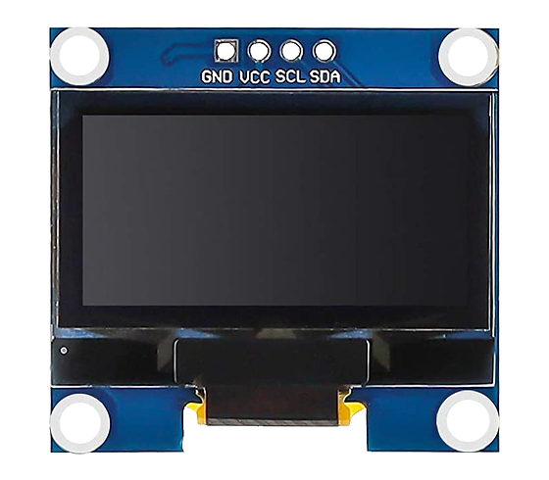
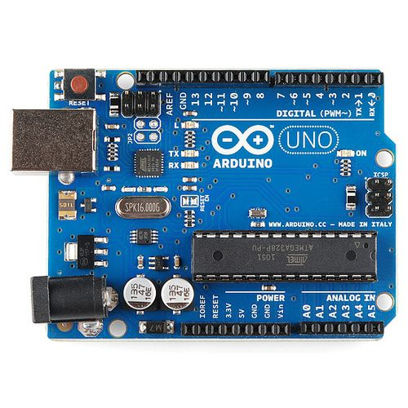
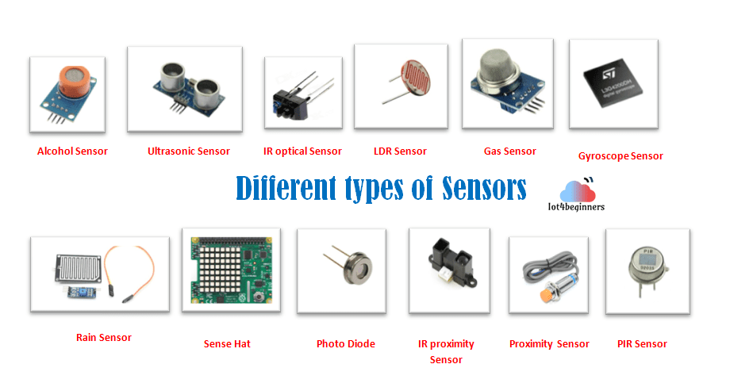
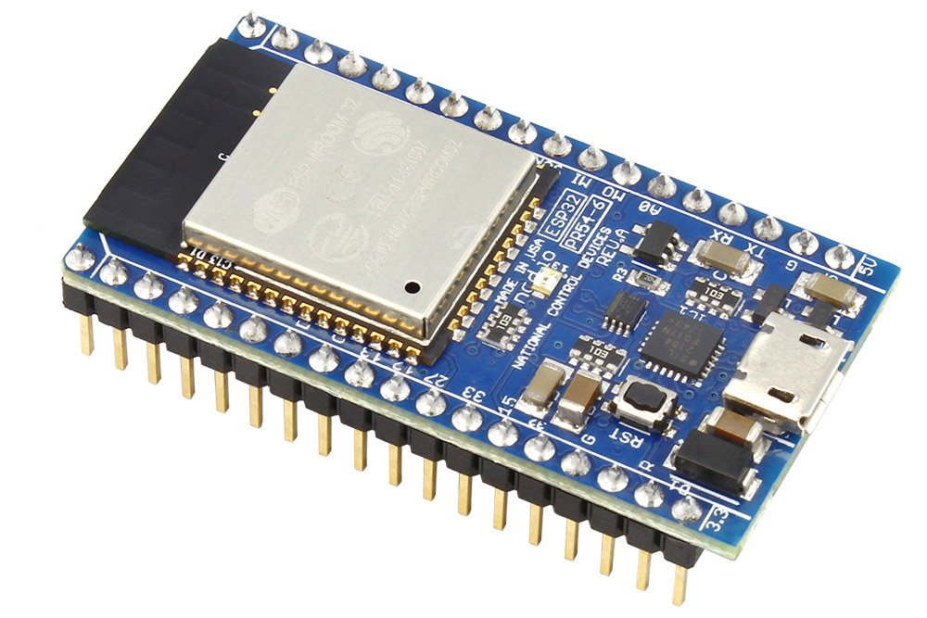
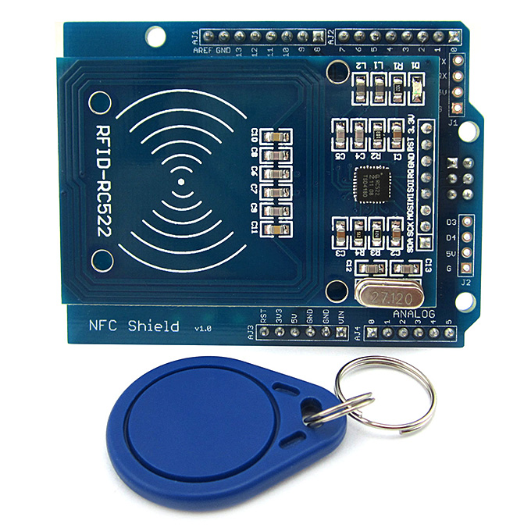
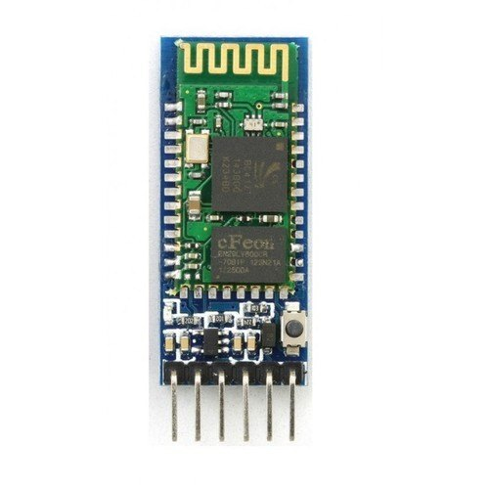

Slide 6
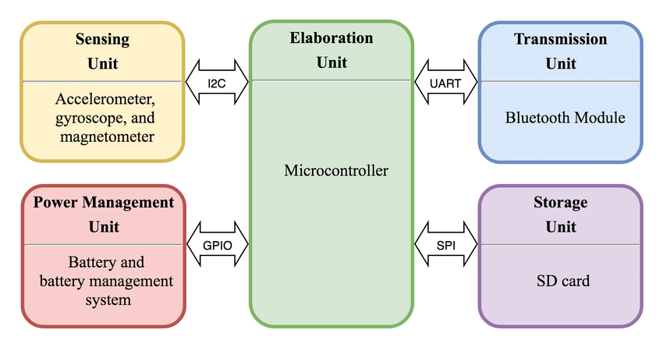
Block Diagram of Wearable Technology

Slide 7
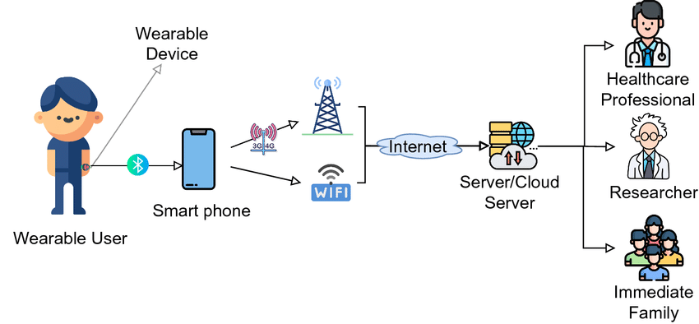
Architecture of Wearable Technology

Slide 8
Applications Of Wearable Technology
The applications of wearable technology in IOT are:
Healthcare Monitoring
Wearables track vital signs such as heart rate, blood pressure, and oxygen levels, enabling remote patient monitoring, early detection of health issues, and improved treatment management.
Fitness and Wellness
Fitness trackers and smartwatches monitor physical activity, sleep patterns, calories burned, and overall wellness, offering personalized fitness recommendations and goals.
Personal Safety
Wearables with GPS tracking, emergency alerts, and SOS buttons enhance personal safety by alerting loved ones or emergency services in case of an accident or emergency.
Smart Home Integration
Wearable devices sync with smart home systems (lights, thermostats, etc.), allowing users to control their home environment based on their preferences or location.
Sports and Performance Tracking
Wearables used by athletes track performance metrics like distance, speed, and technique, helping in improving training and preventing injuries.

Slide 9
Location and Navigation
GPS-enabled wearables, such as smartwatches and fitness trackers, can provide accurate location and navigation data. This is especially valuable for outdoor activities, runners, cyclists, and hikers.
Augmented Reality (AR)
AR glasses are wearable devices that overlay digital information on the user’s field of view, enhancing their perception of the physical world. IoT connectivity in AR glasses can deliver real-time data and interactions, making these devices more powerful and interactive.
Communication
Smartwatches and similar wearables enable users to make calls, send texts, and receive notifications, keeping them connected without needing to pull out their smartphones.
Location-Based Services
IoT in wearables allows for location-based services such as geofencing and location-sharing. Users can set up alerts when they enter or leave specific areas or share their location with family and friends.

Slide 10
Benefits Of Wearable Technology
The Benefits of Wearable Technology in IOT are:
Health and Wellness
Wearable devices with IoT capabilities empower individuals to take control of their health and fitness. They can monitor key metrics, track progress, and receive personalized recommendations for a healthier lifestyle.
Convenience
Wearables make it easier to access information and services without having to pull out a smartphone or other device.
Safety and Security
Location-based services and emergency features in wearables enhance user safety and security. IoT connectivity allows wearables to transmit critical information in emergency situations.
Enhanced Communication
Wearables enable seamless communication, reducing the need to constantly check a smartphone. They allow users to stay connected while keeping their hands and attention free.

Slide 11
Real-Time Data
Wearables equipped with IoT technology provide real-time data, which can be especially valuable in sports and fitness, healthcare, and various professional fields.
Improved Productivity
IoT-powered wearables in the workplace streamline tasks and enhance productivity. Workers can access vital information and instructions without having to consult manuals or look at screens.

Slide 12
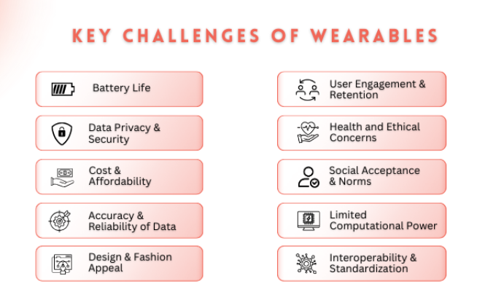
Challenges of Wearable Technology
The key challanges of wearable technology in IOT are:
Battery Life
Data Privacy & Security
Interoperability & Standardization
Accuracy & Reliability of Data
Design & Fashion Appeal
User Engagement & Retention
Health and Ethical Concerns
Limited Computational Power
Social Acceptance and Norms
Cost & Affordability

Slide 13
Opportunities in Wearable Technology
The Future and current Opportunnities in wearable technology are:
Healthcare Wearables
Wearable devices in healthcare will become even more advanced, with potential for early diagnosis and continuous health monitoring. For instance, wearables may monitor biomarkers that detect diseases like cancer or diabetes before symptoms appear, offering opportunities for preventative care and reducing healthcare costs.
Wearables for Work and Productivity
There will be an increased use of wearables for workplace efficiency. Augmented reality (AR) glasses, for example, could be used by technicians for hands-free access to manuals or instructions while working in the field. Wearables could also enhance virtual meetings by providing an immersive experience.
Fashion Meets Technology
As wearables become more ubiquitous, they will continue to merge with fashion. Expect to see more stylish and versatile designs, with companies incorporating high-tech capabilities into everyday clothing or accessories. This trend will make wearable tech more mainstream and appealing to a broader audience.

Slide 14
Sports and Fitness Innovations
The sports and fitness sector will see further innovations in wearable tech. Devices will evolve to provide more precise performance tracking, from tracking biomechanical data to improving athletic recovery. Future wearables may even measure muscle strain, hydration levels, or blood oxygen levels to optimize training routines.

Slide 15
Future Trends of Wearable Technology
The Future trends in Wearable technology are:
Expansion of 5G Connectivity
With the growing adoption of 5G, IoT will experience faster speeds, lower latency, and more reliable connections.
Edge Computing
Edge computing will allow IoT devices to process data locally, reducing the dependency on cloud servers and enabling faster response times
IoT in Smart Cities
Cities are increasingly adopting IoT technologies to improve urban living. It includes intelligent traffic management, waste management, smart street lighting, and energy-efficient buildings.
Improved Security and Privacy Solutions
With the growth of IoT, security concerns will become a focal point. The future of IoT will likely see the implementation of more advanced security features, such as blockchain technology for secure transactions and enhanced encryption for data protection.

Slide 16
Conclusion
The convergence of IoT and wearable technology is reshaping industries and everyday life by offering unprecedented levels of connectivity, data-driven insights, and automation. As these technologies continue to evolve, they present tremendous opportunities for businesses to optimize efficiency, improve decision-making, and enhance user experiences.The integration of advanced technologies like AI, 5G, and edge computing will drive further innovation, making IoT and wearables even smarter and more responsive.

Slide 17


