Slide 1

WIPRO NGA Program – LSP C++ Batch
Capstone Project Presentation – 12 August 2024
Project Title Here - Network Scanner Using Sockets
Presented by – CHAKALI MADHU
www. rpsconsulting. in

Slide 2
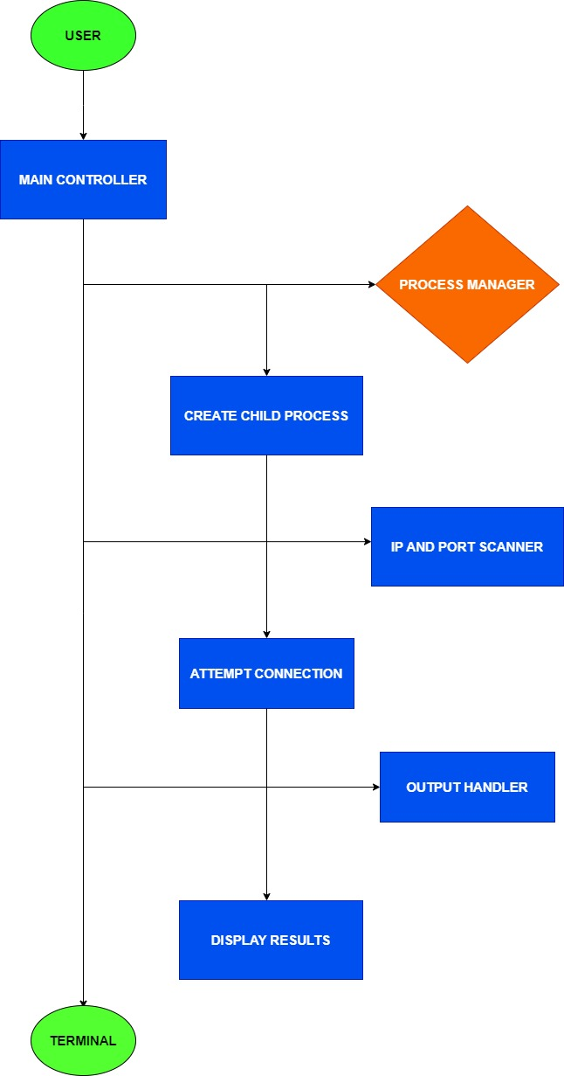

Sequence Diagram

Slide 3
PROJECT OVERVIEW
This project involves creating a Network Scanner using sockets in C on Ubuntu. The scanner is designed to identify open ports on specified IP addresses within a local network. It provides an essential tool for network administrators to assess security vulnerabilities and manage network resources.
INTRODUCTION
The Network Scanner project is implemented using socket programming in C. It systematically scans IP addresses and ports to determine if they are open or closed. This tool can help in identifying potential security loopholes in a network by checking for open ports that may expose a system to attacks.

Slide 4
MOTIVATION
The motivation behind this project is to provide a tool for network administrators and cybersecurity professionals to audit their network infrastructure. By identifying open ports, administrators can close unnecessary or vulnerable ports, reducing the attack surface of their systems.
PROJECT SCOPE
IP Range Scanning: The scanner is capable of scanning a range of IP addresses within a network.
Port Scanning: The project scans multiple specified ports to determine their status (open or closed).

Slide 5
PROJECT SCOPE
Concurrency: The project uses child processes to scan multiple IPs and ports concurrently.
Flexibility: It allows users to define the range of IP addresses and the list of ports to be scanned.

Slide 6
Various Application Tools That Are Used In This Project
Ubuntu Operating System: The project is developed and executed on Ubuntu, providing a robust environment for network programming.
C Programming Language: The core functionality is implemented in C, leveraging its powerful system-level capabilities.
GCC Compiler: Used to compile the C code.
Socket Programming: Sockets are used to establish connections to the specified IP addresses and ports.
.

Slide 7
The Modules That I Have Worked On This Project
Main Controller: The primary module that orchestrates the scanning process.
Process Manager: Manages the creation and handling of child processes.
IP and Port Scanner: The core module that performs the actual scanning of IP addresses and ports.
Output Handler: Captures and displays the results of the scan.

Slide 8
The List Of Functions That Used In This Project
socket(): Creates a new socket for communication.
connect(): Attempts to connect to a specified IP address and port.
select(): Monitors multiple file descriptors to see if any of them are ready for I/O.
fcntl(): Sets file descriptor flags to make sockets non-blocking.
getsockopt(): Retrieves the status of a socket connection.
fork(): Creates child processes for concurrent scanning.
wait(): Waits for child processes to complete.

Slide 9
Timer Functions
Timeout Management with select(): The select() function is used to implement a timeout for socket operations. It ensures that the program does not hang indefinitely if a connection attempt takes too long.

Slide 10
Future Amendments
Support for UDP Scanning: Expanding the tool to scan UDP ports in addition to TCP.
Graphical User Interface (GUI): Developing a user-friendly GUI for ease of use.
Extended Reporting: Enhancing the output to include more detailed reports and logs.
Automated Scheduling: Integrating a scheduling feature to run scans at predefined intervals.

Slide 11
Addressing Common Challenges
Handling Network Latency: The use of non-blocking sockets and timeouts helps in managing network latency effectively.
Concurrent Processing: The implementation of child processes ensures that multiple IPs and ports can be scanned simultaneously, improving efficiency.
Error Handling: Robust error handling mechanisms are incorporated to manage issues such as failed socket creation or connection attempts.

Slide 12
Conclusion
This network scanner project successfully demonstrates how to utilize socket programming in C to perform basic network diagnostics. By scanning specified IP addresses and ports, the tool can identify open and closed ports, which is essential for network administration and security assessments.

