Slide 1

TempoTutor: Learn Music Online
Created by:
Rawan Younis Chaker Yaakoub Souzan Allouch

Slide 2
Content of the presentation:
Introduction to TempoTutor:: meaning behind our name and mission
Technologies used to build the platform: Node.js, React.js, MongoDB, GitHub
Design concept: colors and layout that reflect our brand and values
UML diagram overview
Live demonstration of TempoTutor

Slide 3

About TempoTutor
What Is TempoTutor?
Affordable and accessible online platform for quality music education.
Explanation of the name "TempoTutor":
Tempo is the speed of a musical piece, and a tutor guides users to master tempo and other musical concepts.

Slide 4
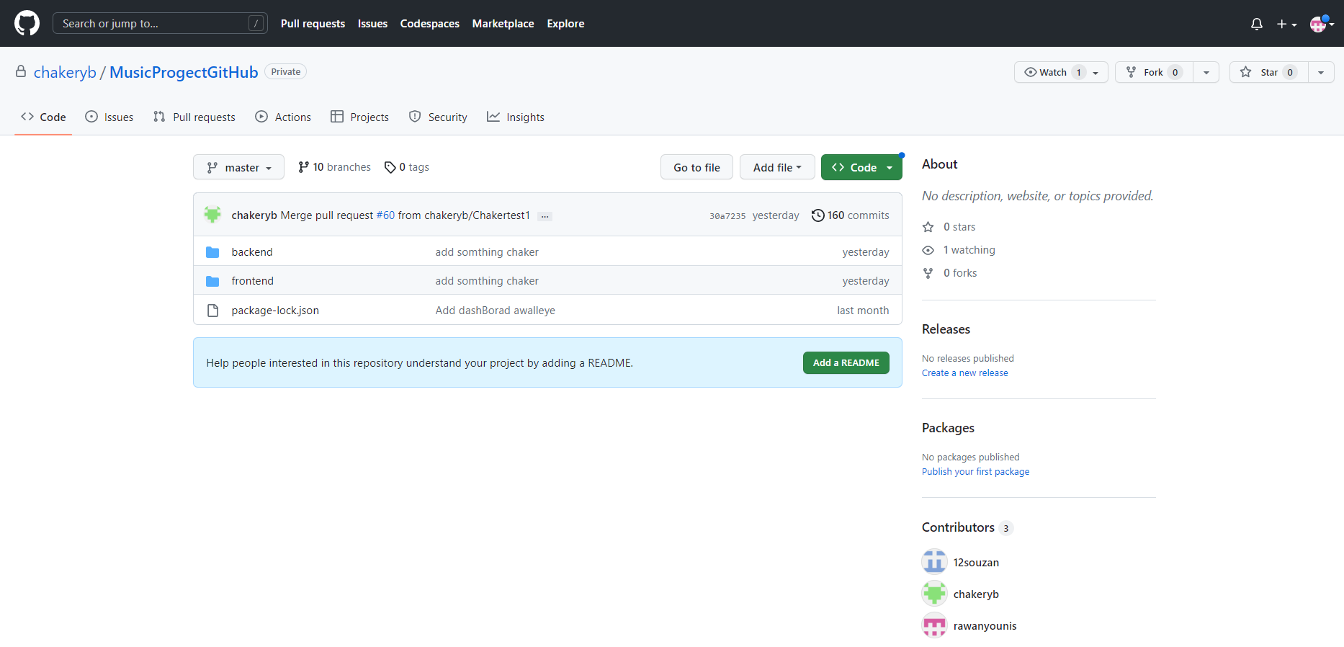
Technologies Used
React.js for frontend development.
Node.js for backend development.
MongoDB for database management.
GitHub for version control and collaboration.

Slide 5
Design Concept
We chose the colors blue and black for the design of our TempoTutor website:
Blue represents confidence, trust, and intelligence, which aligns with our goal of providing quality music education.
Black represents sophistication and professionalism, conveying the high standards of our platform.

