Slide 1


Total Green Driving
Chakit Swarup

Slide 2
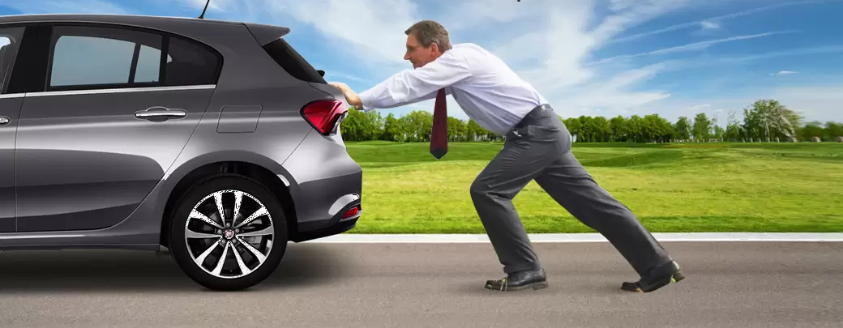
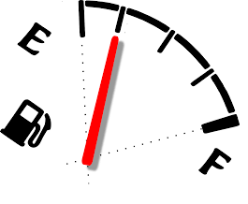
Problem Statement
Electric Vehicles (EVs) have shorter running span.

Slide 3
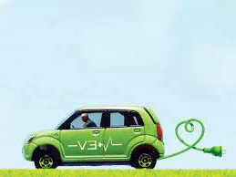
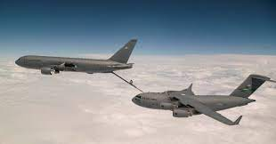
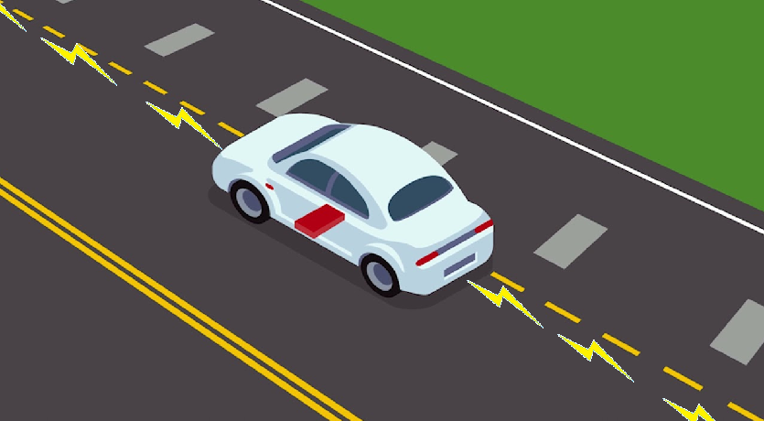

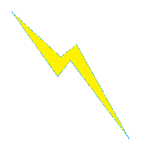
Solution
EVs should be kept charging while
on the run
ie mid way fuelling
Metal Power Strip

Slide 4
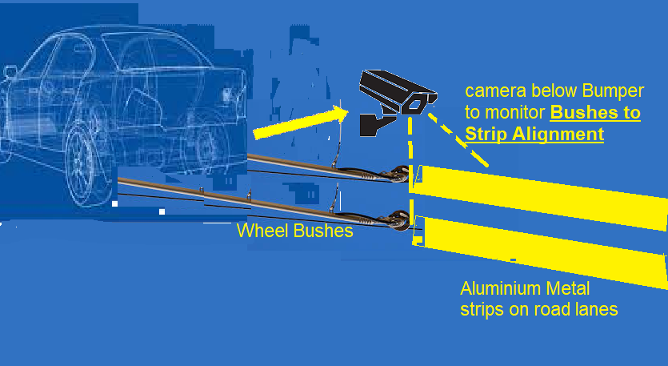
Solution in Detail
IoT based Software to motorize the bushes and keep them align on strips while driving

Slide 5

Benefits
While Car is on the run, its battery requires backup for few miles only to go and while close to power strips enabled road, the vehicle will run like a TRAM and when away from power strips …for that long comes back to internal batteries.
By this solution Any regular Petrol/Diesel car can also be fitted with an EV kit with smaller and cheaper batteries.

Slide 6
Queries
Why did you decide to solve this Problem statement? (Theme 1 Industry Specific Solutions or Theme 2 Green Software Development - Any one or both) Pollution and Global warming is a big health hazard
Which user /advertiser segment would be an early adopter of your product & why? Metro Cities residents or a small but progressive Town
What are the alternatives/competitive products for the problem you are solving? Regular short range EVs , Petrol and Diesel cars
Azure tools or resources which are likely to be used by you for the prototype, talk about methodology, architecture & scalability Cloud based Mobile Apps with Sql-Server syncing
How is your solution better than alternatives and how do you plan to build adoption? Its cost effective , Small munispalities then State and then Federal Government (or respective equivalent) of that country need to be persuaded one by one.
VP Product
SEO Strategist
Product Designer
Content Developer

Slide 7

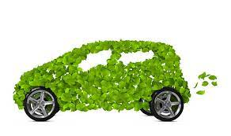
Thank you
Chakit Swarup
Chakit.swarup91@gmail.com

