Slide 1

Instructor Kick-off
Analyze A/B Test Results
© 2019 Udacity. All rights reserved.

Slide 2
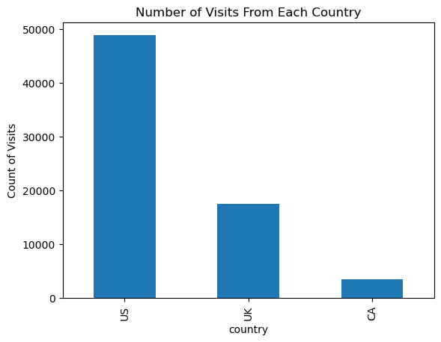
How Was The Experiment Implemented?​
Total Variant Visitors: 35211
Total Control Participants:​ 34678

Slide 3
Conversion Rates
 | U.S. | U.K. | CA
Control | 10.7% | 10.16% | 9.45%
Treatment | 15.8% | 14.87% | 15.40%
Executive Summary: Across all countries, the treatment group shows consistently higher conversion rates (14.87-15.8%) than control (9.45-10.7%). In contrast, country differences are minimal and not statistically significant, suggesting the new page effectively improves conversions regardless of location.

Slide 4
Experiment Results
Treatment Conversion Rate: 15.53%
Control Conversion Rate: 10.53%
Delta in Treatment vs. Control Conversion Rate: +5.01%
p-value: 0.0000
Conclusion: Given the near-zero p-value and substantial 5.01% increase in conversion rate for the treatment group, we have compelling statistical evidence to implement the new page design.

Slide 5
Country Results
Analysis shows no statistically significant differences in conversion rates between countries (US: p=0.170, UK: p=0.905 compared to baseline CA). The treatment effect remains consistent across all geographic regions, suggesting country-specific optimisation is optional.

