Slide 1

- GAME CHANGERS
Gamified Learning Management System (LMS)

Slide 2

Characteristics
Introduction
Preferences/Modes
Points System and level system
LeaderBoard System
Special Rewards

Slide 3
Introduction
It is a gamified Learning Management System(LMS).
It is a single player suited game.
The user or player should Register with a Unique User Id along with Email and Password.
Each preferred mode have the different levels of Questions.
Based on this the leader board is formed and special rewards (Badges)
are allotted.

Slide 4
Preferences/Modes
HTML/CSS
Java Script
C Programming
Python
Java

Slide 5
Points And Level System
Each correct Answer receives a total of 50 points.
A daily bonus of 10 points is added for logging in.
For every 500 points a level increases.
Gets bonus of 100 points for reaching all 5 multiple levels
The points helps in unlocking new courses.

Slide 6
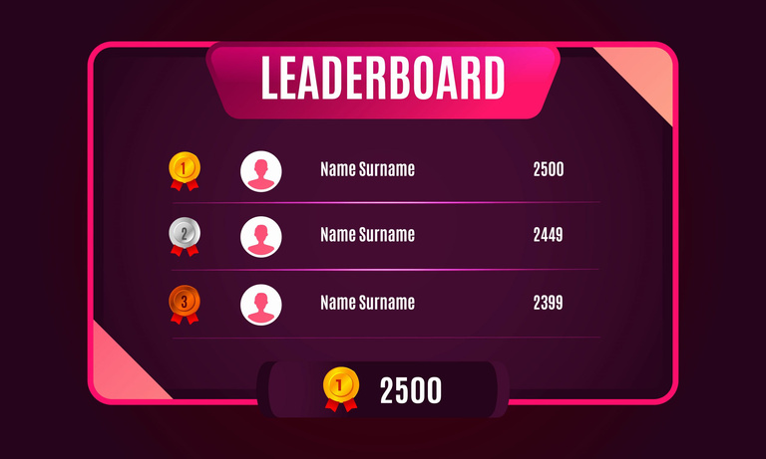
LeaderBoard
All the players with most amount of points get in the
leader board of top 10.
The leader board will update by every 24 hours .
The Player with highest points on leader board gets a 100 points daily.

Slide 7



Special Rewards
For certain number of correct answers players recevies a special badges
10 correctly solved questions = Bronze
30 correctly solved questions = Silver
50 correctly solved questions = Gold-II
75 correctly solved questions = Gold-I
100+ correctly solved questions = Diamond

Slide 8
THANK YOU

