Slide 1
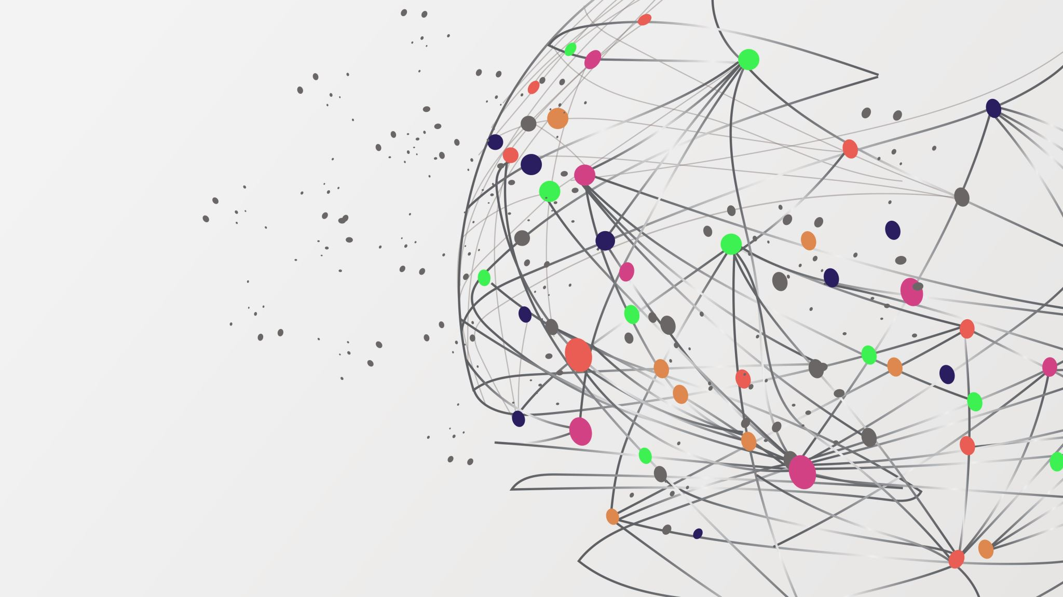
GEOGRAPHICAL UNDERSTANDING OF TWITTER HEALTH RELATED TOPICS BY USING TOPIC MODELLING ALGORITHM

Slide 2
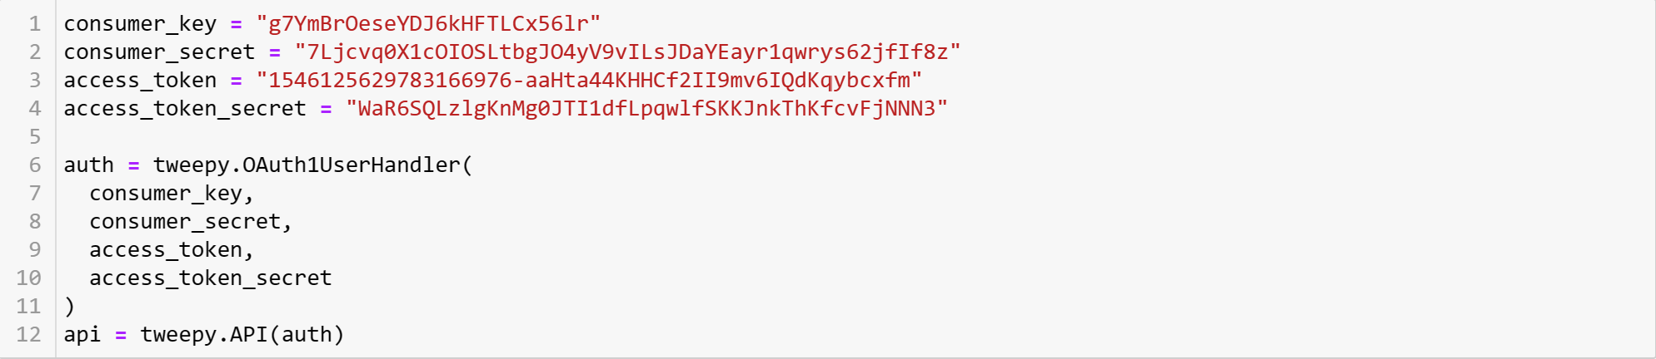
API Authorization

Slide 3
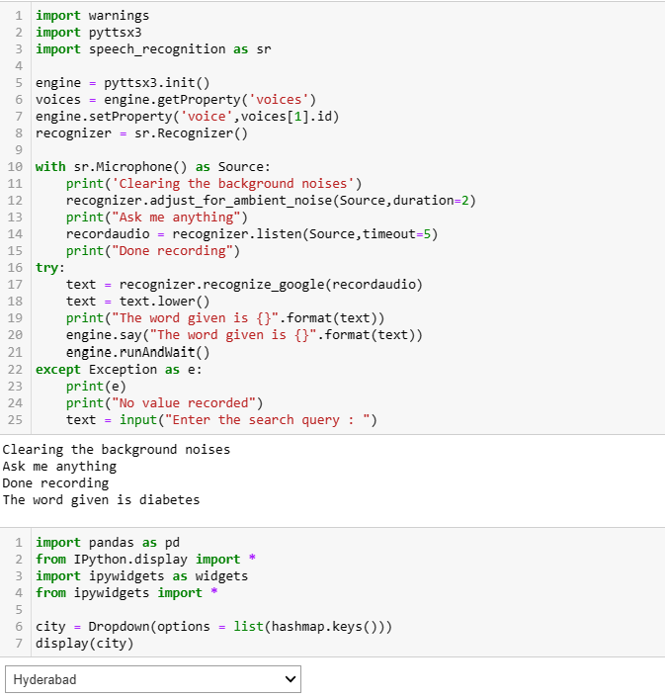
Search Query and location Input

Slide 4
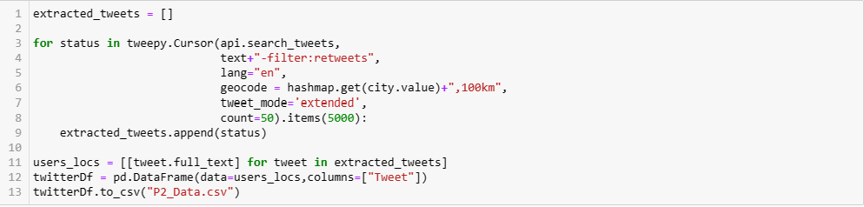
Tweet Extraction

Slide 5
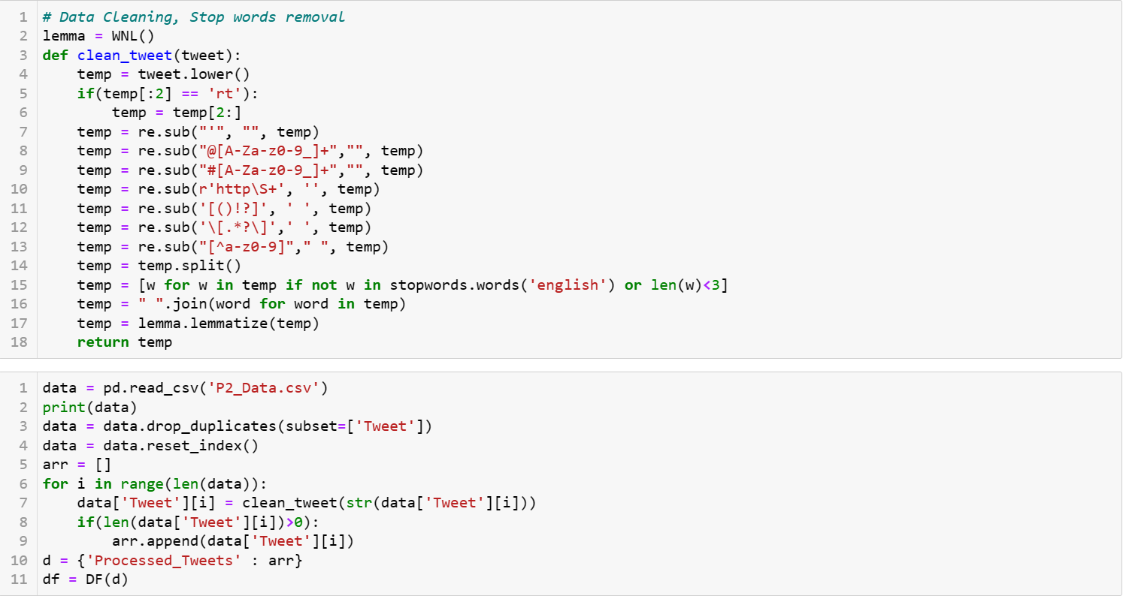
Data Pre-processing

Slide 6
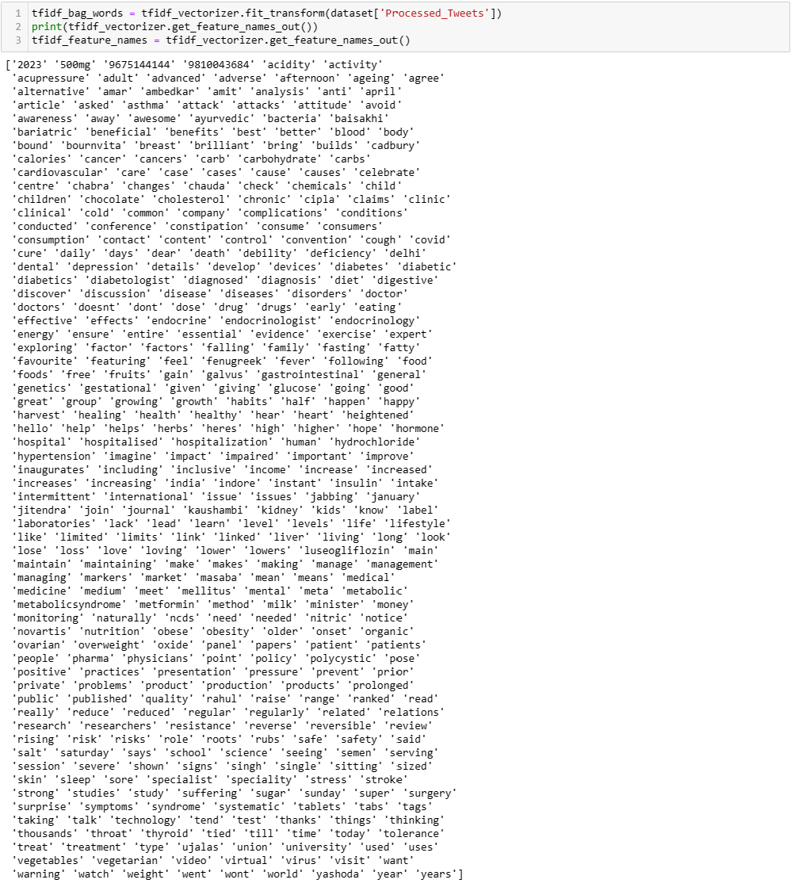
Feature Extraction – TF-IDF

Slide 7
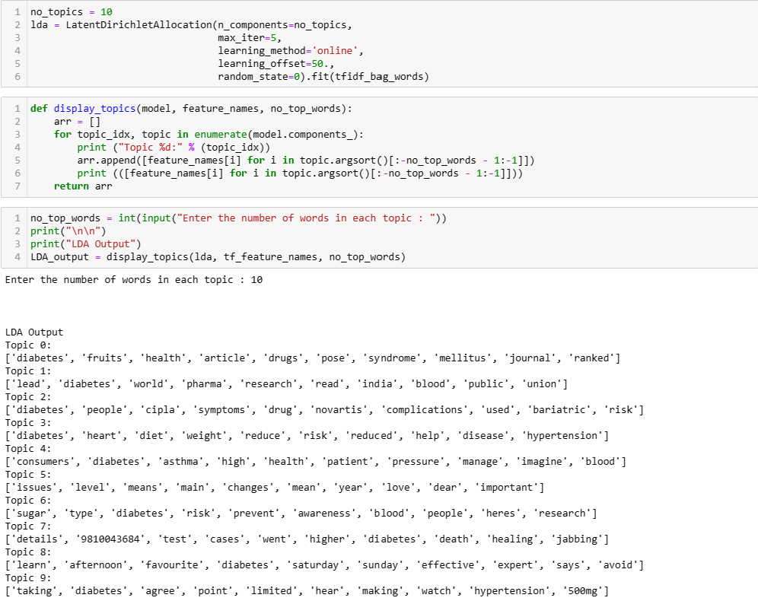
Topic Modelling Application – LDA

Slide 8
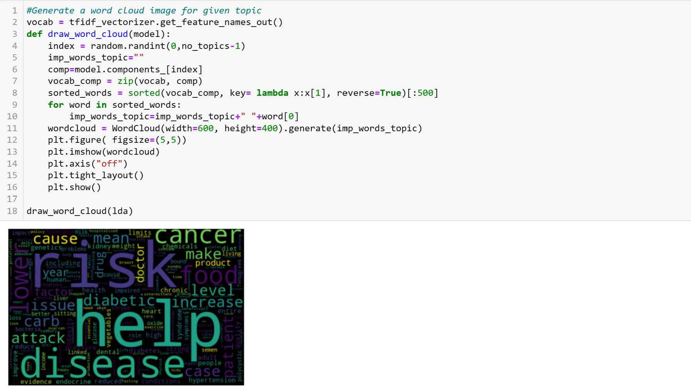
WordCloud Visualization

Slide 9
Thank you
Guide:
Team Members:
Dr. N. Rajasekhar
Parakala Venkata Anirudh 19241A1238
Podduturi Hruthvik Reddy 19241A1240
Shaik Sohel 19241A1251
Thunuguntla Srichakranath 19241A1255

