Slide 1
Artificial Neural Networks
The term "Artificial neural network" refers to a biologically inspired sub-field of artificial intelligence modeled after the brain.
An Artificial neural network is usually a computational network based on biological neural networks that construct the structure of the human brain.
Similar to a human brain has neurons interconnected to each other, artificial neural networks also have neurons that are linked to each other in various layers of the networks.
These neurons are known as nodes.

Slide 2
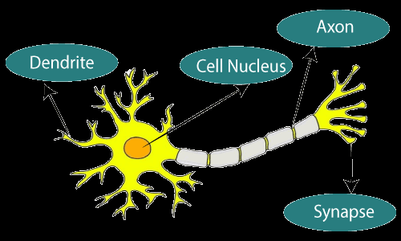
Artificial Neural Networks
The term "Artificial Neural Network" is derived from Biological neural networks that develop the structure of a human brain.
Similar to the human brain that has neurons interconnected to one another, artificial neural networks also have neurons that are interconnected to one another in various layers of the networks.

Slide 3
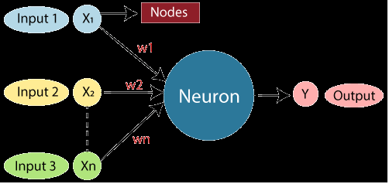
Artificial Neural Networks
The given figure illustrates the typical diagram of Biological Neural Network.
The typical Artificial Neural Network looks something like the given figure.

Slide 4
Artificial Neural Networks
Dendrites from Biological Neural Network represent inputs in Artificial Neural Networks, cell nucleus represents Nodes, synapse represents Weights, and Axon represents Output.
Relationship between Biological neural network and artificial neural network:
Biological Neural Network | Artificial Neural Network
Dendrites | Inputs
Cell nucleus | Nodes
Synapse | Weights
Axon | Output

Slide 5
An Artificial Neural Network in the field of Artificial intelligence where it attempts to mimic the network of neurons makes up a human brain so that computers will have an option to understand things and make decisions in a human-like manner.
The artificial neural network is designed by programming computers to behave simply like interconnected brain cells.
There are around 1000 billion neurons in the human brain. Each neuron has an association point somewhere in the range of 1,000 and 100,000.
In the human brain, data is stored in such a manner as to be distributed, and we can extract more than one piece of this data when necessary from our memory parallelly. We can say that the human brain is made up of incredibly amazing parallel processors.

Slide 6
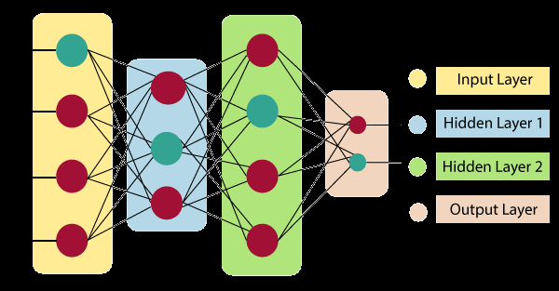
The architecture of an artificial neural network:

Slide 7

Architecture
Input Layer:
As the name suggests, it accepts inputs in several different formats provided by the programmer.
Hidden Layer:
The hidden layer presents in-between input and output layers. It performs all the calculations to find hidden features and patterns.
Output Layer:
The input goes through a series of transformations using the hidden layer, which finally results in output that is conveyed using this layer.
The artificial neural network takes input and computes the weighted sum of the inputs and includes a bias. This computation is represented in the form of a transfer function.

Slide 8
It determines weighted total is passed as an input to an activation function to produce the output. Activation functions choose whether a node should fire or not. Only those who are fired make it to the output layer. There are distinctive activation functions available that can be applied upon the sort of task we are performing.

Slide 9
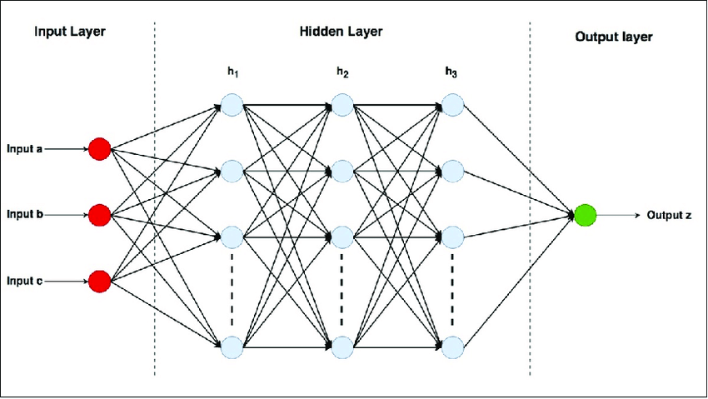
The models of ANN are specified by the three basic entities namely:
The model's synaptic interconnection.
The training rules or learning rules adopted for updating and adjusting the connection weights.
Their activation functions.

Slide 10
In the simplest scenario, the architecture of a neural network consists of some sequential layers, where the layer numbered i is connected to the layer numbered i+1. The layers can be classified into 3 classes:
Input
Hidden
Output
Each layer consists of 1 or more neurons represented by circles. Because the network type is fully-connected, then each neuron in layer i is connected with all neurons in layer i+1. If 2 subsequent layers have X and Y neurons, then the number of in-between connections is X*Y.
For each connection, there is an associated weight. The weight is a floating-point number that measures the importance of the connection between 2 neurons.

Slide 11
Assume that a neuron N₁ at layer 1 is connected to another neuron N₂ at layer 2. Assume also that the value of N₂ is calculated according to the next linear equation.
N₂=w₁N₁+b
If N₁=4, w₁=0.5 (the weight) and b=1 (the bias), then the value of N₂ is 3.
N₂=0.5*4+1=2+1=3
This is how a single weight connects 2 neurons together. Note that the input layer has no learnable parameters at all.

Slide 12
Each neuron at layer i+1 has a weight for each connected neuron at layer i , but it only has a single bias. So, if layer i has 10 neurons and layer i+1 has 6 neurons, then the total number of parameters for layer i+1 is:
=number of weights+number of biases
=10×6 +6=66
The input layer is the first layer in the network, it’s directly connected by the network’s inputs. There can only be a single input layer in the network.

Slide 13
Forward and backward passes in Neural Networks
To train a neural network, there are 2 passes (phases):
Forward
Backward
In the forward pass, we start by propagating the data inputs to the input layer, go through the hidden layer(s), measure the network’s predictions from the output layer, and finally calculate the network error based on the predictions the network made.
This network error measures how far the network is from making the correct prediction. For example, if the correct output is 4 and the network’s prediction is 1.3, then the absolute error of the network is 4-1.3=2.7. Note that the process of propagating the inputs from the input layer to the output layer is called forward propagation. Once the network error is calculated, then the forward propagation phase has ended, and backward pass starts.

Slide 14
In the backward pass, the flow is reversed so that we start by propagating the error to the output layer until reaching the input layer passing through the hidden layer(s). The process of propagating the network error from the output layer to the input layer is called backward propagation, or simple backpropagation.
The backpropagation algorithm is the set of steps used to update network weights to reduce the network error.
The forward and backward phases are repeated from some epochs. In each epoch, the following occurs:
The inputs are propagated from the input to the output layer.
The network error is calculated.
The error is propagated from the output layer to the input layer.

Slide 15
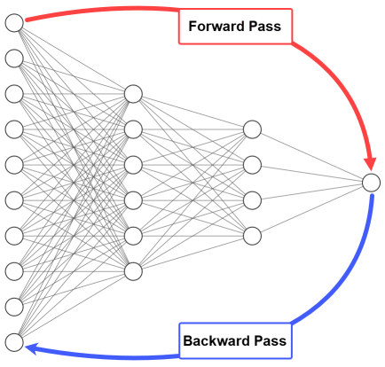

Slide 16
Why use the backpropagation algorithm?
Earlier we discussed that the network is trained using 2 passes: forward and backward. At the end of the forward pass, the network error is calculated, and should be as small as possible.
If the current error is high, the network didn’t learn properly from the data. What does this mean? It means that the current set of weights isn’t accurate enough to reduce the network error and make accurate predictions. As a result, we should update network weights to reduce the network error.
The backpropagation algorithm is one of the algorithms responsible for updating network weights with the objective of reducing the network error.

Slide 17
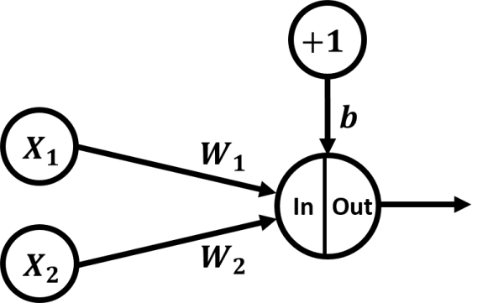
It only has an input layer with 2 inputs (X₁ and X₂), and an output layer with 1 output. There are no hidden layers.
The weights of the inputs are W₁ and W₂, respectively. The bias is treated as a new input neuron to the output neuron which has a fixed value +1 and a weight b. Both the weights and biases could be referred to as parameters.

Slide 18

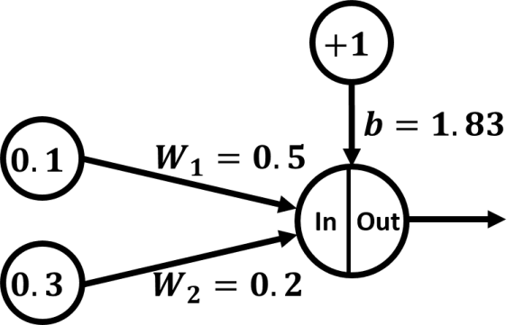
Let’s assume that output layer uses the sigmoid activation function defined by the following equation:
s=X₁* W₁+ X₂*W₂+b

Slide 19
Forward pass
The input of the activation function will be the SOP between each input and its weight. The SOP is then added to the bias to return the output of the neuron:
s=X₁* W₁+ X₂*W₂+b
s=0.1* 0.5+ 0.3*0.2+1.83
s=1.94
The value 1.94 is then applied to the activation function (sigmoid), which results in the value 0.874352143.

Slide 20
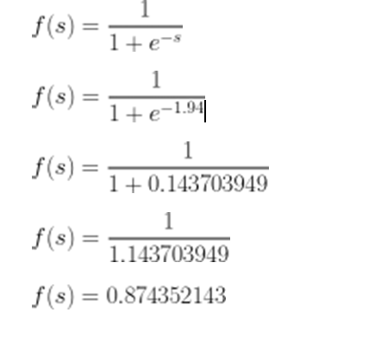

Slide 21
The error functions tell how close the predicted output(s) are from the desired output(s). The optimal value for error is zero, meaning there’s no error at all, and both desired and predicted results are identical. One of the error functions is the squared error function, as defined in the next equation:
Note that the value 1/2 multiplied by the equation is for simplifying the derivatives calculation using the backpropagation algorithm.

Slide 22
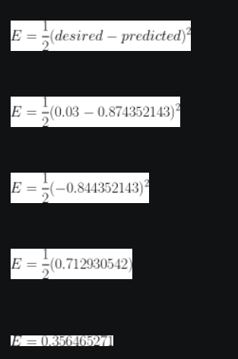
Based on the error function, we can measure the error of our network as follows:

Slide 23
The result shows that there is an error, and a large one: (~0.357). The error just gives us an indication of how far the predicted results are from the desired results.
Knowing that there’s an error, what should we do? We should minimize it. To minimize network error, we must change something in the network. Remember that the only parameters we can change are the weights and biases. We can try different weights and biases, and then test our network.
We calculate the error, then the forward pass ends, and we should start the backward pass to calculate the derivatives and update the parameters.

Slide 24
Parameters update equation
The parameters can be changed according to the next equation:
W_{(n+1)}=W(n)+η[d(n)-Y(n)]X(n)
Where:
n: Training step (0, 1, 2, …).
W(n): Parameters in current training step. Wn=[bn,W1(n),W2(n),W3(n),…, Wm(n)]
η: Learning rate with a value between 0.0 and 1.0.
d(n): Desired output.
Y(n): Predicted output.
X(n): Current input at which the network made false prediction.

Slide 25
For our network, these parameters have the following values:
n: 0
W(n): [1.83, 0.5, 0.2]
η: Because it is a hyperparameter, then we can choose it 0.01 for example.
d(n): [0.03].
Y(n): [0.874352143].
X(n): [+1, 0.1, 0.3]. First value (+1) is for the bias.
We can update our network parameters as follows:
W_{(n+1)}=W(n)+η[d(n)-Y(n)]X(n)
=[1.83, 0.5, 0.2]+0.01[0.03-0.874352143][+1, 0.1, 0.3]
=[1.83, 0.5, 0.2]+0.01[-0.844352143][+1, 0.1, 0.3]
=[1.83, 0.5, 0.2]+-0.00844352143[+1, 0.1, 0.3]
=[1.83, 0.5, 0.2]+[-0.008443521, -0.000844352, -0.002533056]
=[1.821556479, 0.499155648, 0.197466943]

Slide 26
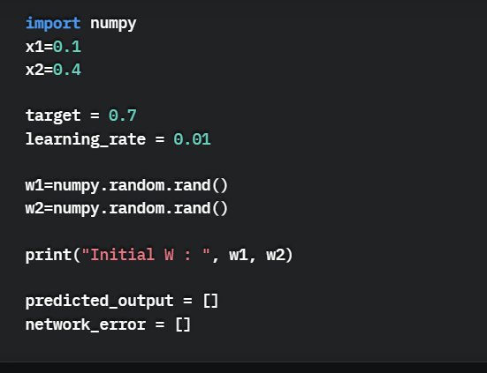
The next code uses NumPy to prepare the inputs (x1=0.1 and x2=0.4), the output with the value 0.7, the learning rate with value 0.01, and assign initial values for the 2 weights w1 and w2. At the end, 2 empty lists are created to hold the network prediction and error in each epoch.

Slide 27
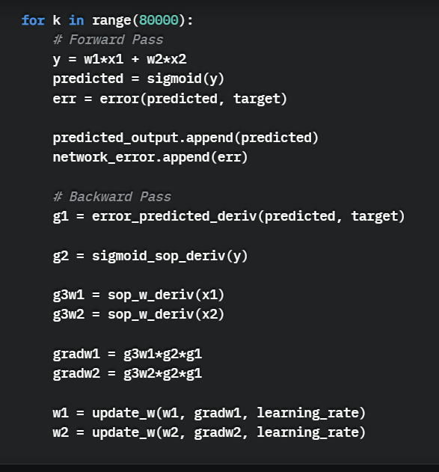
Now, we’re ready to do the forward and backward pass calculations for a number of epochs, using a “for” loop according to the next code. The loop goes through 80,000 epochs.

Slide 28
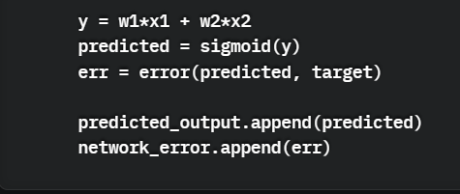
In the forward pass, the following lines are executed that calculate the SOP, apply the sigmoid activation function to get the predicted output, and calculate the error. This appends the current network prediction and error in the predicted_output and network_error lists, respectively.

Slide 29
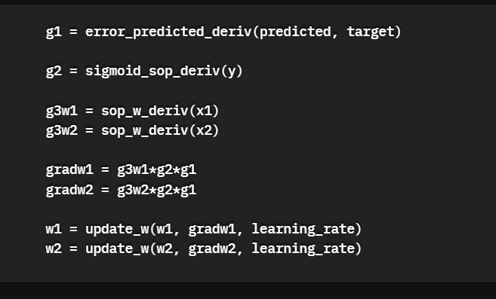
In the backward pass, the emaining lines in the “for” loop are executed to calculate the derivatives in all chains. The derivatives of the error W.R.T to the weights are saved in the variables gradw1 rand gradw2. Finally, the weights are updated by calling the update_w() function.

Slide 30
Supervised learning networks
Deep learning uses supervised learning in situations such as image classification or object detection, as the network is used to predict a label or a number (the input and the output are both known). As the labels of the images are known, the network is used to reduce the error rate, so it is “supervised”.

Slide 31
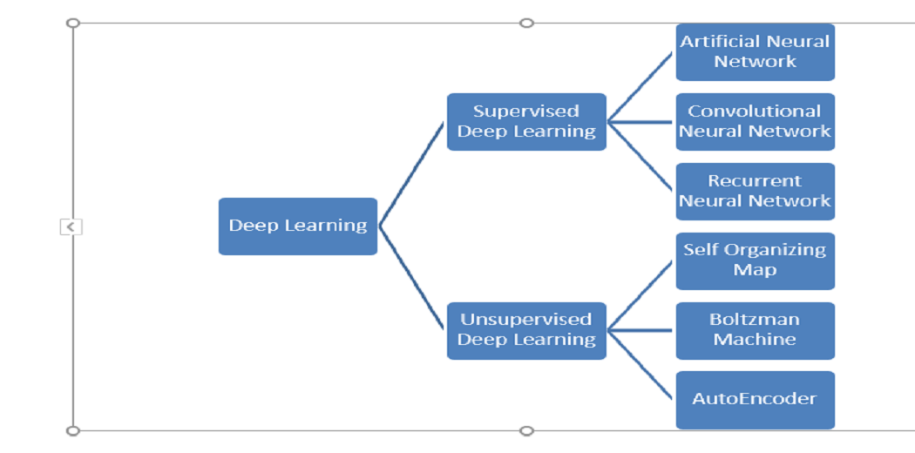
We will discuss supervised deep learning algorithms.
Artificial Neural Network
Convolution Neural Network
Recurrent Neural Network

Slide 32
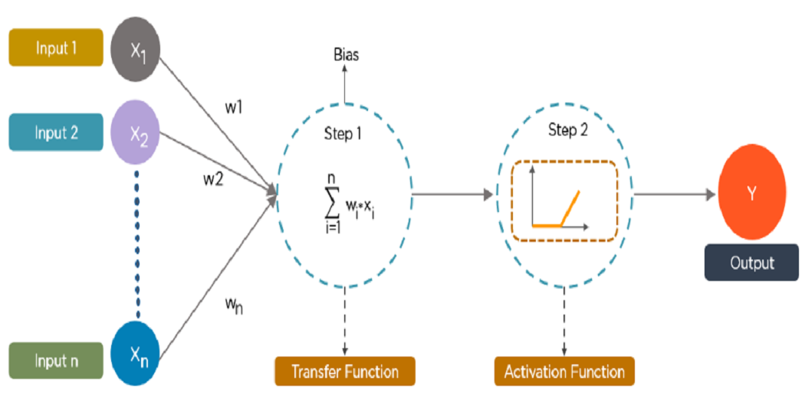
1. Artificial Neural Network:
An artificial Neural Network is the component of a computing system designed in such a way that the human brain analyzes and makes a decision. Ann is the building block of deep learning and solves the problem that seems impossible or very difficult by humans.
Artificial neural networks work like a human brain. The human brain has billions of neurons and each neuron is made up of a cell body that is responsible for computing information by carrying forward information towards hidden neurons and provide final Output.

Slide 33
ANN initially in the training phase learns to identify patterns based on inputs given to the input layer. During this phase, the output of Ann compares with the actual output, and the difference between these two knows as an error.
The aim is to minimize the error by adjusting the weight and bias of the interconnection which is known as back propagation. With the process of back propagation, the difference between the desired output and actual output produces the least error.

Slide 34
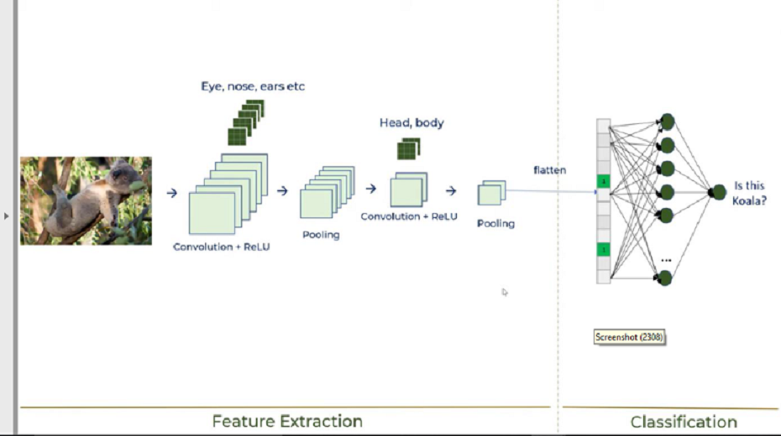
2. Convolution Neural Network
CNN is a supervised type of Deep learning, most preferable used in image recognition and computer vision.

Slide 35
CNN has multiple layers that process and extract important features from the image.
There are mainly 4 steps to how CNN works
Step : 1 Convolution Operation with Relu Activation Function
The objective of the Convolution operation is to find features in the image using feature detectors to preserve the special relationship between pixels. Relu activation function is used to break linearity and want to increase non-linearity because images are themselves are highly non-linear.
Step: 2 Pooling
Pooling is a down-sampling operation that reduces dimensions and computation, reduces over fitting as there are fewer parameters and the model is tolerant towards variation and distortion.

Slide 36
Step: 3 Flattening
Flattening is used to put pooling output into one dimension matrix before further processing.
Step: 4 Fully Connected Layer
A fully connected layer forms when the flattening output is fed into a neural network which further classifies and recognized images.

Slide 37
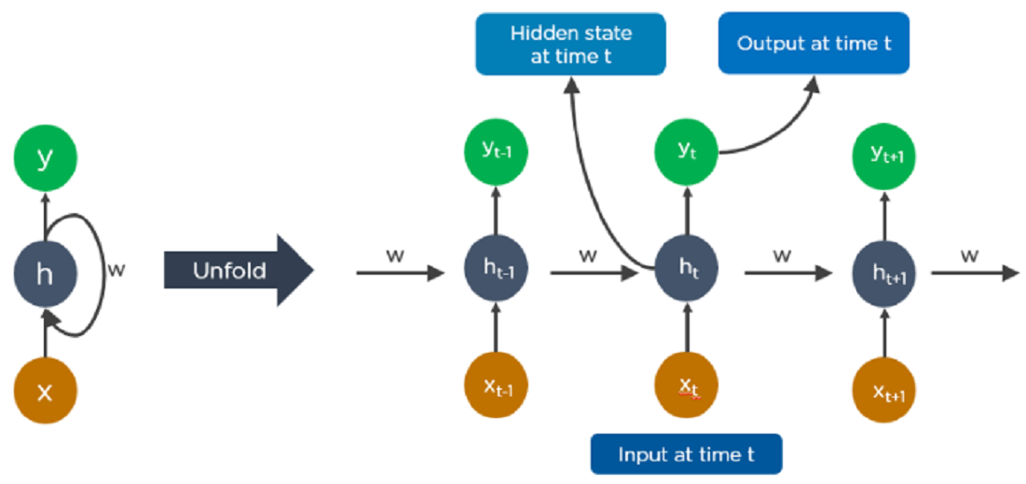
3. Recurrent Neural Networks (RNNs)
RNN is a type of supervised deep learning where the output from the previous step is fed as input to the current step. RNN deep learning algorithm is best suited for sequential data. RNN is most preferably used in image captioning, time-series analysis, natural-language processing, handwriting recognition, and machine translation.

Slide 38
The most vital feature of RNN is the Hidden state, which memorizes some information about a sequence. There are mainly 4 steps of how RNN works.
The output of the hidden state at t-1 fed into input at time t.
Same way, the output at time t fed into input at time t+1.
RNN can process inputs of any considerable length
The RNN computation depends on historical sequence data and the model size doesn’t increase with input size.
In this way, RNN converts the independent activations into dependent, thus reducing the complexity of increasing parameters and remembering each previous output by giving each output as input to the next hidden layer.

Slide 42
Perceptron
IT consists of a set of weights, input values or scores, and a threshold.
Perceptron is a building block of an Artificial Neural Network
Perceptron is Machine Learning algorithm for supervised learning of various binary classification tasks. Further, Perceptron is also understood as an Artificial Neuron or neural network unit that helps to detect certain input data computations in business intelligence.
Perceptron model is also treated as one of the best and simplest types of Artificial Neural networks. However, it is a supervised learning algorithm of binary classifiers. Hence, we can consider it as a single-layer neural network with four main parameters, i.e., input values, weights and Bias, net sum, and an activation function.

Slide 43
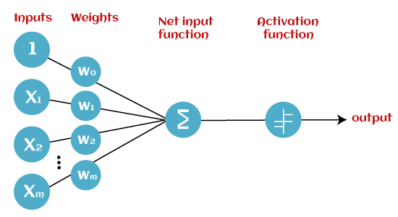
What is Binary classifier?
It is defined as the function that helps in deciding whether input data can be represented as vectors of numbers and belongs to some specific class.
A binary classifier which contains three main components. These are as follows:

Slide 44
Input Nodes or Input Layer:
This is the primary component of Perceptron which accepts the initial data into the system for further processing. Each input node contains a real numerical value.
Weight and Bias:
Weight parameter represents the strength of the connection between units. This is another most important parameter of Perceptron components. Weight is directly proportional to the strength of the associated input neuron in deciding the output. Further, Bias can be considered as the line of intercept in a linear equation.
Activation Function:
These are the final and important components that help to determine whether the neuron will fire or not. Activation Function can be considered primarily as a step function.

Slide 45
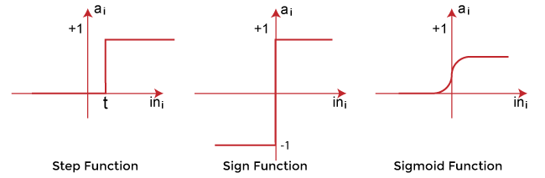
Types of Activation functions:
Sign function
Step function, and
Sigmoid function

Slide 46
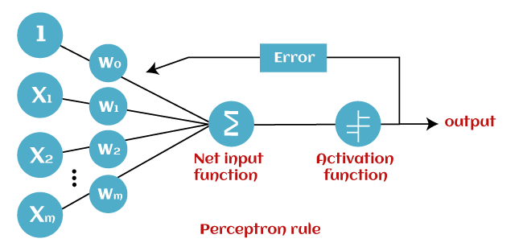
How does Perceptron work?
In Machine Learning, Perceptron is considered as a single-layer neural network that consists of four main parameters named input values (Input nodes), weights and Bias, net sum, and an activation function. The perceptron model begins with the multiplication of all input values and their weights, then adds these values together to create the weighted sum. Then this weighted sum is applied to the activation function 'f' to obtain the desired output. This activation function is also known as the step function and is represented by 'f'.

Slide 47
This step function or Activation function plays a vital role in ensuring that output is mapped between required values (0,1) or (-1,1). It is important to note that the weight of input is indicative of the strength of a node. Similarly, an input's bias value gives the ability to shift the activation function curve up or down.
Perceptron model works in two important steps as follows:
Step-1
In the first step first, multiply all input values with corresponding weight values and then add them to determine the weighted sum. Mathematically, we can calculate the weighted sum as follows:
∑wi*xi = x1*w1 + x2*w2 +…wn*xn
Add a special term called bias 'b' to this weighted sum to improve the model's performance.
∑wi*xi + b

Slide 48
Step-2:
In the second step, an activation function is applied with the above-mentioned weighted sum, which gives us output either in binary form or a continuous value as follows:
Y = f(∑wi*xi + b)
Types of Perceptron Models
Based on the layers, Perceptron models are divided into two types. These are as follows:
Single-layer Perceptron Model
Multi-layer Perceptron model

Slide 49
Single Layer Perceptron Model:
This is one of the easiest Artificial neural networks (ANN) types. A single-layered perceptron model consists feed-forward network and also includes a threshold transfer function inside the model. The main objective of the single-layer perceptron model is to analyze the linearly separable objects with binary outcomes.
In a single layer perceptron model, its algorithms do not contain recorded data, so it begins with inconstantly allocated input for weight parameters. Further, it sums up all inputs (weight). After adding all inputs, if the total sum of all inputs is more than a pre-determined value, the model gets activated and shows the output value as +1.
If the outcome is same as pre-determined or threshold value, then the performance of this model is stated as satisfied, and weight demand does not change. However, this model consists of a few discrepancies triggered when multiple weight inputs values are fed into the model. Hence, to find desired output and minimize errors, some changes should be necessary for the weights input.
"Single-layer perceptron can learn only linearly separable patterns."

Slide 50
Multi-Layered Perceptron Model:
Like a single-layer perceptron model, a multi-layer perceptron model also has the same model structure but has a greater number of hidden layers.
The multi-layer perceptron model is also known as the Backpropagation algorithm, which executes in two stages as follows:
Forward Stage: Activation functions start from the input layer in the forward stage and terminate on the output layer.
Backward Stage: In the backward stage, weight and bias values are modified as per the model's requirement. In this stage, the error between actual output and demanded originated backward on the output layer and ended on the input layer.
Hence, a multi-layered perceptron model has considered as multiple artificial neural networks having various layers in which activation function does not remain linear, similar to a single layer perceptron model. Instead of linear, activation function can be executed as sigmoid, TanH, ReLU, etc., for deployment.
A multi-layer perceptron model has greater processing power and can process linear and non-linear patterns. Further, it can also implement logic gates such as AND, OR, XOR, NAND, NOT, XNOR, NOR.

Slide 51
Advantages of Multi-Layer Perceptron:
A multi-layered perceptron model can be used to solve complex non-linear problems.
It works well with both small and large input data.
It helps us to obtain quick predictions after the training.
It helps to obtain the same accuracy ratio with large as well as small data.
Disadvantages of Multi-Layer Perceptron:
In Multi-layer perceptron, computations are difficult and time-consuming.
In multi-layer Perceptron, it is difficult to predict how much the dependent variable affects each independent variable.
The model functioning depends on the quality of the training.

Slide 52
Perceptron Function
Perceptron function ''f(x)'' can be achieved as output by multiplying the input 'x' with the learned weight coefficient 'w’.
Mathematically, we can express it as follows:
f(x)=1; if w.x+b>0
otherwise, f(x)=0
'w' represents real-valued weights vector
'b' represents the bias
'x' represents a vector of input x values.

Slide 53
Limitations of Perceptron Model
The output of a perceptron can only be a binary number (0 or 1) due to the hard limit transfer function.
Perceptron can only be used to classify the linearly separable sets of input vectors. If input vectors are non-linear, it is not easy to classify them properly.

Slide 54
Adaptive Linear Neuron (Adaline)
Adaline which stands for Adaptive Linear Neuron, is a network having a single linear unit. It was developed by Widrow and Hoff in 1960. Some important points about Adaline are as follows −
It uses bipolar activation function.
Adaline neuron can be trained using Delta rule or Least Mean Square(LMS) rule or widrow-hoff rule
The net input is compared with the target value to compute the error signal.
on the basis of adaptive training algoritham weights are adjusted
The basic structure of Adaline is similar to perceptron having an extra feedback loop with the help of which the actual output is compared with the desired/target output. After comparison on the basis of training algorithm, the weights and bias will be updated.

Slide 55
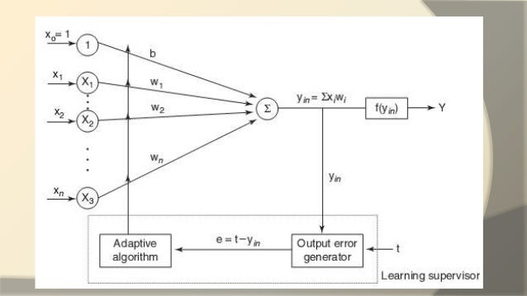

Slide 56
Adaptive Linear Neuron Learning algorithm
Step 0: initialize the weights and the bias are set to some random values but not to zero, also initialize the learning rate α.
Step 1 − perform steps 2-7 when stopping condition is false.
Step 2 − perform steps 3-5 for each bipolar training pair s:t.
Step 3 − Activate each input unit as follows −
xi=si(i=1 to n)
Step 4 − Obtain the net input with the following relation −
yin=∑in xi.wi+b
Here ‘b’ is bias and ‘n’ is the total number of input neurons.
Step 5 Until least mean square is obtained (t - y_{in}), Adjust the weight and bias as follows
w_{i}(new) = w_{i}(old) + α(t - y_{in})x_{i} b(new) = b(old) + α(t - y_{in})
Now calculate the error using => E = (t - y_{in})²
Step 7 − Test for the stopping condition, if error generated is less then or equal to specified tolerance then stop.

Slide 57
Supervised Learning in network
This learning process is dependent. During the training of ANN under supervised learning, the input vector is presented to the network, which will produce an output vector. This output vector is compared with the desired/target output vector. An error signal is generated if there is a difference between the actual output and the desired/target output vector. On the basis of this error signal, the weights would be adjusted until the actual output is matched with the desired output.
Perceptron
Developed by Frank Rosenblatt by using McCulloch and Pitts model
Perceptron is the basic operational unit of artificial neural networks. It employs supervised learning rule and is able to classify the data into two classes.
Operational characteristics of the perceptron: It consists of a single neuron with an arbitrary number of inputs along with adjustable weights, but the output of the neuron is 1 or 0 depending upon the threshold. It also consists of a bias whose weight is always 1. Following figure gives a schematic representation of the perceptron.

Slide 58
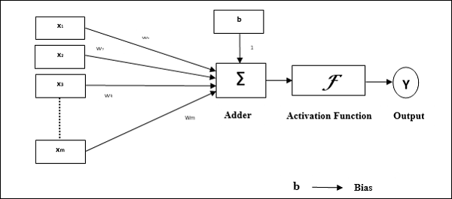
Perceptron thus has the following three basic elements −
Links − It would have a set of connection links, which carries a weight including a bias always having weight 1.
Adder − It adds the input after they are multiplied with their respective weights.
Activation function − It limits the output of neuron. The most basic activation function is a Heaviside step function that has two possible outputs. This function returns 1, if the input is positive, and 0 for any negative input.

Slide 59
Training Algorithm
Perceptron network can be trained for single output unit as well as multiple output units.
Training Algorithm for Single Output Unit
Step 1 − Initialize the following to start the training −
Weights
Bias
Learning rate α
For easy calculation and simplicity, weights and bias must be set equal to 0 and the learning rate must be set equal to 1.
Step 2 − Continue step 3-8 when the stopping condition is not true.
Step 3 − Continue step 4-6 for every training vector x.
Step 4 − Activate each input unit as follows −
xi=si(i=1to n)

Slide 60
Step 5 − Now obtain the net input with the following relation −
y_{in} =b+ ∑xi. wi
Here ‘b’ is bias and ‘n’ is the total number of input neurons.
Step 6 − Apply the following activation unction to obtain the final output.
1 if y_{in} >θ
f(y_{in})= 0 if −θ⩽ y_{in} ⩽θ
⎨ -1 if y_{in} <−θ
Step 7 − Adjust the weight and bias for x = 1 to n and j = 1 to m as follows −
Case 1 − if y_{j} ≠ t_{j} then,
wij(new)=wij(old)+αtjxi bj(new)=bj(old)+αtj
Case 2 − if y_{j} = t_{j} then
wij(new)=wij(old)
bj(new)=bj(old) Here ‘y’ is the actual output and ‘t’ is the desired/target output.
Step 8 − Test for the stopping condition, which will happen when there is no change in weight.

Slide 61
Adaptive Linear Neuron (Adaline)
Adaline which stands for Adaptive Linear Neuron, is a network having a single linear unit. It was developed by Widrow and Hoff in 1960.
Some important points about Adaline are as follows −
It uses bipolar activation function.
It uses delta rule for training to minimize the Mean-Squared Error (MSE) between the actual output and the desired/target output.
The weights and the bias are adjustable.

Slide 62
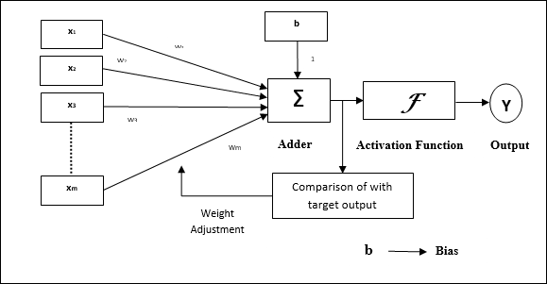
Architecture
The basic structure of Adaline is similar to perceptron having an extra feedback loop with the help of which the actual output is compared with the desired/target output. After comparison on the basis of training algorithm, the weights and bias will be updated.

Slide 63
Advantages of Backpropagation are:
Backpropagation is fast, simple and easy to program
It has no parameters to tune apart from the numbers of input
It is a flexible method as it does not require prior knowledge about the network
It is a standard method that generally works well
It does not need any special mention of the features of the function to be learned.

Slide 64
Associative memory is also known as content addressable memory (CAM) or associative storage or associative array. It is a special type of memory that is optimized for performing searches through data, as opposed to providing a simple direct access to the data based on the address.
it can store the set of patterns as memories when the associative memory is being presented with a key pattern, it responds by producing one of the stored pattern which closely resembles or relates to the key pattern.
it can be viewed as data correlation here. input data is correlated with that of stored data in the CAM.
it forms of two type:

Slide 65
auto associative memory network : An auto-associative memory network, also known as a recurrent neural network, is a type of associative memory that is used to recall a pattern from partial or degraded inputs. In an auto-associative network, the output of the network is fed back into the input, allowing the network to learn and remember the patterns it has been trained on. This type of memory network is commonly used in applications such as speech and image recognition, where the input data may be incomplete or noisy.
hetero associative memory network : A hetero-associative memory network is a type of associative memory that is used to associate one set of patterns with another. In a hetero-associative network, the input pattern is associated with a different output pattern, allowing the network to learn and remember the associations between the two sets of patterns. This type of memory network is commonly used in applications such as data compression and data retrieval.

Slide 66
Associative memory of conventional semiconductor memory (usually RAM) with added comparison circuity that enables a search operation to complete in a single clock cycle. It is a hardware search engine, a special type of computer memory used in certain very high searching applications.
How Does Associative Memory Work?
In conventional memory, data is stored in specific locations, called addresses, and retrieved by referencing those addresses. In associative memory, data is stored together with additional tags or metadata that describe its content. When a search is performed, the associative memory compares the search query with the tags of all stored data, and retrieves the data that matches the query.

Slide 67
Associative memory is designed to quickly find matching data, even when the search query is incomplete or imprecise. This is achieved by using parallel processing techniques, where multiple search queries can be performed simultaneously. The search is also performed in a single step, as opposed to conventional memory where multiple steps are required to locate the data.
Applications of Associative memory :-
It can be only used in memory allocation format.
It is widely used in the database management systems, etc.
Networking: Associative memory is used in network routing tables to quickly find the path to a destination network based on its address.
Image processing: Associative memory is used in image processing applications to search for specific features or patterns within an image.
Artificial intelligence: Associative memory is used in artificial intelligence applications such as expert systems and pattern recognition.
Database management: Associative memory can be used in database management systems to quickly retrieve data based on its content.

Slide 68
Advantages of Associative memory :-
It is used where search time needs to be less or short.
It is suitable for parallel searches.
It is often used to speedup databases.
It is used in page tables used by the virtual memory and used in neural networks.
Disadvantages of Associative memory :-
It is more expensive than RAM.
Each cell must have storage capability and logical circuits for matching its content with external argument.

