Slide 1
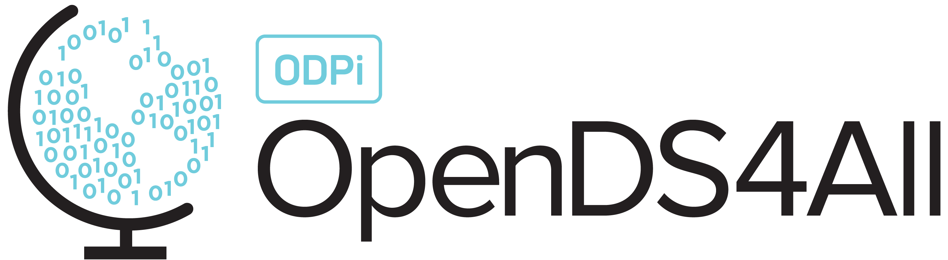
Introduction to Data Science
This work is supported by the National Science Foundation under Award 2021287
Difficulty level: Introductory
Notes:
Initial release, Xumin Liu, Rochester Institute of Technology, 2022.
By Xumin Liu https://www.cs.rit.edu/~xl/
Except where otherwise noted, this work is licensed under a Creative Commons Attribution-4.0 International License https://creativecommons.org/licenses/by/4.0/

Slide 2
Contents
What is Data Science?
Why Data Science?
Data Science vs Other Fields
Data Fairness, Privacy and Ethics

Slide 3
What is Data Science

Slide 4
What is Data Science
The term “Data Science” was coined in 2001, attributed to William S. Cleveland who wrote “Data Science: An Action for Expanding the Technical Areas of the Field of Statistics”.
Wiki definition: Data science is an interdisciplinary field that uses scientific methods, processes, algorithms and systems to extract knowledge and insights from structured and unstructured data, and apply knowledge and actionable insights from data across a broad range of application domains.
Notes:
As data science has its impact so many domains and the efforts have been carried on by people in many disciplines, they have different understanding and different perspectives on what data science is. Here, we are trying to use the most common and widely accepted definition of it, which is the one from Wikipedia page.

Slide 5
OSEMN Process
Obtain: collect data
Data query from databases, Web/PDF scraping, web APIs
Scrub: clean and filter data
GIGO (Garbage In Garbage Out)
Explore: understand the data
Inspect the data and its properties (different types of data)
Computer descriptive statistics and identify simple patterns through visualization
Model: Generate models for prediction or making decisions
Feature selection and reduction
Clustering, Classification, Regression, Association rule discovery
iNterpret data: Storytelling
Interpret the data models and discovered knowledge
Generate data products from the data that can answer business questions
Deliver the results and actionable insights
Notes:
Obtain: scalable way to collect data, such as SQL, web scraping, and scripting using Python and shell scripts, use API to access data
Scrub: data could be messy, such as missing values, corrupted data, inconsistency, etc. If the data is unfiltered and irrelevant, the result will not be meaningful as well.
Explore: exploratory data analysis, once the data is ready, before jumping into AI or machine learning, you will need to first explore the data to get to know the data in general.
Model: to generate models for prediction or making decisions. This is the part where we say magic happens. The findings of using those models go bey
Interpret: to interpret the data models and the discovered knowledge and make them useful for achieving business goals, that is, generating data products.

Slide 6
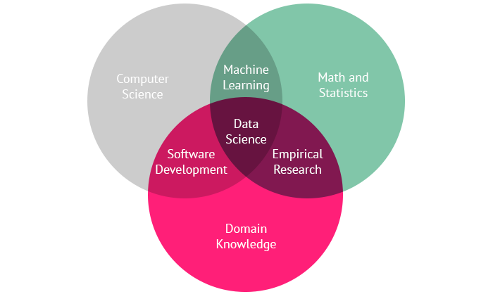
Data Science Venn Diagram
Primary colors:
Computer Science
Math/Statistics
Domain Knowledge
Overlaps:
Machine learning
Software development
Empirical Research
Data Science: the combination of all
Notes:
Computer science or hacking skills: focuses on coding, or hacking skills, coding helps gather and prepare data, as well as automate the steps in the data science OSEMN process.
Math and statistics: focuses on understanding the patterns in the data and learning the algorithms for generating data models.
Machine learning: the overlap between computer science and math and statistics. It is about coding and statistics without domain knowledge, acts like a black box where you throw the data in without knowing what it means, and get back some patterns.
Empirical research: the overlap between math and domain without coding. Here the data is usually small scaled and structured. It focuses on designing the statistical models and interpretation of the result.
Data science is the combination of all of the three, computer science, math, and domain knowledge as it analyzes the data in a certain domain and generates the models that can benefit the decision making in that domain.

Slide 7
Why Data Science

Slide 8
Why Data Science?
Data vs. Information vs. Knowledge
“Data is not information, information is not knowledge, knowledge is not understanding, understanding is not wisdom” – Clifford Stoll (astronomer)
Data: a collection of facts, such as values or measurements
Example: 30 31 34 45 32
Information: meanings of data
Example: The above numbers represent temperature readings in Rochester during November, 2008
Knowledge: Interpretation of information
Example: I need to wear a coat in Rochester during November
Data Science
Turn data into information and onwards up the pyramid – data products
Notes:
Data refers to a collection of facts such as some readings of temperature, like 30, or categorical values such as boy, girl, and so on. Once the data is assigned with meaning, it becomes information. For example, these numbers represent temperature readings in Rochester during Nov. 2008. Information can be directly obtained from the data. Knowledge goes beyond the information but more like the interpretation of information, such as it is reasonable to wear a coat instead of short sleeves in Rochester during November.
Data science is to turn data into information and onwards up this pyramid, i.e., generating the knowledge, which is called as data products.

Slide 9

Example of Data Products
User profile, View history, Movie info. → Netflix Movie Recommendation
Netflix offers over 7K TV shows and movies
Netflix just has a 90-second window to help viewers find a movie or a TV show
Personalized recommendation produce $1 billon a year in value from customer retention
Majority of Netflix users choose 80% recommended by the system
Notes:
Netflix began using analytic tools in 2000 to recommend videos for users to rent. Netflix offers over 7K TV shows and movies. With this number, it is actually impossible for a viewer to find movies they like to watch on their own. Netflix has a 90-second window to help viewers find a movie or a TV show before they leave the platform and visit some other providers, cause that is how patient a typical user is. That’s one of the major reasons why Netflix is so obsessed with personalizing recommendations to hook users.
Netflix’s personalized recommendation algorithms produce $1 billion a year in value from customer retention. It is the main reason that customers stay with Netflix. Majority of Netflix users consider recommendations with 80% of Netflix views coming from the service’s recommendations. Meaning that the recommendation has 80% accuracy of predicting users preference.

Slide 10

Example of Data Products
Purchase history, reviews & rating, item features → Amazon product recommendation
35% of Amazon.com’s revenue is generated by its recommendation engine.
Amazon provides on-site and off-site (email) recommendations
Recommendation based on:
The items in shopping cart or they are currently looking at - Frequently bought together
The browsing history
Related to items being viewed/purchased
Customers with similar purchase history – customer who bought this item also bought
Notes:
Amazon uses data science techniques to make personalized recommendation. The classic recommendation algorithm, called item-based collaborative filtering, was used about 2 decades ago.
Once users login Amazon, they have their own personalized homepages. The content of a homepage is determined by user interests and pervious purchasing history, which are stored in Amazon databases.
About 35% of Amazon’s revenue is generated by its recommendation engine.
Amazon provides both on-site, where appears on its website, and offsite recommendation, such as through emails. The recommendation is not only based on a user’s data, such as browsing history and the purchase history, but also the data from other users. The intuition here is that customers that have similar preference/tastes/requirement tend to have similar shopping style. So Amazon recommends those products purchased by other similar users.

Slide 11
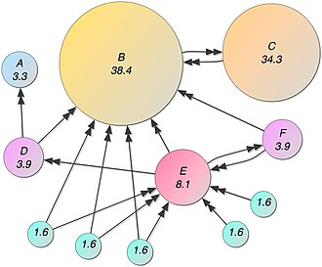
Example of Data Products
In-link, out-link → Page Rank
The first and the best-known algorithm used by Google
PageRank measures the importance of website pages
Notes:
Google was started by inventing the PageRank algorithm.
It ranks websites, such as how much a website is a reputable, or trustable, only from the links between web sites, not the contents of the website.
The information collected here is the topology of the entire website graph where the nodes are websites and edges are their links. For example, if a website, such as B, provides a hyperlink to another website, such as C, a link is formed from B to C. The intuition here is that if B links to C, it kinds of suggests that B trusts C to some degree. So the importance of B can be propagated to C.

Slide 12
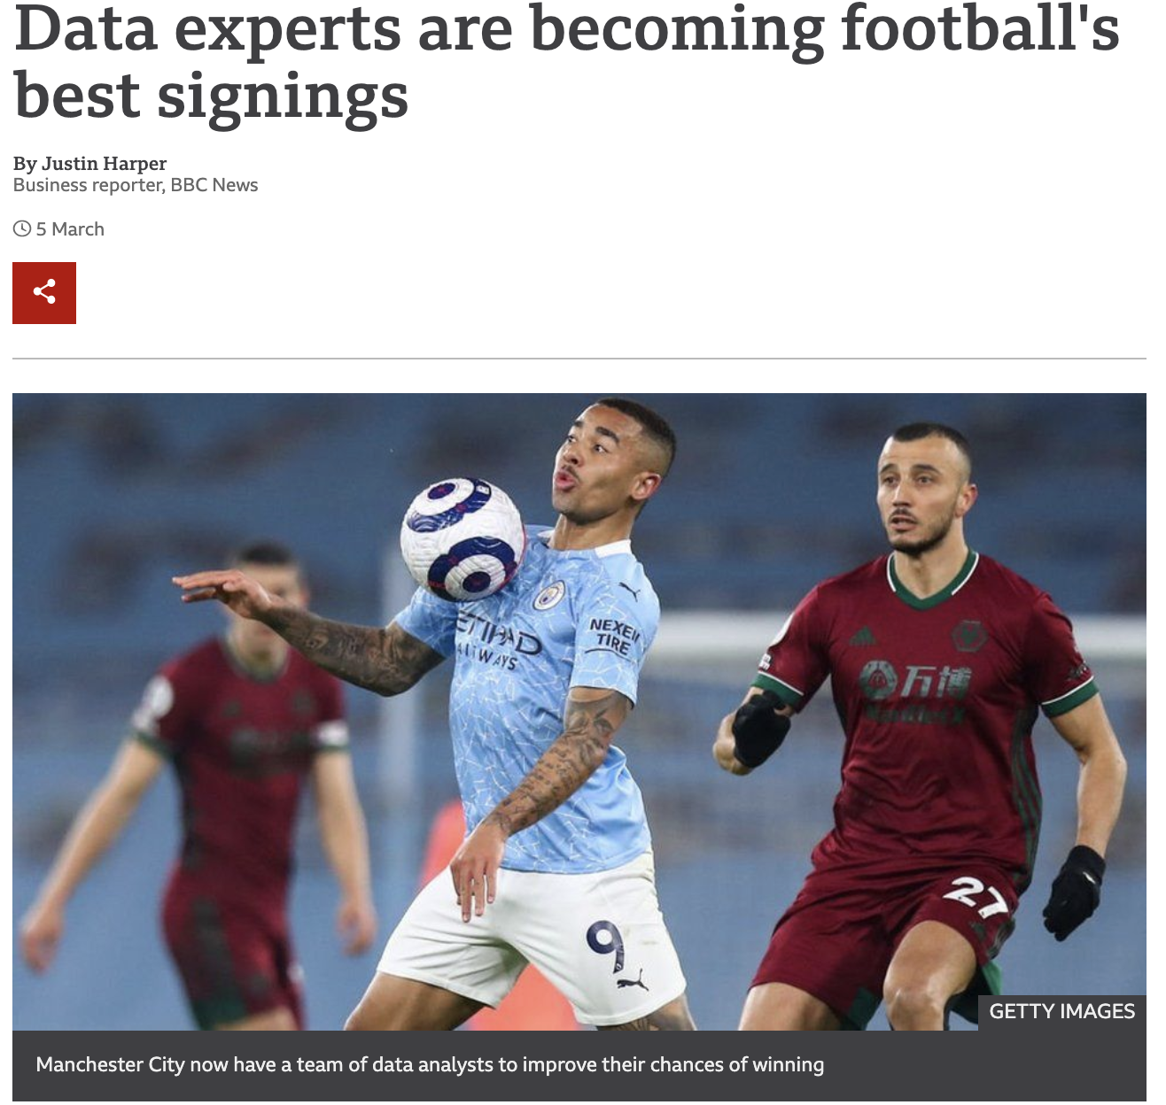
Example of Data Products
Player’s performance, opposition, ball-related data, → Decisions that help win
Notes:
Data science has played more and more important roles in sports. This news is about a data scientist, Laurie Shaw, becomes one of the most high-profile signings as he joined Manchester City. His expertise can be to use data science to analyze millions of stats about player’s performance, opposition, ball-related data to make decision, such as better manage player fatigue, injury, illness, recruiting new players or coaches.

Slide 13

Example of Data Products
Health and fitness data → personal workout plan, health suggestions
Wearables can track a specific condition and help maintain good health.
Wearables can be worn from head to toe.
The average person is likely to generate more than 1 million gigabytes of health-related data in their lifetime.
Notes:
Data science can help turn the health related data into something useful for our health. Smart wearables are popular these days, such as smart helmets, glasses, headphones, footwear, and watches. In some cases, people can implant smart devices in their body.
Wearables can collect lots of data such as steps taken, food and water intake, calories burned, sleep movement, and breathing. And those devices generate massive data in a high speed. The data can be used to come up with personal workout plan, making health suggestions, recommend health product.

Slide 14
Other Examples
Transaction data → Fraud Detection
Email data → spam detection
Image data → face detection
Review data --> Sentiment analysis
Notes:
Many examples of data products in various domains. We can analyze transaction data to detect credit card fraud. We can analyze email data to identify spams. We can analyze image data to identify people in a picture. We can analyze user reviews to perform sentiment analysis. In all of those examples, data are collected and analyzed to generate valuable knowledge as data products.

Slide 15
Data Science vs Other Fields

Slide 16
Data Science vs Big Data
Big Data
Focus on efficient use of data
Deals with 5V issues of managing and analyzing data
Data Size: Volume
Data Stream: Velocity
Data Types: Variety
Data Quality: Veracity
Information for decision making: Value
Data Science
Focus on turning data to data products
Covers all the steps of extracting information and knowledge from data, including capture, pre-processing, storage, retrieval, post-processing, analysis, visualization, and so on.
Notes:
Big data focuses on the “big” issues, which is how to efficiently use data. When people use this term, they usually refer to the 5V challenges, including Volume, meaning the massive size of data, Velocity, meaning the data can be generated in a high speed, Variety, meaning that the data can have various formats such as structured, textual data, image data, and media data, and so on. Veracity is about the quality of data or whether the data source is trustable or not. And the last V is value, which refers to the usefulness of the result of analyzing the data.
Data science focuses on turning data into knowledge or data products. It covers all the steps related to collect, handle, and analyze data. It may not always have big data issues, for example, you can perform an analysis in a small scale dataset, but we see it more and more common that people analyze large scale datasets and deal with big data issues in a data science task.

Slide 17
Data Science vs Machine Learning
Machine learning
Focus on develop statistic models that allow computer to learn patterns from data
A group of techniques used by data scientists
Technical, prove mathematical properties of models
Data Science
Focus on extract knowledge from data
It is interdisciplinary that covers many areas including machine learning and other different tools
Not just technical, understand empirical properties of models
Notes:
Data science covers machine learning but also covers domain knowledge. Machine learning is frequently mentioned together with data science as a means to analyze data and generate predictive models. Machine learning focuses on the mathematical, computational, and technical part of the data science, while data science is interdisciplinary where domain knowledge also plays an important role.

Slide 18
Data Science vs Databases
Databases
Data size: modest
Structured data format and uniform data schema
High requirement on data integrity
Support information query and data manipulation
Data Science
Data size: Massive
Unstructured data, various data format (text, structured, image, graph, media…)
Low requirements on data integrity
Support knowledge discovery
Notes:
Databases focus on managing data while data science focuses on analyzing data. They deal with different types of data and provide different supports.
A data science task may deal with a larger scale of data than a database deals with. A database typically stores the data within an organization but a data science task may analyze data collected from multiple organizations.
Database usually deal with structured and use the same schema to organized data. Data in a data science task can be unstructured and in various formats.
Database has a high requirement on data integrity as it serves the purpose of storing and querying. So it needs to ensure the quality of the querying result and it usually has low tolerant on data inconsistency. A data science task does not care about the data integrity that much. It allows inconsistency of data but treat that as noises. It aims to find a pattern that most of the records agree and ignores outliers.

Slide 19
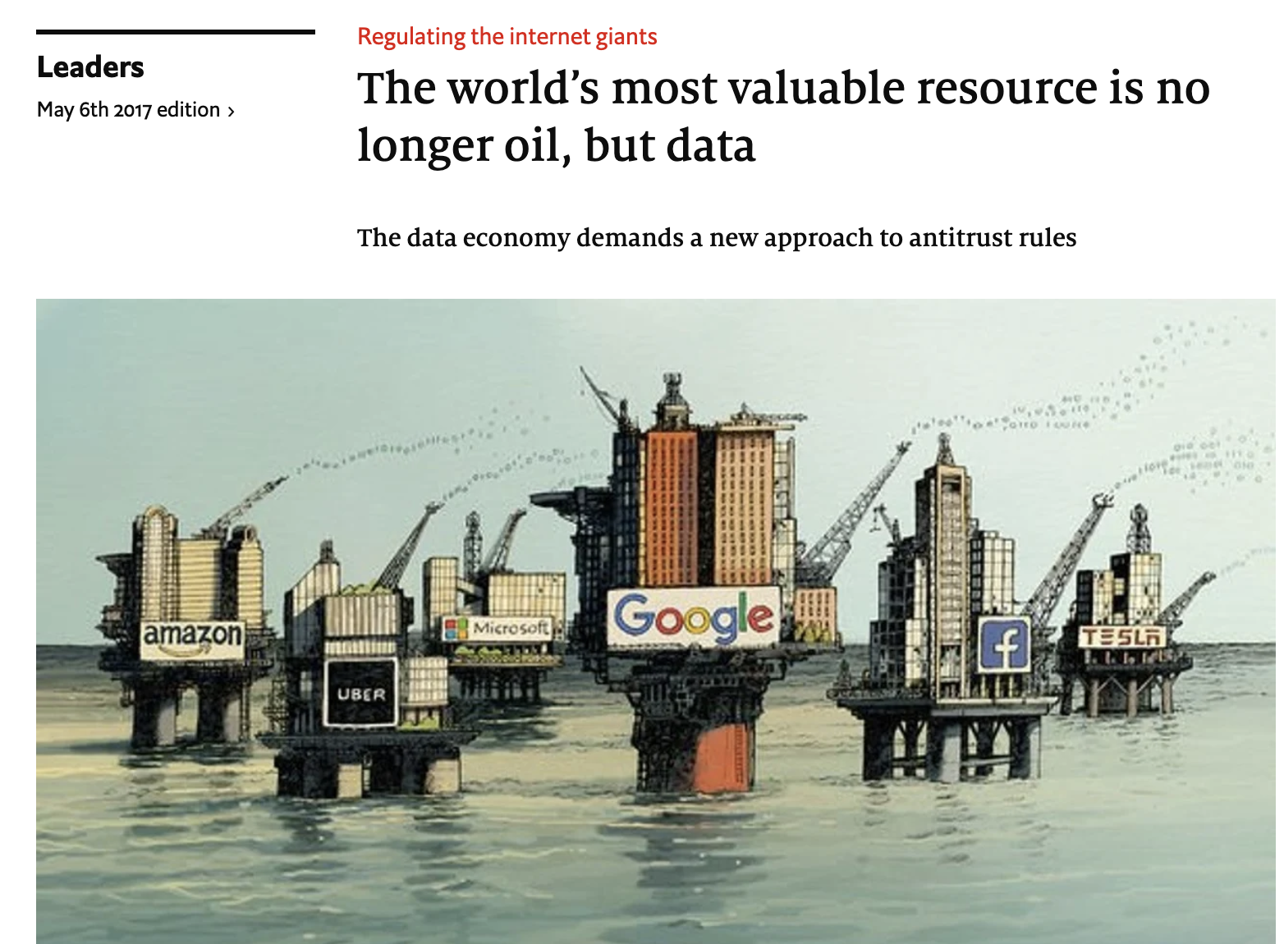
Data is the new Oil!
https://www.economist.com/leaders/2017/05/06/the-worlds-most-valuable-resource-is-no-longer-oil-but-data
Notes:
“Data is the new oil." Coined in 2006 by Clive Huby, a British data commercialization entrepreneur.
This phrase suggest that, just like crude oil, data is valuable. Without being refined, it cannot be used. Like how the oil needs to be changed into gas and other valuable materials, data needs to be processed and analyzed to generate valuable knowledge.

Slide 20
Data Fairness, Privacy and Ethics

Slide 21
Data Fairness, Privacy and Ethics
Data ethics are recognized as a crucial skill for Data Scientists.
Extensive use of massive data (personal or sensitive data), reliance on machine learning algorithms to make decision, reduction of human involvement can cause ethical challenges.
Data collection: privacy
Algorithms: fairness and bias
Notes:
Data ethics are considered as a crucial skill for data scientists.
Due to the fact that data science has been widely and frequently used in our lives, data has been extensively collected and used to make decisions that will affect our lives. There are so many ethical issues we need to address. For example, when data is collected and used, sensitive or personal information need to be protected to ensure privacy.
One of the power of using machine learning algorithm is the reduction of human involvement. But it may also cause the situation where fairness is violated and the bias models are generated.

Slide 22
Data Privacy
A large amount of data constantly collected in our daily lives.
Social media (facebook …)
Health data (smart watch…)
Medical data (covid test result…)
Location data (traffic camera… )
Privacy issues:
Unauthorized use of data
Personal data is used without getting consent first
Data breach
Intentional or unintentional release of personal information to an untrusted party (Facebook security breach
Privacy by Design (PbD): embed data privacy requirements into product design and development.
Notes:
With or without being aware, a large amount of data is constantly collected in our daily lives. That raised a question that how to protect privacy.
Two types of scenarios where it fails to protect privacy. One is unauthorized use of data. That is, the personal data is used without getting consent first. The consent covers not only whether the data can be used, but also how it is used. Another one is data breach. That is intentional or unintentional release of personal information to an untrusted party.
To provide privacy protection, privacy by design (PbD) principles require that data privacy requirements needs to be incorporated into the whole engineering process, including product design and development and delivery. This applies to any data product as well, i.e., all the products generated from data science processes need to follow proactively privacy protection during its engineering process.

Slide 23
Data Fairness, Privacy and Ethics
Data Fairness:
Machine learning models for decision making can reinforce stereotypes and have adverse racial or socioeconomic implications
Machine learning tools work as a black box and are difficult for humans to interpret and determine appropriate inputs and ethical implications of results.
Checklist:
Test the training data to ensure it it is fair
Study and understand possible source of bias in data
Have a project team with diversity of opinions, backgrounds, and kinds of thoughts
…
Notes:
Data fairness aims to generate unbiased data products.
Machine learning models aim to find patterns from collected data. If there is any bias existed in the data, such bias or stereotypes can be reinforced during the learning process and generated biased models. If we know how machine learning tools work and interfere when such bias is generated, that might be helpful for avoiding the situation. But unfortunately most of the machine learning tools work as a black box. It is hard for humans to interpret and determine how the input triggers the bias result and how to fix it.
The input of a machine learning model usually determines the output. If the input is biased, then it is likely the output is also biased. And if the output determines our decision making in our real life, such as what job to recommend, it will further reinforce the related stereotype. To avoid this situation, we should always be aware of data fairness issue, test if the collected data is fair or not, whether there is any bias in the data, whether the project has enough diversity of opinions to get involved in the data collection, processing, and interpretation of result.

