Slide 1

Feature Engineering
This work is supported by the National Science Foundation under Award 2021287
Difficulty level: Introductory
Notes:
Initial release, Xumin Liu, Rochester Institute of Technology, 2022.
By Xumin Liu https://www.cs.rit.edu/~xl/
Except where otherwise noted, this work is licensed under a Creative Commons Attribution-4.0 International License https://creativecommons.org/licenses/by/4.0/

Slide 2
Contents
Feature Engineering
Encoding
Scaling
Binning
Notes:
In this lecture, we use two datasets in the example:
Titanic dataset: https://www.kaggle.com/competitions/titanic/data
Covid Vaccination dataset: Kaggle: https://www.kaggle.com/datasets/gpreda/covid-world-vaccination-progress
Please contact Xumin Liu (xmlics@rit.edu) for the code used in the slides.

Slide 3
Feature Engineering

Slide 4
What is feature engineering?
Wiki: Feature engineering is the process of using domain knowledge to extract features (characteristics, properties, attributes) from raw data
A feature is a property shared by independent units on which analysis or prediction is to be done. Features are used by predictive models and influence results
Required skills: math and programming
Notes:
Feature engineering is the next step of data cleaning. The purpose is to prepare the data in the appropriate format and semantics for the downstream machine learning model. Features can be attributes of a data record or derived from those attributes.

Slide 5
Feature Engineering vs Data Cleaning
Data Cleaning
Target at noisy data or incorrect data
Standard steps for all applications
Correct or remove values
Feature Engineering
Prepare data for machine learning models
Convert the data from given format to desirable format
Transform, remove, or add features
More task specific, need domain knowledge
Notes:
Feature engineering has a different focus from data cleaning. Data cleaning targets at noisy data. General methods such as removing outliers and null values are used for cleaning. Feature engineering focuses on preparing the data. It is task specific.

Slide 6
Feature engineering
Data Preprocessing
Categorical features
Numerical/continuous features
Textual features
Image features
Notes:
The topic covers some standard data preprocessing techniques and the methods that deal with different types of features. In this lecture, we will not cover textual and image features.

Slide 7
Data Preprocessing
Further clean and prepare the data
Convert data type of a column
DataFrame.astype() https://pandas.pydata.org/docs/reference/api/pandas.DataFrame.astype.html
Remove unwanted columns or rows
DataFrame.drop() https://pandas.pydata.org/docs/reference/api/pandas.DataFrame.drop.html
Remove unwanted characters or words
Str.replace(target, ‘’)
Notes:
Data preprocessing takes the further step on cleaning the data (more application specific), such as removing unwanted columns/rows/characters/words. It also converts data type of a column if needed.

Slide 8
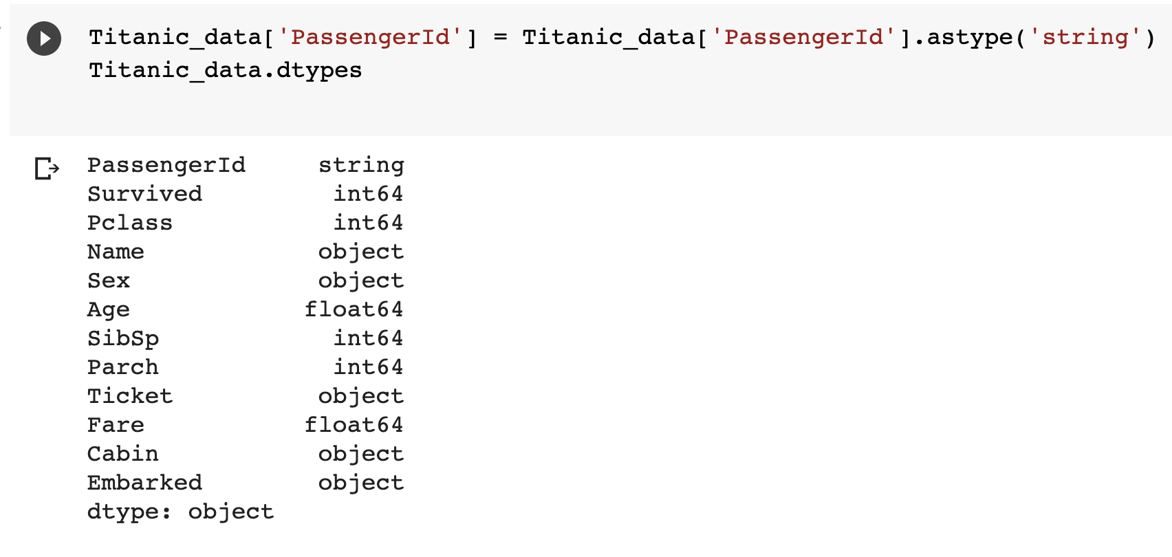
Convert data type of a column
Why?
Leverage the type methods
Many machine learning libraries do not take non-numeric input
pd.DataFrame.astype()
Notes:
By converting the data type of a column, we can leverage the corresponding type methods to process the data, such as after converting the type of PassengerId to string, we can locate those IDs starts with “1”. Another important reason of doing type conversion is to prepare the data in the format, such as numeric, that is acceptable by machine learning libraries.

Slide 9
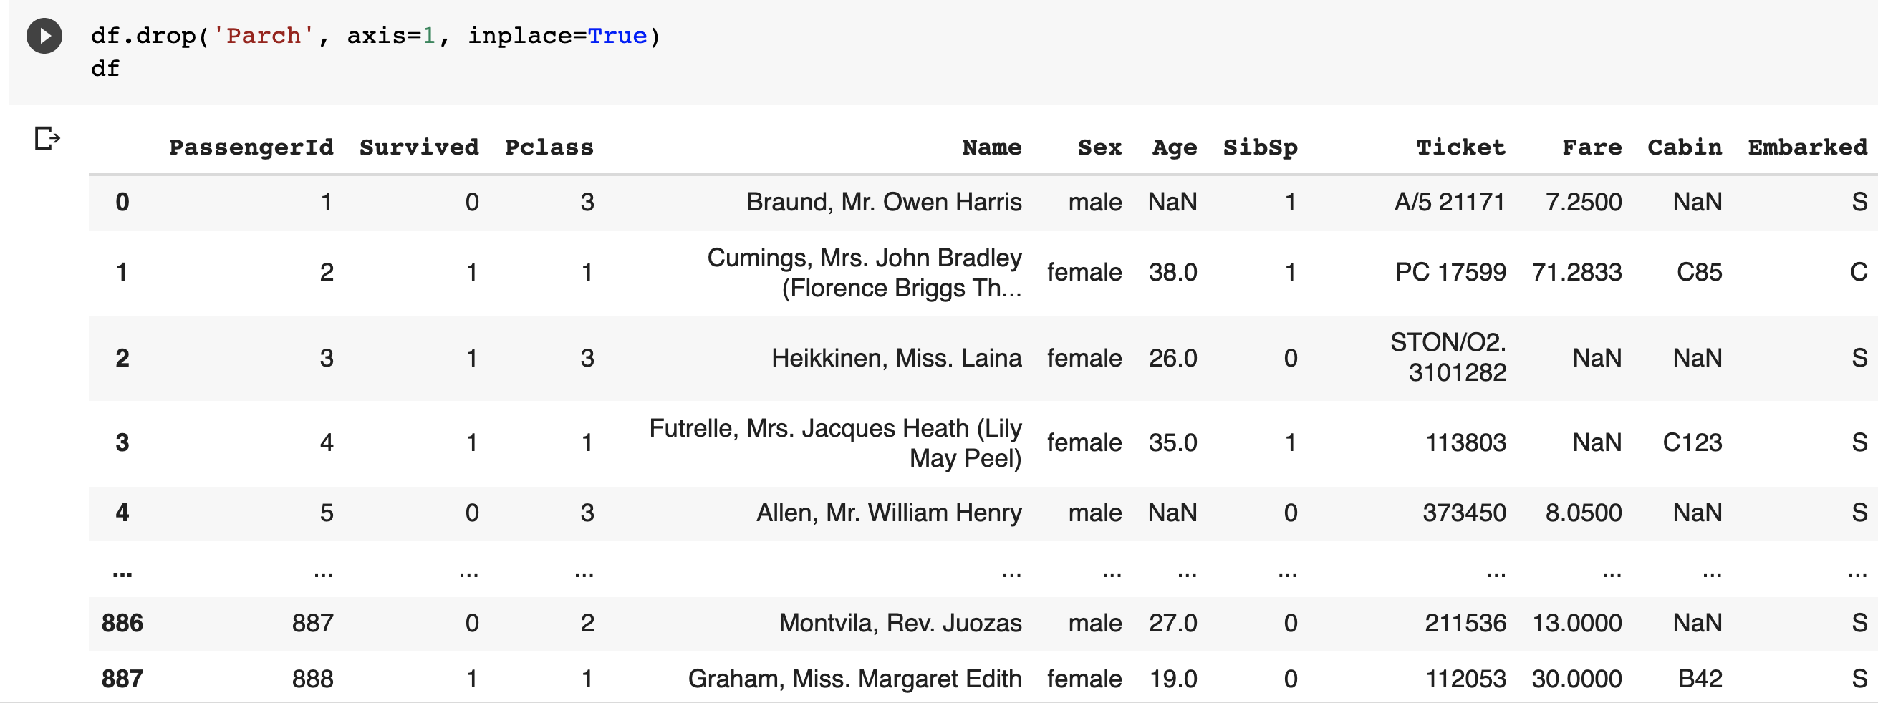
Remove unwanted columns or rows

Slide 10
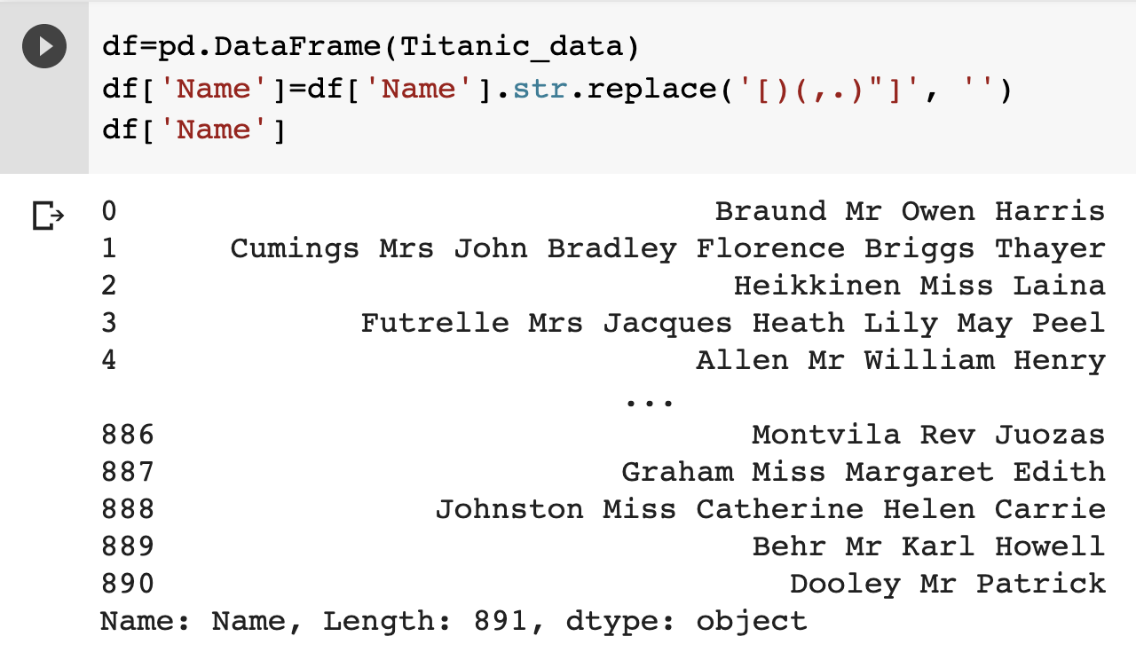
Remove unwanted characters or words

Slide 11
Categorical features
Take on values from a limited set
Ordinal values
Rankings (1-10), size (XS, S, M, L, XL)
Nominal values
Example: ID numbers, eye color, zip codes
Machine learning models cannot work with categorical features
Encoding: the process of converting categorical features values to numerical forms
Notes:
For categorical features, there can be ordering among the values (i.e., ordinal values) or not (i.e., nominal values). It is likely that those values are not numeric. Since machine learning models usually do not work with non-numerical values, we need to encode the values in numerical format if we decide to include them in the analysis. The encoding should keep the ordering among the values if needed.

Slide 12
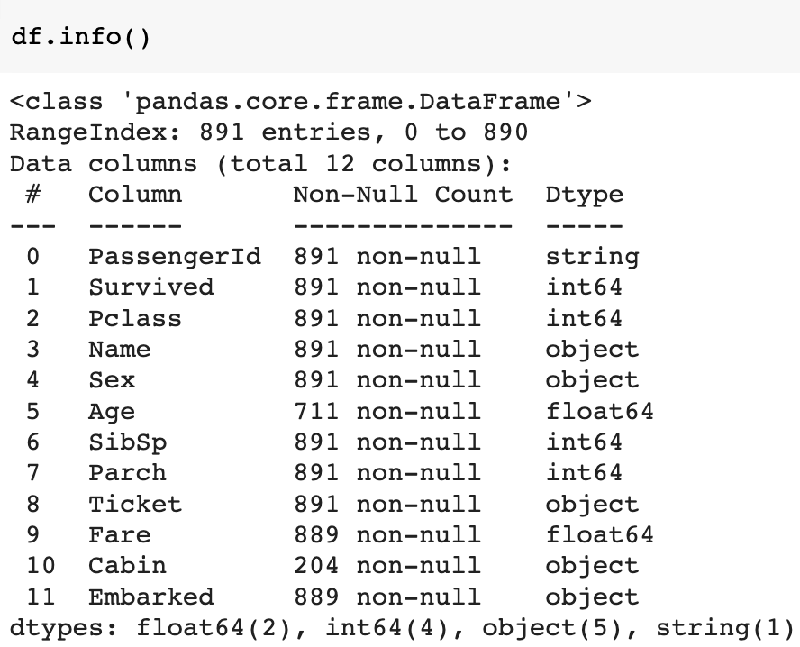
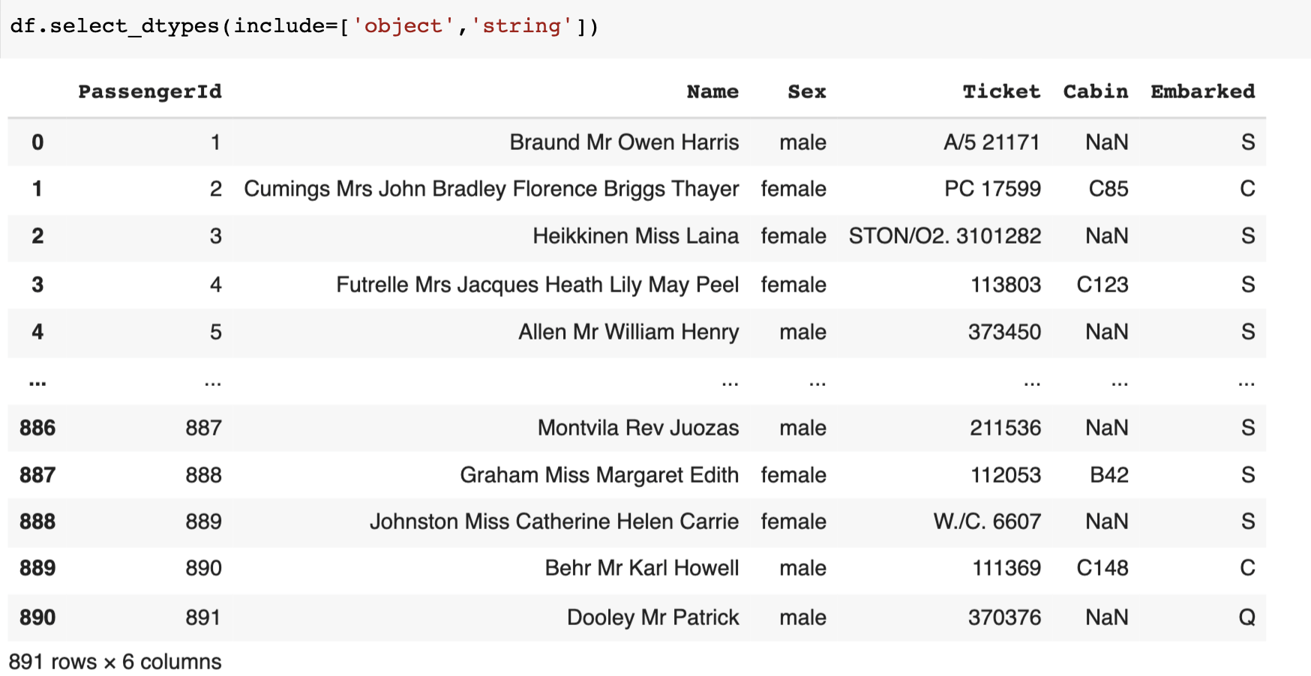
Check if a column is non-numeric
Notes:
Use dataframe.info() to display the data type of each column. string and object here are non-numeric ones. Use dataframe.select_dtypes(include=[the list of targeted types] to display the columns that have the matched types.

Slide 13
Encoding

Slide 14
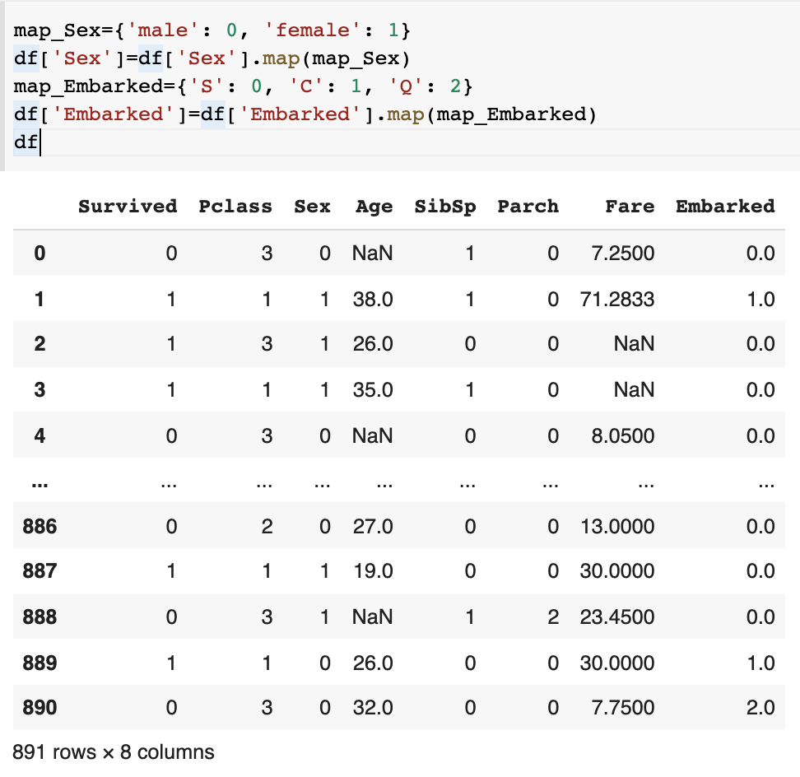
Encoding
Manual Encoding
Use dictionary
Notes:
Encoding here is to generate the numeric values for a column with discrete values. There are several ways of doing it. The first one is to define the mapping dictionary (i.e., map_Embarked), where the mapping between the original values and the new values is defined. The ordering in the original values if there is any needs to be kept in the new values.

Slide 15
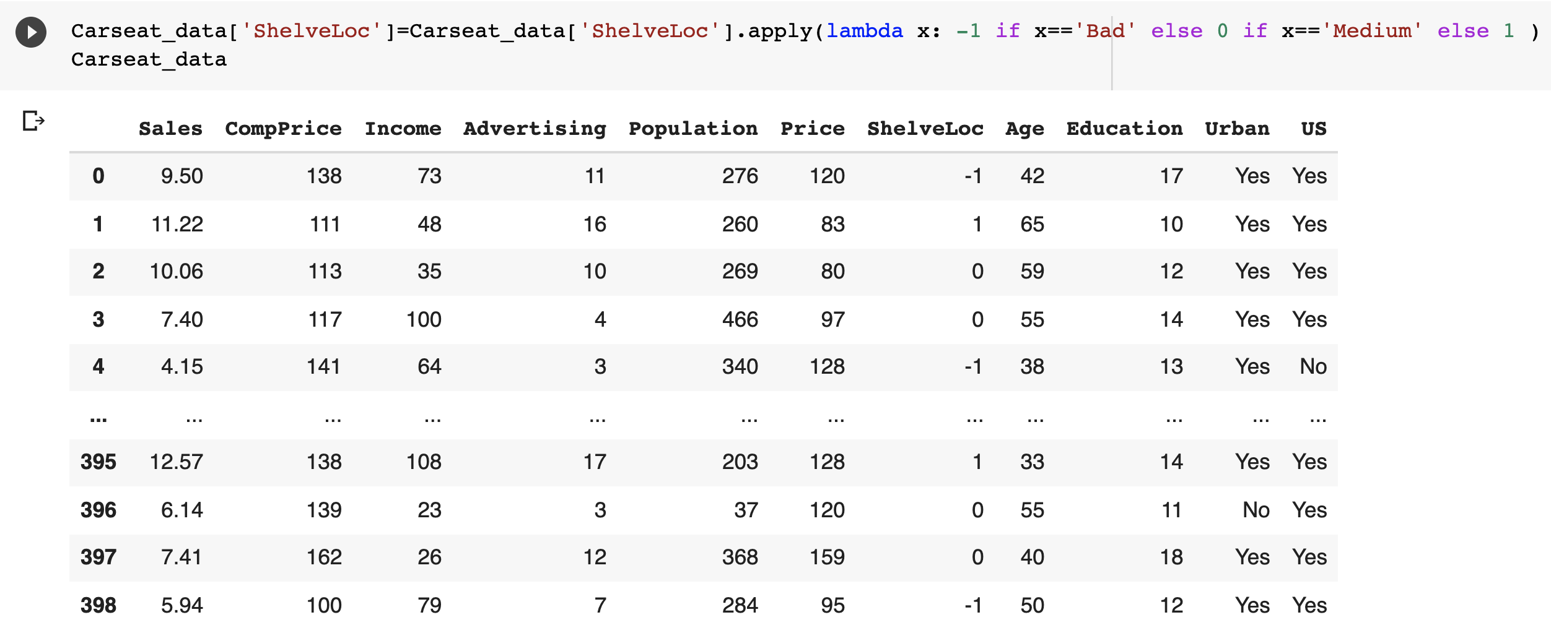
Encoding
Manual Encoding
Use pd.DataFrame.apply() and lambda function
https://pandas.pydata.org/docs/reference/api/pandas.DataFrame.apply.html
The code is not as clear as using dictionary but is more scalable
Notes:
Another manual encoding method is to use dataframe.apply() and lambda function. It is to apply a lambda function that determines the new values to a column. It is not as straightforward as using a mapping dictionary but is more scalable as you don’t need to list all the original values of that column in the dictionary.

Slide 16
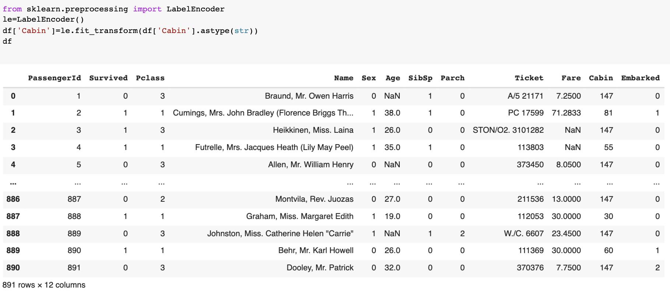

Encoding
Auto-encoding: Sklearn.preprocessing.labelEncoder()
Notes:
Sklearn supports automatic encodings. Use sklean.preprocessing.labelEncoder() method (https://scikit-learn.org/stable/modules/generated/sklearn.preprocessing.LabelEncoder.html) to generate numeric values for a column. It basically encode the original values with the values between 0 and (# of values -1). It can be used for both nominal and ordinal values. Sklearn also offers other encoding methods, such as OneHotEncoder() for nominal and OrdinalEncoder() for ordinal values.

Slide 17
Numerical/continuous features
Transformation (for columns)
Log transformation
Scaling (for rows)
Min-Max Scaler
Standard Scaler
Convert to discrete data
Binarization
Binning
Notes:
For numeric values, there are some commons ways of preparing the data.

Slide 18
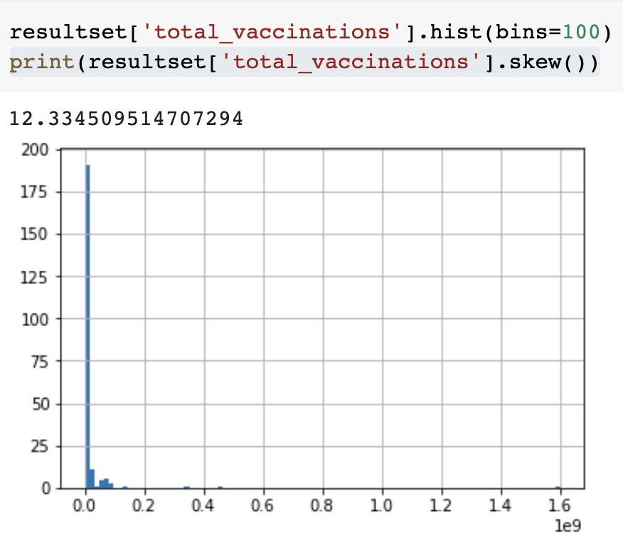
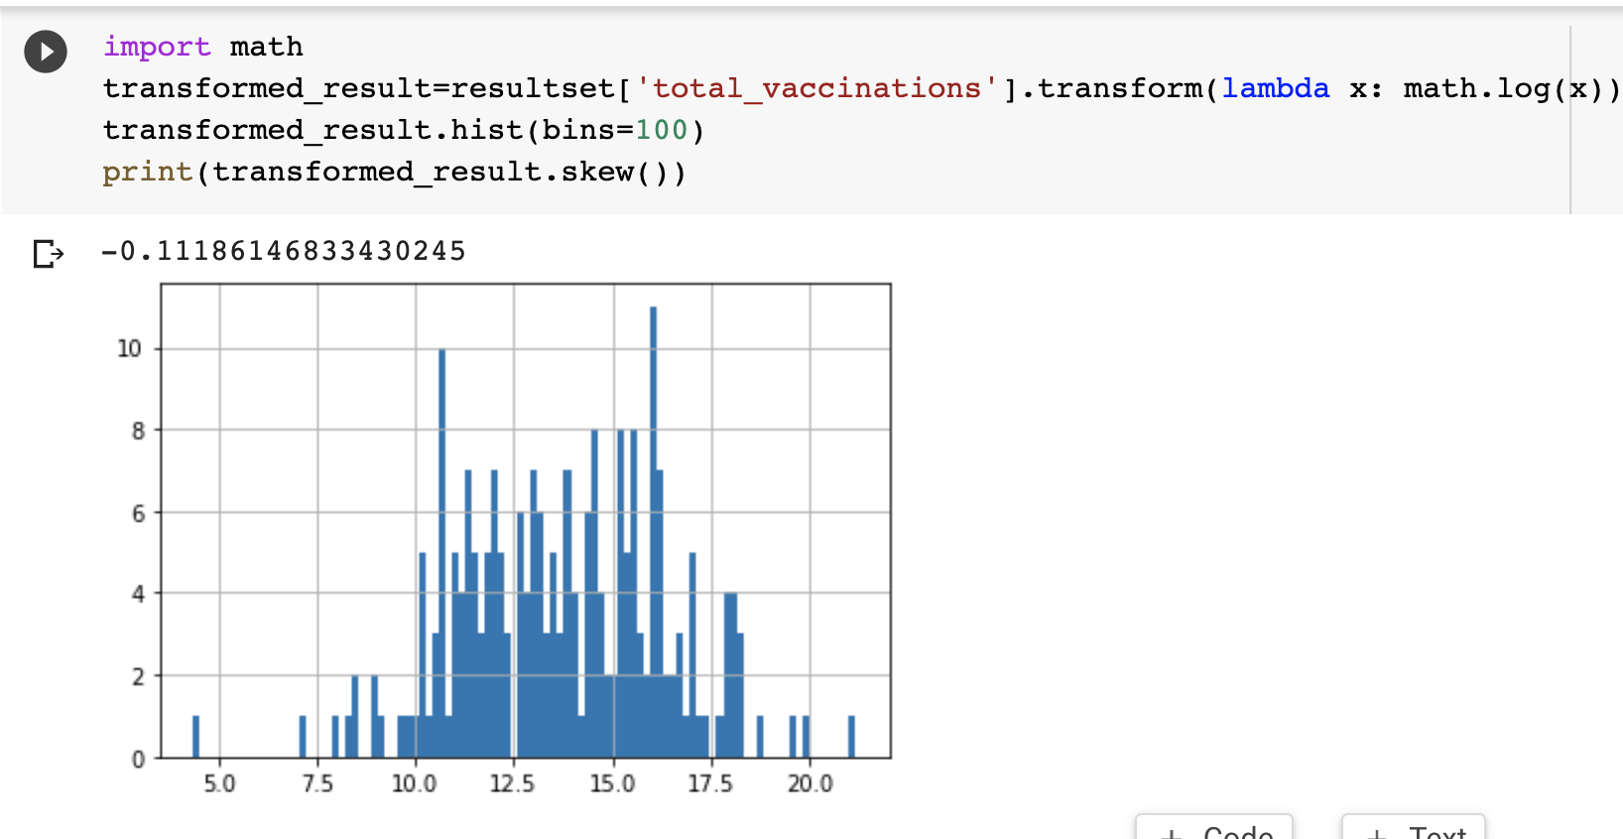
Log Transformation
Deals with skewed data, make the distribution more “normal”
Machine learning models work better with ”normal” data
Notes:
Log transformation is to perform a log function to the values of a column. This can reduce the skewness of the data.

Slide 19
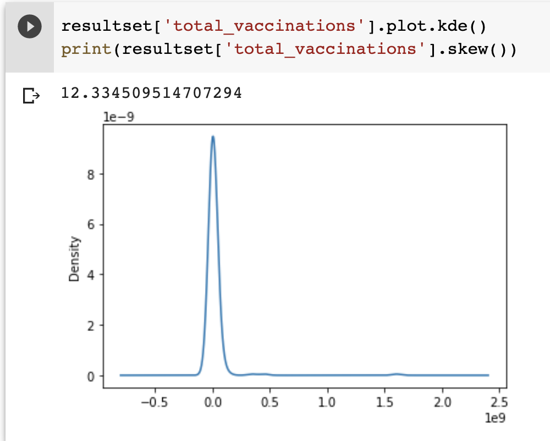
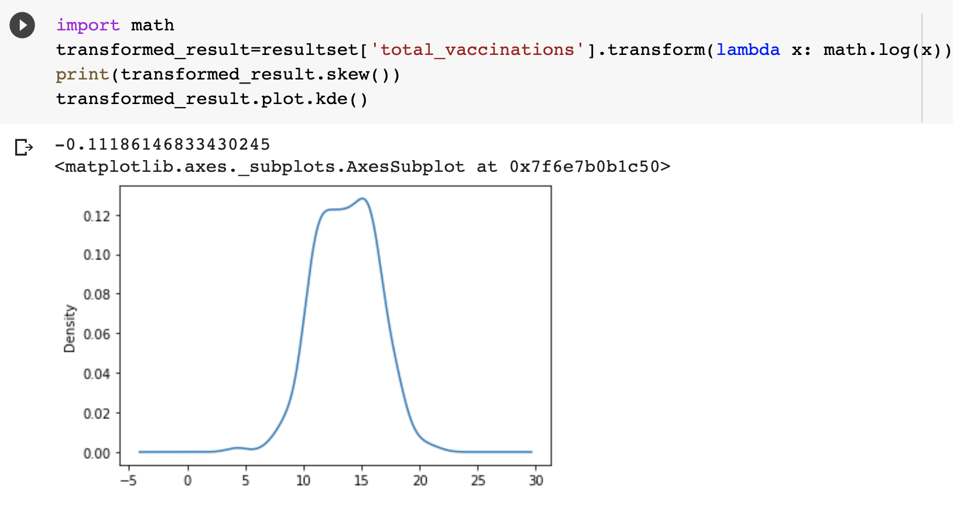
Log Transformation
Deals with skewed data, make the distribution more “normal”
Machine learning models work better with ”normal” data
Will raise issues with zero and negative values
Notes:
Another example of making the data more normal with log transformation.
As a log function is performed on the values, this method doesn’t work with zero or negative values.

Slide 20
Scaling

Slide 21




Scaling – why?
Features can span varying degrees of magnitude, range, and unit
May mess up distance-based algorithms
May mislead some machine learning models
People in which groups are considered more similar?
Height: 1.8m
Weight: 180 lb
Height: 1.6m
Weight: 170 lb
Height: 1.8m
Weight: 180 lb
Height: 1.8m
Weight: 200 lb
d =10.002
d =20
Notes:
Scaling is to transform the values to a specific scale, typically within [0,1] or [-1,1].
Different degrees of magnitude, range, and unit among features and mislead some machine learning models as the difference in one feature may dominate the difference in another one caused by different scales.
Like in the example, the people in the second group are more similar but their difference would be much larger than the one in the first group due to the fact that height and weight have different scales.

Slide 22
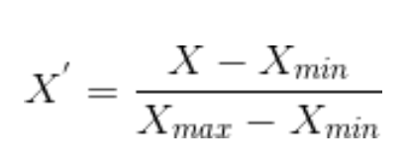
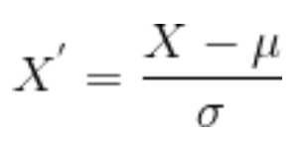
Scaling – how?
Standardization
Zero mean
No bounding range, but about 68% falls in [-1,1]
Fit for Gaussian distribution
Normalization
Min-Max scaling
Rescale values to [0,1]
Fit for non-Gaussian distribution
mean
Standard deviation
In practice, you may want to try both and choose the one that works better
Notes:
Normalization rescales values to [0,1] and is suitable for the data following non-Gaussian distribution.
Standardization rescales to the values with zero mean. It has no bounding range but about 2/3 new values falls in the range of [-1,1]. It is suitable for the data following Gaussian distribution.

Slide 23
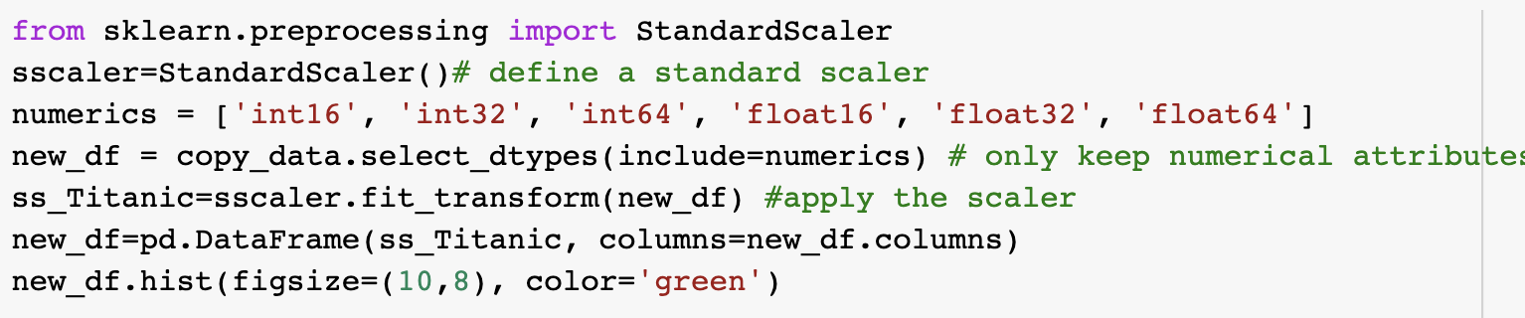
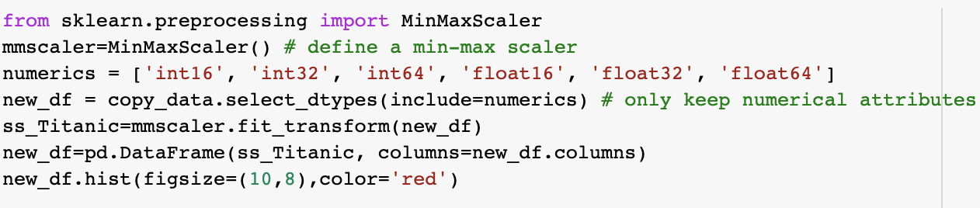
Implementation
Scikit-Learn Preprocessing library
https://scikit-learn.org/stable/modules/classes.html#module-sklearn.preprocessing
sklean.preprocessing.StandardScaler
sklearn.preprocessing.MinMaxScaler
Notes:
Sklearn provides libraries for data scaling.

Slide 24
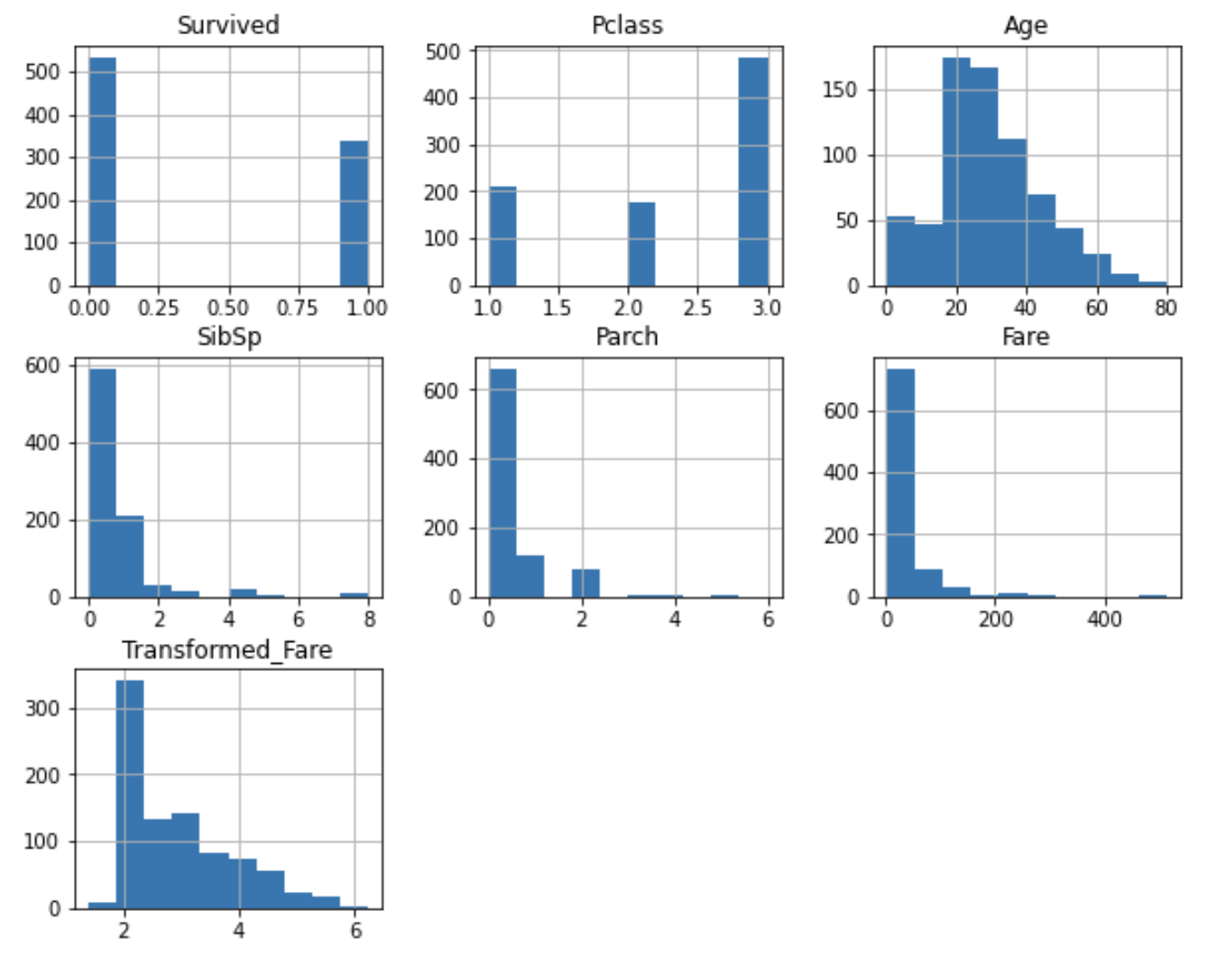
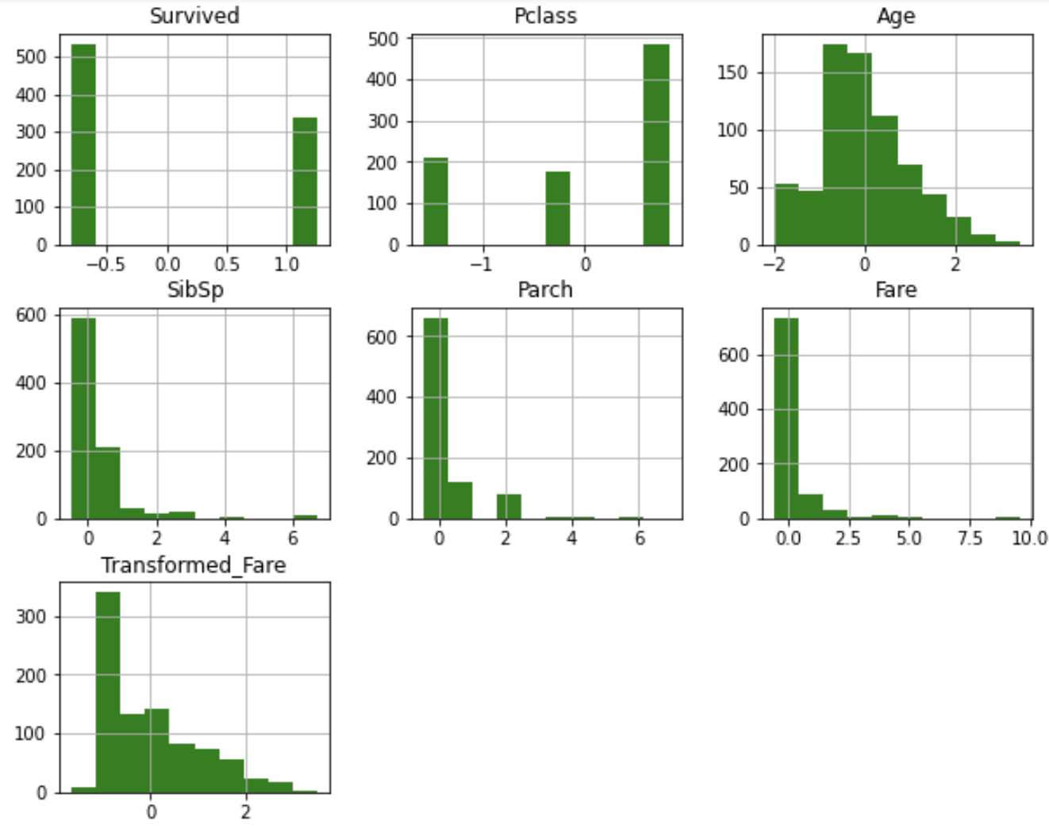
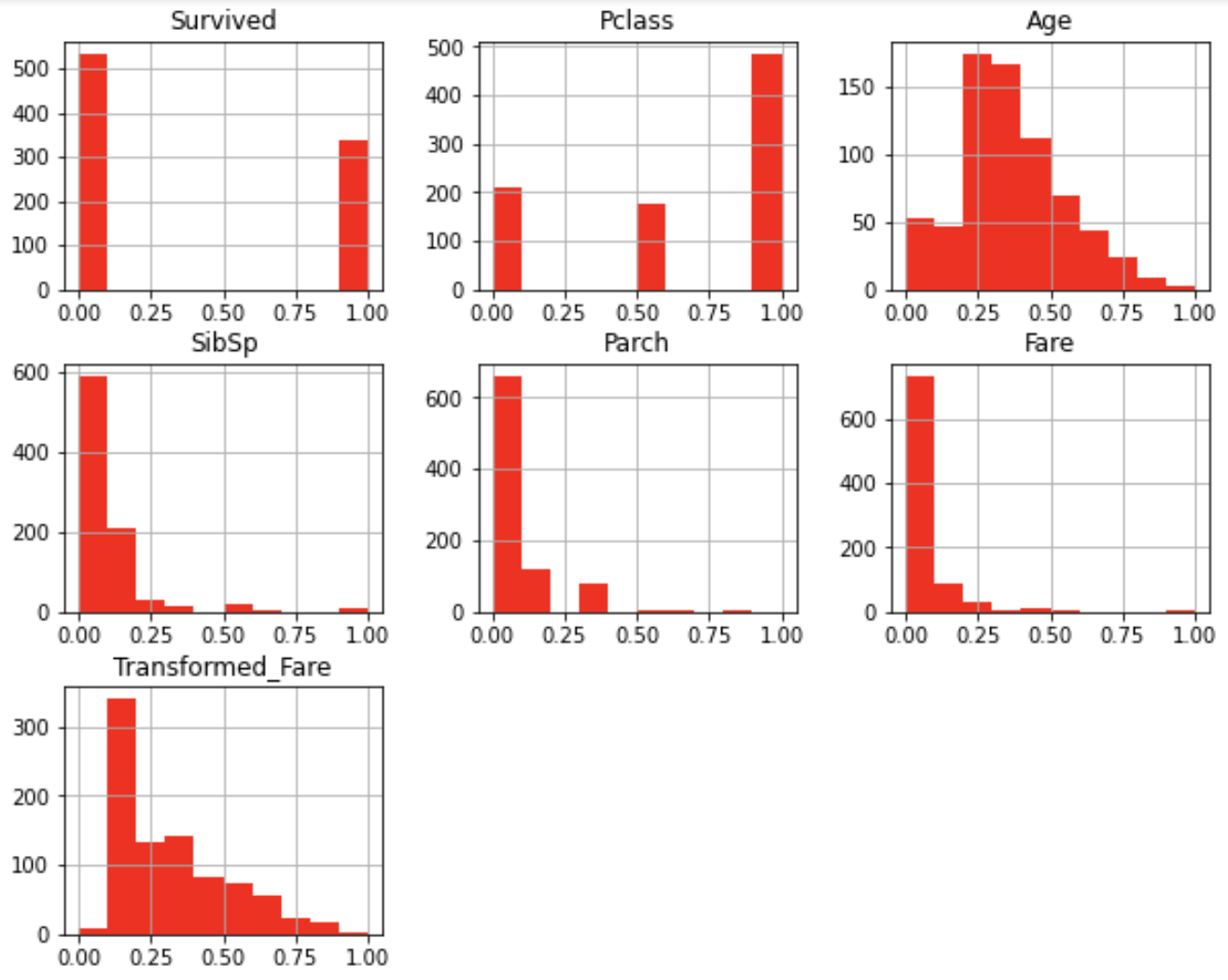
Scaling result
Standard scaling
Min-Max scaling
Original
Notes:
We use histogram to show the data distributions before and after the scaling. We can see that scaling doesn’t change the distribution.

Slide 25
Binning

Slide 26
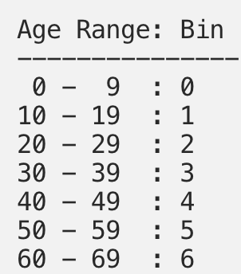
Convert to discrete values
Derived features to better serve the machine learning models
Transform numerical values to discrete values
Binarization
Price of a car → luxury: 1 or economy: 0
Rating → like: 1 or dislike: 0
Binning: each bin defines a range
Time → morning: 0, afternoon: 1, evening: 2
Age → child: 0, adult: 1, senior: 2 or
Notes:
We can discretize continuous values to discrete ones if that can better serve the machine learning models. For example, instead of considering the actual ages, we may be more interested in which age group a person is (e.g., child, teen, adult, senior).
Binarization is to generate two possible discrete values.
Binning is to generate any number of discrete values. Each value corresponds to a bin and each bin defines a range.

Slide 27
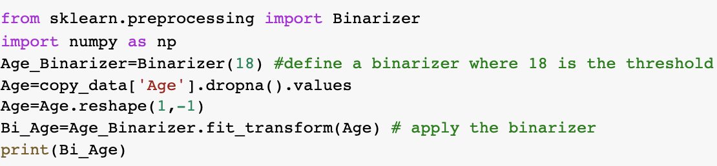
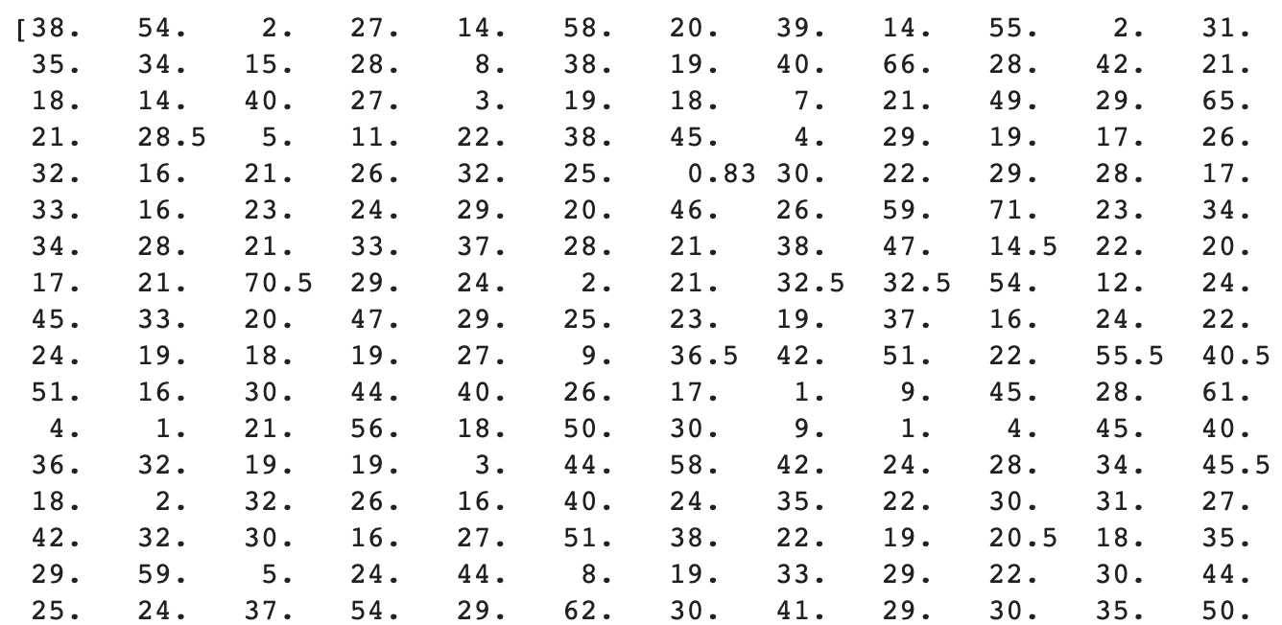
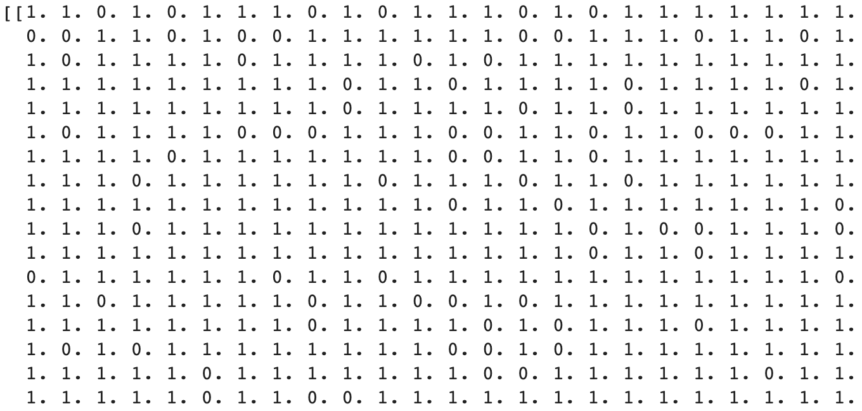
Binarization
Convert values to 0 or 1, depending on a threshold
Use scikit-learn.preprocessing.Binarizer
Notes:
Binarization converts values to 0 or 1. A threshold is needed to determine where the values are split.

Slide 28
Binning
or k-bins, k is the number of bins
Strategies:
Manual
Uniform
Quantile
Clustered

Slide 29
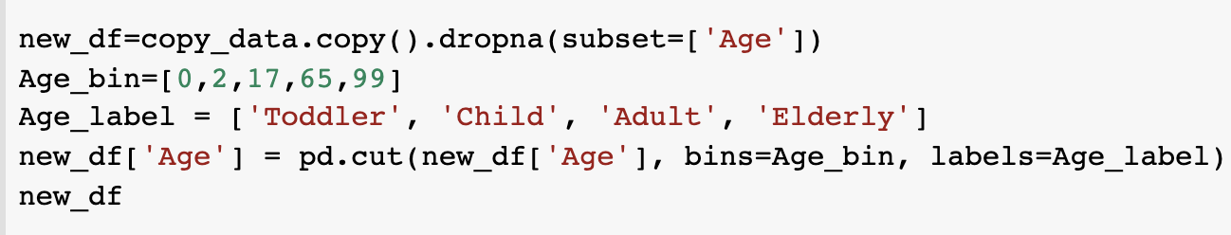
Manual Binning
pandas.cut(x, bins, labels) https://pandas.pydata.org/docs/reference/api/pandas.cut.html
Notes:
Manual binning is to manually specify the ranges of bins. In this example, the ranges of bins are defined as (0,2] (mapped to Toddler), (2,17] (mapped to Child), …

Slide 30
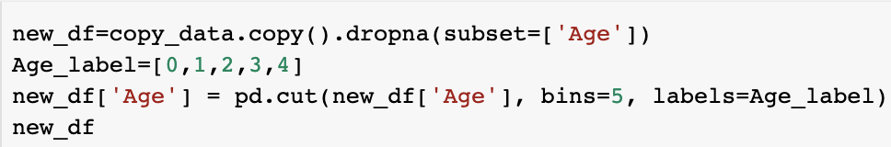
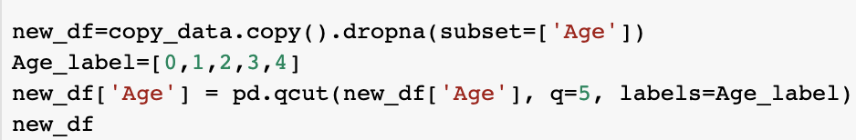
Uniform vs Quantile Binning
Uniform Binning
Fixed-width: each bin contains a specific numeric range
Use pandas.cut()
Quantile Binning
Fixed number of values: split based on percentiles
Use pandas.qcut()
Bin Age Range Count
0 (0.34, 16.336] 99
1 (16.336, 32.252] 342
2 (32.252, 48.168] 182
3 (48.168，64.084] 68
4 (64.084, 80.0] 11
Bin Age Range Count
0 (0.419, 19.0] 162
1 (19.0, 25] 141
2 (25.0, 31.0] 138
3 (31.0-41.8] 135
4 (41.8, 80.0] 126
Notes:
Uniform binning method is to generate bins so each bin has the same or similar range. Use pandas.cut() method, specify the total number of bins and the corresponding labels/values.
Quantile binning method is to generate bins so each bin has the same or similar number of data records.
Use pandas.qcut() method, specifying the number of bins and the corresponding labels/values.

Slide 31
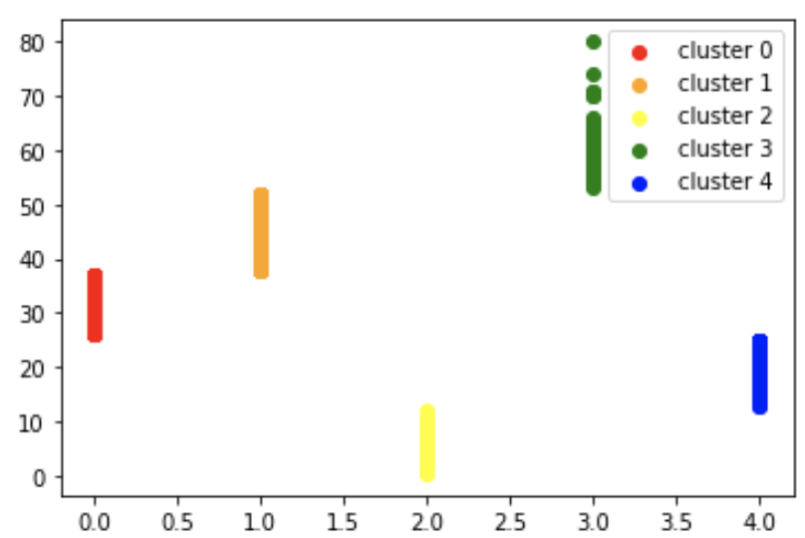
Clustered Binning
Use 1-D K-means clustering algorithm to learn optimal binning
K-means is a distance grouping algorithm (covered later in the course)
Generates K groups, each one corresponds to a bin
Bin Age Range Count
0 [26.0, 37.0] 133
1 [38, 52] 133
2 [0.42, 12] 68
3 [53，80] 51
4 [13, 25] 229
Notes:
K-means based clustered binning is to generate K bins based on the distance between values. K-means algorithm is used to learn the optimal binning result.

Slide 32
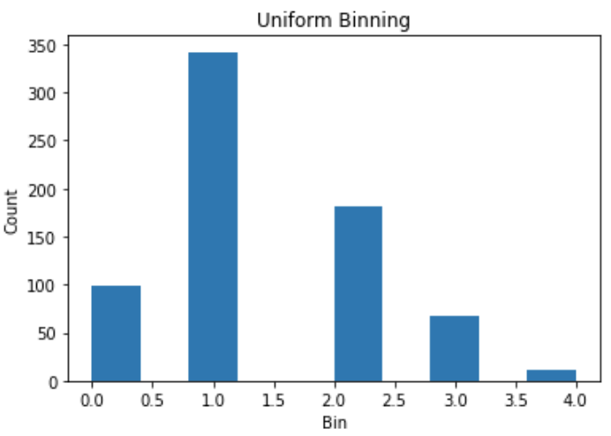
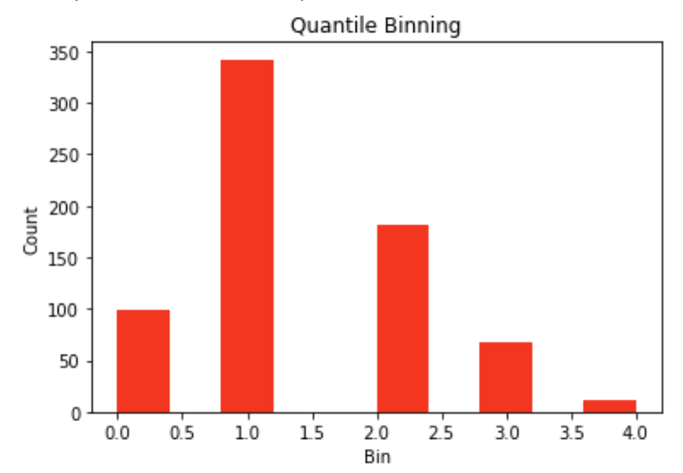
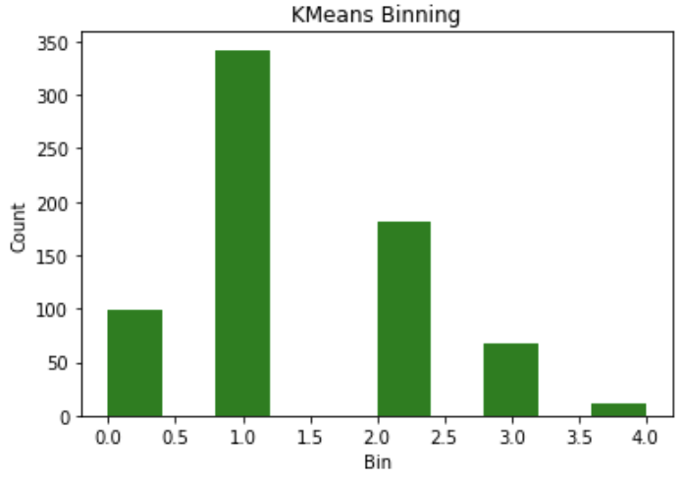
Scikit-Learn library
Sklearn.preprocessing.KBinsDiscretizer(n_bins, encode, strategy )
n_bins: the number of bins, e.g., n_bins=5
encode: method used to encode the transformed result. e.g., encode=‘ordinal’
strategy: uniform, quantile, kmeans, e.g., strategy=‘uniform’
Notes:
Scikit-learn supports the three binning strategies.
https://scikit-learn.org/stable/modules/generated/sklearn.preprocessing.KBinsDiscretizer.html
In the method, we can specify the number of bins, the encode method (e.g., ‘onehot’ and ‘onehot-dense’ for nominal and ‘ordinal’ for ordinal values), and the binning strategy (i.e., ‘uniform’, ‘quantitle’, ‘kmeans’).

