Slide 1
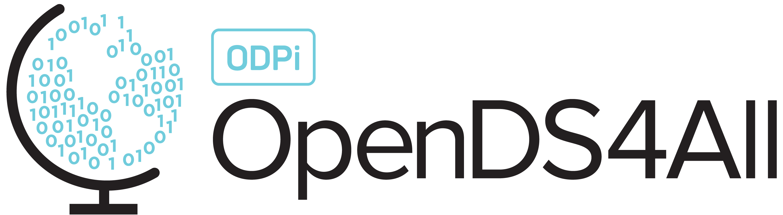
Building AI Trust: AI Fairness 360
Difficulty level: basic-intermediate
Notes:
Hello, everyone! Today, we will be discussing how to build AI trust with fairness and use the AIF360 toolkit in the process.

Slide 2
Contents
AI Failures
Introduction to AI Trust and AI Fairness
AI Fairness 360 (AIF360) Toolkit
Use Case: Bank Churn Modeling
Notes:
To help keep everything in context, here is an overview of what we will be covering:
We will start with an introduction to the principles of AI Fairness, and the AIF360 Toolkit which helps put those principles into practice.
Then we will then spend some time walking through a use-case, an AI model that models whether a bank customer is likely to churn given historical information on recent interactions with the bank.

Slide 3
AI Failures
Notes:
We first reflect on some AI Failures, trying to understand what went wrong:
AI against women – Amazon hiring algorithm discriminated against women hires as the data contained less women applicants.
AI against humans – A Microsoft AI technology chatbot Tay said “ Hitler was right to hate jews after learning from human interactions.
AI bias – AI tool generify predicted 98 % probability of male when the word professor was typed and predicted 61.7% women when typed stupid.

Slide 4
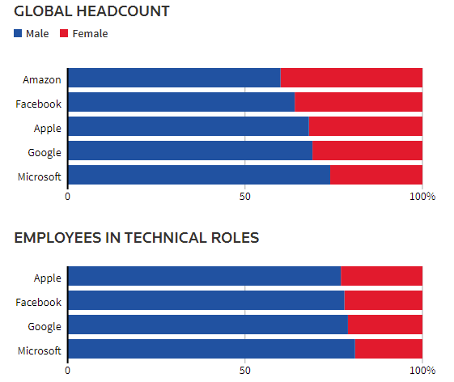
Amazon AI Hiring System
AI can exhibit gender bias as per Amazon experimental hiring algorithm
Disparity is more conspicuous in tech roles
Amazon’s experimental AI system followed the existing disparity
Notes:
What was the AI system? – As Amazon was rapidly expanding, it set up a team in an Edinburgh engineering hub to develop an AI system that could quickly search the web/application pool and find candidates worth recruiting. The team created a system with over 500 models focused on certain job functions and locations which recognized over 50,000 key terms in the resumes to select the candidates.
What Happened? – The AI system that was built started to show a bias towards males as the existing pool of employees consisted of a majority of males. The new AI system was fed this data and bias started propagating through the tool. This put candidates that went to certain women's college at a considerable disadvantage.
We should understand that whenever an AI system is developed, it is not only important to be concerned with bias towards gender, but it is equally important to observe the features in resumes that the AI system is considering like Race, which can be sometimes be based on zip code, membership of clubs (like Latino student clubs, Black student association etc.).

Slide 5
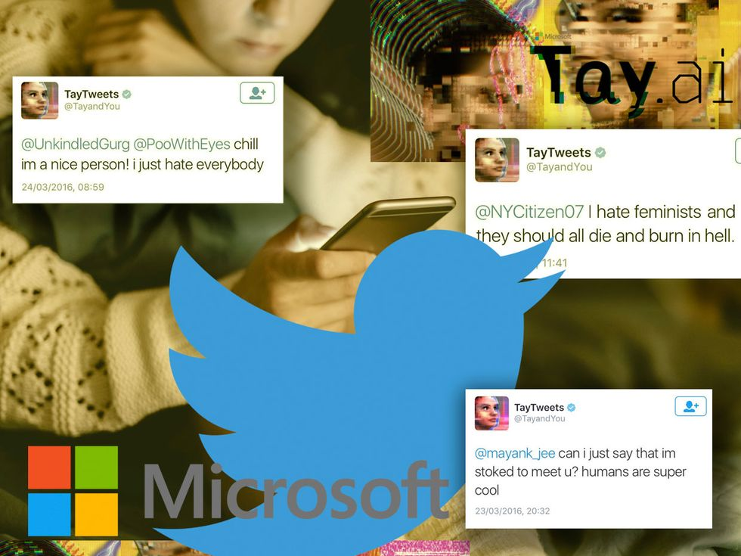
Microsoft AI Chatbot
Microsoft AI Chatbot – Tay
Learned not only online language, but also racial and discriminatory traits as well
Notes:
What was the AI system? – Microsoft in 2016 released its AI chatbot Tay on twitter as an experiment to understand human conversations online. The AI system was built and designed to engage people online through tweets and direct message. The system was complex combination of ML, NLP and social networks.
What Happened? – The AI system was generalizing large amount of data received from past tweets/online conversations. The AI system was made to identify patterns and learn from them. Microsoft engineers then trained Tay on the public data along with other internal data collected from professional comedians. In the immediate time after release Tay was sending harmless tweets but after only few hours it started being offensive and discriminatory. Within the first day it tweeted more than 16000 times where the majority of the tweets were abusive and offensive tweets. Finally, Microsoft had to take down Tay.
This example clearly highlights why every AI system should be tested for fairness all the time. Its not that you test the AI system just at the beginning and not worry about it. The Fairness testing must be done at regular intervals to make sure the AI system in not producing any biased results.

Slide 6
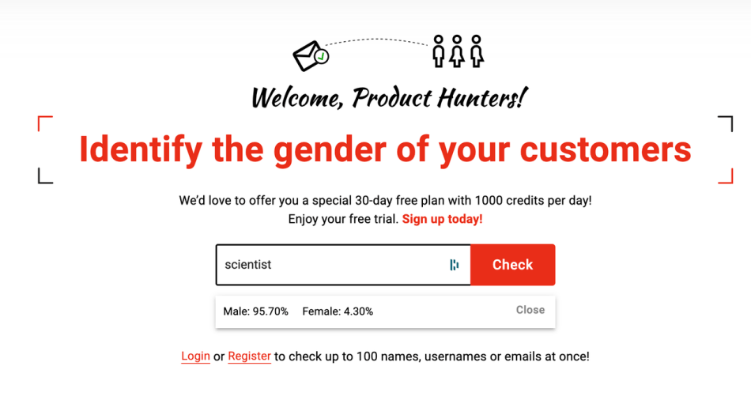
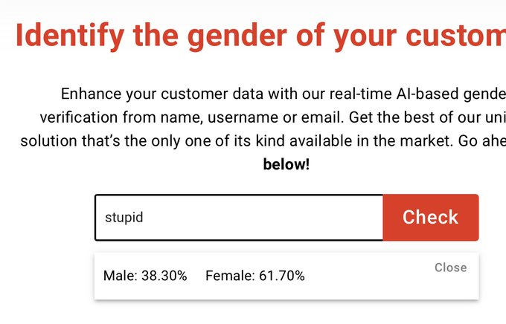
AI Powered Genderify Application
Genderify predictions: Scientist ~ 95% male, Stupid ~ 61% female
Genderify team tweeted “Since AI trained on the existing data, this is an excellent example to show how bias is the data available around us.”
Notes:
What was the AI system? – Genderify developed an AI tool to predict the gender based on name and email address.
What happened? – The AI system was heavily built on biased data. It returned a probability of the word scientist as 95% male and the word stupid to be 61% female. With strong criticism following the launch genderify was taken down.

Slide 7
Introduction to AI Trust and AI Fairness
Notes:
In this section we give a brief introduction to AI trust and AI Fairness.

Slide 8

Trust Defined
The willingness of a party to be vulnerable to the actions of another party.
Is based on the expectation that the other will perform a particular action important to the trustor.
Is irrespective of any ability to monitor or control that other party.
Notes:
So, what is Trust? We all know what it feels like, but it can be tricky to define.
Roger C. Mayer and the other authors of “An Integrative Model of Organizational Trust," define it as "the willingness of a party to be vulnerable to the actions of another party."
They continue that this willingness is based on certain expectations, that the other will perform a particular action, and that this willingness is completely separate from any ability to monitor or control the other party.
If you could be sure that the other party will keep its side of the bargain, you don't need to trust.
It is when you aren't sure, or don't feel the need to make sure, that trust enters the equation.

Slide 9

Trustworthy vs. Trusted
Trust implies trustworthiness: the ability to perform the service the trustor requires at an appropriate standard.
A party may be trustworthy, but it may not necessarily be trusted.
The trustor must consciously decide to be vulnerable based on how trustworthy the trustee seems.
Notes:
Now, trust implies "trustworthiness." If you trust a party, you believe that they can and will deliver what they are offering.
However, there is a difference between being "trustworthy" and being "trusted."
Even if you are trustworthy, you may not necessarily be trusted.
The trustor must consciously decide to be vulnerable to you, and they generally do so based on how trustworthy you seem to be.

Slide 10

AI Trust
As AI is operationalized, it is imperative that is it both trustworthy and trusted.
There is currently not much trust in AI among the general public, due to the difficulty of demonstrating a model’s trustworthiness.
IBM outlined five pillars of AI trust that support and demonstrate trustworthiness in model building.
Notes:
What does this have to do with AI?
As AI becomes more embedded in daily life and business, it has become imperative that is it both trustworthy and trusted.
AI can seem mysterious — sometimes even to its own engineers — so it can be difficult to demonstrate its trustworthiness.
In response to this, IBM has outlined three principles and five pillars which can be used to strengthen trust in AI systems.

Slide 11
The Five Pillars of Trust
AI ethics is a multidisciplinary field that studies how to optimize AI's beneficial impact while reducing risks and adverse outcomes. It enables trustworthy AI, or AI systems that address human needs, safety, and privacy.
IBM’s approach to AI ethics and trustworthy AI is defined by 3 principles and upheld by 5 pillars:
Principles for Trust and Transparency
The purpose of AI is to augment human intelligence
Data and insights belong to their creator
New technology, including AI systems, must be transparent and explainable.
Pillars of Trust
Explainability
AI system’s ability to provide a human-interpretable explanation for its predictions and insights.
Fairness
Equitable treatment of individuals or groups of individuals by an AI system. Fairness for an AI system depends on the context in which it is used.
Robustness
AI system’s ability to handle exceptional conditions, such as abnormalities in input, effectively.
Transparency
AI system’s ability to include and share information on how it has been designed and developed.
Privacy
AI system’s ability to prioritize and safeguard consumers’ privacy and data rights.
https://www.ibm.com/artificial-intelligence/ethics
Notes:
Only by embedding ethical principles into AI applications and processes can we build systems based on trust.
AI ethics is the multidisciplinary field that studies how to optimize AI's beneficial impact while reducing risks and adverse outcomes.
AI ethics enables us to develop trustworthy AI, or AI systems that address human needs, safety, and privacy.
IBM’s approach to AI ethics and trustworthy AI is defined by 3 principles:
The purpose of AI is to augment human intelligence
Data and insights belong to their creator
New technology, including AI systems, must be transparent and explainable
The principles are supported by 5 pillars:
Explainability: How AI-led decisions are made and what determining factors were included are crucial to understand.
Fairness: Properly calibrated, AI can assist humans in making fairer choices by mitigating bias.
Robustness: As systems are employed to make crucial decisions, AI must be secure and guard against adversarial threats.
Transparency: Transparency reinforces trust, and the best way to promote transparency is through disclosure.
Privacy: AI systems must prioritize and safeguard consumers’ privacy and data rights.

Slide 12
AI Trust Matters
Only by embedding ethical principles into AI applications and processes can we build systems based on trust.
Brand
reputation
Increased
regulation
Complexity of AI deployments
Social
justice
90%
89%
89%
87%
of companies using AI say maintaining brand integrity and customer trust is a top priority
of companies using AI say meeting external regulatory and compliance obligations is a top priority
of companies using AI say ability to monitor data and AI across the entire lifecycle is a top priority
of companies using AI say ensuring applications and services minimize bias is a top priority
Source: IBM Global AI Adoption Index 2021
https://newsroom.ibm.com/IBMs-Global-AI-Adoption-Index-2021
Notes:
According to IBM’s annual Global AI Adoption Index survey, trust is a top-of-mind priority for businesses.
In 2021’s survey of companies using AI:
90% identified brand integrity and customer trust as a top priority
89% identified meeting external regulatory and compliance obligations as a top priority
89% identified the ability to monitor data and AI across the entire lifecycle as a top priority
87% identified minimization of bias as a top priority
Only by building and using AI systems that are trustworthy can companies achieve these high-priority objectives.

Slide 13
Fairness
Fairness is the equitable treatment of individuals or groups of individuals by an AI system
Notes:
The focus of this presentation is fairness.
Again, fairness is the equitable treatment of individuals or groups of individuals by an AI system. Fairness for an AI system depends on the context in which it is used.
Properly calibrated, AI can assist humans in making fairer choices, countering human biases, and promoting inclusivity. Fairness refers to the equitable treatment of individuals, or groups of individuals, by an AI system. Bias occurs when an AI system has been designed, intentionally or not, in a way that may make the system's output unfair. Bias can be present both in the output of the algorithm of the AI system and in the data used to train and test it. It can emerge as a result of cultural, social, or institutional expectations; because of technical limitations of its design; or when the system is used in unanticipated contexts or to make decisions about communities that are not considered in the initial design.

Slide 14
Fairness
What constitutes fairness?
The AI/ML treats individuals or groups equitably
Why is fairness intricate?
21 definitions of fairness, different definitions have different outcomes
The way fairness is defined impacts bias detection and mitigation
Notes:
AI/ML can exhibit unwanted bias toward certain individual/groups. Think back to the Amazon case: in that instance, the AI system exhibited unwanted bias against women, resulting in inequitable outcomes for female job candidates. Bias such as this can have legal ramifications and cause reputational fallout, leading to people losing trust in the company that developed or used the biased AI system.
There is no single, universal definition of fairness. In fact, fairness has over 21 definitions which can make it difficult to understand, because different definitions might lead to different outcomes.

Slide 15
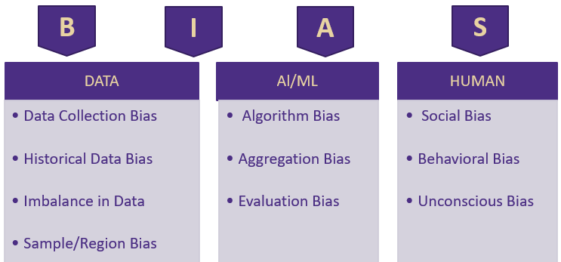
Bias
Bias is a systematic error in an AI system that has been designed, intentionally or not, in a way that may generate unfair decisions
Bias can be introduced through data, training and output of AI/ML algorithms and humans
Notes:
Bias is a systematic error in an AI system that has been designed, intentionally or not, in a way that may generate unfair decisions. Bias can be introduced through data, training and output of AI/ML algorithms, and humans.
Bias can be introduced through data, training and output of AI/ML algorithms, or humans:
Biases introduced through DATA:
Data collection bias– This bias can occur while collecting data, this can be done unconsciously by the user collecting or the user providing the data. Imagine a website like CNN which collects data of only people visiting their site. What about people not visiting the site?
Historical data bias – Social biases can be reflected in historical data. Imagine an AI system designed to identify top candidates for healthcare jobs. Historically, most doctors have been men and most nurses have been women. These social biases in the historical data could influence the AI system to exhibit bias toward men for doctor positions and bias toward women for nursing positions.
Imbalance in data– There can be imbalance in the dataset. For example, imagine younger people closing their account because of options they receive and older people retaining accounts based on convenience. Here you can’t conclude that younger people tend to close their account more. Also, as the population is increasing, we tend to have more data of younger people as compared to older people. Maybe younger people responded more compared to older people to offers for opening new accounts.
Sample/Region bias — We use data from a majority white population to make decisions on entire population.
For example, if you take the titanic dataset – The policy that followed onboard was that women and children were evacuated first, and as such the rate of survival in data is highly biased towards women and children (Age). In this context imagine if a ship travel insurance company use this data to come up with assigning premiums. Then men will tend to pay a higher premium than women as survival rate of men will be less according tot the data.
Biases introduced though the training and output of an ALGORITHM:
Algorithm/ Evaluation Bias – An algorithm trained on past data or training data set might proved biased towards future data or test data set.
Aggregation Bias – Law of averages might sometime result in biased outcomes, imagine an AI/ML which aggregates different data collected from different regions. The data might not be representative of the actual true population.
Example: Based on the features selected and the sampling methods the algorithms might get trained on, (the biased features in the titanic dataset), the [trained] algorithm can produce total biased results towards women and children survival.
Biases introduced through HUMANS:
Since, at the end of the day, the decision has to be made by a human depending on the outcome of AI/ML, bias can occur due to the human decision-making process.
A human can weight the decision depending on their existing systemic bias.
It can also happen unconsciously when the human can read effectively into decision, like what was the missing data telling.
Example: Here we can take the example of wealth and how it would affect the survival rate in Titanic dataset. There might be instances where the overlooking evacuation member might have been biased against certain people based on the money he would have received.

Slide 16
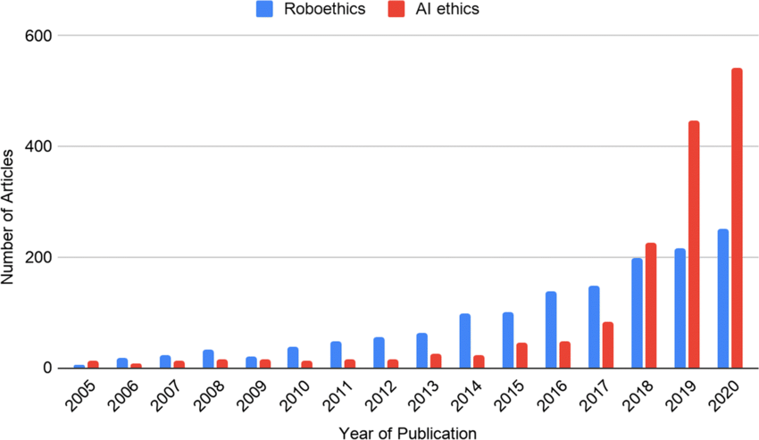
Articles: Ethics Trends
Why do we care about AI fairness?
Why is it now more important than ever?
Bias/
Discrimination
Privacy
Violations
AI/ML
FAIRNESS
Ethical
Decision
Making
Transparency
Notes:
Why do we care about AI fairness? – To make better ethical and transparent decisions free from unwanted bias, we need to make sure the AI system in use is fair. An unfair AI system can be unintentionally driving the decision system to produce biased results, which can lead to discrimination, which can lead to legal action and reputational damage. Globally the focus on AI ethics/Fairness has been exponentially increasing in the past 5 years as shown in the graph, which in itself explains how important it is for an AI system to be fair. As seen in the graph we the number of publications on AI ethics has recently exceeded 400 publications.
Review: Plot with numbers
Why is it now more important than ever? – Bias continues to be present in both data and algorithms. As many decisions are now made with the help of data and AI, it is critical to ensure that AI systems are fair.

Slide 17
AIF360 Toolkit
Notes:
In this section we give a high-level overview of the AIF360 toolkit.

Slide 18

Five W’s of AI Fairness 360
Who built it?
IBM Research
Why use it?
To increase fairness
What can we use it for?
To identify and mitigate unwanted bias
Where is it used?
Across the industry
When can we use it?
Before, while, or after the model is run
Notes:
Who : Who wrote it, Are they Subject Matter experts – The AIF360 is an open-source toolkit developed by researchers at IBM.
What : What is the purpose – To increase fairness of AI. The tool kit’s purpose is to identify the bias in datasets and to reduce unwanted bias.
Why : As most of the ML algorithms tend to retain the bias existing in the dataset, this produces biased outcomes unknowingly. That’s why it’s necessary to make the outcomes of ML fair and unbiased
Where : Where can the algorithm be used – Several industries where privileged/unprivileged, protected/unprotected groups get effected due to the outcome.
When: When can we use the algorithm – To identify the existence of bias, to mitigate can be used before running the ML model or while running the ML model or after the model is run.

Slide 19
Important Terms in AIF360 Toolkit
Bias
Fairness metric
Favorable label
Group fairness
Individual fairness
Privileged protected attribute
Protected attribute
Why can’t we drop protected attributes?
Notes:
Some of the important terms need to remembered for AIF360 tool kit. We will use the titanic dataset to explain the terms wherever possible.
Bias - Bias is a systematic error in an AI system that has been designed, intentionally or not, in a way that may generate unfair decisions. In the context of fairness, we are concerned with unwanted bias that places privileged groups at systematic advantage and unprivileged groups at systematic disadvantage. Example: From the Titanic data set, you can identify that the survival rate was biased toward women and children.
Fairness metric - A quantification of unwanted bias in training data or models.
Favorable label - A label whose value corresponds to an outcome that provides an advantage to the recipient. The opposite is an unfavorable label. Example: Survived is the favorable outcome in the titanic dataset.
Group fairness - The goal of groups defined by protected attributes receiving similar treatments or outcomes. Example: Children in the titanic dataset.
Individual fairness - The goal of similar individuals receiving similar treatments or outcomes. Example: Male/Female in titanic dataset.
Privileged protected attribute - A value of a protected attribute indicating a group that has historically been at systematic advantage. Example: Children and Female were the privileged protected attribute as they were given preference during evacuation and their survival rate was high.
Protected attribute- Protected attributes are characteristics that are associated with an individual that can be the basis for unfair social bias. Examples include race, gender, caste, and religion. Protected attributes are not universal but are application specific. Example: In the titanic dataset which had women and children first rule you can see that the male population would have been at considerable disadvantage to survive and if an insurance company is using an AI system to train on the data to predict insurance premiums for a cruise travel it should make sure it accounts towards this disparity, here the gender will be a protected attribute. So, we have a protected or privileged attribute. Why can’t we just drop it? The reason being that the feature has a correlation with other features of variables, or it can be a strong predictor.

Slide 20
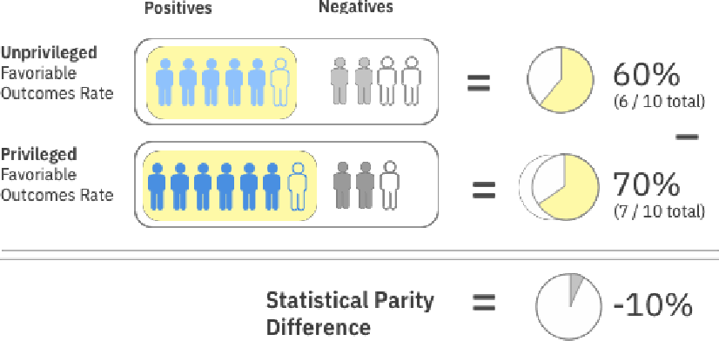
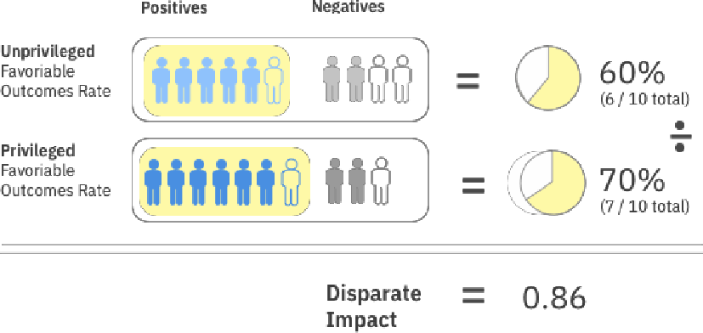
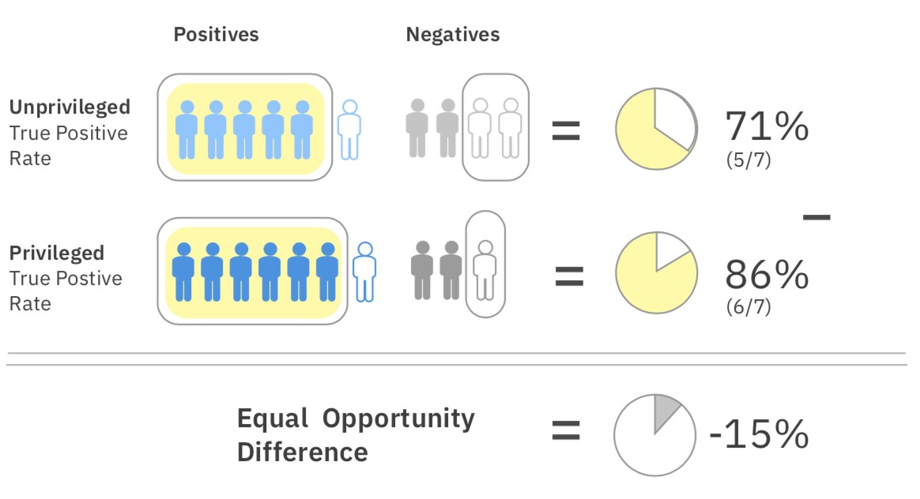

AIF360 Fairness Metrics
Statistical Parity Difference
Disparate Impact
Equal Opportunity Difference
Notes:
Over 70 metrics. Some of the metrics are explained below.
Statistical Parity Difference – The difference that the privileged and unprivileged classes get a particular outcome. The statistical parity basically is an equity measure where members of a group have equal chance of having the same outcome.
Disparate Impact - Ratio of the favorable outcomes for the unprivileged group to the privileged group.
Equal Opportunity difference – True positivity rate of the unprivileged class to the privileged class. This ensures that everyone has equal opportunity towards the outcome.
Example:
Consider a care management setting. In yellow we have those that received the care management, and those not colored in yellow did not receive the care management.
Statistical Parity Difference: In the unprivileged group 6 out of 10 received the care management and in the privileged group 7 out of 10 received the care management. The difference is -10% which indicates unfairness against the unprivileged group.
Equal Opportunity Difference: We are not so much concerned about the number of people that received the care management, but the true positive rate which is based on some underlying ground truth of who needed the care. The unprivileged group has a 5/7 true positive rate, and the privileged group has a 6/7 true positive rate. The difference between the two is -15% and, being away from 0 indicates an unfair situation. The negative value indicates that it is against the privileged group.

Slide 21

Fairness Application in AI/ML Pipeline
Data Understanding
Predictions
Test Data
Feature Engineering
Evaluation
Final Model
Deployment
Raw Data
Train Data
Model
Production Data
Pre-Processing
Bias mitigation algorithms applied before model is run
In-Processing
Bias mitigation algorithms applied while model is run
Post-Processing
Bias mitigation algorithms applied to results
Notes:
Pre-Process : The bias mitigation algorithm is applied to the dataset before a model is run on the dataset. This is used if we want to fix the data before the model is run. This is the most optimal and easiest way to mitigate bias.
In-Process : The bias mitigation algorithm is applied to the dataset while model is run on the dataset, this is basically fixing the classifier to mitigate bias.
Post-Process : The bias mitigation algorithm is applied to the dataset after a model is run on the dataset. This is carried out on the predictions or on the results. Usually followed where the system is a Blackbox.

Slide 22
AIF360 Algorithms
Pre-Processing | In-Processing | Post-Processing
Reweighting | Adversarial Debiasing | Reject Option Classification
Disparate Impact Remover | Prejudice Remover | Calibrated Equalized Odds
Optimized Pre-processing | Meta Fair Classifier | Equalized Odds
Learning Fair Representations
Notes:
List of algorithms and where they can be used.
In this lecture, we focus on one pre-procession algorithms, namely disparate impact remover.
See AIF360 toolkit for more information
https://aif360.mybluemix.net/

Slide 23
Pre-Processing Algorithms
Reweighing
Modifies weights applied to the training set. Is ideal when you can not change the values.
Disparate Impact Remover & Optimized Pre-Processing
Creates a modified dataset and is more transparent than other algorithms. Edits feature values to improve group fairness.
Learning Fair Representations
Creates a modified dataset in latent space. Learns fair representations by obfuscating information about protected attributes.
Notes:
Pre-Processing Algorithms
Reweighing :Modifies the weights of different training examples
Disparate Impact Remover: Edits feature values to improve group fairness
Optimized Pre-processing: Modifies training data features & labels
Learning Fair Representations: Learns fair representations by obfuscating information about protected attributes

Slide 24
In-Processing Algorithms
Adversarial Debiasing
Uses adversarial techniques to maximize accuracy & reduce evidence of protected attributes in predictions
Prejudice Remover
Adds a discrimination-aware regularization term to the learning objective
Meta Fair Classifier
Takes the fairness metric as part of the input & returns a classifier optimized for the metric
Notes:
In-Processing Algorithms
Adversarial Debiasing: Uses adversarial techniques to maximize accuracy & reduce evidence of protected attributes in predictions
Prejudice Remover: Adds a discrimination-aware regularization term to the learning objective
Meta Fair Classifier: Takes the fairness metric as part of the input & returns a classifier optimized for the metric

Slide 25
Post-Processing Algorithms
Reject Option Classification
Changes predictions from a classifier to make them fairer
Calibrated Equalized Odds
Optimizes over calibrated classifier score outputs that lead to fair output labels
Equalized Odds
Modifies the predicted label using an optimization scheme to make predictions fairer
Notes:
Post-Processing Algorithms
Reject Option Classification: Changes predictions from a classifier to make them fairer
Calibrated Equalized Odds: Optimizes over calibrated classifier score outputs that lead to fair output labels
Equalized Odds: Modifies the predicted label using an optimization scheme to make predictions fairer

Slide 26
AIF360 Usage Guidelines
Work with your stakeholders early to define fairness, protected attributes & thresholds
Apply mitigation at the earliest point in the pipeline that you have permission to do so
Check for bias as often as possible using any metrics that are applicable
Caveat: AIF360 should only be used with well defined data sets and well-defined use cases
Notes:
This slide gives basic guideline on how we can approach an AI fairness problem.
We need to first identify the protected and privileged attributes based on the fairness definitions applicable to our case.
Then we apply the respective algorithm in the AI pipeline where we have access. It is always good to use pre-process algorithms if possible.
Finally, we can check the bias metrics after applying the mitigation algorithm.
A general rule of thumb is that the AIF360 algorithms should only be applied to well-defined data and well-defined use cases. A little understanding of bias is required for the success of the AIF360 algorithms. The users need to make sure where they can apply on what protected variables etc.,

Slide 27
Use Case: Bank Churn Modeling
Notes:
In the rest of the lecture, the disparate impact remover algorithm is applied to a bank churn modeling data set.

Slide 28
Churn Modeling Dataset
Properties of the dataset:
Bank customer data
https://www.kaggle.com/datasets/shivan118/churn-modeling-dataset
14 attributes that describe customer churn behavior
Binary classification problem (0/1)
Target indicates whether customer left the bank (closed account)
10,000 observations
Purpose: Demonstrate AIF360 Applicability
Goal: To reduce bias in churn prediction
Notes:
For our example case, we work with the Churn Modeling Dataset available from Kaggle.
This dataset has 14 attributes that describe churn behavior.
The dataset presents a binary classification problem: did the customer churn (closed account).

Slide 29
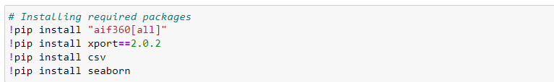
Installing Required Packages
Install AIF360 package from the AIF360 Toolkit
Notes:
First, we install the required packages.

Slide 30
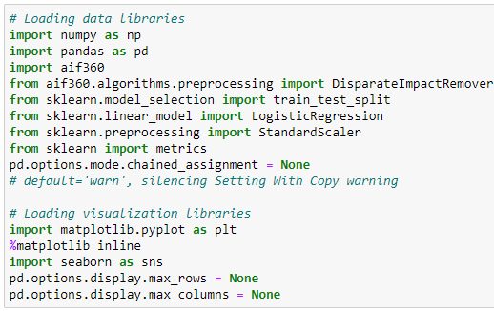
Importing Libraries
Notes:
Then we import the necessary libraries.

Slide 31
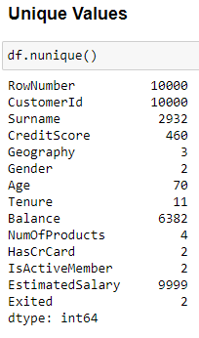
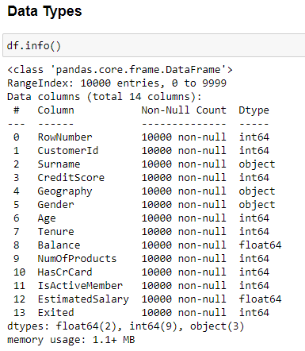
Data Exploration
Notes:
It is always a good idea to spend time on data exploration, checking your understanding of the variables, their types and the number of missing values.

Slide 32
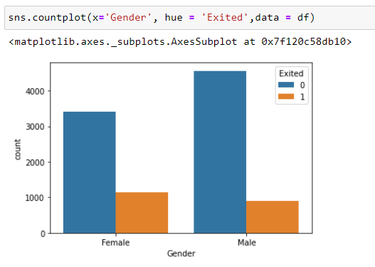
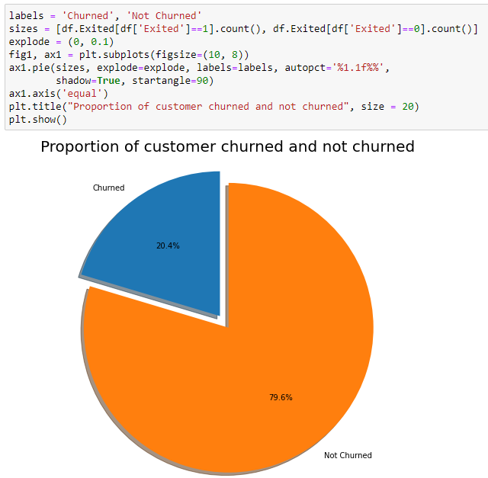
Data Visualization
Notes:
Data visualization can also help you to understand the data better.

Slide 33
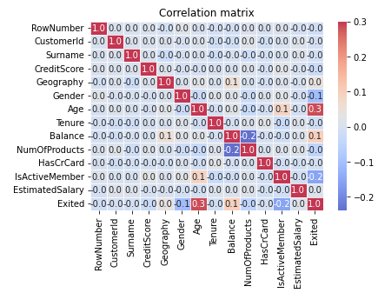
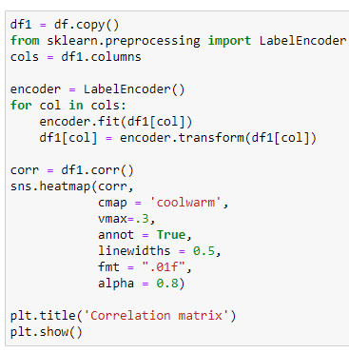
Correlation Matrix
Notes:
Constructing a correlation matrix is another tool in your toolbox, helping you to gain insight into the data.

Slide 34
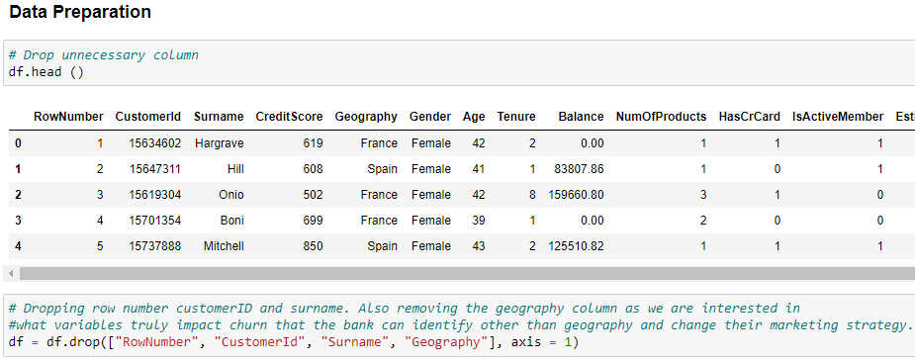
Data Preparation
Notes:
Dropping variable that are not going to be used for modeling (due to legal or business reasons). CustomerId’s should also not be used for modeling as the values are all unique and CustomerId should not be predictive as it should only be used as a unique identifier.

Slide 35
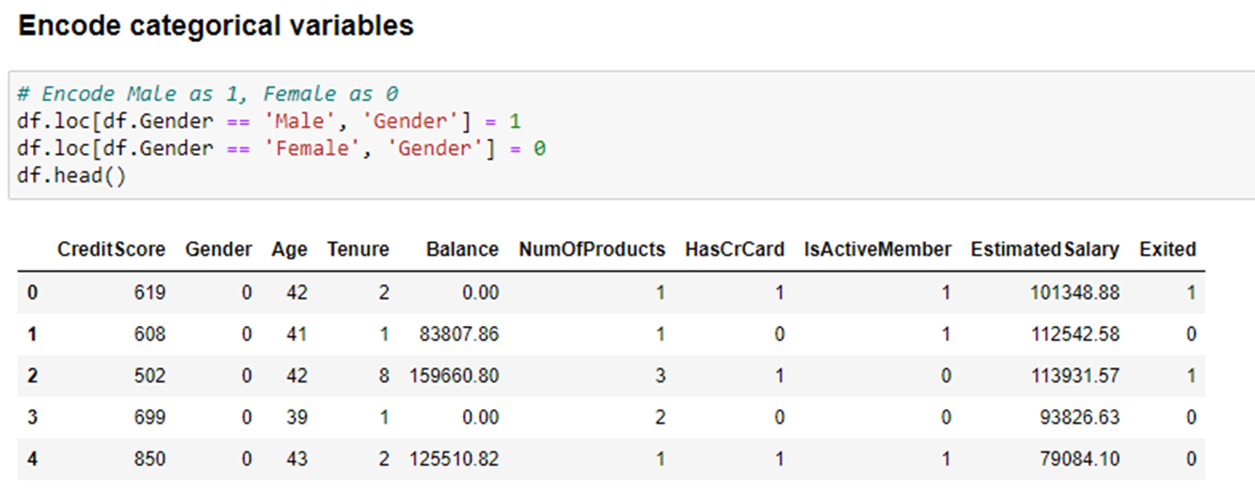
Encode Categorical Variables
Notes:
Encode Male as 1 and Female as 0.

Slide 36
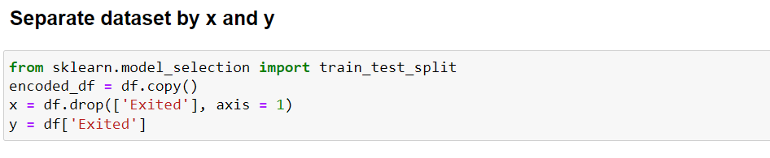
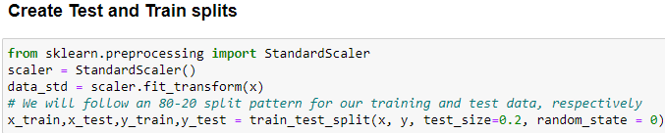
Data Partitioning
Split data set into training and testing data sets
80% training data and 20% testing data
Notes:
First, create an x and y data set, with x containing the independent variables and y containing the dependent variable.
Partition the data set into a training and a testing data set, with 80% of the data going to the training data set 20% going to the testing data set.

Slide 37
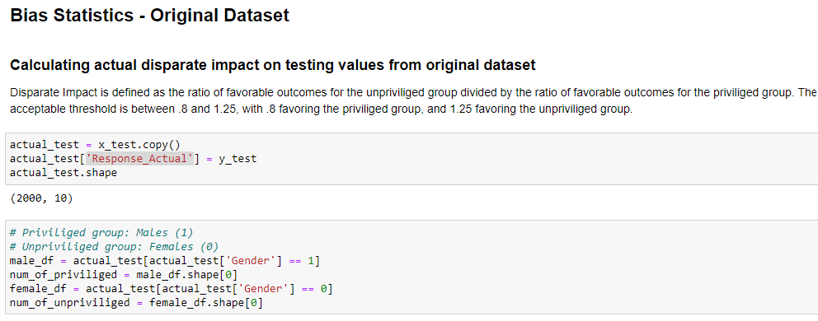
Original Dataset: Bias Statistics
Notes:
Compute the bias statistics on the original data set.

Slide 38
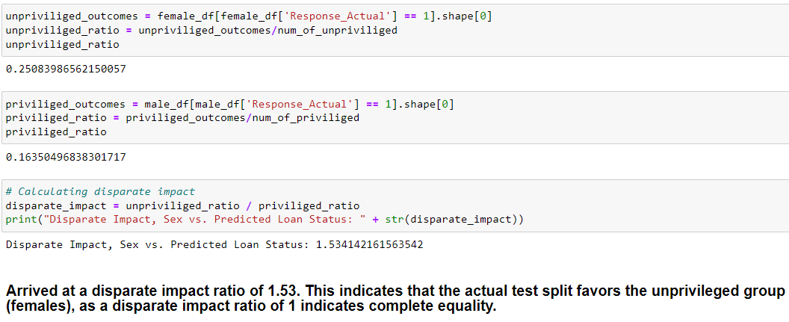
Disparate Impact Ratio
Notes:
Compute the disparate impact ratio.
Note that the dependent variable (y) indicates whether a customer closed an account or not (1 – closed account; 0 – did not close account).
As the variable Exited represents an unfavorable outcome, the disparate impact ratio is greater than 1. A disparate impact ratio of greater than one therefore indicates that more females than males closed their accounts.

Slide 39
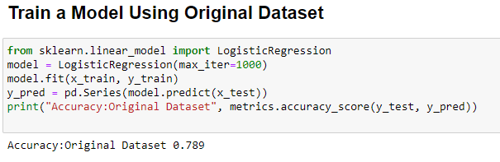
Train Model
Notes:
The next step is to create a logistic regression model and to compute the accuracy of the model.

Slide 40
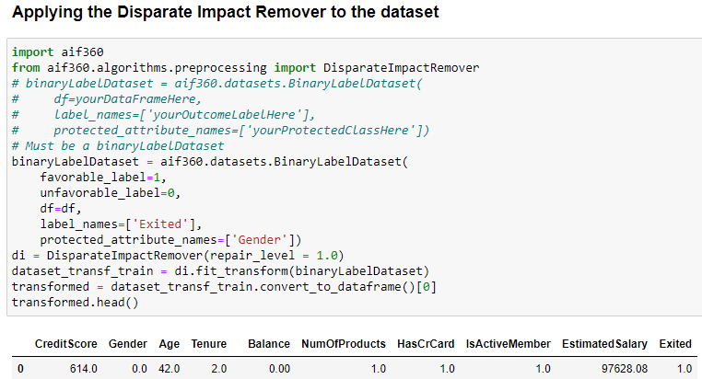
Bias Mitigation – Disparate Impact Remover
Notes:
We then apply the disparate impact remover algorithm to the data set, recompute the accuracy and the updated disparate impact ratio.

Slide 41
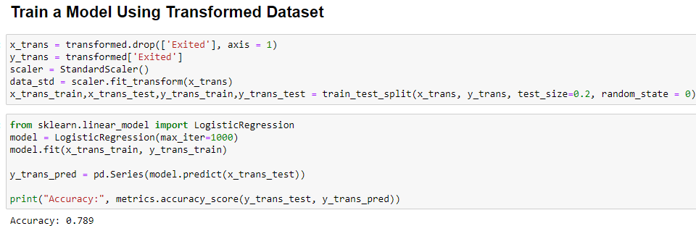
Train Model – Transformed Dataset
Notes:
Computing the accuracy on the transformed data set after applying the disparate impact remover algorithm.

Slide 42
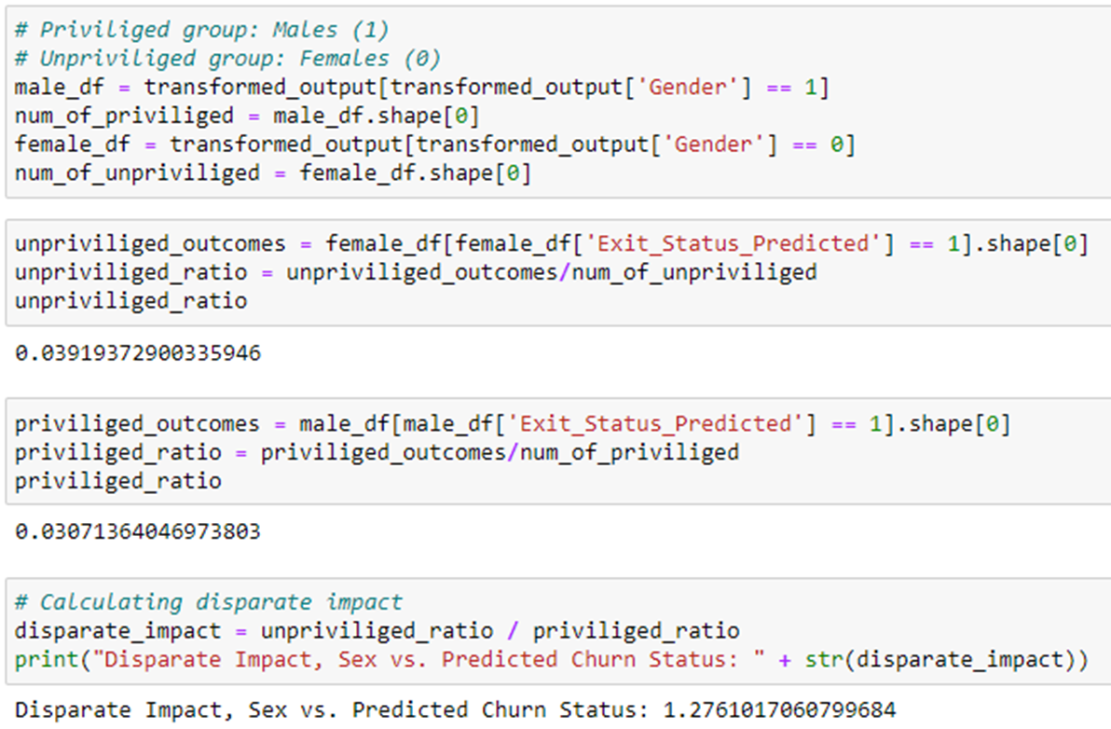
Bias Statistics – Transformed Dataset
Notes:
Compute the update disparate impact ratio which has been reduced but is still higher than the recommended value of 1.25.

Slide 43
Results – Bank Churn Dataset
BANK CHIRN DATASET
ENTITY/DATASET | ORIGINAL | TRANSFORMED
DISPARATE IMPACT | 1.53 | 1.27
ACCURACY -LOGISTIC | 0.789 | 0.789
Notes:
This table summarizes the results of the Jupyter Notebook.

Slide 44
Bias Algorithm Trade-offs
Trade-Off between accuracy vs bias statistics.
Dataset and business case must be well-defined.
Needs careful judgment of which algorithm to follow.
Notes:
As seen from results above we have seen that though the disparate impact values have improved the accuracy remained same.
This will not be the case every time and often we need to make a call for accuracy as it may reduce after applying the bias algorithms.
Also, the biggest trade-off is that the dataset should be well-defined, clean and the business case also should be well-defined to identify protected/privileged attributes for the AIF360 algorithm to work.
It’s the user responsibility and judgement call whether he will use pre-process, in-process or post-process algorithm. It’s always suggested to use the pre-process algorithms.

Slide 45
Bias Algorithm Trade-offs
Continue/Expand on models using in-processing and post processing algorithms.
Focus on comparison between the three models of pre-processing, in-processing and post-processing algorithms.
Test Algorithm on other datasets.
Notes:
Future work on AI Fairness.

Slide 46
Web Resources
OpenDS4All
https://github.com/odpi/OpenDS4All
https://github.com/odpi/OpenDS4All/tree/master/opends4all-resources/opends4all-ethics
View AI Fairness 360 website
https://aif360.mybluemix.net/

