Slide 1
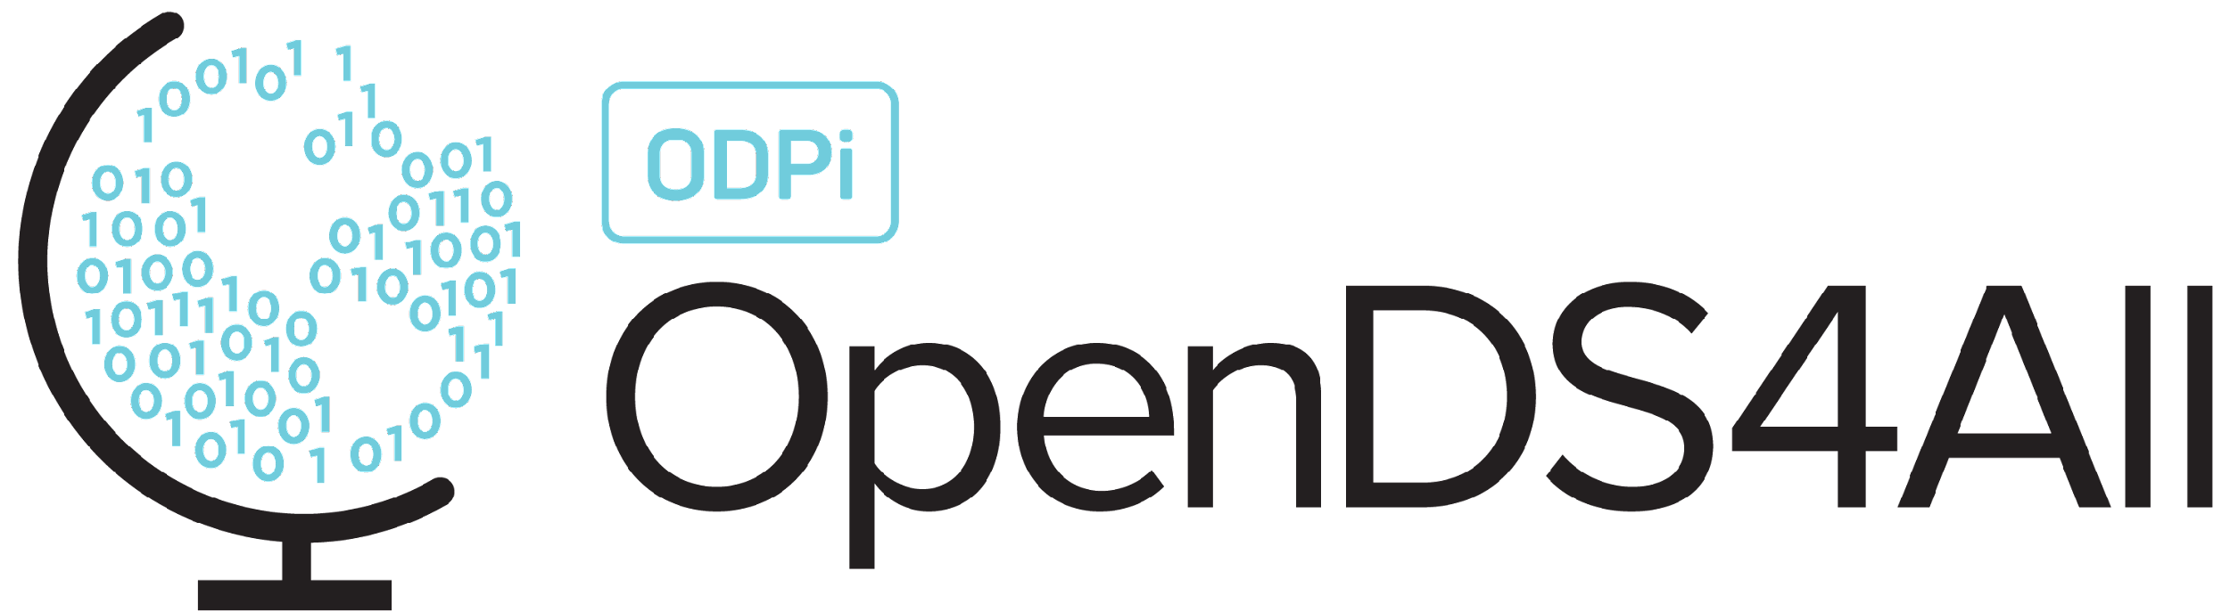
Introduction to Data Classification
This work is supported by the National Science Foundation under Award 2021287
Difficulty level: Introductory
Some contents are borrowed from the slides of Introduction to Data Mining [1]
[1] P.N. Tan, M. Steinbach, A. Karpatne, V. Kumar, Introduction to Data Mining, Second Edition, https://www-users.cse.umn.edu/~kumar001/dmbook/index.php
Notes:
Initial release, Xumin Liu, Rochester Institute of Technology, 2022.
By Xumin Liu https://www.cs.rit.edu/~xl/
Except where otherwise noted, this work is licensed under a Creative Commons Attribution-4.0 International License https://creativecommons.org/licenses/by/4.0/

Slide 2
Contents
Introduction to Data Classification
Decision Tree
KNN Classifier

Slide 3
Introduction to Data Classification

Slide 4
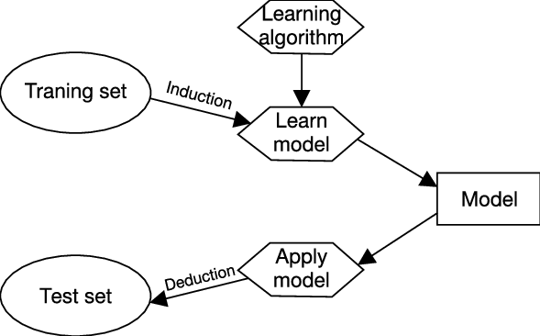
Data Classification
Supervised learning
Prediction: find a model to predict the class (or label)
Notes:
Data classification is to classify data records, i.e., label them, based on their features. The targeted variable, i.e., the label, has a discrete value. It is a supervised learning so the learning requires a training set, where both the features and labels of data records are known. Using learning algorithms, such as decision tree and KNN classifier, a model is learned. This process is referred to as induction. Later, we can use this model to predict the label of a data record in the test set. This process is referred to as deduction.

Slide 5
Data Classification
Construct models based on training examples
Both features and targets (i.e., labels) are observed in the training set
Predict some unknown class labels
Features are known but labels are unknown
Typical algorithms
Decision tree, Naïve Bayesian classification, K nearest neighbor classifier (KNN), neural networks, support vector machines, random forest, logistic regression …
Typical applications
Identifying email spams, labeling images, …
Notes:
In this lecture, we will cover the two simple but popular classification algorithms: decision tree and K nearest neighbor classifiers.

Slide 6
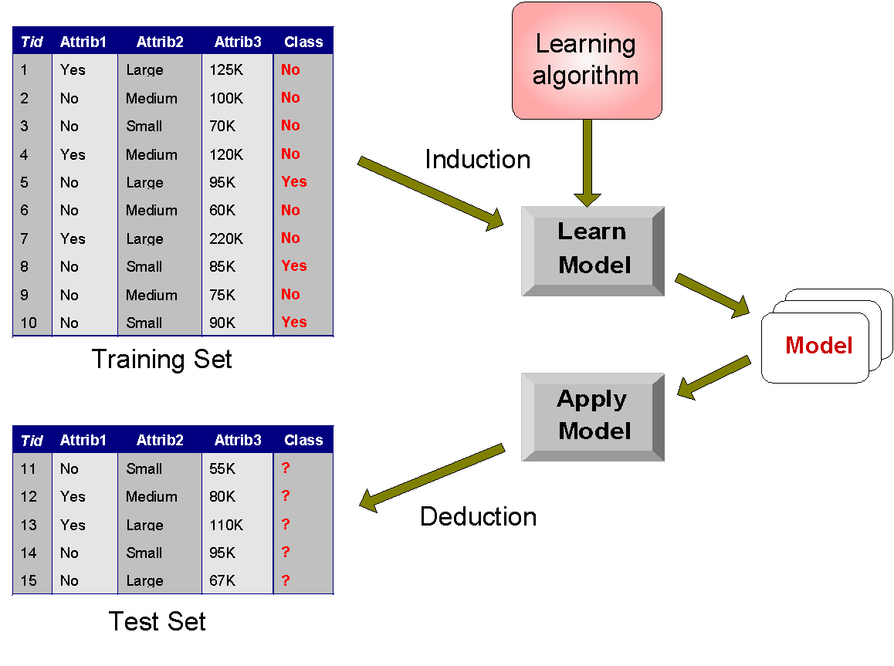
An Example
Notes:
In this example, the targeted variable is “class” where the labels can be Yes or No. Once a model is learned through the induction process, the model can be applied to the data records in the test set to compute their labels.

Slide 7
Decision Tree

Slide 8
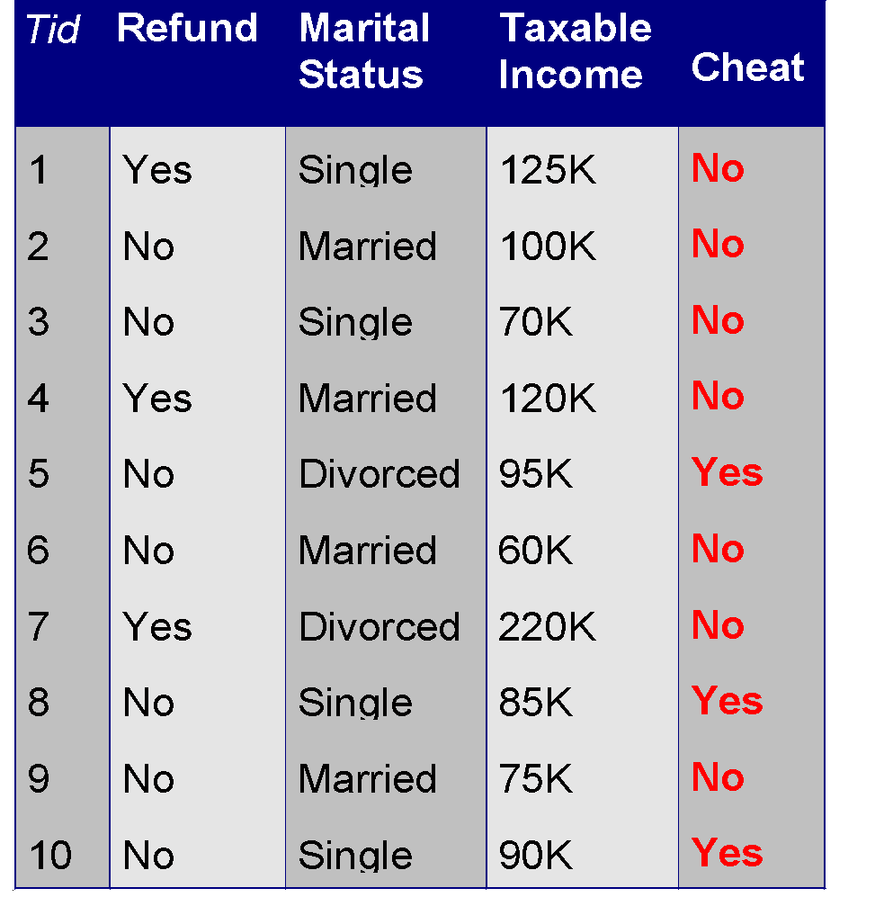
Decision Tree
The learned model can be represented as a tree where each leaf node corresponds to a class
Root Node
class
Internal Node
Refund
Yes
No
NO
MarSt
Single, Divorced
Married
Leaf Node
TaxInc
NO
< 80K
> 80K
NO
YES
Training Data
Model: Decision Tree
Notes:
Decision tree is a classification algorithm that generates a tree-structured model. Like in this example, the learned model can be represented as a tree where each leaf node is associated with a label and a non-leaf (or internal) node is associated with a condition on the values of an attribute.

Slide 9
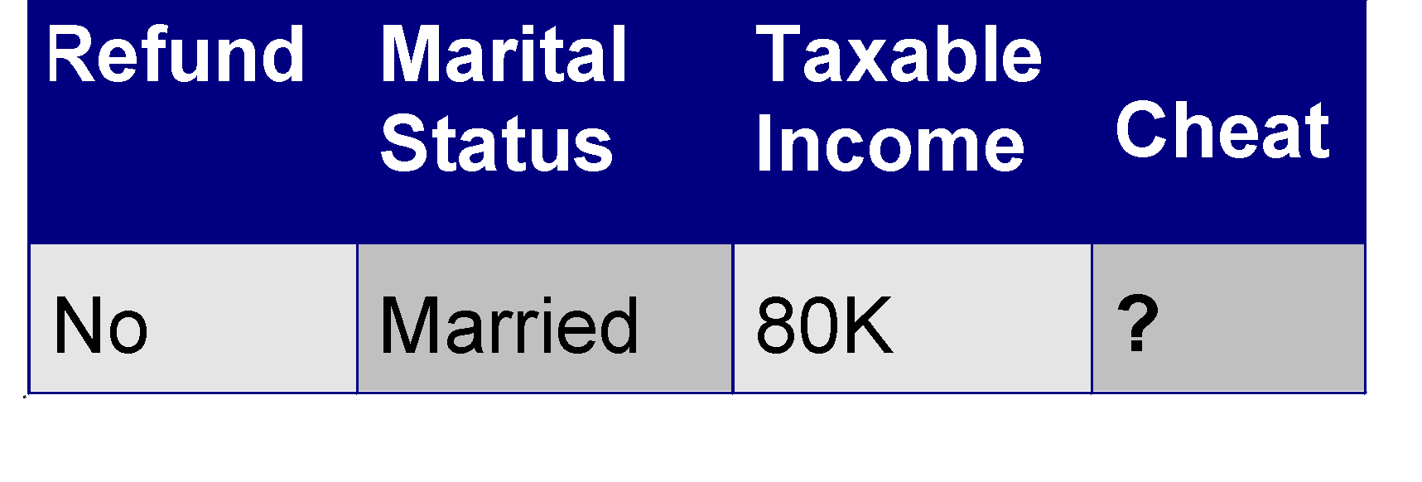
Applying the Model to Test Data
Start from the root of the tree.
Test Data
Refund
Yes
No
NO
MarSt
Single, Divorced
Married
TaxInc
NO
predicted label
< 80K
> 80K
NO
YES
Notes:
To use the model to make a prediction, the system starts with the root node. Use the associated condition of each node to navigate the traverse. In this example, the tested data record has No value for Refund, so it goes to the MarSt node, the value of Martial Status is Married, so it goes to the leaf node with the label of No. That will be the predicted result.

Slide 10
Hunt’s Algorithm
Used to build decision trees
General Methodology
Start by assuming that all data instances belong to the majority class
Find the “best” attribute to be the root of the tree using a node purity metric
Leaf nodes are created when a decision from a node split leads to data instances of only one class
Internal nodes are created using the best remaining attribute when a decision leads to data instances of two or more classes
Notes:
Hunt’s Algorithm is widely used to build decision trees in a recursive manner. It starts with a tree with only one root node. The root node includes the whole training set and its label is the majority class. It then finds the best attribute to be associated with the root node and split the node based on the values of that attribute. The selection of the attribute is linked to a node purity metric, i.e., finding an attribute that can lead to the best purity after the splitting. Typical metrics of impurity of a node include Gini index, Entropy, and Classification Error. If a node contains the records with more than one labels, the node will be split using a different splitting condition (usually with a different attribute). The splitting of the nodes gets repeated until it meets certain stopping criteria, such as reaching the max depth of the tree, all the leaf nodes are pure (i.e., only containing the records with the same label), or running out of the attributes for splitting.

Slide 11
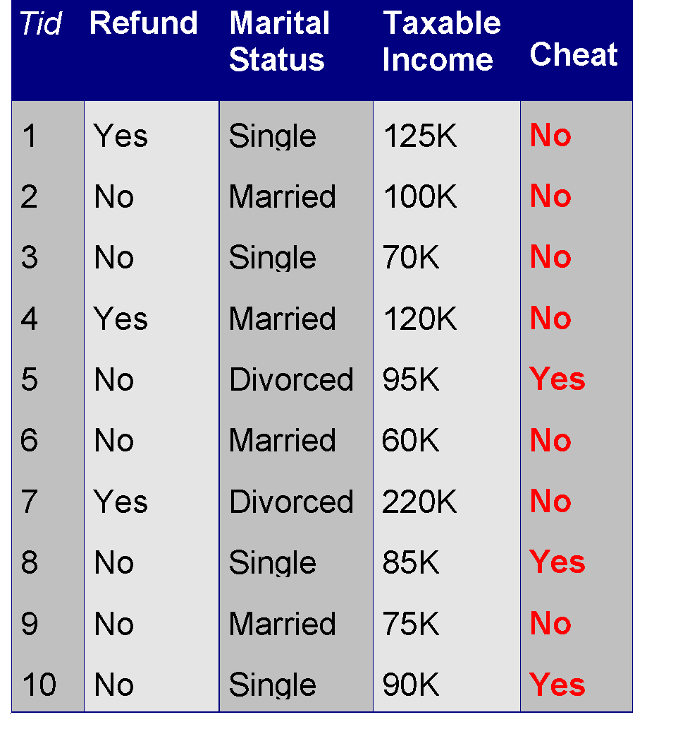
Hunt’s Algorithm
Refund
No
No
Yes
No
No
Refund
Yes
No
Refund
No
Marital
Status
Yes
No
Single,
Divorced
Married
No
Marital
Status
Taxable
Income
No
Single,
Divorced
Married
< 80K
>= 80K
Yes
No
No
Yes

Slide 12
Practical Issues with Decision Trees
When do we stop building the tree?
All data instances have been evaluated
All attributes have been added to the tree
Remaining data instances are “similar enough”
In this case, there will be classification errors that the analyst/customer must be willing to deal with
What happens when we use continuous attributes?
The decision tree algorithm is forced to discretize the data itself, potentially leading to suboptimal discretization
Notes:
For continuous attributes, the algorithm discretizes the values to create splitting conditions. It may cause suboptimal discretization issues, i.e., it chooses the splitting that leads to the minimal impurity for the current step but may not be optimal globally.

Slide 13
Several Notes about Decision Trees
Pros:
Easy to interpret for small-sized trees
Don’t require any scaling
Extremely fast at classifying unknown records
Can easily handle redundant or irrelevant attributes (unless the attributes are interacting)
Cons:
Space of possible decision trees is exponentially large
Each decision boundary involves only a single attribute
Notes:
Decision tree is an interpretable model, which allows humans to understand how the features affect the label, especially if the tree is small and easy to be comprehended. It doesn’t require to scale the data as only one attribute is considered at a time. It is efficient to apply the model to classify unknown records since the time complexity is proportional to the depth of the tree. It handles redundant or irrelevant attributes well as those attributes cannot reduce the impurity and are unlikely to be selected.
The limitations of decision trees include: given a large dataset with continuous attributes, it is very likely to generate a large size tree, which can cause overfitting issue and make the tree hard to interpret. Another issue is that each splitting condition involves only one single attribute instead of combining multiple attributes together. It doesn’t fit the data well if there is such a pattern in the data.

Slide 14
Implementation
Sklearn.tree.DecisionTreeClassifier
https://scikit-learn.org/stable/modules/generated/sklearn.tree.DecisionTreeClassifier.html
Scrub the data (cleaning, preprocessing feature engineering, selection…)
Sklearn decision tree package does not take null values or the values with non-numeric types
Specify the features (X) and target (y)
Split the data into training and testing sets
sklearn.model_selection.train_test_split() https://scikit-learn.org/stable/modules/generated/sklearn.model_selection.train_test_split.html
Generate the tree
Specify the parameters: max_depth,
Make the prediction
Notes:
To use the sklearn decision tree library, it is common to scrub the data first, including taking care of the null values and non-numeric values.
Then specify what are included in the features, i.e., X, and what is the targeted variable, i.e., Y. The next step is to split the dataset into training and testing set. Typically we use 0.3 or 0.2 for testing set, meaning 30% or 20% of the data goes to the test set.
Several parameters can be tuned when generating a tree, such as the impurity metrics and the maximal depth of the tree.

Slide 15
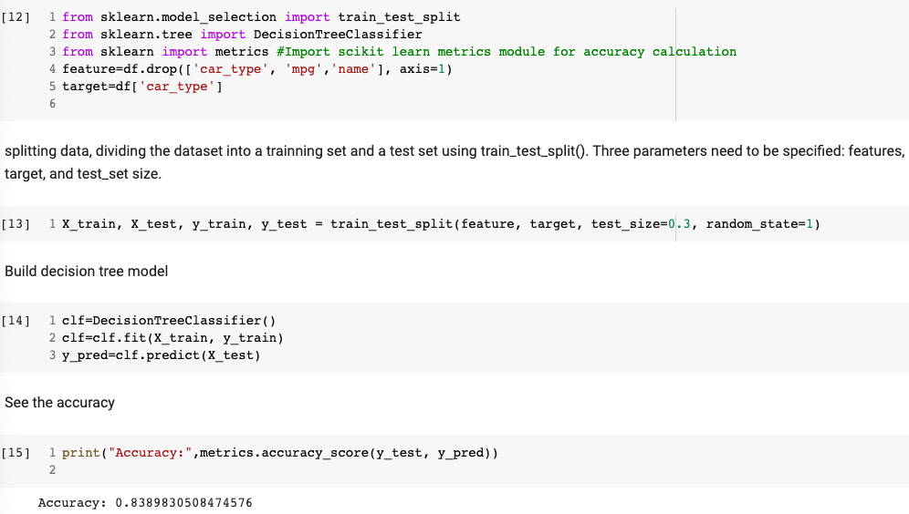
Implementation

Slide 16
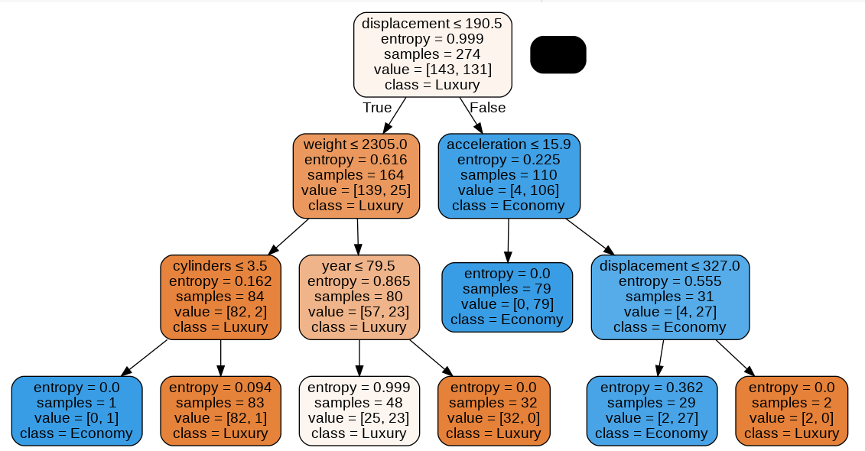
Implementation
Visualize the tree:
Notes:
In each node, the following information is given: the splitting condition, the impurity of the node, such as entropy, the larger the entropy is, the more mixed or the more impure the node is, the number of records included in the node (i.e., samples), the number of the records in each class, and the majority label of the node. The system uses blue and orange to color code the two classes and the darkness of the nodes to indicate how pure a node is.

Slide 17
KNN Classifier

Slide 18
K Nearest Neighbor Classifier
Basic idea: label an instance based on those in the training set that are most similar to it, i.e., the k nearest neighbors
To determine the nearest neighbors: compute distance to the training records, identify k nearest neighbors
Label the new instance: use class labels of nearest neighbors to determine the class label of unknown record (e.g., by taking majority vote, or weight the vote according to distance)
Notes:
KNN classifier is another classification algorithm. The basic idea is to use the labels of K most similar records in the training set to determine the label of an unknow record. The similarity between two records is measured based on a distance metric.
Once all the K nearest neighbors are identified, the label of the new record is determined by integrating the labels of the neighbors. We can either choose the majority vote (in that case K needs to be an odd number), or weight the vote according to the distance so the most similar the neighbor is, the more weight it carries, for example, weight = 1/square(distance).

Slide 19
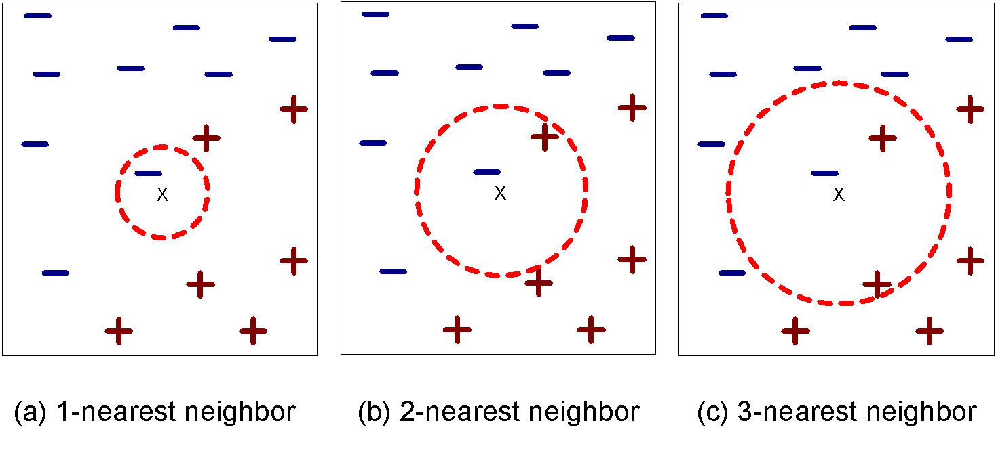
Definition of Nearest Neighbor
K-nearest neighbors of a record x are data points that have the k smallest distance to x
Notes:
K determines how many neighbors will be considered. The larger it is, the more records in the training set will be considered. This may cause the misleading from records with the different label. If we chose a small value for K, it reduces the distraction but makes the prediction result sensitive to outliers.

Slide 20
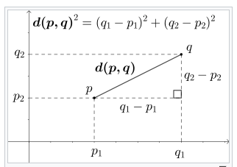
Compute Distances
Euclidean distance:
E.g., for two-dimensional data:
Other distance metrics:
Minkowski distance
Hamming distance (for two binary data strings)
Cosine distance
Notes:
It is typical to use Euclidean distance as the metric to measure the similarity between two nodes. Minkowski is the generalization of Euclidean distance. Hamming distance is used for two binary data strings where only 0s and 1s are included in the strings. Cosine distance is typically used to measure the distance between two vectors.

Slide 21
Practical Issues with KNN Classifier
Problem with Euclidean measure:
High dimensional data – Curse of dimensionality
Solution: reduce the dimensions through feature selection or PCA
Scaling issues:
Attributes may have different magnitudes
E.g., the range of incomes vs the range of height
Solution: scale the data through min-max scaler or standard scaler
We may not want to treat all attributes the same
Solution: assign a weight to each attribute, the more important an attribute is, the higher weight it gets (needs domain knowledge)
Notes:
Using Euclidean distance to measure the similarity in high dimensional data can cause the dimensionality issue. The data records can be very sparse in a high dimensional space so even the most similar neighbors could be very distant. In this case, we should reduce the dimensions using the techniques we have learned from feature selection topic.
As Euclidean distance sums up the squares of distances for all attributes, the different scales of those attributes could cause issues as the distances of some attributes could trivialize the distances of other attributes. To address this issue, we can use the data scaling techniques we have learned before.
Instead of treating all attributes the same when measuring the similarity, we may want to assign more weights to some attributes than to others, as suggested by domain experts.

Slide 22
Several Notes about KNN Classifier
KNN classifiers are lazy learners
It does not build models explicitly
Unlike eager learners such as decision tree induction and rule-based systems
Classifying unknown records are relatively expensive
Avoid having to compute distance to all objects in the training set
Multi-dimensional access methods (kd or ball trees)
Create a tree-like data structure to fast find k nearest neighbors on the tree
Notes:
KNN is considered as a lazy learner as there is no explicit model learned. There is no training process either. This makes the classification expensive as for each new record, the system needs to find the K most similar records by computing the distance between the record and each record in the training set. To avoid this expensive computation, a k-d (k-dimensional) tree or ball tree is generated to organized the data records in a k-dimensional space that allows to quickly query K nearest neighbors of a given record. It works similarity like indexes in a database.

Slide 23
Implementation
Sklearn.neighbors.KNeightborsClassifier
https://scikit-learn.org/stable/modules/generated/sklearn.neighbors.KNeighborsClassifier.html
Steps:
1. Scrub the data (cleaning, preprocessing feature engineering, selection…)
• Sklearn KNN classifier does not take null values or the values with non-numeric types
2. Specify the features (X) and target (y)
3. Split the data into training and testing sets
• sklearn.model_selection.train_test_split() https://scikit-learn.org/stable/modules/generated/sklearn.model_selection.train_test_split.html
4. Generate the tree
• specify the parameters: n_neighbors=5, weights=‘uniform’
5.Make the prediction
Notes:
Before generating a KNN classifier, we need to scrub the data like for generating decision trees. Null values and non-numeric values should be taken care of first. After that, we need to specify the features, i.e., X, and the targeted variable, i.e., Y, and then split the data into training and testing set. To generate the tree, we can tune some parameters, such as n_neighbors for the value of K, weights for how to assign weights to the votes of neighbors.

Slide 24
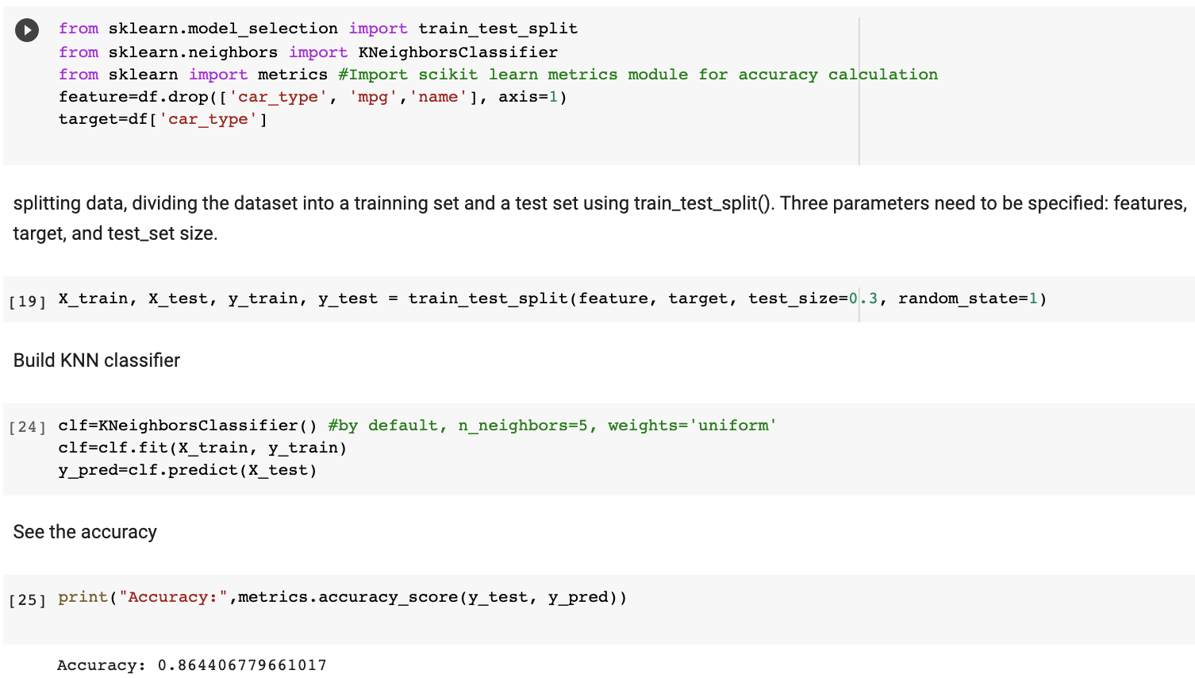
Implementation

Slide 25
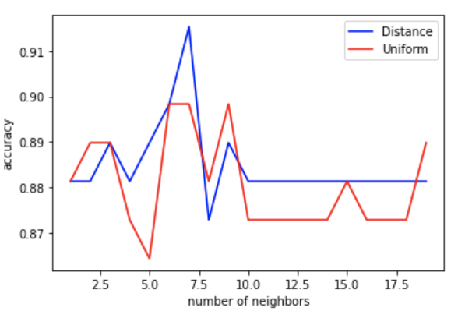
Parameter Tuning
Notes:
The figure shows the performance of the classifier, indicated by its accuracy, changes with the tuning of its parameters. Distance based weighting scheme overall performs better than uniform based one. The performance increases with the number of neighbors in the beginning but drops after a while. That means the performance is determined by k’s value and the optimal value of k cannot be too small or too large.

