Slide 1
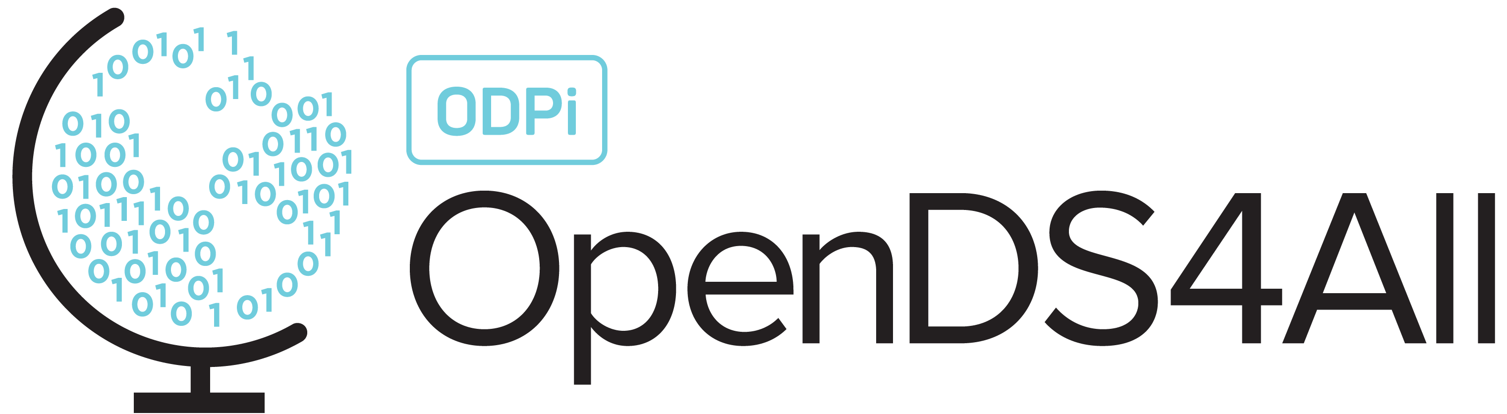
Data Types
This work is supported by the National Science Foundation under Award 2021287
Difficulty level: Introductory
Notes:
Initial release, Xumin Liu, Rochester Institute of Technology, 2022.
By Xumin Liu https://www.cs.rit.edu/~xl/
Except where otherwise noted, this work is licensed under a Creative Commons Attribution-4.0 International License https://creativecommons.org/licenses/by/4.0/

Slide 2
Contents
Data Types

Slide 3
Why Data Types?
Important information about data:
Determines valid domains, i.e., range of values
Different types are treated differently
Different syntax in Python
To get data type in Python:
Use the function type(): type(x)
Notes:
Data types carry some important information about data, specially on syntax level, for example, it defines the valid domains, i.e., the range of values. Through data type, we can perform some sort of data integrity check on it.
Different types of data are processed differently such as we can multiplicate two integers but not two strings. Python defines different syntax for different data types. Given a value, or a variable, to see what data type is has, we can use the function type().

Slide 4
Common Data Types
Numeric:
Integer: int
Float: float
String: str
Boolean: bool
Collections:
List: list
Set: set
Tuple: tuple
Notes:
Some common data types supported in python are listed, which are always frequently used in data science applications. There are also some other commonly used types in data science such as arrays and tuples, which are similar to list.

Slide 5
Integer
Numeric values
-5, 0, 2, …
Operators:
x + y, x - y, x * y, x / y
x % y (reminder), //(floored quotient)
-x (negated), abs(x) (absolute)
x**y (x to the power y)
x<y (comparison, return true/false result)
Notes:
Integer variables have numeric values and the operators that can be performed on integer variables/values are listed.

Slide 6
Float
Numeric values
4.0, -2.5, …
Operations
Same as the ones for integer: +, -, *, /, //, %, -, abs()
Round to n digits: round(x[,n])
Return a pair of integers with the ratio equals to the instance: float.as_integer_ratio(x)
Return if the instance is finite with integral value: float.is_integer(x)
Notes:
Float variables have numeric values and the operators that can be performed on float variables/values are listed. Compared to integers, they have some special operators such as rounding, getting the ratio equation, and check if a float has an integral value.

Slide 7
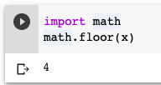
Math Module in Python
Provides access to many mathematical functions
You need to import it before its use
math.trunc(x), math.floor(x), math.ceil(x)
math.factorial(integer)
math.gcd(integer, integer)
math.exp(x)
math.log(x) or math.log(x,n)
More on https://docs.python.org/3/library/math.html
Notes:
Python provides a math module to allow various operators on numerical variables/values. You need to import the math module before using its functions.

Slide 8
String
Textual data, need to be quoted
single quotes ‘hello world’; double quotes “hello world”; triple quotes ‘’’hello world ’’’
Methods:
+ (join together) ; *n (print n times)
upper(): change all letters to uppercase; lower(): change all the letters to lowercase
capitalize(): capitalize the first letter of a string
find(sub): find the lowest index in the string where substring sub is loated
isnumeric(): if all characters are numeric; isalpha(): if all characters are alphabetic
islower(): if all cased characters are lowercase; isupper(): if all cased characters are uppcase;
isspace(): if there are only whitespace characters in the string
Notes:
String type is used for textual data. The value needs to be quoted. Python provides various operators/methods for string type.

Slide 9




String(cont.)
More methods:
join(): returns a string created by joining the elements of an iterable, separated by a string separator
replace(old,new): returns a copy of the string with all occurrences of substring old replaced by new
split(sep) returns a list of the words in the string, using sep as the delimiter string
strip([char]): returns a copy of the string with the leading and trailing characters removed, specified in the chars argument. If omitted, the leading and trailing whitespace will be removed.
Notes:
More methods for string type.

Slide 10
Boolean
Subset of integers
Two values: True and False
Operators:
x or y: if x is False, then y, if x is True, then True
x and y: if x is False, then x, if x is True, then y
not x: if x is False, then True, else False
Notes:
Boolean is a subset of integers as it has only two possible values, True and False. It is usually used as a flag showing the different status of a certain situation. It is frequently used as a part of conditions that determine what to do next.
Three operators for Boolean type: or, and, and not.

Slide 11
List & Set & Tuple
Sequence types: store multiple items with same or different data types
list: fruitlist=[”apple”, “banana”, “orange”, “cherry”]
ordered, changeable, duplicates allowed
set: fruitset={“apple”, “banana”, “orange”, “cherry”}
unordered, unchangeable, duplicates not allowed, will be dropped
tuple: fruittuple=(“apple”, “banana”, “orange”, “cherry”)
ordered, unchangeable, duplicates allowed
Methods
len(): get how many items a list/set/tuple has; in: check if an object is a member
List: list.append(x), list.insert(i,x), list.remove(x), list.clear(), list.count(x), list.sort(), list.reverse()
Set: set.add(x), set.remove(x), set.clear()
Tuple: tuple.count(x), tuple.count(x)
Notes:
List and Set are both for data collections. They store multiple items with same or different data types. List is surrounded by squared brackets, set is surrounded by curly brackets
List is ordered: the ordering among items is meaningful, items are indexed; changeable: we can change/add/remove items in a list; duplicates allowed: we can have duplicate items in a list.
Set is unordered, items are not indexed, unchangeable (you can’t change but can add/remove), and duplicates not allowed. Duplications will be dropped from a set.
Tuple is ordered, items are indexed, unchangeable, and duplicates allowed.
The difference between List and Tuple is List is changeable but Tuple is not. That makes Tuple more memory efficient than List since Python its size is fixed and Python doesn’t need to allocate more space for potential future change.

Slide 12
Dict
Store data values in key:value pairs
Dict items are ordered, changeable, and duplicates are not allowed
thisfruit = {"name":"Apple","color":"Red","price":2}
Some other formats:
thisfruit=dict(name="apple",color="red",price=2)
thisfruit=dict(zip(['name', 'color', 'price'], ["apple", "red", 2]))
Cannot have two items with the same key, the duplicate values will overwrite existing ones
Methods:
len(): get the number of items
list(d): get the list of keys, values(d): get the list of values
d[key]: get the item in d with the key,
d[key]=value: set d[key] to the value
key in d: check if d has the key
Notes:
Dict type is used to store data values in key: value pairs. It is written with curly brackets. The pairs are separated by a comma.
Items in a dictionary are ordered/indexed, changeable, and duplicates are not allowed.
You can define a dict variable in various formats.
Some popular methods for Dict type are listed.

Slide 13
Type Conversion
Implicit type conversion
Automatically done by Python interpreter
For example: Int + float = float
Explicit type conversion
Conversion is explicitly specified
int(x): convert to integer
float(x): convert to float
str(x):convert to string
list(x): convert a collection to list
set(x): convert a collection to set
Notes:
Type conversion allows to convert the data type of a variable to perform certain methods on it.
The conversion can be done implicitly or explicitly. Implicit conversion is automatically done by Python interpreter if the variable is treated as if it has the converted type.
Explicit conversion requires the involvement of users. The conversion needs to be explicitly specified and the value needs to be qualified for the conversion (can you convert a string “conversion” to an integer?)

