Slide 1

Association Rule Discovery
This work is supported by the National Science Foundation under Award 2021287
Difficulty level: Introductory
Some contents are borrowed from the slides of Introduction to Data Mining [1]
[1] P.N. Tan, M. Steinbach, A. Karpatne, V. Kumar, Introduction to Data Mining, Second Edition, https://www-users.cse.umn.edu/~kumar001/dmbook/index.php
Notes:
Initial release, Xumin Liu, Rochester Institute of Technology, 2022.
By Xumin Liu https://www.cs.rit.edu/~xl/
Except where otherwise noted, this work is licensed under a Creative Commons Attribution-4.0 International License https://creativecommons.org/licenses/by/4.0/

Slide 2
Contents
Association Rule Discovery
Association Rule
Evaluation of Association Rule
Notes:
In this lecture, we use the market basket optimization dataset in the example: https://www.kaggle.com/datasets/devchauhan1/market-basket-optimisationcsv
Please contact Xumin Liu (xmlics@rit.edu) for the demo code shown in the lecture.

Slide 3
Association Rule Discovery

Slide 4
Association Rule Discovery
Wiki: is a rule-based machine learning method for discovering interesting relations between variables in large databases. It is intended to identify strong rules discovered in databases using some measures of interestingness
Produce dependency rules which will predict occurrence of an item based on occurrences of other items
Input: a collection of records (e.g., transactions)
Output: a set of interesting rules
Rules Discovered:
{Milk} --> {Coke}
{Diaper, Milk} --> {Beer}
Notes:
Association rule is to discover co-occurrence of items in the same record. The input is a collection of records, such as shopping receipts. The output is a set of interesting dependency rules where the occurrence of left-side items can determine the occurrence of right-side items. For example, the first rule suggests that people who buy milk tend to buy coke in the same transaction.

Slide 5
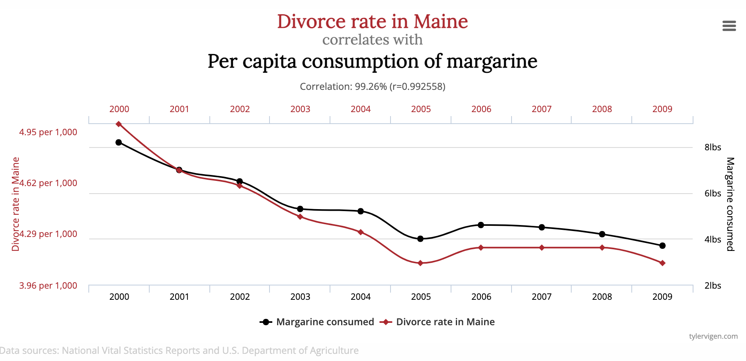
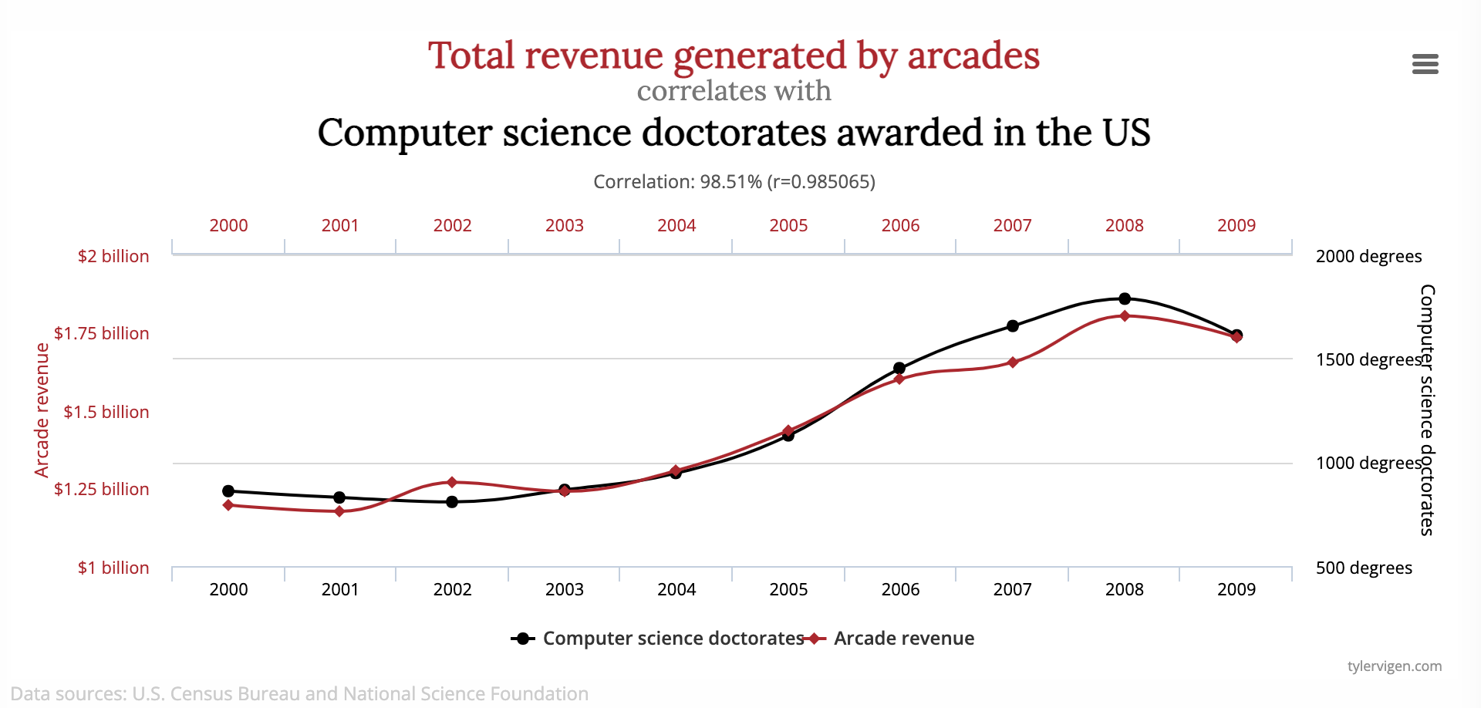
Association Rule Discovery
Unsupervised learning:
No target variable
No training/test splitting
The discovered rules indicate co-occurrence but not necessarily causality
Association may suggest causality but not they are not equivalent
Needs human input to determine causality
http://www.tylervigen.com/spurious-correlations
Notes:
Co-occurrence of two events doesn’t mean there is any causality between them. In each of the two figures, we can see two events are highly correlated but there is no causality between them. However, Co-occurence may suggest causality, for example, there might be some reason cause the people who buy milks also buy coke. We need the input from domain experts to decide if there is causal relationship beween two associated items/events.

Slide 6
Association Rule Discovery: Example
Find potential correlation between events:
Customers who buy HDTV are more likely to buy exercise machines
Customers who buy Tea are more likely to buy Muffins
Patients who have a stoke are more likely to have hypertension
Patients who have tested positive COVID are more likely to develop a fever
Notes:
Finding association rules can help identify dependency between two items or events. We can utilize the rules to make decision. For example, suppose customers who buy HDTV are more likely to buy exercise machine. If we want to encourage people to buy exercise machines, we can put HDTVs and exercise machines close to each other in the store, or offer a promotion on HDTVs. Association rule discovery can also benefit the healthcare domain to find the causality between symptoms and a diagnosis.

Slide 7
How To?
Steps:
Find frequent itemsets
Discover association rules
Evaluation based discovery:
Enumerate potential candidates
Use evaluation metrics to select those qualified
Frequent itemsets: support
Association rules: support, confidence, lift
Notes:
The basic idea of association rule discovery is to enumerate all possible rules and find those strong patterns, i.e., supported by enough records in the dataset. It starts with finding frequent itemsets and generate association rules from those itemsets. Whether a itemset is frequent or not, and whether an association rule is interesting or not are determined by evaluation metrics. Typical metrics include support, confidence, and lift.

Slide 8
Frequent Itemset
Itemset: a set of one or more items
e.g., {Bread, Diaper, Beer}
Frequent itemset
An itemset whose support meet the threshold
E.g., min_support=0.02
Support:
The fraction of the number of transactions that contains an itemset
e.g., s({Bread, Diaper, Beer}) = 2/5
Notes:
Support of an itemset is the fraction of the number of transactions that contains the itemset. Using a threshold on the support, such as 0.02, we can determine if an itemset is frequent or not.

Slide 9
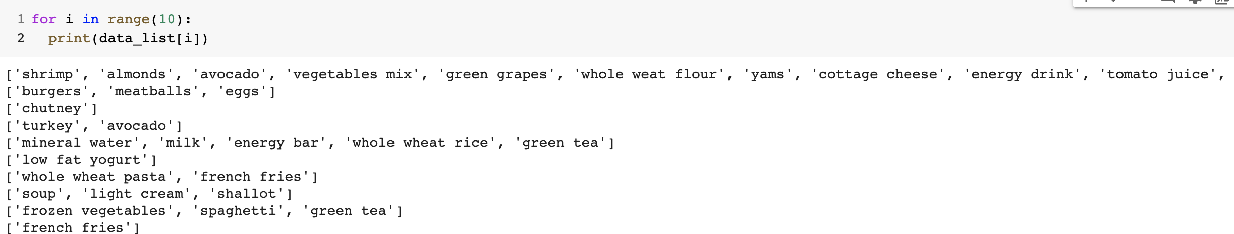
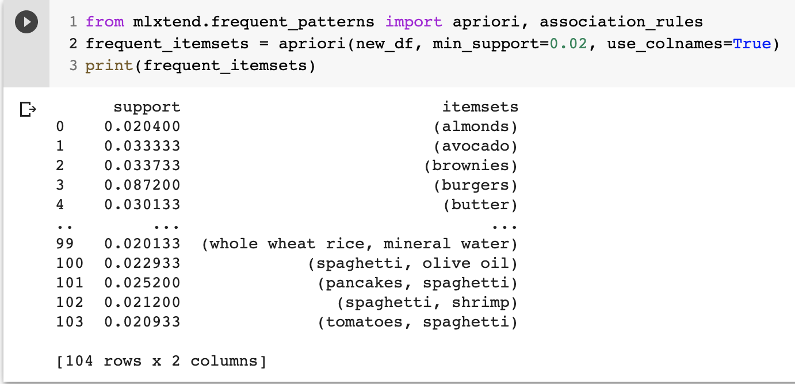
Example
Transaction lists:
Frequent itemsets
Notes:
Here is an example of frequent items in a transaction dataset. First we print out the transaction data, where each line corresponds to a transaction. Then we print out the list of frequent itemsets. Here the threshold is set as 0.02. The support of {almonds} is 0.0204. The support of {burgers} is 0.087200.

Slide 10
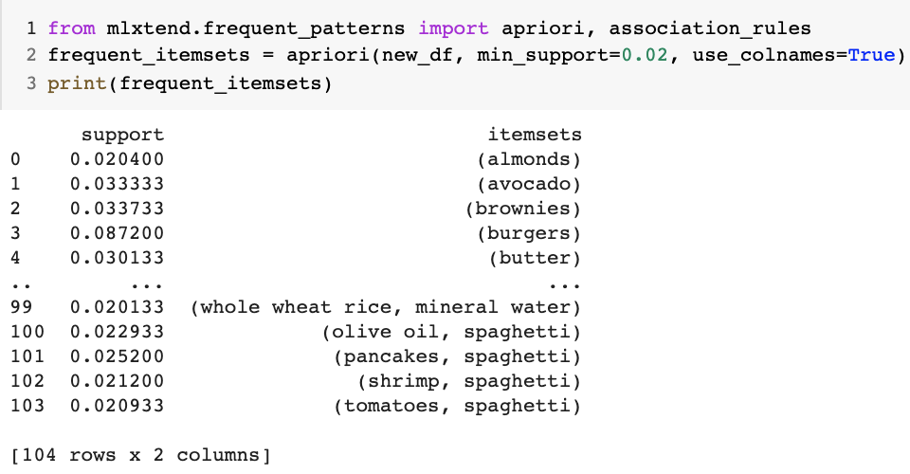
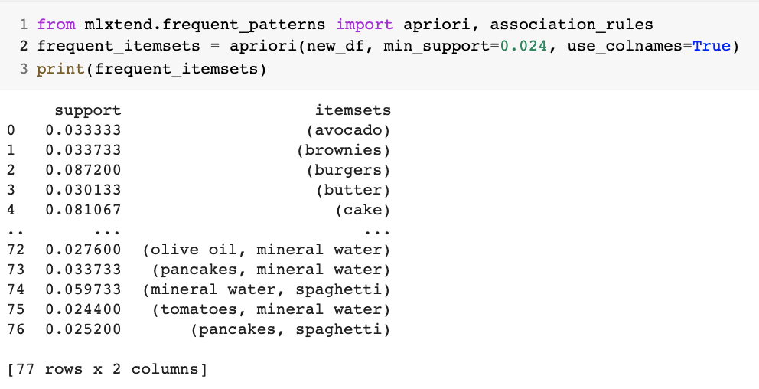
Support Threshold
Notes:
By tuning the support threshold, we can get different lists of frequent itemsets. The higher the threshold is, the less frequent itemsets we have.

Slide 11
Association Rule

Slide 12
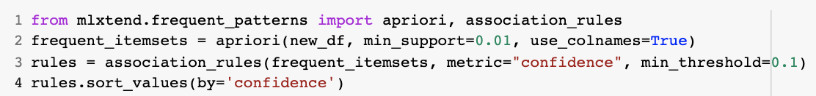
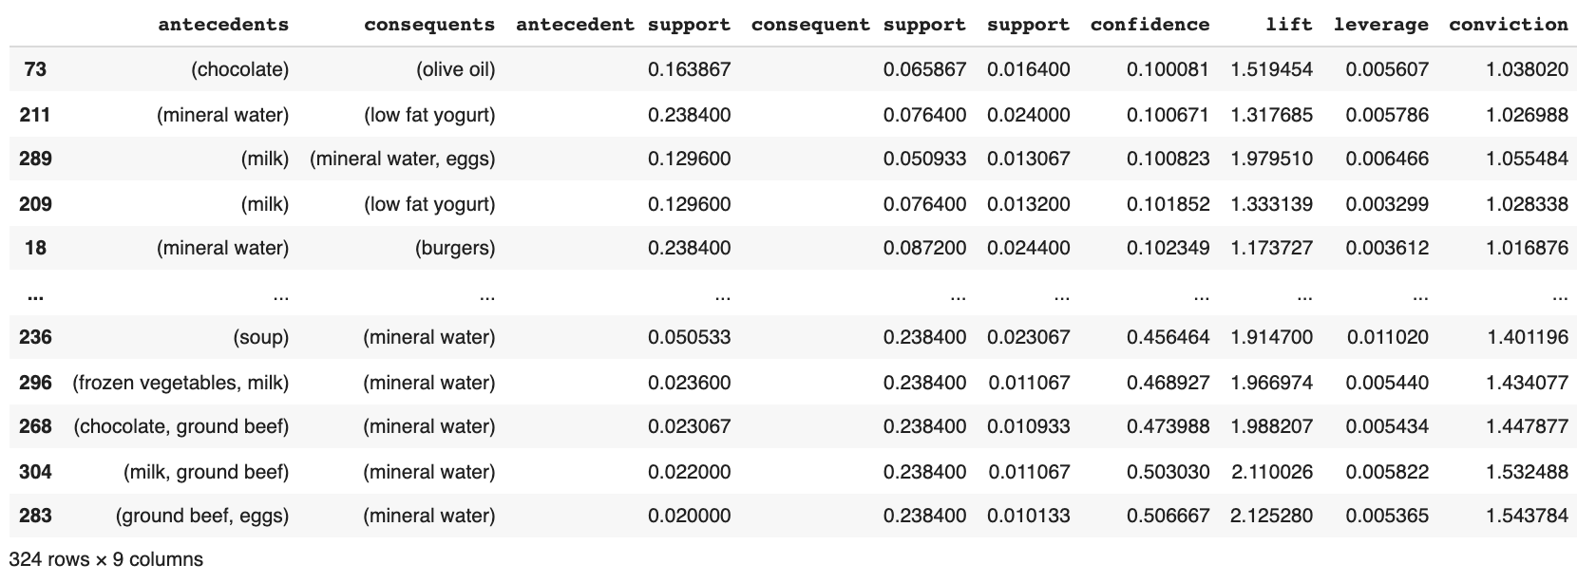

Association Rule
X → Y, where X and Y are itemsets
E.g., {Diaper, Milk} → {Beer}
Antecedents
consequents
Notes:
In an association rule, the left side itemset is referred to as Antecedents and the right side itemset is referred to as consequents. The semantic of an association rule is that, the occurrence of the antecedents can predict the occurrence of the consequents. Confidence is a metric that determine if an association rule is interesting enough. It measures how confidence we can be if we see the consequents given the occurrence of the antecedents.

Slide 13
Evaluation Metric for r: X → Y
Support:
The fraction of transactions that contains both X and Y
How often is this rule applicable in the dataset?
The support of r is the support of the itemset: {X, Y}
Confidence: (conditional probability of Y given X)
How often items in Y appear in transactions that contain X?
How reliable is the rule?
Notes:
The support of an association rule is the support of the itemset combining X and Y.
The confidence of an association rule is a conditional probability of Y given X, i.e., the ratio of the support of {X, Y} to the support of {X}.

Slide 14

Generating Association Rules
Start with generating frequent itemsets
The support of r: X → Y is the same of the support of {X, Y}
With the same frequent itemset, there are multiple rules with different confidences
E.g., with {Milk, Diaper, Beer}
Example of Rules:
{Milk,Diapers} → {Beer} (s=0.4, c=0.67) {Milk,Beer} → {Diaper} (s=0.4, c=1.0)
{Diapers,Beer} → {Milk} (s=0.4, c=0.67)
{Beer} → {Milk,Diapers} (s=0.4, c=0.67) {Diapers} → {Milk,Beer} (s=0.4, c=0.5)
{Milk} → {Diapers,Beer} (s=0.4, c=0.5)
Notes:
An interesting association rule needs to have enough support, i.e., support (X, Y) needs to be above the threshold. Therefore, we should enumerate those rules only from the frequent itemsets. For the same itemset, there can be many combinations to form X and Y. But they can have different confidence. Only those have enough confidence will be selected.

Slide 15
Evaluation of Association Rule

Slide 16
Contingency Table
Given X → Y or {X,Y}, information needed to compute interestingness can be obtained from a contingency table
Contingency table
 | Y | Y
X | f₁₁ | f₁₀ | f₁₊
X | f₀₁ | f₀₀ | f_{o+}
 | f₊₁ | f₊₀ | N
f₁₁: support of X and Y f₁₀: support of X and Y f₀₁: support of X and Y f₀₀: support of X and Y
Used to define various measures
support, confidence, …
Notes:
A contingency table summarizes the association of two items/events. Here the rows correspond to the antecedents and the columns correspond to the consequents. We can compute the metrics from this table.

Slide 17
Limitation of Confidence
Suppose a rule r: Tea → Coffee
confidence(r)=P(Coffee|Tea) = 15/20 = 0.75, which is larger than 50%, meaning people who drink tea are more likely to drink coffee than not drink coffee. So the rule seems reasonable
but P(Coffee) = 0.9, which means knowing that a person drinks tea reduces the probability that the person drinks coffee!
P(Coffee|Tea) = 75/80 = 0.9375
Desired rules: confidence (X→Y)>support(Y)
 | Coffee | Coffee
Tea | 15 | 5 | 20
Tea | 75 | 5 | 80
 | 90 | 10 | 100
Notes:
Confidence of a rule equals the conditional probability of X and Y, i.e., the probability of Y given X.
Although the confidence of the rule is 0.75, it is lower than the support of Y itself. So it is not enough to only consider the confidence of the rule. We prefer those rules where the occurrence of X encourages the occurrence of Y.

Slide 18
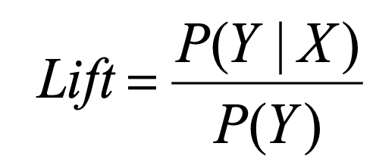
Statistical Independence
Two events are statistically independent if
P(Y|X) = P(Y) or P(X,Y) = P(X) × P(Y)
This is equivalent to: confidence(X → Y)=support(Y)
Criterion: Lift
Lift>1: P(X,Y) > P(X) × P(Y) : X & Y are positively correlated (desired rules)
Lift<1: P(X,Y) < P(X) × P(Y) : X & Y are negatively correlated (not desired)
Lift=1: P(X, Y)=P(X) × P(Y): X & Y are statistically independent (not desired)
Notes:
Two events are statistically independence of one’s occurrence doesn’t change another one’s occurrence.
Lift measures the correlations of two events. We prefer those rules that have large than 1 lift score.

Slide 19
Example: Lift
 | Coffee | Coffee
Tea | 15 | 5 | 20
Tea | 75 | 5 | 80
 | 90 | 10 | 100
Association Rule: Tea → Coffee
Confidence= P(Coffee|Tea) = 0.75
but P(Coffee) = 0.9
Lift = 0.75/0.9= 0.8333 (< 1, therefore is negatively associated)

Slide 20
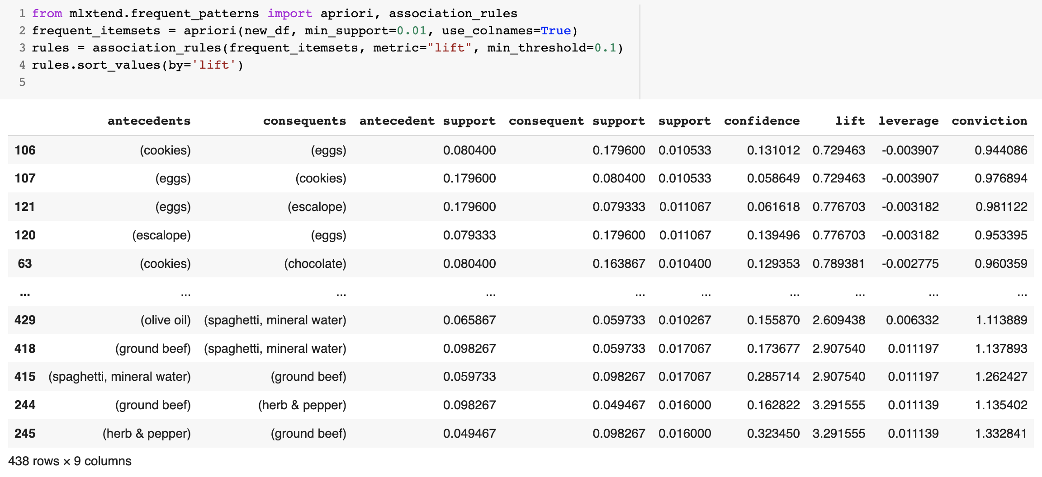
Implementation
Notes:
In this example, we select those rules using lift metric.

