Slide 1
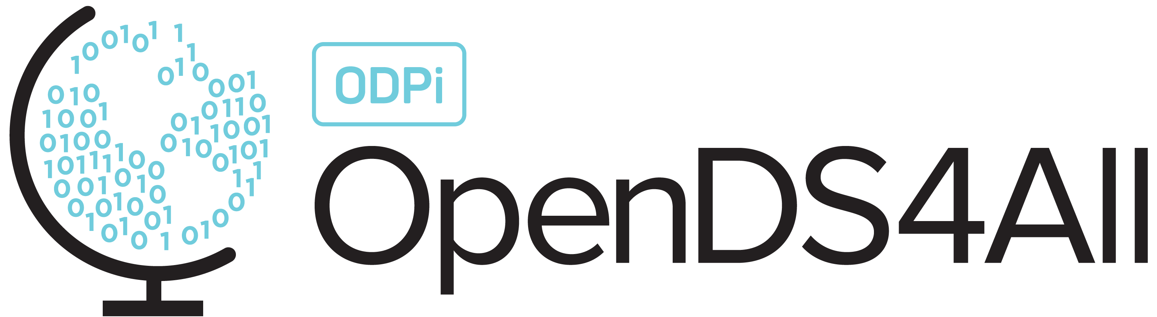
Data Clustering
This work is supported by the National Science Foundation under Award 2021287
Difficulty level: Introductory
Notes:
Initial release, Xumin Liu, Rochester Institute of Technology, 2022.
By Xumin Liu https://www.cs.rit.edu/~xl/
Except where otherwise noted, this work is licensed under a Creative Commons Attribution-4.0 International License https://creativecommons.org/licenses/by/4.0/

Slide 2
Contents
Clustering
K-Means Algorithm
Evaluate the Clustering Result
Notes:
In this lecture, we use the auto-mpg dataset in the example: https://www.kaggle.com/datasets/uciml/autompg-dataset
Please contact Xumin Liu (xmlics@rit.edu) for the demo code shown in the lecture.

Slide 3
Clustering

Slide 4
Clustering
Wiki: cluster analysis or clustering is the task of grouping a set of objects in such as way that objects in the same group (called a cluster) are more similar (in some sense) to each other than to those in other groups (clusters)
Inter-cluster distances are maximized
Intra-cluster distances are minimized
Notes:
The basic idea of clustering is to find an organization of data objects so that similar ones are group together and dissimilar ones are assigned to different groups. It is usually modeled as an optimization problem where the intra-cluster distances are minimize (highly cohesive) and the inter-cluster distances are maximized (well separated).

Slide 5
Clustering
Unsupervised learning:
Only features (X) are observed, no target variable
No splitting of training set and test set
No ground truth
K=2
How many clusters?
K=4
K=3
Notes:
Clustering is unsupervised learning, meaning there is no target variable, i.e., Y, no need of training set, and no ground truth to guide the learning process. Like for the 8 data objects in the figure, there are multiple clustering results if we assume different numbers of clusters.

Slide 6
Clustering
Can be used for:
Exploratory data analysis
Data preprocessing (data aggregation)
Applications:
Market segmentation: subdivide a market into distinct subsets of customers where any subset may conceivably be selected as a market target to be reached with a distinct marketing mix
Notes:
Clustering is typically used for exploratory data analysis as the clustering result can help understand the underlying structure/organization of the data objects. It can also used as to perform data preprocessing, to aggregate the similar objects together, using the center point of each cluster to represent the entire cluster. This can reduce the analysis complexity as well as deal with the noises in the data.

Slide 7
Clustering Types
Partitional clustering: no overlap between clusters
Hierarchical clustering: clusters are nested
K=4
3 clusters: {p1},{p2,p3}, {p4}
4 clusters: {p1},{p2},{p3}, {p4}
Notes:
In partitional clustering, there is no overlap between clusters. A data object belongs to one and only one cluster.
In hierarchical clustering, clusters are nested. Like in the left example, data objects in a cluster such as p2 also belong to the upper-level clusters. The result of hierarchical clustering can also be translated into a partitional clustering result by performing a horizontal projection on the hierarchical structure.

Slide 8
K-Means Algorithm

Slide 9
K-Means Algorithm
Mostly widely used partitional clustering approach
Simple and efficient
Design:
Input: a collection of data records, the number of clusters, i.e., K
Process:
Randomly choose K points as the initial centroids,
Generate K clusters by assigning all points to the closest centroid
Recompute the centroid of each cluster
Repeat steps 2, 3 until the centroid don’t change
Notes:
K-means is a distance based clustering algorithm.

Slide 10
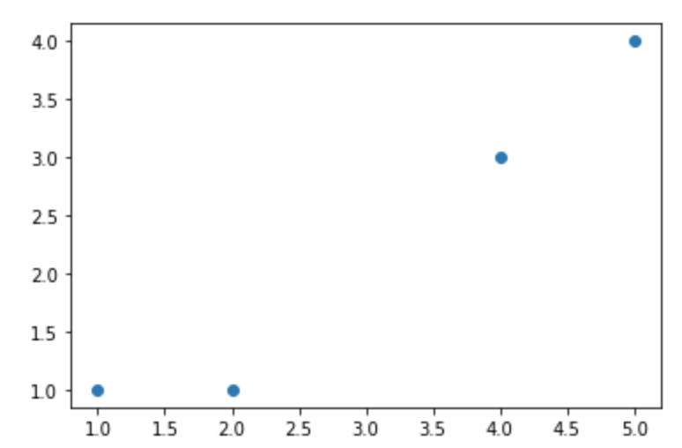
Example
Given the four points with their attribute values, cluster them into two clusters
Object | Attribute 1 (x) | Attribute 2 (y)
A | 1 | 1
B | 2 | 1
C | 4 | 3
D | 5 | 4
Suppose the initial centroids are A and B, Euclidean distance is used
Iteration 1: C1 (A), C2(B,C,D); updated centroids: C_C1(1,1); C_C2(11/3, 8/3)
Iteration 2: C1(A, B), C2(C, D); updated centroids: C_C1(1.5, 1), C_C2(4.5, 3.5)
Iteration 3: C1(A, B), C2(C, D); centroids keep the same, so the process ends

Slide 11
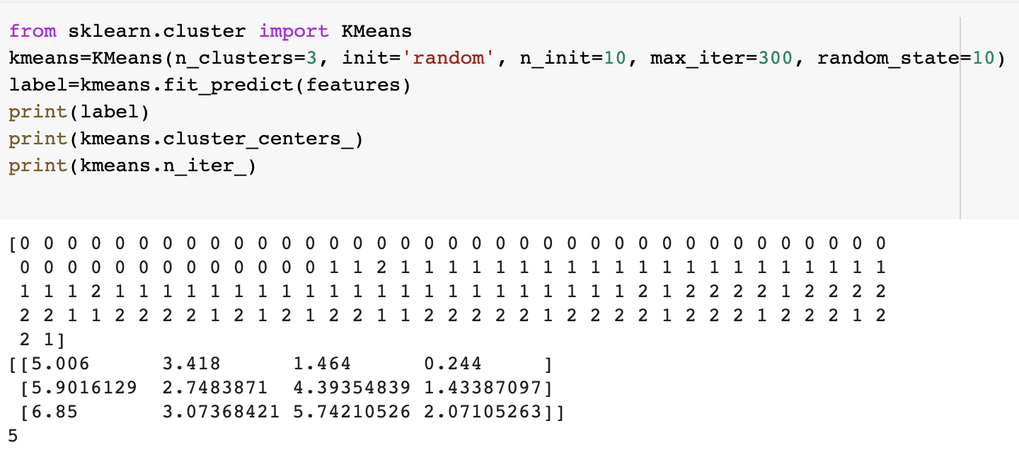
Implementation
sklearn.cluster.Kmeans: https://scikit-learn.org/stable/modules/generated/sklearn.cluster.KMeans.html
Notes:
n_cluster specified the number of clusters. Label shows the membership of each object in the dataset. 0 is the first cluster, 1 is the second, and 2 is the third. Kmeans.cluster_centers_ shows the coordinates of the centroid for each cluster. n_iter_ shows how many iterations the system takes to converge and generate the final clustering result.

Slide 12
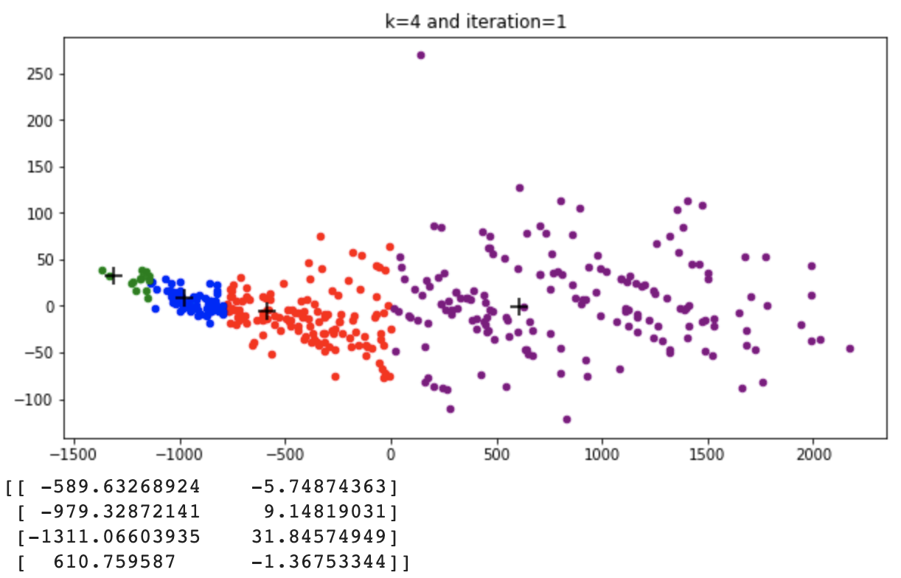
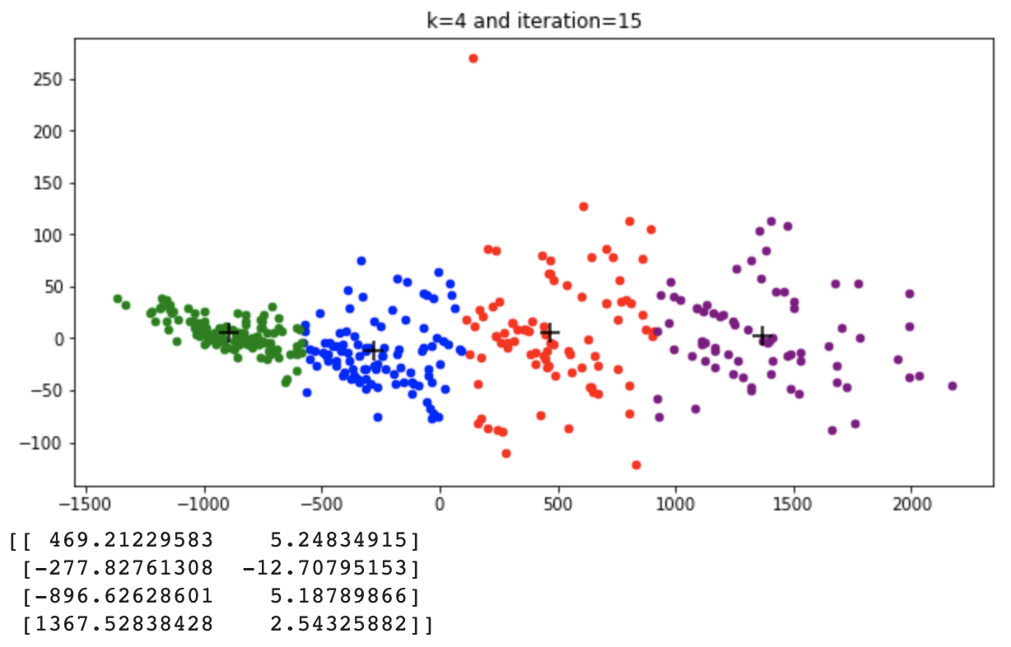
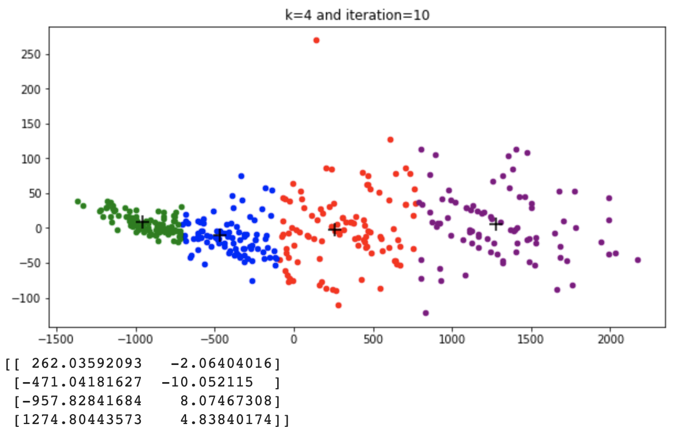
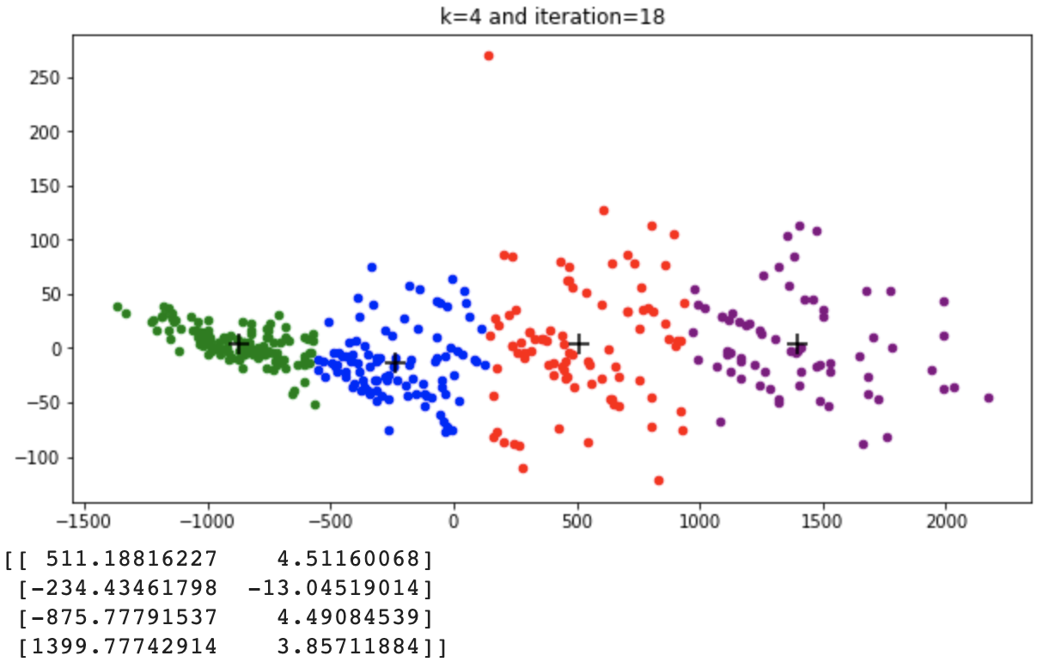
Implementation
Notes:
The figures shows how the clustering result changes and how the centroids change their position during each iteration.

Slide 13
Preprocessing for K-Means
K-means is sensitive to outliers
Eliminate outliers
K-means is sensitive to distance metrics
Normalize the data
Notes:
As K-means is distance based and all the objects in the data set are considered, kmeans clusteing result is sensitive to outliers as the location of the centroid will be affected by the locations of outliers. Meanwhile, k means can also be used to detect outliers. If a cluster is too far from other clusters and contains a small number of objects, that suggests the objects in that clusters are noises.
K-means is sensitive to distance metrics, for example if we use Euclidean distance, we should standardize the data first to ensure the values of all attributes have the similar scale.

Slide 14
Evaluate the Clustering Result

Slide 15
Evaluate the Clustering Result
External index:
Evaluate how much the cluster labels match some externally provided class labels (ground truth is needed)
Supervised
Internal index:
Evaluate the goodness of a clustering structure
Unsupervised
Notes:
Using external index, i.e., ground truth, to evaluate the quality of a clustering result is considered as a supervised approach. In this case, the clustering result is usually verified by the labels of data objects, where the assumption is that the objects with the same label are similar and should be assigned to the same cluster.
Using internal index is unsupervised as no external information is needed. It evaluates the quality of a clustering result based on its structure, i.e., whether the clusters are highly cohesive and well separated from each other.

Slide 16
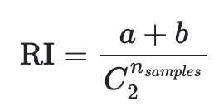

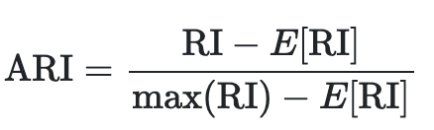
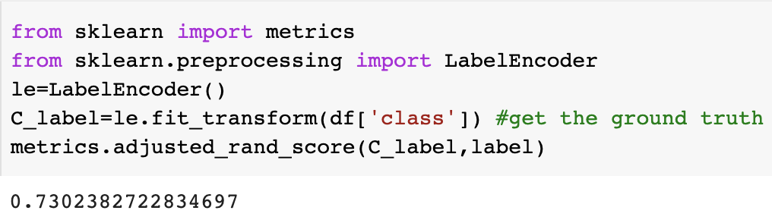
External Index
Adjusted Rand Index (ARI)
RI measures the similarity of the two assignments (clustering labels and true labels), ignoring permutations
Fits for balanced clusters
ARI adjusts RI
The higher, the better
Perfect labeling is scored : 1.0
a: the number of pairs of elements that are in different sets in C (i.e., the ground truth) and in different sets in K (i.e., the clustering labels)
b: the number of pairs of elements that are in the same set in C and in the same set in K
is the total number of possible pairs in the dataset

Slide 17
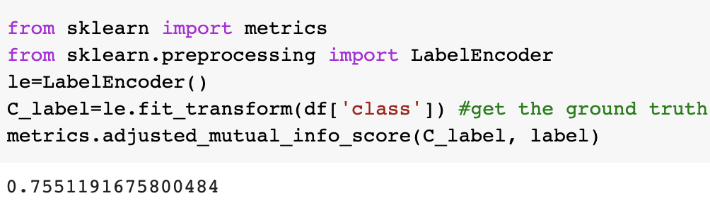
External Index
Adjusted Mutual Information (AMI)
MI measures the agreement of the two assignments by computing the entropy
Perfect labeling is scored 1.0
Fit for unbalanced clusters
Notes:
Here the C_label is the ground truth, label is the clutsering result.

Slide 18
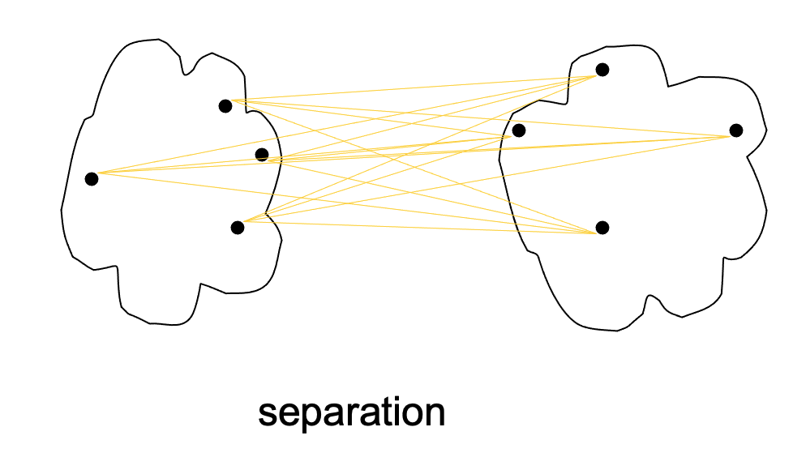
Internal Index
Measurement:
Cohesion: measures how closely related are objects in a cluster
Sum of Squares Error (SSE or inertia)
Separation: measures how distinct or well-separated a cluster is from other clusters
Between cluster Sum of Squares
cohesion
|C_{i}| is the size of cluster i

Slide 19
Internal Measures: Cohesion and Separation
Example: SSE
BSS + WSS = constant
m
×
×
×
1
m₁
2
3
4
m₂
5
K=1 cluster:
K=2 clusters:
Notes:
When K=1, all the four objects are in the same cluster. m is the centroid.
When k=2, the first two objects are in the first cluster and the last two objects are in the second cluster.
In either case, they have the same sum of BSS and WSS.

Slide 20
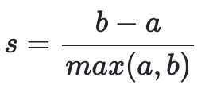
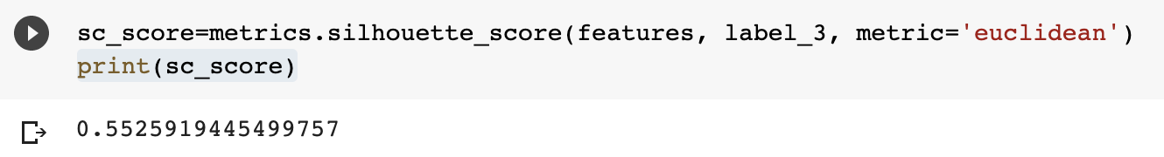
Internal Index
Silhouette Coefficient
Combine both SSE and BSS
No need for ground truth labels
For an individual point, i:
Calculate a = average distance of i to the points in its cluster
Calculate b = min (average distance of i to points in another cluster)
The silhouette coefficient for a point is then given by
Typically between 0 and 1.
The closer to 1 the better
Can calculate the average silhouette coefficient for a cluster or a clustering
Notes:
When computing SC score, no true label is needed.

Slide 21
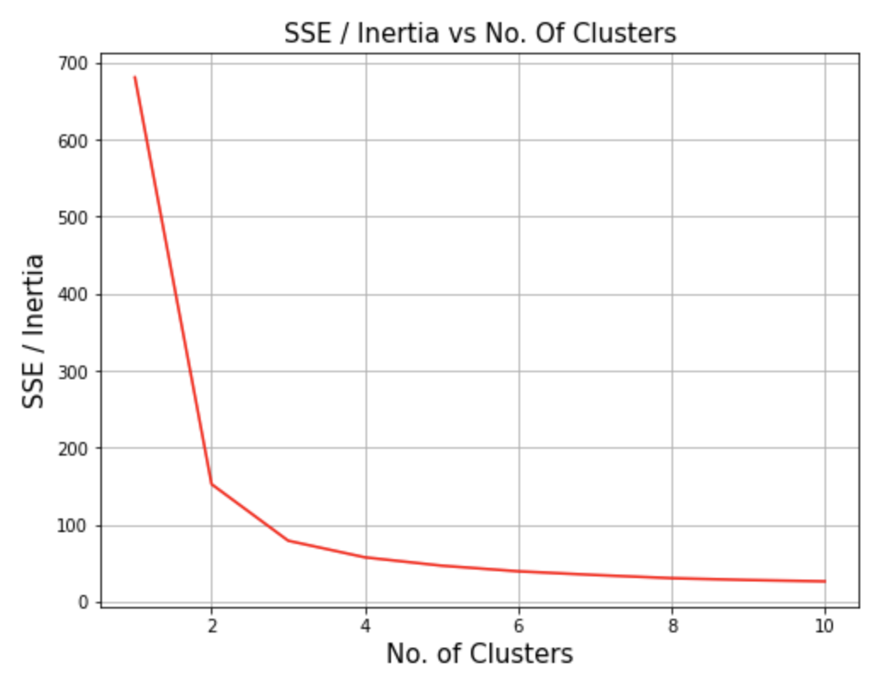

Finding the optimal K
Elbow method
Plot SSE vs. K and identify the “elbow point”
Notes:
Elbow method is to detect the optimal K value by running several trials on different values of K, computing the SSE for each clustering result, and then choosing the point of infection on the curve, i.e., the elbow. Like in the example, k=3 is the elbow point.

Slide 22
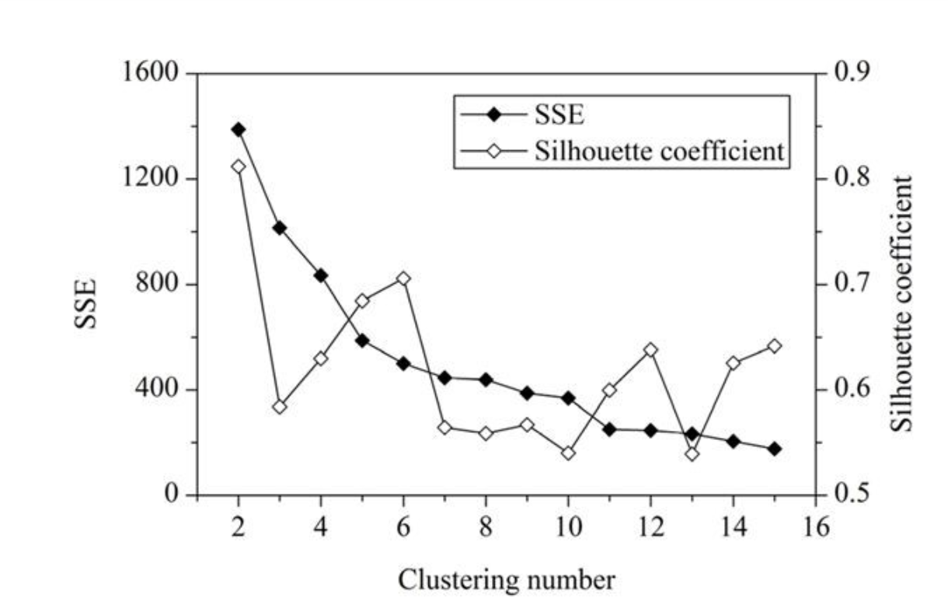
Another Approach
What should be the best choice for number of clusters based on the following results?
Notes:
Another approach of finding the optimal K is to leverage both SSE and silhouette coefficient. In this figure, we plot them in the same figure regardless their different scales. Although k=11 is the elbow point, K=6 seems to be another good option as the SC score is higher and the difference in SSE is not significant.

