Slide 1
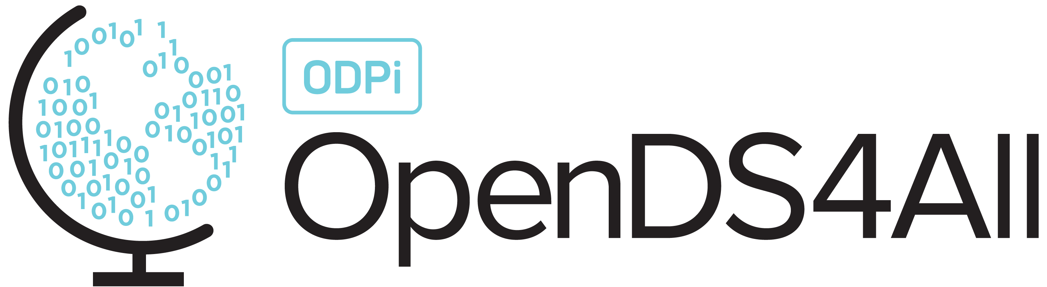
Overview of Machine Learning Models
This work is supported by the National Science Foundation under Award 2021287
Difficulty level: Introductory
Notes:
Initial release, Xumin Liu, Rochester Institute of Technology, 2022.
By Xumin Liu https://www.cs.rit.edu/~xl/
Except where otherwise noted, this work is licensed under a Creative Commons Attribution-4.0 International License https://creativecommons.org/licenses/by/4.0/

Slide 2
Contents
Introduction to Machine Learning
Supervised Learning vs Unsurprised Learning

Slide 3
Introduction to Machine Learning

Slide 4
What is Machine Learning?
Suppose we observe and for
X: a set of attributes/features,
Y: a targeted variable (to be predicted)
n: the number of observations
There may be a relationship between Y and at least one of the X’s.
We can model the relationship as
Later on, we can use X to predict Y for an unseen records
E.g., if a passenger can survive, if an email is a spam, what is the customer’s rating…
an unknown function
is a random error with mean zero
Notes:
Y is the targeted variable, X is observable features
The assumption is that we can derive the value of Y from the observations of X features. The relationship is modeled as f. Once we have f and X, we can predict Y’s value.

Slide 5
A Simple Example
Notes:
Each point in the figure corresponds to a data records. We can learn the relationship between X and Y from those records and use the learned relationship to determine Y’s value for new records.

Slide 6
A Simple Example
ε_{i}
f
Notes:
The red line shows a learned f model from the observations. It fits the data pretty well. The y’s value on the line (predicted) and the actual y value could be different. With a good model, their differences, i.e., errors, should be random with zero mean.

Slide 7
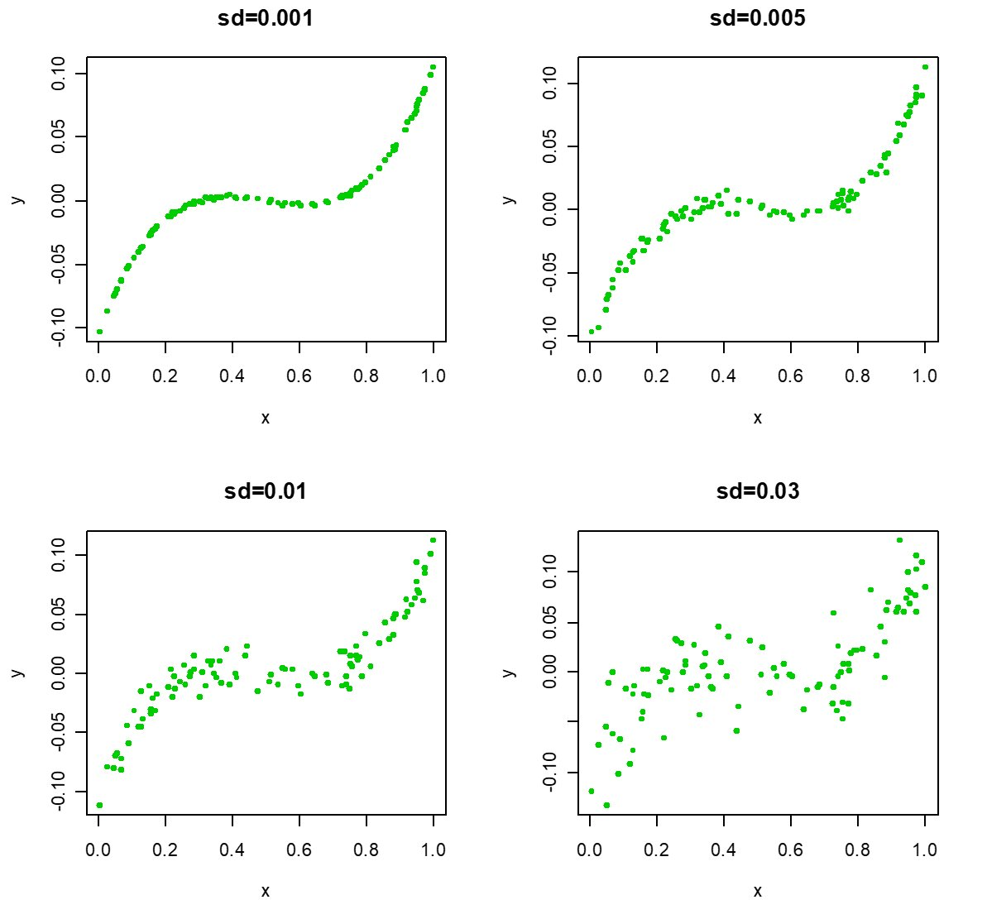
Different Standard Deviations
The difficulty of estimating f will depend on the standard deviation of the ε’s.
Notes:
The larger standard deviations of a dataset is, the more difficult to estimate f. From these figures, the first one has the lowest standard deviation and we can easily find a smooth line fitting the data. The last one has the highest standard deviation and the data is quite chaos. It is obviously the hardest one to estimate the f model.

Slide 8
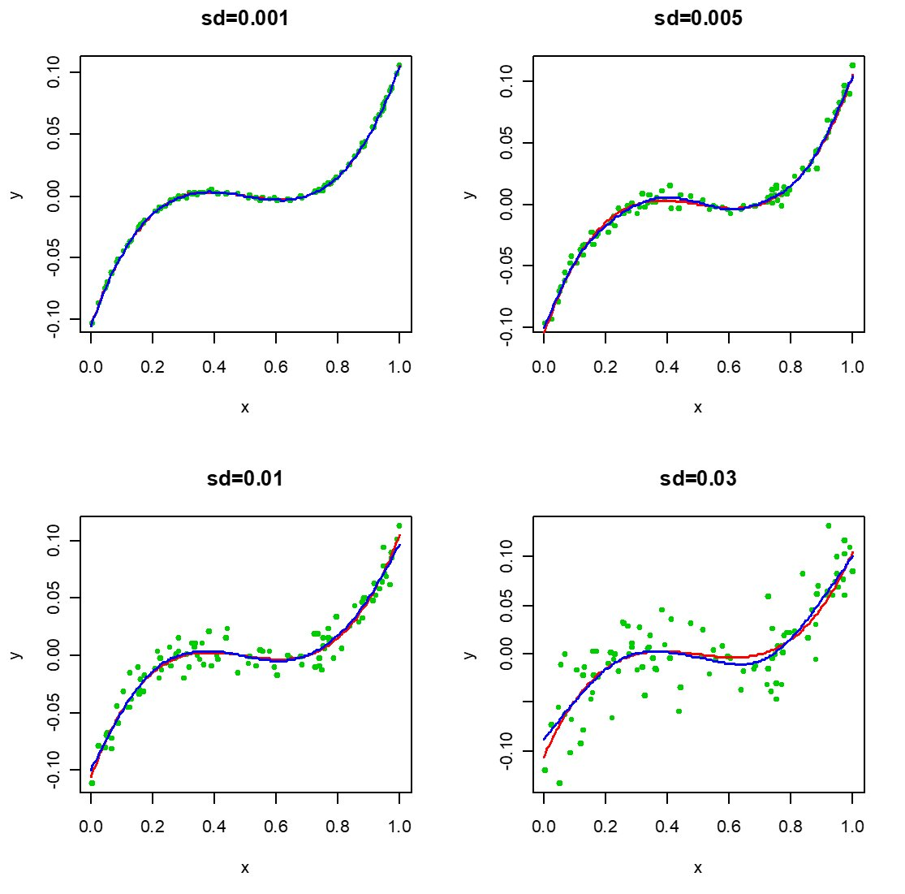
Different Standard Deviations
Notes:
This one shows the true model and the model learned from the data using a machine learning algorithm. In the data with the lowest sd, the two models perfectly align together. The higher the sd is, the more difference is between the two models.

Slide 9
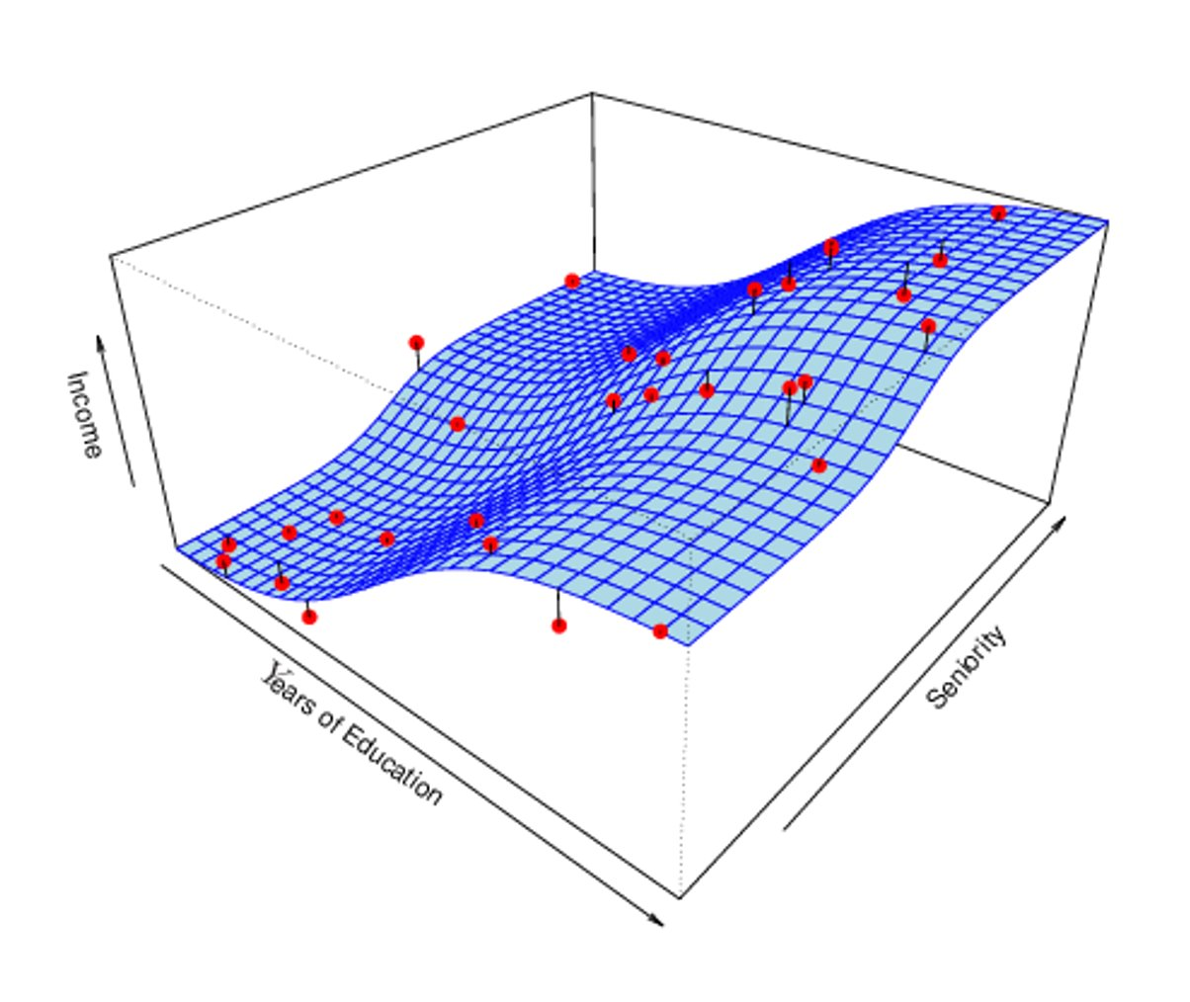
Income vs Education Seniority
Notes:
This example shows the model between Income, i.e., the targeted variable, and two features, Years of Education and Seniority. The red spots represent the data records. The blue surface represents the learned model.

Slide 10
Why do we Estimate f?
Machine Learning (or Statistics Learning) is about how to estimate f
The term statistical learning refers to using the data to “learn” f
There are 2 reasons for estimating f
Prediction
Inference
Notes:
Machine learning methods are designed to estimate the definition of f from the data so that we can use f to make prediction or inference.

Slide 11
Prediction
If we can produce a good estimate for f (and the variance of ε is not too large) we can make accurate predictions for the response, Y, based on a new value of X
Example: direct mailing prediction
Interested in predicting how much money an individual will donate based on observations from 90,000 people on which we have recorded over 400 different characteristics.
X: characteristics
Y: the donation amount
For a given individual should I send out a mailing?
Predict Y given X using f
Notes:
Predication is to predict values of the target variables using f and X.

Slide 12
Inference
Alternatively, we may also be interested in the type of relationship between Y and the X's
For example
Which particular predictors actually affect the response?
Is the relationship positive or negative?
Is the relationship a simple linear one or is it more complicated etc.?
Notes:
Inference is to study the relationship such as the type of relationship, the influence of a feature on the targeted variable.

Slide 13
Example: Housing Inference
Wish to predict median house price based on 14 variables
Probably want to understand which factors have the biggest effect on the response and how big the effect is
E.g., how much impact does a river view have on the house value etc.
Notes:
Studying on what factors impact on the price of a house can help us make investment decision.

Slide 14
Another Example
Wish to learn the impact of three different media, i.e., newspaper, radio, TV, on the sales
Examine the relationship between the sales and budget for each of the three media
Purpose: Achieve better budget allocation
Notes:
Wish to learn the impact of three different media, i.e., newspaper, radio, TV, on the sales
Examine the relationship between the sales and budget for each of the three media,
Purpose: Achieve better budget allocation.

Slide 15
Supervised Learning vs Unsurprised Learning

Slide 16
Supervised vs Unsupervised Learning
Supervised Learning:
Both the predictors, X_{i}, and the response, Y_{i}, are observed
Example: predict if an email is spam or not
A dataset where both the email features and email labels are given
Crowdsourcing: annotate (label) items at a low cost
Models: classification, regression
Unsupervised Learning:
Only the X_{i}’s are observed
Example: market segmentation where we try to divide potential customers into groups based on their characteristics
Models: clustering, association rule discovery
Notes:
In supervised learning, the targeted variable Y is observable, such as the labels of emails or the selling prices of houses. The learning process is supervised based on a training dataset where Y’s value for each record is known. It is typical to leverage crowdsourcing to label large scale data at a low cost. Typical machine learning models for supervise learnings can be categorized into classification and regression.
In unsupervised learning, Y is not observable. Labeled data is not required for the learning process. It aims to learn some specific pattern in the data. Typical models can be for data clustering and association rule discovery.

Slide 17
Supervised Learning
Given a collection of instances (training set)
Each data instance contains a set of attributes where one of the attributes is the target variable (Y)
Create a model for the target variable (Y) as a function of the values of the other attributes (X)
Goal:
When applying the model to previously unseen data instances, Y’s value should be computed as accurately as possible
A test set is used to determine the performance of the model. Usually, a data set is divided into training and test sets, with the training set used to build the model and the test set used to validate it
Notes:
In a supervised learning, a training set is required where the values of the features, i.e., X, and the targeted variable, i.e., Y, are given. The learning result is a model that can be used to compute Y’s value based on X’s value.
A test set is used to evaluate the performance of the learned model. The predicted labels of the data records in the set will be compared to the true labels to determine how accurate the model is for the prediction.

Slide 18
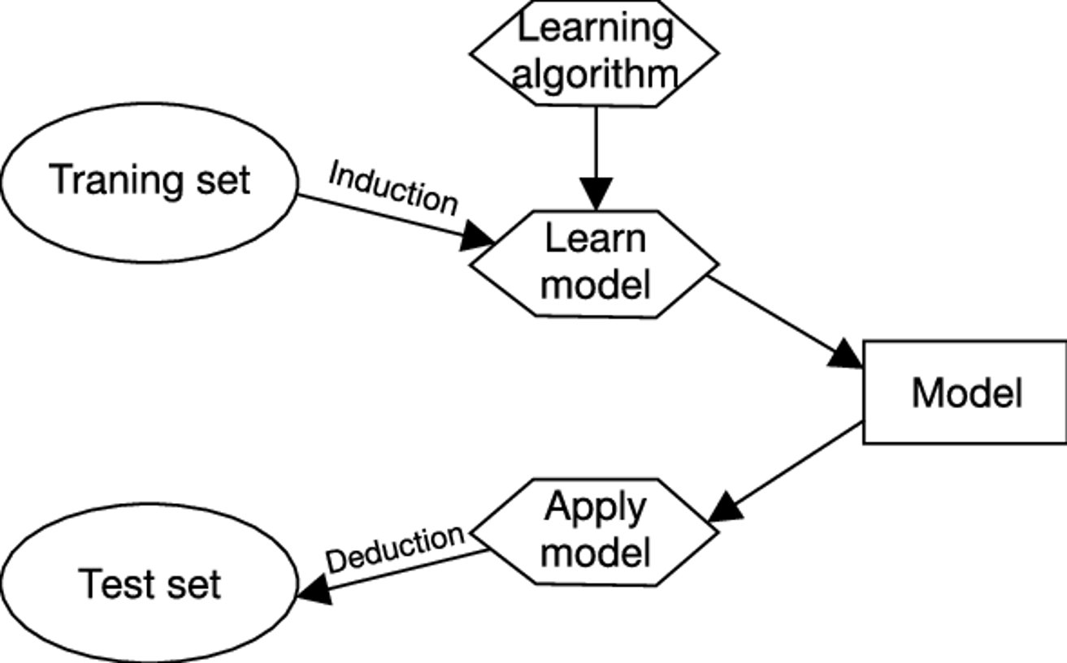
Supervised Learning
Induction: go from specific instances to general principles (model)
Deduction: go from general principles (model) to a specific conclusion

Slide 19
Clustering
Finding groups of objects such that the objects in a group are similar (related) to one another and different from (unrelated to) the objects in other groups
Inter-cluster distances are maximized
Intra-cluster distances are minimized
Notes:
Clustering is to group data objects so that similar ones are grouped together and different ones fall into different groups. The ideal clustering result should minimize the intra-cluster distances and maximize the inter-cluster distances.

Slide 20
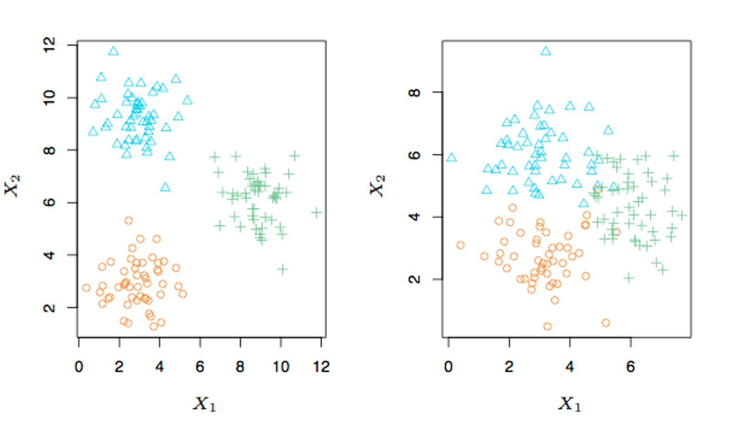
A Simple Clustering Example
Notes:
The data objects are grouped into three clusters, represented with different colors and markers. In the left figure, the clusters are well separated. The clusters in the right figure are not.

Slide 21
Clustering Example
Market Segmentation:
Goal: subdivide a market into distinct subsets of customers where any subset may conceivably be selected as a market target to be reached with a distinct marketing mix
Approach:
Collect different attributes of customers based on their geographical and lifestyle related information
Find clusters of similar customers
Measure the clustering quality by observing buying patterns of customers in same cluster vs. those from different clusters
Notes:
Generating clusters for customers helps summarize the types of customers and make marketing decisions.

Slide 22
Association Rule Discovery: Definition
Given a set of records each of which contain some number of items from a given collection;
Produce dependency rules which will predict occurrence of an item based on occurrences of other items
Rules Discovered:
{Milk} --> {Coke}
{Diaper, Milk} --> {Beer}
Notes:
Association rule discovery is usually used in transaction data, where each transaction contains several items. The targeted pattern is related to the dependency between those items.

Slide 23
Association Rule Discovery: Example
Find potential correlation between events:
Customers who buy HDTV are more likely to buy exercise machines
Customers who buy Tea are more likely to buy Muffins
Patients who have a stoke are more likely to have hypertension
Patients who have tested positive COVID are more likely to develop a fever
Notes:
Association rule discovery can also be used to find the potential correlation between events.

