Slide 1

Building AI Trust: AI Explainability 360
Difficulty level: basic-intermediate
Notes:
Hello Everyone!
Today we will be discussing how to build AI trust with explainability, in particular how to use the AIX360 toolkit to do so.

Slide 2
Contents
Introduction to AI Trust
Explainability
AI Explainability 360
Use Case Walkthrough
Data Explanation with Protodash
Global Model Explanation with BRCG
Local Model Explanation with LIME and SHAP
Deep Learning Explanation with SHAP
Notes:
To help keep everything in context, here is an overview of what we will be covering:
We will start with an introduction to the principles of AI Trust, and the AIX360 Toolkit which helps put those principles into practice.
Then we will then spend some time walking through a use-case, an AI model that diagnoses breast cancer, to demonstrate how to use a few of the algorithms in the toolkit.
Finally, we will offer an example of how these tools can also be used for more intricate Deep Learning projects.

Slide 3
Introduction to AI Trust

Slide 4

When a Computer Program Keeps You in Jail
“Technological advancement is, in theory, a welcome development.”
“But in practice, aspects of automation are making the justice system less fair for criminal defendants.”
“The developers tend to view their technologies as trade secrets.”
“As a result, they often refuse to disclose details about how their tools work.”
https://www.nytimes.com/2017/06/13/opinion/how-computers-are-harming-criminal-justice.html
https://nicic.gov/when-computer-program-keeps-you-jail-2017-0
Notes:
Reply from the United States Department of Justice
When a Computer Program Keeps You in Jail (2017) | National Institute of Corrections (nicic.gov)
on the New York Times article “When a Computer Program Keeps You in Jail”
Opinion | When a Computer Program Keeps You in Jail - The New York Times (nytimes.com)
"Technological advancement is, in theory, a welcome development. But in practice, aspects of automation are making the justice system less fair for criminal defendants. The root of the problem is that automated criminal justice technologies are largely privately owned and sold for profit. The developers tend to view their technologies as trade secrets. As a result, they often refuse to disclose details about how their tools work, even to criminal defendants and their attorneys, even under a protective order, even in the controlled context of a criminal proceeding or parole hearing."

Slide 5

Trust Defined
The willingness of a party to be vulnerable to the actions of another party.
Is based on the expectation that the other will perform a particular action important to the trustor.
Is irrespective of any ability to monitor or control that other party.
Notes:
So, what is Trust? We all know what it feels like, but it can be tricky to define.
Roger C. Mayer and the other authors of “An Integrative Model of Organizational Trust," define it as "the willingness of a party to be vulnerable to the actions of another party."
They continue that this willingness is based on certain expectations, that the other will perform a particular action, and that this willingness is completely separate from any ability to monitor or control the other party.
If you could be sure that the other party will keep its side of the bargain, you don't need to trust.
It is when you aren't sure, or don't feel the need to make sure, that trust enters the equation.

Slide 6

Trustworthy vs. Trusted
Trust implies trustworthiness: the ability to perform the service the trustor requires at an appropriate standard.
A party may be trustworthy, but it may not necessarily be trusted.
The trustor must consciously decide to be vulnerable based on how trustworthy the trustee seems.
Notes:
Now, trust implies "trustworthiness." If you trust a party, you believe that they can and will deliver what they are offering. However, there is a difference between being "trustworthy" and being "trusted."
Even if you are trustworthy, you may not necessarily be trusted.
The trustor must consciously decide to be vulnerable to you, and they generally do so based on how trustworthy you seem to be.

Slide 7

AI Trust
As AI is operationalized, it is imperative that is it both trustworthy and trusted.
There is currently not much trust in AI among the general public, due to the difficulty of demonstrating a model’s trustworthiness.
IBM outlined five pillars of AI trust that support and demonstrate trustworthiness in model building.
Notes:
What does this have to do with AI?
As AI becomes more embedded in daily life and business, it has become imperative that is it both trustworthy and trusted.
AI can seem mysterious — sometimes even to its own engineers — so it can be difficult to demonstrate its trustworthiness.
In response to this, IBM has outlined three principles and five pillars which can be used to strengthen trust in AI systems.

Slide 8
The Five Pillars of Trust
AI ethics is a multidisciplinary field that studies how to optimize AI's beneficial impact while reducing risks and adverse outcomes. It enables trustworthy AI, or AI systems that address human needs, safety, and privacy.
IBM’s approach to AI ethics and trustworthy AI is defined by 3 principles and upheld by 5 pillars:
Principles for Trust and Transparency
The purpose of AI is to augment human intelligence
Data and insights belong to their creator
New technology, including AI systems, must be transparent and explainable.
Pillars of Trust
Explainability
AI system’s ability to provide a human-interpretable explanation for its predictions and insights.
Fairness
Equitable treatment of individuals or groups of individuals by an AI system. Fairness for an AI system depends on the context in which it is used.
Robustness
AI system’s ability to handle exceptional conditions, such as abnormalities in input, effectively.
Transparency
AI system’s ability to include and share information on how it has been designed and developed.
Privacy
AI system’s ability to prioritize and safeguard consumers’ privacy and data rights.
https://www.ibm.com/artificial-intelligence/ethics
Notes:
Only by embedding ethical principles into AI applications and processes can we build systems based on trust.
AI ethics is the multidisciplinary field that studies how to optimize AI's beneficial impact while reducing risks and adverse outcomes.
AI ethics enables us to develop trustworthy AI, or AI systems that address human needs, safety, and privacy.
IBM’s approach to AI ethics and trustworthy AI is defined by 3 principles:
The purpose of AI is to augment human intelligence
Data and insights belong to their creator
New technology, including AI systems, must be transparent and explainable
The principles are supported by 5 pillars:
Explainability: How AI-led decisions are made and what determining factors were included are crucial to understand.
Fairness: Properly calibrated, AI can assist humans in making fairer choices by mitigating bias.
Robustness: As systems are employed to make crucial decisions, AI must be secure and guard against adversarial threats.
Transparency: Transparency reinforces trust, and the best way to promote transparency is through disclosure.
Privacy: AI systems must prioritize and safeguard consumers’ privacy and data rights

Slide 9
AI Trust Matters
Only by embedding ethical principles into AI applications and processes can we build systems based on trust.
Brand
reputation
Increased
regulation
Complexity of AI deployments
Social
justice
90%
89%
89%
87%
of companies using AI say maintaining brand integrity and customer trust is a top priority
of companies using AI say meeting external regulatory and compliance obligations is a top priority
of companies using AI say ability to monitor data and AI across the entire lifecycle is a top priority
of companies using AI say ensuring applications and services minimize bias is a top priority
Source: IBM Global AI Adoption Index 2021
https://newsroom.ibm.com/IBMs-Global-AI-Adoption-Index-2021
Notes:
According to IBM’s annual Global AI Adoption Index survey, trust is a top-of-mind priority for businesses.
In 2021’s survey of companies using AI:
90% identified brand integrity and customer trust as a top priority
89% identified meeting external regulatory and compliance obligations as a top priority
89% identified the ability to monitor data and AI across the entire lifecycle as a top priority
87% identified minimization of bias as a top priority
Only by building and using AI systems that are trustworthy can companies achieve these high-priority objectives.

Slide 10
Explainability

Slide 11
Explainability
Explainability is the ability of an AI system to provide a human-interpretable explanation for its predictions and insights
Notes:
The focus of this presentation is explainability.
Again, explainability is the ability of an AI system to provide a human-interpretable explanation for its predictions and insights. In other words, explainability is the ability of an AI system to explain and contextualize how and why it arrived at a particular conclusion.
An AI system should be transparent, particularly about what went into its algorithm’s recommendations, as relevant to a variety of stakeholders with a variety of objectives. Any AI system on the market that is making determinations or recommendations with potentially significant implications for individuals should be able to explain and contextualize how and why it arrived at a particular conclusion. An AI system is intelligible if its functionality and operations can be explained non-technically to a person not skilled in the art. When systems have significant implications on individuals, the owners and operators should make available — as appropriate and in a context that the relevant end-user can understand — documentation that detail essential information for consumers to be aware of, such as confidence measures, levels of procedural regularity, and error analysis.

Slide 12
The Importance of AI Explainability
Quality:
Stakeholders must monitor and manage ML models to mitigate the risk of unwanted bias and performance drift
Legality:
Governing bodies are increasingly mandating transparency, auditability, and explainability
Trust:
'Opening the black box' will help engender trust that ML models can make intelligent, ethical, beneficial decisions
Notes:
However, though difficult, it is absolutely crucial for reasons even beyond building trust.
First of all, it is important to be able to explain AI so that stakeholders can monitor it, to make sure that it is truly trustworthy and mitigate the risk of unethical bias and performance drift.
It is also starting to become a legal requirement. Governing bodies are increasingly mandating transparency, auditability, and explainability.
Finally, of course, it is important that AI is explainable in order to engender trust that ML models can make intelligent, ethical, beneficial decisions.

Slide 13
AI Explainability 360

Slide 14
AIX360
The AI Explainability 360 toolkit:
housed on the IBM Research Trusted AI site
an open-source library of algorithms
can help interpret data and machine learning models in a more intuitive way
It contains:
tools to help explain large quantities of data
explainable models
can help illustrate decisions using weights, factors, similar examples, contrasting examples, and other values
Notes:
The AI Explainability 360 toolkit, housed on the Trusted AI repository, is an open-source library of algorithms that can help interpret data and machine learning models in a more intuitive way.
It contains tools to help explain large quantities of data, and explainable models that can help illustrate decisions using weights, factors, similar examples, contrasting examples, and other values.

Slide 15
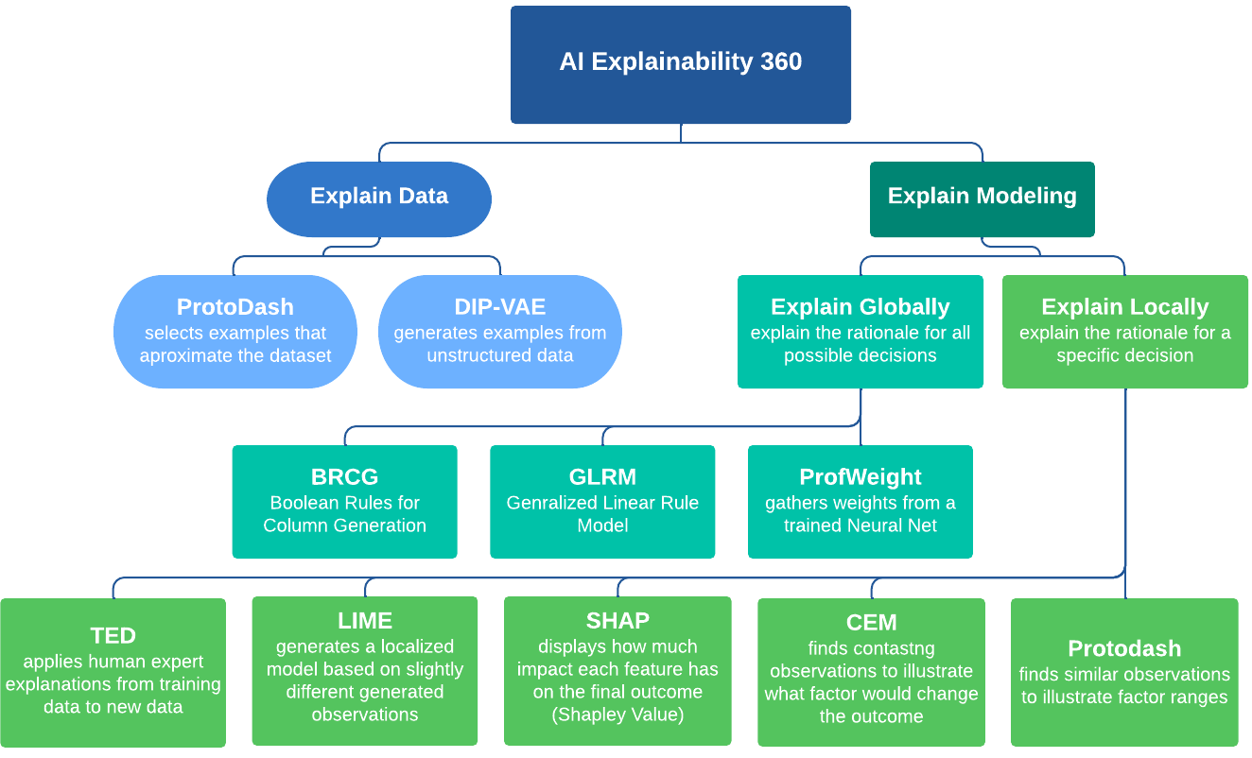
The AIX360 Toolkit
Notes:
Here is a decision tree illustrating all the tools currently included in the library

Slide 16
Tools to Explain Datasets
Notes:
On the left, are tools for explaining data.
Protodash is for tabular data, the kind of data that you might imagine represented in a spreadsheet. Protodash will select examples from the dataset that help illustrate the entire dataset, and we will see this in action later on during our use-case.
DIP-VAE is for unstructured data like images. It will generate examples that demonstrate the entire dataset.

Slide 17
Tools to Explain Models
Notes:
On the right we have the tools to explain AI models, both globally and locally.
The global tools use see highlighted here are directly interpretable models designed to explain the rationale for the entire model.
BRCG, which we will see demonstrated later on, is for classification problems: sorting instances into one class or another.
GLRM is for regression problems: the kind of problems where you are trying to generate a number.
ProfWeight is specifically for Neural Networks. Instead of generating its own model from scratch, it will pull out insights from an already trained NN model.

Slide 18
Tools to Explain Specific Model Predictions or Results
Notes:
Now, maybe we are not interested in explaining the entire model. Maybe we want to know why the model performed the way it did in a specific instance. In this case we are looking for a local explanation, and the AIX360 toolkit has a bunch of tools for these cases.
TED: will take explanations from training data and apply it to new data.
LIME: makes a mini-model just for the one instance, and we will dive deeper into it later.
SHAP: uses Shapley values to pick out what factors most influenced the final outcome, and we will look at this one, too.
CEM and Protodash will pull out contrasting and similar examples.

Slide 19
The Full AIX360 Toolkit
Notes:
This toolkit is still being actively developed, but it already offers tools to cover a wide range of cases where explainability is important.

Slide 20
Use Case Walkthrough Breast Cancer Wisconsin (Diagnostic) Data Set
Notes:
So, lets walk through a case where we can actually use them.

Slide 21
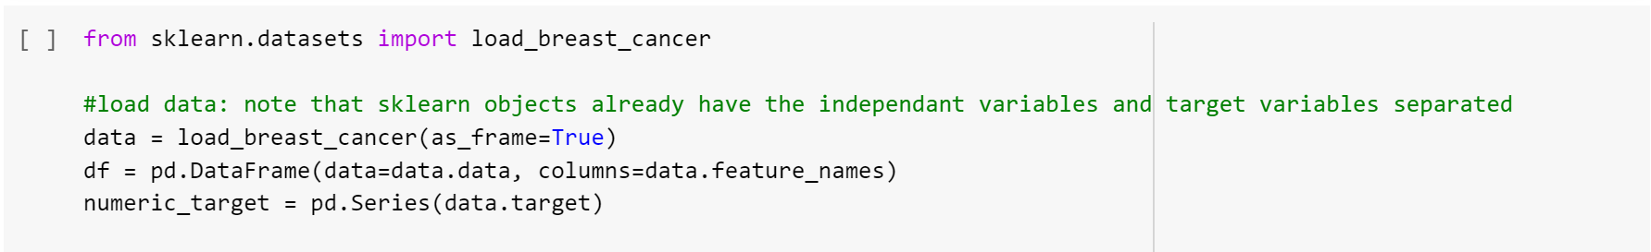
UCI Breast Cancer Wisconsin Dataset
Properties of the data set:
32 attributes that describe cell nuclei
already cleaned
binary classification problem
part of the sklearn package, so it is easy to download
Notes:
For our example case, we are going to be working with the UCI Breast Cancer Wisconsin dataset.
This is a dataset of 32 numerical attributes that describe cell nuclei pulled from breast tissue. The dataset presents a clear binary classification problem: is the mass benign or malignant.
It is also already part of the sklearn package, so it is easy to download and play with, and those of you who are interested in the code can see how right here.

Slide 22



UCI Breast Cancer Wisconsin Dataset
Engineer
Doctor
An engineer will want to evaluate the entire model for performance and compliance.
A doctor will be interested in the results for their patients and how those results compare to other groups or cases.
The patient will only have access to their own results.
They will have domain knowledge regarding the data used by the model.
They will have the least domain knowledge but the most interest in the trustworthiness of the model.
Patient
They will have knowledge of machine learning algorithms and concepts.
Provides an excellent example of how the same dataset and model might require multiple explanations for different audiences.
Notes:
This dataset also provides an example of how the same dataset and model might require multiple explanations for different audiences.
An Engineer will want to evaluate the entire model. They will already have the most knowledge of how the model works, so the explanation can be fairly technical.
A Doctor won't care as much about the entire model, they will want to evaluate the specific results for their patients. They will have a lot of domain knowledge involving breast cancer, so they will be probably most interested in diving deeply into the data.
Finally, the patient themselves will probably have little understanding of machine learning or medicine. They may have the least trust and the most interest in understanding how the model has come to its decision.

Slide 23
Data Explanation AIX360 Protodash Explainer

Slide 24
Why Protodash?
Protodash is for structured data such as our dataset
DIP-VAE is for unstructured data such as images
Notes:
Why Protodash?
As we mentioned before, Protodash is the tool for structured data like our dataset. DIP-VAE is strictly for unstructured data such as images.

Slide 25
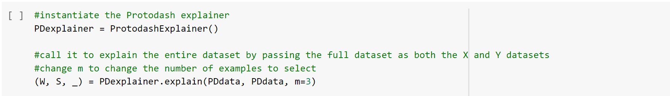
Data Explanation with Protodash
Protodash selects observations that are representative of the trends and weights of the larger group so that a user can get a "feel" for the entire dataset.
For example, if asked to choose one observation, it will choose the most 'average' observation. If asked to choose 10 observations, it will choose 10 that cover the range of the entire dataset.
Notes:
Protodash works by selecting observations that are representative of the trends and weights of the larger group so that a user can get a "feel" for the entire dataset.
For instance, if asked to choose one observation, it will choose the most 'average' observation. If asked to choose 10 observations, it will choose 10 that cover the range of the entire dataset.

Slide 26
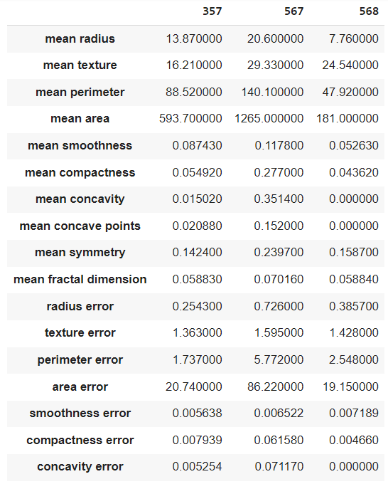
Data Explanation with Protodash
In the example to the left, the algorithm chose three observations: 357, 567 and 568
A doctor would be able to look at these examples, understand what is contained in the entire dataset, and provide an expert opinion on its use for modeling
Notes:
Here on the left you can see Protodash's choice of three examples.
These numbers may not be easily understood by the layman. B,ut a doctor would be able to look at these examples, understand what is contained in the entire dataset, and provide an expert opinion on its use for modeling.

Slide 27
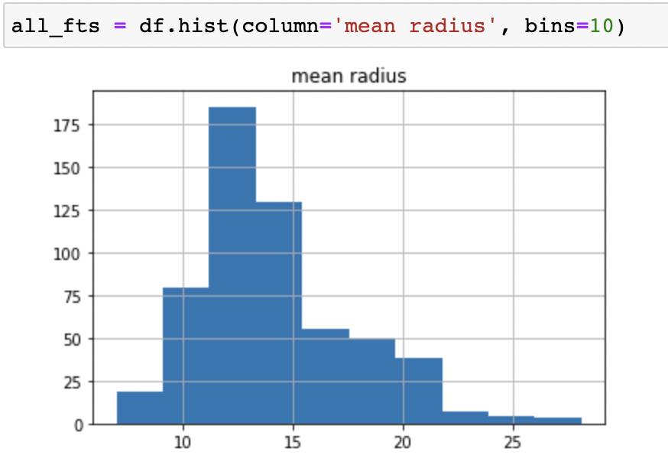
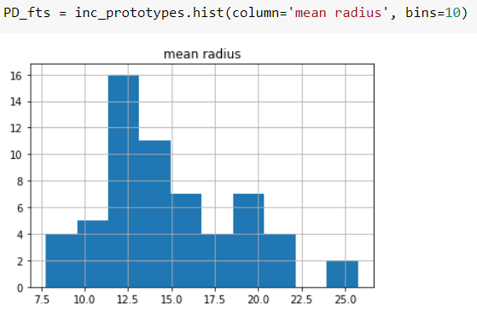
Data Exploration with Protodash
FULL DATASET
As larger subsets are requested, the observations selected will approximate the statistics of the entire dataset, as demonstrated here
An engineer might be interested in these subsets to use for quick modeling, and to get a more mathematical “feel” for the dataset
SUBSET OF 60
Notes:
As larger subsets are requested, the observations selected will approximate the statistics of the entire dataset, as you can see in the images here. The top image is a histogram of "mean radius" in the entire dataset, and the bottom image is "mean radius" in the subset chosen by Protodash.
An engineer might be interested in these subsets to use for quick modeling, and to get a more mathematical “feel” for the dataset.

Slide 28
Global Model Explanation AIX360 BRCG Explainer

Slide 29

Global Model Explanation
The ability to articulate the reasoning of the entire model and all the different cases that it handles.
Some models are simple enough that their reasoning can be easily interpreted into human language. These are called “directly interpretable models.”
All the tools that AIX360 includes for global explanations, and some for local explanations, are directly interpretable models.
Notes:
When we discuss “global explanation” we are referring to the ability to articulate the reasoning of the entire model and all the different cases that it handles.
Some models are simple enough that their reasoning can be easily interpreted into human language. These are called “directly interpretable models.” All the tools that AIX360 includes for global explanations, and some for local explanations, are directly interpretable models.

Slide 30
Why BRCG?
Since the data is divided into classes (benign and malignant), we use BRCG
GLRM provides additional functionality for regression problems
ProfWeight is strictly for Neural Networks
Notes:
Why BRCG?
Since our data is divided into classes: benign and malignant, so we will use BRCG.
If we were working with a problem that provided numerical predictions, we would use GLRM, and if we were using a Neural Network, we would use ProfWeight.

Slide 31
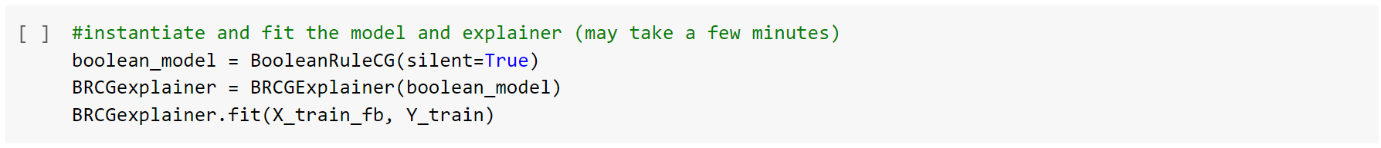
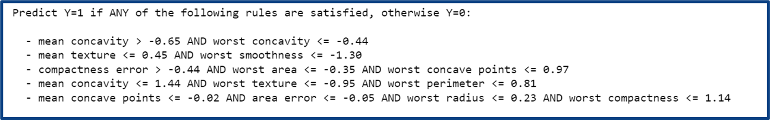
Global Model Explanation with BRCG
Creates a series of "yes" or "no" questions that classify the data.
In our case, it generates several requirements that classify the observations as benign (1) or malignant (0).
Easy to print in a way that a human can read.
Notes:
BRCG is short for "Boolean Rules for Column Generation". A Boolean rule is a "yes or no" rule, and BRCG creates a series of "yes" or "no" questions that classify the data. In our case, it generates several requirements that classify the observations as benign (1) or malignant (0).
The requirements are easy to print out in a way that a human can read.
You can see here: the first requirement is if the mean concavity is greater than -0.65 AND the worst concavity is less than or equal to -0.44, the mass is benign.
Another combination that would indicate benign is if the mean texture is less than or equal to 0.45 AND its worst smoothness is less than or equal to –1.30.
Again, since we aren't doctors, this might not make sense to us, but now we know what questions to ask, don't we? We can see the rules the model has generated for itself.

Slide 32
Global Model Explanation with BRCG
When these rules are visible, various audiences can use them to make sure that the model is making reasonable choices based on expected factors.
It can also be used to demonstrate that the model’s performance can be trusted.
Notes:
Once we have these rules printed out, anyone can use them to make sure that the model is making reasonable choices based on expected factors.
For instance, an engineer can make sure the model isn't making choices based on irrelevant factors,
A doctor can make sure that the choices make sense medically,
and the general public can be comfortable knowing that they can see the workings of the model.

Slide 33
Local Model Explanation AIX360 LIME and SHAP Explainer
Notes:
Let's move on to local explanations. We are going to look at two tools for this: LIME and SHAP

Slide 34

Local Model Explanation
When we discuss “local explanation” we are referring to the ability to explain a specific result from the model.
Why was this particular mass determined to be malignant? How confident are you is the result?
Notes:
When we discuss “local explanation” we are referring to the ability to explain a specific result from the model. Why was this particular mass determined to be malignant? How sure is the result?

Slide 35
Base Model
In order to use any of the AIX360 local explainers, you need the model that gave the result that we want explained.
This model may be as complex as is required for the task at hand.
For this demonstration we will use a simple logistic regression model.
Notes:
In order to use any of the AIX360 local explainers, need the model that gave us the result that we want explained.
This model may be as complex as is required for the task at hand, but for this demonstration we will use a simple logistic regression model.

Slide 36
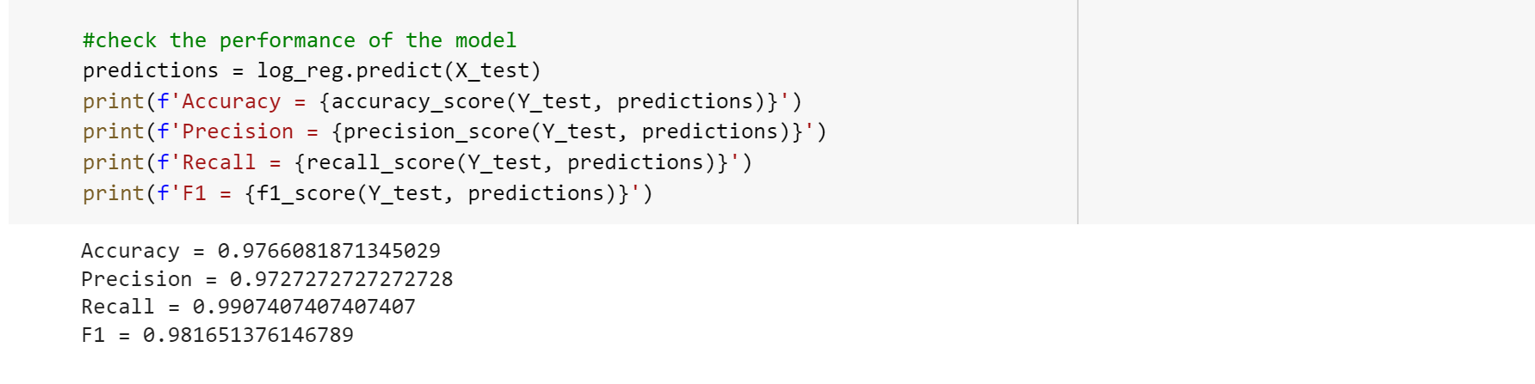
Base Model
First check the performance of the model.
Once we are confident that our model performs well, we redirect our attention to LIME.
Notes:
We first check the performance of the model since if it doesn't work then our explanation will not be much use.
Our example model is sitting at 97% accuracy, which is fantastic, so we can be confident in moving forward to our first local explainer: LIME

Slide 37
Why LIME?
TED requires that the original data include explanations
We will skip to LIME, which will generate its own explanation
Notes:
Here we are in our local explainer tools. We skipped TED because TED requires that the original data had attached explanations. We need to generate our own explanation, so we will start with LIME.

Slide 38
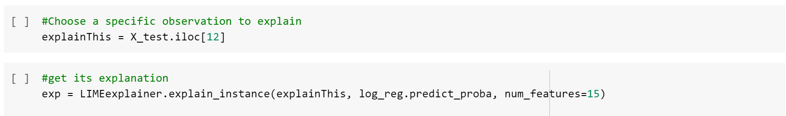
Local Model Explanation with LIME
LIME generates mutated versions of the observation that we want to explain, feeds them to the original model, and quantifies what mutations alter the result of the model.
In this way, LIME builds a directly interpretable model that reflects only the decisions that pertain to this specific case, without getting into the complexities of the entire model.
https://github.com/Trusted-AI/AIX360/tree/master/aix360/algorithms/lime
Notes:
Local Interpretable Model-Agnostic Explanation (LIME) works by first creating slightly mutated versions of the observation that we want to explain.
It then feeds these version to our original model, and observes how the model performs.
In this way, LIME builds a directly interpretable mini-model that reflects only the decisions that pertain to this specific case, without getting into the complexities of the entire model.

Slide 39
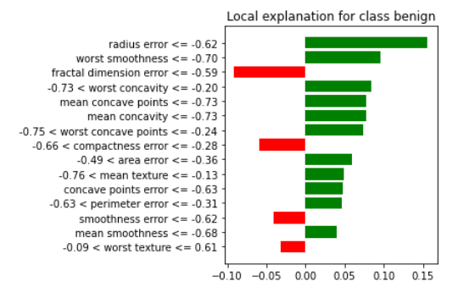
Local Model Explanation with LIME
The characteristics that indicate the positive class (benign) are listed here.
Once the directly-interpretable LIME model is trained, its reasoning is easy to display.
The colored bars show how well or how badly the case matched the characteristic.
Notes:
Once the directly-interpretable LIME model is trained, its reasoning is easy to display.
You can see on the left of the image we have the different characteristics that LIME determined were indicators of the positive class (benign).
And then on the right, bars that indicate if our example contained that characteristic or not: green for contained, red for did not contain.

Slide 40
The characteristics that indicate the positive class (benign) are listed here.
Local Model Explanation with LIME
The abundance of green bars show that the mass in question is benign.
The doctor can see quickly which factors are healthy and which may need to be checked.
The doctors can use their domain knowledge to ensure that the diagnosis is trustworthy.
The colored bars show how well or how badly the case matched the characteristic.
Notes:
In this case, the abundance of green bars show us that the mass in question is benign.
The doctor can see at a glance which factors are healthy and which may need to be checked.
They can use their domain knowledge to ensure that the diagnosis is trustworthy.
For instance, we can also see that there are a few factors that might indicate that the mass is not benign, like fractal dimension error, and a doctor would be able to take a closer look at these to confirm that they were not important instead of just blindly trusting the model.

Slide 41
Why SHAP?
LIME generates a simple model specifically for one case
SHAP uses all the data to calculate the importance of each factor.
Notes:
Another local explainer is SHAP. While LIME generates a simple model specifically for its case, SHAP uses all the data to calculate the importance of each factor.

Slide 42
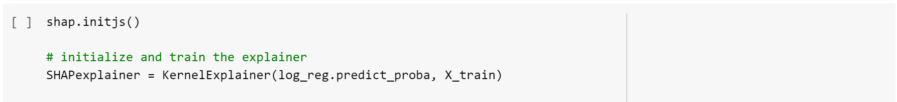
Local Model Explanation with SHAP
SHAP is based on Shapley values, mathematical quantifiers that were originally developed for game theory.
SHAP finds a base value that represents the general imbalance in the dataset, and then sequentially adds features and observes how much they influence the final result.
https://github.com/Trusted-AI/AIX360/tree/master/aix360/algorithms/shap
Notes:
Is anyone familiar with Shapley values?
Shapley values were originally developed for game theory, actually, but they work just as well here in the machine learning world.
The formula first calculates a "base value" that represents the general imbalance in the dataset: if you chose a random instance, how much greater is the chance that it is benign than the chance it is negative.
Once this base value was established, the formula sequentially adds the different characteristics of the observation and observes how much they influence the final result.

Slide 43
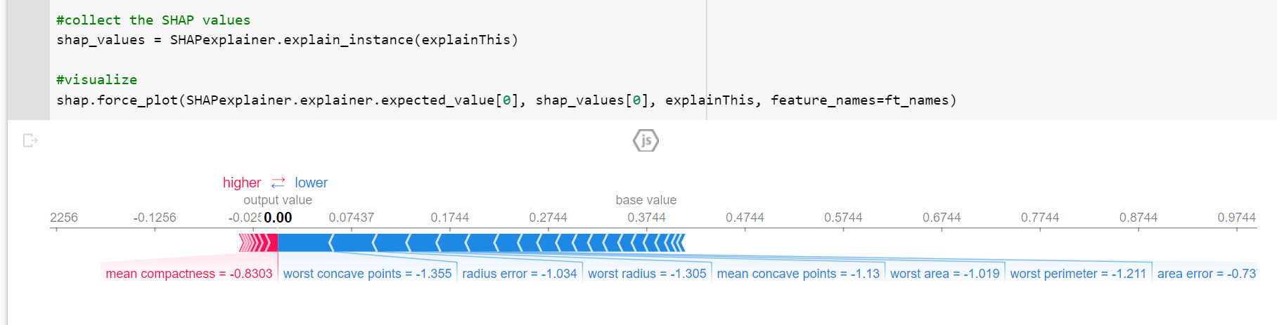
Local Model Explanation with SHAP
SHAP calculates which factors had the most impact on the diagnosis.
https://github.com/Trusted-AI/AIX360/tree/master/aix360/algorithms/shap
Notes:
In this way, SHAP calculates which factors had the most impact on the diagnosis.
You can see a graphical output of SHAP here, with blue factors pulling the diagnosis towards benign, and red factors pulling the diagnosis towards malignant.

Slide 44
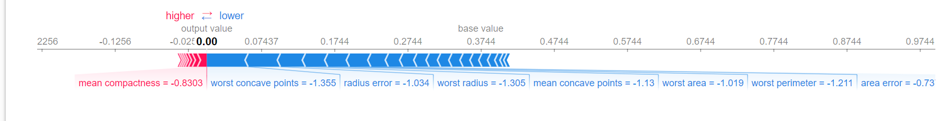
Local Model Explanation with SHAP
In this example, the doctor can see clearly which factors were most important in the benign diagnosis, and how the factors that pull the diagnosis towards malignant (left) are much less important.
Notes:
In this example, the doctor can see clearly which factors were most important in the benign diagnosis: in this case, on the right, "worst concave points" and "radius error" are the factors that most indicate that this mass is benign.
They could also see, to the left, that "mean compactness" indicated that the mass was malignant, but notice that it is much smaller than "worst concave points." Its not a strong indication that the mass is malignant. Worst concavity and these other factors give a much stronger indication that the mass is benign.

Slide 45
Deep Learning Explainability SHAP Deep Learner Explainer applied to Images
Notes:
Let's move on to local explanations. We are going to look at two tools for this: LIME and SHAP

Slide 46

Deep Learning Explainability
Many of the tools in the AIX360 toolkit, including SHAP, can be used to explain deep learning models as well.
This is important because deep learning models are much less explainable than traditional models, with potentially millions of parameters and hundreds of layers.
Notes:
Many of the tools in the AIX360 toolkit including SHAP can be used to explain deep learning models as well.
Why is explainability important for Deep Learning models? Well, although deep neural networks can produce more accurate results than traditional machine learning, they are much less explainable. They often have millions of parameters and hundreds of layers, which makes explaining their reasoning very difficult.

Slide 47
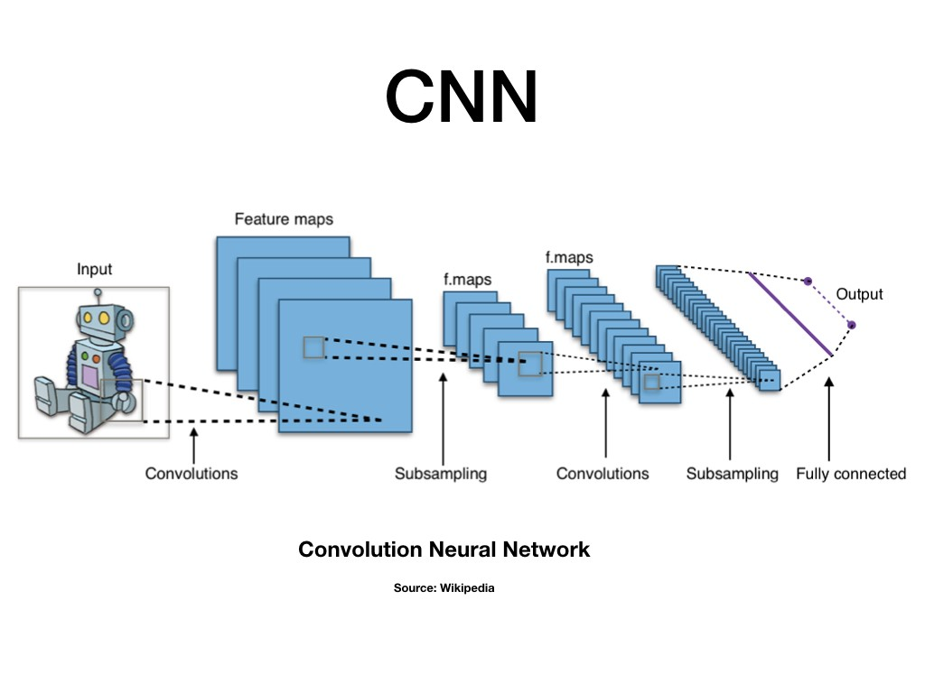
Background
The three key deep learning layers are:
input layers for receiving input
hidden layers for processing
output layer for generating the result.
Convolutional Neural Network (CNN) combines multilayer neural networks with the layers that can extract the main features relevant to classification.
Notes:
Let’s provide brief background information about the deep learning approach to image classification problem. It employs a layered neural network to identify patterns in the images. There are 3 main type of layers and they depend on each other: The data is received by the input layer, passed on to the hidden layers for processing and then the output layer generates the result. The specific image classification algorithm that we are going to use in this tutorial is Convolutional Neural Network that automatically generates and learns features of images.

Slide 48
Image Classification Explainability
Image Classification is fundamental in Computer Vision.
The SHAP explainer can shed light on the Computer Vision models.
CNN can be explained by the score contributions on each pixel for a predicted image class.
The objective in this section: testing the SHAP Deep Explainer performance for a CNN model on a small new dataset.
Notes:
Image classification can be considered as the fundamental topic for computer vision. For these problems, SHAP Deep Explainer can be one of the most used ways of explaining the deep learning models. CNN can be explained by the scores on each pixel on a predicted image class to decide what pixel contribute mostly. The advantage is that SHAP provides both global and local explainability.
In this tutorial, we are going to use a simple multiclass Image Classification problem to illustrate a Deep Learning explainability with SHAP Deep Explainer.
The idea here is to test this explainer’s performance for a CNN pre-trained model in which only the final layer is trained based on 3 classes for a small dataset.

Slide 49
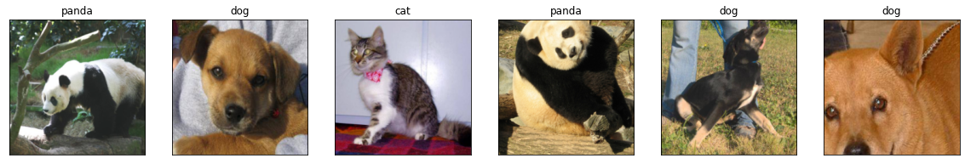
Data Preparation
Dataset: Animal Image dataset (cat, dog and panda) that includes 1000 images in each category.
Split: 85/15 (85% training and 15% testing)
Random samples from the train loader
Notes:
A new Animal Image dataset is used for this problem which has 3 classes: cat, dog and panda. This is fairly a small dataset with only 1000 images in each class. 2 main reasons why we decided to choose a small dataset.
We want to make sure that people can run this tutorial without waiting for long,
If the explainer provides reasonable information even with small data available, then we don’t have to have millions of images in our dataset in order to be able to apply the deep explainer.

Slide 50
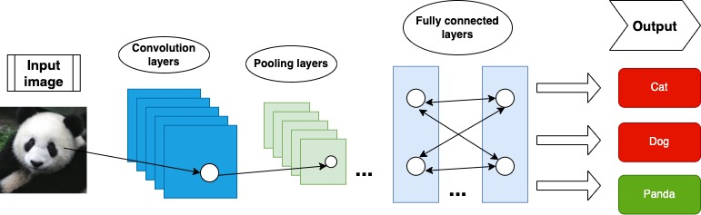
Model
Environment: PyTorch
Importing the pre-trained ResNet-18 model + training final layer based on 3 classes
Model accuracy: 98%
Notes:
As for the modeling part, we imported the pre-trained ResNet model but we trained the final layer based on our 3 classes. This gave us 98% of accuracy
This diagram shows the model architecture for our specific problem.

Slide 51



SHAP Deep Explainer in Action
Load images for the Deep Explainer
Define the background and test images
Instantiate the SHAP Deep Explainer algorithm based on the background images and the model
Notes:
How does the Deep Explainer work? First, we have to load some images for explainer in order to use the SHAP module. We then need to define the background and test images for the Deep Explainer algorithm. As background images we use 100 images out of the batch of 128, while for the test images the next 5 images in the batch is used. We are using only small number of samples here as the Deep Explainer algorithm can be computationally expensive.
We can finally instantiate our Deep Explainer algorithm based on the background images and the model.

Slide 52
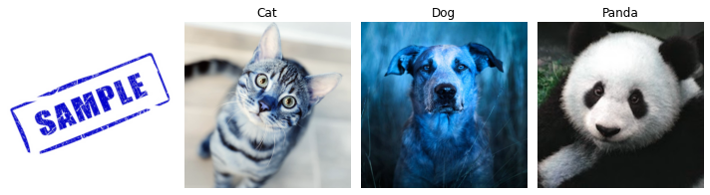
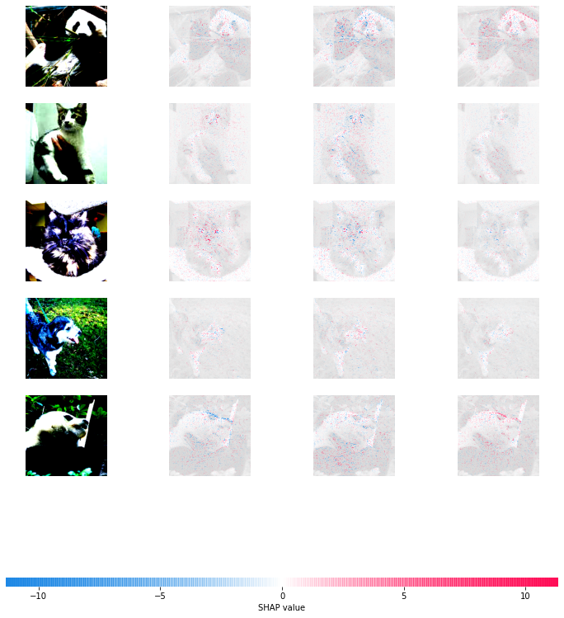
Deep Explainer Results
The rows represent the test images, while the columns represent the true values.
The highlighted pixels clarify the contribution probability.
So, red pixels demonstrate positive, while blue pixels indicate negative contribution to classifying an image for a particular class.
Deep Explainer has focused on the face, especially the eyes and nose.
The algorithm focuses on the differentiating factors.
Notes:
Alright! This is the result based on Deep Explainer. The rows represent the test images, while the columns represent the true values.
To be clear, Red pixels demonstrate positive SHAP values in other words the pixels that contributed to classifying an image while Blue pixels demonstrate negative SHAP values or not classifying an image to a particular class.
The outcome based on the test images is that the Deep Explainer has focused on the face, especially the eyes and nose while differentiating these 3 animals. For example, the algorithm highlighted the pixels of the animals’ eyes and nose as red whenever the model predicted a true value. Also blue pixels were highlighted whenever the model didn’t classify panda as a cat or dog for instance.

Slide 53
Summary
Trust is essential to integrating AI in a meaningful way into daily business.
Explainability, the ability to provide a clear and relevant explanation of a model's decision, is one of the pillars of that trust.
The AIX360 Toolkit can help explain data, models, and model decisions in clear and visual ways for a variety of audiences.
Notes:
To summarize what we have discussed;
Trust is essential to integrating AI in a meaningful way into daily business.
Explainability, the ability to provide a clear and relevant explanation of a model's decision, is one of the pillars of that trust.
The AIX360 Toolkit can help explain data, models, and model decisions in clear and visual ways for a variety of audiences.

