Slide 1

Getting Started with the Data
This work is supported by the National Science Foundation under Award 2021287
Difficulty level: Introductory
Notes:
Initial release, Xumin Liu, Rochester Institute of Technology, 2022.
By Xumin Liu https://www.cs.rit.edu/~xl/
Except where otherwise noted, this work is licensed under a Creative Commons Attribution-4.0 International License https://creativecommons.org/licenses/by/4.0/

Slide 2
Contents
Load the Data
Review the Data
Query the Data
Sort the Data
Notes:
In this lecture, we use a census dataset in the examples: https://www.kaggle.com/datasets/muonneutrino/us-census-demographic-data
Please contact Xumin Liu (xmlics@rit.edu) for the demo code shown in the lecture.

Slide 3
Load the Data

Slide 4
How the Data is Stored
Files (locally or online)
Text files (.txt)
Formatted files (.csv, .xslx)
PDF (.pdf)
Images (.jpg)
…
Databases
Sql (mySQL, Oracle, …)
noSQL (MongoDB, Hbase)
Web
html
xml
json
Notes:
Data can be stored in many places, locally or online; in many formats: unstructured text file, structured file like csv or excel files, pdf files, image files and so on.
Data can be stored in database for more regulated and efficient management. The traditional databases are relational ones such as MySQL, Oracle server, Microsoft SQL server, and so on. The common features of those databases include: using SQL as the query language, high requirement on data integrity and consistency, and a uniform data schema to organize data. NoSQL databases support a variety of data formats and data query languages. They have different design compared to SQL databases, usually have more flexible data schema and higher tolerance on data inconsistency, but provides a better performance for some applications. Examples of those NoSQL databases are MongoDB, Amazon Hbase, Google File system, and so on.
Data can be stored on the Web such as the information embedded in web pages. The files containing the data usually have the format of HTML, XML, and JSON.

Slide 5
How the Data is Stored
Files (locally or online)
Text files (.txt)
Formatted files (.csv, .xslx)
PDF (.pdf)
Images (.jpg)
…
Databases
Sql (mySQL, Oracle, …)
noSQL (MongoDB, Hbase)
Web
html
xml
json
Notes:
In this lecture, we focus on a type of formatted files, .csv file, which is a common file type for data science tasks.

Slide 6
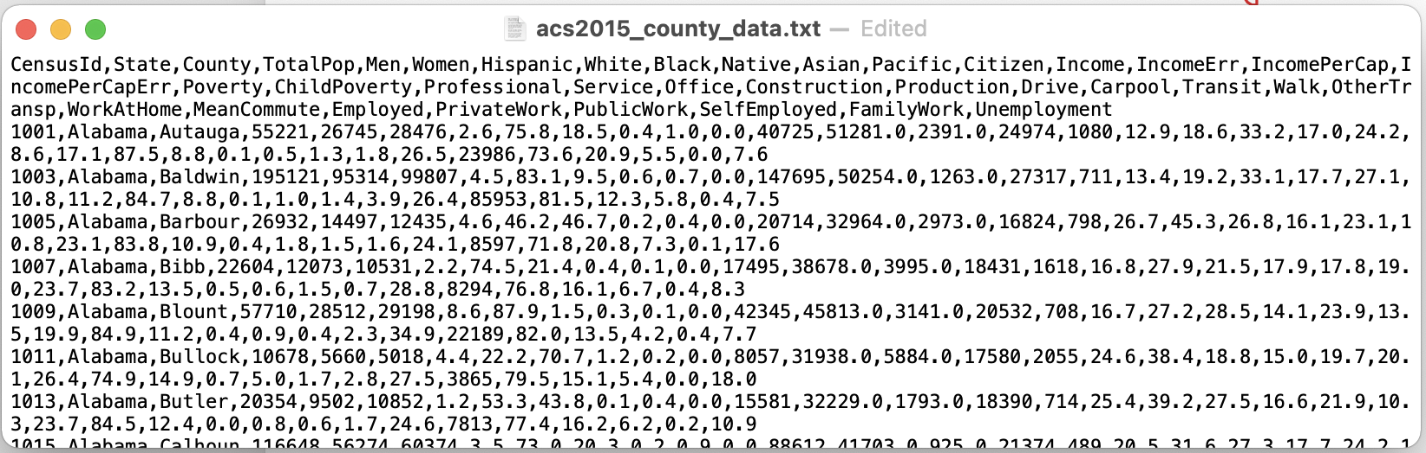
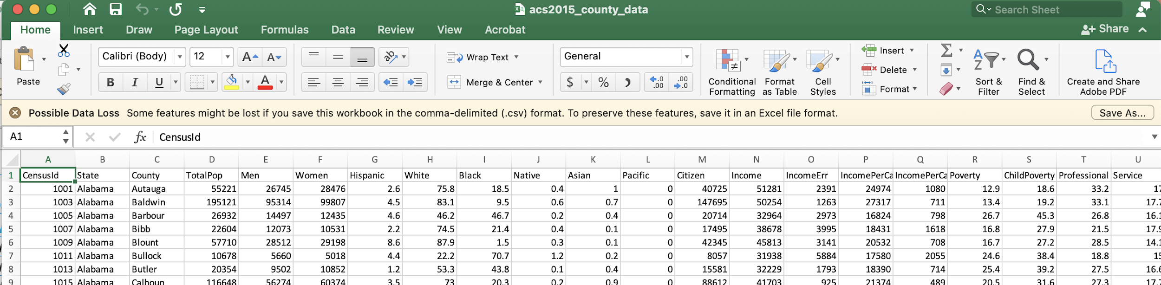
CSV Files
separated by comma
Comma-Separated Values file
Can be opened in Excel
First line lists the attributes, each of the following line corresponds to a record
Notes:
CSV standards for Comma-Separated Values file. Each file has a collection of records and each record corresponds to a line. The first line lists the attributes, each cell is separated by comma. The system uses the comma as the delimiter. And if you need to have this comma character as part of the value, you need to quote it to show that this comma is not a delimiter. With the separation by comma, this file forms a collection of columns as well where each column represents an attribute.
You can also use excel to open a CSV file, and those columns and rows can be clearly displayed.

Slide 7
Python Pandas DataFrames
Pandas: a Python library, a standard for data analysis and management (import it before use)
Dataframe: A type with “two-dimensional, size-mutable, potentially heterogeneous tabular data structure with labeled axes (rows and columns)”
A table of data, or a set of formatted two dimensional data
Each row represents a record (a data sample), e.g., a student
Each column represents an attribute, e.g., studentID, age, major…
The data in every column usually has the same data type (integer, string, …)
Notes:
Python uses DataFrame to hold the data. It is part of the pandas package, which is a popular python library for data manipulation and analysis.
You need to import it before use it. It is common to use “pd” for Pandas.
A dataframe is a Python data type. It has 2 dimensions, rows and columns. It is size mutable, meaning that you can change the shape of it, like adding/deleting rows and columns. It is potentially heterogeneous, meaning usually values for the same column have the same data type but you can also have values with different data types for a column. That provides a good flexibility to hold the data collected from real world applications, but also can cause some data integrity issue.
The rows and columns are indexed.

Slide 8

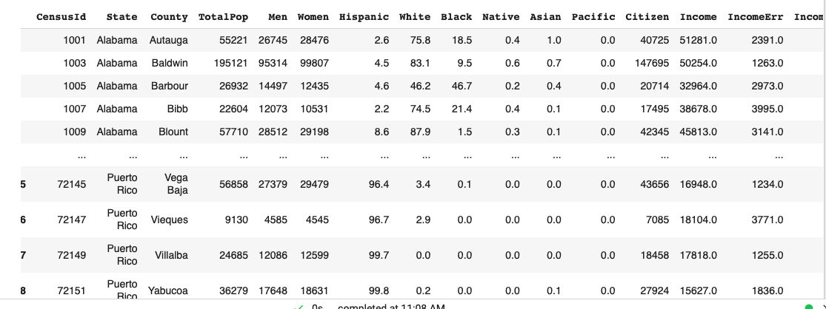

Create DataFrame from CSV Data
file name
load data from csv: use Pandas’ read_csv()
mydata has the type of DataFrame
import pandas first
mydata is a Dataframe
Notes:
Create a dataframe by loading the data from a csv file, using read_csv(). https://pandas.pydata.org/docs/reference/api/pandas.read_csv.html

Slide 9
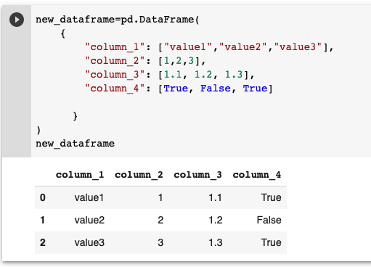
Create Dataframe Manually
Specify the column name and values for each row
Values are specified as a list
Notes:
Create a dataframe manually by specifying the structure (i.e., column names) and the values.

Slide 10
Review the Data

Slide 11
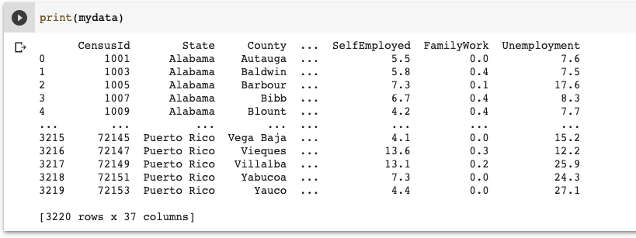

View the Data
Print(mydata): display the content and the shape of a data frame
mydata.shape: show the shape (#of rows and #of columns)
Notes:
Use Python print() function to view the data. By default, only the top 5 and the last 5 tuples are displayed. Display the value of a dataframe.shape attribute to show the shape of it, i.e., the number of rows and the number of columns.

Slide 12
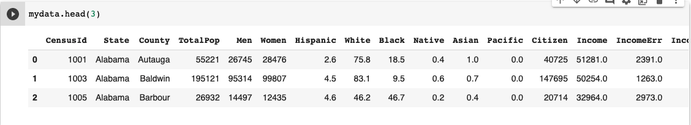
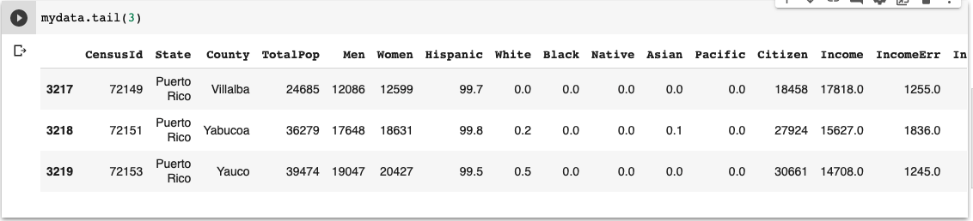
View the Data(cont.)
Head(): show the specified number of the beginning rows
Tail(): show the specified number of the ending rows
By default, the number is 5
Notes:
Use head() or tail() functions to show the specified number of the beginning or ending rows.

Slide 13
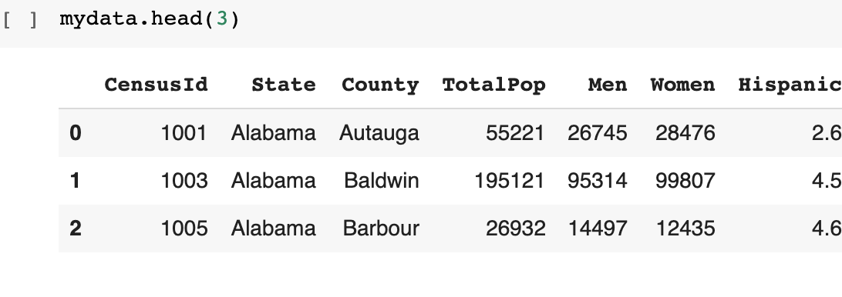
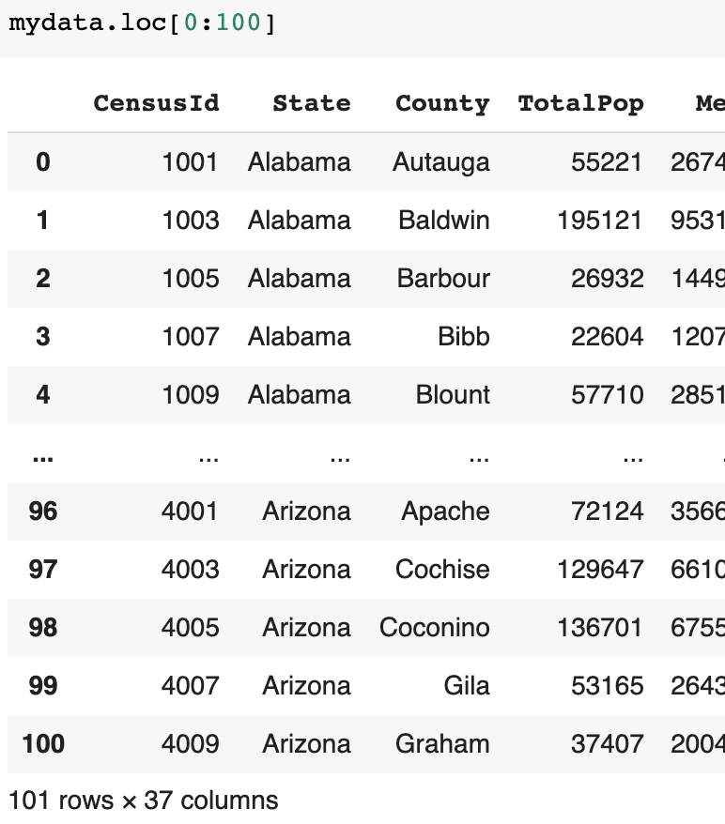
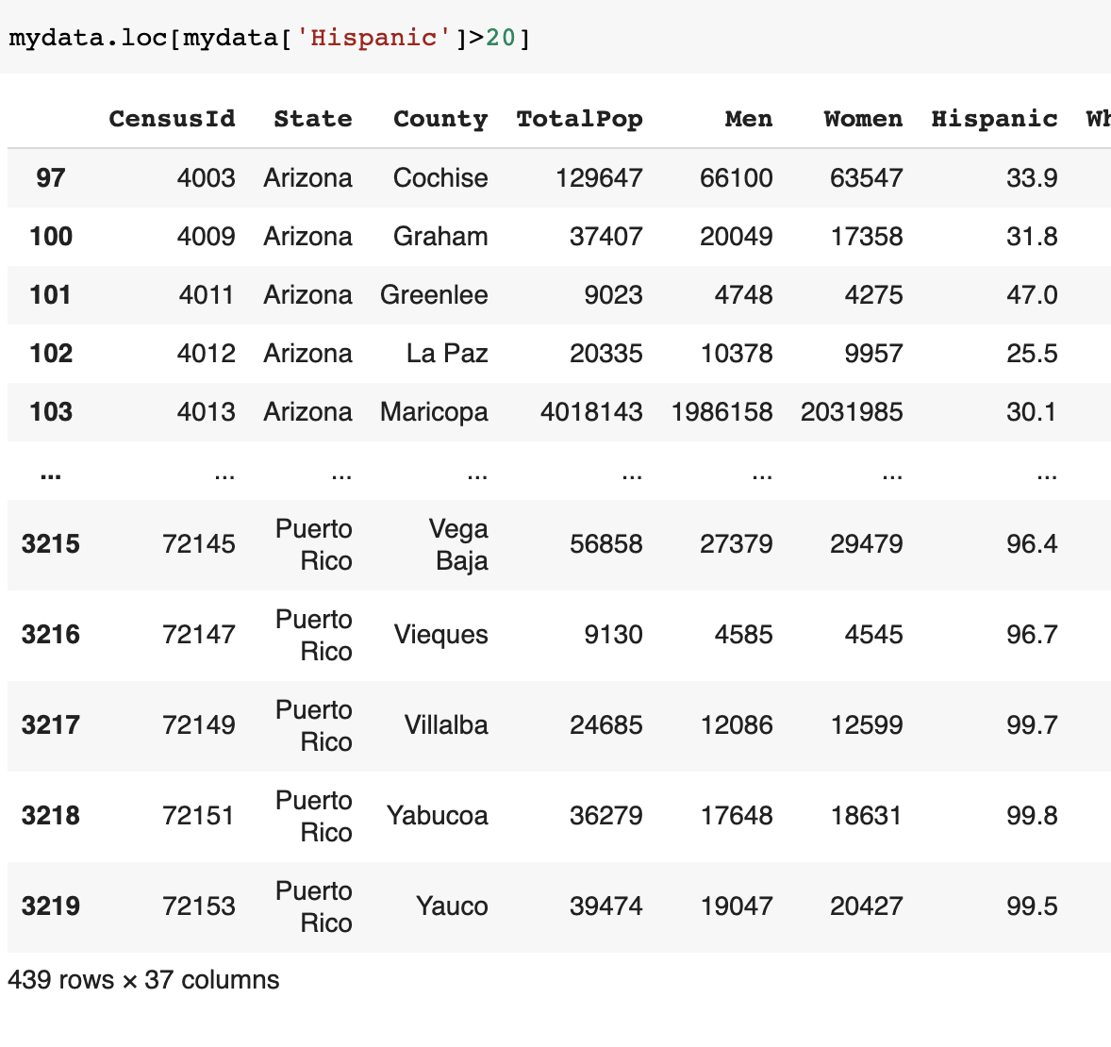
Display the Specified Rows and Columns
Dataframe.loc[]
Display the rows with indexes
Display the row with condition
Notes:
Use dataframe.loc[] to display the rows and columns by label(s) or a boolean array.
https://pandas.pydata.org/docs/reference/api/pandas.DataFrame.loc.html

Slide 14
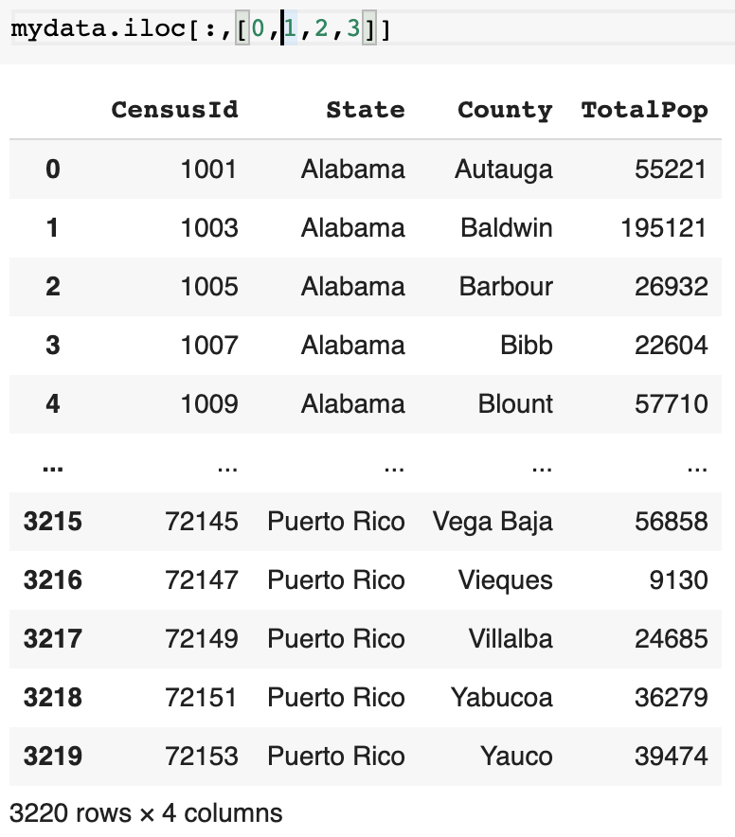
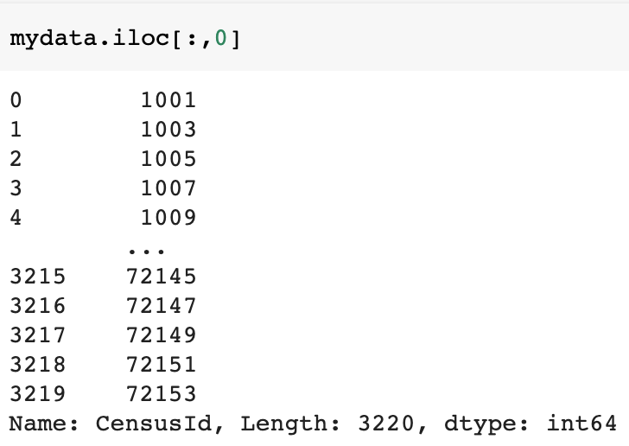
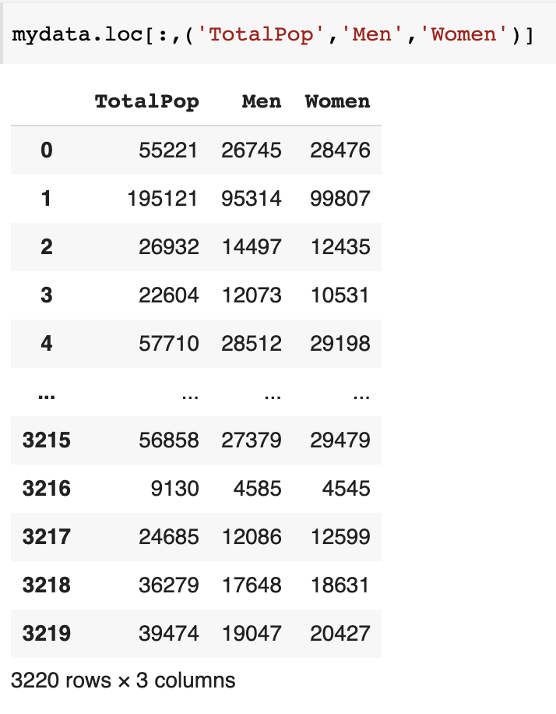
Display the Specified Rows and Columns
0
1
2
3
4
5
6
Display the columns with indexes
Dataframe.iloc(:, index(es))
Display the columns with names
Dataframe.loc(:, name(s))
Notes:
Use dataframe.iloc[] to display the rows and columns by position. https://pandas.pydata.org/docs/reference/api/pandas.DataFrame.iloc.html
If you want to use the column names to specify the display condition, use dataframe.loc[]

Slide 15
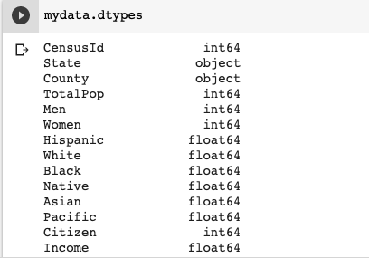
Check Data Type of a Column
Other types: bool, datetime64 (Date and time values), category (finite list of text values such as female/male), …
str or mixed
Notes:
Use Dataframe.dtypes to check the data types of columns.

Slide 16
Query the Data

Slide 17
Query the Data
Why?
Find the information meet the interest
Select the data relevant to a data science task
Query scenarios:
Find the populations of Rochester in 1900 and 1950
Find the weather readings of Rochester in Nov. 2020
Find the daily new covid case numbers in Monroe county in July 2021
…
Notes:
Querying a dataset serves for two purposes: find some specific information or select a subset of the data for further process.
Some query scenarios for a census dataset are listed.

Slide 18
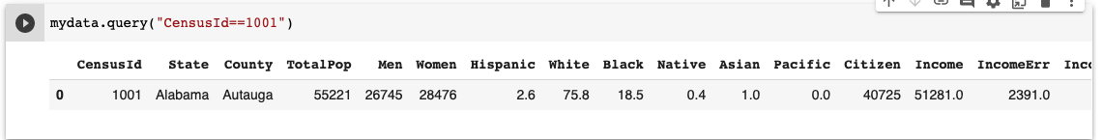
Query Format
A query consists of
Context: which dataframe needs to be queried?
Condition: what requirement needs to be met?
Pandas.DataFrame.query: mydata.query(expr, inplace)
expr: the query string to evaluate (query condition)
inplace: is a boolean indicating whether the query should modify the data in place or return a modified copy
Returns the DataFrame with the filtered rows following the query expression
Notes:
To specify a query, you need to specify its context, i.e., which dataframe needs to be queried, and the query condition, i.e., what determines if a data record should be displayed or not.
Use dataframe.query() function to specify the query. Here the dataframe specifies the context and the query expression specifies the query condition, as the parameter of the function. inplace can be either True or False, indicating if the query should modify the dataset. (https://pandas.pydata.org/docs/reference/api/pandas.DataFrame.query.html)
The result of this function is has a dataframe type.

Slide 19
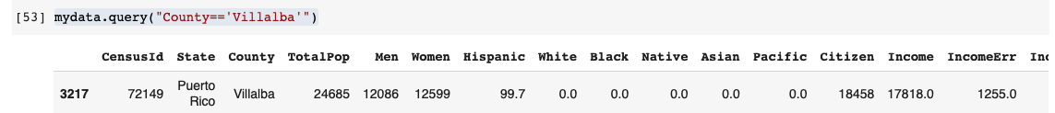
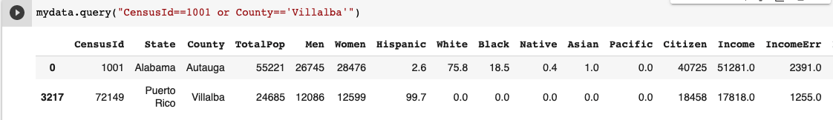
How to Specify Query Conditions?
One condition: use >, <, >=, <=, ==, !=
Multiple conditions: use and or or to connect
Notes:
A query expression can have one or more than one conditions.

Slide 20
Examples
How to specify the following query conditions:
Show the records for Monroe county in New York state.
Show the records for all New York counties
Show the records for those counties that have over 90% White population
Show the records for those counties that have more men then women
Show the records for those counties that TotalPop is not the sum of Men and Women
Show the records for those counties that have below average income ( a little bit tricky…)
Notes:
Write the python code for the queries. The python code can be found in the in-class demo folder.

Slide 21
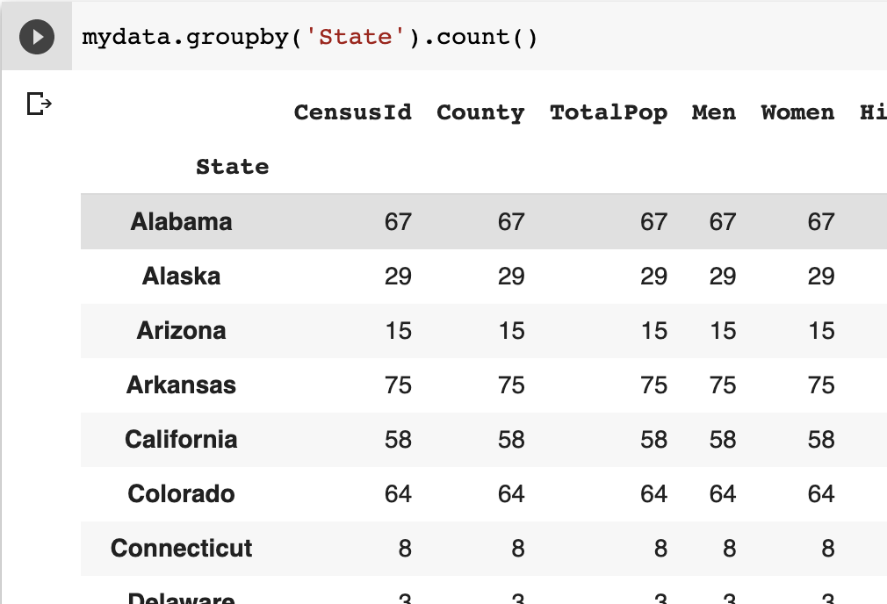
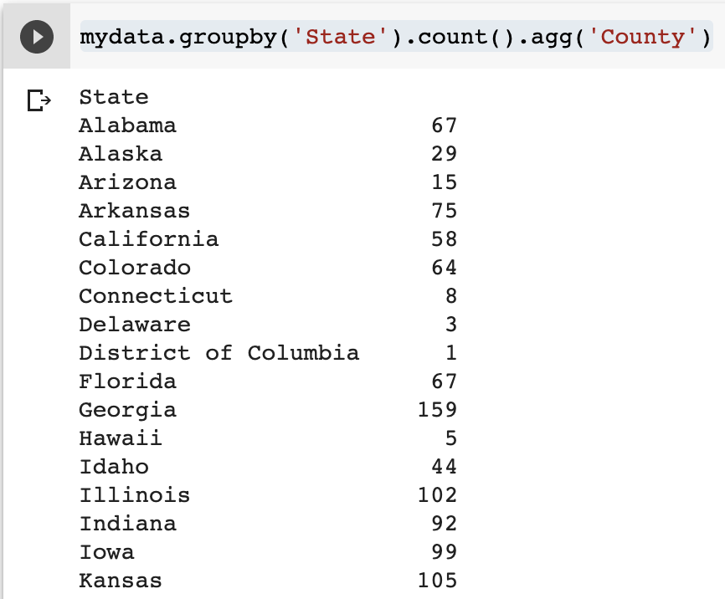
Groupby
Groupby
Group the records with the same value of a certain column
E.g.,the students with the same major, the counties in the same state
Operations: count(), sum()
Aggregation: aggregate on a certain column agg(col)
Notes:
Use dataframe.groupby() function to group the records based on a certain column. Aggregation functions, such as count(), sum() can be applied to each group.
https://pandas.pydata.org/docs/reference/api/pandas.DataFrame.groupby.html

Slide 22
Sorting the Data

Slide 23
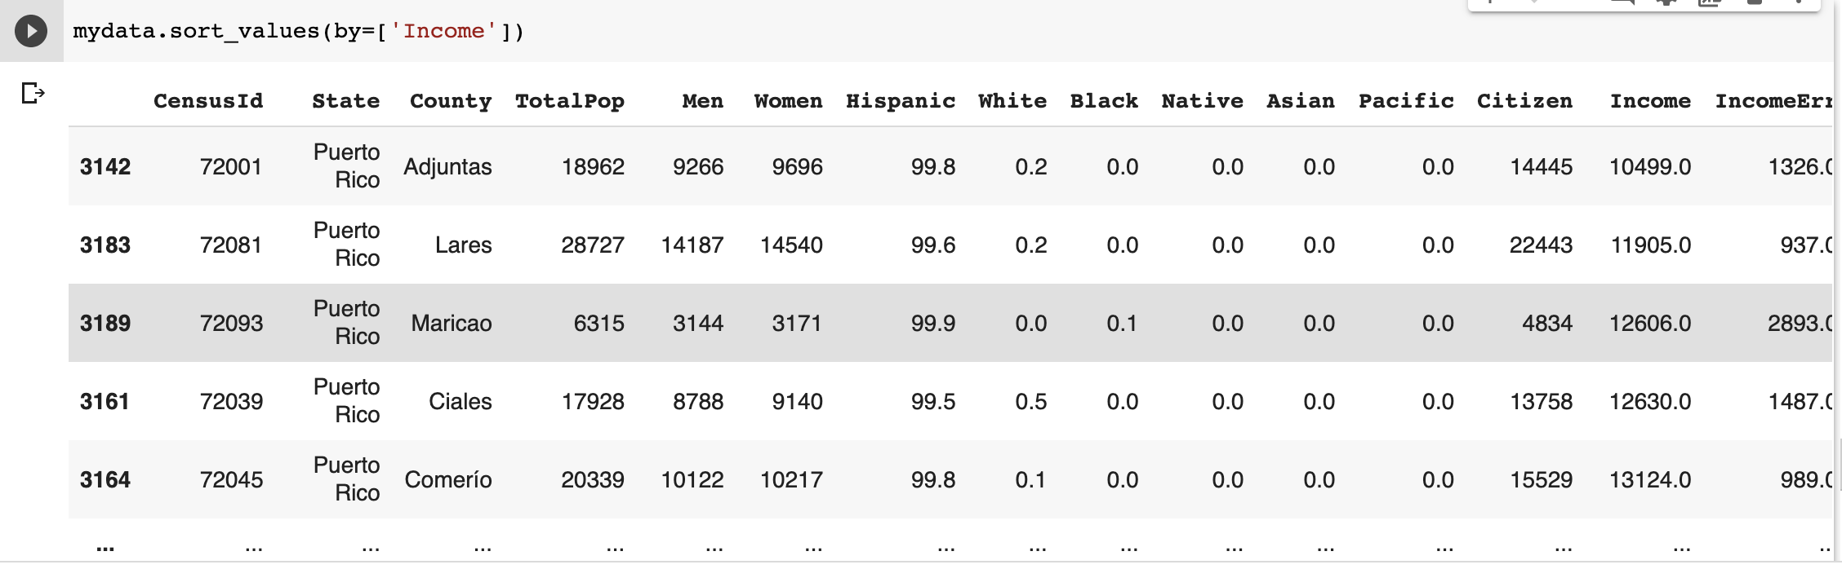
Sorting the Data
Why sort?
Display the data in an interesting way (show the matched products by price)
pandas.DataFrame.sort_values (by, ascending, inplace)
by: str or a list of str (one column or multiple columns)
ascending: True or False (by default, True)
inplace: True or False (by default, False)
Notes:
Sorting the data based on the value(s) of certain row(s) or column(s) provides an interesting view of the data. Use Dataframe.sort_values() function to sort the rows (axis=0, default values) or columns (axis=1).
https://pandas.pydata.org/docs/reference/api/pandas.DataFrame.sort_values.html

Slide 24
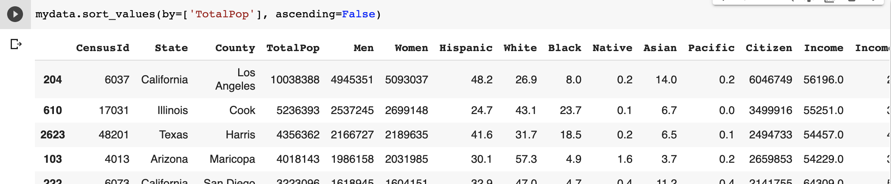
Sorting the Data
Notes:
Sort the census data by the values of “TotalPop” in descending order.

Slide 25
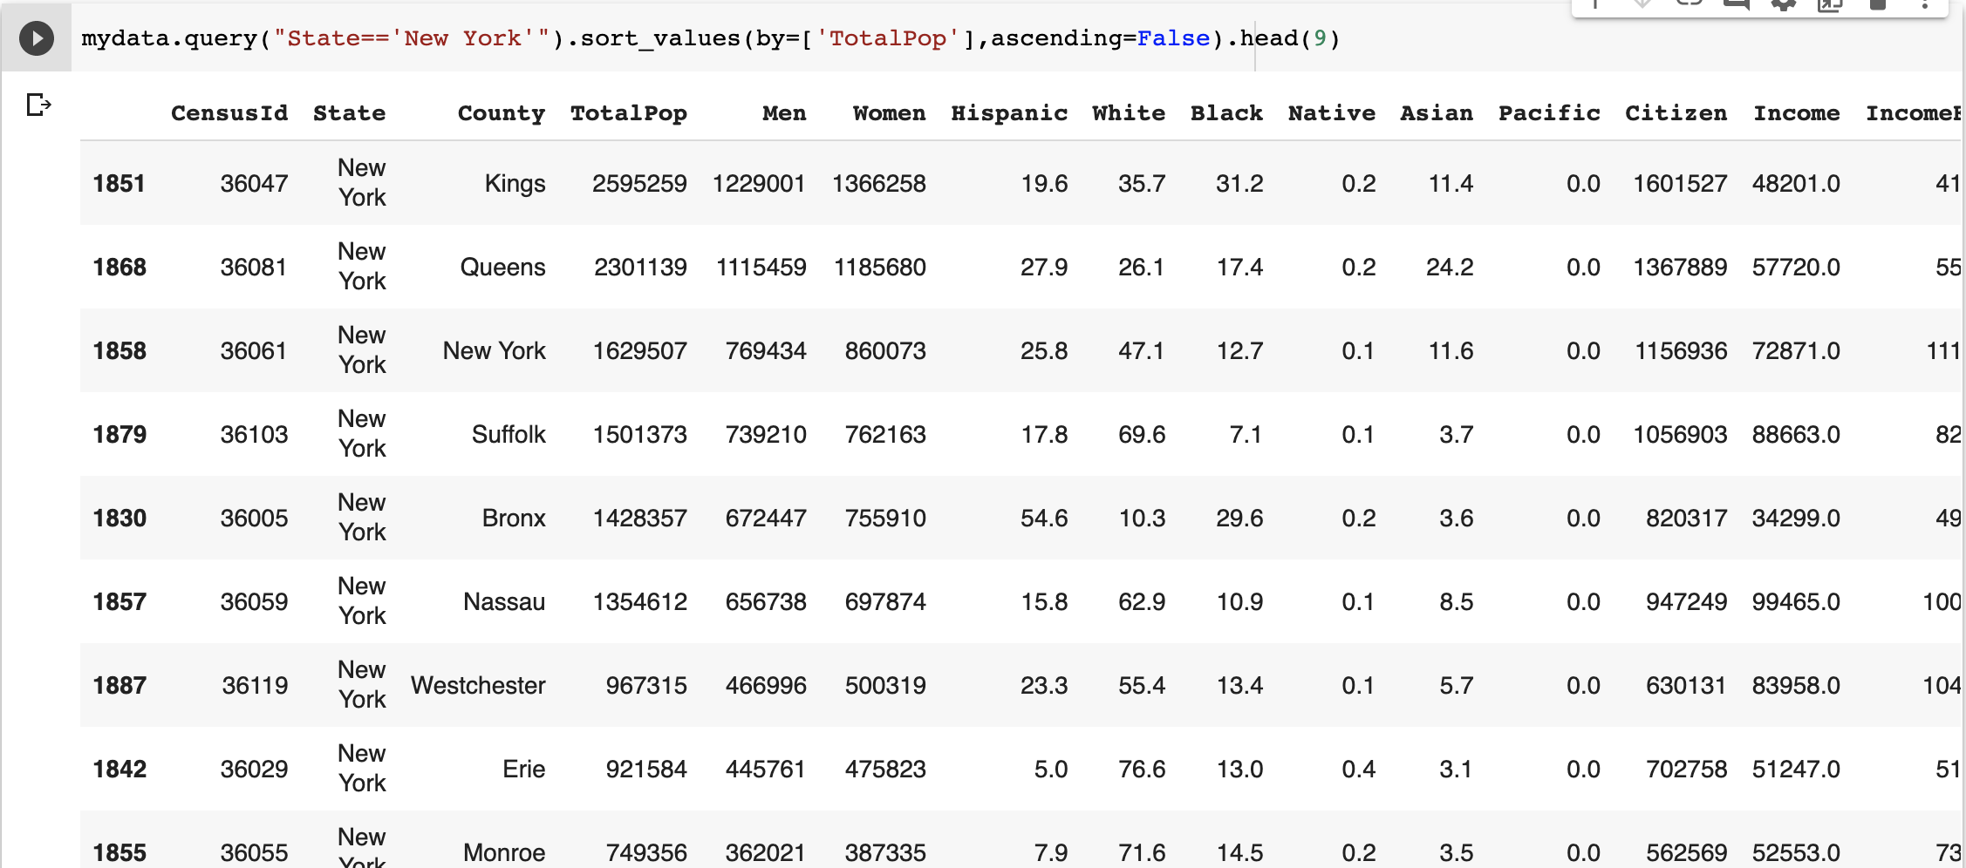
Sort the Query Result
Notes:
Get the records for NY states, sort those records by the values of “TotalPop” in descending order, and show the first 9 records.

