Slide 1
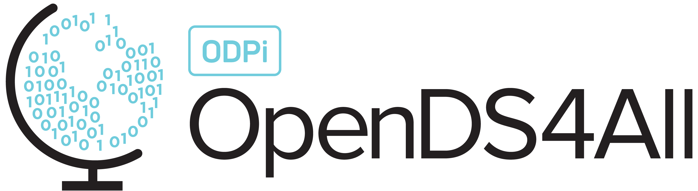
Deep Learning: Transfer Learning for Computer Vision
Notes:
This is an introductory lecture on deep learning for computer vision with a special focus on image recognition with transfer learning.
It is helpful if you have basic knowledge of convolutional neural networks. The slides gives you an overall theoretical understanding of transfer learning and a practical application.

Slide 2
Contents
Overview of Transfer Learning for Computer Vision
ImageNet Challenge
Using Pre-Trained Models to Solve Problems
Hands on Transfer Learning with Keras and Tensorflow
Notes:
The lecture is divided into 4 important topics.

Slide 3
Recall from Convolutional Neural Networks
Convolutional Neural Networks (CNNs) are very good pattern recognizers
CNNs learn rich features of an image
Various techniques like dropout, max pooling, activation functions and the like enable CNNs to learn unique features unique to an image
Pretrained Models – These are CNNs trained from scratch on millions of images to learn various patterns and can recognize a class from a set of classes ( ~1000 )
Notes:
Before diving into transfer learning, lets have a recall from Convolutional Neural Networks.

Slide 4
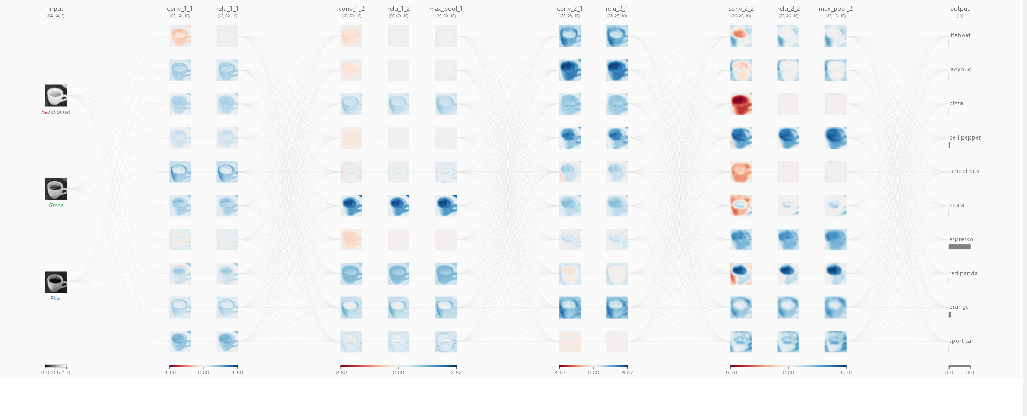
Visualizing a pre-trained Neural Network
Notes:
CNNs are not a “blackbox” this is how CNNs learn patterns from images once its trained.

Slide 5
Problems with Training CNNs from Scratch
CNNs require millions of images to predict with very good accuracy
Computationally it is very expensive
Training time is very high
You may not have the required millions of images to solve a custom use case
Notes:
These are some limitations when you train CNNs from scratch.

Slide 6
Transfer Learning for Image Classification
Notes:
Image Classification – Given an image, the network can predict what class the image belongs to. Eg : If you have an image of a dog and you feed it to the neural network model, the neural network model if trained on dog images can easily classify a dog image as a dog.

Slide 7
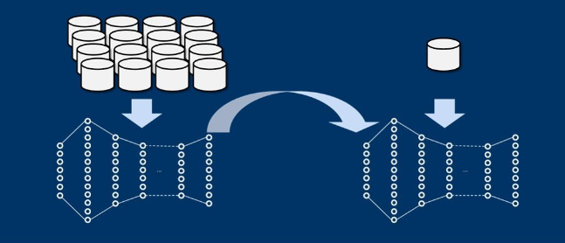
Introduction to Transfer Learning for Computer Vision
Standard Dataset with Millions of Images
Custom Data
Pre-Trained Neural Network
Custom Classes
Training a CNN from scratch
Notes:
Transfer Learning – Transfer the weights from the neural network and modify the last layer to suit your need.

Slide 8
What is Transfer Learning?
A technique to reuse a pre-trained CNN to train on
custom data
Notes:
This is the theoretical definition of Transfer Learning.

Slide 9
How to do Transfer Learning?
Take a pre-trained model and cut off the last layer of the network
Attach a new head with the number of classes of your choice
Train the model but freeze all layers except the last layer, or
Fine tune pre-trained model by unfreezing last few layers and training only the last few layers
Notes:
Generic pipeline followed to perform transfer learning.

Slide 10
Why Transfer Learning Works?
The pre-trained model has already learnt the most important features
Reusing the same neurons (filters) and just changing the last layer helps in getting very high accuracy
Also, if you notice from the visualization slide, the model pretty much learns the same initial features such as edges etc. and learns more important features towards the end
Notes:
Its important to understand why transfer learning works. This slide explains the theory behind why transfer learning works.

Slide 11
Why Transfer Learning is Popular?
Needs less data to make a prediction for a class of your choice
Training time is very fast
Computationally very inexpensive
Solves real world problems

Slide 12
ImageNet Dataset

Slide 13
ImageNet Dataset
The dataset is used to train CNNs from scratch and beat the highest metric with each year
The dataset consists of 1000 classes and each class having close to a ~100,000 images
CNNs can be trained from scratch because the dataset has lots of data for each class with different shapes and sizes
Notes:
This dataset is used as a standard since it has images with 1000 classes with varied shapes and has many million images. The dataset is a benchmark that helps in gauging an architecture of a neural network model.

Slide 14
ImageNet Large Scale Visual Recognition Challenge (ILSVRC)
The competition evaluates algorithms for object detection and image classification at large scale
Motivation is to measure the progress of computer vision for large scale images
More like Olympics for Computer Vision
Notes:
There are many papers published in well known conferences related to ILSVRC and this competition has helped in the innovation of computer vision and helping the computer vision community and the world.

Slide 15
Pre-Trained Networks
They are open source CNNs that’s trained on ImageNet Challenge Dataset
These CNNs have won the competition of ImageNet challenge
Each network has a special feature that’s optimized to recognize better with each passing year
Notes:
Since these neural network models are open source, they can be used to fine tune neural network models. Also, the pre-trained models help in not training neural network models from scratch and thus saves huge infrastructure cost and time.

Slide 16
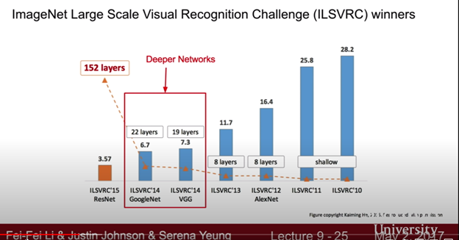
Summary on Different Model Architecture
Notes:
Notice the drop in reduction in error rate because of adopting CNNs over the last 10 years.

Slide 17
Hands on Transfer Learning for Image Classification

Slide 18
Overview
Let's train a simple cat and a dog classifier (given an image, the model has to predict whether an image has a dog or a cat)
The dataset contains 2000 images of cats and dogs
We apply transfer learning to train a pre-trained network to recognize a cat or a dog, given an image
Notes:
Here we will perform transfer learning on a custom dataset.

Slide 19
Pipeline
Load the pre-trained model
Customize the last layer of the network to be equal to the number of classes
Train the model with specific hyperparameter
Calculate performance of the model
Notes:
This a generic pipeline that is used in building training pipelines that use transfer learning.

Slide 20
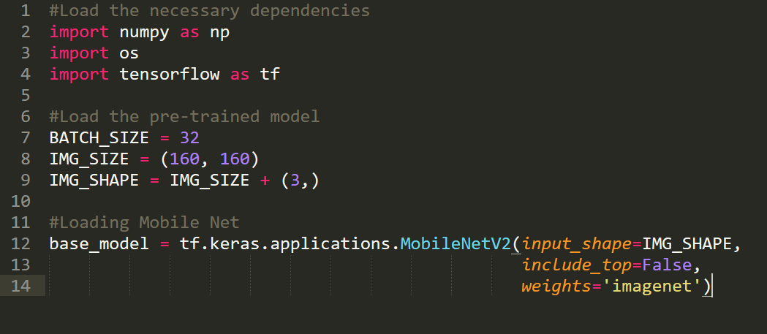
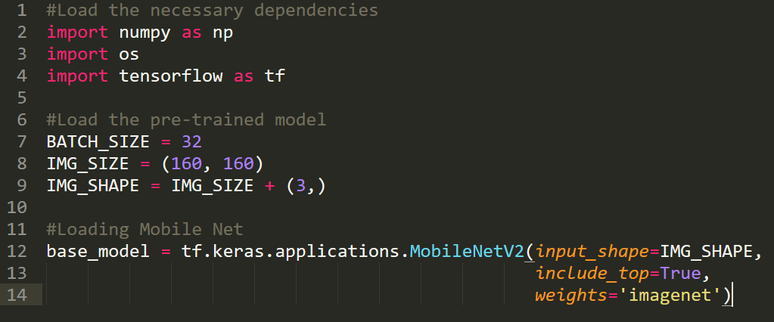
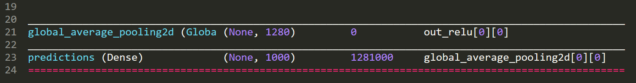
Loading a Pre-trained Model
Loading a pre-trained model trained on imagenet weights
Most models can be imported with keras applications and used to pre-load the image net model
Top = True , will have 1000 classes
Notes:
The red box –denotes how different pre-trained neural network models can be imported into the pipeline.

Slide 21
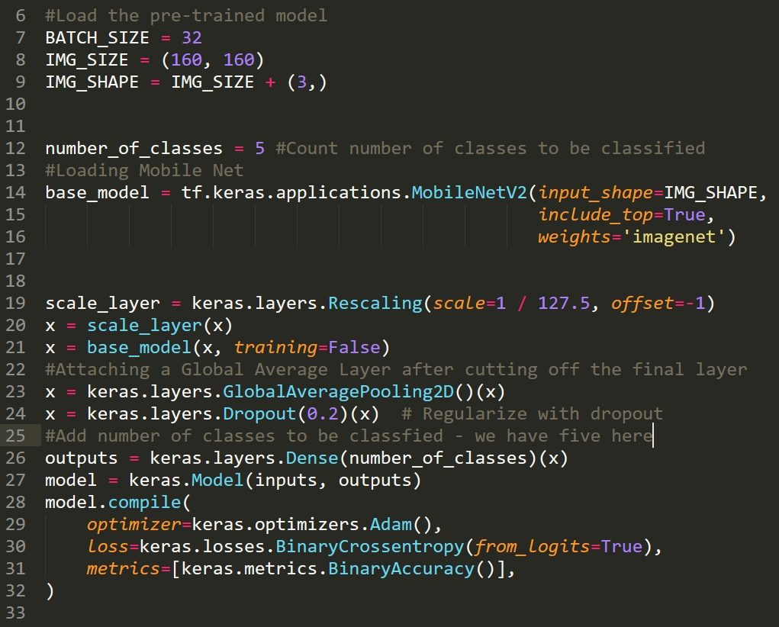
Attach a Custom Final Layer
We have cut the final layer and attached a custom layer.
The custom layer has same number of neurons as the number of classes for the final layer
Notes:
Pre-trained neural networks models have 1000 neurons in the last layer. Since we are training a dog and a cat classifier and that we have only 2 classes. We must cut down the last layer and attach a custom layer with neurons that’s equal to the number of classes and retrain the last layer.

Slide 22
Training the Neural Network
Notes:
The above command will train only the last layer of the neural network model.

Slide 23
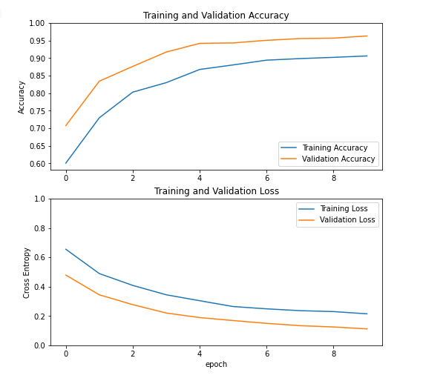
Understanding the Learning Curve
Fig 1
Fig 2
Notes:
From Fig 1 : We see that, with more epochs the accuracy on training data and validation data improves
From Fig2 : We see that the loss is reducing over time- this clearly indicates that the neural network model is learning.

Slide 24
Learning
From the graph on the previous slide, we see that the model is clearly underfitting
Sometimes, this happens when there is not enough data to just change the last layer and we need to train a few more layers towards the end
Last few layers, always has the maximum information about an image
Fine tuning the last few layers helps the model learn features better and can generalize well
Notes:
After training just, the last layer of the neural network. This is what we learnt from the experiment.

Slide 25
Fine-Tuning
A technique that helps in unfreezing and training only the last few layers to get better accuracy and better model performance

Slide 26
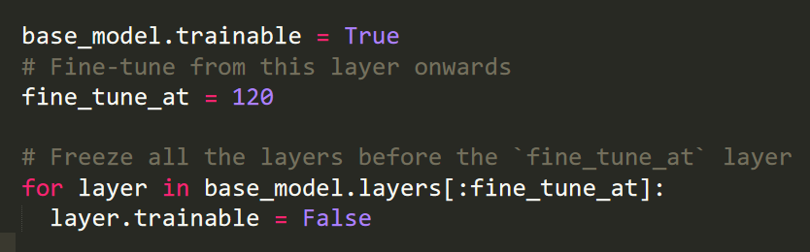
Unfreezing the Last Few Layers
Here, we are freezing only layers up to 120 and after 120 we are unfreezing all the layers

Slide 27
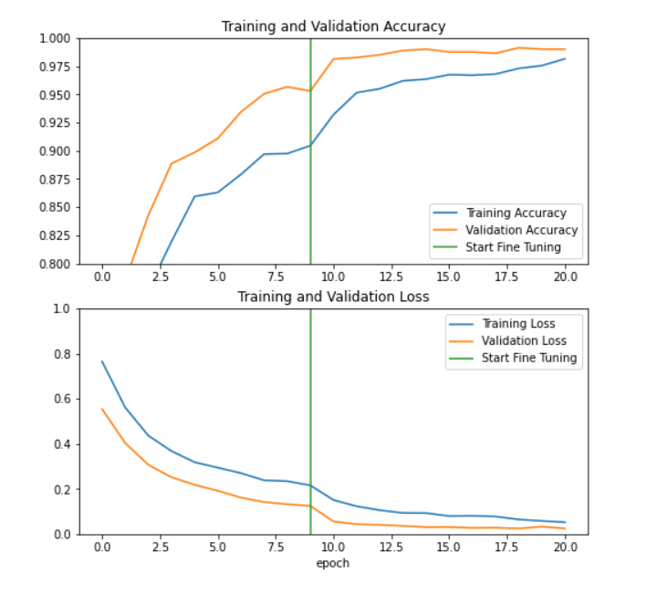
Learning Curves
Fig 1
Fig 2
Notes:
From Fig 1 : We can clearly see that the training and validation accuracies are close to each other. This means, the model is learning and able to generalize well and not underfitting or overfitting. Similarly with Fig 2

Slide 28
Learning
We can clearly see that the model performance is much better
We can see a convergence in the graph

Slide 29
Inference
From the graph on the previous slide, we can see that model has learnt well by feeding just 1000 images.
The technique can be applied to any custom data and perform simple recognition tasks

Slide 30
Conclusion
We used a small number of images of cats and dogs, and we were able to build a simple cat and dog classifier
The same technique can be applied to different images and build very good object recognizing systems

Slide 31
Summary
Transfer learning techniques are applied when data is scarce
Accuracy is generally very high
It is computationally very inexpensive and hence widely adopted
Can be applied on any kind of images (retail, healthcare, automotive etc.)

Slide 32
References
Ian Goodfellow, Yoshua Bengio and Aaron Courville. 2017 Deep Learning: MIT Press Publication
Chollet, Francois. 2017. Deep Learning with Python. New York, NY: Manning Publications
https://www.tensorflow.org/tutorials/images/transfer_learning

