Slide 1
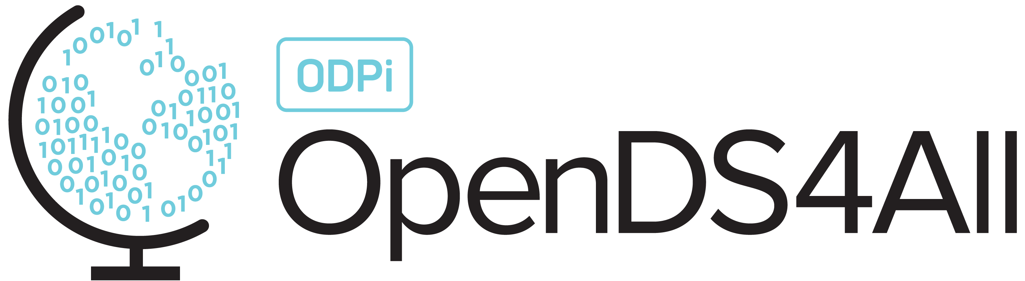
Data Classification - Evaluation Metrics
This work is supported by the National Science Foundation under Award 2021287
Difficulty level: Introductory
Some contents are borrowed from the slides of Introduction to Data Mining [1]
[1] P.N. Tan, M. Steinbach, A. Karpatne, V. Kumar, Introduction to Data Mining, Second Edition, https://www-users.cse.umn.edu/~kumar001/dmbook/index.php
Notes:
Initial release, Xumin Liu, Rochester Institute of Technology, 2022.
By Xumin Liu https://www.cs.rit.edu/~xl/
Except where otherwise noted, this work is licensed under a Creative Commons Attribution-4.0 International License https://creativecommons.org/licenses/by/4.0/

Slide 2
Contents
Classification Errors
Cross Validation
Confusion Matrix
Precision vs Recall
ROC Curve

Slide 3
Classification Errors

Slide 4
Classification Errors
Training errors: committed on the training set
Minimizing training error could cause overfitting issues
Test errors: committed on the test set
Standard way to measure the quality of a model
Generalization errors: committed over random selection of records from same distribution
Ideally, we can choose the model has the minimal general errors
Notes:
Classification errors refer to the difference between the actual labels and the labels computed by a model. The errors are evaluated in different learning phases and for different purposes. During the training phase, a model is learned to minimize the errors so that the model can fit the records in the training set the best. This may cause the overfitting issues where the model fits the data too well and be too complex. During the test phase, the errors committed on the test set are used to evaluate the quality of a model. Once a model is selected and in use, the errors that are committed on the new records are called as generalization errors. As the purpose of learning a model is to make prediction to future records/events, the model with the minimal generalization errors is ideal.

Slide 5
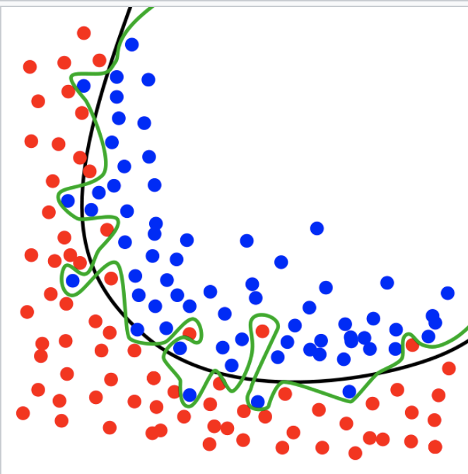
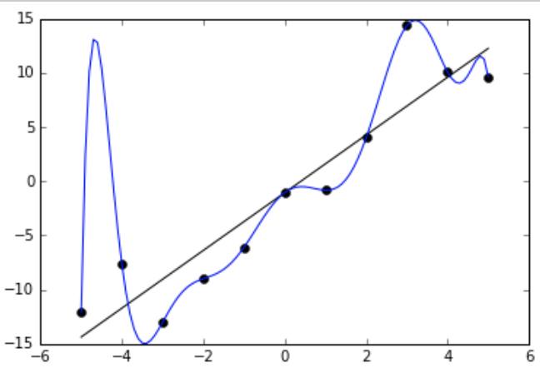
Overfitting Issue
Wiki: Overfitting is the production of an analysis that corresponds too closely or exactly to a particular set of data and may therefore fail to fit additional data or predict future observations reliably
Contains more parameters than can be justified by the data
Notes:
Overfitting can be caused by minimizing the training errors during the training process. It causes the situation that the learned model fits the data too well, sometimes, even fits the data perfectly with 0 training error. This can cause the model too complex to perform well against the data records outside of the training set, such as the ones in the testing set and other unseen records. This also makes the models sensitive to noises in the data and cannot generalize well to new data.
The overfitted models are more jaggy than the true models as the overfitted ones have more parameters, i.e., be more complex.

Slide 6
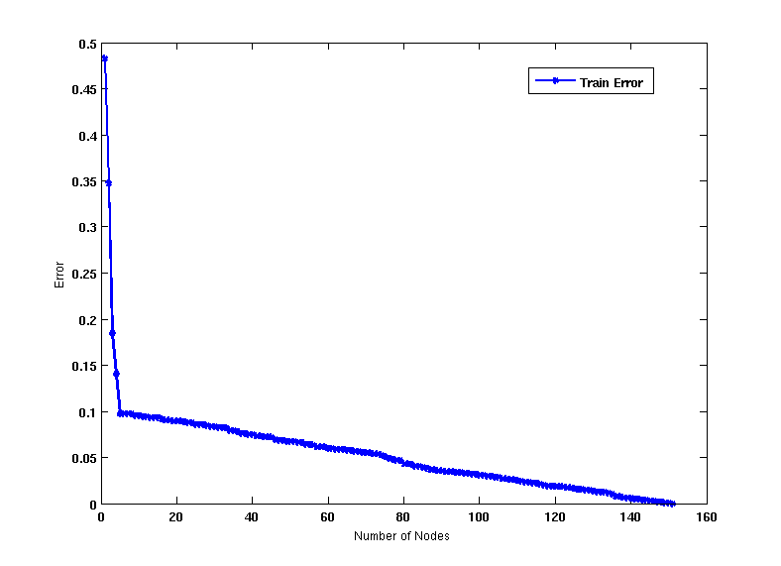
Which Tree is Better?
Decision Tree with 4 nodes
Decision Tree with 50 nodes
Which tree is better?
Notes:
In this example, the second tree with 50 nodes has lower training errors but is likely to have overfitting issue. The number of nodes increases but the training error decreases slowly.
Therefore the first tree is better.

Slide 7
Cross Validation

Slide 8
Cross-validation
Cross validation: a resampling method to avoid selection bias
Partition data into k disjoint subsets
k-fold: train on k-1 partitions, test on the remaining one
3-fold cross-validation
Notes:
After generating a model from the training set, we use the test set to evaluate how well the model fits the unseen data records. This can help identify overfitting issue or select the best model.
Cross validation is a resampling method that selects different portions of the data to train and test a model during each iteration. It is better than doing the training and testing only once since the result of the latter one can be sensitive to how the data is split into training and test sets.

Slide 9
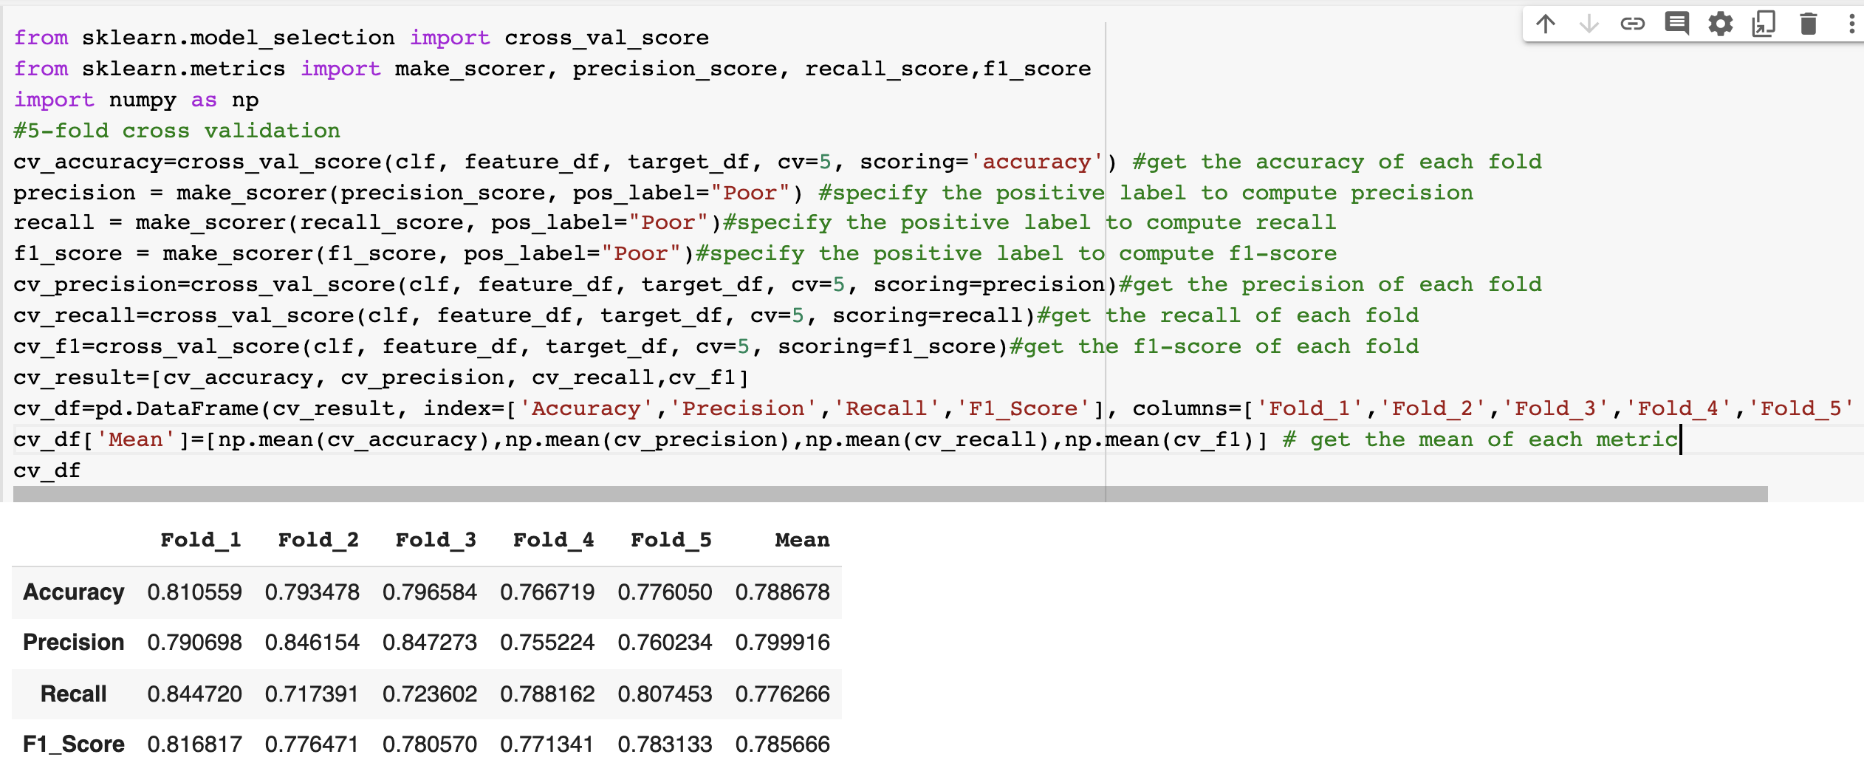
Implementation
Sklearn.model_selection.cross_val_score
https://scikit-learn.org/stable/modules/generated/sklearn.model_selection.cross_val_score.html
Notes:
In this example, we use the US census data (https://www.kaggle.com/datasets/muonneutrino/us-census-demographic-data) and classify each county in US as ‘poor’ or ‘rich’. Please contact Xumin Liu (xmlics@rit.edu) for the complete Python code.

Slide 10
Confusion Matrix

Slide 11
Confusion Matrix
Confusion matrix:
Defines the performance of a classification model
Represented as a table
 | PREDICTED CLASS
ACTUAL CLASS |  | Class=Yes | Class=No
 | Class=Yes | a | b
 | Class=No | c | d
a: TP (true positive) b: FN (false negative)
c: FP (false positive) d: TN (true negative)
Notes:
By applying a model to the test set, we can generation a confusion matrix, which is a standard way to summarize the performance of a classification.
In this table,
a is the number of data records in the test set where both the true label and the predicted label are “Yes”, i.e., true positive.
b is the number of data records in the test set where the true label is “Yes” but are mistakenly labeled as “No”, i.e., false negative.
c is the number of data records in the test set where the true label is “No” but are mistakenly labeled as ”Yes”, i.e., false positive.
d is the number of data records in the test set where both the true label and the predicted label are “No”, i.e., true negative.

Slide 12
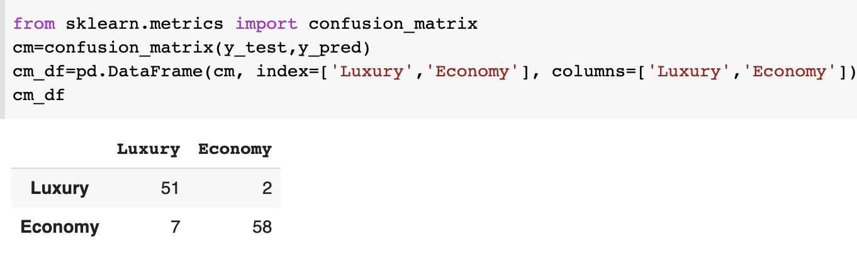
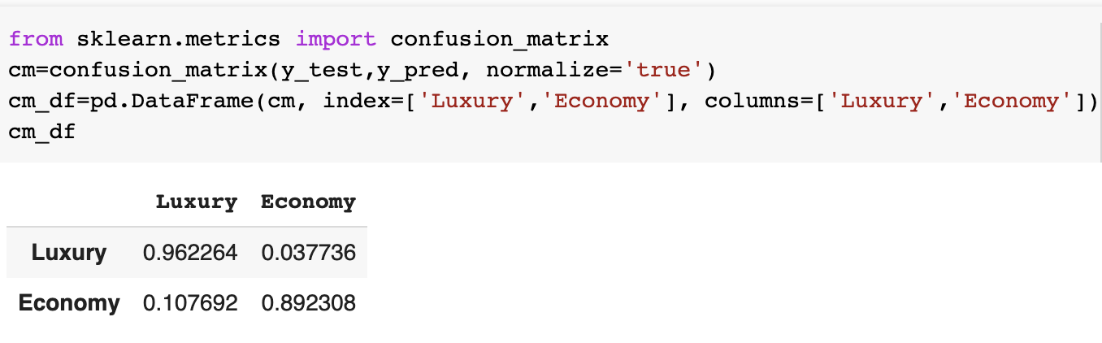
Confusion Matrix
Normalized on rows
Notes:
The example shows how to use sklearn library to display a confusion matrix.

Slide 13
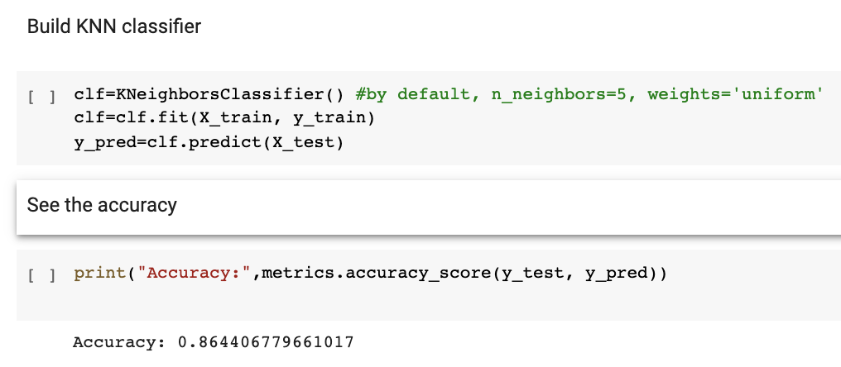
Evaluation Metrics - Accuracy
Accuracy on the test set
# of correctly predicted records/# of all records
Notes:
A common evaluation metric for classification models is accuracy. That is the ratio of the number of correctly predicted records to the total number of records.

Slide 14
Compute Accuracy from Confusion Matrix
 | PREDICTED CLASS
ACTUAL CLASS |  | Class=Yes | Class=No
 | Class=Yes | a (TP) | b (FN)
 | Class=No | c (FP) | d (TN)
e.g., The percentage of emails that are being labeled correctly
Notes:
It can be computed from a confusion matrix where the numbers of a and d (true positive and true negative) are summed up as the nominator, and be divided by the total number of records, i.e., the sum of all the numbers of the matrix.

Slide 15
Issue of Using Accuracy
Does not deal with imbalance issue well
E.g., detecting spam emails where 99% are normal and 1% are spams
Given a model that labels every email as normal, the model has 99% accuracy – but is that good?
Lots of classification problems where the classes are skewed (more records from one class than another)
Credit card fraud
Covid test
Notes:
Accuracy doesn’t evaluate the performance well if there is an imbalance issue, i.e., a big gap between the two classes.
However, in many cases, we take more interested in those rare cases, e.g., positive covid test results or fraud credit card transactions. Using accuracy doesn’t evaluate well the capability of a classifier detecting those rare cases.

Slide 16
Alternative Measures
 | PREDICTED CLASS
ACTUAL CLASS |  | Class=Yes | Class=No
 | Class=Yes | a | b
 | Class=No | c | d
Need to specify what is the ”true” label
e.g., The percentage of emails labeled as “spam” that are actually spam
e.g., The percentage of spam emails are labeled as “spam”
Combines Precision and Recall
Notes:
Alternative metrics include precision, recall, and F-measure (or F-score).

Slide 17
Precision vs Recall

Slide 18
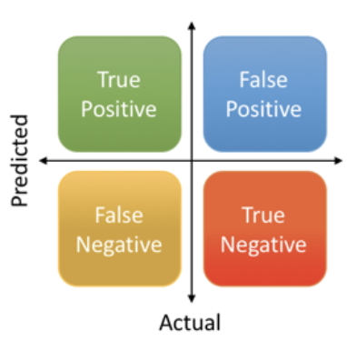


Precision vs Recall
$$Precision=\frac{True Postive}{True Positive+False Postiive}$$
$$Recall=\frac{True Postive}{True Positive+False Negative}$$
Precision is sensitive to False Positive
Recall is sensitive to False Negative
Which one is more affordable, False Positive or False Negative?
Detect if an apple is poison or not - High recall
Choose stocks to invest – High precision
Notes:
We can select a model based on how much we can afford false positive or false negative.

Slide 19
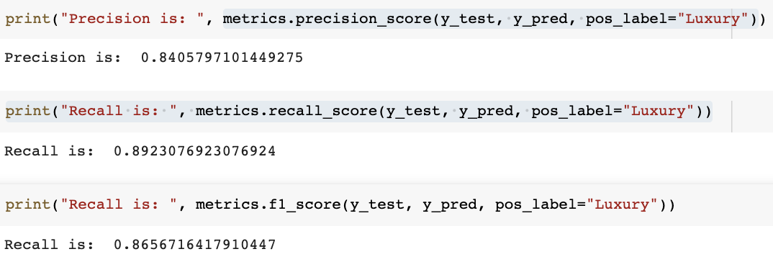
Precision, Recall, F1-score

