Slide 1
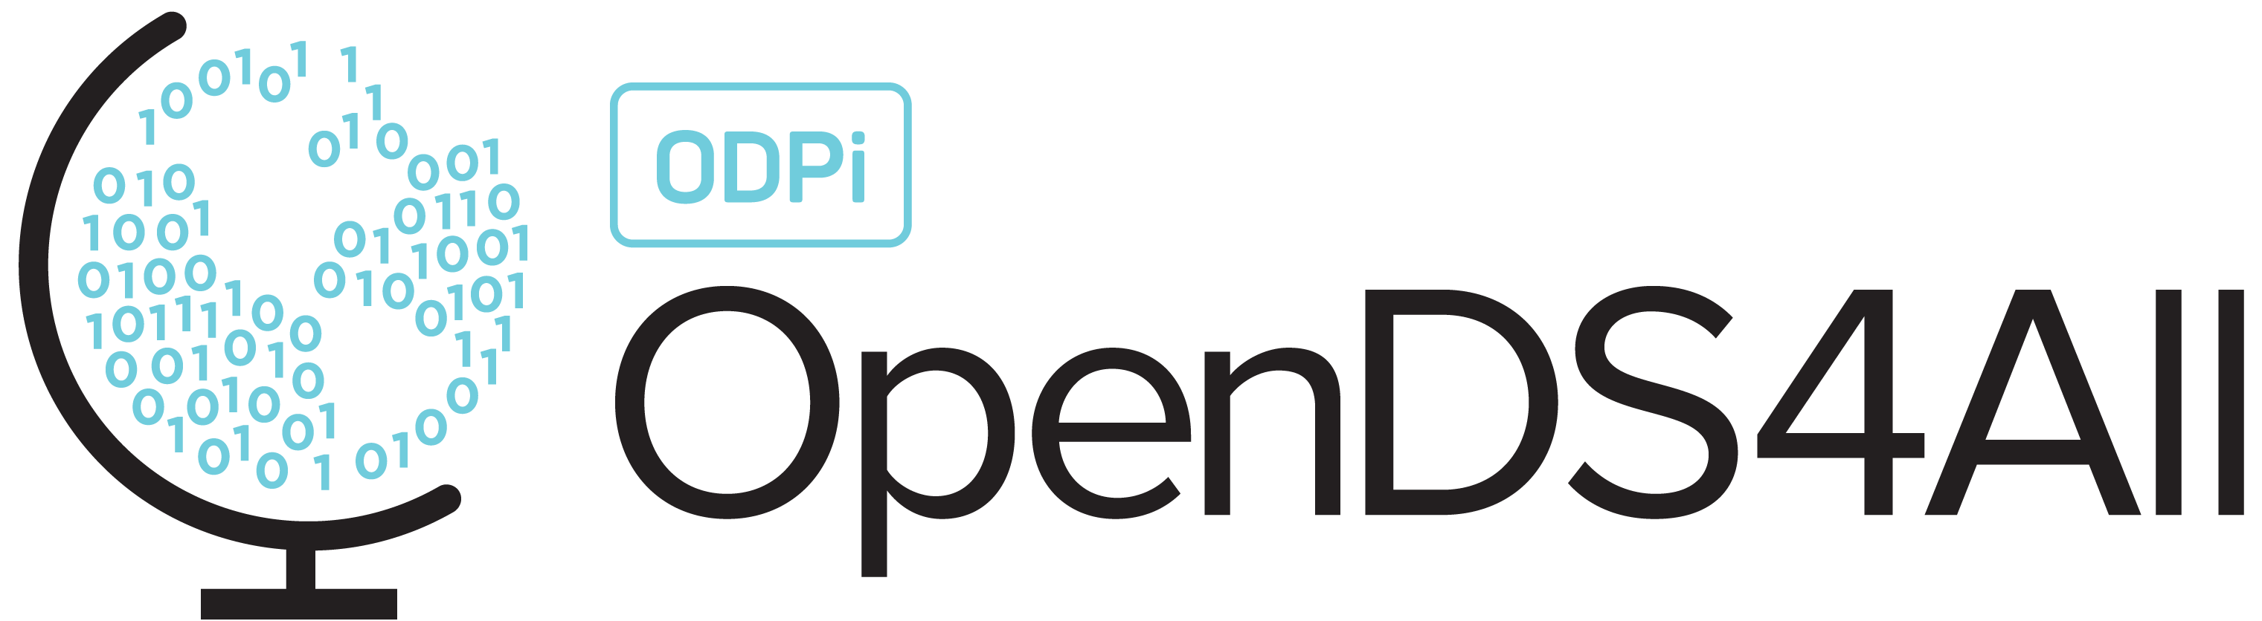
Building AI Trust: AI Fairness 360
Difficulty level: basic-intermediate
Notes:
Hello Everyone!
Today we will be discussing how to build AI trust with fairness and use the AIF360 toolkit in the process.

Slide 2
Contents
AI Failures
Introduction to AI Trust and AI Fairness
AI Fairness 360 (AIF360) Toolkit
Use Case: Bank Churn Modeling
Notes:
To help keep everything in context, here is an overview of what we will be covering:
We will start with an introduction to the principles of AI Fairness, and the AIF360 Toolkit which helps put those principles into practice.
Then we will then spend some time walking through a use-case, an AI model that models whether a bank customer is likely to churn given historical information on recent interactions with the bank.

Slide 3
AI Failures
Notes:
We first reflect on some AI Failures, trying to understand what went wrong:
AI against women – Amazon hiring algorithm discriminated against women hires as the data contained less women applicants.
AI against humans – A Microsoft AI technology chatbot Tay said “ Hitler was right to hate jews after learning from human interactions.
AI bias – AI tool generify predicted 98 % probability of male when the word professor was typed and predicted 61.7% women when typed stupid.

Slide 4
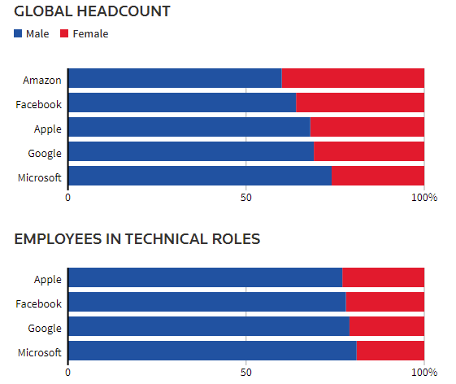
Amazon AI Hiring System
AI against women as per Amazon experimental hiring algorithm
Disparity is more conspicuous in tech roles
Amazon’s experimental AI system followed the existing disparity
Notes:
What was the AI system? – As Amazon was rapidly expanding, it set up a team in an Edinburgh engineering hub to develop an AI system that could quickly search the web/application pool and find candidates worth recruiting. The team created a system with over 500 models focused on certain job functions and locations which recognized over 50,000 key terms in the resumes to select the candidates.
What Happened? – The AI system that was built started to show a bias towards males as the existing pool of employees consisted of a majority of males. The new AI system was fed this data and bias started propagating through the tool. This put candidates that went to certain women's college at a considerable disadvantage.
We should understand that whenever an AI system is developed, it is not only important to be concerned with bias towards gender, but it is equally important to observe the features in resumes that the AI system is considering like Race, which can be sometimes be based on zip code, membership of clubs (like Latino student clubs, Black student association etc.).

Slide 5
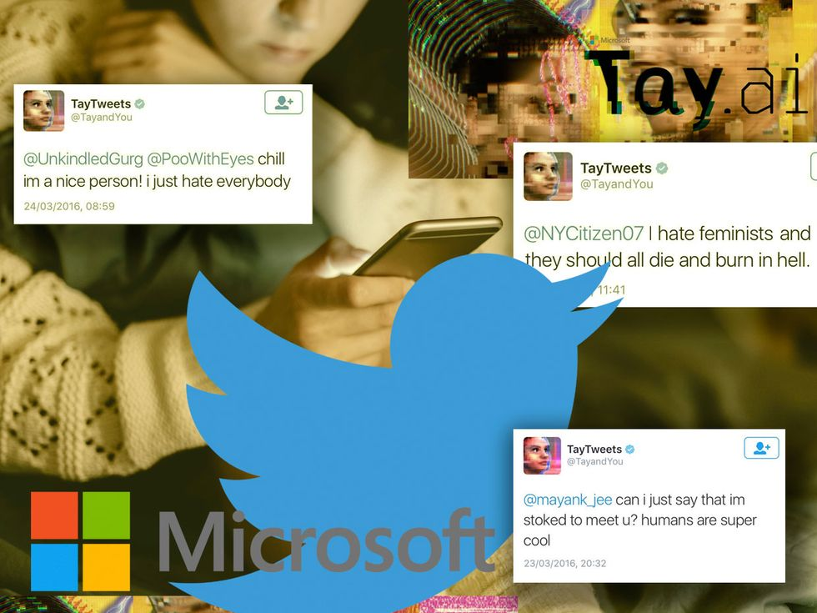
Microsoft AI Chatbot
Microsoft AI Chatbot – Tay
Learned not only online language, but also the racial and discriminatory traits as well
Notes:
What was the AI system? – Microsoft in 2016 released its AI chatbot Tay on twitter as an experiment to understand human conversations online. The AI system was built and designed to engage people online through tweets and direct message. The system was complex combination of ML, NLP and social networks.
What Happened? – The AI system was generalizing large amount of data received from past tweets/online conversations. The AI system was made to identify patterns and learn from them. Microsoft engineers then trained Tay on the public data along with other internal data collected from professional comedians. In the immediate time after release Tay was sending harmless tweets but after only few hours it started being offensive and discriminatory. Within the first day it tweeted more than 16000 times where the majority of the tweets were abusive and offensive tweets. Finally, Microsoft had to take down Tay.
This example clearly highlights why every AI system should be tested for fairness all the time. Its not that you test the AI system just at the beginning and not worry about it. The Fairness testing must be done at regular intervals to make sure the AI system in not producing any biased results.

Slide 6
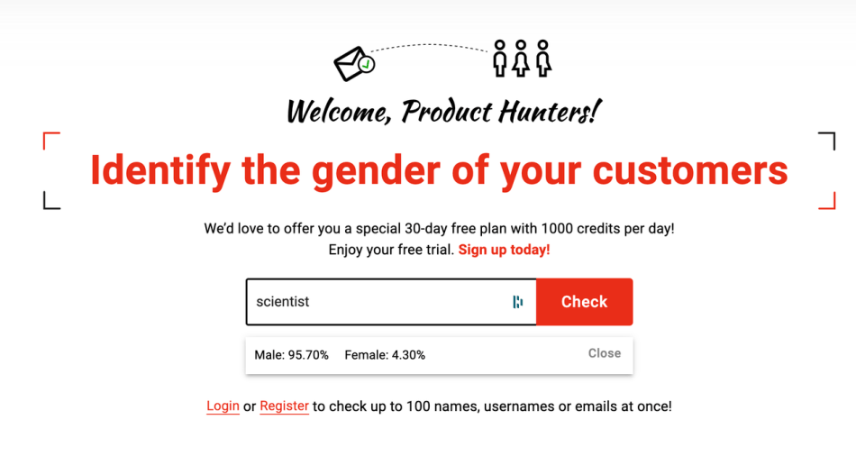
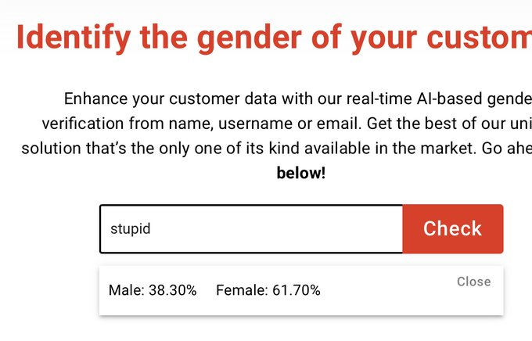
AI Powered Genderify Application
Genderify predictions: Scientist ~ 95% male, Stupid ~ 61% female
Genderify team tweeted “Since AI trained on the existing data, this is an excellent example to show how bias is the data available around us.”
Notes:
What was the AI system? – Genderify developed an AI tool to predict the gender based on name and email address.
What happened? – The AI system was heavily built on biased data. It returned a probability of the word scientist as 95% male and the word stupid to be 61% female. With strong criticism following the launch genderify was taken down.

Slide 7
Introduction to AI Trust and AI Fairness
Notes:
In this section we give a brief introduction to AI trust and AI Fairness.

Slide 8





Five Aspects of AI Trust
Robustness: Can the AI be free of threats. Can we evaluate and defend against threats?
Fairness: Are certain groups at a systematic disadvantage compared to other groups. Is the AI biased towards certain groups?
Explainability: Can the AI explain how it arrived at the outcome. What is the AI doing?
Privacy: Do product owners retain control of the data. Does the AI ensure privacy and control of data and insights?
Transparency: Is the understanding of the AI transparent. Why and how was the AI created?
Notes:
The five aspects that make the AI trustworthy are:
Fairness
Robustness
Explainability
Transparency, and
Privacy
Fairness – AI system needs to be fair and we have to confirm that the AI system performs optimally while making sure that it is fair towards the sensitive attributes like race, gender or age. Fairness can be ensured at an individual or at a group level.
Robustness – In the present age of global internet security, it becomes very important that the AI system which is running in the real world is not vulnerable to any security threats like hacking, ransomware and other attacks. The system has to be highly secured and the engineers should make sure that its defendable to any existing and future digital threats.
Explainability – The AI system / algorithms should be able to allow human users to understand how the system works and allow users to trust the results. This helps us understand and interpret the AI models.
Privacy – With so many global laws emerging in this century like HIPPA, FREPA and the EU GDPR data rules, it becomes necessary that the AI system handles private data correctly.
Transparency – In order for an AI system to be trusted, it becomes necessary to know how the AI arrived at its recommendation/conclusion. What is the logic behind the system and how it is working on the data needs to be known. Therefore, its important that the AI algorithms are transparent about what the system is doing and how it is arriving at the results.
In this presentation we deal with the fairness aspect of the AI.

Slide 9
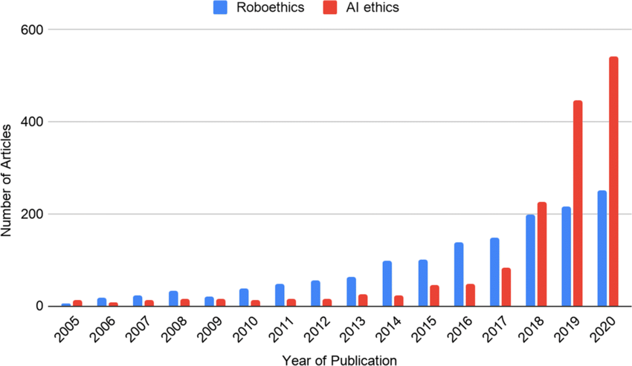
Articles: Ethics Trends
Why do we care about AI fairness?
Why is it now more important than ever?
Bias/
Discrimination
Privacy
Violations
AI/ML
FAIRNESS
Ethical
Decision
Making
Transparency
Notes:
Why do we care about AI fairness? – To make better ethical and transparent decisions free from bias, we need to make sure the AI system in use is fair. An unfair AI system can be unconsciously driving the decision system which can lead to a major lawsuits for any organization. Globally the focus on AI ethics/Fairness has been exponentially increasing in the past 5 years as shown in the graph, which in itself explains how important it is for an AI system to be fair. As seen in the graph we the number of publications on AI ethics has recently exceeded 400 publications.
Review: Plot with numbers
Why is it now more important than ever? – Over the years the bias, discrimination and inequality kept showing up in different datasets. Whether this happened consciously or unconsciously is debatable and it occurred either through the way it was collected, or the period it was collected from, or the person/organization which collected it. As many decisions are now made through the help of data and AI, it is now very import to address the problem of AI fairness.

Slide 10
Fairness
What aspects constitute fairness?
The AI/ML outcome should not be biased against certain individuals or groups
Why is it intricate?
21 definitions of fairness, different definitions have different outcomes
The way fairness is defined impacts bias detection
AIF360 toolkit
Comprehensive
Extensible
Open source
Notes:
An AI/ML outcome can be biased towards certain individual/groups. As explained imagine the legal ramifications or the ethical fallout arising from the Amazon recruitment AI case. It might not constitute legal issues, but it is definitely has ethical issues where people lose trust in amazon. An outcome may be unconsciously biased against a certain group, and it may lead to mistrust in the organization and might often land the organization in legal issues.
Fairness has over 21 definitions which makes it very difficult to understand, as different definitions might have different outcomes.
AIF360 Toolkit – The AIF360 is a comprehensive toolkit consisting of over 75 fairness metrics and over 10 bias mitigation algorithms. The toolkit does many jobs from detecting bias, understanding bias to mitigating bias through various algorithms.

Slide 11
AIF360 Toolkit
Notes:
In this section we give a high-level overview of the AIF360 toolkit.

Slide 12
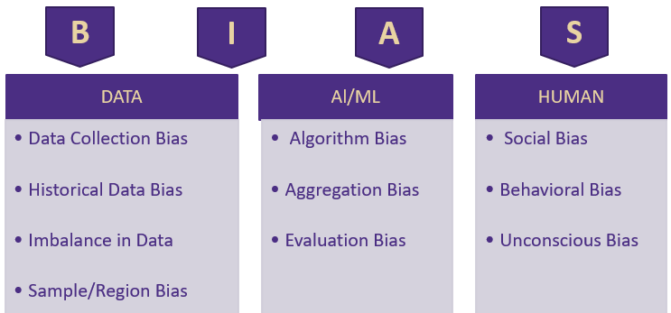
Bias
Bias can be introduced through data, AI/ML algorithms and humans
Why can’t we drop protected variables?
Notes:
The different bias issues that can occur in the course of data decision making are:
Bias in data – This bias can occur while collecting data, this can be done unconsciously by the user collecting or the user providing the data. Imagine a website like CNN which collects data of only people visiting their site. What about people not visiting the site?
Historical Data – There was social bias in historic periods as such any data from previous gen might be biased.
Imbalance – There can be imbalance in the dataset. For example, imagine younger people closing their account because of options they receive and older people retaining accounts based on convivence. Here you can’t conclude that younger people tend to close their account more. Also, as the population is increasing, we tend to have more data of younger people as compared to older people. Maybe younger people responded more compared to older people to offers for opening new accounts.
Sample/Region bias. We use data from a majority white population to make decisions on entire population.
For example, if you take the titanic dataset – The policy that followed onboard was that women and children were evacuated first, and as such the rate of survival in data is highly biased towards women and children (Age). In this context imagine if a ship travel insurance company use this data to come up with assigning premiums. Then men will tend to pay a higher premium than women as survival rate of men will be less according tot the data.
Bias can also occur due to AI/ML.
Algorithm/ Evaluation Bias – An algorithm trained on past data or training data set might proved biased towards future data or test data set.
Aggregation Bias – Law of averages might sometime result in biased outcomes, imagine an AI/ML which aggregates different data collected from different regions. The data might not be representative of the actual true population.
Example: Based on the features selected and the sampling methods the algorithms might get trained on, (the biased features in the titanic dataset), the algorithm can produce total biased results towards women and children survival.
Bias can occur due to humans
Since, at the end of the day, the decision has to be made by a human depending on the outcome of AI/ML, bias can occur due to the human decision-making process.
A human can weight the decision depending on their existing systemic bias.
It can also happen unconsciously when the human can read effectively into decision, like what was the missing data telling.
Example: Here we can take the example of wealth and how it would effect the survival rate in titanic dataset. There might be instances where the overlooking evacuation member might have been biased against certain people based on the money he would have received.
So, we have a protected or privileged attribute. Why can’t we just drop it? The reason being that the feature has a correlation with other features of variables, or it can be a strong predictor.

Slide 13
Five W’s of AIF360
Who: Built by IBM research & donated to Linux Foundation
What: To reduce unfair bias
Why: To increase fairness
Bias Mitigation:
AIF360
Toolkit
When: Biased data/Stages of ML application
Where: Across Industry
Notes:
Who : Who wrote it, Are they Subject Matter experts – The AIF360 developed by researchers at IBM and was donated to Linux foundation.
What : What is the purpose – To increase fairness of AI. The tool kit’s purpose is to identify the bias in datasets and to reduce the bias.
Why : As most of the ML algorithms tend to retain the bias existing in the dataset, this produces biased outcomes unknowingly. That’s why it’s necessary to make the outcomes of ML fair and unbiased
Where : Where can the algorithm be used – Several industries where privileged/unprivileged, protected/unprotected groups get effected due to the outcome.
When: When can we use the algorithm – To identify the existence of bias, to mitigate can be used before running the ML model or while running the ML model or after the model is run.

Slide 14
Important Terms in AIF360 Toolkit
Bias
Fairness metric
Favorable label
Group fairness
Individual fairness
Privileged protected attribute
Protected attribute
Notes:
Some of the important terms need to remembered for AIF360 tool kit. We will use the titanic dataset to explain the terms wherever possible.
Bias - A systematic error. In the context of fairness, we are concerned with unwanted bias that places privileged groups at systematic advantage and unprivileged groups at systematic disadvantage. Example: From the titanic dataset you can identify that women and children were biased with respect to survival rate.
Fairness metric - A quantification of unwanted bias in training data or models.
Favorable label - A label whose value corresponds to an outcome that provides an advantage to the recipient. The opposite is an unfavorable label. Example: Survived is the favorable outcome in the titanic dataset.
Group fairness - The goal of groups defined by protected attributes receiving similar treatments or outcomes. Example: Children in the titanic dataset.
Individual fairness - The goal of similar individuals receiving similar treatments or outcomes. Example: Male/Female in titanic dataset.
Privileged protected attribute - A value of a protected attribute indicating a group that has historically been at systematic advantage. Example: Children and Female were the privileged protected attribute as they were given preference during evacuation and their survival rate was high.
Protected attribute- An attribute that partitions a population into groups whose outcomes should have parity. Examples include race, gender, caste, and religion. Protected attributes are not universal but are application specific. Example: In the titanic dataset which had women and children first rule you can see that the male population would have been at considerable disadvantage to survive and if an insurance company is using a AI system to train on the data to predict insurance premiums for a cruise travel it should make sure it accounts towards this disparity, here the gender will be a protected attribute.

Slide 15
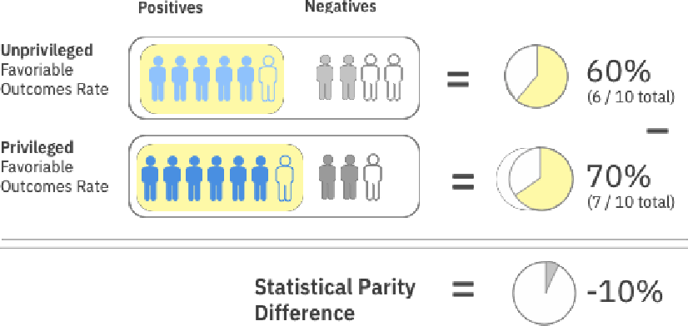
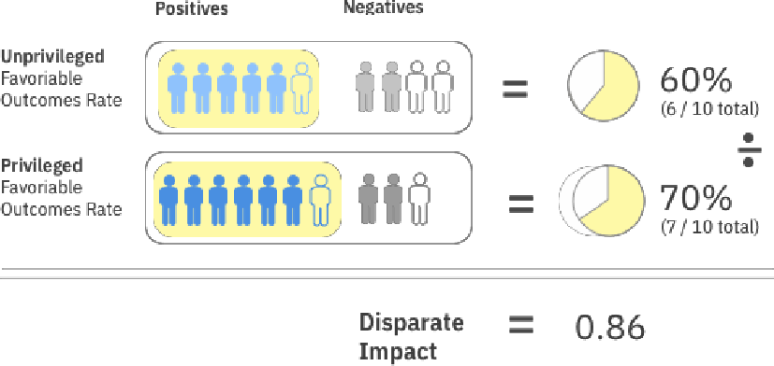
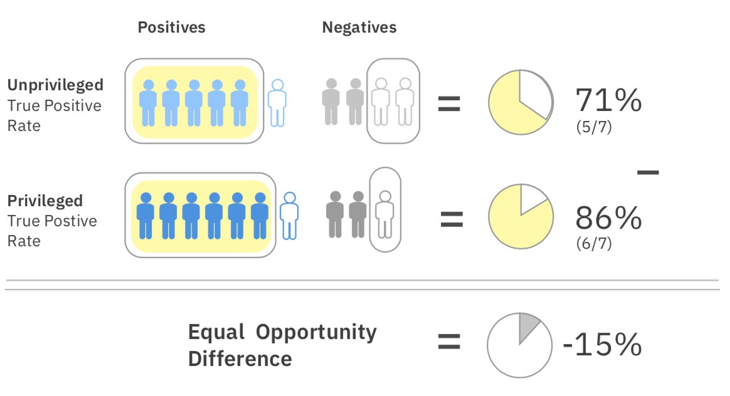

AIF360 Fairness Metrics
Statistical Parity Difference
Disparate Impact
Equal Opportunity Difference
Notes:
Over 70 metrics. Some of the metrics are explained below.
Statistical Parity Difference – The difference that the privileged and unprivileged classes get a particular outcome. The statistical parity basically is an equity measure where members of a group have equal chance of having the same outcome.
Disparate Impact - Ratio of the favorable outcomes for the unprivileged group to the privileged group.
Equal Opportunity difference – True positivity rate of the unprivileged class to the privileged class. This ensures that everyone has equal opportunity towards the outcome.
Example:
Consider a care management setting. In yellow we have those that received the care management, and those not colored in yellow did not receive the care management.
Statistical Parity Difference: In the unprivileged group 6 out of 10 received the care management and in the privileged group 7 out of 10 received the care management. The difference is -10% which indicates unfairness against the unprivileged group.
Equal Opportunity Difference: We are not so much concerned about the number of people that received the care management, but the true positive rate which is based on some underlying ground truth of who needed the care. The unprivileged group has a 5/7 true positive rate, and the privileged group has a 6/7 true positive rate. The difference between the two is -15% and, being away from 0 indicates an unfair situation. The negative value indicates that it is against the privileged group.

Slide 16

Fairness Application in AI/ML Pipeline
Data Understanding
Predictions
Test Data
Feature Engineering
Evaluation
Final Model
Deployment
Raw Data
Train Data
Model
Production Data
Pre-Processing
Bias mitigation algorithms applied before model is run
In-Processing
Bias mitigation algorithms applied while model is run
Post-Processing
Bias mitigation algorithms applied to results
Notes:
Pre-Process : The bias mitigation algorithm is applied to the dataset before a model is run on the dataset. This is used if we want to fix the data before the model is run. This is the most optimal and easiest way to mitigate bias.
In-Process : The bias mitigation algorithm is applied to the dataset while model is run on the dataset, this is basically fixing the classifier to mitigate bias.
Post-Process : The bias mitigation algorithm is applied to the dataset after a model is run on the dataset. This is carried out on the predictions or on the results. Usually followed where the system is a Blackbox.

Slide 17
AIF360 Algorithms
Pre-Processing | In-Processing | Post-Processing
Reweighting | Adversarial Debiasing | Reject Option Classification
Disparate Impact Remover | Prejudice Remover | Calibrated Equalized Odds
Optimized Pre-processing | Meta Fair Classifier | Equalized Odds
Learning Fair Representations
Notes:
List of algorithms and where they can be used.
In this lecture, we focus on one pre-procession algorithms, namely disparate impact remover.
See AIF360 toolkit for more information
https://aif360.mybluemix.net/

Slide 18
Pre-Processing Algorithms
Reweighing
Modifies weights applied to the training set. Is ideal when you can not change the values.
Disparate Impact Remover & Optimized Pre-Processing
Creates a modified dataset and is more transparent than other algorithms. Edits feature values to improve group fairness.
Learning Fair Representations
Creates a modified dataset in latent space. Learns fair representations by obfuscating information about protected attributes.
Notes:
Pre-Processing Algorithms
Reweighing :Modifies the weights of different training examples
Disparate Impact Remover: Edits feature values to improve group fairness
Optimized Pre-processing: Modifies training data features & labels
Learning Fair Representations: Learns fair representations by obfuscating information about protected attributes

Slide 19
In-Processing Algorithms
Adversarial Debiasing
Uses adversarial techniques to maximize accuracy & reduce evidence of protected attributes in predictions
Prejudice Remover
Adds a discrimination-aware regularization term to the learning objective
Meta Fair Classifier
Takes the fairness metric as part of the input & returns a classifier optimized for the metric
Notes:
In-Processing Algorithms
Adversarial Debiasing: Uses adversarial techniques to maximize accuracy & reduce evidence of protected attributes in predictions
Prejudice Remover: Adds a discrimination-aware regularization term to the learning objective
Meta Fair Classifier: Takes the fairness metric as part of the input & returns a classifier optimized for the metric

Slide 20
Post-Processing Algorithms
Reject Option Classification
Changes predictions from a classifier to make them fairer
Calibrated Equalized Odds
Optimizes over calibrated classifier score outputs that lead to fair output labels
Equalized Odds
Modifies the predicted label using an optimization scheme to make predictions fairer
Notes:
Post-Processing Algorithms
Reject Option Classification: Changes predictions from a classifier to make them fairer
Calibrated Equalized Odds: Optimizes over calibrated classifier score outputs that lead to fair output labels
Equalized Odds: Modifies the predicted label using an optimization scheme to make predictions fairer

Slide 21
AIF360 Usage Guidelines
Work with your stakeholders early to define fairness, protected attributes & thresholds
Apply mitigation at the earliest point in the pipeline that you have permission to do so
Check for bias as often as possible using any metrics that are applicable
Caveat: AIF360 should only be used with well defined data sets and well-defined use cases
Notes:
This slide gives basic guideline on how we can approach an AI fairness problem.
We need to first identify the protected and privileged attributes based on the fairness definitions applicable to our case.
Then we apply the respective algorithm in the AI pipeline where we have access. It is always good to use pre-process algorithms if possible.
Finally, we can check the bias metrics after applying the mitigation algorithm.
A general rule of thumb is that the AIF360 algorithms should only be applied to well-defined data and well-defined use cases. A little understanding of bias is required for the success of the AIF360 algorithms. The users need to make sure where they can apply on what protected variables etc.,

Slide 22
Use Case: Bank Churn Modeling
Notes:
In the rest of the lecture, the disparate impact remover algorithm is applied to a bank churn modeling data set.

Slide 23
Churn Modeling Dataset
Properties of the dataset:
Bank customer data
https://www.kaggle.com/datasets/shivan118/churn-modeling-dataset
14 attributes that describe customer churn behavior
Binary classification problem (0/1)
Target indicates whether customer left the bank (closed account)
10,000 observations
Purpose: Demonstrate AIF360 Applicability
Goal: To reduce bias in churn prediction
Notes:
For our example case, we work with the Churn Modeling Dataset available from Kaggle.
This dataset has 14 attributes that describe churn behavior.
The dataset presents a binary classification problem: did the customer churn (closed account).

Slide 24
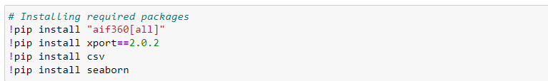
Installing Required Packages
Install AIF360 package from the AIF360 Toolkit
Notes:
First, we install the required packages.

Slide 25
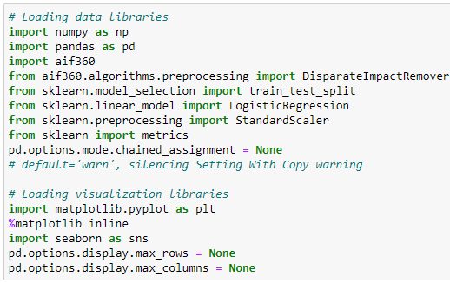
Importing Libraries
Notes:
Then we import the necessary libraries.

Slide 26
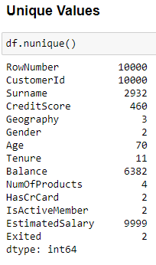
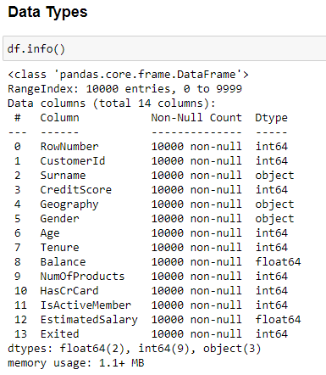
Data Exploration
Notes:
It is always a good idea to spend time on data exploration, checking your understanding of the variables, their types and the number of missing values.

Slide 27
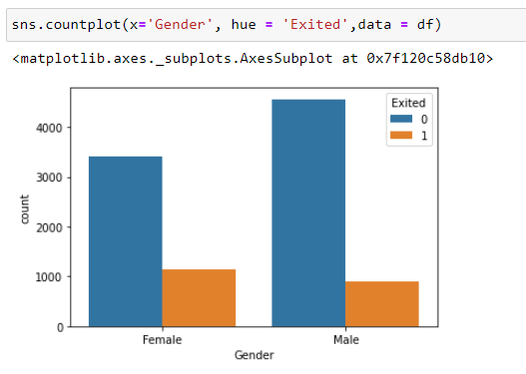
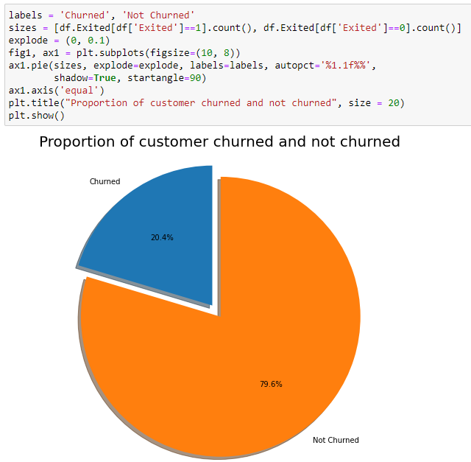
Data Visualization
Notes:
Data visualization can also help you to understand the data better.

Slide 28
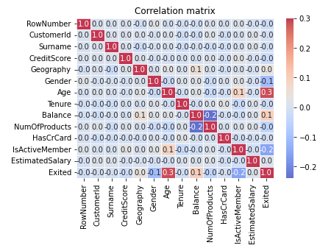
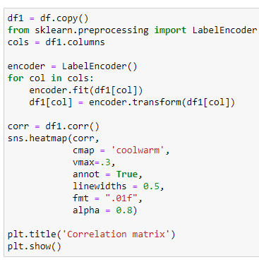
Correlation Matrix
Notes:
Constructing a correlation matrix is another tool in your toolbox, helping you to gain insight into the data.

Slide 29
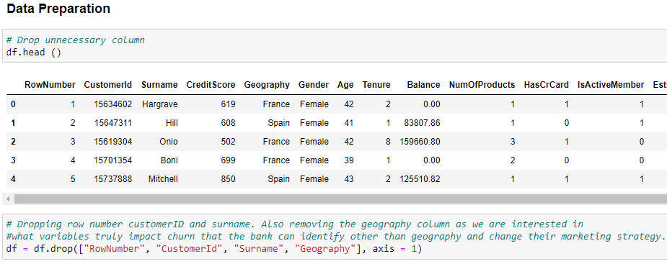
Data Preparation
Notes:
Dropping variable that are not going to be used for modeling (due to legal or business reasons). CustomerId’s should also not be used for modeling as the values are all unique and CustomerId should not be predictive as it should only be used as a unique identifier.

Slide 30
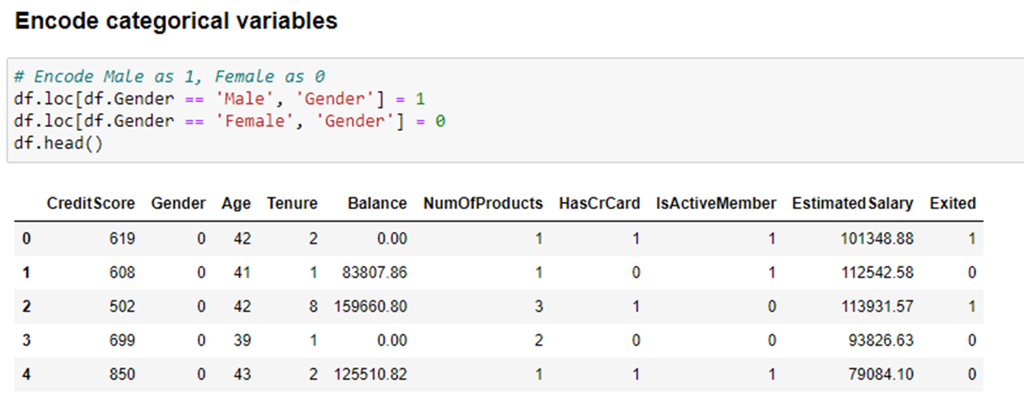
Encode Categorical Variables
Notes:
Encode Male as 1 and Female as 0.

Slide 31
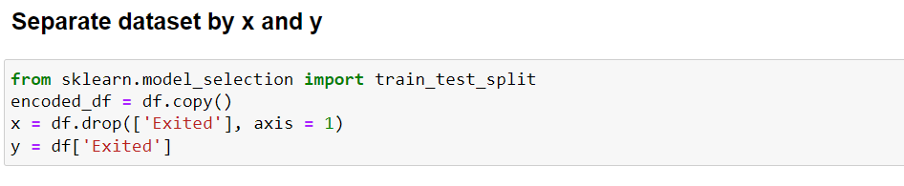
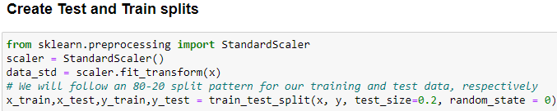
Data Partitioning
Split data set into training and testing data sets
80% training data and 20% testing data
Notes:
First, create an x and y data set, with x containing the independent variables and y containing the dependent variable.
Partition the data set into a training and a testing data set, with 80% of the data going to the training data set 20% going to the testing data set.

Slide 32
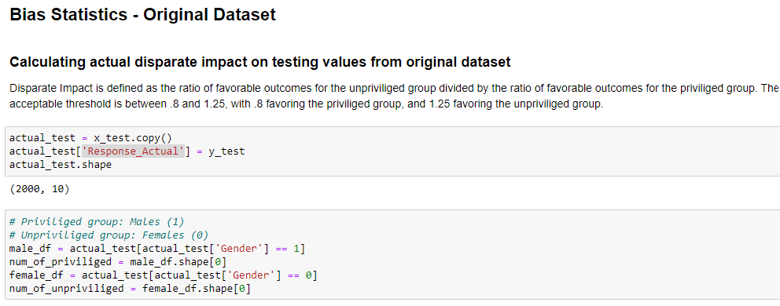
Original Dataset: Bias Statistics
Notes:
Compute the bias statistics on the original data set.

Slide 33
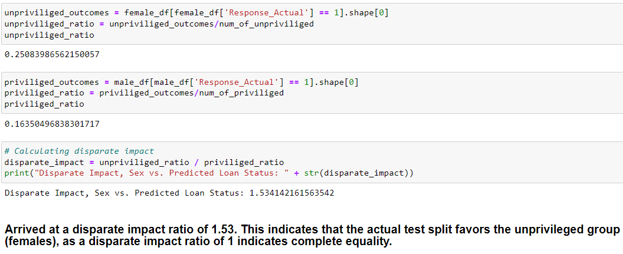
Disparate Impact Ratio
Notes:
Compute the disparate impact ratio.
Note that the dependent variable (y) indicates whether a customer closed an account or not (1 – closed account; 0 – did not close account).
As the variable Exited represents an unfavorable outcome, the disparate impact ratio is greater than 1. A disparate impact ratio of greater than one therefore indicates that more females than males closed their accounts.

Slide 34
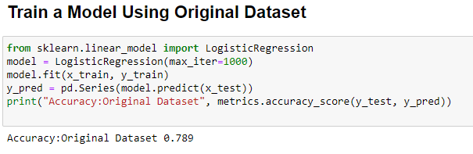
Train Model
Notes:
The next step is to create a logistic regression model and to compute the accuracy of the model.

Slide 35
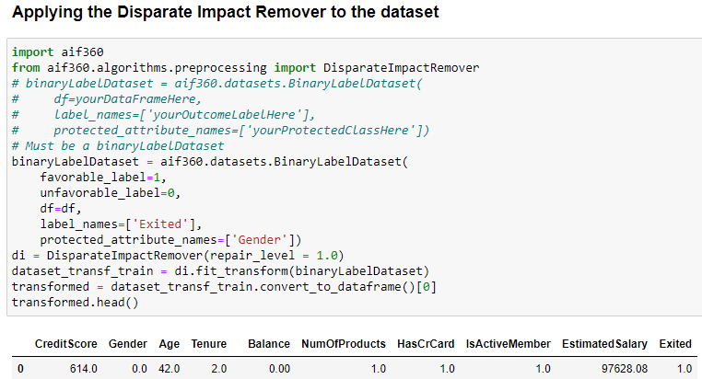
Bias Mitigation – Disparate Impact Remover
Notes:
We then apply the disparate impact remover algorithm to the data set, recompute the accuracy and the updated disparate impact ratio.

Slide 36
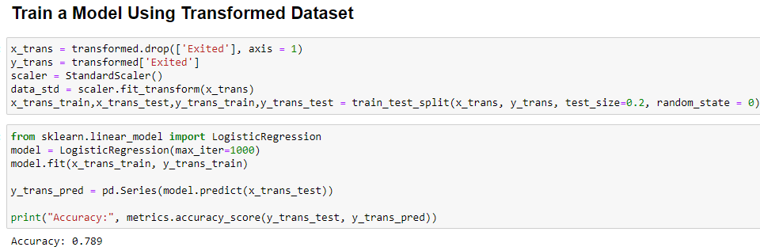
Train Model – Transformed Dataset
Notes:
Computing the accuracy on the transformed data set after applying the disparate impact remover algorithm.

Slide 37
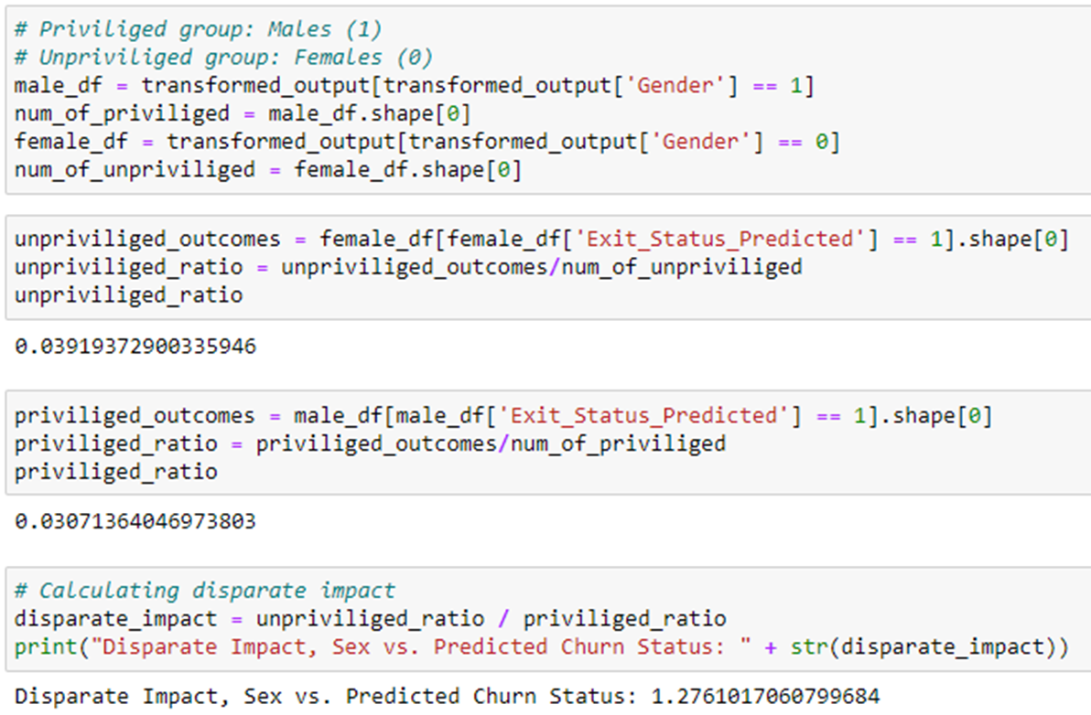
Bias Statistics – Transformed Dataset
Notes:
Compute the update disparate impact ratio which has been reduced but is still higher than the recommended value of 1.25.

Slide 38
Results – Bank Churn Dataset
BANK CHIRN DATASET
ENTITY/DATASET | ORIGINAL | TRANSFORMED
DISPARATE IMPACT | 1.53 | 1.27
ACCURACY -LOGISTIC | 0.789 | 0.789
Notes:
This table summarizes the results of the Jupyter Notebook.

Slide 39
Bias Algorithm Trade-offs
Trade-Off between accuracy vs bias statistics.
Dataset and business case must be well-defined.
Needs careful judgment of which algorithm to follow.
Notes:
As seen from results above we have seen that though the disparate impact values have improved the accuracy remained same.
This will not be the case every time and often we need to make a call for accuracy as it may reduce after applying the bias algorithms.
Also, the biggest trade-off is that the dataset should be well-defined, clean and the business case also should be well-defined to identify protected/privileged attributes for the AIF360 algorithm to work.
It’s the user responsibility and judgement call whether he will use pre-process, in-process or post-process algorithm. It’s always suggested to use the pre-process algorithms.

Slide 40
Bias Algorithm Trade-offs
Continue/Expand on models using in-processing and post processing algorithms.
Focus on comparison between the three models of pre-processing, in-processing and post-processing algorithms.
Test Algorithm on other datasets.
Notes:
Future work on AI Fairness.

Slide 41
Web Resources
OpenDS4All
https://github.com/odpi/OpenDS4All
https://github.com/odpi/OpenDS4All/tree/master/opends4all-resources/opends4all-ethics
View AI Fairness 360 website
https://aif360.mybluemix.net/

