Slide 1
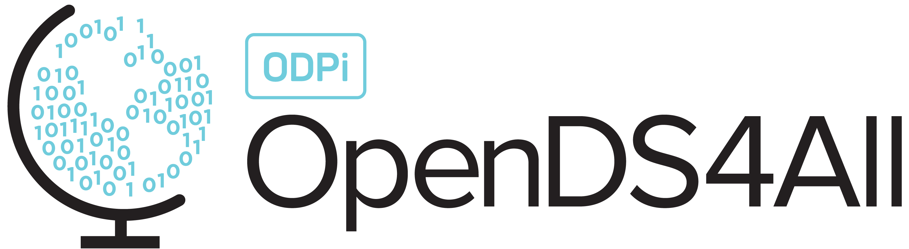
Ethics for Data and AI

Slide 2
Agenda
Why trust and ethics matter
Ethics surrounding data
Ethics surrounding algorithms
Ethics surrounding AI

Slide 3
Why trust and ethics matter

Slide 4








Data science models affect most aspects of society…
Admissions decisions
Employment decisions
Credit risk assessment
Healthcare analysis
Chatbots
Online recommendations
Driving & travel support
Ad placement & news curation
Notes:
Data, algorithms, and AI are everywhere, transforming how we live and work, sometimes in ways we realize and sometimes in ways we do not. Today, algorithms help academic institutions make admissions decisions. They help companies decide who to hire and how to compensate them. They can aid financial institutions in determining who to grant a loan to and at what rate, and support doctors in analyzing medical images or making treatment plans. In our personal lives, data, algorithms, and AI power the chatbots that help us get customer service, the recommendation engines that show us items we might like to purchase, the GPS systems that help us navigate, and the ads we’re served online.

Slide 5
… but they can carry risks and introduce ethical concerns
Admissions decisions
Employment decisions
Credit risk assessment
Healthcare analysis
Fairness, transparency, explainability, privacy, robustness
Fairness, transparency, explainability, privacy
Fairness, privacy, robustness, explainability, transparency
Fairness, privacy, robustness, explainability, transparency
Chatbots
Online recommendations
Driving & travel support
Ad placement & news curation
Privacy, robustness, transparency
Explainability, privacy, robustness
Robustness, privacy, transparency
Fairness, explainability,
privacy
Notes:
But data, algorithms, and AI are not without risk, and as they become more embedded in our everyday lives, the potential consequences of those risks become steeper.

Slide 6
A good data scientist must understand
the potential risks
and unintended consequences surrounding data and algorithms.
Notes:
Therefore, it is critical that data scientists can conceptualize risk and unintended consequences in the context of data, algorithms, and AI, as data scientists can embed ethical principles and guardrails into models and algorithms from their inception, mitigating risk from the start.

Slide 7




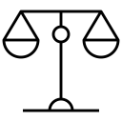



What does it take to build trust in an algorithm or machine?
Accuracy
Data quality
Testing
Robustness
Fairness
Privacy
Transparency
Explainability
Notes:
When considering an algorithm or an AI system, especially one that’s involved in high-stakes decision making, there are some foundational questions that a person is likely to want to know the answers to:
Is it accurate? In other words, can it reliably do what it’s designed to do?
Was the data used to train the model high-quality? In other words, was it evaluated across aspects such as relevancy, currency, clarity, completeness, representativeness, and inclusion?
How was the model tested?
Is it fair? In other words, will it deliver equitable results?
Is it easy to understand? In other words, could a non-technical person understand why it makes a particular decision or arrives at a particular conclusion?
Is it transparent? In other words, could a non-technical person learn about how and why the system was designed, if they wanted to?
Does it handle privacy? In other words, does it keep data private and adhere to applicable privacy laws and expectations?
What happens under unforeseen conditions? In other words, is it safe and secure from hackers and attacks?
It is highly unlikely that any algorithm or machine will ever be 100% accurate or error-free, but qualities like accuracy, data quality, testing, robustness, fairness, privacy, transparency, and explainability help people understand how to account for the fact that no system is perfect.

Slide 8
Why does trust matter?
As algorithms are increasingly used to augment human intelligence and aid human decision-making, it is critical that people can trust that:
The outcomes of these systems are trustworthy and aligned with human ethics and expectations
Unintended consequences are identified, mitigated, and tracked
Notes:
Trust matters because it is the factor that enables data, algorithms, and AI to deliver value. It is the factor that empowers users and consumers to adopt these diverse systems with confidence. It does not matter how sophisticated a model or system is — if people do not trust it, they will not use it. This is especially true for models and systems that directly impact people’s lives or livelihoods.

Slide 9
Doing the right thing
What motivates people to do the right thing?
Ethics (culturally agreed-upon morals and standards of action)
Laws and legal/criminal liability
Fear of non-legal consequences (e.g., reputational harm)
Notes:
Working to build trust by ensuring that models and systems are aligned with human ethics and expectations is the right thing to do. As humans, we are motived to do the right thing for several reasons.
One reason is ethics. Ethics are culturally agreed-upon morals and standards of action. Ethics are a kind of social contract by which we all abide. Ethics are often unwritten and inherently understood. We voluntarily abide by ethics because it makes the world a better place for all of us. Ethics are the cornerstone of civilization.
Laws and legal/criminal liability also motivate us to do the right thing. The consequences of breaking the law incentivize us to follow the law.
Additionally, non-legal consequences can motivate us to do the right thing. For example, we might be judged by our family, friends, or colleagues if we don’t do the right thing.
Here’s an example: Ethical principles stop me from stealing your car — culturally, we recognize and respect the boundaries of ownership and personal property. The law also stops me from stealing your car — I do not want to go to jail for stealing your car. Non-legal consequences are also a factor — if word got out that I stole your car, you might beat me up or my other friends might abandon me for lack of trust.
Here’s a different example: If you tell me a secret and I agree not to tell it but do, it is not a crime and I will suffer no legal consequences. However, it might damage my reputation with others, or I could lose your friendship. And I will have acted unethically by breaching our culturally agreed-upon standard of confidence. So, while ethics and law often align, it is not always the case that was is ethical is also legal or that what is legal is also ethical.

Slide 10
Doing the right thing
What motivates models and systems to do the right thing?
Nothing inherent — and that’s why those who work with data and AI must understand how to embed ethical principles into the models and systems they design, build, train, deploy, manage, and use
Notes:
On the other hand, models and systems have no motivation to do the right thing because they have no inherent concept of the “right thing.” They have no inherent understanding of ethics, no incentive to follow the law, and no stake in avoiding non-legal consequences. It falls to the people who design, build, train, deploy, manage and use models and systems to embed ethics into them so that they align with human expectations.

Slide 11
Ethics surrounding data

Slide 12
Ethical principles around data
The principles for ethical human subjects research defined by the Belmont Report (1978) have been generally accepted by the academic community to guide algorithmic design:
Respect for persons
Autonomy: People should have the right to control their data
Informed consent: People should explicitly approve the use of their data based on understanding
Beneficence
People should not be harmed by their data or the way it is used
When people’s data is used, it should be to their benefit
Justice
People should be treated fairly and equitably by algorithms
Notes:
Many of the industry standards for ethical use of data are shaped by human subjects research. The Belmont Report, published in 1978, outlined three main principles for ethical human subjects research that have been adapted for use in algorithmic design today:
Respect for persons
Beneficence
Justice

Slide 13

Data collection
Data about us is constantly being collected!
Cameras
Cell phone location reporting
Accelerometers
Wearable tech
Social media
Click-throughs, cookies
Do I own data collected about me?
What if I don’t like what the data says about me?
Can I control how the data is used?
Notes:
There is a lot of recent discussion around the ethics of how data is collected, whether we “own” it, and can control how it can be deleted. For example, the EU’s data protection law (GDPR) gives individuals the right to ask organizations to delete their personal data.

Slide 14
Data and informed consent
In human subjects research, there is a notion of informed consent
Must understand what is being done
Must voluntarily consent to the experiment
Must have the right to withdraw consent at any time
But informed consent is not always required in “ordinary conduct of business”
Example: A/B testing is permitted and used often on social media
But this is a very fine line…
Notes:
In human subjects research, researchers must ensure informed consent. In other words, subjects must understand what is being done to them, must provide affirmative consent to what is being done to them, and must have the right to withdraw that consent at any time. Those same principles are now being applied to data collection, but what are the implications for informed consent as it relates to data for companies that rely on data collection, such as Facebook or Google?
Informed consent is not always legally required for “ordinary conduct of business.” Some jurisdictions to require it (the EU, for example) as do some industries (banking, for example). For example, there is no informed consent required for A/B testing, such as when Facebook previews a new timeline to a subset of its users. But where is the line for this kind of testing?

Slide 15
Example: Facebook’s mood manipulation experiment
In 2012, researchers at Facebook and Cornell University manipulated the newsfeed of selected Facebook users:
Some users were shown more positive articles
Others were shown more negative or sad articles
These selected users demonstrated “emotional contagion”
People who were shown more positive articles posted more positive articles themselves on Facebook
People who were shown shown more negative articles posted more negative articles
Source: Kramer AD, Guillory JE, Hancock JT. Experimental evidence of massive-scale emotional contagion through social networks. Proc Natl Acad Sci U S A. 2014 Jun 17;111(24):8788-90. doi: 10.1073/pnas.1320040111. Epub 2014 Jun 2. PMID: 24889601; PMCID: PMC4066473

Slide 16
Was this legal?
Facebook’s terms of service: Users relinquish the use of their data for “data analysis, testing, [and] research.”
Facebook statement: “This research was conducted for a single week in 2012 and none of the data used was associated with a specific person’s Facebook account. We do research to improve our services and to make the content people see on Facebook as relevant and engaging as possible. A big part of this is understanding how people respond to different types of content, whether it’s positive or negative in tone, news from friends, or information from pages they follow. We carefully consider what research we do and have a strong internal review process. There is no unnecessary collection of people’s data in connection with these research initiatives and all data is stored securely.”
Notes:
Facebook didn’t ask anyone if they wanted to be part of the study — users had no opportunity to provide informed consent.

Slide 17
Was this ethical?
“And at the end of the day, the actual impact on people in the experiment was the minimal amount to statistically detect it […] Having written and designed this experiment myself, I can tell you that our goal was never to upset anyone. […] In hindsight, the research benefits of the paper may not have justified all of this anxiety.”
- Adam D.I. Kramer, Facebook social psychologist

Slide 18
Ethical issues with data and informed consent
Informed consent can be difficult to give
In order to understand what is being done with their data, users must slog through pages of complex Terms and Conditions
Most people just click through because the Terms and Conditions are unintelligible to laypeople
How the data, once collected, is going to be used can be difficult to control
Data is often collected first and used later, for purposes not defined at the time of collection
Notes:
There are several issues with informed consent with data.
First, the terms of consent are frequently difficult to understand and buried in fine print. Most of us ignore the terms of usage and just click through because they’re too complex to understand and too long to read.
Second, it is difficult to control how data, once collected, could be used in the future. It is difficult to keep track of how it is copied and reused.

Slide 19
Intellectual property
Patents only protect implementations, not ideas
Artistic expression can be copyrighted: exclusive legal right to print, publish, perform, film or record and authorize others to do the same
Derivative work can be created with permission
There’s also a notion of citation, in which we give credit to the owner
What about data?
Wikipedia, Yelp, Rotten Tomatoes, TripAdvisor, phone books, recipes
A clinical data set, a company’s data, your gene sequence, …
Notes:
There are legal protections available for some types of intellectual property, but other types fall into a gray area. For example, what about content that is created by users of a platform — for example, a restaurant review created by an individual and published on Yelp? Does the user retain any rights to that content, or does the platform own and control the content? What about data about people, such as medical records?
The concept of ownership in these cases is complex. Ownership of data or license to use data may be governed by common law, statutory law, and terms of a license or contract.

Slide 20
Ethics surrounding data:
Spotlight on privacy
Notes:
Privacy is a basic human need. Privacy is not black and white – it is an exercise of control. Loss of privacy occurs when there’s a loss of control over personal data.

Slide 21
Privacy is not simple
Many rules and laws govern the use of collected information, including:
HIPAA: Health Insurance Portability and Accountability Act
FERPA: Family Educational Rights and Privacy Act
GDPR: General Data Protection Regulation (Europe)
However, “information leakage” can lead to unexpected disclosures and unintended consequences
Example: By collecting smart water meter data unrelated to billing, utilities can derive information about consumer households, such as eating and sleeping routines, how many people are home and at what times, etc.
In the wrong hands, this information could cause harm
“Privacy by trust” versus “privacy by design”
Notes:
Privacy is complex because it is often governed by rules and laws, such as HIPAA, FERPA, or GDPR. The landscape of privacy-related regulations is evolving rapidly.
Despite the highly regulated nature of this space, there are many opportunities for privacy breaches, some of which are not obvious. For example, a 2014 report [https://takebackyourpower.net/comprehensive-report-how-smart-meters-invade-privacy/] on smart water meters found that smart meters enable utilities to collect data beyond what is necessary for billing, which could lead them to derive information about households that breaches privacy. For example, smart water meter data could reveal who is home and when, how many people live in a home, what the home’s routines are, what appliances are used and when, and more. In the wrong hands, this data could be harmful. For example, data pertaining to who is home and when in the hands of a burglar could facilitate a break-in.
Practitioners and companies should consider “privacy by trust” vs. “privacy by design.” Privacy by trust is the current operating model: consumers have little autonomy over their data and must (blindly) trust that companies will safeguard their privacy. In contrast, privacy by design is a model in which consumers have autonomy over their data by default, and practitioners/companies design their models and systems to put control over user privacy into the hands of the users themselves.

Slide 22
Example: OKCupid data publicly released
In 2016, a Danish research team publicly released a vast dataset of the usernames, ages, genders, locations, and other profiling characteristics of over 70,000 OkCupid users
Did they attempt to anonymize?
Researcher’s response: “… all the data found in the dataset are or were already publicly available, so releasing this dataset merely presents it in a more useful form.”
Source: https://www.wired.com/2016/05/okcupid-study-reveals-perils-big-data-science/

Slide 23
Was the OkCupid data public?
Posting publicly ≠ consent for data collection!
Data acquired by scraping, likely from an OkCupid profile researchers created for the purpose of accessing data
OkCupid users may restrict the visibility of their profiles to logged-in users only
Likely that the researchers collected—and released—profiles that were intended to not be publicly viewable

Slide 24
De-identification example: Group Insurance Commission
In 1997, after then-Massachusetts Governor William Weld collapsed at an event, MIT grad student Latanya Sweeney used publicly-available, de-identified health records from the Massachusetts Group Insurance Commission to locate his diagnosis and prescriptions
Is removing identifiable information from data (e.g. name, phone, address…) sufficient to protect the identity of individuals?
Source: https://arstechnica.com/tech-policy/2009/09/your-secrets-live-online-in-databases-of-ruin/

Slide 25
Differential Privacy
When do you feel safe releasing personal information, e.g. completing a survey about your tastes in movies?
When your answers have no impact on the privatized released result?
When, with high probability, an attacker looking at the privatized released result cannot learn any new information about you?
These are not achievable
Differential privacy aims to maximize the accuracy of queries from statistical databases while minimizing the chances of identifying its records by adding noise
The privatized released result is nearly the same whether or not you submit your information
Source: https://www.quantamagazine.org/a-mathematical-approach-to-safeguarding-private-data-20121210
Notes:
The question of whether released data is “safe” (i.e. whether or not an individual can be identified using the released data) is a topic that has been well studied in the computer science community. One notion that has been formalized is ”differential privacy”, whose goal is to provide as much statistical information as possible from a dataset while guaranteeing that an individual cannot be identified.
Differential privacy ensures, for example, that a person can contribute their genetic information to a medical database without fear that anyone analyzing the database will be able to figure out which genetic information is hers — or even whether she has participated in the database at all. And it achieves this security guarantee in a way that allows researchers to use the database to make new discoveries.
Ideas from this research are now finding their way into practice, e.g. the US Census Bureau (2008, commuting patterns), Google (2015, historical traffic statistics), among others.

Slide 26
Ethics surrounding algorithms

Slide 27

Algorithms are not neutral
Algorithms can encode human biases
Training data set isn’t representative
Past population is not representative of the future population
Overfitting to underrepresented data is common
Notes:
Algorithms are developed and trained by humans, so they can learn and replicate human biases.
One way that algorithms can learn biases is through non-representative training data. When training data does not accurately reflect the target population, the algorithm will not adequately account for the underrepresented group(s).
Another way that algorithms can learn biases is through outdated historical data. For example, an algorithm designed to predict successful applicants for jobs in tech might learn that male applicants are much more likely than female applications to success if they’re trained on hiring and performance data of tech employees from the last 25 years because females have historically held fewer tech jobs in that time period.
A third way that algorithms can learn biases is by overfitting, or training an algorithm on too-specific a population. When this happens, it is difficult for the algorithm to be deployed in other scenarios or with other populations.

Slide 28
Three possible ways to get “bad” results from “good” data
Correlated attributes
Misleading results
p-hacking
Notes:
We’ll give some examples of these on the next slides.

Slide 29
Example: Correlated attributes
A retailer decided to win business from their competitors by offering lower online prices to customers living near a competitor
Seems fine so far, right?
However, competitor stores happened to be located in higher income areas, not in rural areas or lower-income neighborhoods
So, those living in rural areas and lower-income neighborhoods see higher prices than those in suburban areas and higher-income neighborhoods
Source: https://www.wsj.com/articles/SB10001424127887323777204578189391813881534
Notes:
Staples was not intending to offer better prices to people in higher income areas, they were merely trying to compete with Office Max. But there was a correlation between income level and where Office Max stores are located.

Slide 30
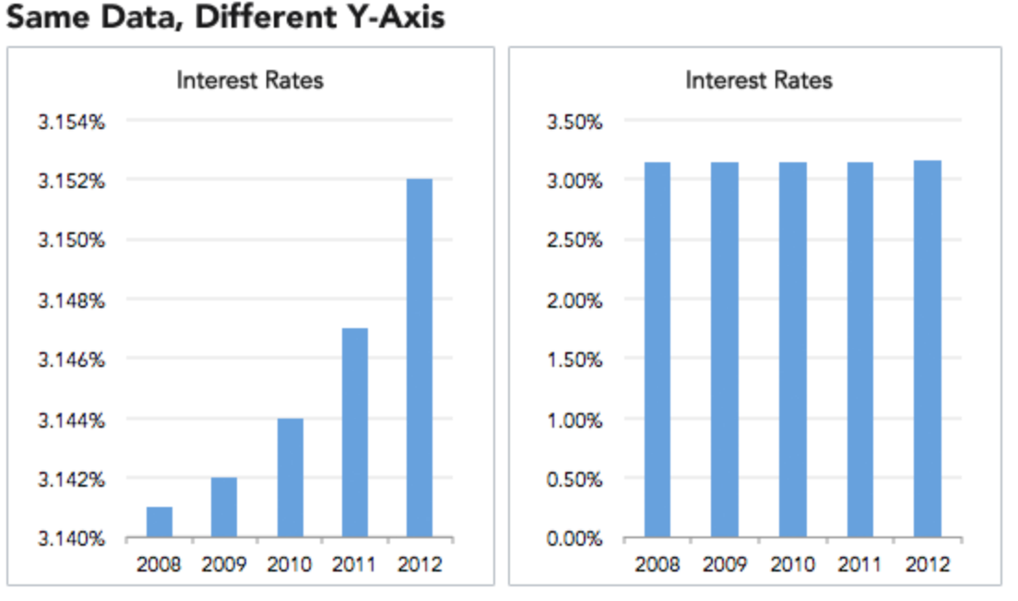
Example: Misleading results
Notes:
Data can also be presented graphically that are misleading. In the bar chart to the left, it appears that there is a dramatic increase in interest rates from 2008 to 2012; however, if the y-axis is changed to start at 0, it is not so dramatic a change.

Slide 31
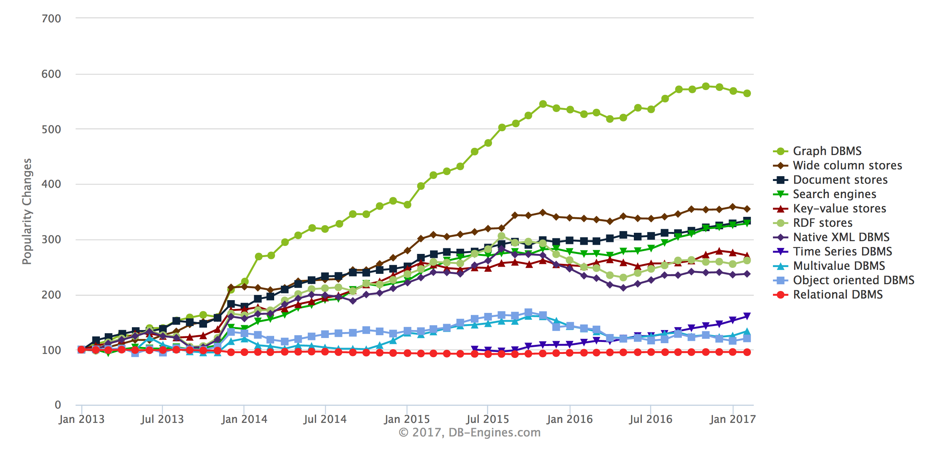
Example: Misleading results
Notes:
As another example, in this figure the y-axis shows how different types of DBMS have changed in popularity, leading the viewer with the impression that graph DBMS are the “most popular”. However, relational DBMS (in red at the bottom) have been around a long time and are very popular. However, their popularity has not changed significantly over this time period, and they continue to command by far the largest market share of all these systems. Thje graphic is misleading since it leads you to believe that relational DBMS are “losing” with respect to NoSQL systems.

Slide 32
p-Hacking
Select which observations or features to include in the model
Try lots of different models
Report the best one as “significant”
Notes:
The p-value is used in the context of null hypothesis testing in order to quantify the statistical significance of evidence. In null hypothesis testing, a claim is assumed to be valid if its counter-claim is improbable.
P-hacking (aka data dredging, data fishing, data snooping, or data butchery) is a term coined in 2014 by Regina Nuzzo Nature. It is the misuse of data analytics to find patterns in data that can be presented as statistically significant, dramatically increasing and understating the risk of false positives. This is done by performing many statistical tests on the data and only reporting those that come back with significant results.

Slide 33
Ethics surrounding algorithms:
Spotlight on fairness
Notes:
Privacy is a basic human need
Privacy is not black and white – it is an exercise of control
Loss of privacy occurs when there’s a loss of control over personal data

Slide 34
Fairness
Fairness is the equitable treatment of individuals or groups of individuals by an algorithm
Equal ≠ equitable
Equal: Individuals or groups receive identical treatment
Equitable: Individuals or groups are treated differently so that they reach the identical outcome
Notes:
Fairness is the equitable treatment of individuals or groups of individuals by an AI system. Fairness for an AI system depends on the context in which it is used.
Properly calibrated, AI can assist humans in making fairer choices, countering human biases, and promoting inclusivity. Fairness refers to the equitable treatment of individuals, or groups of individuals, by an AI system. Bias occurs when an AI system has been designed, intentionally or not, in a way that may make the system's output unfair. Bias can be present both in the output of the algorithm of the AI system and in the data used to train and test it. It can emerge as a result of cultural, social, or institutional expectations; because of technical limitations of its design; or when the system is used in unanticipated contexts or to make decisions about communities that are not considered in the initial design.
Fairness focuses on equity, not equality. Equity involves recognizing disparities between different groups and treating them differently so that they reach an identical outcome. Equality involves treating groups the same, even if it means they reach different outcomes. Equity helps ensure that underrepresented or marginalized groups are appropriately accounted for.

Slide 35
Fairness
Fairness has been studied in social choice theory, game theory, economics and law
Currently trendy in theoretical computer science
Discrimination of an individual: An individual from the target group gets treated differently from an otherwise identical individual not from the target group
Discrimination in aggregate outcome: The percentage success of the target group compared to that of the general population
Dwork, Hardt, Pitassi, Reingold and Zemel,
“Fairness through Awareness”
Proc. 3rd Innovations in Theoretical Computer Science, 2012.
Notes:
It is important that algorithms be “fair”, e.g. classify people in ways that are consistent with commonsense notions of fairness. For example, we wouldn’t think it’s ethical for a bank to offer one set of lending terms to minority applicants and another to white applicants. But as recent work has shown — most notably in the book “Weapons of Math Destruction” by the mathematician Cathy O’Neil — discrimination that we reject in normal life can creep into algorithms.
Suppose you had a minority group in which the smart students were steered toward math and science, and a dominant group in which the smart students were steered toward finance. Now if someone wanted to write a quick-and-dirty classifier to find smart students, they might look for students who study finance because the majority is much bigger than the minority. The problem is that not only is this unfair to the minority, but it also has reduced utility compared to a classifier that understands that if you’re a member of the minority and you study math, you should be viewed as similar to a member of the majority who studies finance.
Individual fairness is also not enough to ensure group fairness. For example, suppose you are looking at college admissions and you’re thinking about using test scores as your admission criterion. If you have two groups that have very different performance on standardized tests, then you won’t get group fairness if you have one threshold for the standardized-test score.
For a lengthier discussion, see the book The Ethical Algorithm: The Science of Socially Aware Algorithm Design by Michael Kearns and Aaron Roth. Another great resource is an interview with Cynthia Dwork, https://www.quantamagazine.org/making-algorithms-fair-an-interview-with-cynthia-dwork-20161123.

Slide 36
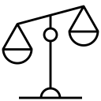
Example: Recidivism prediction
Algorithms are sometimes used in sentencing and parole to predict an individual’s likelihood to re-offend
A 2016 ProPublica analysis found that many of these algorithms are bias against Black people
Source: https://www.propublica.org/article/machine-bias-risk-assessments-in-criminal-sentencing
Notes:
Another example of lack of algorithmic fairness are the algorithms frequently used in sentencing and parole, which generate a score predicting the likelihood of an individual committing a future crime.
However, it is not clear the the algorithms used are predictive, and they seem to show racial disparities.
‘For example, Propublica obtained the risk scores assigned by one such algorithm to more than 7,000 people arrested in Broward County, Florida, in 2013 and 2014 and checked to see how many were charged with new crimes over the next two years. They found that the score proved remarkably unreliable in forecasting violent crime: Only 20 percent of the people predicted to commit violent crimes actually went on to do so. When a full range of crimes were taken into account — including misdemeanors such as driving with an expired license — the algorithm was only somewhat more accurate than a coin flip.
They also discovered significant racial disparities: In forecasting who would re-offend, the algorithm made mistakes with black and white defendants at roughly the same rate but in very different ways. The formula was particularly likely to falsely flag black defendants as future criminals, wrongly labeling them this way at almost twice the rate as white defendants. White defendants were mislabeled as low risk more often than black defendants.

Slide 37
Ethics surrounding AI

Slide 38

AI trust
As AI is operationalized, it is imperative that is it both trustworthy and trusted
Trust in AI can be difficult to build because AI can seem complex to the general public
IBM outlined five pillars of AI trust that support and demonstrate trustworthiness in model building
Notes:
Data and algorithms are the lifeblood of AI, so it’s worth considering the ethics surrounding AI in addition to the ethics surrounding data and algorithms, because they’re all connected.
As AI becomes more embedded in daily life and business, it has become imperative that is it both trustworthy and trusted. AI can seem mysterious — sometimes even to its own engineers — so it can be difficult to demonstrate its trustworthiness. In response to this, IBM has outlined three principles and five pillars which can be used to strengthen trust in AI systems.

Slide 39

The Five Pillars of Trust
AI ethics is a multidisciplinary field that studies how to optimize AI's beneficial impact while reducing risks and adverse outcomes. It enables trustworthy AI, or AI systems that address human needs, safety, and privacy.
IBM has defined 3 principles and 5 pillars for AI ethics and trustworthy AI:
Principles for Trust and Transparency
The purpose of AI is to augment human intelligence
Data and insights belong to their creator
New technology, including AI systems, must be transparent and explainable
Pillars of Trust
Explainability
AI system’s ability to provide a human-interpretable explanation for its predictions and insights.
Fairness
Equitable treatment of individuals or groups of individuals by an AI system. Fairness for an AI system depends on the context in which it is used.
Robustness
AI system’s ability to handle exceptional conditions, such as abnormalities in input, effectively.
Transparency
AI system’s ability to include and share information on how it has been designed and developed.
Privacy
AI system’s ability to prioritize and safeguard consumers’ privacy and data rights.
Source: https://www.ibm.com/artificial-intelligence/ethics
Notes:
Only by embedding ethical principles into AI applications and processes can we build systems based on trust.
AI ethics is the multidisciplinary field that studies how to optimize AI's beneficial impact while reducing risks and adverse outcomes.
AI ethics enables us to develop trustworthy AI, or AI systems that address human needs, safety, and privacy.
IBM’s approach to AI ethics and trustworthy AI is defined by 3 principles:
The purpose of AI is to augment human intelligence
Data and insights belong to their creator
New technology, including AI systems, must be transparent and explainable
The principles are supported by 5 pillars:
Explainability: How AI-led decisions are made and what determining factors were included are crucial to understand.
Fairness: Properly calibrated, AI can assist humans in making fairer choices by mitigating bias.
Robustness: As systems are employed to make crucial decisions, AI must be secure and guard against adversarial threats.
Transparency: Transparency reinforces trust, and the best way to promote transparency is through disclosure.
Privacy: AI systems must prioritize and safeguard consumers’ privacy and data rights.
We have already discussed privacy and fairness. Let’s focus on explainabilty, transparency, and robustness in the context of AI.

Slide 40
Ethics surrounding AI:
Spotlight on transparency,
explainability, and robustness

Slide 41
Transparency and explainability
Transparency:
Awareness of when an AI system is in use and sharing appropriate information with stakeholders on how the AI system has been designed and developed.
Explainability:
The ability of an AI system to provide insights that humans can use to understand the causes of the system's predictions.
Notes:
Transparency and explainability are distinct, yet related, concepts. The goal of both is giving greater visibility into the inner workings of AI systems so that people can better understand why and how they work.
Transparency focuses on sharing information about a system with stakeholders so that they understand how the system was designed and developed. In other words, transparency enables people to understand how a system works.
Explainability focuses on sharing insights about how a system reached an individual prediction or outcome. In other words, explainability drills down a level further than transparency and enables people to understand how the system reached a specific prediction or outcome.
Here’s an analogy: Transparency is like an explanation of how to solve calculus problems, and explainability is like seeing the work that went into solving a specific calculus problem.

Slide 42
Reproducibility
Transparency and explainability enable reproducibility
We need to be able to reproduce results, but …
The algorithms used in data science are complicated
When things “go wrong”, we need to understand why
Research code is often shared; commercial algorithms less so
The data often cannot be shared
Notes:
Generally speaking, transparency and explainability enable reproducibility by making details about an AI system available to users , stakeholders, and auditors.
However, this can be difficult to achieve because the algorithms (in particular, ML algorithms) are complex and it is often difficult to understand the dependencies between data and code. Furthermore when the algorithms may be “black boxes”, making it impossible to open them up to reason about results. Furthermore, there may be privacy issues associated with the data and it cannot be shared.

Slide 43
Facilitating reproducibility
To facilitate reproducibility, the “FAIR” principles have been proposed:
Findable
Accessible
Interoperable
Reusable
Techniques: versioning (git), provenance tracking (data derivation history), workflow systems, metadata capture, open standards
https://www.nature.com/articles/sdata201618
Notes:
The FAIR Data Principles were proposed as guideline for those wishing to enhance the transparency of their data and research results. As opposed to other initiatives that focus on the human side of things, these principles put specific emphasis on enhancing the ability of machines to automatically find and use the data, in addition to supporting its reuse by individuals.
https://www.nature.com/articles/sdata201618
There is a lot of ongoing research in how to facilitate reproducibility especially with respect to provenance – understanding the “why” and “where” of data. Examples include providing provenance tracking environments for different execution environments (e.g. Jupyter notebooks or R-markdown source documents) and understanding provenance through machine learning operations.

Slide 44
Robustness
The ability of an AI system to effectively handle exceptional conditions, such as abnormalities in input
AI robustness also allows AI systems to respond well to deliberate adversarial attacks, minimize security risks, and enable confidence in system outcomes
Notes:
As systems are increasingly used to help make crucial decisions, it is imperative that AI is secure and robust. AI systems must be actively defended from adversarial attacks, minimizing security risks and enabling confidence in system outcomes.
Robustness enables systems to respond well to intentional and unintentional interference and exceptional conditions, like abnormalities in input.

Slide 45
Summary

Slide 46
Key takeaways: Ethics surrounding data, algorithms, and AI
There is nothing inherent in algorithms or AI systems that makes them do the right thing, so data scientists must encode ethics into the systems they build
Ethical issues often aren’t spotted until there are unintended consequences, so it is critical to consider them throughout the data & AI lifecycle
It can be costly to re-engineer or abandon an algorithm or system if an ethical issue is discovered — this can be avoided when ethics are considered from ideation and throughout the lifecycle
Privacy, fairness, transparency, explainability, and robustness are pillars that guide the ethical use of data, algorithms, and AI
A good data scientist must understand the potential risks and ethical issues surrounding data, algorithms, and AI to build trustworthy systems!

