Slide 1

Data Exploration and Visualization
Difficulty level: Introductory
Case Study I: Covid_data
Notes:
Initial release, Xumin Liu, Rochester Institute of Technology, 2022.
By Xumin Liu https://www.cs.rit.edu/~xl/
Except where otherwise noted, this work is licensed under a Creative Commons Attribution-4.0 International License https://creativecommons.org/licenses/by/4.0/

Slide 2
Dataset Description
COVID-19 World Vaccination Progress
Contains the information about daily and total vaccination for COVID-19
Data source:
Kaggle: https://www.kaggle.com/gpreda/covid-world-vaccination-progress
Acknowledgement:
The data were collected by Our World in Data.
Notes:
Please contact Xumin Liu (xmlics@rit.edu) for the demo code shown in the slides.

Slide 3
Tell a story about it
Load the clean the data
Poke around the data
How many countries it covers?
What is the duration of the data?
Vaccine usage
The most recent usage of vaccines in all countries
The highest and lowest vaccinated countries
The usage of vaccines in US over time
Which vaccines are used where?
The list of countries where each vaccine is used
The total number of countries for each vaccine
Notes:
In this case study we will use the basic exploration and visualization techniques to analyze the covid dataset and make sense of it following the steps/answering the questions.

Slide 4
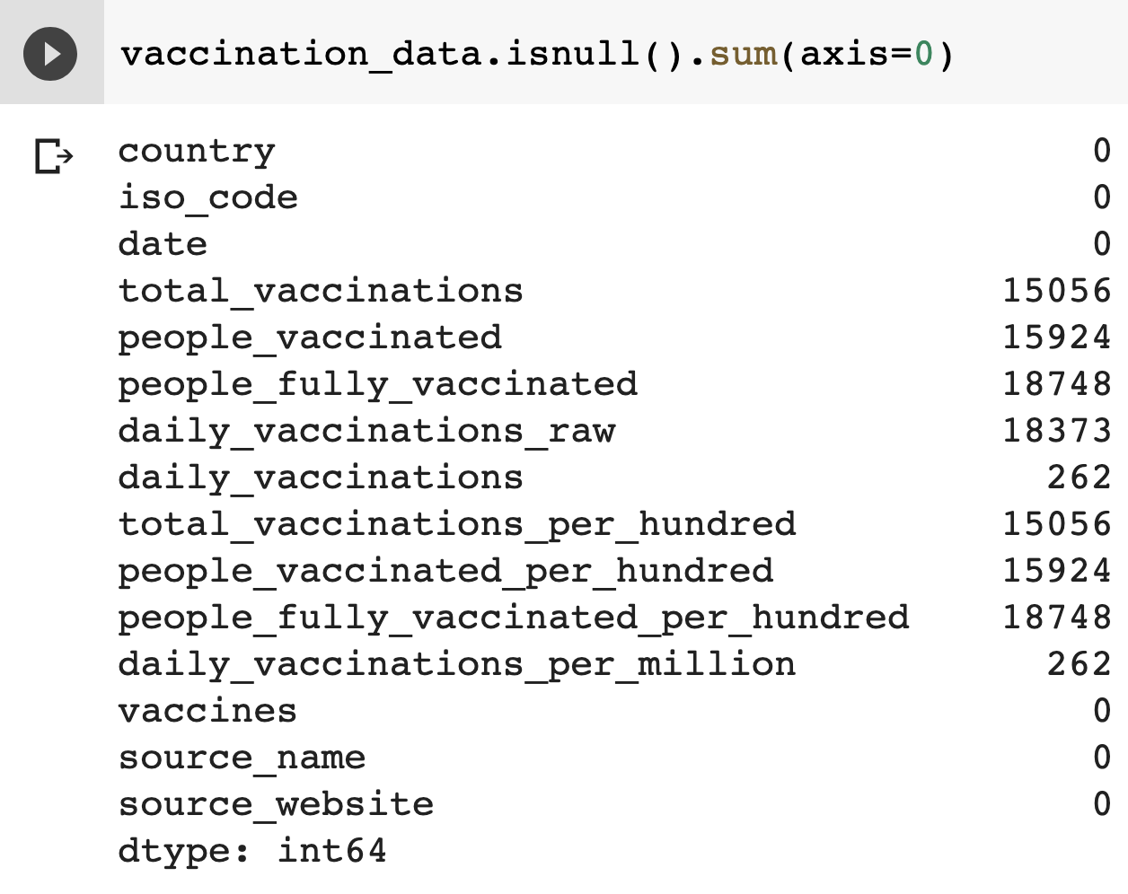
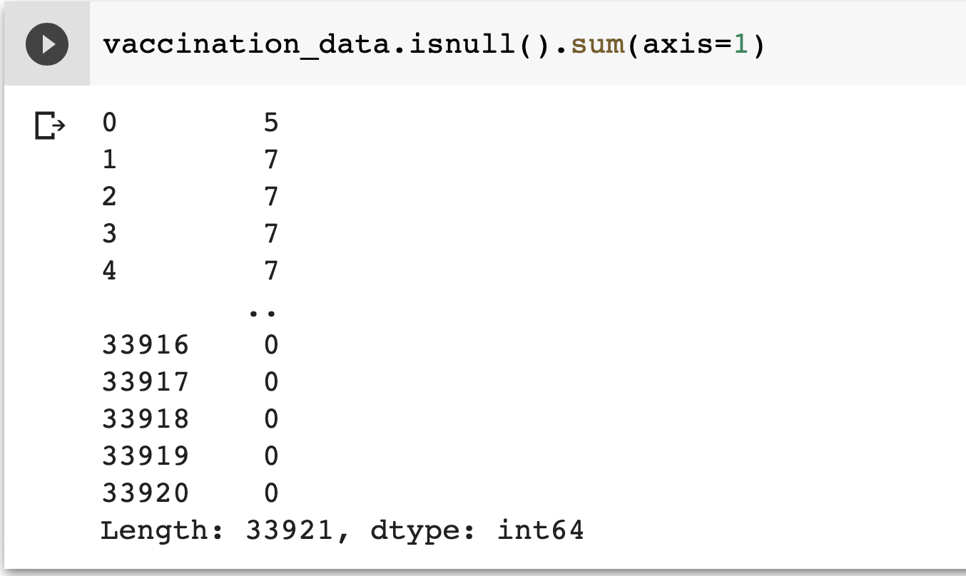
Clean the Data
1. Check if there are any null values
Notes:
The first step is to clean the data. Check if there are any null value. Use axis’s value to specify if the checking is made on rows or on columns.

Slide 5
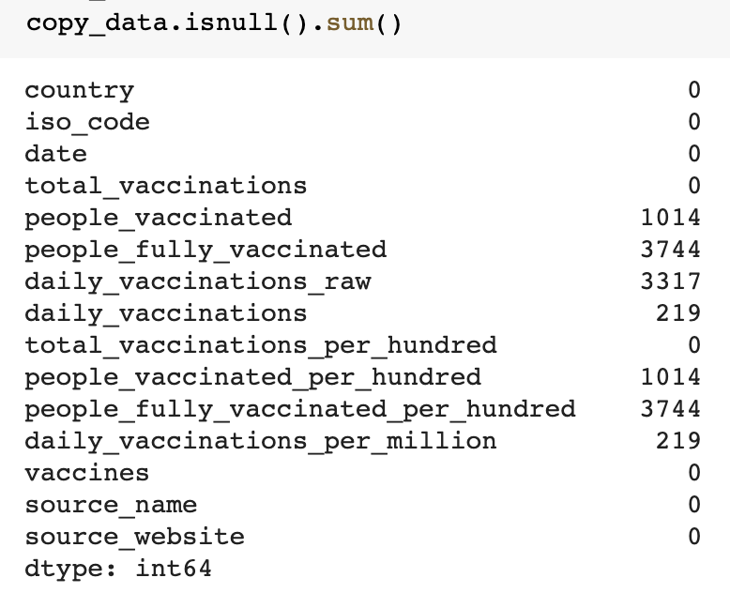
Clean the Data
2. Drop the rows that has null value for total_vaccinations
Notes:
As “total_vaccinations” is one of the targeted column, we should drop those records having null values for this column.

Slide 6
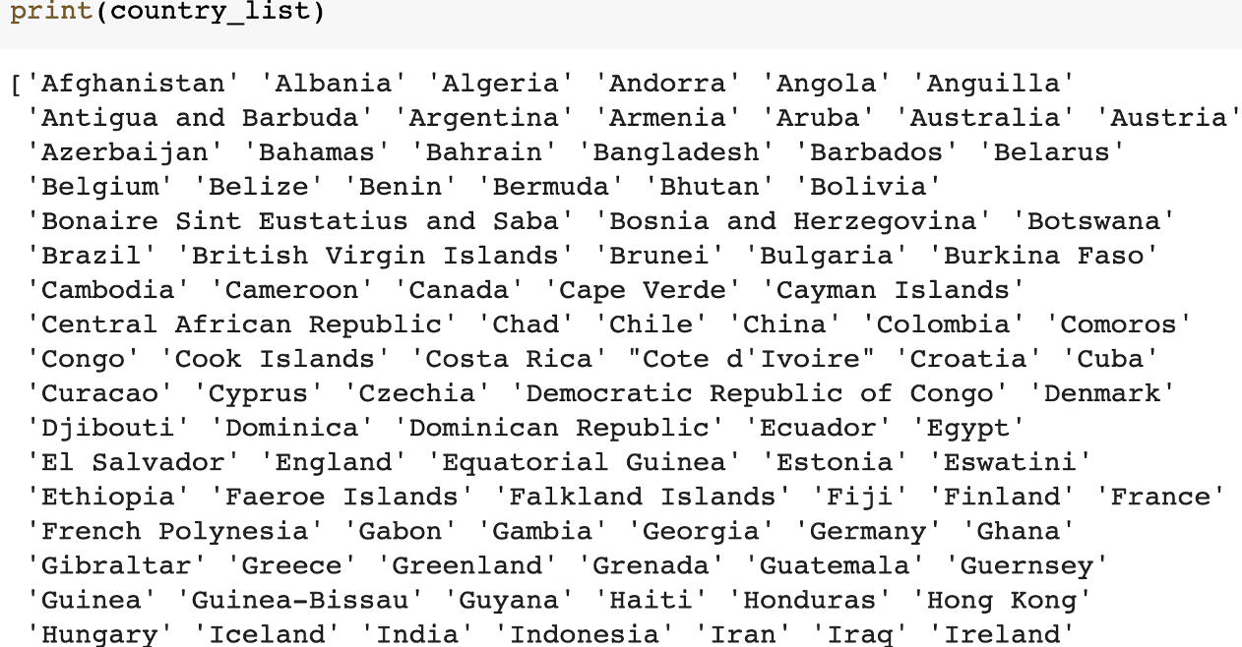
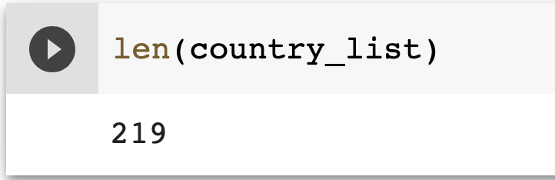
Poke Around the Data
What are the countries covered?
The time duration of the data
Notes:
Do some simple query to better understand the data, such as the countries and the duration covered in the dataset.

Slide 7
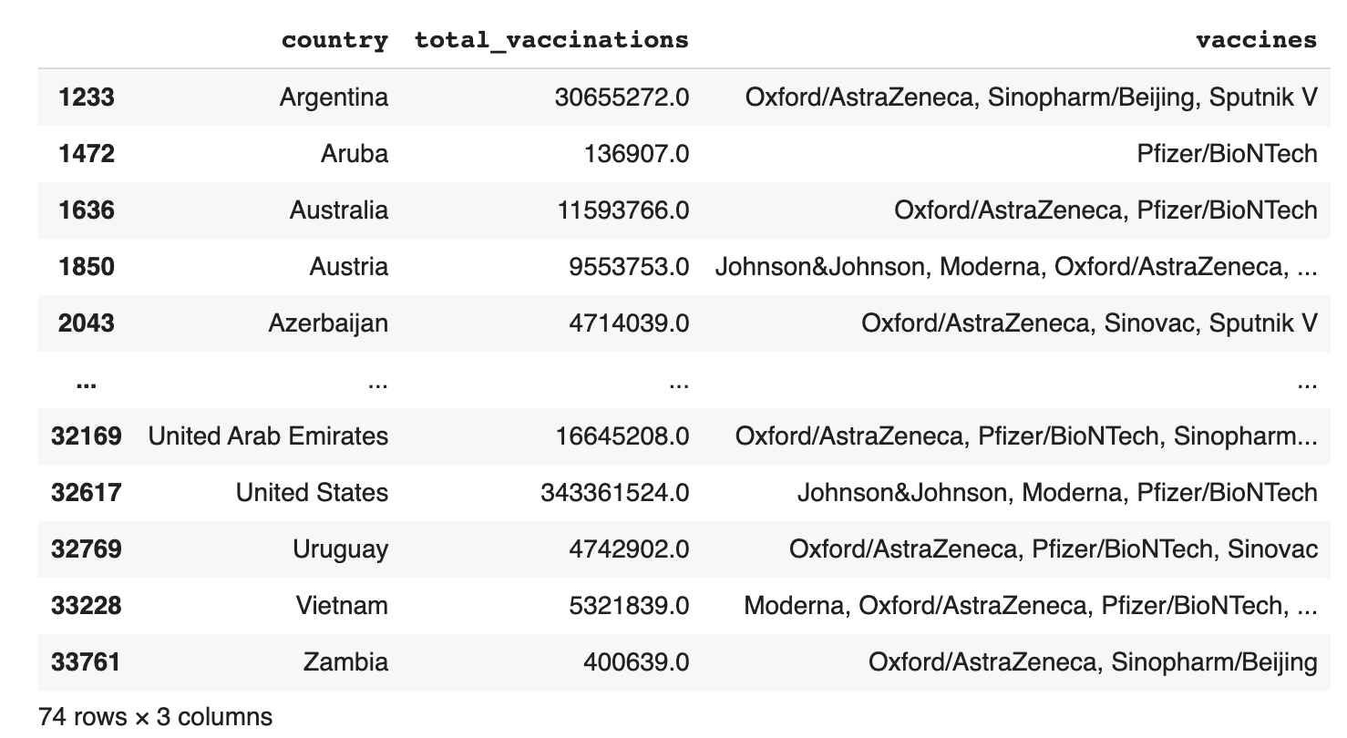
Data Query
The most recent record for each country. First try the condition date==‘2021-07-28’
Notes:
After checking the data, we found each country has a record for each covered day. To get the most recent information, we only want to keep the records that show the most recent information. We first try to set the condition on the most recent date, set it as “2021-07-28” as that is the largest value for the date column.
The query result shows there are 74 rows. This is different from the total number of countries. That suggests that for some countries, the most recent date is earlier than “2021-07-28” .

Slide 8
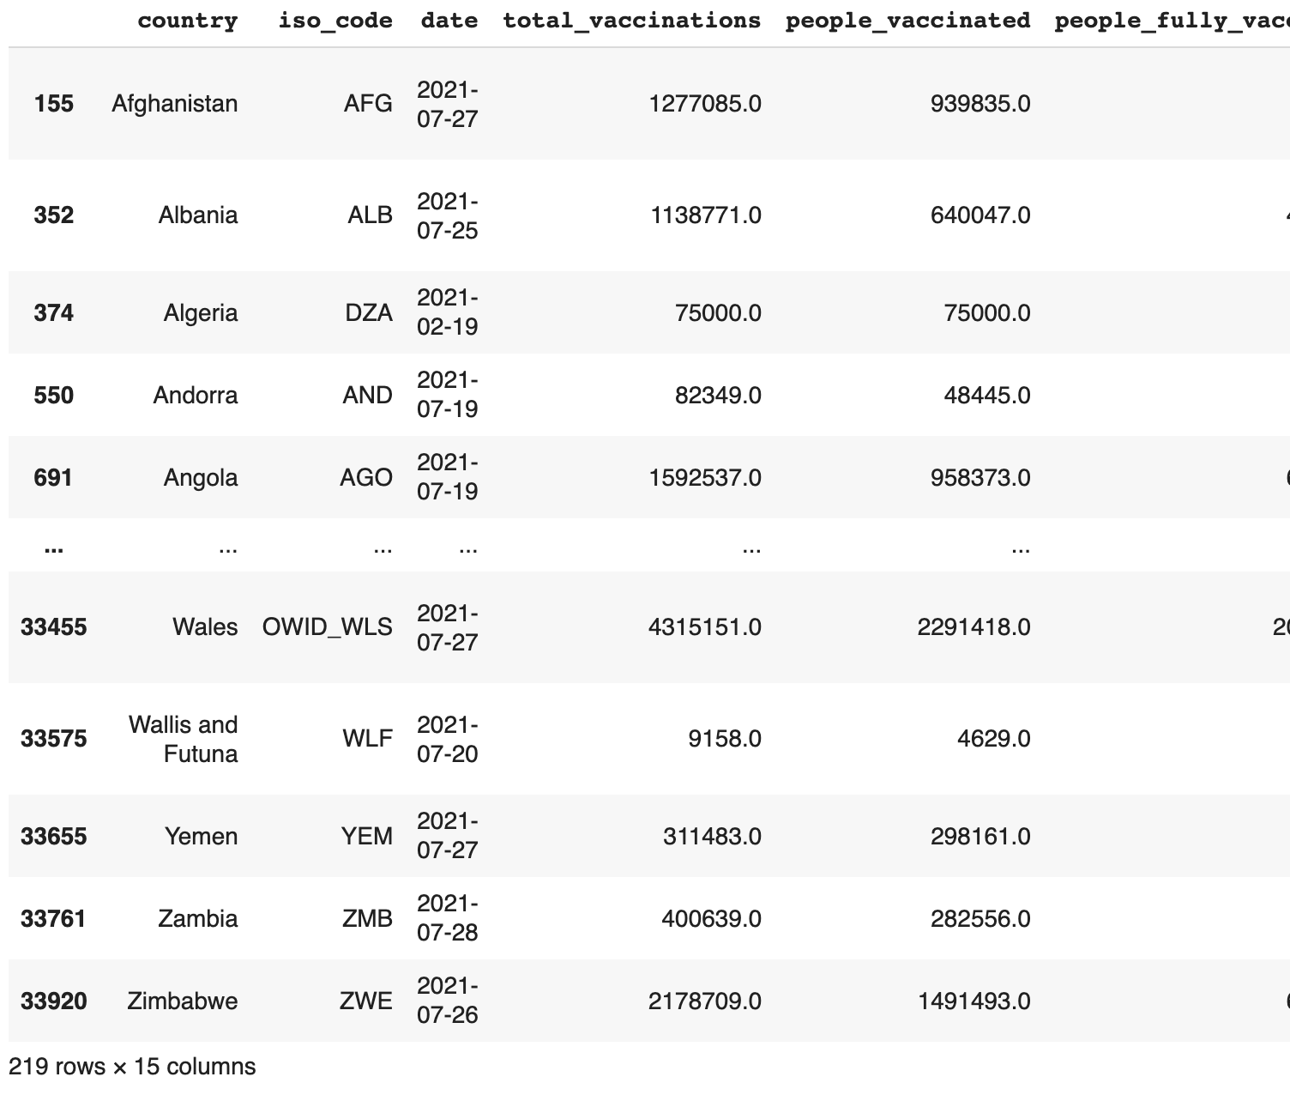
Data Query
The most recent record for each country.
Sort the records by country and date: df.sort_values(by=[‘country’,’date’])
Choose the last record for each country group. (use for loop)
Notes:
To address the issue, we want to find the most recent record for each country. We sort the records by the combination of two columns, “country” and “date”. So the records are first sorted/grouped by the values of “country”. Within each group, the records are sorted by the values of “date”. The sorting following ascending order so the record for each country with the latest date will be display the last in that group. We then choose those records and display them. The result shows there are 219 rows, which is consistent with the total number of the countries.

Slide 9
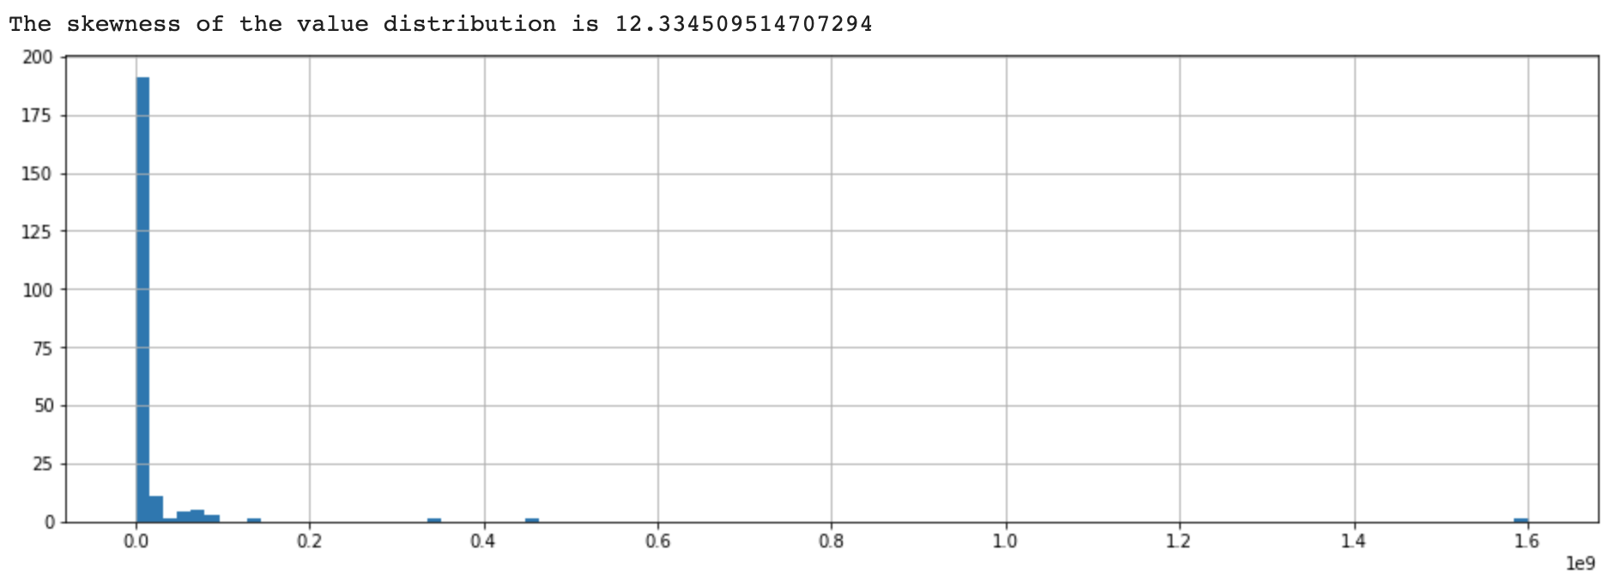
Total_vaccinations value distribution and skewness
Notes:
Both the histogram plot of the “total_vaccination” values and the skewness score clearly indicate that the data is severely skewed. That is consistent with the real world situation, where some countries had very high number of vaccination (such as US and China) but some others had very few.

Slide 10
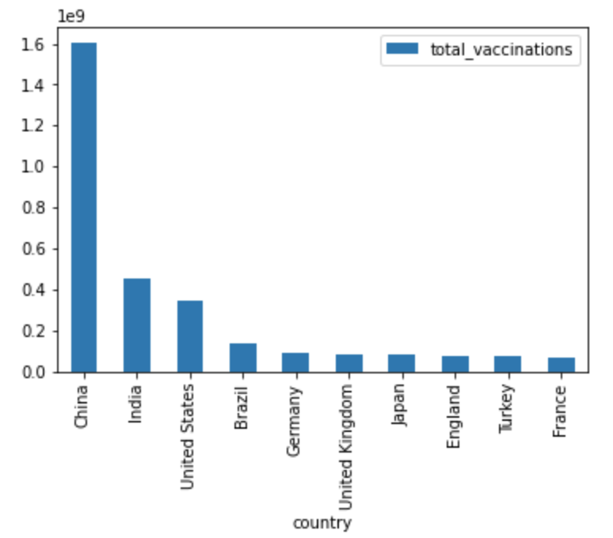
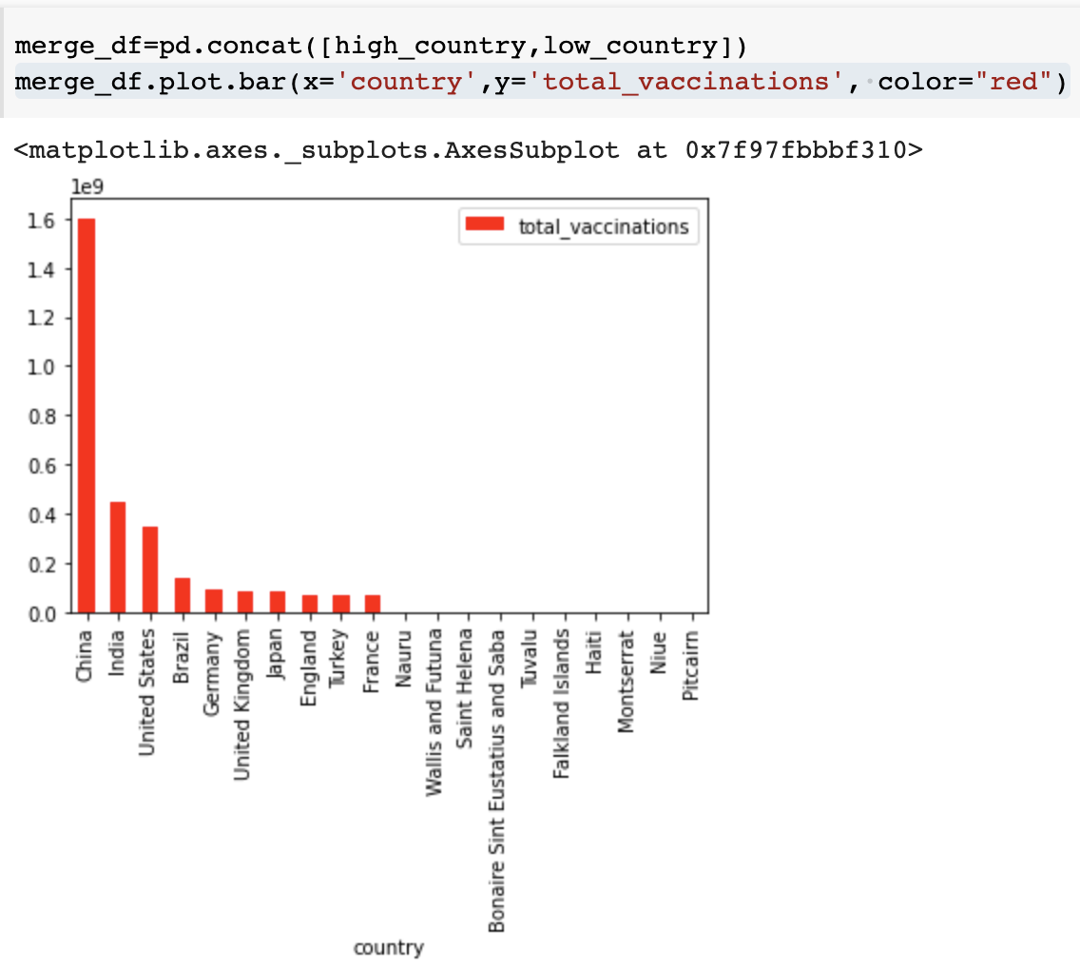
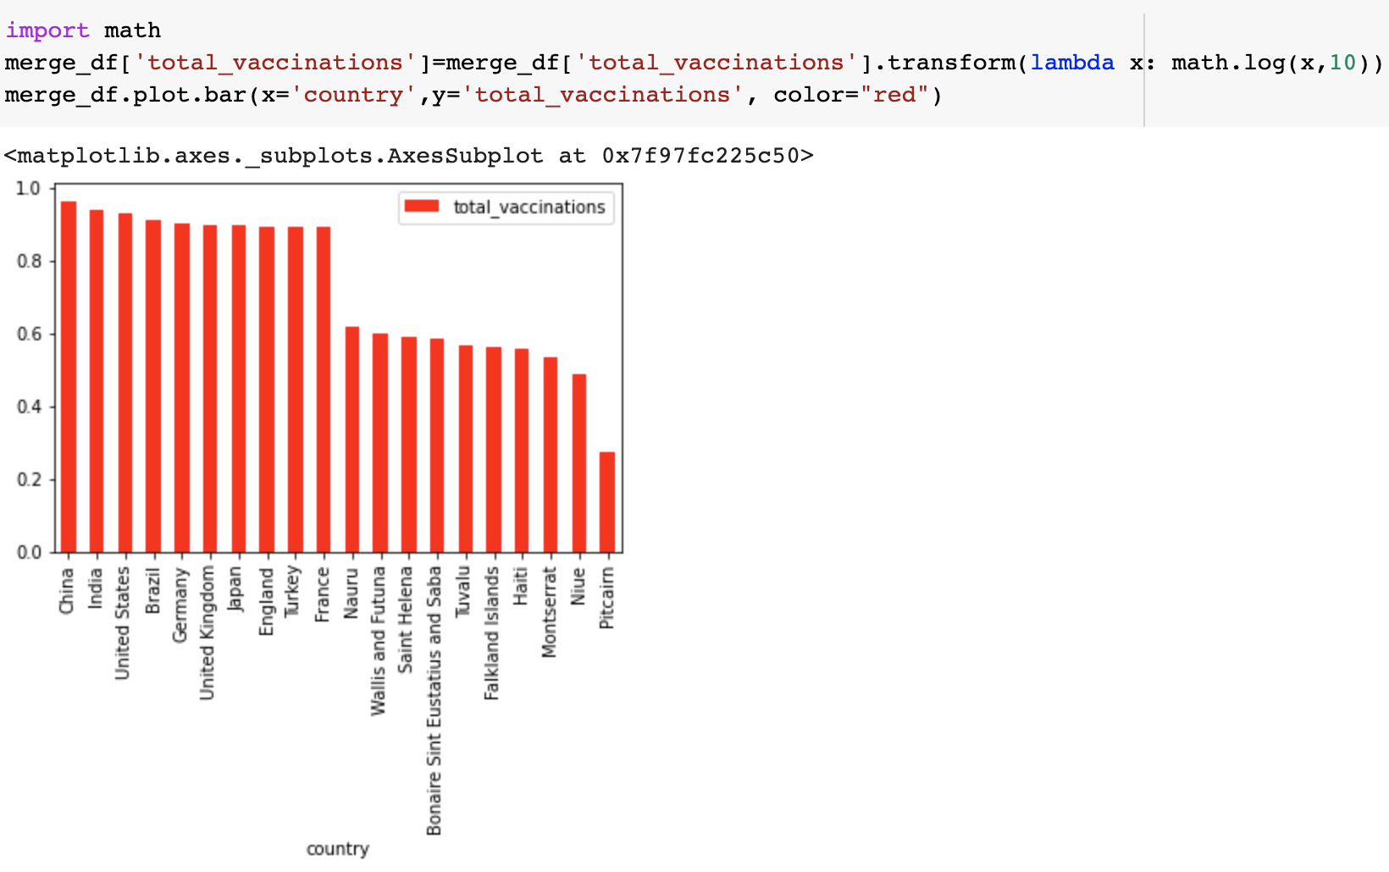
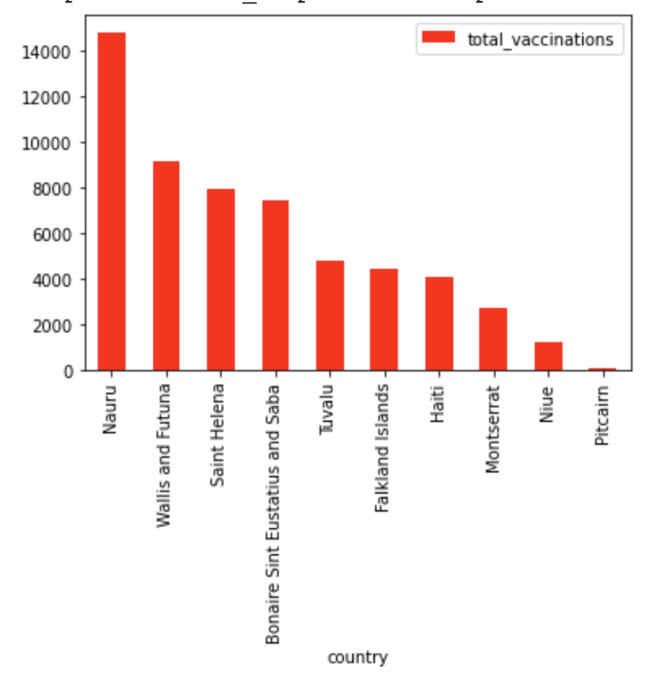
Vaccine Usage
highest
The highest and lowest vaccinated countries
lowest
before transformation
after transformation
Notes:
We use bar chart to visualize the total vaccination numbers for those countries having the highest and lowest values, like in the two plots on the right side. If we put those countries in the same chart, due to the magnitude-level difference, the bars for those lowest values are invisible. A better visualization solution is to apply the log transformation to the values first and then plot the transformed values.

Slide 11
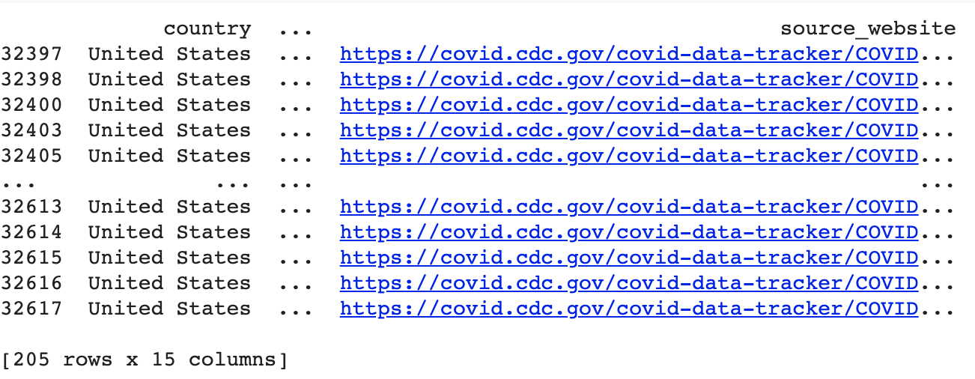
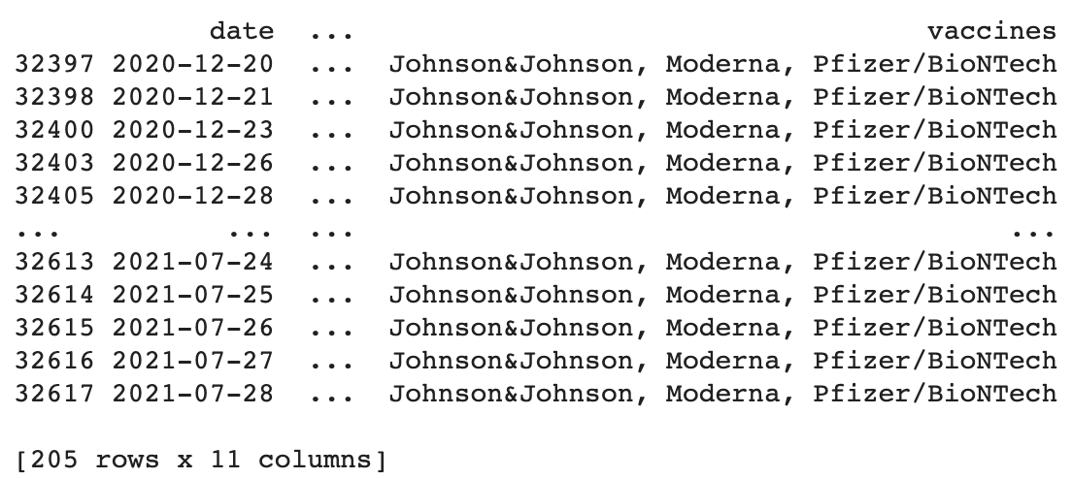
Vaccination Records in US
Display
Drop the columns we don’t need, including country, source, name, iso_code, source_website
Notes:
Now we zoom in the vaccination records in US. Drop the columns that we won’t use.

Slide 12
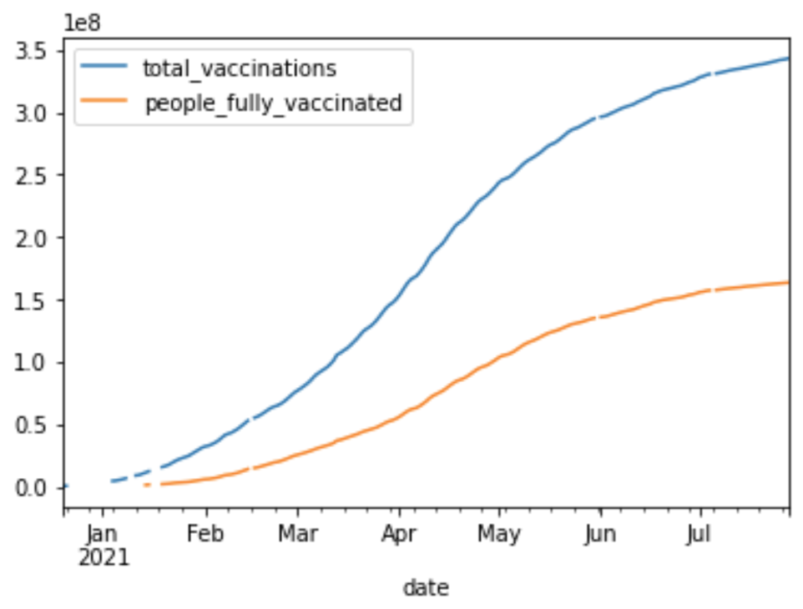
The Usage of Vaccines in US
Notes:
Use a line graph to show the trend of vaccinations in US.

Slide 13
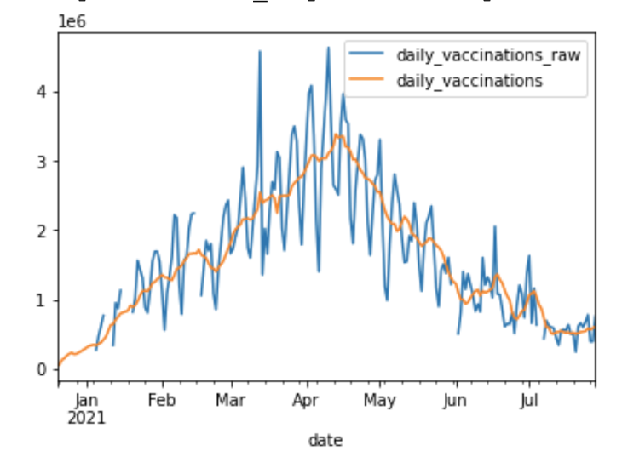
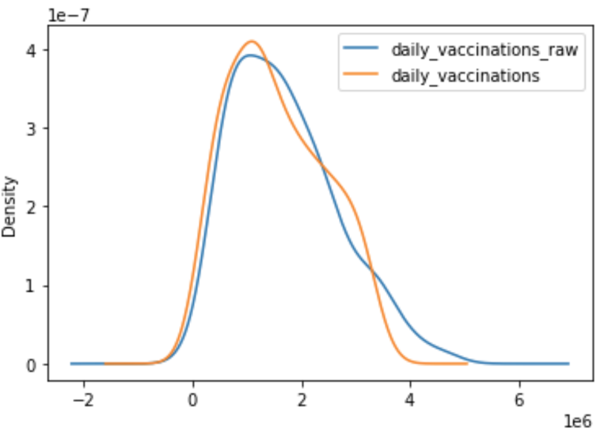
Daily Vaccinations Over Time
Notes:
The line for daily_vaccinations_raw is more jaggy than daily_vaccinations. This may because the raw data is more noisy.
The KDE plot suggests that the two sets of values follow the similar distribution.

Slide 14
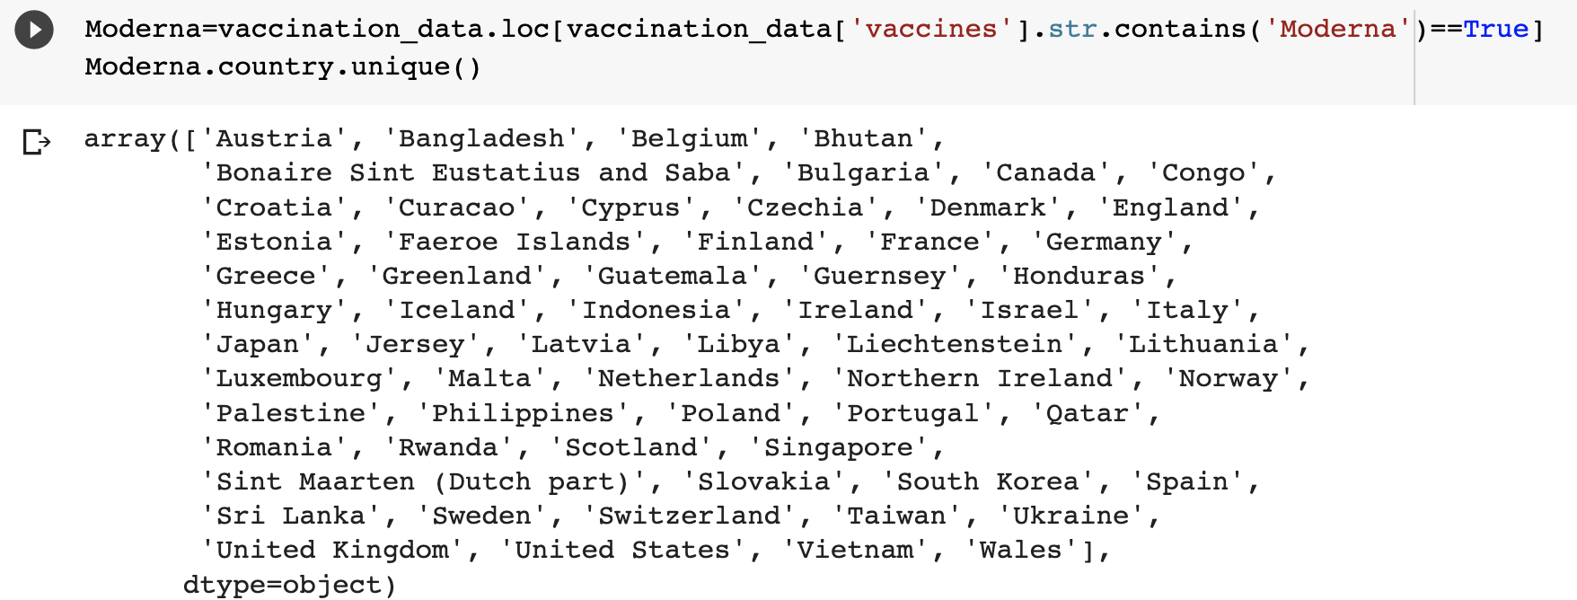
What countries use what vaccines?
Notes:
For each vaccine, list the countries that use it.

Slide 15
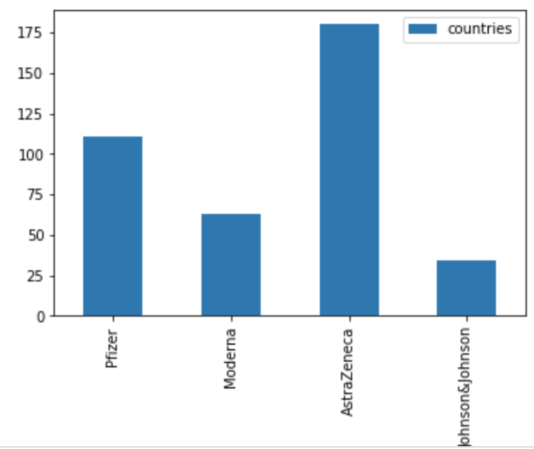
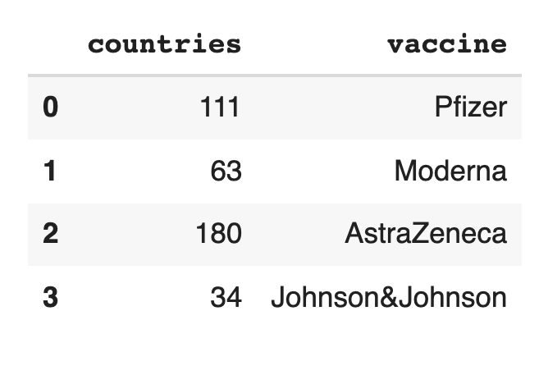
Visualize the usage of vaccines with different brands
Notes:
Generate the aggregation information, i.e., the total counts of countries for each vaccine and then visualize with a bar chart.

