Slide 1

Data Exploration and Visualization
This work is supported by the National Science Foundation under Award 2021287
Difficulty level: Introductory
Case Study I: Census_data
Notes:
Initial release, Xumin Liu, Rochester Institute of Technology, 2022.

Slide 2
Dataset Description
US Census Demographic Data
Contains the information about demographic and economic
Data source:
Kaggle: https://www.kaggle.com/muonneutrino/us-census-demographic-data
Acknowledgement:
The data were collected by the US Census Bureau
Notes:
Please contact Xumin Liu (xmlics@rit.edu) for the demo code used in the slides.

Slide 3
Tell a story about economic status
Steps to answer some interesting questions:
Load and clean the data
Poke around the data:
What are the richest and poorest counties? What are the gaps?
What are the richest and poorest states? What are the gaps?
What are the Income value distribution?
What determines if a county is rich or not?
Show the distribution of Incomes and check if it follows normal distribution, and study the skewness of the data
Visualize the correlation between Incomes and some other features, such as population related, employment type related, poverty related, and so on. Explain the visualization result.
Notes:
In this case study we will use the basic exploration and visualization techniques to analyze the covid dataset and make sense of it following the steps/answering the questions.

Slide 4
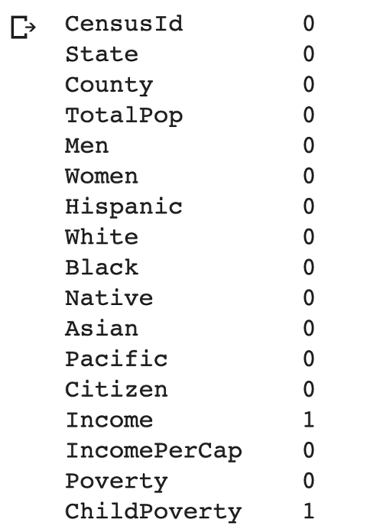
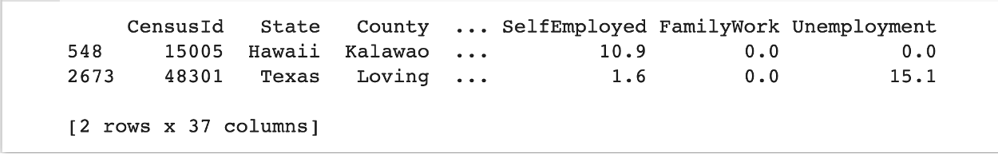
Clean the data
Check if there are any null values
Check the records where there are null values
Notes:
The first step is to clean the data. Check if there are any null value. It shows one null value for Income and one null value for ChildPoverty. They may exist in one record or two different records. By performing a quick check on the data, we found the corresponding data records.

Slide 5
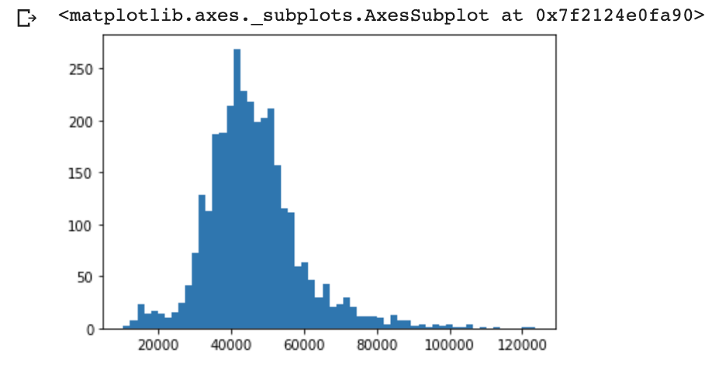
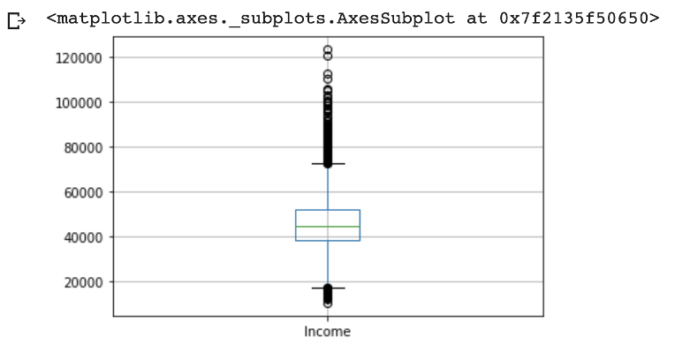
Poke around the data
Income values distribution
Notes:
As Income is the targeted attribute, we visualize its value distribution to get a rough idea. The histogram shows it roughly follows a normal distribution where the mean value is a bit above 40,000. The boxplot confirms that. It also shows there are many outliers in the dataset.

Slide 6
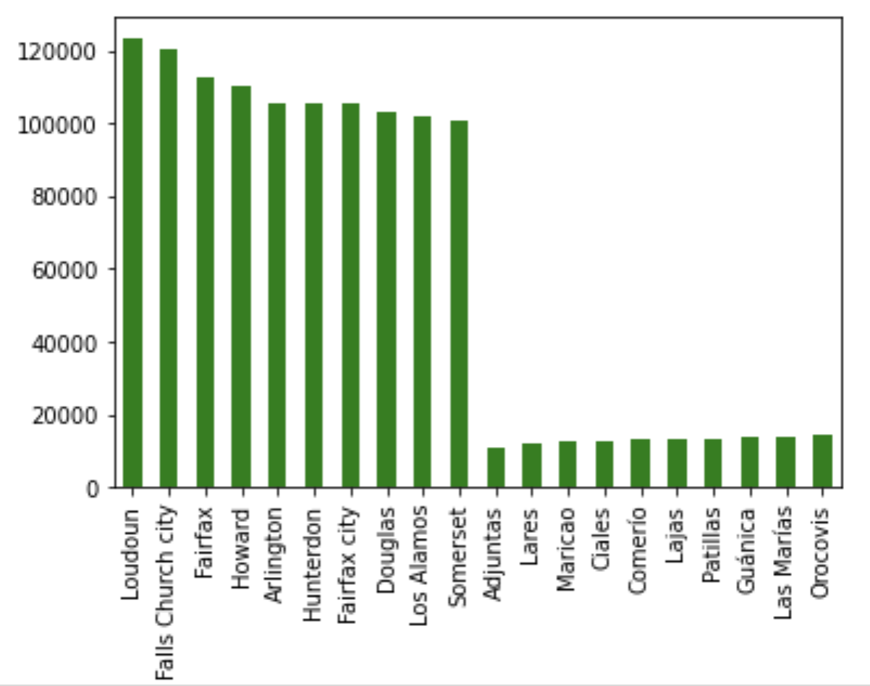
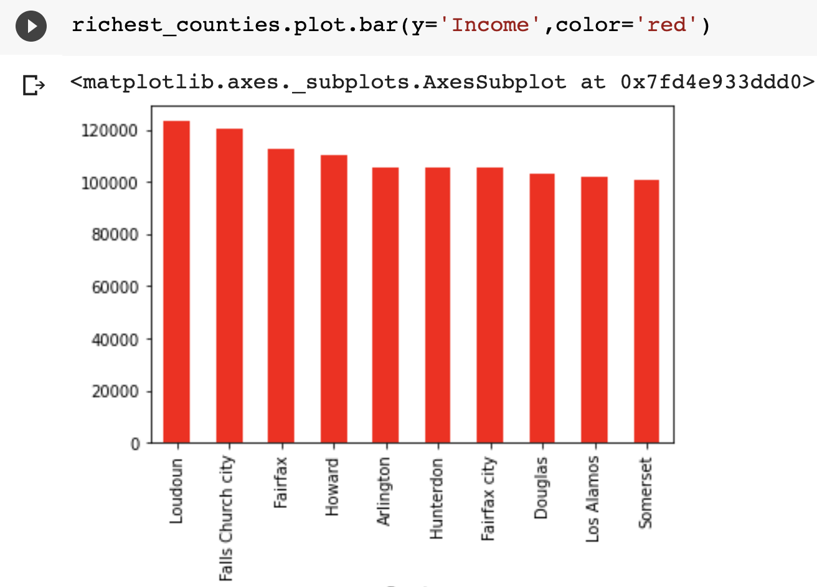
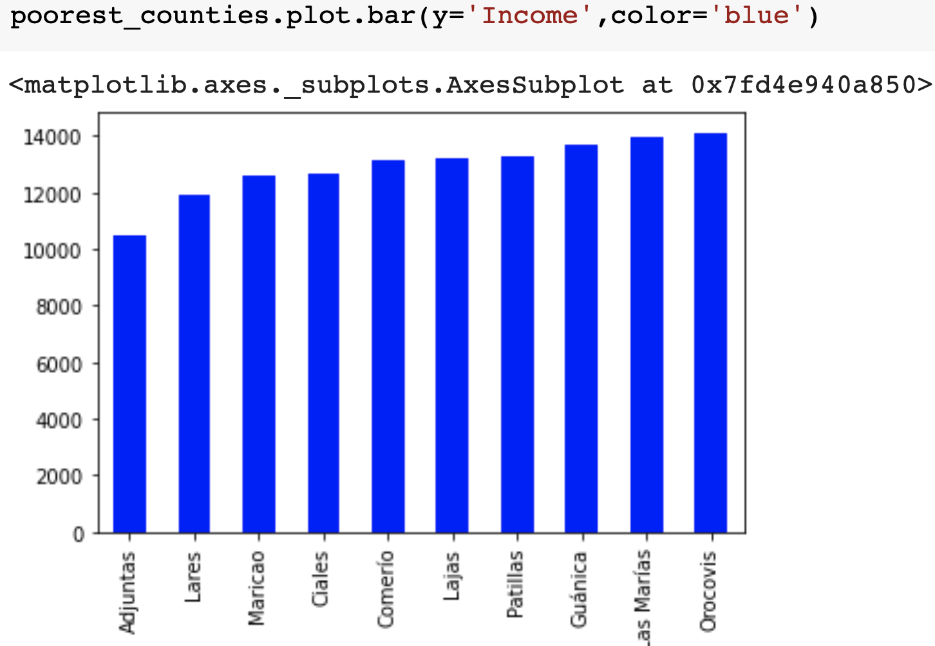
Poke around the data
What are the richest and poorest counties and their gaps?
Notes:
Display the richest and poorest counties using bar charts.
To check the gap of these two groups, it is better to put them in the same chart instead of displaying separately, with different y-axis scale.

Slide 7
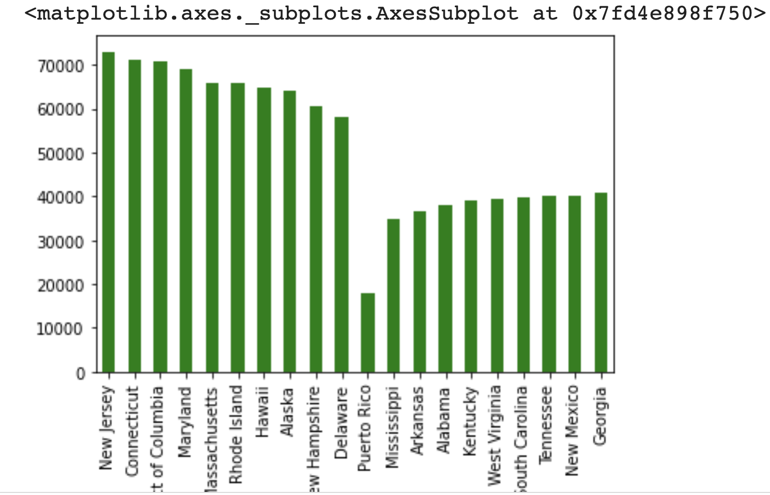
Poke around the data
What are the richest and poorest states and their gaps?
Notes:
Display the richest and poorest state. In order to get the average income for each state, we aggregate the data from all the counties in that state using the formula: sum(county_income*county_TotalPop)/sum(county_TotalPop).
As we use aggregated data here, the gaps are not that significant and the data is smoothier.

Slide 8
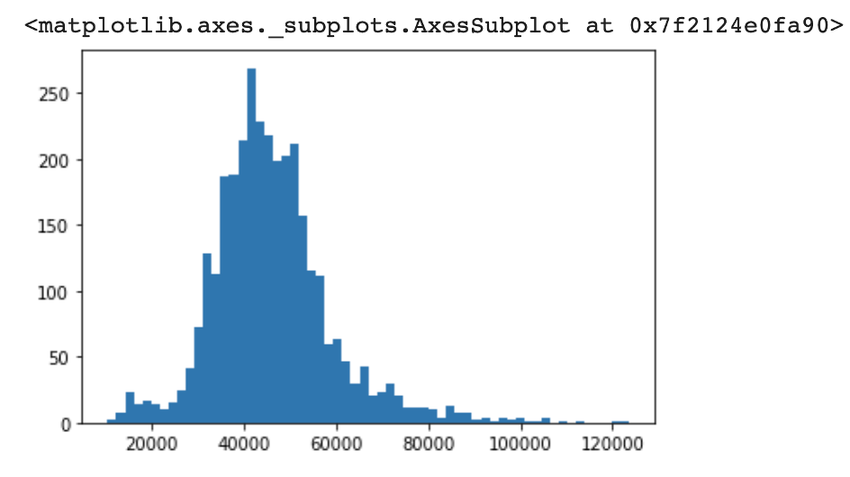
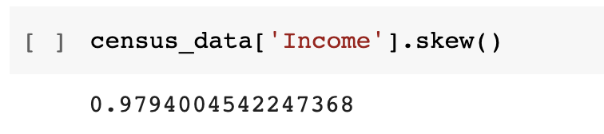
What determines if a county is rich or not?
1. Show the distribution of Incomes and check if it follows normal distribution, and study the skewness of the data
Notes:
Both the histogram plot and the skewness score shows that the income values are slightly tely skewed and the tail is on right side.

Slide 9
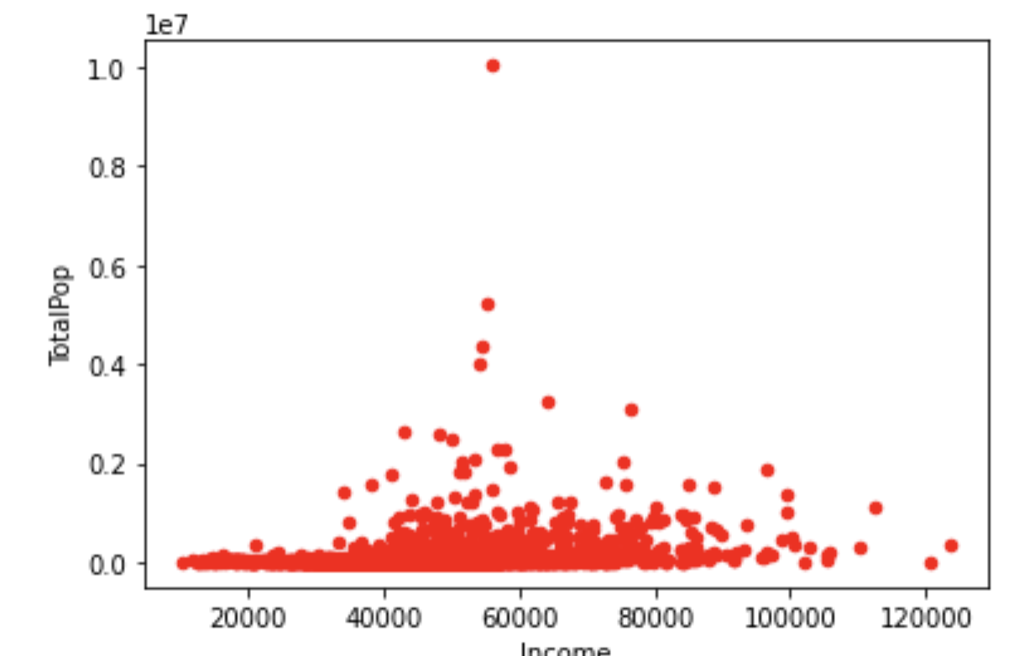
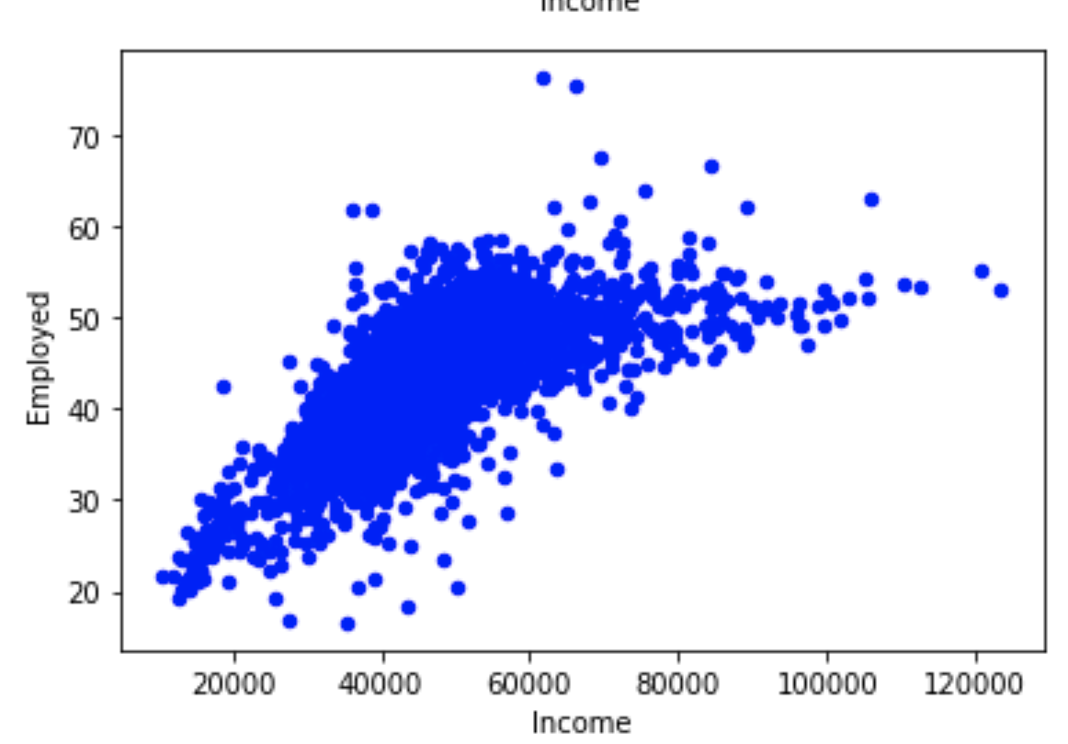
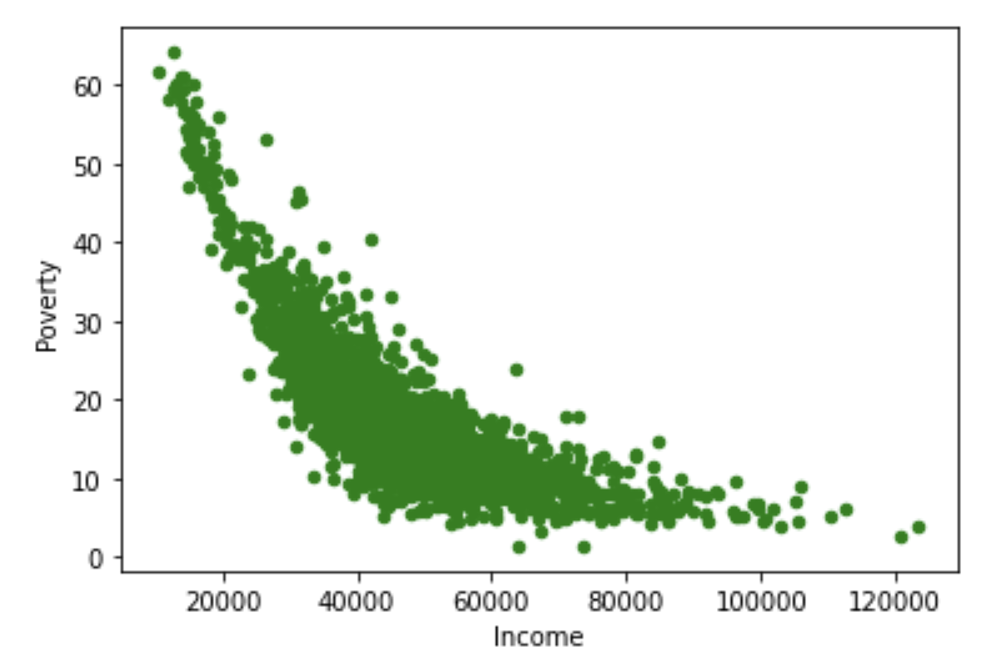
What determines if a county is rich or not?
2. The correlations between Income and other features
Notes:
Examine the correlation between income and other features such as population, employment rate, and poverty rate, to find the related factors. The scatter plots show that the income has no correlation with TotalPop, a positive correlation with Employed, and a negative correlation with Poverty.

Slide 10
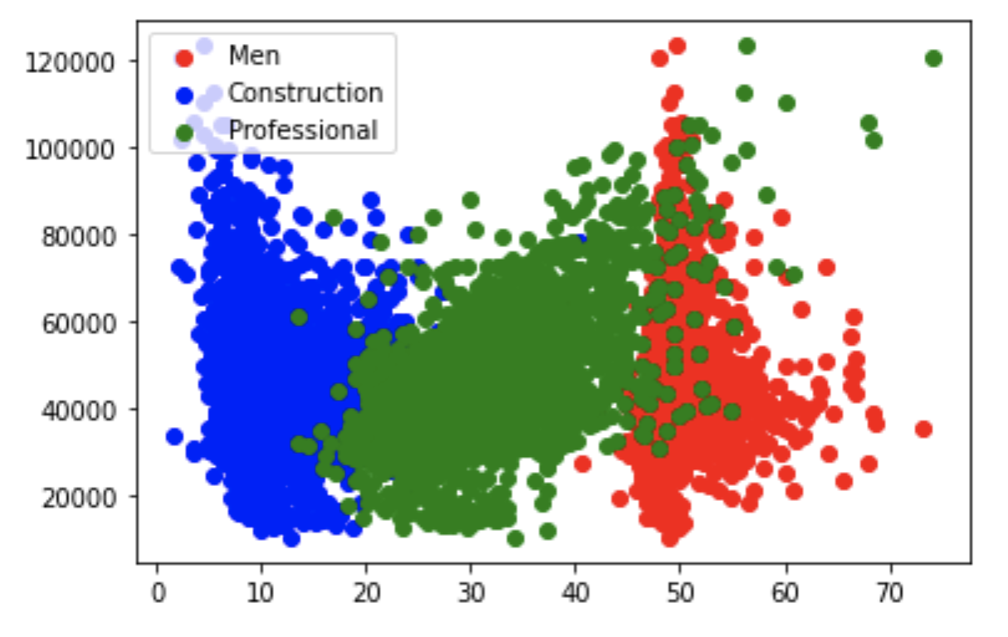
What determines if a county is rich or not?
2. The correlations between Income and other features
Notes:
Visualize the correlation between Income and three other features in the same plot so they can be compared together. Only Professional has a clear correlation, which is positive, with Income.

Slide 11
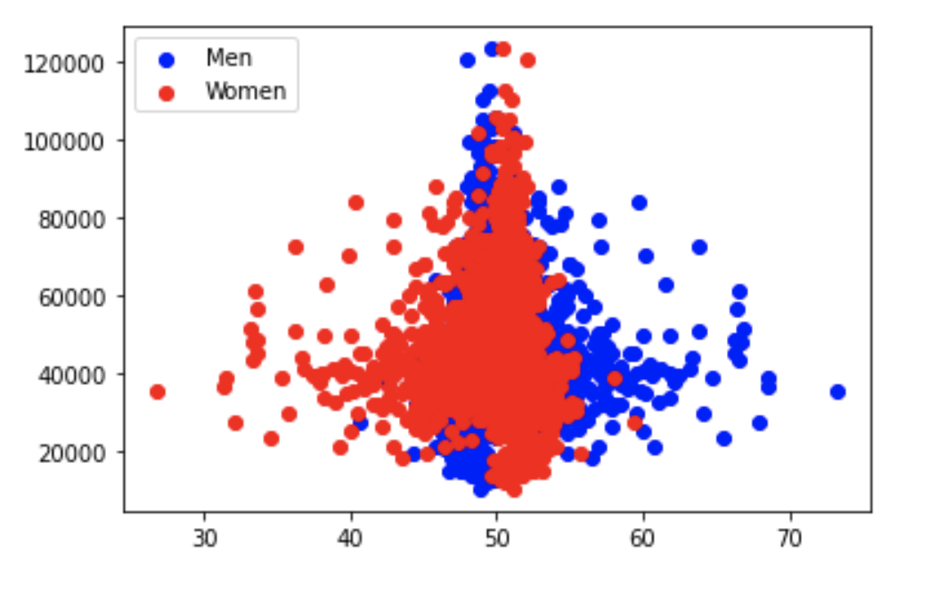
Income vs Population features
Gender Groups
Notes:
Now we will look at each type of groups. First is the gender groups. Men and Women show the same correlation with Income. This makes sense as the two attributes are correlated/dependent with each other.

Slide 12
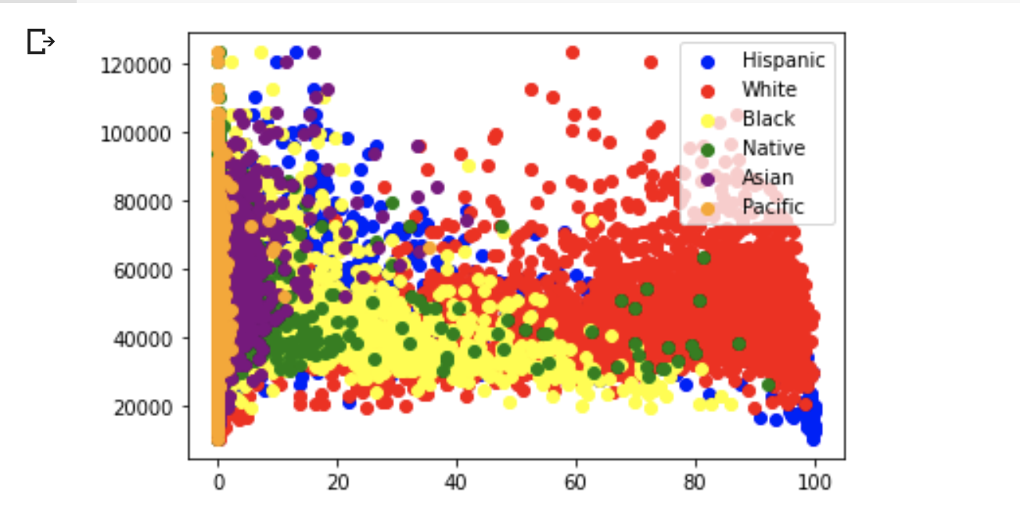
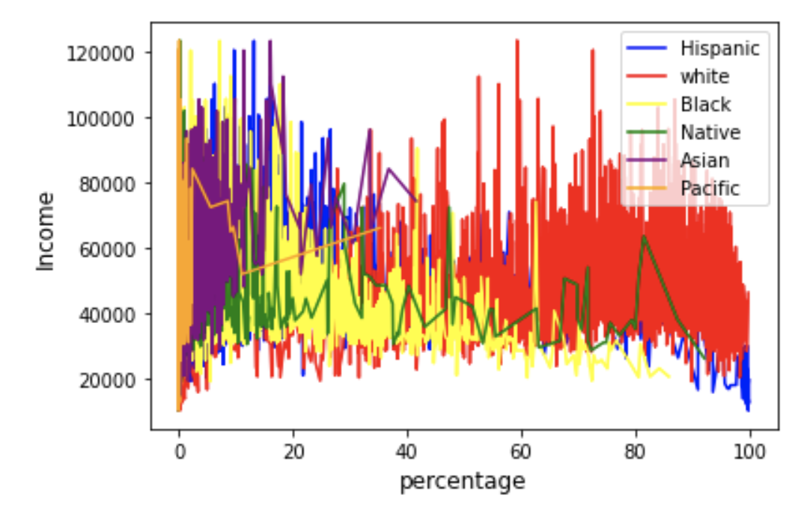
Income vs Population features
Racial Groups
Notes:
Check on the racial groups. The correlations are all weak but “Black” seems to have a more observable correlation, which is negative. Also from the plots, we can see that White has the highest population and Pacific has the lowest one.

Slide 13
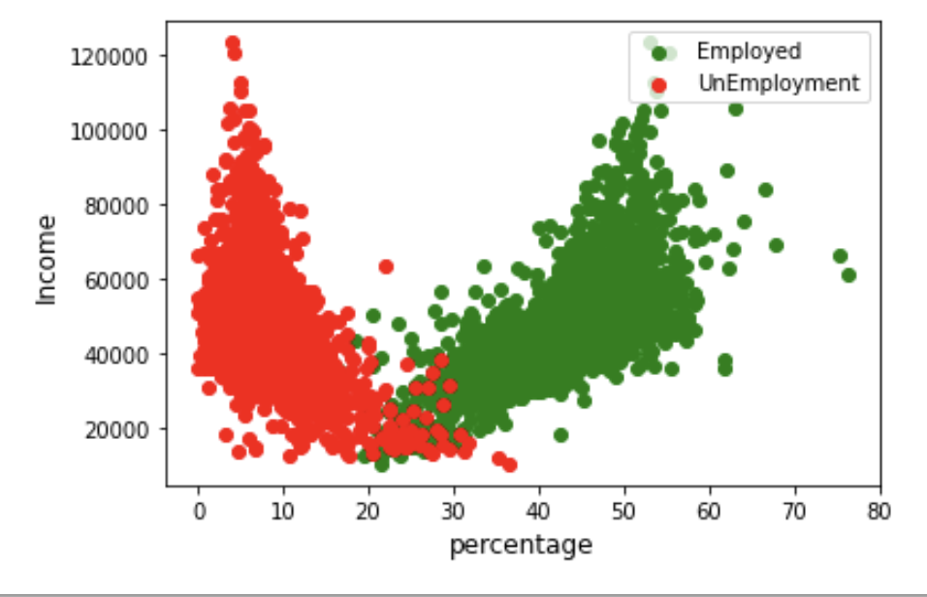
Income vs Employment features
Employment status
Notes:
Income is positively correlated with Employed and negatively correlated with UnEmployed.

Slide 14
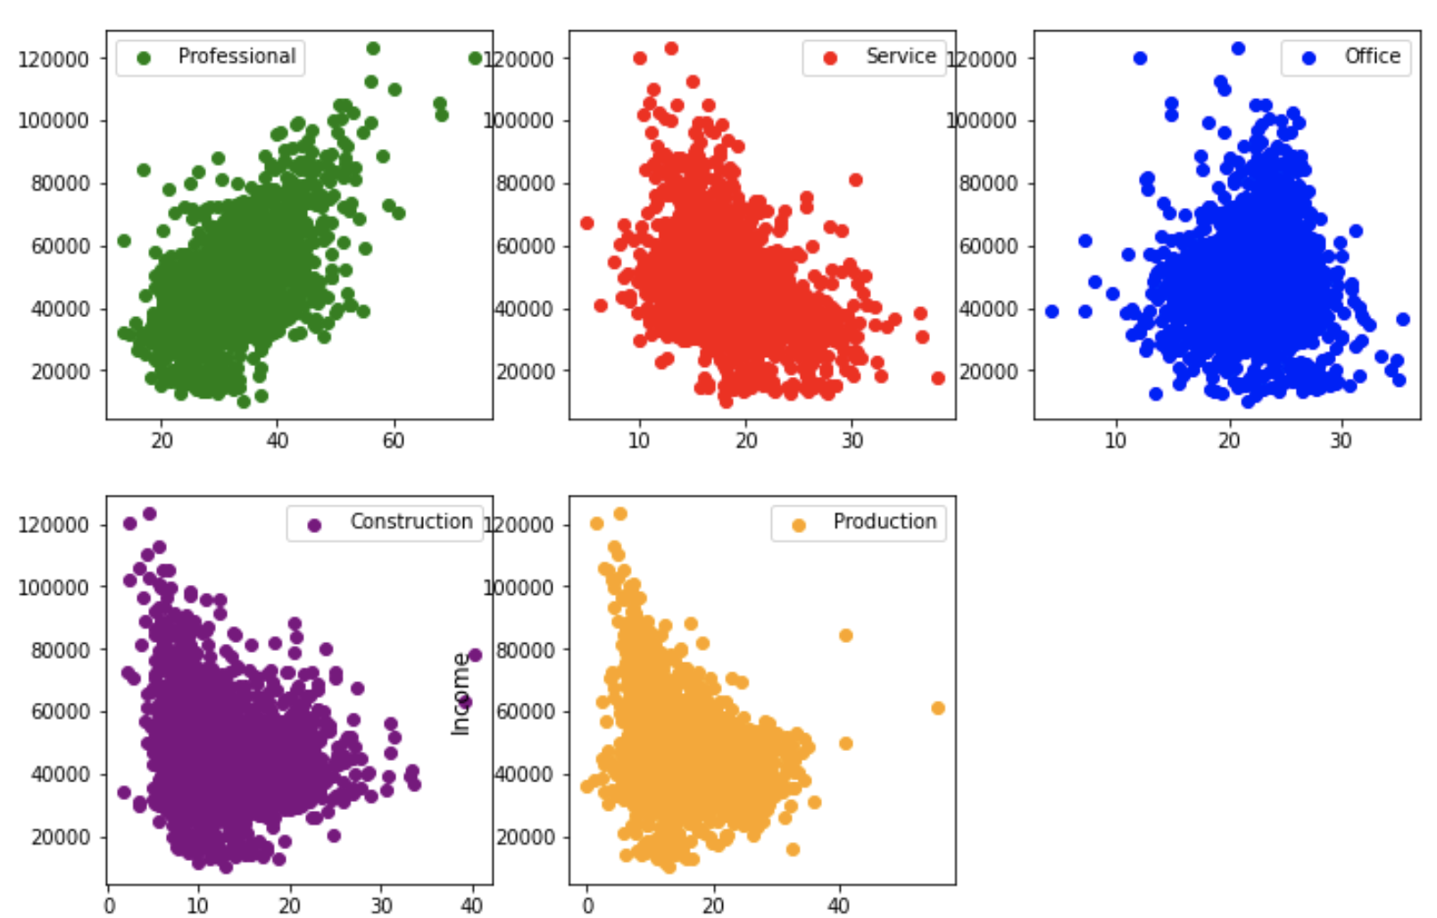
Income vs Employment features
Position Type
Notes:
For different position types, Income has a positive correlation with ”Professional”, negative correlation with “Service”, no clear correlation with “Office”, slightly negative correlation with “Construction”, and slightly negative correlation with “Production”.

Slide 15
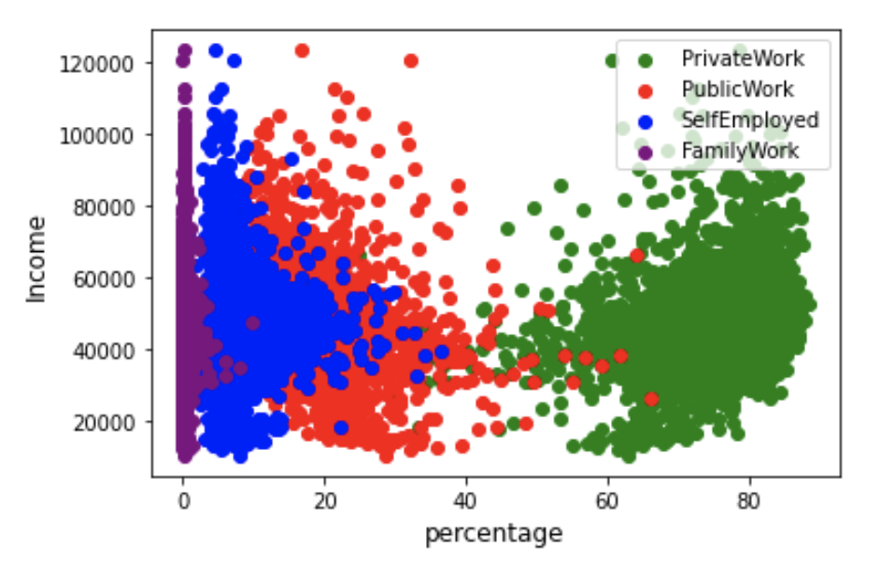
Income vs Employment features
Employment type
Notes:
For Employment types, no clear correlation with FamilyWork and SelfEmployed, slightly negative correlation with PublicWork, positive correlation with PrivateWork. By plotting them together, we can compare the values of those types. Most of the employments are of type private work, and then public work. FmailyWork is the one with the least percentage.

