Slide 1

Data Visualization
This work is supported by the National Science Foundation under Award 2021287
Difficulty level: Introductory
Notes:
Initial release, Xumin Liu, Rochester Institute of Technology, 2022.
By Xumin Liu https://www.cs.rit.edu/~xl/
Except where otherwise noted, this work is licensed under a Creative Commons Attribution-4.0 International License https://creativecommons.org/licenses/by/4.0/

Slide 2
Contents
Visualization
Representation – Data Objects
Standard Visualization Components
Notes:
In this lecture, we use two datasets in the example:
Titanic dataset: https://www.kaggle.com/competitions/titanic/data
US census dataset: https://www.kaggle.com/datasets/muonneutrino/us-census-demographic-data
Iris dataset: https://www.kaggle.com/datasets/uciml/iris
Please contact Xumin Liu (xmlics@rit.edu) for the demo code shown in the lecture.

Slide 3
Visualization
Display information in a graphic or tabular format
Interpret the visualized information by a person
Leverage human capabilities to find patterns
Facilitate the communication between machines and humans
Machines: map data (objects, attributes, relationships) to graphic elements (points, lines, shapes, and colors)
Human: absorb the visual information and detect patterns, trends, outliers,…
Notes:
Data visualization helps humans better understand data and identify some simple patterns with their visual perception capability.
Through visualization, information can be displayed as a graph, or figure, or a table, to be read by humans. This step provides input to human instead of machines find patterns. Visualization maps information in the data to graphic elements to facilitate the communication between machines and humans. A good visualization allows humans quickly absorb the information contained in the data, which help them understand the data and identify some interesting patterns.

Slide 4
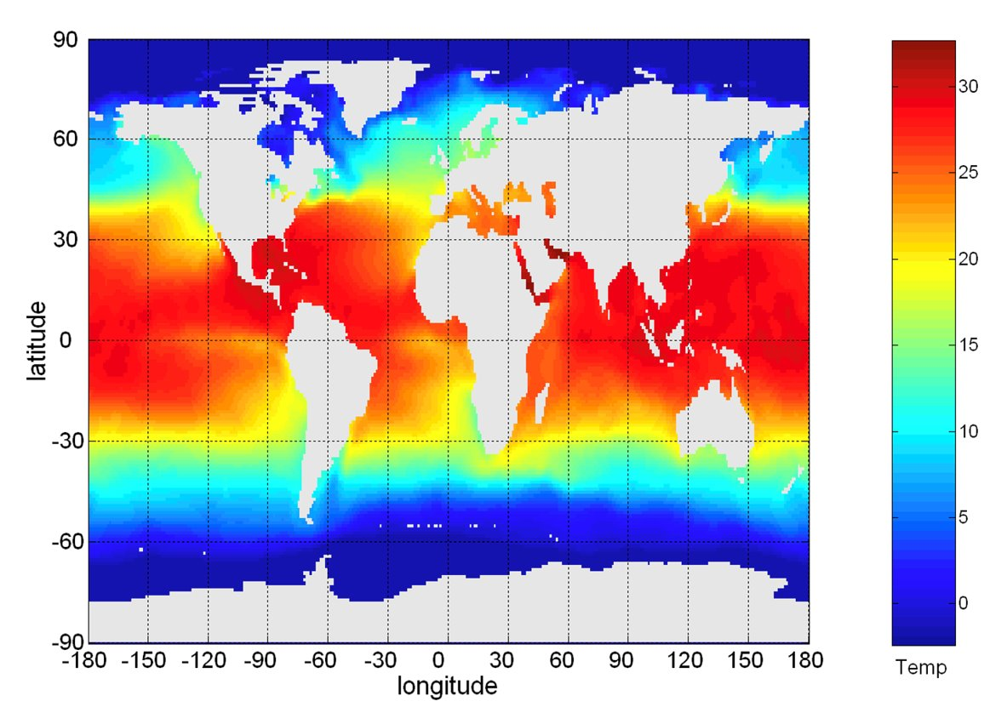
Visualization
The following shows the Sea Surface Temperature (SST) for July 1982
Tens of thousands of data points are summarized in a single figure
Source: Pang-Ning Tan, Michael Steinbach, Anuj Karpatne, and Vipin Kumar. Introduction to Data Mining
Notes:
In this example, the visualization allows humans to quicky understand the relationship between temperature and latitude from tens of thousands of data points.

Slide 5
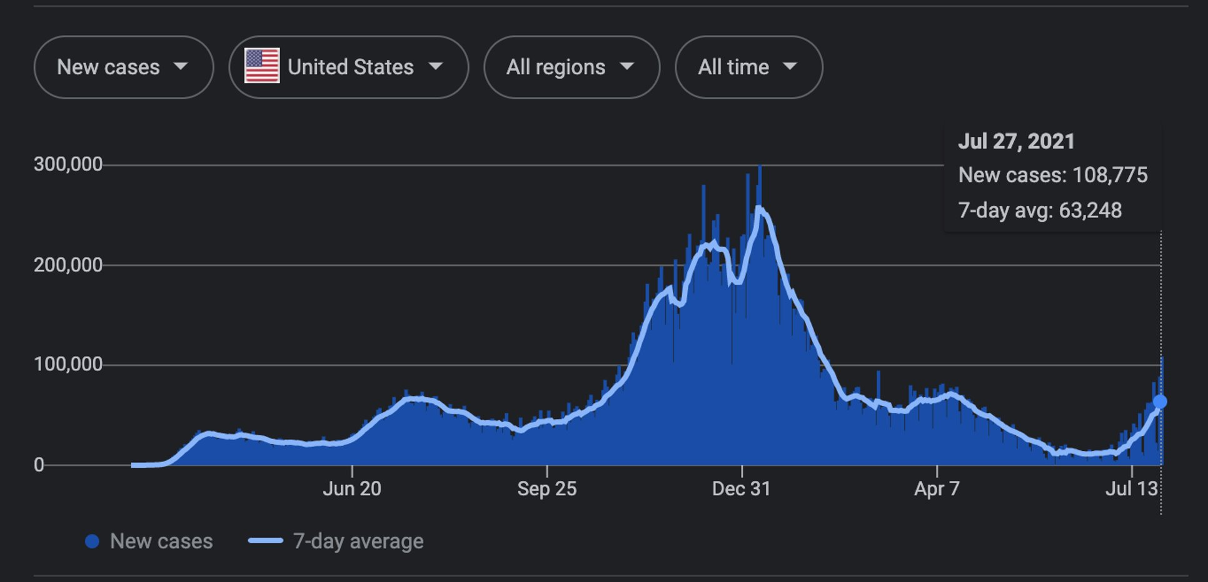
Example: US Covid Cases
Source: Google
Notes:
This visualization allows humans to quickly understand the trend of COVID cases over the time from hundreds of data points.

Slide 6
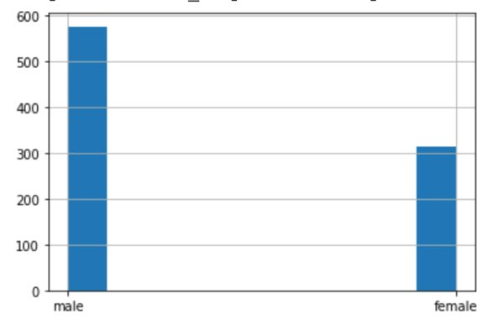
Representation – Data Objects
If only one categorical attribute to be considered
Aggregate it into the corresponding category and then represent that category
E.g., if we only consider the gender of a person
If multiple attributes are considered
A row of a table or a line on a graph
A point in a two- or three-dimensional space
Notes:
Through visualization, data points are mapped to graphic representations. Different visualization techniques can be used to do the mapping. If only one attribute with categorical values is considered, it is typical to group those records into corresponding categories and show the total count of each category through bar chart or histogram.
If multiple attributes are considered, a data object can be represented as a row of a table or a line on a graph. It can also be mapped to a point in a two or three dimensional space, where the dimensions are either the attributes of a data objects or transformed from the attributes. The distance of two points in such a space always indicates how similar two data objects are.

Slide 7
Representation
Attribute values
Numeric: mapped to continuous, ordered graphical features location, intensity, color, size
Categorical: each category can be mapped to a distinct position, color, shape, orientation, or column in a table.
Relationships
Explicit: links between nodes
Implicit: maps to the relationships to graphic elements
Notes:
For numeric attribute values, they are mapped to continuous, ordered graphic features, such as through the location, intensity, color, and/or size of a data point, to carry the information related to the ordering among the values.
For categorical attribute values, the assumption is that there is no ordering among the values. Each value can be represented with unique location, color, shape, and so on.
The relationship between data objects can also be visualized through explicit links or be derived from their graphic features, such as close locations, same/similar colors, …

Slide 8
Standard Visualization Components
Visualization components:
Title
Axis labels (with correct units)
Legends
Line color/line type
Marker color/shape
Properly scaled axes (usually y-axis)
Color scale with appropriate contrast
Python packages:
Matplotlib.pyplot library https://matplotlib.org/
Seaborn library: https://seaborn.pydata.org/
Notes:
Standard visualization components include title of the figure, the labels of x and y axes, the legend of each line, the line properties (color, type, …), the marker properties (color, style,…).
Axes should be properly scaled to make a good visualization result. If we plot the data to multiple figures and compare them, the axes of each figure should be scaled the same for an easy comparison.
Humans tend to use color to tell the intensity/value difference. So the colors of data points should also follow the convention (such as warmer colors correspond to higher temperatures, or darker color correspond to larger values), and be scaled with appropriate contrast.
Python uses several package for visualization. Two of the most commonly used ones are matplotlib and seaborn.

Slide 9
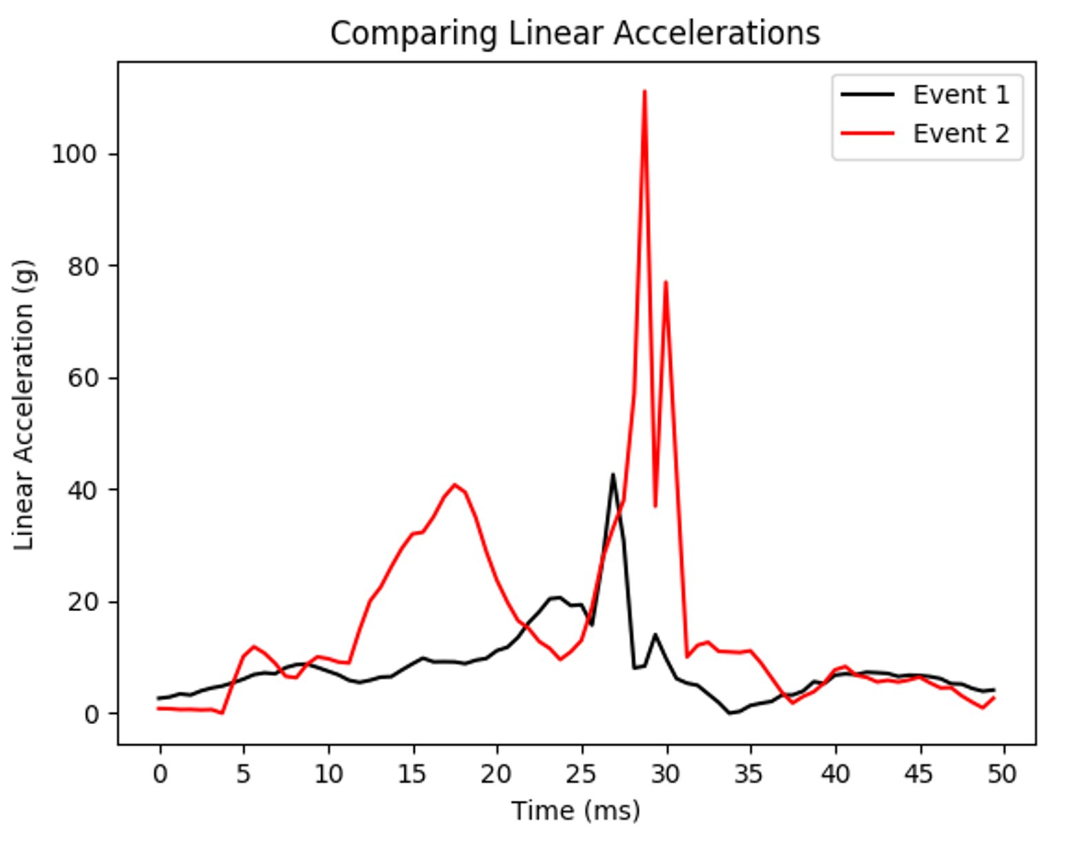
Line Color
Notes:
This figure shows the usage of colors to differentiate two events.

Slide 10
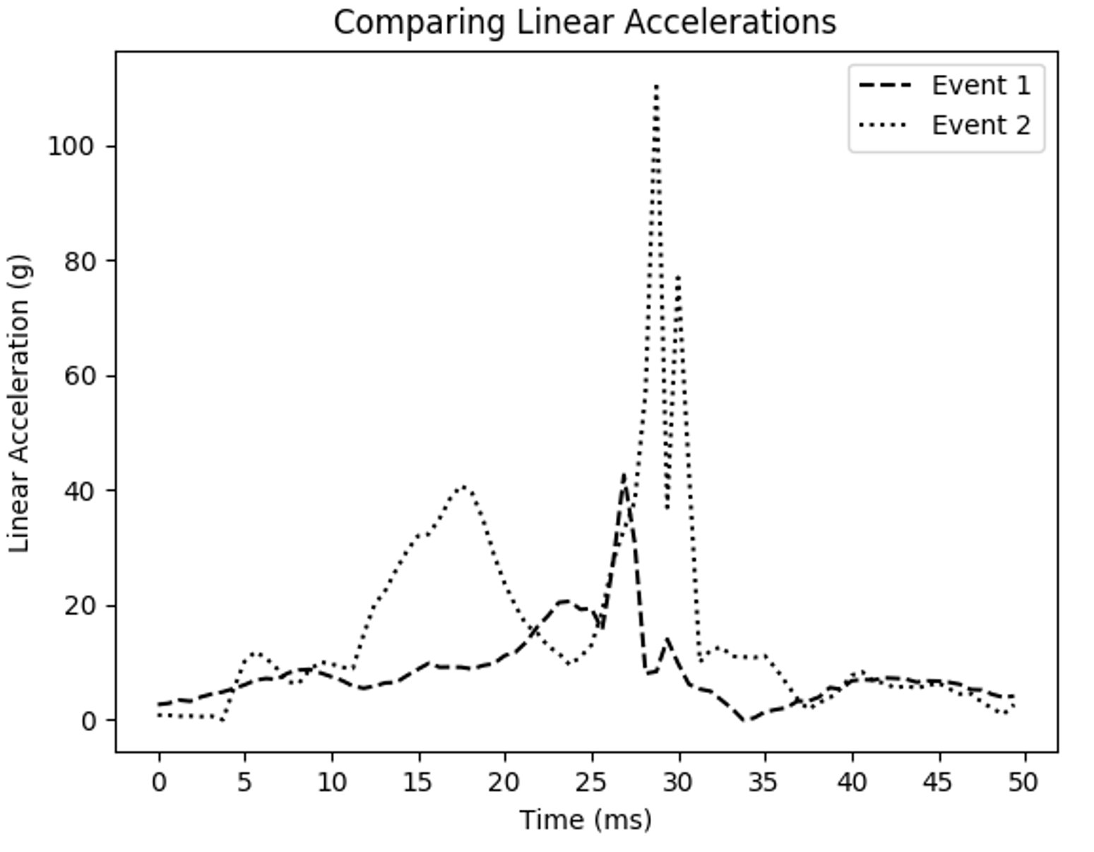
Line Type
Notes:
This figure shows the usage of line styles to differentiate two events.

Slide 11
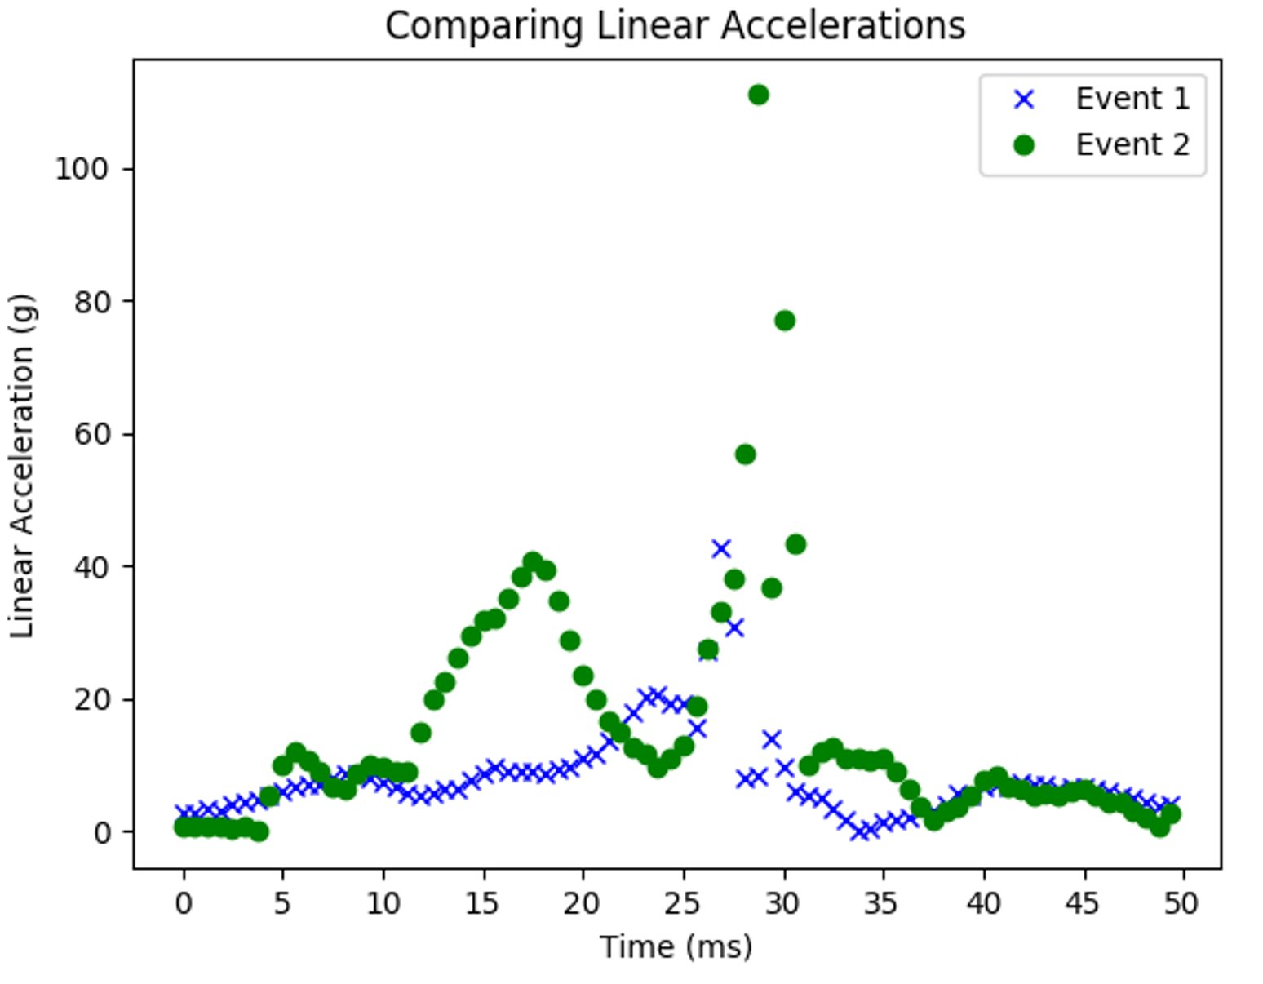
Marker
Notes:
This figure shows the usage of colors and styles of markers to differentiate two events.

Slide 12
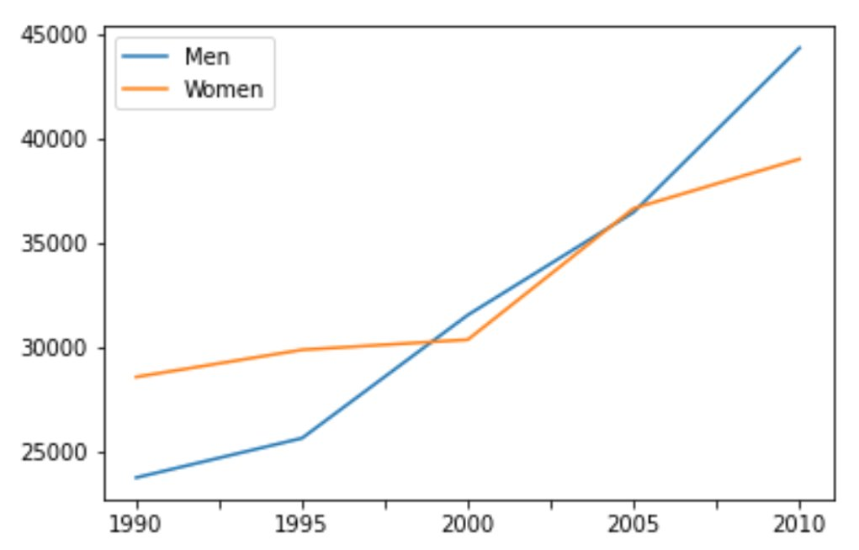
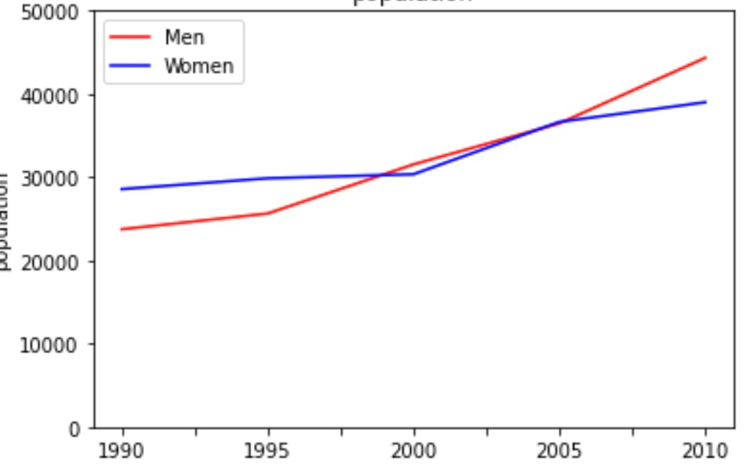
Axis Scaling
Notes:
This example shows the visualization effects with different Y-axis scales. The left one better highlights the difference between the two gender groups compared to the right one.

Slide 13
Visualization Techniques
Histogram
Box Plots
Pie Chart
Bar Chart
Scatter Plots
Heap Map

Slide 14
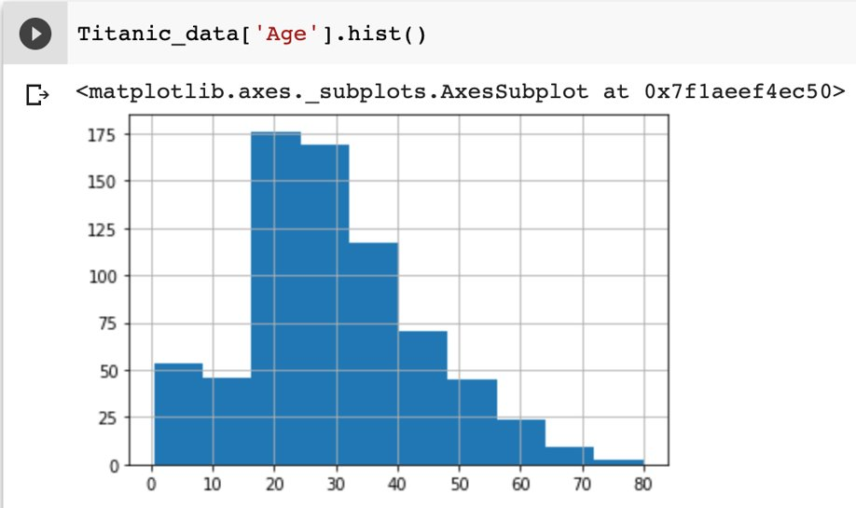
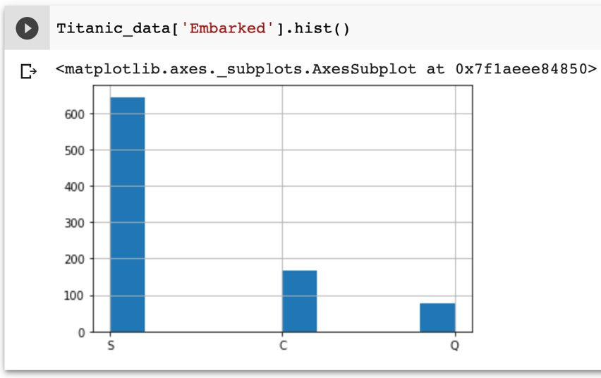
Histogram
Shows the distribution of values of a single variable
Divide the possible values into bins and shows the number of objects in each bin
For categorical data, each value is a bin
For continuous data, the range of values is evenly distributed into bins
Notes:
Histogram can be used to visualize the value distribution for both numerical and categorical values.
For continuous variables, you can tune the number of bins to determine the granularity and smoothness of visualization result. The more the bins, the more jaggy the histogram plot is.
Titanic dataset is used in this slide.

Slide 15
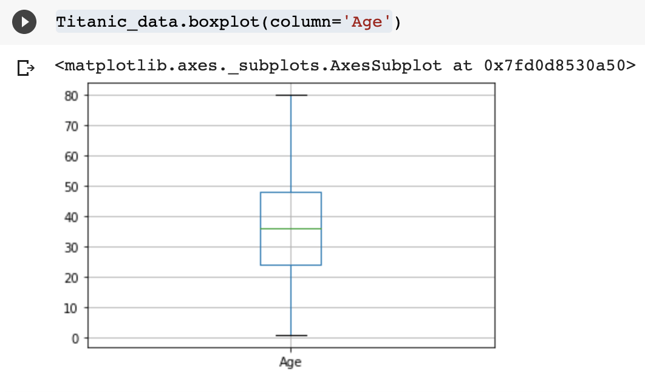
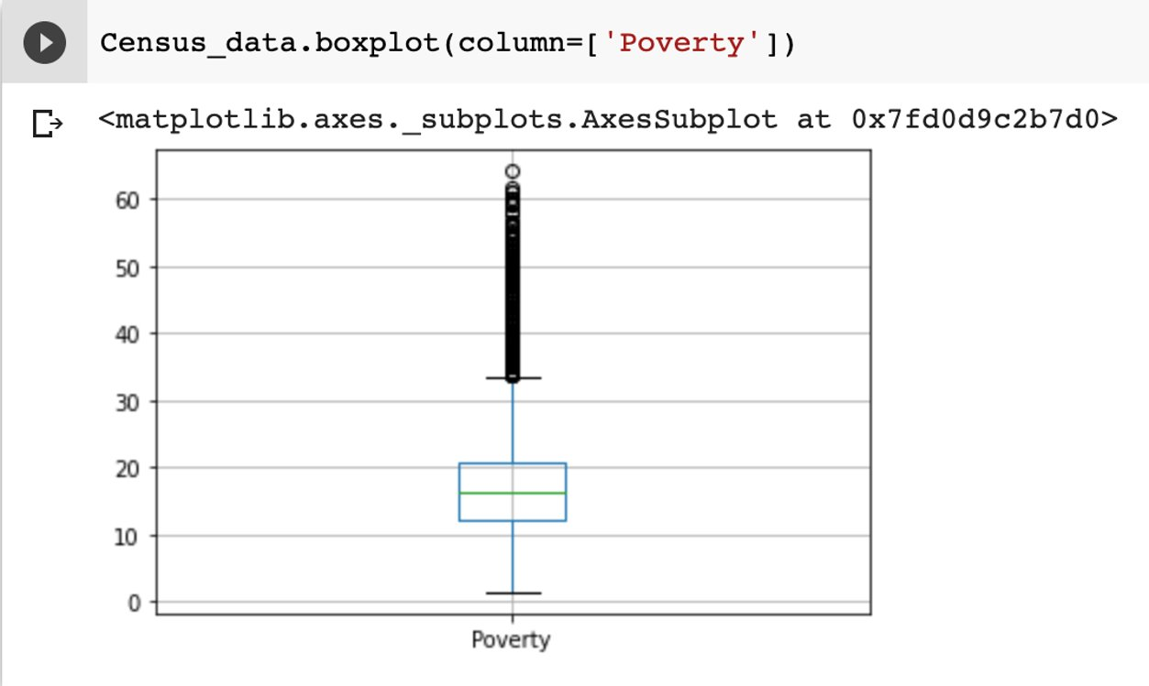
Box Plots
Shows the distribution of the values of a single numerical attribute
Provides a simple graphical depiction of interquartile range and outliers
Maximum
(Q3+1.5*IQR)
Q1
75th percentile
IQR
Interquartile Range
Q2
50th percentile
Q3
25th percentile
Minimum
(Q3+1.5*IQR)
Notes:
Box plots are used to visualize the value distribution for a single numerical attribute. It shows the mean, the IQR, and range of the values. The values outside the range are represented as outliers.
Titanic dataset is used in the left plot.
Census dataset is used in the right plot.

Slide 16
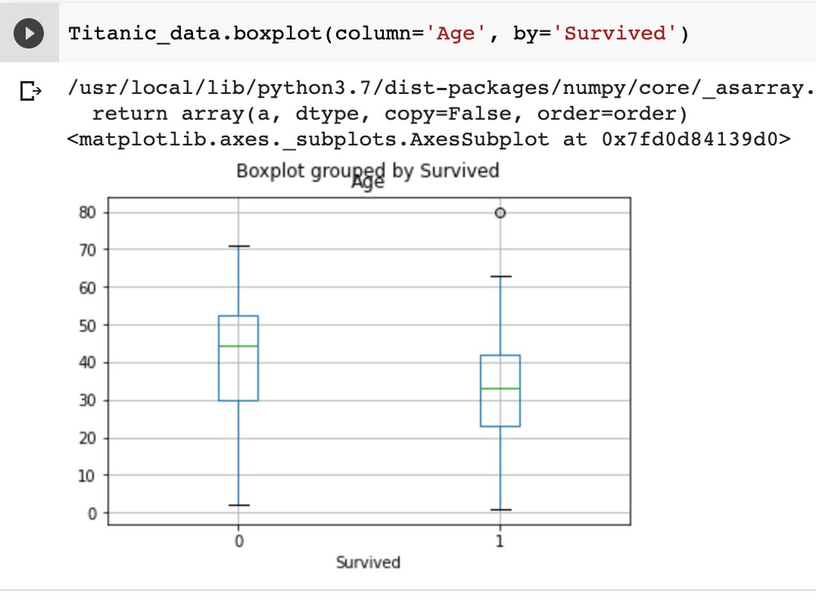
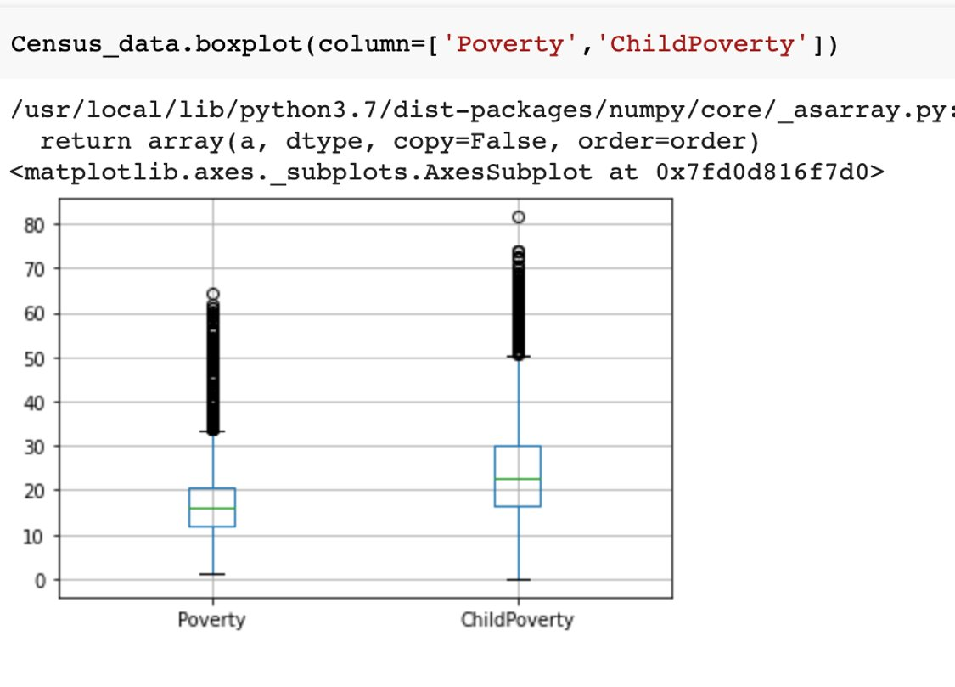
Box Plots
Group by
Multiple Columns
Notes:
Python’s boxplot function allows to group data records based on the values of a column, such as ”Survived” in the example, and visualize the value distribution of another column, such as “Age”, for each value of “Survived”.
You can also plot the value distributions of multiple columns in the same figure, like in the right figure.
Titanic dataset is used in the left plot.
Census dataset is used in the right plot.

Slide 17
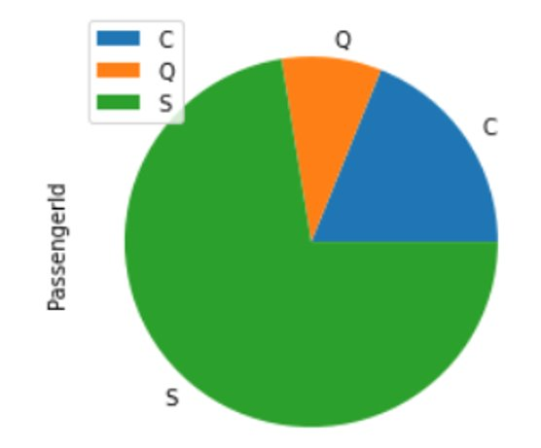
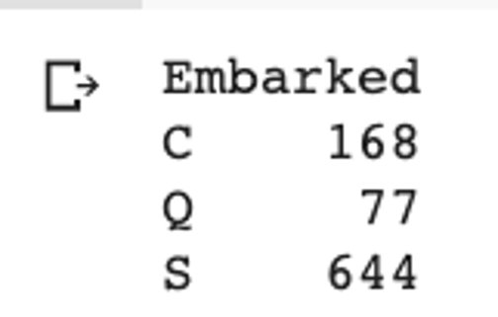
Pie Chart
Display the proportional distribution.
Provide one portion for each index, so if you want to show “Embarked” value distribution …
However, it is not a good way to visualize data, try not to use it
The difference of slice sizes can be hard to tell
Not effective for attributes with a large number of possible values
Use a table instead
Notes:
Pie chart can be used to display the proportional distribution of values for a categorical attribute. It uses different colors for those values and generate a pie shape chart.
However, it is not encouraged to use pie charts in many cases. Humans cannot easily pick up the difference of slice sizes and could have wrong comprehension of the information. Like in this example, it is hard to tell that the size of the slice with value “S” is about 8 times of the size for value “Q”. If there is a large number of indices, the difference between slices could be very slight and hard to identify. Using a table to summary the information is usually more effective.
Titanic dataset is used in the slide.

Slide 18
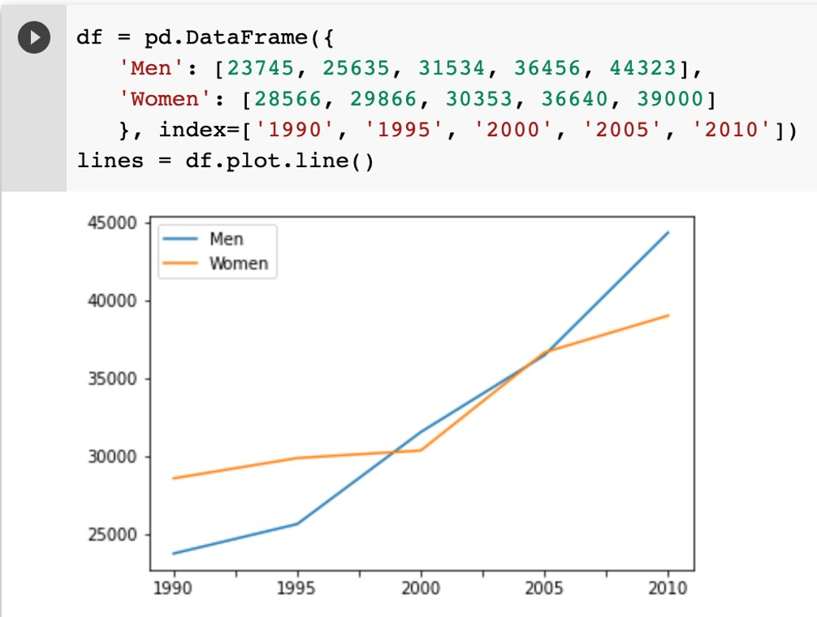
Line Graph
Displays the evolution of one or more numeric attribute values
Need to determine what x-axis and y-axis represents
By default, x=axis is the index
You can have multiple columns for y-axis
Notes:
Line graph is usually used to show the change or trend of values over certain index, such as time. Selecting multiple columns for y-axis results in multiple lines. Each line corresponds to a selected column.

Slide 19
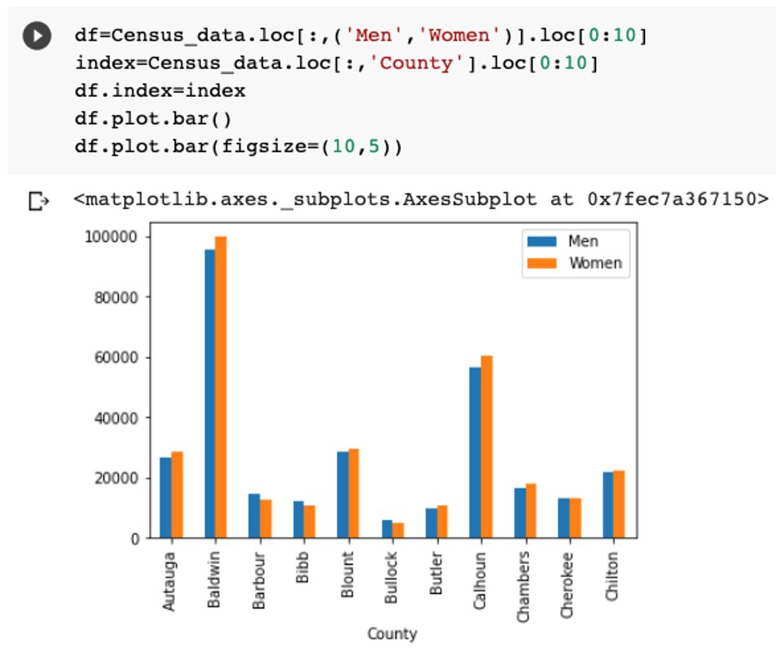
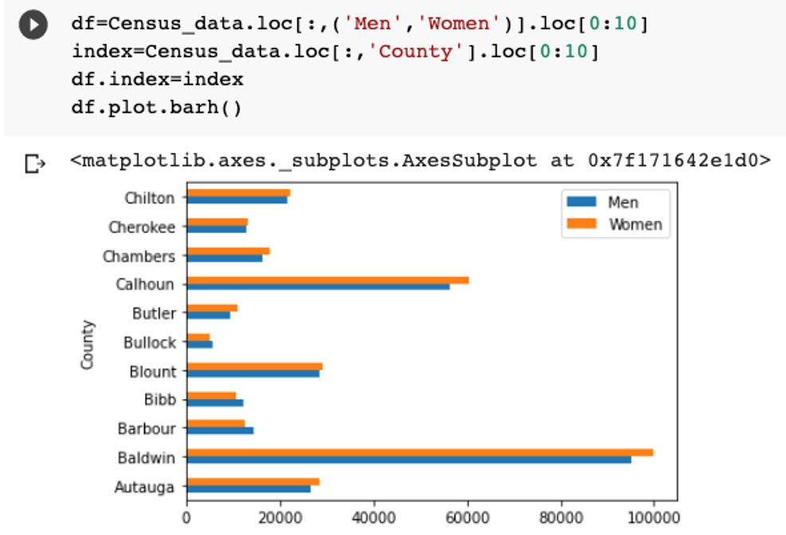
Bar Chart
Shows the summary or aggregated information of categorical values
X: categories (i.e., county)
Y: specific information (the men/women population)
Notes:
Bar chart can be used to visualize the summary or aggregated information of categorical values. The height/length of a bar is proportional to the value it represents. X axis represents the values of a category and y-axis represents the specific information, such as the counts, the sum, or other aggregated information.
Census dataset is used in the slide.

Slide 20
Scatter Plot
Used for continuous values
Attribute values determine the position (x,y)
2-d or 3-d scatter plot (2-d is most common)
Other additional attribute values can be visualized via the size, shape, color …
Can be used to
Display the correlation relationship between a pair of attributes
Distinguish data objects of a class from others by visualize their values (2-d)
Notes:
Scatter plot are used to display values for a pair of numerical attributes, corresponding to x and y axes. The value pairs determine the location of data points in the plot.
Other attribute values can be displayed through coding the points on size/color/shape.
Scatter plot is an effective visualization techniques to identify correlation relationship between attributes, display the value distributions, identify object clusters and outliers.

Slide 21
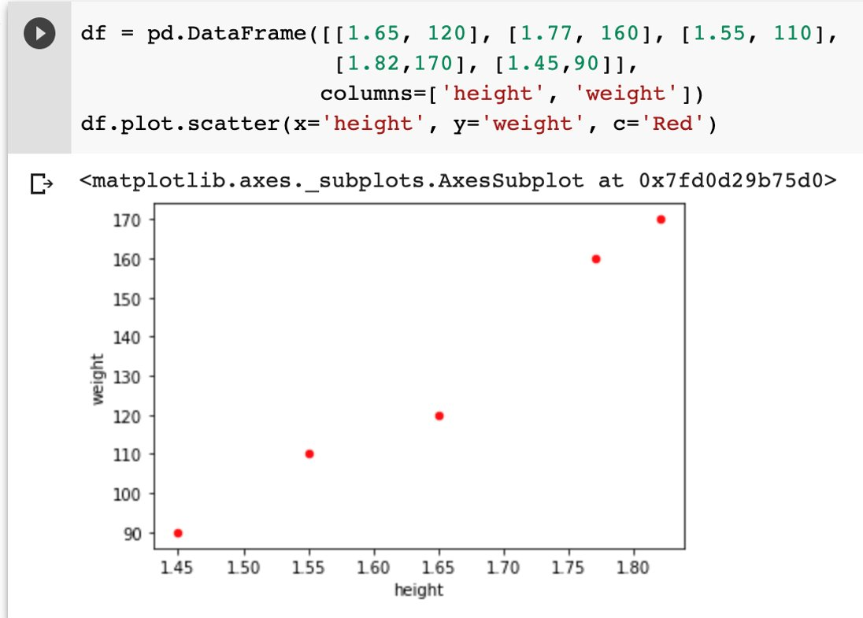
Scatter Plot
Specify the coordinate (x, y)
Notes:
This figure shows a scatter plot of a dataset where each data record contains the height and weight of a person. From the plot, we can see the two attributes roughly form a linear relationship, indicating the correlation between them.

Slide 22
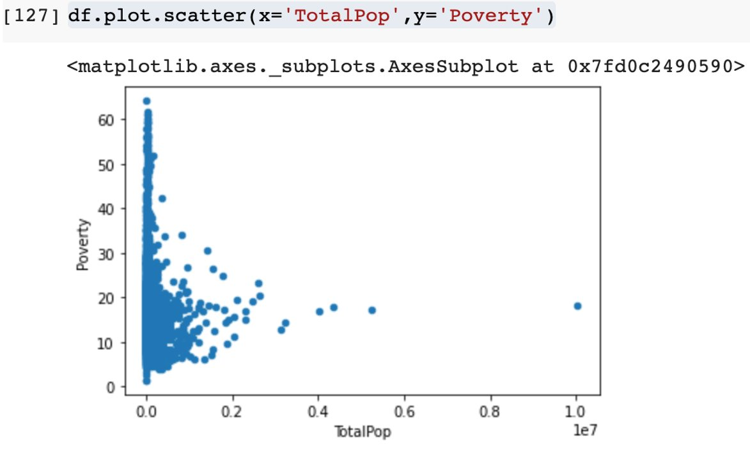
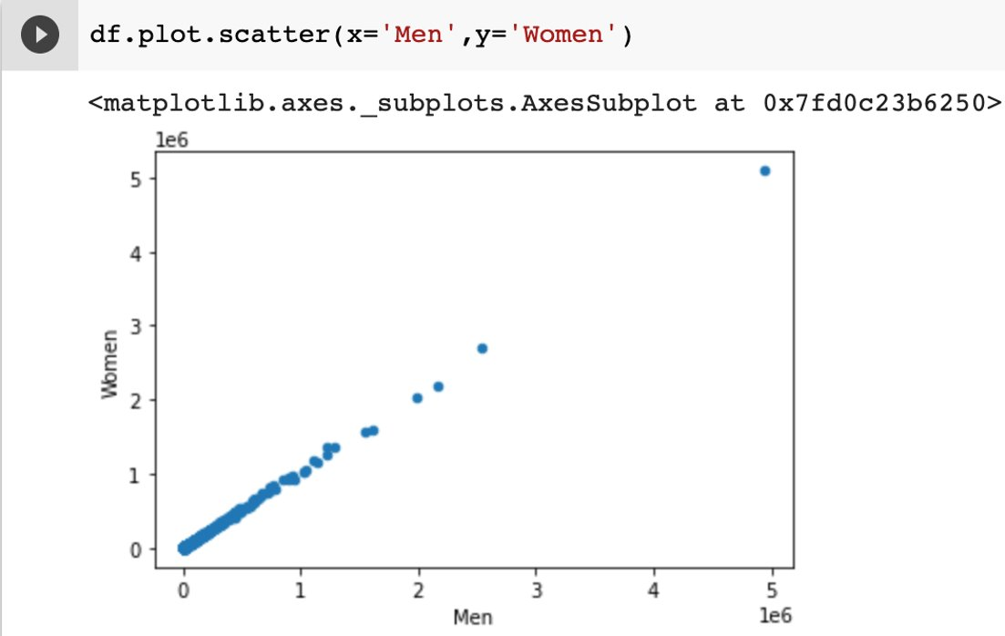
Scatter Plot
Correlation of two attributes
Notes:
The left plot suggests that there is no obvious correlation between ”TotalPop” and “Poverty”.
The right plot suggests a clear correlation between ”Men” and “Women”.
Census dataset is used in the slide.

Slide 23
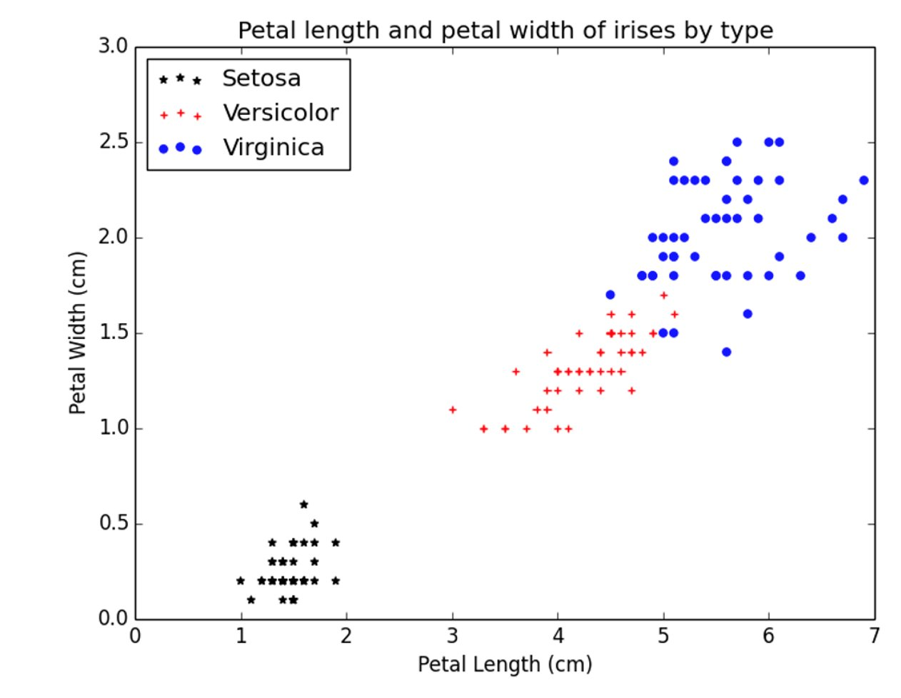
Scatter Plot
Distinguish data instances of different classes
Notes:
This slot shows the three different types of iris based on their petal length and petal width values. The records of the same type are clustered together in the figure.

Slide 24
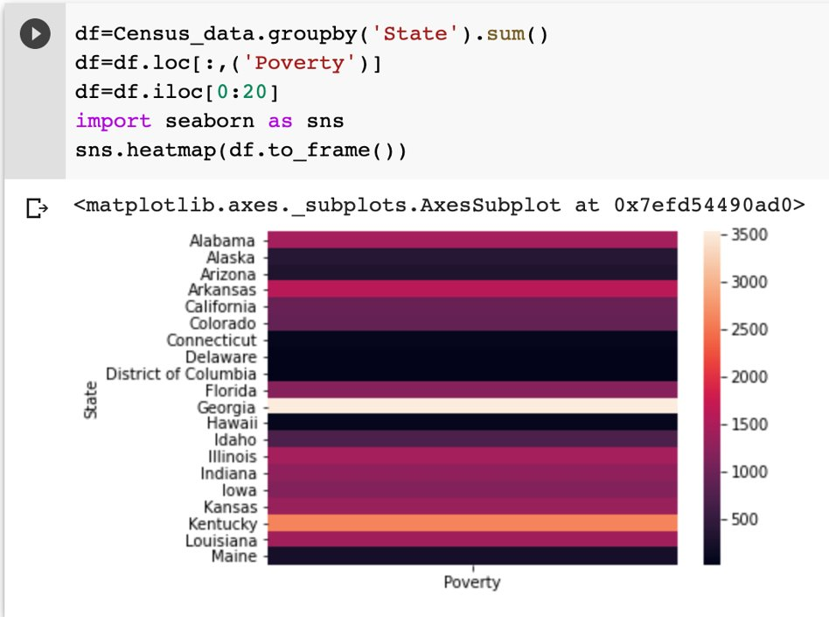
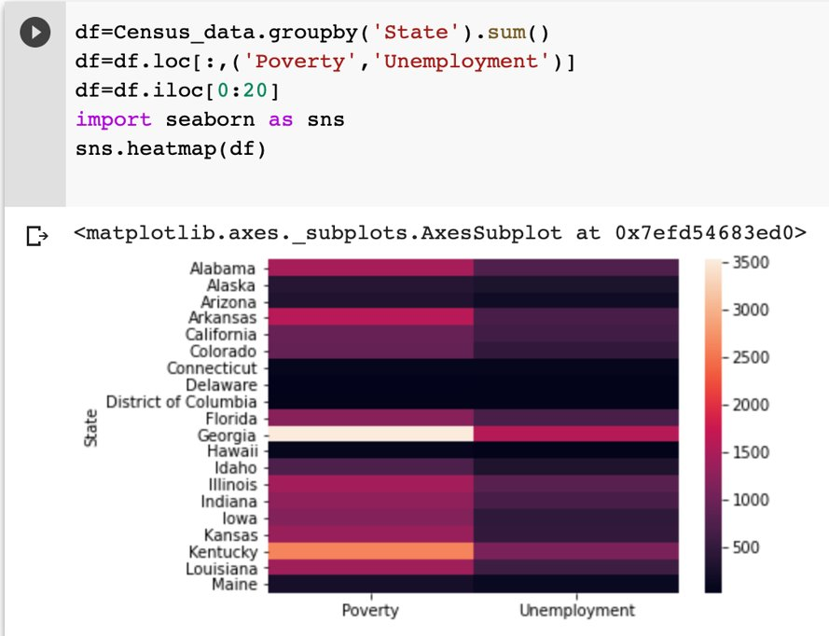
Heat Map
Display values via the variations in coloring
It is easy to comprehend colors than numbers for a person
Can be used to visualize variance across multiple variables to detect correlation patterns
Use seaborn library https://seaborn.pydata.org/
Notes:
Heatmap provides visual cues by linking the magnitude of values to the intensity of colors. It can be used for one variable or multiple variables to detect correlation among them .
Census dataset is used in the slide.

