Slide 1

Data Cleaning
This work is supported by the National Science Foundation under Award 2021287
Difficulty level: Introductory
Notes:
Initial release, Xumin Liu, Rochester Institute of Technology, 2022.
By Xumin Liu https://www.cs.rit.edu/~xl/
Except where otherwise noted, this work is licensed under a Creative Commons Attribution-4.0 International License https://creativecommons.org/licenses/by/4.0/

Slide 2
Contents
Data Cleaning
Data Quality Issues
Handling the Data
Notes:
In this lecture, we use Titanic dataset in the examples: https://www.kaggle.com/competitions/titanic/data
Please contact Xumin Liu (xmlics@rit.edu) for the code used in the slides.

Slide 3
Data Cleaning

Slide 4
Data Cleaning
Wiki: the process of detecting and correcting (or removing) corrupt or inaccurate records from a record set, table, or database and refers to identifying incomplete, incorrect, inaccurate or irrelevant parts of the data and then replacing, modifying, or deleting the dirty or coarse data.
An important step
GIGO: Garbage In, Garbage Out
Notes:
The process of data cleaning focuses on the detection and correction of data quality issues.
Data cleaning is an important step in a data science task. It is hard to avoid data quality issues in real world scenarios. Using dirty data to generate analysis can cause poor predications and dangerous outcomes. In addition, most machine learning algorithms only work with the data that is properly cleaned, such as no null values.

Slide 5
Data Cleaning
Data Quality Issues
How to detect quality issues
How to address the issues

Slide 6
Data Quality Issues

Slide 7
What can cause data quality issues?
Measurement error:
The recorded value deviated from the true value
Caused by humans and/or devices
Collection error:
Omit or duplicate data
Input error
Others
Unavailable information, problematic input
Noises in data
…
Notes:
Data quality issues can be caused due to many factors. It can be generated during any step of data collection.

Slide 8
Data Quality Issues
Missing Data
Duplicated Data
Irregular data: Noise + Outliers
Inconsistent Data
Notes:
Data quality issues include missing data, i.e., null values in a dataset; duplicated data, i.e., the same data object is recorded multiple times, irregular data, i.e., noise or outliers, and inconsistent data, i.e., the values that violate some predefined semantic/data integrity.

Slide 9
Missing Data
A common data quality issue
Can be caused by collection error or the information is not available
Most machine learning models do not accept missing data
Can be easily detected and corrected
Notes:
Missing data is a very common data quality issue. It can be easily detected and corrected.

Slide 10
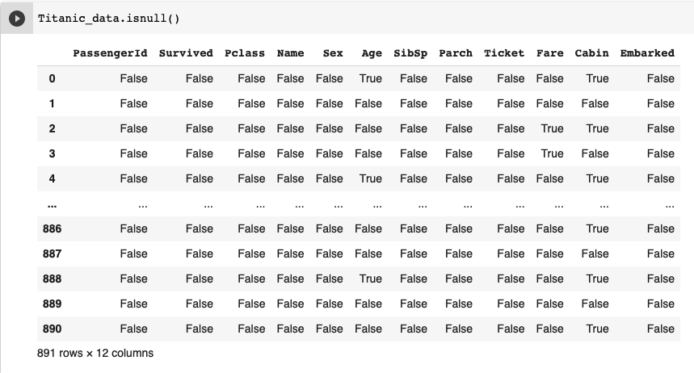
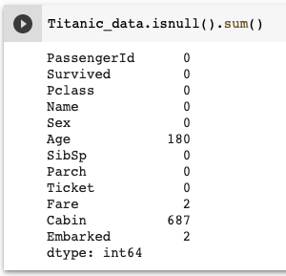
Detect Missing Data
df.isnull() or pd.isnull(df)
Summary: df.isnull().sum() or pd.isnull(df).sum()

Slide 11
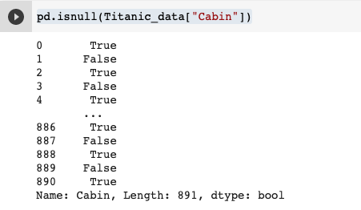

Checking Missing Data for a Column
df[column_name].isnull() or pd.isnull(df[column_name])
Summary:
Notes:
Specify the column name to check if values are null or not.

Slide 12
Handle the Missing Data
Eliminate data objects
Fill in the blank

Slide 13
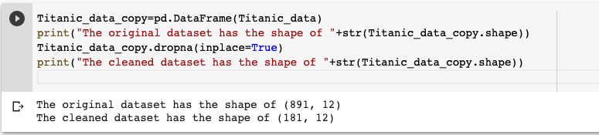
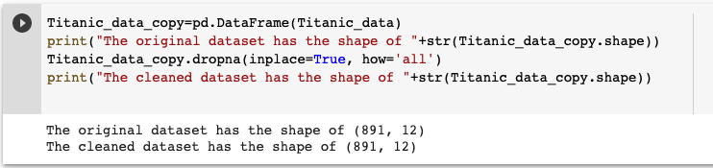

Eliminate Data Objects with Null Values
Drop the rows – use dropna()
Drop the rows where all elements are missing (empty entries)
Notes:
Use dataframe.dropna() function to remove records/columns with null values. ‘inplace‘ parameter controls if the change is made to the dataset. ’how’ parameter controls if condition on the removal, whether there is at least one (i.e., any), or all the values are null (i.e., all).
https://pandas.pydata.org/docs/reference/api/pandas.DataFrame.dropna.html

Slide 14
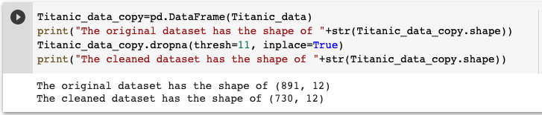
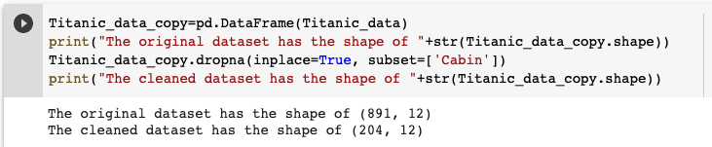

Eliminate Data Objects with Null Values
Drop the rows with a threshold dropna(thresh=10) – have at least 10 not null values
Define in which columns to look for null values dropna(subset=[‘col1’,’col2’]
Notes:
‘thresh‘ controls the condition of removal: minimum number of null values.
‘subset’ specify which columns to look into.

Slide 15
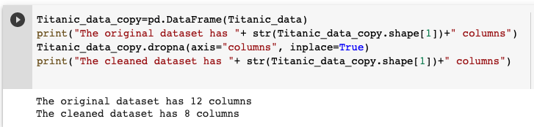

Eliminate Data Objects with Null Values
Drop the columns
Notes:
‘axis’ controls if the rows or columns will be dropped.

Slide 16
Handle the Missing Data
Eliminate data objects
Fill in the blank

Slide 17
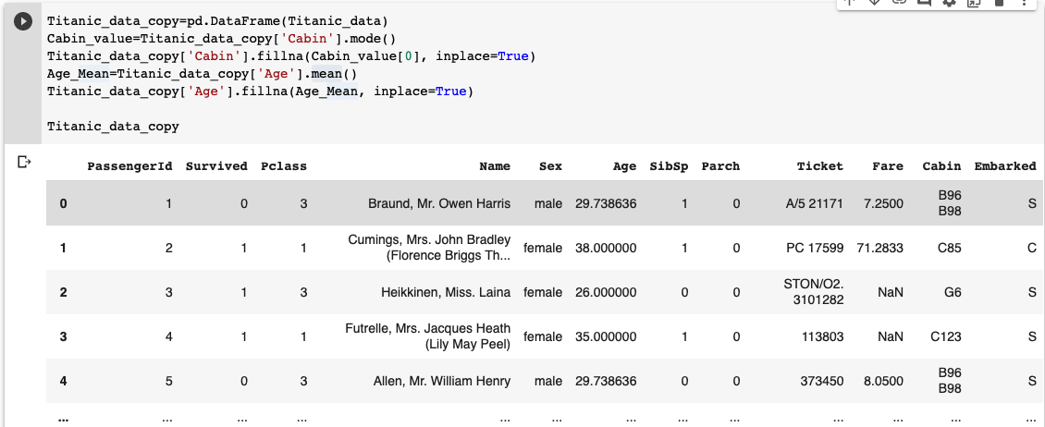
Fill in the Blank
Candidate values:
Mean value: df[column].mean()
Median value: df[column].median()
Mode value: df[column].mode()
Specified value
Fill in the values: - dataframe[column].fillna(value, inplace)
Notes:
Some common options for fill in the black include using mean, median, mode values. You can also specify a value to replace a null value.
Use dataframe.fillna() function: https://pandas.pydata.org/docs/reference/api/pandas.DataFrame.fillna.html

Slide 18
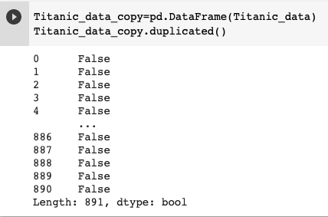


Duplicated Data
What is duplicated data?
If two data rows have the same value for every column (by default), or for some certain columns
Could be caused by data collection error or merge data from heterogeneous sources
Detect duplication dataframe.duplicated() or dataframe.duplicated().any()
Remove duplicates dataframe.drop_duplicates()
Notes:
Duplication should be avoided in a dataset as that will cause many issues such as distorting data distribution, misleading a machine learning model, and resulting in wrong analysis result.
Use dataframe.duplicated() function to detect duplicates: https://pandas.pydata.org/docs/reference/api/pandas.DataFrame.duplicated.html
Use dataframe.drop_duplicates() function to remove dupliates: https://pandas.pydata.org/docs/reference/api/pandas.DataFrame.drop_duplicates.html

Slide 19

Duplicated Data
Check if a columns is unique (such as studentID to student) dataframe[column].is_unique

Slide 20
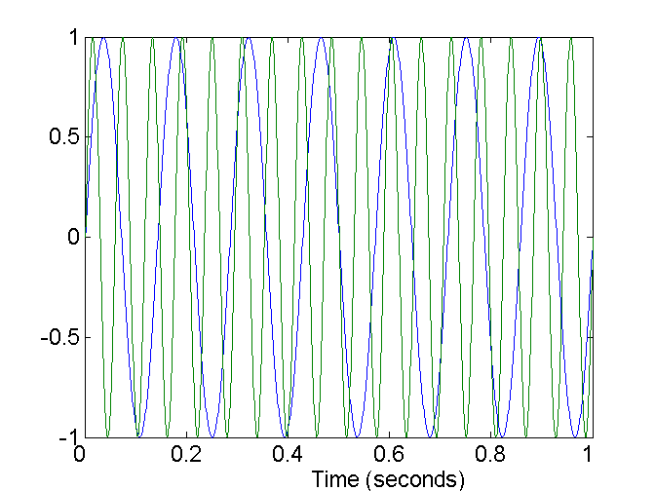
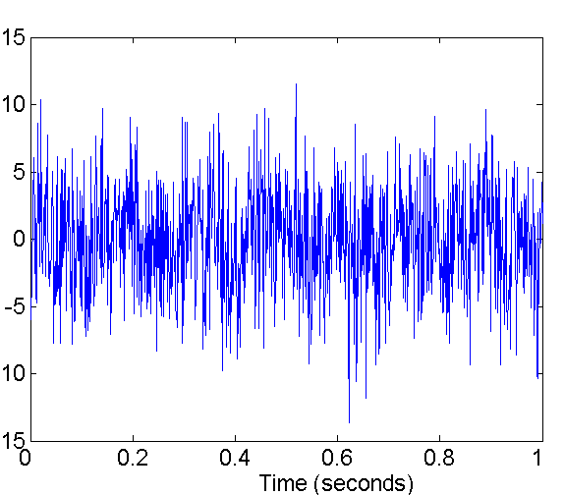
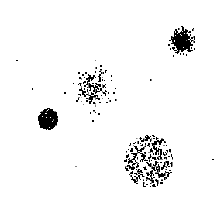
Irregular Data
Noises
Modification of original data
Distortion of a person’s voice
Outliers
Objects that are significantly different than most of others
A weather temperature reading of 75F on someday in January in Rochester area
Two Sine Waves
Two Sine Waves + Noise
Notes:
Both noises and outliers should be removed from a dataset as they can mislead analysis process and cause low quality of the result.

Slide 21
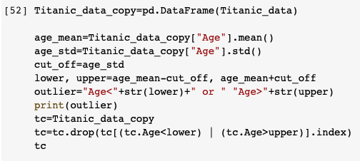
Handle Outliers
Define outliers
Specify ranges using simple univariate statistics such as standard deviation and interquartile range
Through visualization (later in this semester)
Remove outliers
Use dataframe.drop(condition)
Notes:
Unlike null values, we need to define what are considered as outliers in order to identify and correct them. A common way is to follow the same principle of trimmed mean, removing those that are too far from the mean. Another approach is to project the data records to a space through visualization so outliers can be spotted.
Once outliers are identified, we can use dataframe.drop() method to remove those outliers. https://pandas.pydata.org/docs/reference/api/pandas.DataFrame.drop.html

Slide 22
Inconsistent Data
Data inconsistency issue
Inconsistent data type
Inconsistent data format
Data semantic issue:
e.g., SSN should have 9 digits, age cannot be negative
Address data should have street number and name, city, state, zip code
“computer” is not an accepted value for color attribute
Others
Typo: “RTIT” instead of “RIT”
Extra space, illegal characters
Notes:
Data inconsistent issues can be on syntactic or semantic level. They are application specific and need to be explicitly defined.

Slide 23
Fix the Inconsistency
Determine what is consistency
Specify the legal values
Use regular expressions (https://docs.python.org/3/howto/regex.html)
How to correct
Remove the illegal entries
Replace with a specified value
Notes:
Data integrity can be defined by defining the legal values or through regular expression. Once they are defined, the entries that violate the integrity can be removed or replaced.

