Slide 1

Feature Selection
This work is supported by the National Science Foundation under Award 2021287
Difficulty level: Introductory
Notes:
Initial release, Xumin Liu, Rochester Institute of Technology, 2022.
By Xumin Liu https://www.cs.rit.edu/~xl/
Except where otherwise noted, this work is licensed under a Creative Commons Attribution-4.0 International License https://creativecommons.org/licenses/by/4.0/

Slide 2
Contents
Feature Selection - Overview
Feature Selection Approaches
Principle Component Analysis
Notes:
In this lecture, we use the census dataset in the examples: https://www.kaggle.com/muonneutrino/us-census-demographic-data
Please contact Xumin Liu (xmlics@rit.edu) for the code used in the slides.

Slide 3
Feature Selection - Overview

Slide 4
Feature Selection - Overview
Wiki: feature selection, a.k.a, variable selection, attribute selection, or variable subset selection, is the process of selecting a subset of relevant features (variables, predictors) for use in model construction.
Simply the models to make them easier to interpret by users
Shorter training times
Avoid the curse of dimensionality
Feature selection is to select those relevant, remove irrelevant or redundant features.
Notes:
Given a data analysis task, select those features that are relevant to the task to reduce the complexity of the learned model. This will help improve the interpretability of the model as well as reduce the training time.
Many machine learning models assume the independency between input features. Feature selection will also remove those redundance ones.

Slide 5
Curse of Dimensionality
Data dimension: the number of features of a data object
E.g., points (x,y): 2D; points (x, y, z): 3D, COVID-data: 37 dimensions
High dimensional data
Data objects with a large number of dimensions
Textual data: each term corresponds to a dimension
Imaging data: each pixel corresponds to a dimension
Curse of dimensionality: when # of dimension grows
Computations become more expensive
Data objects become more sparse
Notes:
Curse of dimensionality refers to the situation where the performance of a machine learning process significantly drops when the number of dimension increases. With a high number of features, computation on those features will be more expensive and data objects become more sparse in a higher dimensional space.

Slide 6
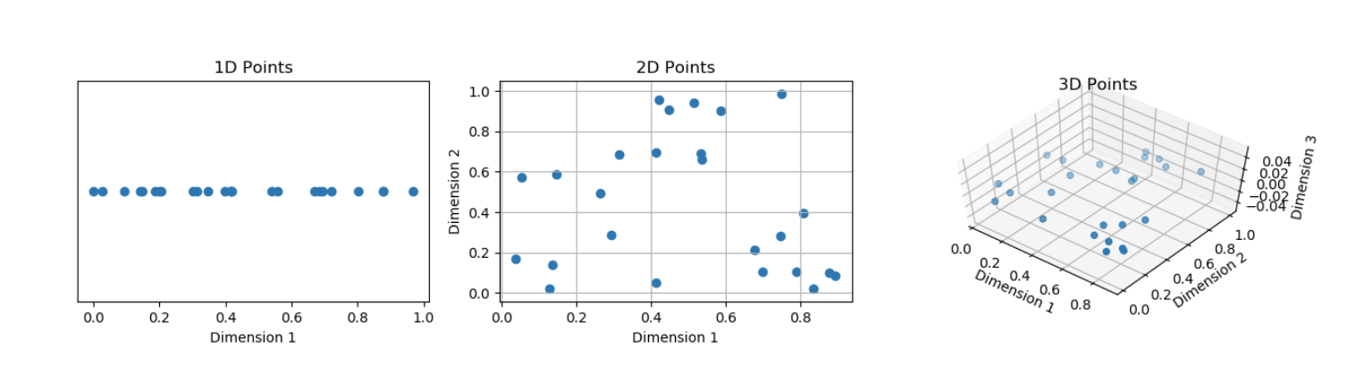
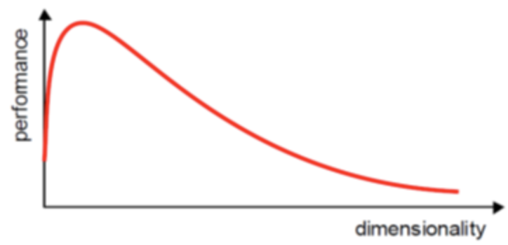
Curse of Dimensionality
25 points in 1-D, 2-D, 3-D: patterns are less discernible
Performance increases until an optimal number of features is reached
Notes:
The example shows how the same group of data records are visualized in different dimensional spaces. They become more sparse when the dimension is higher.
Performance of data analysis increases initially when more features are included as that allows more information to be used. After a certain point, the performance significantly drops due to the curse of dimensionality. To address this, we use feature selection to reduce the number of selected attributes.

Slide 7
Feature Selection Approaches

Slide 8
Selection Approaches
Given a targeted variable
Remove irrelevant variables
Remove redundant variables
Select relevant features
Principle Component Analysis (PCA):
Project original feature space into a lower-dimensional space
Notes:
Feature selection is associated with a targeted analysis task. Given a targeted variable, feature selection aims to only select those relevant ones.
PCA is another way of reducing the data dimensionality. It transfers the original features to new ones in a lower dimensional space.

Slide 9
Remove Irrelevant Features
Features having low variance
Near to zero, or features having zero variance
Should we keep them???
Features having unique values
ID, name …
Should we keep them???
Notes:
We should remove those features that have low variance or have unique values.

Slide 10
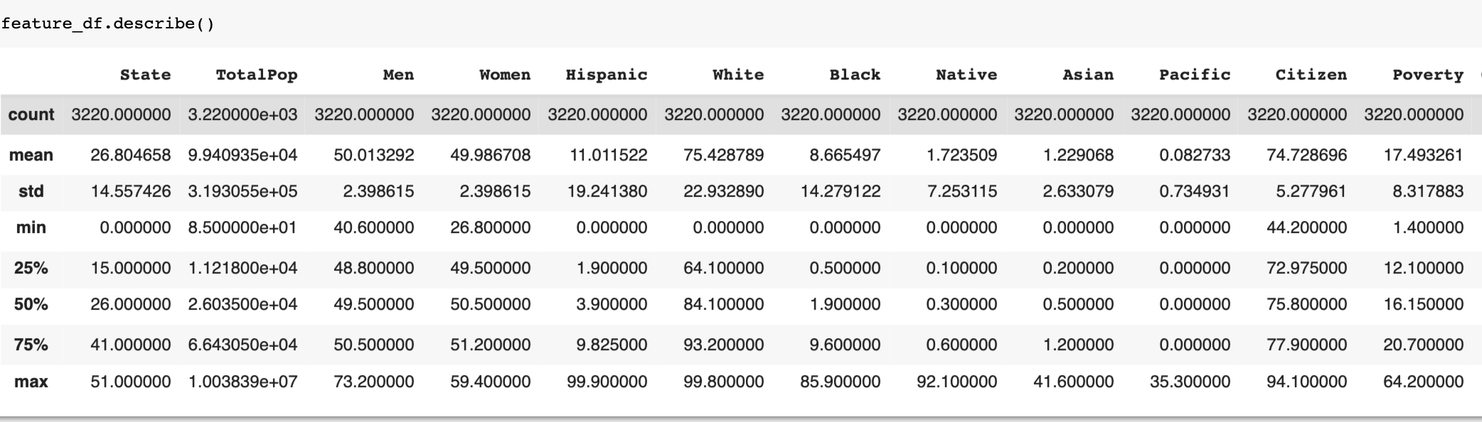
Remove Features With Low Variance
Low variance suggests less predictive power
Especially those features have very low, near to zero, variance
By default, remove all zero-variance features (no information provided to discriminate or predict a target)
Set variance threshold
Notes:
Use dataframe.describe() to check the variance of each attribute.

Slide 11
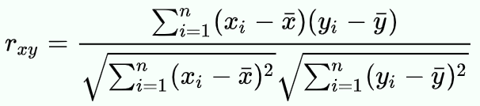
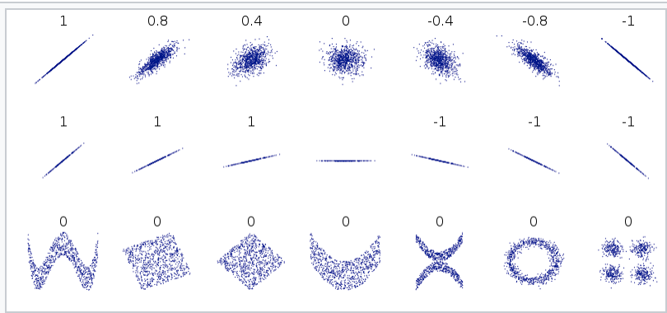

Correlation Analysis
Pearson’s coefficient: test the linear relationship between two features
0: no correlation
1: positive correlation
-1: negative correlation
X, Y covariance
X’s standard deviation
y’s standard deviation
Notes:
Use correlation analysis to check the relevance between a pair of attributes.

Slide 12
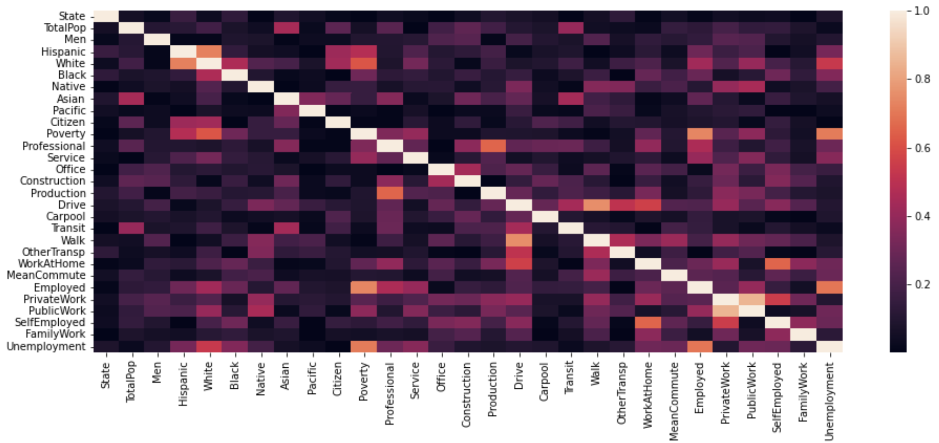
Correlation Analysis
Use heatmap
Notes:
Heatmap allows us to quickly identify the high/low correlation. Here, the lighter the color is, the higher the correlation is.

Slide 13
Drop Correlated Variables
The dropping should not lose information
Only when the correlation is strong enough
E.g, one is derived from another one, Men_percentage=1-Women_percentage
Decisions need to be made:
What is considered as strong correlation – threshold
Which column to be removed?
Be careful when dropping a column, in many cases, need domain knowledge, and further investigation
Notes:
Many machine learning models assume independency among input features. If two features are highly correlated, one of them should be dropped.
The selection of the dropped feature should be made carefully.

Slide 14
Select The Most Relevant Features
Select the top-K features:sklearn.feature_selection.SelectKBest
Score_Func:
f_classif: ANOVA F-value between label/feature for classification tasks
mutual_info_classif: Mutual information for a discrete target
chi2: Chi-squared stats of non-negative features for classification tasks
f_regression: F-value between label/feature for regression tasks
mutual_info_regression: Mutual information for a continuous target
Notes:
Use the sklean.feature_selection.SelectKBest() method to get the top K relevant features.
https://scikit-learn.org/stable/modules/generated/sklearn.feature_selection.SelectKBest.html

Slide 15
Null hypothesis, F-Statistics and p-value
Null hypothesis: a group of the features are irrelevant to the targeted variable – no predictive power
F-Statistics: measures if a group of features are significant or not
Compares the model with zero predictor variable, whether adding the features improve the predicative capability
The higher a F Statistic(or F value) is, the higher probability that the null hypothesis is not true → selected features have higher predictive capability
Threshold: f-critical value
Notes:
When selecting the top K relevant features, the null hypothesis is that a feature is irrelevant to the targeted variable.
F-Statistics measures if a feature is relevant or not. The higher the score is, the higher the predictive power a feature has. We are looking for those features have high F-value.

Slide 16
P-Value
p-value: measure the probability of finding an observation given the assumption that the null hypothesis is true
The lower p-value it is, the higher probability the null hypothesis is not true, → selected features have higher predictive capability
Threshold: 0.05 (targeted features with p value lower than 0.05)
Notes:
p-value measures the probability of the null hypothesis is true. We are looking for the features have low p-values.

Slide 17
ANOVA F-Value
Analysis of Variance
F-test
Whether the means from two samples of data (i.e., features and targeted variable) are from the same distribution or not
Features are continuous, targeted variable is categorical
Notes:
ANOVA F-value is suitable for a prediction task where the continuous features are used to predict a categorical variable.

Slide 18
F-Regression
Checking the linear correlation relationships between a feature and the targeted variable
Continuous features, continuous targeted variable
F-value between label/feature for regression tasks
p-values of features for predicting “Income”
Notes:
F-Regression is suitable for a prediction task where the continuous features are used to predict a continuous variable.

Slide 19
Chi-Squared Stats
Correlation analysis for Categorical data
Compute chi-squared stats between each non-negative feature and class – Chi-Square test of independence
Select the n features with the highest value (weeds out irrelevant features)
Notes:
F-Regression is suitable for a prediction task where the categorical features are used to predict a categorical variable.

Slide 20
Mutual Information
A general way that works for both continuous and discrete variables
Measure the reduction in uncertainty for targeted variable given a known value of a feature
mutual_info_regression: for a continuous target
mutual_info_classif: for a discrete target
Notes:
mutual_info_regression is suitable for a prediction task where the non-negative continuous/continuous features are used to predict a non-negative continuous variable.
mutual_info_classif is suitable for a prediction task where the non-negative continuous/continuous features are used to predict a non-negative discrete variable.

Slide 21
Summary
Score_func | features | target
f_classif | Continuous/Categorical | Categorical
mutual_info_classif | Continuous/Categorical | Categorical
chi2 | Categorical | Categorical
f_regression | Continuous | Continuous
mutual_info_regression | Continuous/Categorical | Continuous

Slide 22
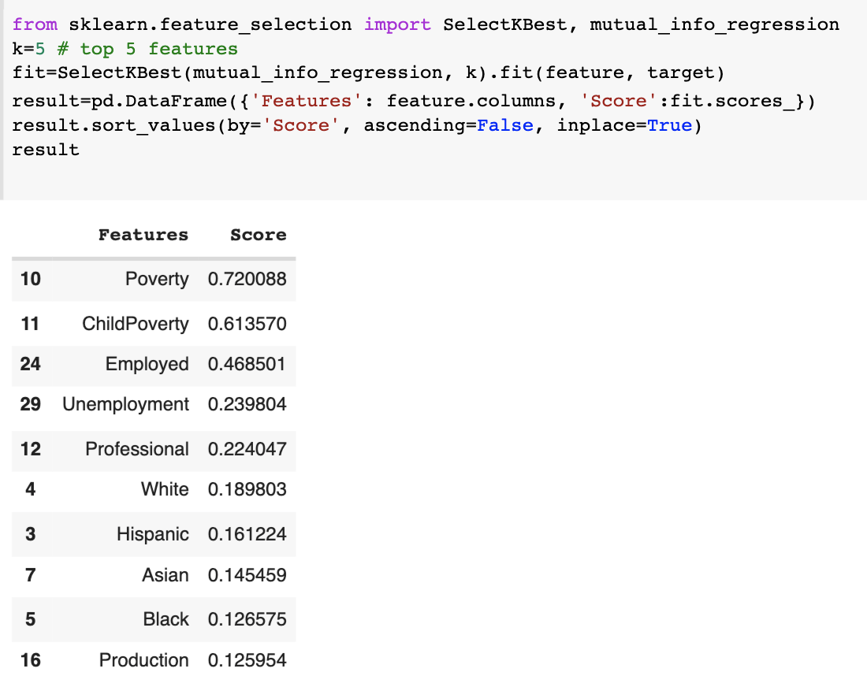
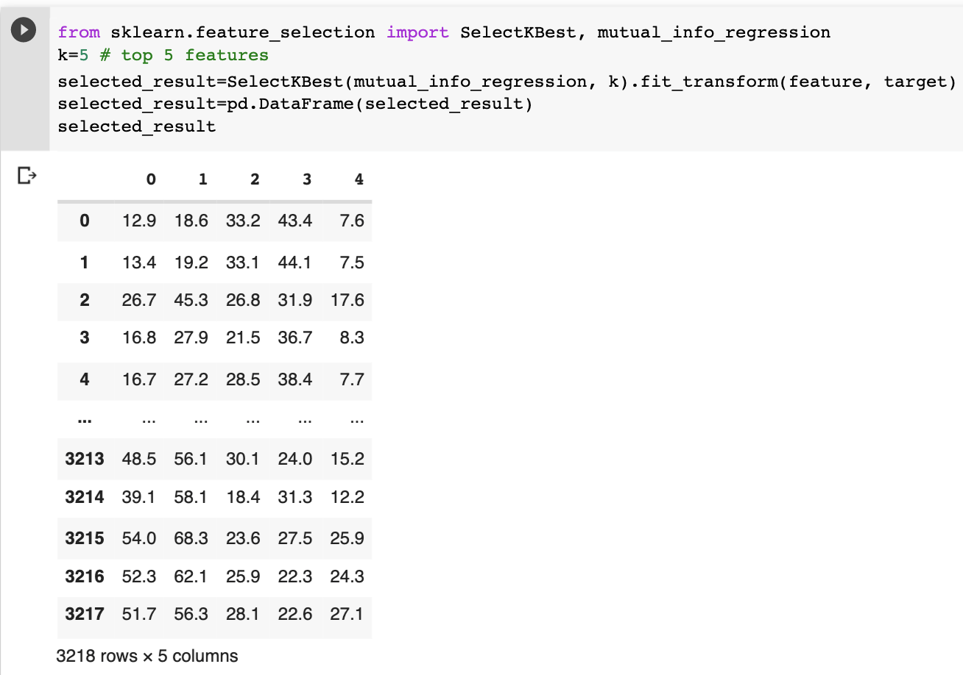
Sklearn

Slide 23
Principle Component Analysis (PCA)
Project the current features to a new, lower-dimensional feature space
Generate derived features – feature extraction
Reduce redundant features – decrease the dimensionality and complexity of the model
PCA is a popular linear feature extraction method
Notes:
PCA transforms a set of the original features to another set with the specified size. Each derived feature is a linear combination of the original features.
The transformation is not guided by a targeted variable. It is an optimized process where the information loss should be minimized.

Slide 24
Principle Component Analysis (PCA)
minimize the information loss, i.e.,
K<<N
reconstruction
original
Notes:
PCA transforms a set of the original features to another set with the specified size. Each derived feature is a linear combination of the original features.
The transformation is not guided by a targeted variable. It is an optimized process where the information loss should be minimized.

Slide 25
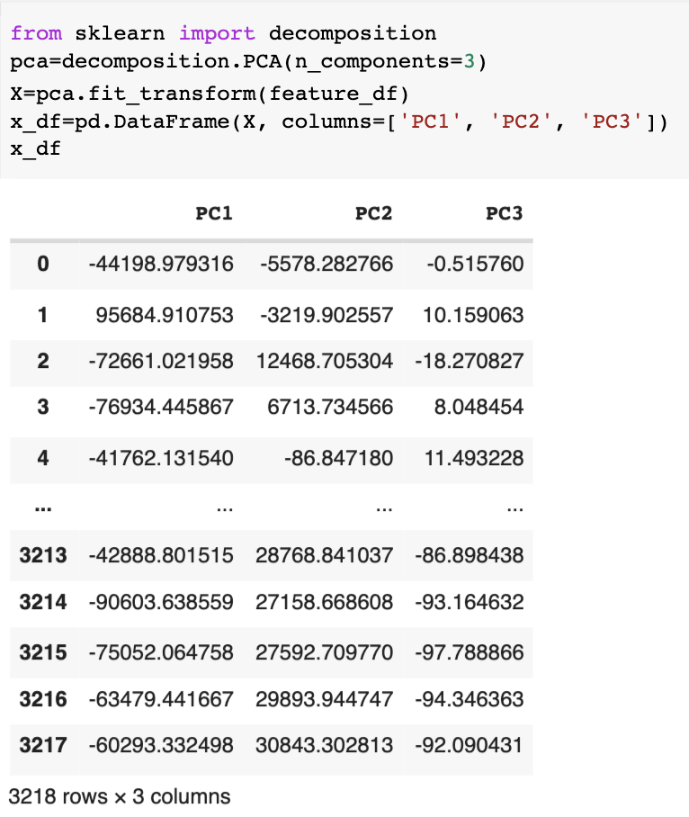
PCA
Generates new features and dimensions
Each feature is a linear combinations of the original ones
Each feature is uncorrelated with one another
Capture as much of the original variance in the data
Each feature is called as a principle component
Notes:
The new features are independent from each other, which serves a machine learning algorithm well. The first derived feature captures the most variance from the data, the second one captures the second most, and so on.
It can effectively reduce the dimensionality but the new features are not interpretable.

