Slide 1

Summary Statistics for Data Exploration
This work is supported by the National Science Foundation under Award 2021287
Difficulty level: Introductory
Notes:
Initial release, Xumin Liu, Rochester Institute of Technology, 2022.
By Xumin Liu https://www.cs.rit.edu/~xl/
Except where otherwise noted, this work is licensed under a Creative Commons Attribution-4.0 International License https://creativecommons.org/licenses/by/4.0/

Slide 2
Contents
Exploratory Data Analysis
Summary Statistics
Probability Distributions

Slide 3
Exploratory Data Analysis

Slide 4
Exploratory Data Analysis
Preliminary investigation of the data to better understand its characteristics
Helps select the proper data preprocessing and analysis techniques
Use human’s abilities to recognize patterns in data
Techniques:
Summary Statistics and probability distributions for Data Science
Data Visualization
Notes:
This is a preliminary investigation of the data, i.e., get to know the data in general and identify some patterns that can help us decide how to proceed.
It helps people build intuitions and know better for the further steps such as data preprocessing and analysis.

Slide 5
Summary Statistics

Slide 6
Summary Statistics
Describe or summarize the basic features of the data
Univariate analysis: describe the distribution of a single variable
Who is the richest celebrity? – maximum(net_worth)
Which state has the lowest COVID case number? –minimum(case_number)
What is the average age of RIT students? – mean(age)
What is the middle income of the employees? - median(income)
What are the most common color of horses? – mode(color)
What is the range of salaries of data scientists? –range(salary)
How stable the profits are over the years? – standard deviation (profit)
…
Notes:
Summary statistics are mainly used to describe or summarize the basic features of the data, or summarize some patterns in a set of data objects or observations.

Slide 7
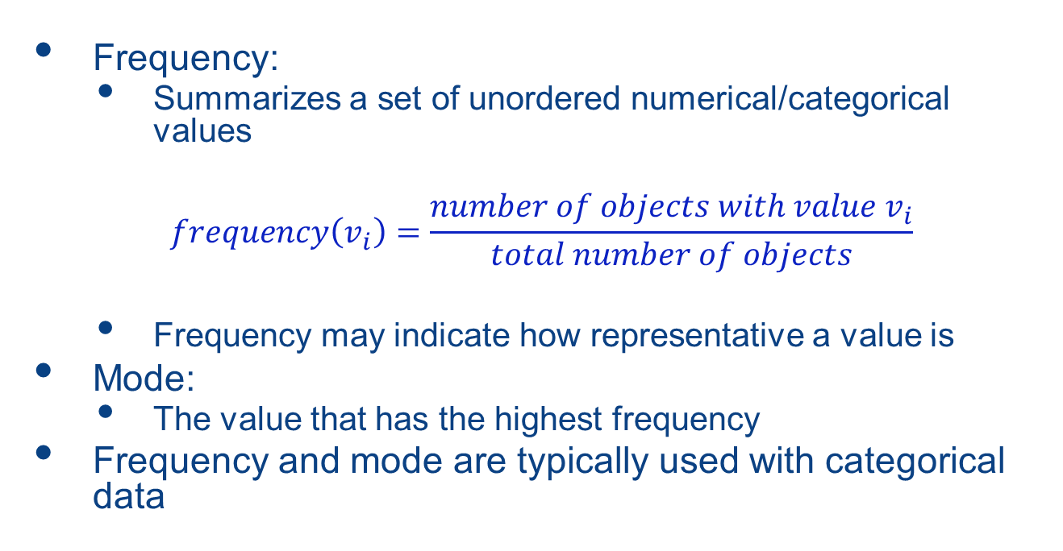
Frequencies and Mode
Frequency:
Summarizes a set of unordered numerical/categorical values
$$frequency\left(v_{i}\right)=\frac{number of objects with value v_{i}}{total number of objects}$$
Frequency may indicate how representative a value is
Mode:
The value that has the highest frequency
Frequency and mode are typically used with categorical data
Notes:
Frequencies and mode are typically used with categorical data. Frequency of a value measures how representative the value is in a dataset.

Slide 8
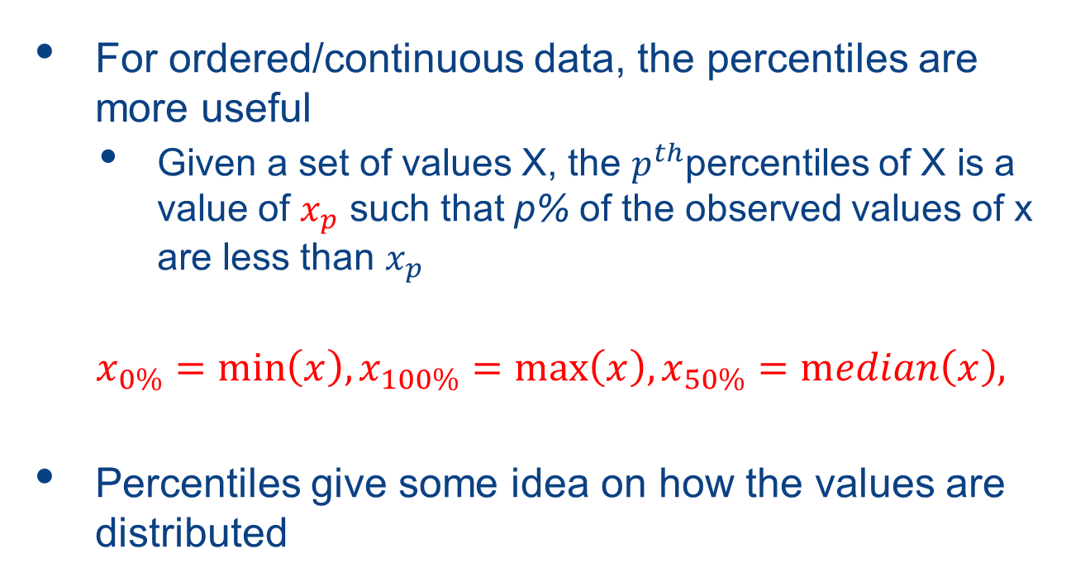
Percentiles
For ordered/continuous data, the percentiles are more useful
Given a set of values X, the $p^{th}$percentiles of X is a value of $x_{p}$ such that p% of the observed values of x are less than $x_{p}$
$$x_{0\%}=\min\left(x\right),x_{100\%}=\max\left(x\right),x_{50\%}=\operatorname{median}\left(x\right),$$
Percentiles give some idea on how the values are distributed
Notes:
Percentiles show the value distributions for ordered/continuous data.

Slide 9
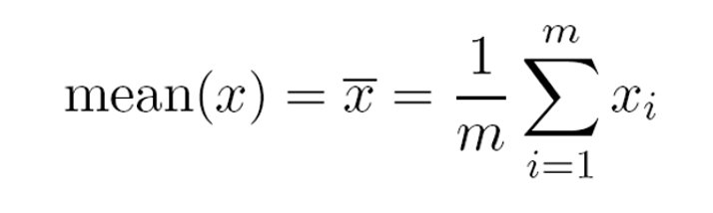
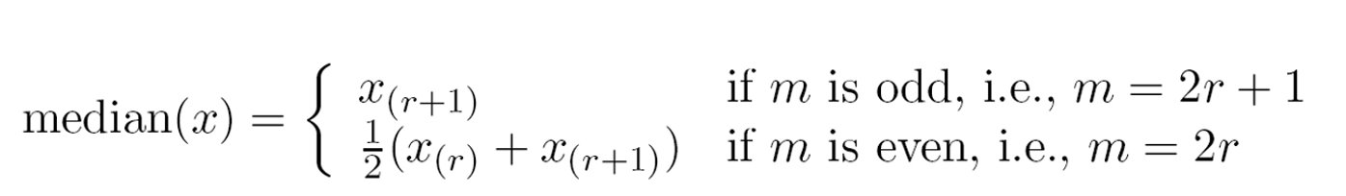
Measure of Location: Mean and Median
Widely used for continuous data, measure the location of a set of values
Mean is the average of the values, can be sensitive to outliers
The mean of {1, 2, 3, 4, 100} is 22
Median is the middle value if there are an odd number of values, or the average of the two middle values if the number is even.
The median of {1,2, 3, 4, 100} is 3
Notes:
Mean and Median indicate the location, i.e., where the values are centered around. Mean is more sensitive to outliers than median.

Slide 10
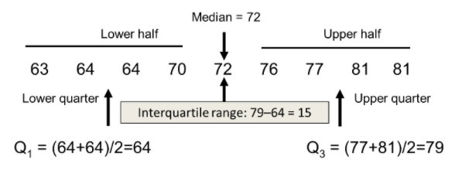
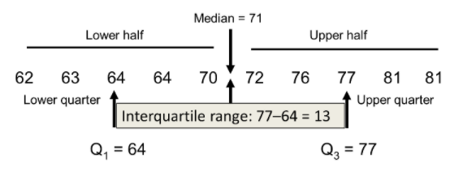
Median Examples
x
x
x
x
x
Notes:
The computation of median for data sets with odd/even number of values.

Slide 11
Trimmed Mean
To deal with the outlier issue, use trimmed mean
Given a percentage p, the top and bottom (p/2)% of the data is considered as outliers and is thrown out to compute the mean.
Notes:
Trimmed Mean helps address the outlier issue by removing the top and bottom percentiles, which are considered as outliers, before computing the mean.

Slide 12
Measure of Spread: Range and Variance
Range: the difference between the max and min values
Indicate whether the values are widely spread out or relatively concentrated around a single point such as the mean
Could be misleading if most of the values are concentrated in a narrow band of values
Notes:
Range is used to measure the spread of values. It can be misleading for some irregular data.

Slide 13
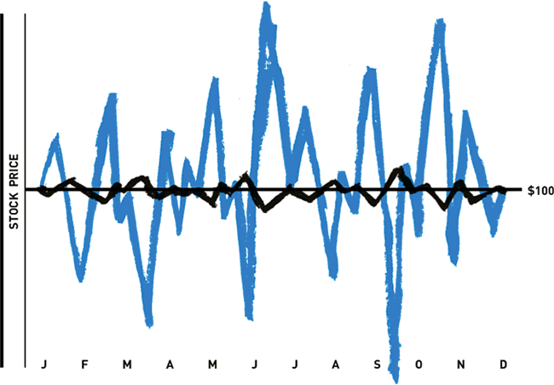


Measure of Spread: Range and Variance
The variance or standard deviation ( the square root of variance) is the most common measure of the spread of a set of points
mean
A low variance indicates that the values tend to be close to the mean – stable data
A high variance indicates that the values are spread out over a wider range
Notes:
Variance is used to measure the spread of deviation from the mean. The lower the variance is, the more stable the data is.

Slide 14
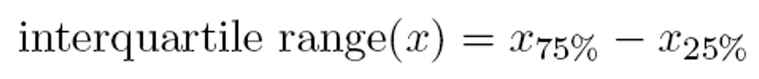
IQR(Interquartile Range)
Both mean and variance also sensitive to outliers, so IQR (interquartile range) is often used
IQR: the difference between 75% and 25% percentiles
Also called as: midspread, middle 50%, H-spread
Notes:
IQR takes the similar idea as trimmed mean when capturing the range of values. It improves the accuracy of dataset statistics by only consider the middle 50% of the data.

Slide 15
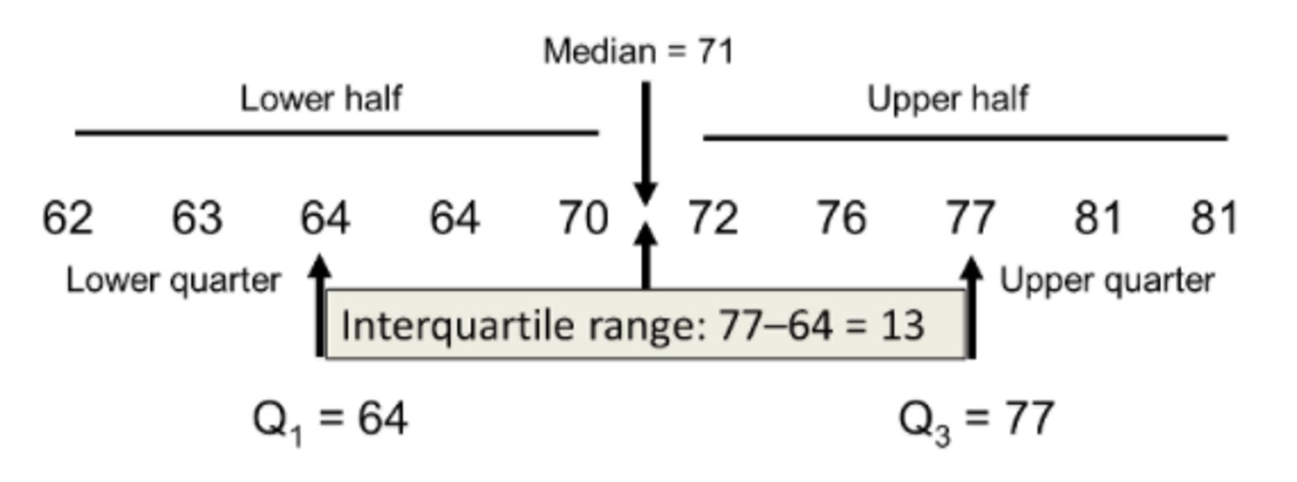
IQR w/ Even Number of Samples
Notes:
An example of computing the IQR of a dataset with an even number of items.

Slide 16
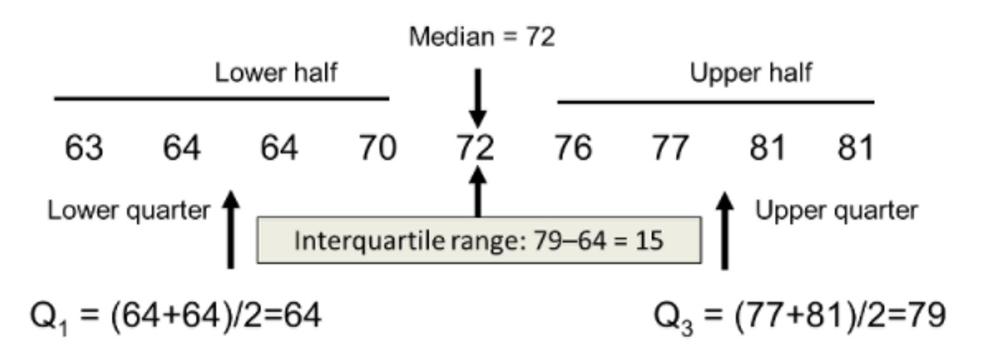
IQR w/ Odd Number of Samples
Notes:
An example of computing the IQR of a dataset with a odd number of items.

Slide 17
Probability Distributions

Slide 18
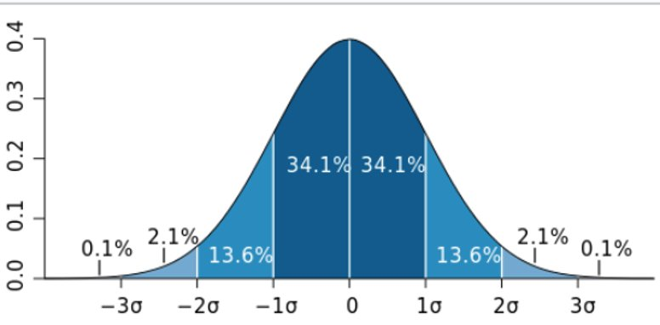
Probability Distributions
Probability – how likely something is to happen
How likely it will rain tomorrow? P(X=rain)
What is the probability the stock price will go up? P(X=up)
What is the chance of getting 10 as the sum when rolling 2 dice? P(X=10)
Probability distribution: express the probability of the entire set of values that X can take.
P(X=head)=0.5, P(X=tail)=0.5
Probability Density Function (PDF)
Notes:
Probability distributions are used to describe statistical patterns in a dataset. It provides a mathematical expression on the probabilities of occurrence of an event, such as observing a certain value for X in a dataset.
Probability Density Function is a function that computes the probability of a variable falling within a particular range of values.

Slide 19
Common Probabilistic Distributions
Bernoulli distribution
Binomial distribution
Uniform distribution
Normal distribution
Notes:
In this lecture, we go over four probabilistic distributions commonly used in data science tasks.

Slide 20
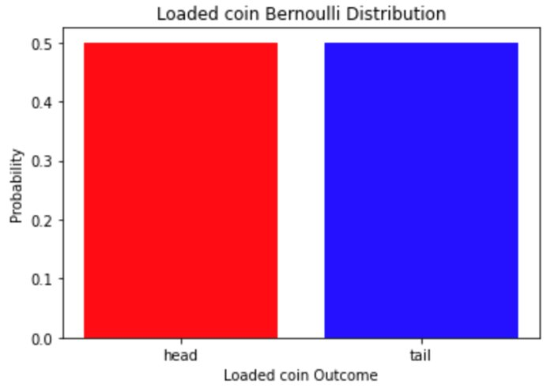
Bernoulli Distribution
For categorical data or discrete data
Two possible outcomes and one single trial
The possibilities are p and 1-p
E.g., toss an unbiased coin p=0.5
Notes:
Bernoulli distribution is used for the events where there are two possible outcomes and one single trial, such as tossing a biased or unbiased coin.

Slide 21
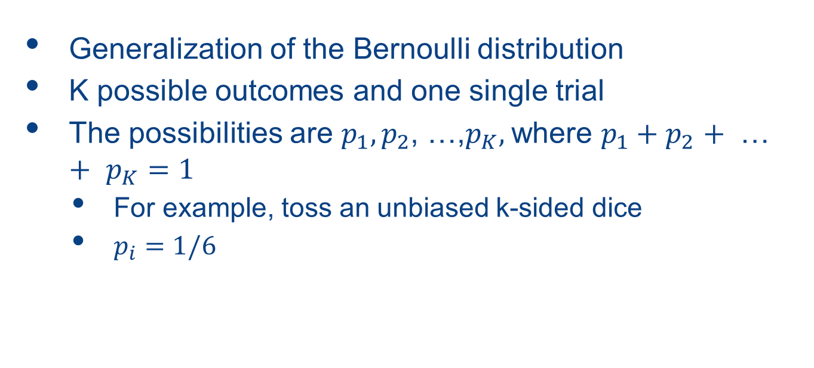
Categorical Distribution
Generalization of the Bernoulli distribution
K possible outcomes and one single trial
The possibilities are $p_{1},p_{2}$, …,$p_{K},$where $p_{1}+p_{2}$ $+$ … $+$ $p_{K}=1$
For example, toss an unbiased k-sided dice
$p_{i}=1/6$
Notes:
Categorical distribution models the possible results of a random event that have K possible outcomes.

Slide 22
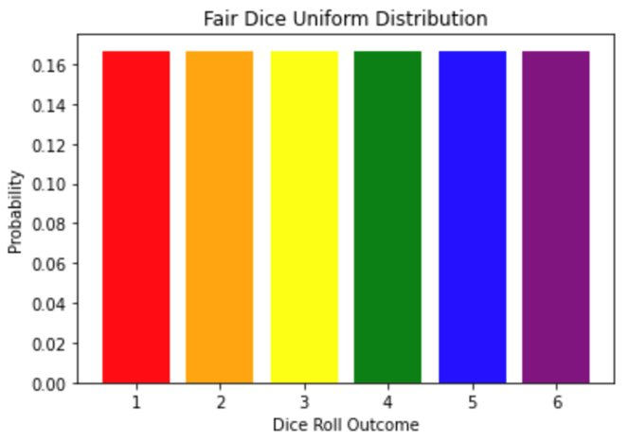
Uniform Distribution
For both discrete and numeric data
Any number of possible outcomes
All the outcomes have the same probability
e.g., roll a fair dice
Notes:
Uniform distribution is a special case of categorical distribution. All the outcomes have the same probability.

Slide 23
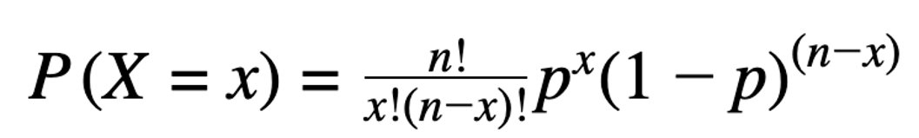
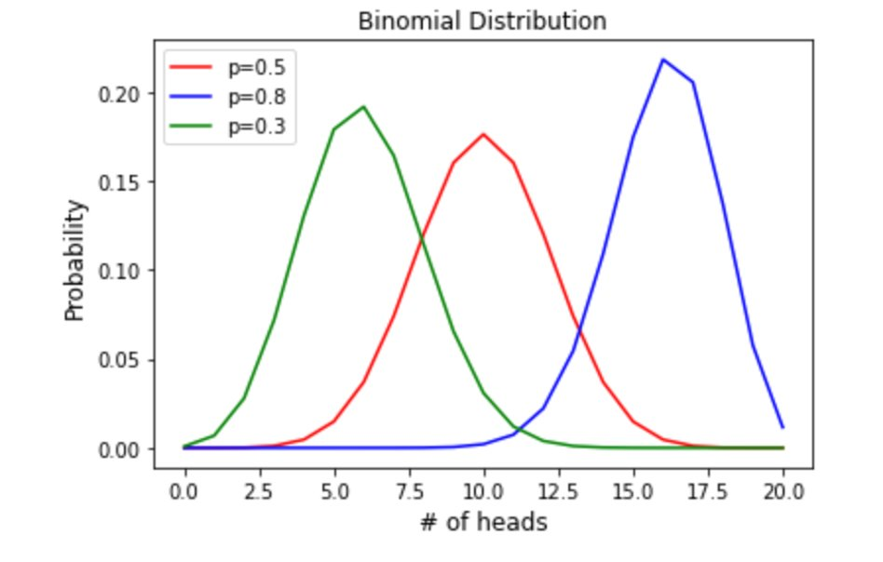
Binomial Distribution
The sum of outcomes of an event following a Bernoulli distribution
Used in binary outcome events but with multiple trials
E.g., the probability of getting X heads in 20 trials
Notes:
Binomial distribution is used for those events where there are multiple trials and only two possible outcomes for each trial. It models the probability distribution of the sum of outcomes from those trials.

Slide 24
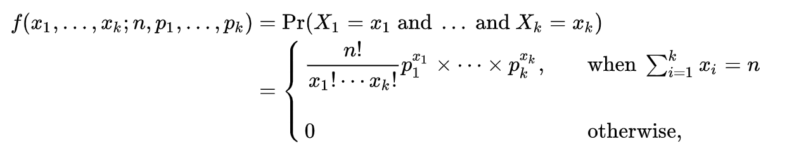
Multinomial Distribution
A generalization of Binomial distribution
The probability of the outcomes of an event following a categorical distribution
Used in categorical outcome events but with multiple trials
E.g., the probability of counts for each side after rolling a 6-sided die rolled 20 times
Notes:
Multinomial distribution is a generalization of Binomial Distribution. It captures the probability of an event having multiple trials where each trial have K possible outcomes.

Slide 25
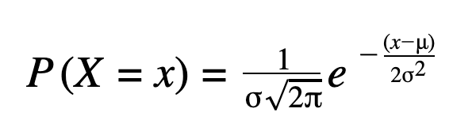
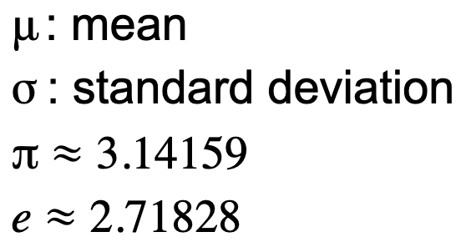
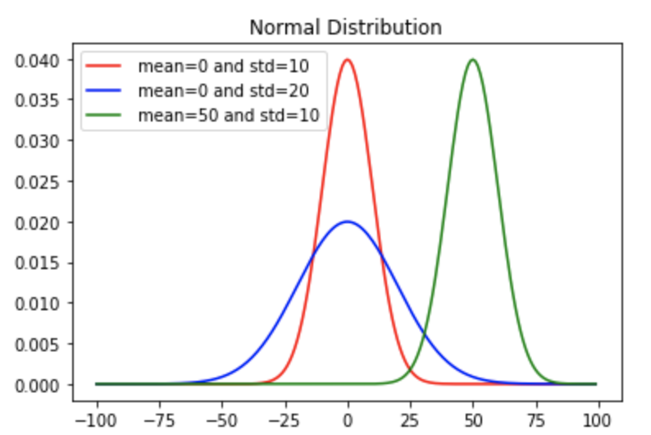
Normal(Gaussian) Distribution
One of the most common distributions for continuous data
e.g., Income distribution in the economy
Used for real-valued random variables with unknown distribution
Determined by the mean and standard deviation
Notes:
Normal distribution is a probability distribution for continuous data. It is one of the most common distributions for random variables in real world applications. If a distribution is unknown, normal distribution is assumed.
The probability density function of the distribution is determined by the mean and the standard deviation. The mean determines the location of the central point and the standard deviation determines the shape the curve. The higher the standard deviation is, the wider the curve is.

Slide 26
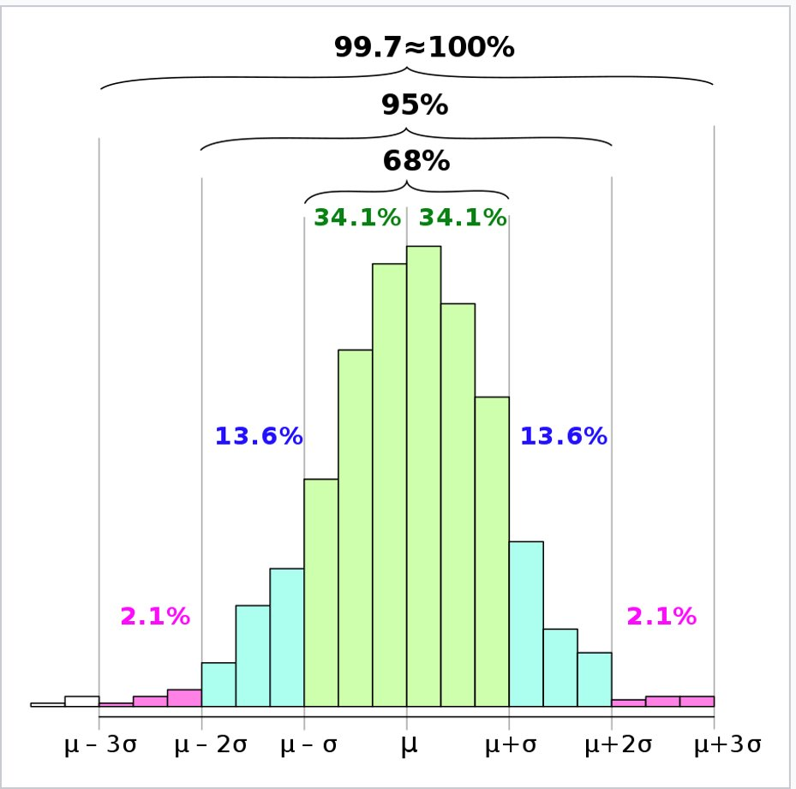
Normal(Gaussian) Distribution
Empirical rule (68-95-99.7)
68% of values fall into the range of (mean-std, mean+std)
95% of values fall into the range of (mean-2*std, mean+2*std)
99.7% of values fall into the range of (mean-3*std, mean+3*std)
Can be used to
Predict final outcomes
Test if a data set is normally distributed
Determine outliers
Notes:
Normal distribution follows the 68-95-99.7 empirical rule. Under the rule, 68% of the data falls within one standard deviation from the mean, 95% of the data falls within two standard deviations from the mean, 99.7% of the data falls within three standard deviations from the mean.
Using the rule, we can roughly predict the final outcomes by directly applying the rule with the mean and the standard deviation.
We can test if a data set is normally distributed by checking if the data follows the empirical rule. We can also use the rule to identify outliers, i.e., those that are far from the mean. It is typical to consider a value as a potential outlier if it is outside the limit of three standard deviation.

Slide 27
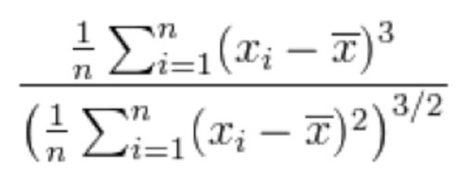
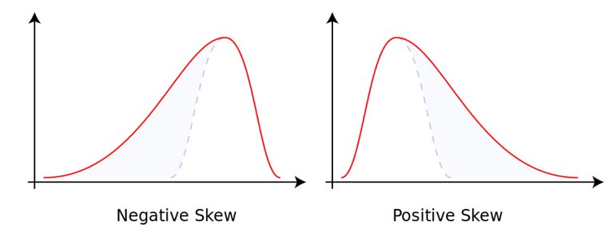
Data Skewness
Measure asymmetry of a probabilistic distribution
Fisher-Pearson coefficient of skewness
Zero skewness suggests perfect symmetrical data (not likely)
The absolute value of skewness indicates how much the distribution is skewed
[0,0.5]:approximately symmetric
[0.5-1]; moderately skewed
>1: highly skewed
Positive value suggests the data is skewed towards the right side
Negative value suggest the data is skewed towards the left side
Notes:
Many machine learning models assume a normal distribution on its input data. In reality, most of the datasets are not normally distributed. Data are usually skewed, i.e., the distribution is not symmetric to the mean. Data skewness measures the asymmetry of a probabilistic distribution. Fisher-Pearson coefficient is a standard measure for data skewness.
Data skewness can be positive (the tail is on the right), zero (perfect symmetrical), or negative (the tail is on the left).

Slide 28
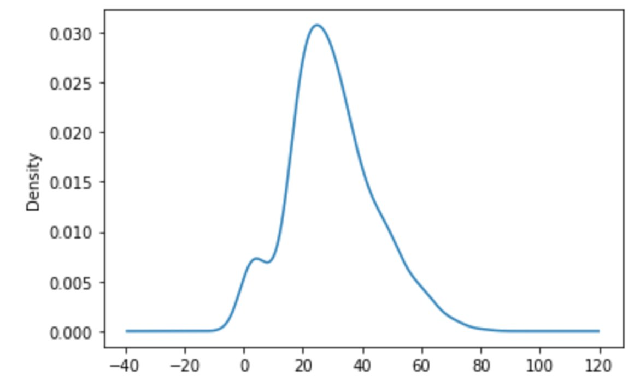
Kernel Density Estimation(KDE)
Generate kernel Density Estimate plot using Gaussian Kernels
Notes:
KDE is a way to estimate an unknown probability density function of values in a dataset. It creates a smooth curve among the existing data points. The curve is calculated by the kernel function which considers the distance of all the points in each specific location. The more values are around a certain location, the higher the probability of seeing a value in that location is.
The figure shows a KDE plot that visualizes the value distribution using a Gaussian kernel function. It is common to use KDE plot to capture the value distribution pattern in a dataset.

