Slide 1

Under the Guidance of:
Dr.Adeline Johnsana J.S mam
DEPARTMENT OF ARTIFICIAL INTELLIGENCE AND MACHINE LEARNING
BATCH:2020-2024
MINI PROJECT
VIVID TONES
Team members:
Gajji Chakrapani-20D41A6620
Bethi Divya-20D41A6609
Vuppala Likitha-20D41A6660
Avula Rishikesh-20D41A6604

Slide 2
CONTENTS
Abstract
Introduction
Existing System
Proposed System
Models
Modules
System architecture

Slide 3
ABSTRACT
VividTones is a captivating and challenging problem in computer vision and image processing, aiming to add natural and realistic colours to grayscale or monochrome images. for image colorization using two different pre-trained deep learning models: ECCVGenerator and SIGGRAPH. The code also includes functions for image loading, preprocessing, and post-processing and pre trained models. The task of vivid tones holds immense practical value across various domains, such as historical image restoration, artistic rendering, and multimedia content generation. The goal is to automate the process of inferring colours for objects and scenes within an image, harnessing the power of artificial intelligence and deep learning techniques.
In conclusion, VividTones is a dynamic and evolving field with applications spanning various industries. Contemporary approaches leverage deep learning techniques to generate colorized images with remarkable realism and fidelity. However, addressing ethical considerations and promoting responsible use are essential aspects of advancing this technology further. As image colorization continues to progress, it holds the promise of enriching our visual experiences and preserving the heritage of historical imagery

Slide 4
INTRODUCTION
VividTones is a computer vision and image processing technique that adds color to grayscale or black-and-white images. It's a process of automatically assigning colors to different objects and regions within an image based on its content.
This technology leverages deep learning models and neural networks to analyze the grayscale input and predict suitable colors for various elements in the image, creating a visually appealing and realistic colorized version.
This project is about making black and white pictures colorful. You know how old photos are usually in black and white? Well, this project uses computer programs to add colors to those photos. It's like turning a grayscale picture into a colorful one.

Slide 5
EXISTING SYSTEM
In the existing system, people manually add color to black and white images.
It's a time-consuming process where individuals carefully paint or digitally color each part of the image by hand.
This method relies on human skills and can be slow and challenging, especially for detailed images.

Slide 6
Manual Coloring: In the existing system, adding color to black and white images is a completely manual process.
Human Labour: People are responsible for the entire colorization task. They must meticulously select colors, apply them to different parts of the image, and ensure accuracy.
Time-Consuming: Coloring each part of the image by hand is time-consuming, especially for complex or large images.
Artistic Skills: The existing system heavily relies on the artistic skills of individuals. Not everyone can do it well, and it requires practice and patience.
Labour-Intensive: It's a labour-intensive process, and the quality of the final colorization depends on the skill level of the person doing it.

Slide 7
PROPOSED SYSTEM
The proposed system introduces a more efficient way to add color to black and white images.
It uses special computer programs (ECCV16 and SIGGRAPH17) that have learned how to automatically add colors to pictures.
Instead of manual coloring, you provide the black and white image to the computer models, and they quickly and accurately do the coloring for you.
This makes the process much faster, easier, and accessible to anyone without requiring artistic skills.

Slide 8
Automated Colorization: The proposed system offers an automated approach to add color to black and white images.
Computer Models: Instead of manual effort, the system utilizes specialized computer models (ECCV16 and SIGGRAPH17) designed to colorize images.
Efficient: This automated process is significantly faster, allowing for the rapid colorization of images, even complex ones.
No Artistic Skills Required: The proposed system doesn't require users to have artistic skills. Anyone can use it, making it accessible to a broader audience.
Consistency: The quality and consistency of colorization are maintained, as the computer models apply colors systematically based on their learned knowledge.

Slide 9
APPLICATIONS
Historical Image Restoration
Artistic Expression
Historical Research
Art Restoration
Preservation of Memories

Slide 10
MODELS
ECCV16: ECCV stands for "European Conference on Computer Vision," and the "16" likely refers to the year 2016. Therefore, ECCV16 refers to a model or approach related to computer vision that was presented or published at the European Conference on Computer Vision in the year 2016.
SIGGRAPH17: SIGGRAPH stands for "Special Interest Group on Computer Graphics and Interactive Techniques," and the "17" likely refers to the year 2017. SIGGRAPH is a renowned conference in the field of computer graphics and interactive techniques. Therefore, SIGGRAPH17 refers to a model or approach related to computer graphics and interactive techniques that was presented or published at the SIGGRAPH conference in the year 2017.

Slide 11
LIBRARIES USED
PYTORCH
PIL(PILLOW)
NUMPY

Slide 12
PyTorch:-
PyTorch is a powerful and popular Python library for deep learning and machine learning tasks. It's like a toolbox that provides various tools and functions specifically designed for building and training neural networks, which are used in tasks like image recognition, natural language processing, and more.
One of the key features of PyTorch is its ability to create and manipulate tensors, which are similar to multi-dimensional arrays. Tensors are at the core of deep learning computations, allowing you to perform operations like matrix multiplications and gradients efficiently. PyTorch also offers automatic differentiation, making it easier to compute gradients and update the parameters of neural networks during training.
Moreover, PyTorch provides a wide range of pre-built layers, loss functions, and optimization algorithms, simplifying the process of designing and training neural networks. Its dynamic computation graph allows for flexible model architectures and dynamic control flow, making it easier to experiment with different network structures.
In summary, PyTorch is a versatile library that empowers developers and researchers to work with neural networks effectively. Its intuitive design and extensive community support have made it a preferred choice for deep learning tasks, enabling innovations in artificial intelligence and machine learning.

Slide 13
SYSTEM ARCHITECTURE
Input image
preprocessing
Colorization model selection
output image

Slide 14
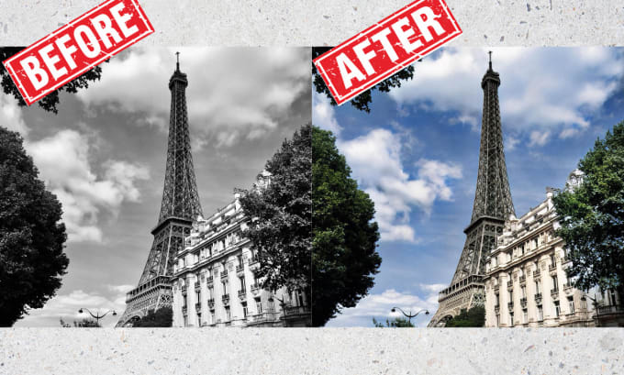

Slide 15
THANK YOU

