Slide 1
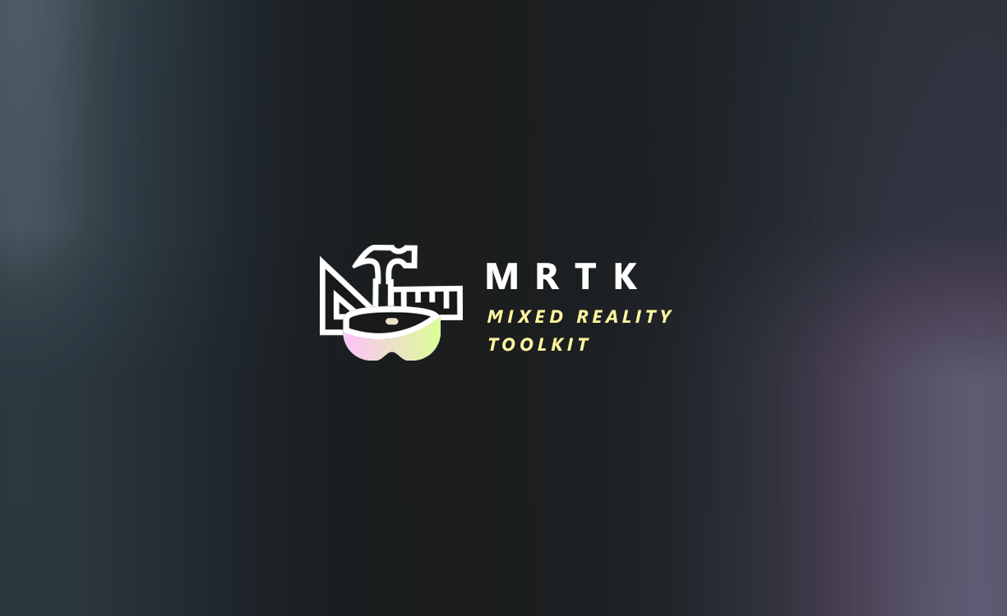

Slide 2
Mixed Reality Toolkit Mapping With Input Actions
Quick overview of the MRTK Input Actions
Creating Input Actions
Input Action Rules
Mapping Actions
Consuming Actions

Slide 3

Mixed Reality Toolkit
Multi-Platform
Performance by Default
Individual Components
New Architecture
Centralised Configuration
Mixed Reality Toolkit V2
Centralised Configuration

Slide 4
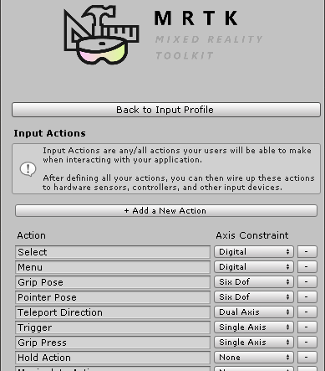
MRTK v2 Input Actions MRTK -> Input Settings -> Input Actions Profile

Slide 5
Basic input seems simple
Adding more platforms creates unnecessary complexity
Unity’s solution only hardcodes input at design time
Press Space
Jump

Slide 6

Basic input seems simple
Adding more platforms creates unnecessary complexity
Unity’s solution only hardcodes input at design time
Press A
Jump

Slide 7
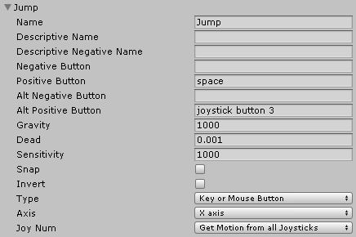
Basic input seems simple
Adding more platforms creates unnecessary complexity
Unity’s solution only hardcodes input at design time
Press Space
Jump
Space configured for “Jump”

Slide 8

Break apart: -Physical (device input) from
-Logical (game input)
Allow runtime configuration
Customization!

Slide 9



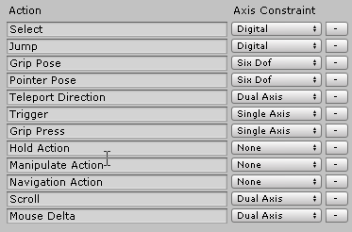




Mixed Reality Toolkit Creating Input Actions
Mapping
Profile
Input
Actions
Profile

Slide 10
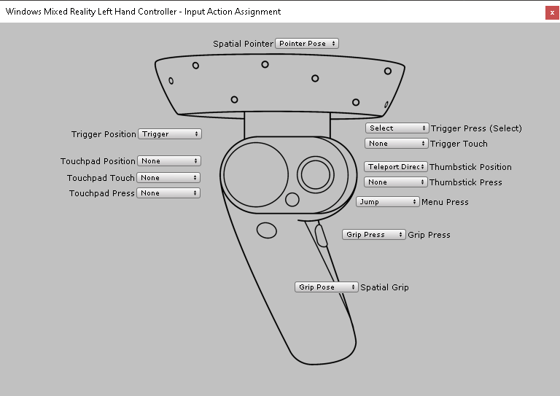

Mixed Reality Toolkit Creating Controller Mapping Profiles
* Hot swappable
Input
Actions
Profile
Mapping
Profile

Slide 11
Mixed Reality Toolkit Creating Input Actions
Mapping
Profile
Input
Actions
Profile

Slide 12
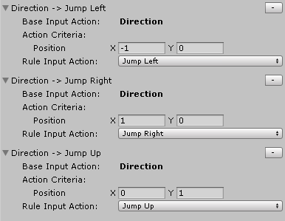
Mixed Reality Toolkit Applying Rules
Which Way?
Jump
Left
Jump Up
Jump Right
Mapping
Profile

Slide 13

Demo
Walking through the configuration wilderness

