Slide 1
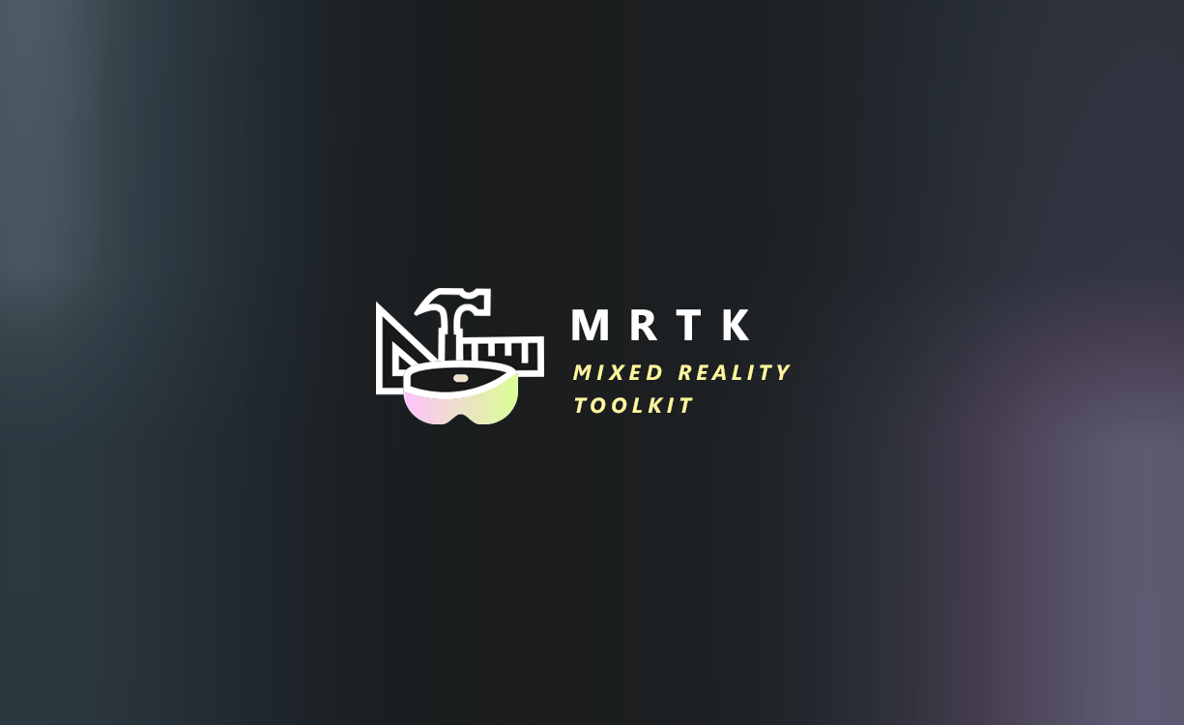

Slide 2
Mixed Reality Toolkit Quick Start
Quick overview of the Mixed Reality Toolkit vNext project
Setting up your Unity project for the MRTK
Installing the MRTK and running your scene
Quick tips
Beta and beyond

Slide 3
What this session is about
It’s NOT
A complete overview of the new Mixed Reality Toolkit
It is
A high level introduction
Quick run through to show you how to get started with the MRTK
A Fun playground to wet your feet

Slide 4

Mixed Reality Toolkit
Multi-Platform
Performance by Default
Individual Components
New Architecture
Centralised Configuration
Mixed Reality Toolkit
HoloToolkit

Slide 5
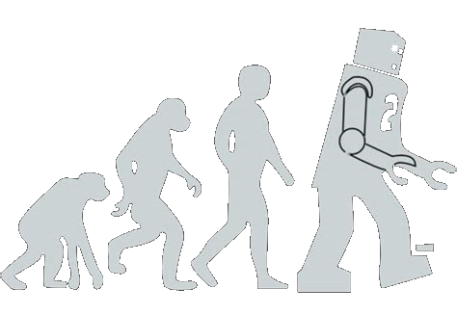
Mixed Reality Toolkit
Multi-Platform
Performance by Default
Individual Components
New Architecture
Centralised Configuration
Mixed Reality Toolkit
HoloToolkit

Slide 6

Quick Start
The only way to fly

Slide 7
Current status
First Beta releasing for November
Aiming for feature parity with HTK on Release

