Slide 1


Slide 2
Mixed Reality Toolkit Configuration Quick Start
Quick overview of the Mixed Reality Toolkit configuration
Starting with the MRTK defaults
Copying the configuration for a quick start
Creating your own configuration
Tips n Tricks

Slide 3

Mixed Reality Toolkit
Multi-Platform
Performance by Default
Individual Components
New Architecture
Centralised Configuration
Mixed Reality Toolkit V2
Centralised Configuration

Slide 4
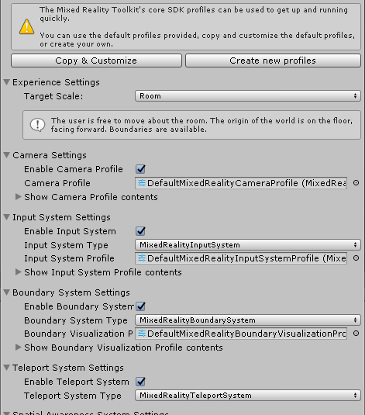
MRTK v2 Configuration Profiles

Slide 5
Master Configuration
Input
Focus
Pointer
Camera
Actions
Controllers
Gesture
Speech
Configuration is managed centrally
Each Service / Function manages its own configuration
Each configuration can be swapped out at runtime*
Boundary
Teleport
Spatial
Diagnostics

Slide 6


The MRTK v2 comes with a full set of preconfigured defaults
You can copy these to customise, dropping things you don’t need
OR, you can start fresh and create your own

Slide 7

Demo
Walking through the configuration wilderness

