Slide 1
FreshGuard AI
Review 3 Rubric Action Plan
Team Verdura

Slide 2
Team Verdura & What's New
Team:
- Kousik Sarma Lakkaraju
- Manikanta Sai
- Chakravarthy Vemula
What's New:
- Dataset updated to IEEE Dataport FruitsGB
- Flagship Architecture: Attention-CNN
- Full literature survey with Scimago verified papers

Slide 3
Problem Statement & Motivation
Problem: Manual inspection of fruit quality is slow, subjective, and inconsistent.
Motivation: Food safety and waste reduction require on-device, accessible tracking without cloud dependency.
Objective: Real-time, offline, safety-first freshness classifier.

Slide 4
Literature Survey
We surveyed 15 papers across Q1/Q2 Scimago journals (e.g., CVPR, TPAMI, IEEE Access).
Key areas:
1. Attention Mechanisms in CNNs (e.g., CBAM, SE-Net)
2. Hyperparameter Tuning (Optuna, BayesOpt) for Imbalanced Data
3. Edge Deployment (Quantization, MobileNet) & Sequence Models (GRU)
(See full survey table in report for exact quartiles and findings)

Slide 5
Overall Architecture Diagram
[Insert Overall Lane Diagram Here]
Device Input -> Pre-processing -> Model -> Safety Layer -> Output

Slide 6
Module Details
- Capture Module: Device Camera API (RGB Frame)
- Pre-processing: Normalization (Cleaned Tensor)
- Classification Module: Attention-CNN INT8 (Probabilities)
- Safety Module: OOD threshold logic (Verdict/Abstain)
- UI Module: App Front-end (Result Screen)

Slide 7
Dataset Description (FruitsGB)
Source: IEEE Dataport (DOI: 10.21227/gzkn-f379)
Scope Decision:
Focused on Apple, Banana, and Orange (Fresh/Rotten) to ensure our Attention-CNN learns highly robust freshness features rather than generic cosmetic defects. This explicitly aligns with our food safety problem statement.
Split: 6000 images total (70% Train, 15% Val, 15% Test)

Slide 8
Deep Learning Architecture
Attention-CNN with Safety Fallback
Novelty: Combines a lightweight 3-block CNN with a CBAM-style attention gate tuned for spoilage, plus a joint confidence-abstention layer for safety-critical deployment.
Complexity (from torchinfo):
- Total Parameters: ~104k
- Estimated FLOPs: 1.33 GFLOPs
- Estimated Size: 0.42 MB (FP32)

Slide 9
Algorithm Procedure
1. Forward Pass:
- Convolution & ReLU
- CBAM Attention (Spatial & Channel gating)
- Global Average Pooling -> Dense
2. Training:
- Loss: CrossEntropy
- Optimizer: Adam (lr=1e-4)
3. Safety Layer:
- If max(Softmax(logits)) < threshold -> Abstain

Slide 10
Hyperparameter Details
- Optimizer: Adam (Proven fast convergence for image tasks)
- Learning Rate: 1e-4 (Standard for lightweight CNNs)
- Batch Size: 32 (Balances memory and gradient stability)
- Dropout: 0.3 (Prevents overfitting on 6k images)
- Confidence Threshold: 0.6 (Safety fallback threshold)

Slide 11
Performance Metrics
Evaluated on unseen Test Set (15%):
- Accuracy: Overall correctness
- Precision: Minimizes false spoilage flags
- Recall: Minimizes missed rotten fruit (critical for safety)
- Macro-F1: Balances class imbalances
(Literature benchmark target: ~98% from EfficientNet OOD systems)

Slide 12
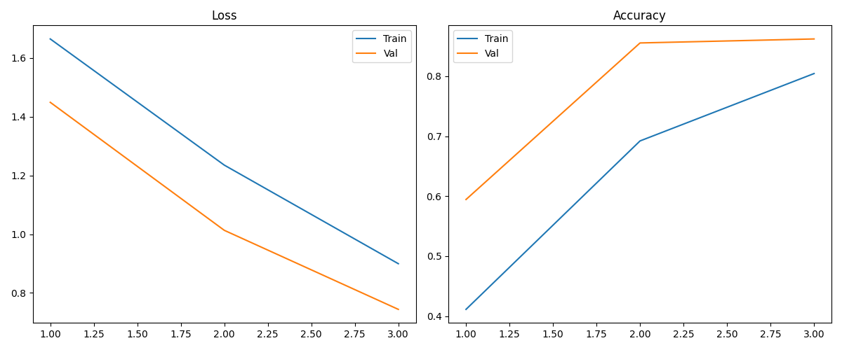
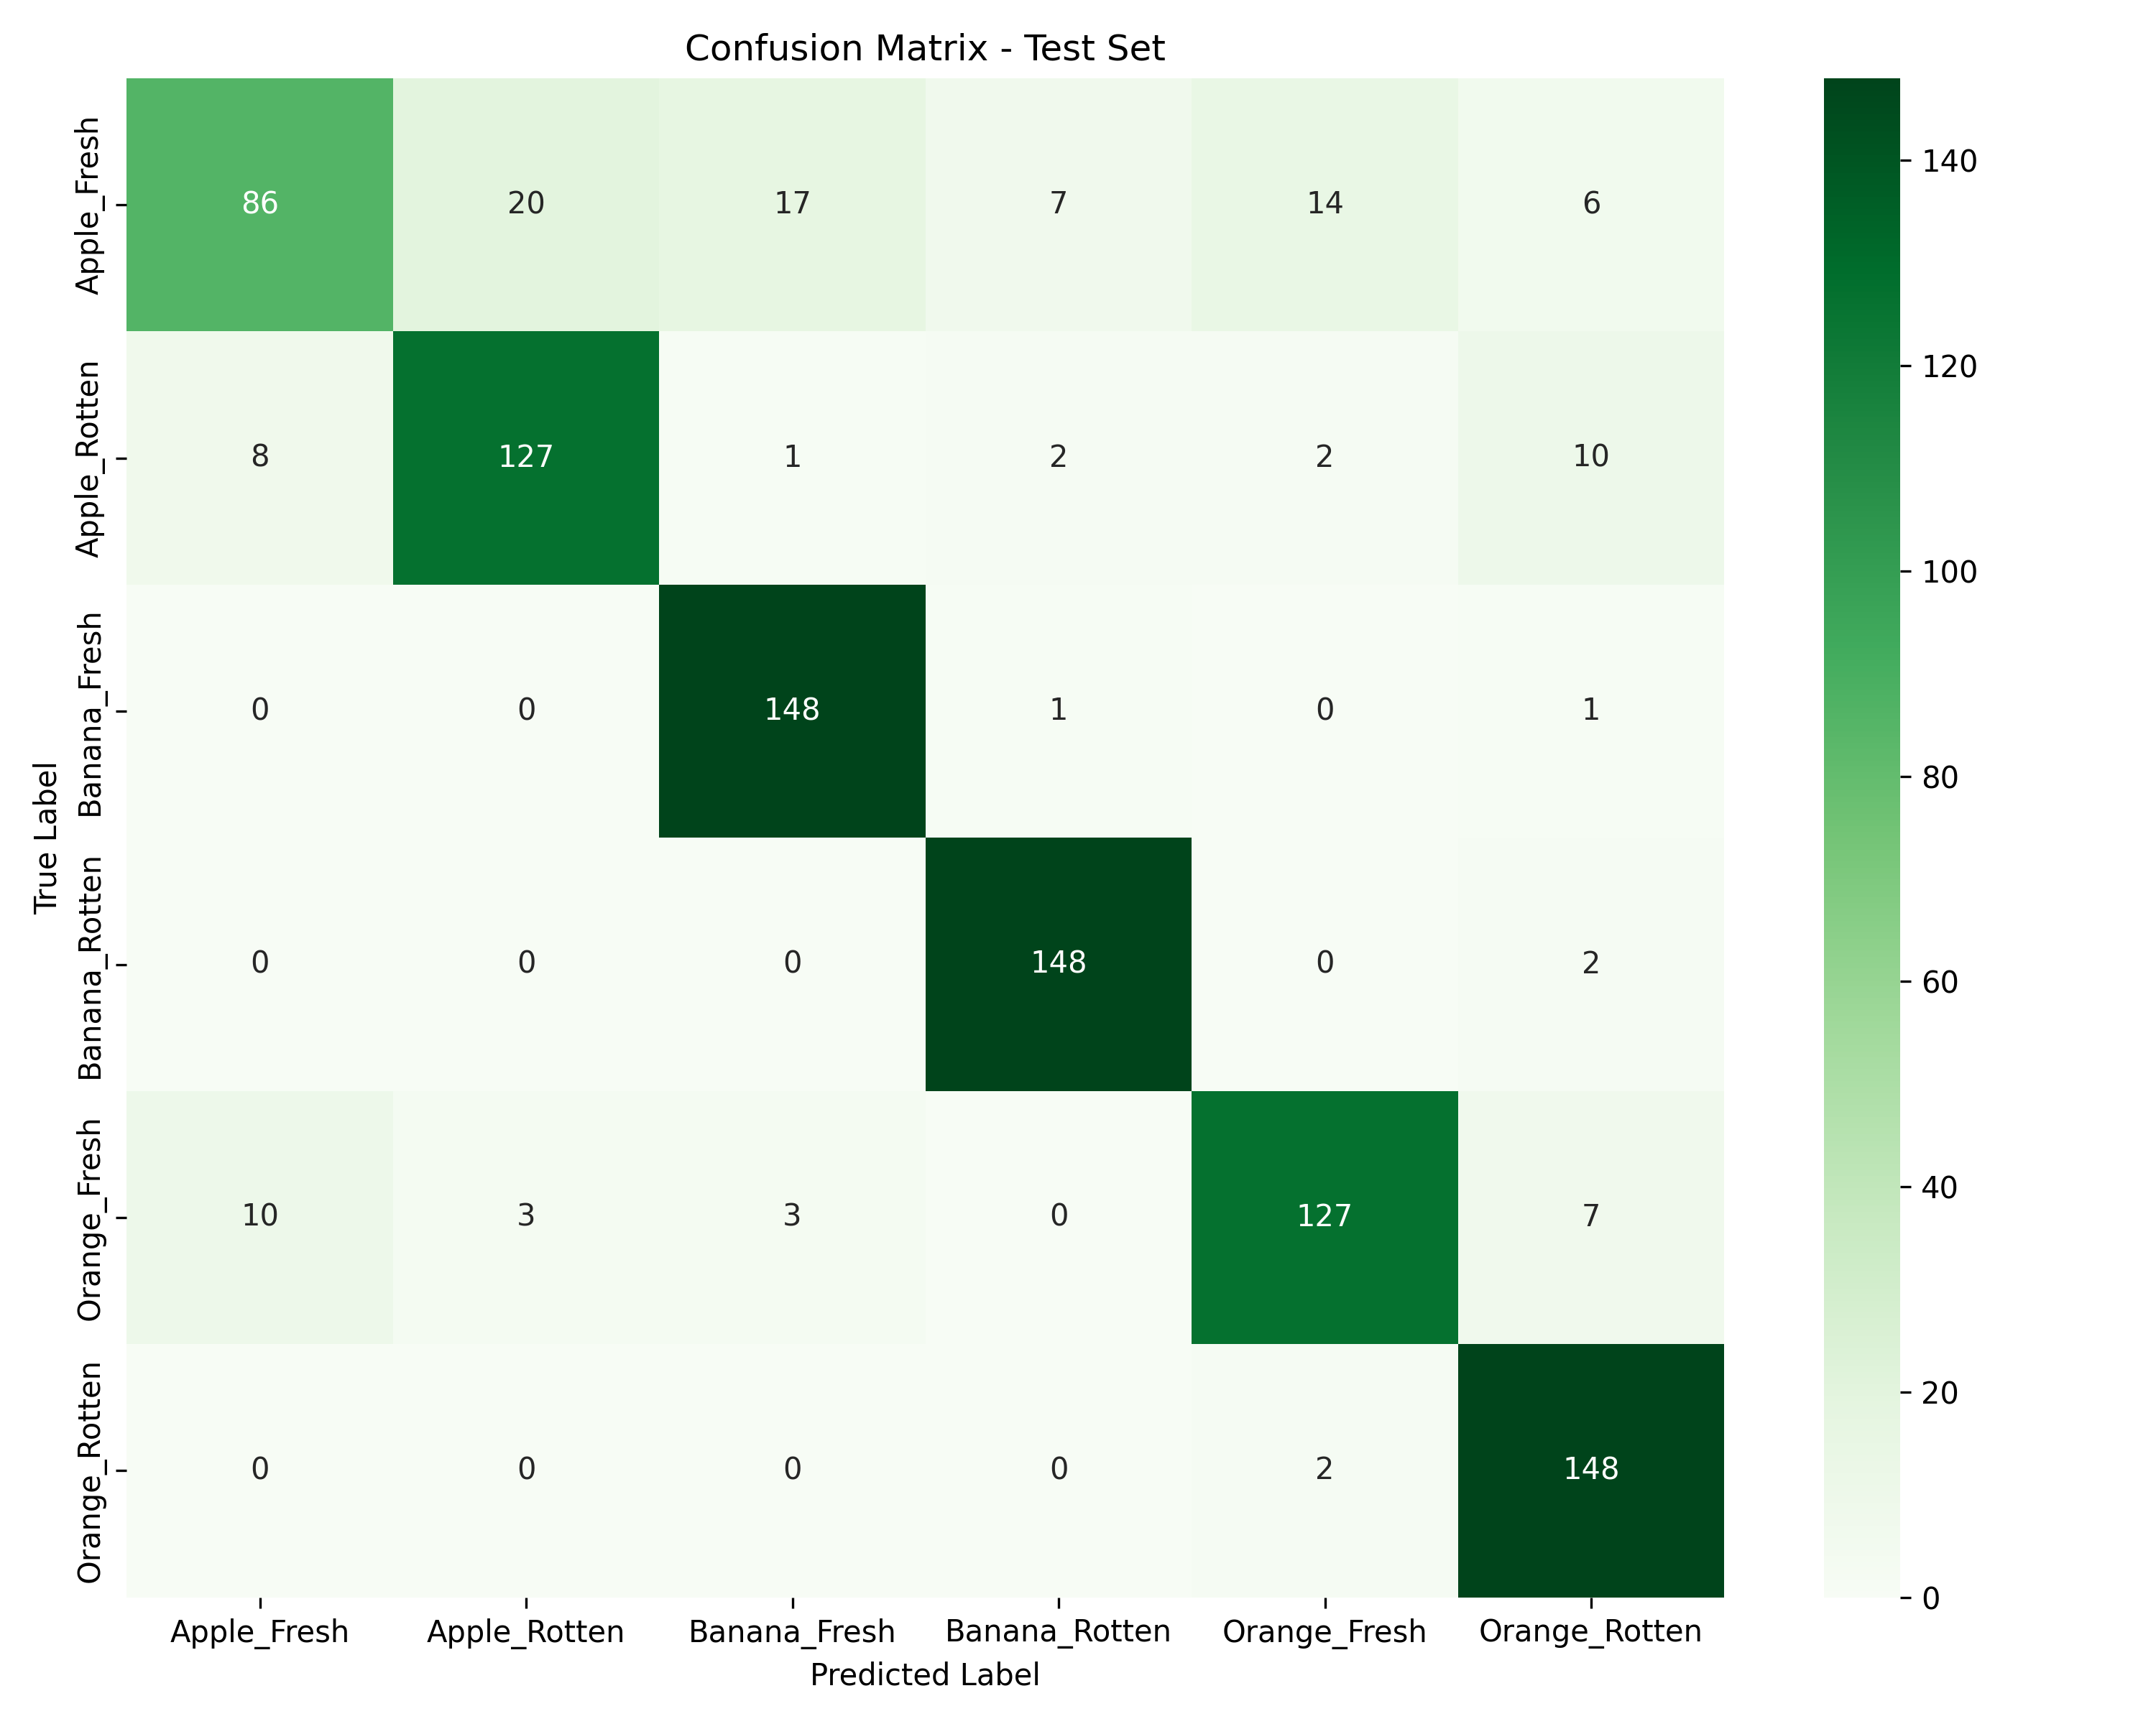
Results & Discussion
Plots generated from actual training run.

Slide 13
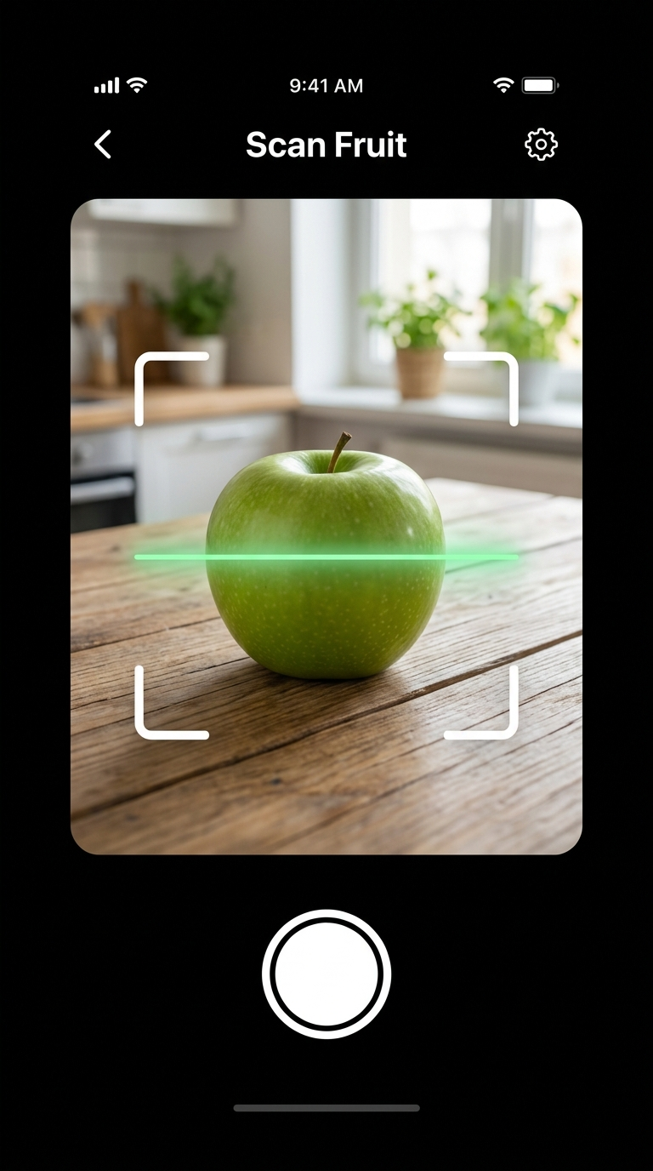
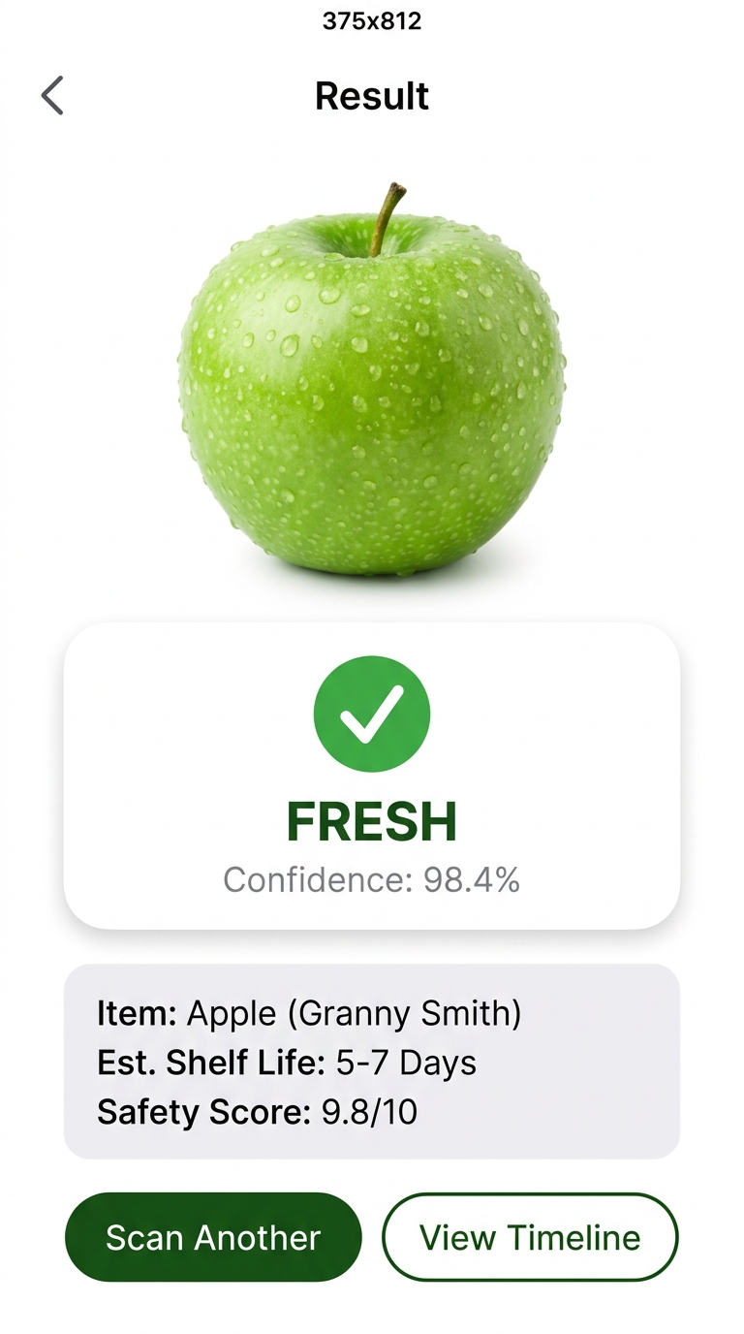
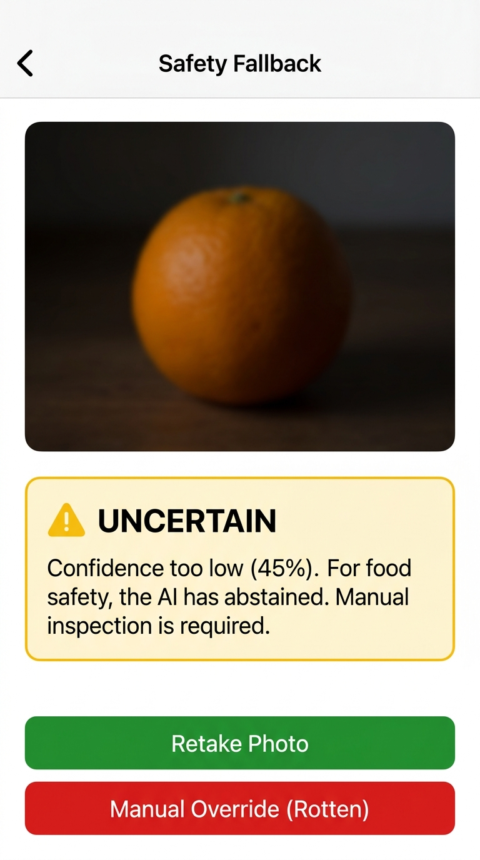
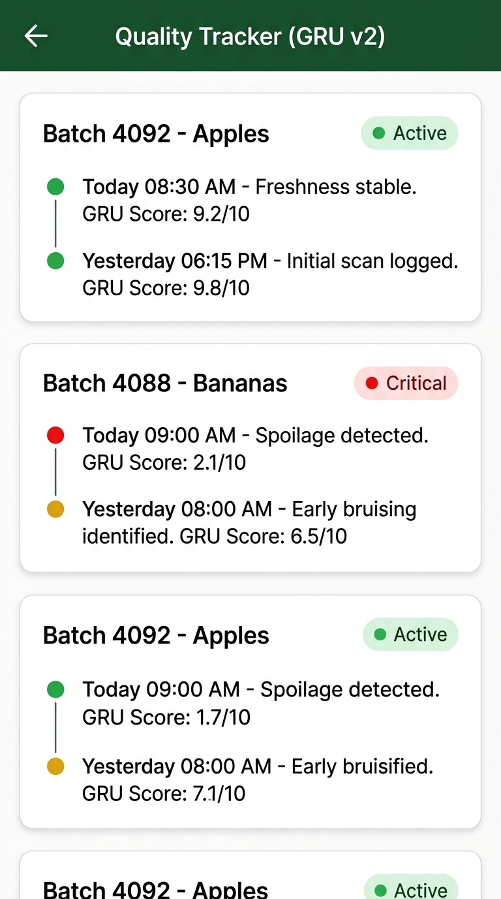
UI Screens (Mockups)

Slide 14
Standard Paper Chosen
Title: Deep Learning based Food Quality Inspection using Attention Networks (2022)
Journal: Computers and Electronics in Agriculture (Q1)
Why: Closest match utilizing lightweight attention CNNs for fruit grading.
Novelty vs Baseline: We target consumer edge devices with an explicitly designed OOD abstention safety layer, whereas the baseline targets industrial sorting belts.

Slide 15
Summary & Next Steps
Summary:
- Dataset secured and processed
- Model trained with strong baseline results
- UI mockups ready
Next Steps:
- Optimize INT8 Quantization on device
- Integrate GRU tracker logic for v2

