Slide 1

Conversational AI Sales Agent with Review-Driven Bidding
Innovative AI enhancing sales through customer feedback
Notes:
---

Slide 2
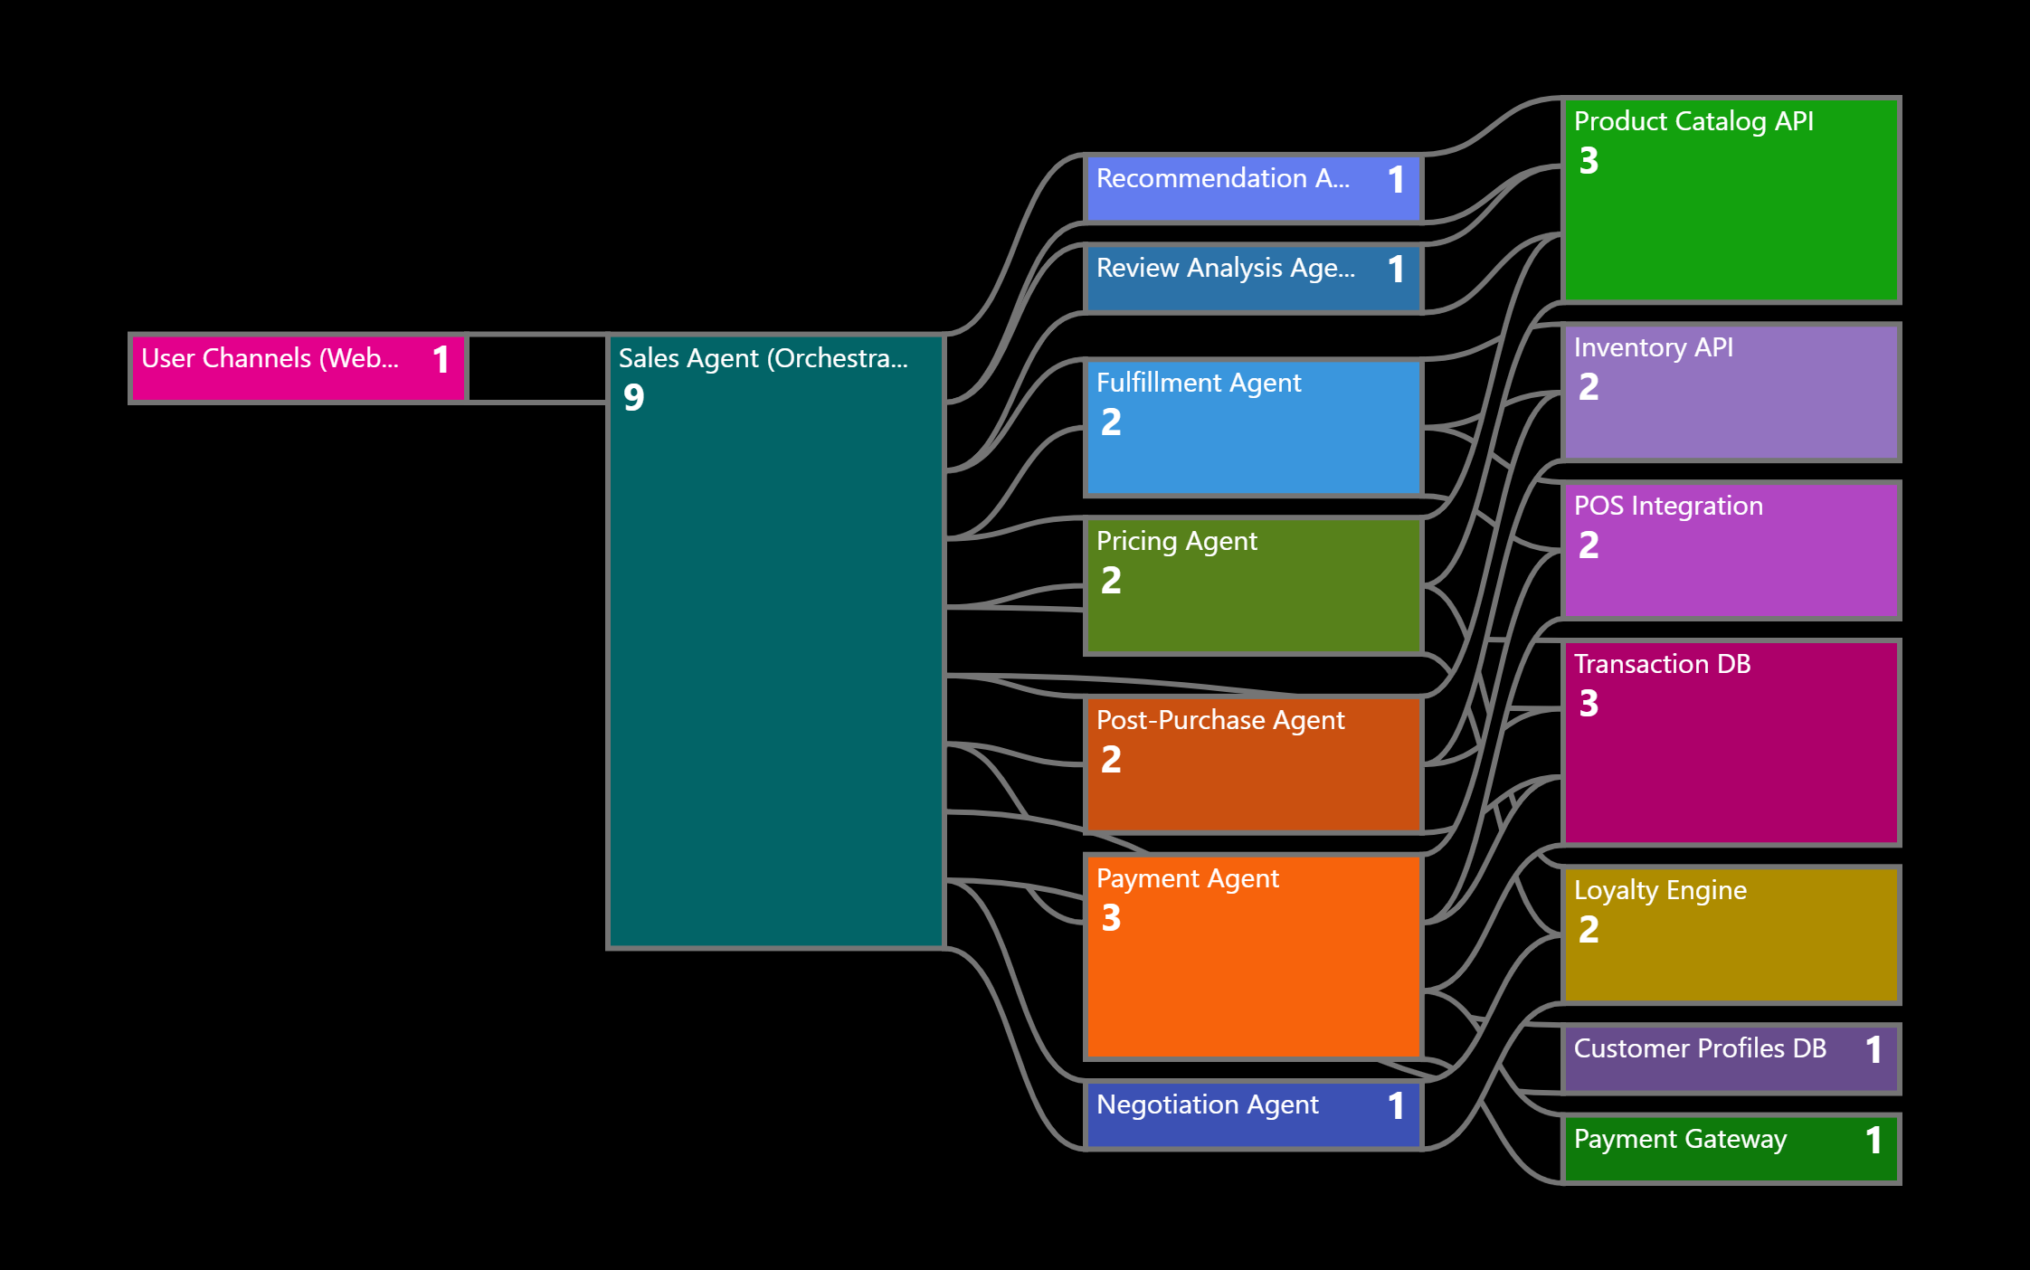
Architecture Diagram

Slide 3

Overview of the intelligent conversational agent
Seamless Multi-Channel Interaction
  The agent interacts with customers via web chat, mobile apps, messaging platforms, and in-store kiosks for a unified experience.
Specialized Worker Agents
  Worker Agents handle specific tasks like product recommendations, inventory checks, payment processing, and support.
Personalized Shopping Experience
  The agent delivers real-time tailored recommendations by anticipating customer needs to boost conversion and AOV.
Notes:
The AI-driven conversational sales agent is designed to revolutionize the retail shopping experience by providing a seamless and personalized interaction across multiple customer touchpoints. This agent mimics a top-tier sales associate and engages customers through web chat, mobile apps, messaging platforms like WhatsApp, and in-store kiosks. It orchestrates a network of specialized Worker Agents to handle tasks such as product recommendations, inventory checks, payment processing, and post-purchase support. The goal is to unify fragmented shopping experiences and increase conversion rates and average order value (AOV) by anticipating customer needs and delivering tailored recommendations in real time.

Slide 4
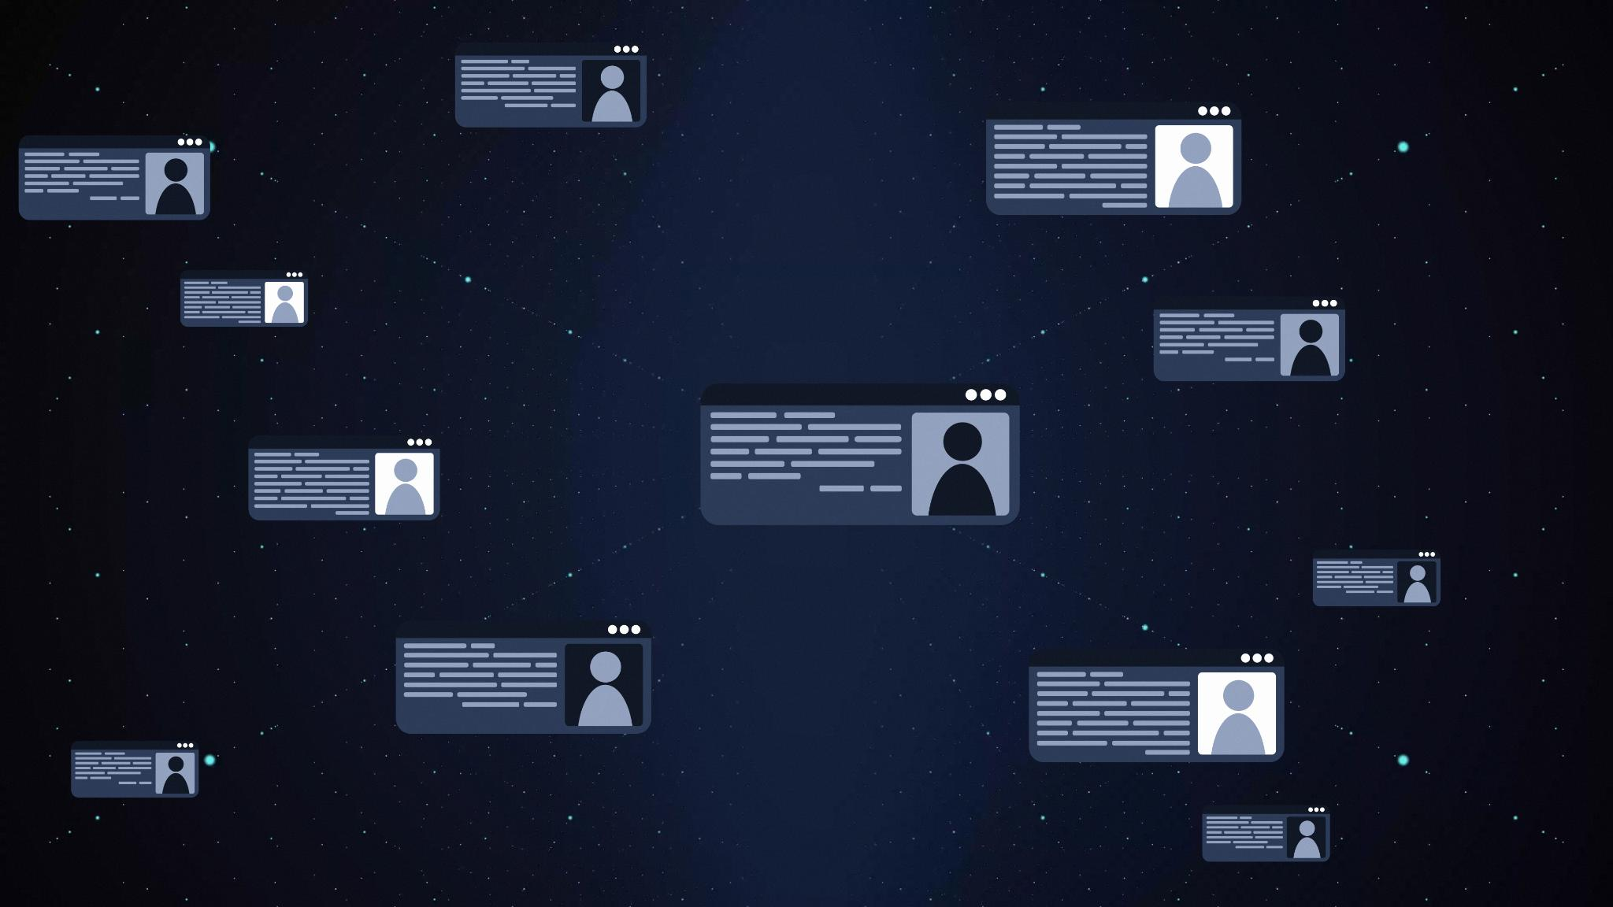
Flow from message to product booking
Proactive Customer Messaging
  AI agent sends proactive messages to customers via their preferred communication channels to initiate engagement.
Personalized Conversation & Suggestions
  Bot personalizes product suggestions based on customer profiles and maintains conversation continuity across channels.
Review, Pricing & Bidding
  Conversation includes review aggregation, price quoting, and a bidding loop to ensure customer satisfaction before purchase.
Product Booking and Fulfillment
  Once price is agreed, the agent books the product and coordinates delivery or in-store pickup on chosen platform.
Notes:
---
This slide references information from the following file: https://jp-prod.asyncgw.teams.microsoft.com/v1/objects/0-ea-d3-fa43f367ecffa82be89aef3639e5fb40/views/original/conversational_ai_architecture.png
The customer engagement flow begins with the AI agent sending a proactive message to the customer via their preferred channel. Upon clicking the message, the bot initiates a personalized conversation that includes product suggestions based on the customer's profile and preferences. The agent maintains session continuity even if the customer switches channels, such as moving from a mobile app to an in-store kiosk. The conversation progresses through review aggregation, price quoting, and a bidding loop if the customer is not satisfied with the initial offer. Once the customer agrees to a price, the agent books the product on the selected platform, such as Amazon or Flipkart, and coordinates delivery or in-store pickup.

Slide 5
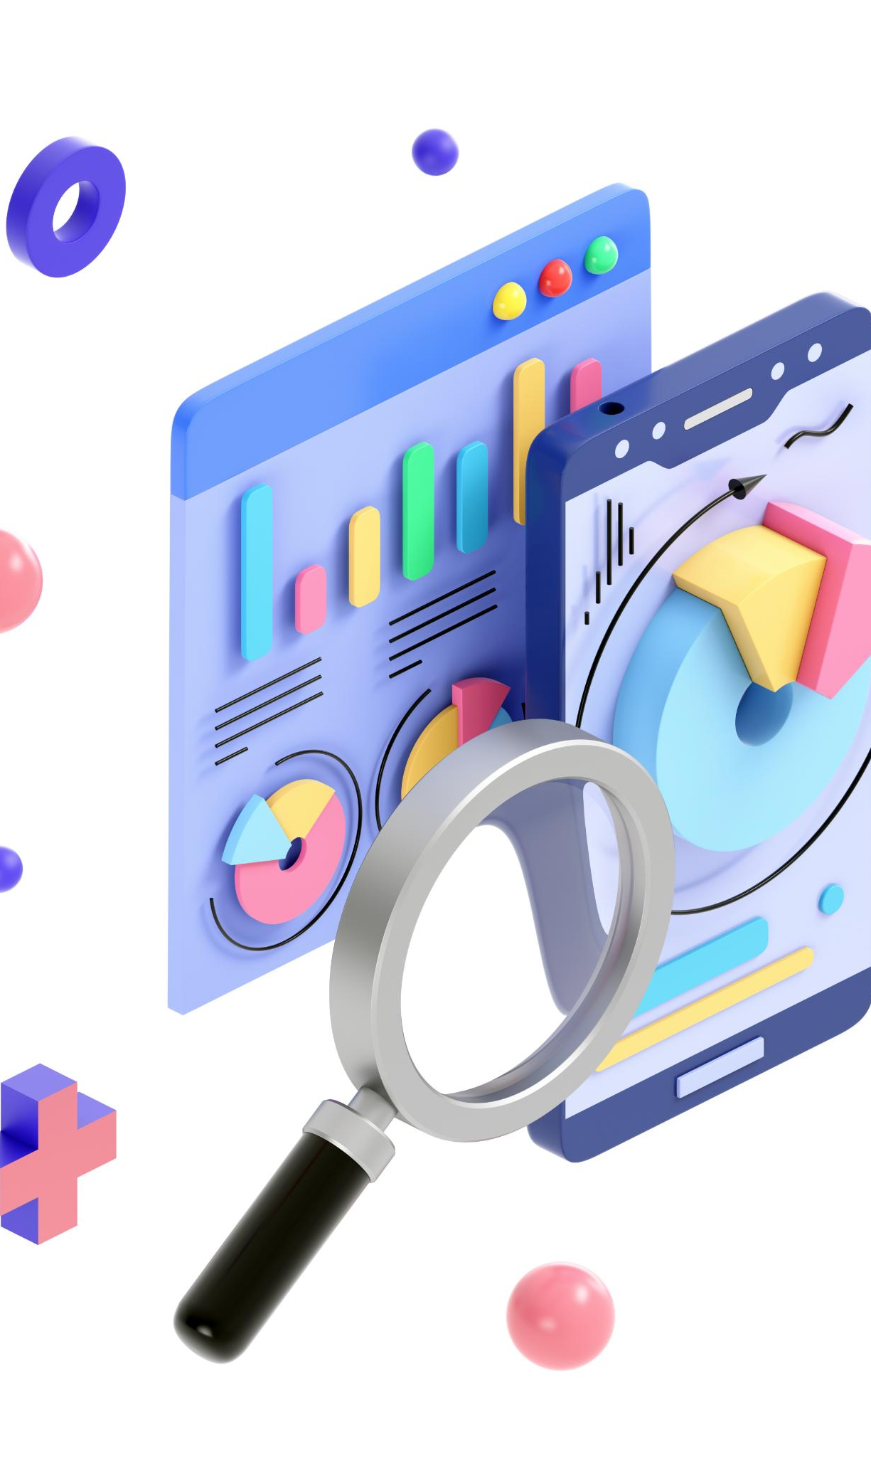
Collecting and analyzing customer reviews
Review Collection Platforms
  The agent gathers customer reviews from multiple platforms like Amazon, Flipkart, and brand websites for comprehensive data.
Sentiment Analysis with NLP
  Natural language processing is used to analyze sentiments, extracting key pros and cons from customer feedback.
Summary and Presentation
  Summarized insights help customers make informed decisions by presenting concise product pros and cons.
Aggregate Ratings and Themes
  The agent considers average ratings and highlights common themes for a holistic view of product performance.
Notes:
The Review Analysis Agent collects customer reviews from various platforms including Amazon, Flipkart, and brand websites. It uses natural language processing (NLP) techniques to perform sentiment analysis and summarize the key pros and cons of each product. This information is then presented to the customer in a concise and informative manner, helping them make informed decisions. By leveraging real user feedback, the agent builds trust and enhances the credibility of its recommendations. The review aggregation process also considers average ratings and highlights common themes across platforms to provide a holistic view of product performance.

Slide 6
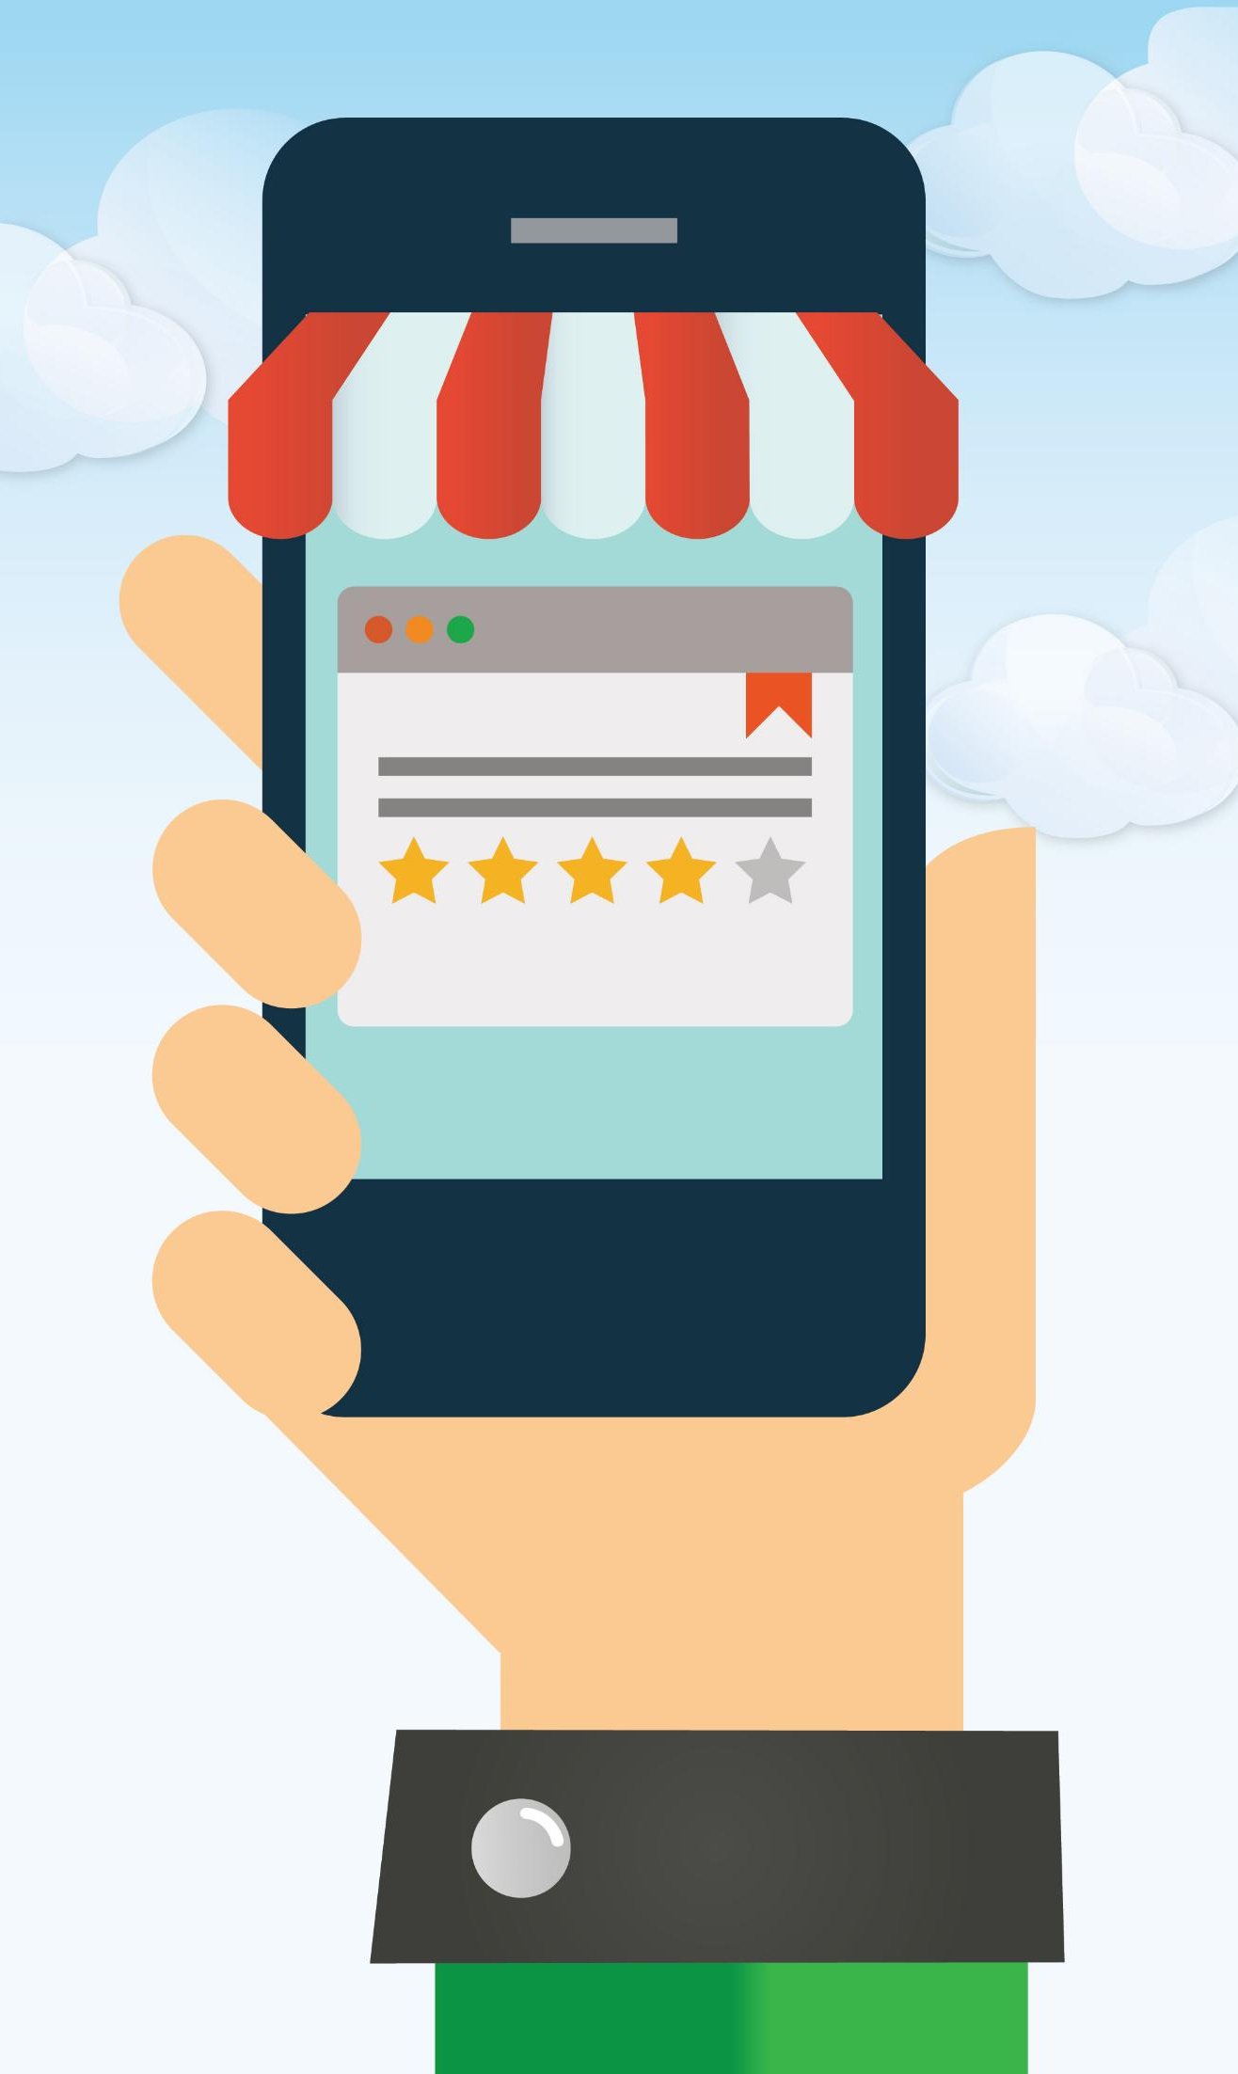
Comparing prices and quoting competitive offers
Multi-platform Price Comparison
  The Pricing Agent evaluates product prices from various platforms to find the best deal for customers.
Incorporating Discounts and Offers
  Promotions, loyalty discounts, and seasonal offers are factored in to quote competitive prices.
Negotiation Loop Preparation
  If customers are dissatisfied, the agent prepares to enter a negotiation process to improve offers.
Balancing Cost and Value
  Review quality and platform reliability are considered alongside price for a balanced final offer.
Notes:
The Pricing Agent compares product prices across multiple platforms such as Amazon, Flipkart, and the brand's own website. It takes into account ongoing promotions, loyalty discounts, and seasonal offers to quote a competitive price to the customer. If the customer expresses dissatisfaction with the quoted price, the agent prepares to enter a negotiation loop. This price quoting mechanism ensures transparency and helps the customer feel confident that they are receiving the best possible deal. The agent also considers review quality and platform reliability when determining the final quoted price, aiming to balance cost with value.

Slide 7

Dynamic negotiation to drive purchase
Dynamic Bidding Process
  The agent conducts up to five negotiation rounds using discounts and product bundles to persuade customers.
Customer Engagement Tactics
  Urgency tactics like limited stock alerts and loyalty point redemptions enhance perceived value and drive purchases.
Adaptive Negotiation Strategy
  The agent adapts offers based on customer responses, mimicking human sales psychology to finalize sales.
Graceful Exit and Alternatives
  If negotiations fail after five rounds, the agent exits politely or proposes alternative products for the customer.
Notes:
If the customer rejects the initial price quote, the Negotiation Agent initiates a dynamic bidding loop that can run up to five rounds. During each round, the agent may apply incremental discounts, suggest product bundles, offer loyalty point redemption, or use urgency tactics such as limited stock alerts. The goal is to persuade the customer to complete the purchase by addressing objections and enhancing perceived value. This negotiation strategy mimics human sales psychology and adapts based on customer responses. If the customer accepts an offer at any stage, the loop ends and the product is booked. If all five attempts fail, the agent gracefully exits the conversation or suggests alternative products.

Slide 8
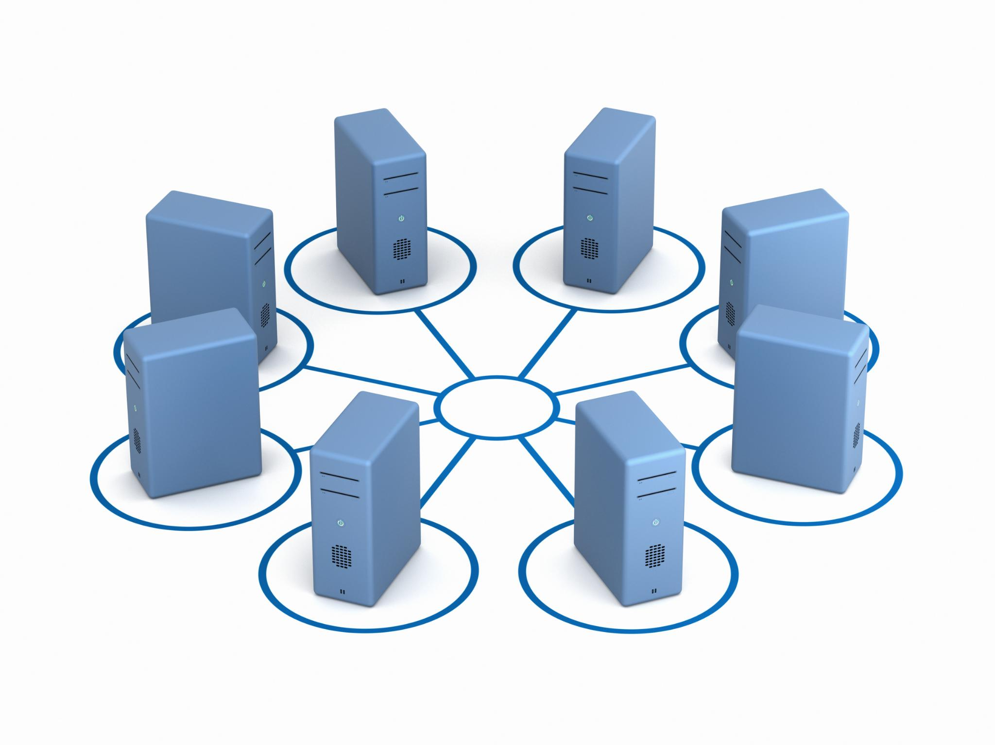
Final booking and system architecture
Booking Process Overview
  The Fulfillment Agent books products after customer acceptance, coordinating delivery or pickup based on preferences and inventory.
System Architecture Components
  The system features a Sales Agent orchestrator, multiple Worker Agents, external APIs, and a data layer for profiles and transactions.
Scalability and Integration
  Modular architecture allows scalability and easy integration of new services like gift wrapping and express delivery.
Notes:
---
This slide references information from the following file: https://jp-prod.asyncgw.teams.microsoft.com/v1/objects/0-ea-d1-956d7c52cdd3bbdf446e624ef6422d7a/views/original/sales_agent_flowchart.png
Once the customer accepts the final offer, the Fulfillment Agent books the product on the selected platform, such as Amazon or Flipkart. It coordinates delivery or in-store pickup based on customer preferences and inventory availability. The system architecture supporting this process includes a central Sales Agent orchestrator, multiple Worker Agents, external APIs for product catalog, inventory, payment, and loyalty services, and a data layer comprising customer profiles and transaction databases. This modular architecture ensures scalability and allows for easy integration of new capabilities like gift wrapping or express delivery. The architecture diagram illustrates the interactions between user channels, agents, external systems, and data layers.

